Slide 1
Inheritance
Inheritance allows a software developer to derive a new class by extending an existing one.
The existing class is called the parent class or superclass
The derived class is called the child class or subclass.
Inheritance creates an is-a relationship.
The subclass is a more specific version of the original.
class Student extends Person {
…
}

Slide 2
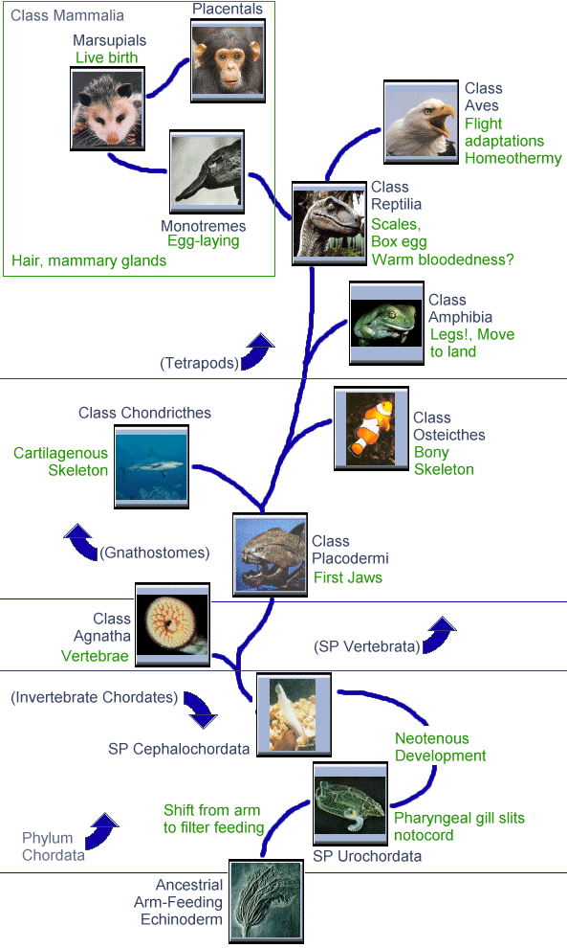
Inheritance
Terminology:
class - a data type
extend - to make a new class that inherits the properties of an existing class
superclass - A parent or “base” class
subclass - a child class that inherits, or extends, a superclass.

Slide 3
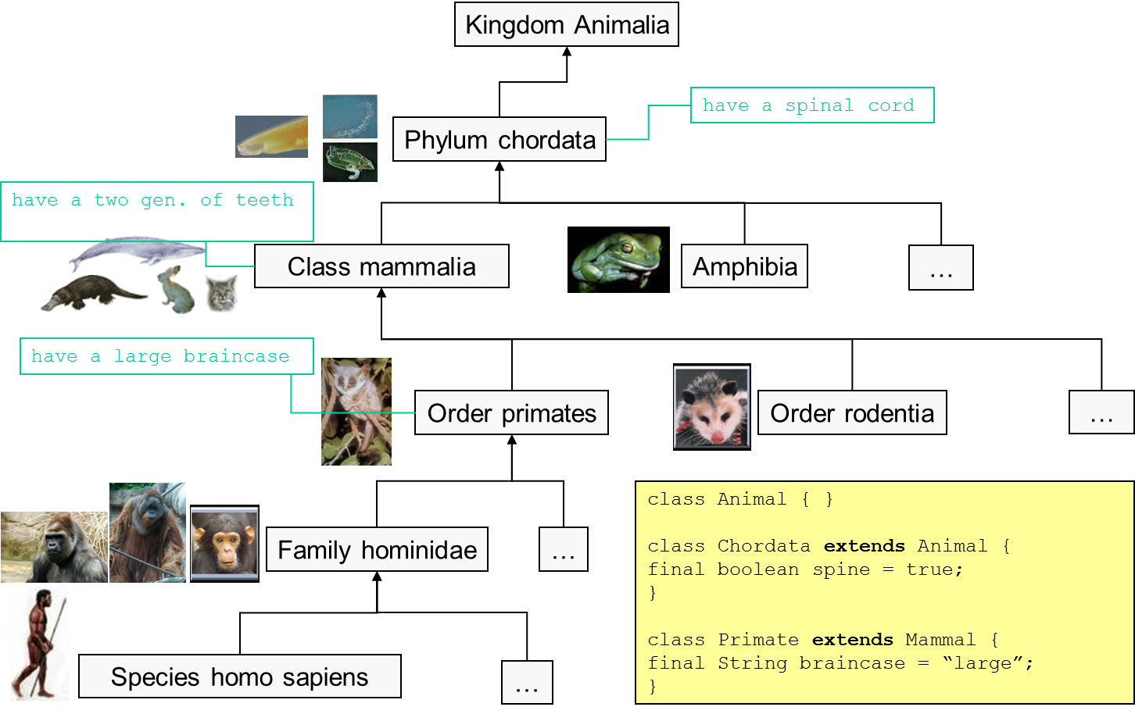
Kingdom Animalia – Phylum Chordata

Slide 4
Window World
Window
Modal Window
Dialog box
Alert window
…
Non-Modal Window
OS Window(minimizable, closeable, maximizable)
Window w/ Menu
Window w/ ribbon
…
Toast alerts
…
…

Slide 5
Software Reuse
The child class inherits members (methods and data) from the parent (inheritance)
To tailor a derived class, the programmer can add new variables or methods, or can even modify the inherited ones. (customization/specialization)
Design approach: Class hierarchies
Advantage: Software reuse
By using existing components to create new ones, we benefit from the effort that went into the design, implementation, and testing of the existing software.
class Student extends Person { … }
class Person {
private String name;
public String getName() { return name; }
}
Student s = …;
System.out.println(s.getName());

Slide 6
Polymorphism in Variables
Polymorphism allows a single variable to refer to objects from different subclasses in the same inheritance hierarchy
For example:
class Student extends Person {
…
}
class Customer extends Person {}
Person p = new Student();
…
p = new Customer();
p will support all the methods from Person in both cases.

Slide 7
Creating an Array
We can exploit the class hierarchy when we use an array, by combining objects from the Window classes.
Window theWindows = new Window[40];
. . .
theWindows[0] = new MenuWindow();
theWindows[1] = new ToastAlert();
theWindows[2] = new RibbonWindow();
. . .

Slide 8
State of the Array
The array theWindows has elements referring to instances of both MenuWindow, ToastAlert and RibbonWindow classes. In fact any class that is inheriting from Window
0 1 2 3 38 39
MenuWindow
ToastAlert
MenuWindow
AlertWindow
ToastAlert
RibbonWindow

Slide 9
Polymorphism and Method Invocation
To show all of the windows, we can now
for (int i = 0; i < theWindows.length ; i++) {
theWindows[i].show();
}
for (Window window : theWindows) {
window.show();
}

Slide 10
The “instanceof” Operator
The instanceof operator allows us to learn the class of an object.
The following code will only show ToastAlert windows.
for (Window window : theWindows){
if(window instanceof ToastAlert) {
window.show();
}
}

Slide 11
Inheritance and Constructors
Unlike members of a superclass, constructors of a superclass are not inherited by its subclasses.
You must define a constructor for a class or use the default (empty) constructor.
The statement: super(); calls the superclass’s constructor.
Provide arguments to suit the parent constructor:
class Student extends Person {
public Student(String name) {
super(name);
}
}
class Person {
public Person(String name) { … }
}

