Slide 1
Polymorphism in Methods
There are two types of polymorphism in methods:
Overloading and Overriding
Overloading
In any class, you can use the same name for different methods with different signature.
Signature = name + list of parameter types
Overloading is resolved by the compiler at compile time.
The compiler will choose the correct method by matching on argument types

Slide 2
Polymorphism in Methods
Overriding
A method in a subclass can have the same name and signature as a method in the superclass.
Overriding is resolved at runtime.
if an object of the subclass, the subclass method is invoked
if an object of the superclass, the superclass method is invoked
technical term: late binding or delayed binding.

Slide 3
Forcing Overriding off: Final
A class which has the keyword final at the start of a class declaration cannot be extended!
A method with the keyword final at the head of its declaration cannot be overridden when its class is inherited!

Slide 4
Forcing Overriding: Abstract
The keyword abstract forces overriding to take place.
When used at the start of a class definition:
zero or more of the class methods are abstract
An abstract method has no body
labelling a method abstract forces some subclass to override it and provide a concrete implementation for the method.
Labelling a method abstract requires the class to be labelled abstract as well.

Slide 5
Superclass/Subclass Compatibility
superclass = subclass // always valid
subclass = (subclass) superclass // valid at compile time, checked at runtime
subclass = superclass // not valid, requires a cast to compile
someClass = unrelatedClass // won’t compile
someClass = (someClass) unrelatedClass // won’t compile
Java language is
static/manifestly typed,
supports partial type inference and
is strongly typed.

Slide 6
Static vs Dynamic typing
In static typing all expressions have their types determined prior to the program being run at compile-time.
For example, 1 and (2+2) are integer expressions
they cannot be passed to a function that expects a string.
Statically-typed languages can be manifestly typed or type-inferred. Most statically-typed languages, such as C++ and Java, are manifestly typed.
However, many manifestly typed languages support partial type inference;
As seen above Java infer types in certain limited cases.

Slide 7
Weak and strong typing
Weak typing allows a value of one type to be treated as another, for example treating a string as a number. This can occasionally be useful, but it can also cause bugs; such languages are often termed unsafe.
Strongly-typed languages are often termed type-safe or safe, but they do not make bugs impossible. Java is strongly typed.
As show above casting can be used to treat a child as a parent
Want to study more:
http://www.sitepoint.com/typing-versus-dynamic-typing/

Slide 8
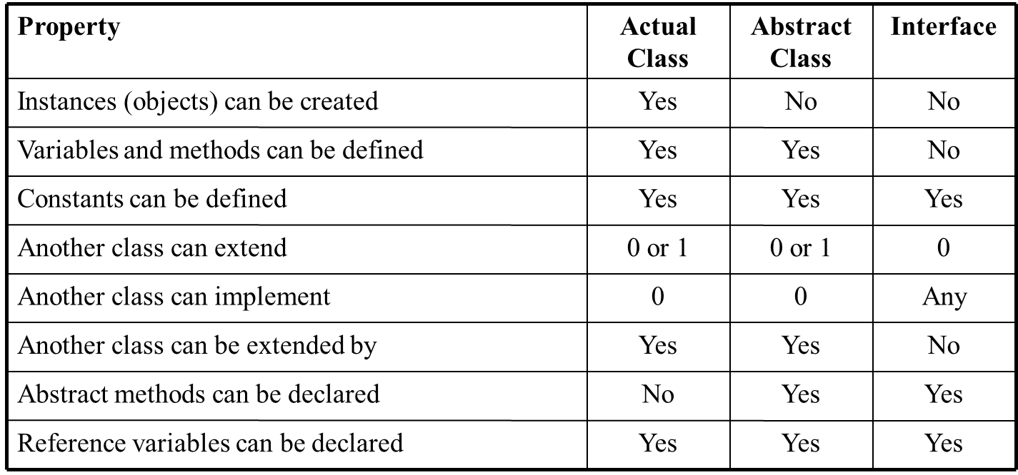
Actual Classes, Abstract Classes and Interfaces

