Slide 1
Craft Demo
SBG Platform Service Craft Demonstration

Slide 2
Who am I
Personal
Name: Shivang Shah
Love to Travel, Take Photos & Swim
Some of my photography work here: https://500px.com/shivangshah
Open Source contributions – Spring Sleuth (distributed tracing), Swagger
Professional
Principal Software Engineer @ Gap Inc.
Senior Software Engineer @ TOTVS | Labs
Software Engineer @ IBM
Software Engineer @ Verizon Wireless
Github profile: https://github.com/shivangshah

Slide 3
Projects
E-commerce monolith Platform decomposition to Microservices (12 factored apps) @ Gap Inc.
Use-case: Decompose Monolith App to 12 Factor, DDD based, microservices
Technologies: Spring ecosystem, Netflix OSS, Pivotal Cloudfoundry, Jenkins, Spock, APIGEE
Customer traffic heatmap @ Gap Inc.
Technologies: Spring ecosystem, Netflix OSS, Cloudfoundry, Elasticsearch, Kibana
Master Data Management @ TOTVS | Labs
Use-case: Manage & maximize quality of customer data by providing Data Management Solutions to promote & distribute cleansed data across systems
Technologies: DropWizard, Jersey, RxJava, Couchbase, Elasticsearch, AWS
Identity Management @ TOTVS | Labs
Use-case: Providing Identity Management Solutions to Enterprises
Technologies: DropWizard, Jersey, Couchbase, RxJava, Neo4J, AWS and 3rd party integrations with Facebook, Google, Linkedin.
IBM Content Manager @ IBM
Use-case: Content Management Produce for Enterprises
Technologies: IBM Proprietary technologies + DOJO framework

Slide 4
Enterprise Twitter
User Stories
User Management
As a User, my profile in Enterprise Twitter is auto-imported through Corporate LDAP
As a User, I can login to the Application using my LDAP credentials
Social Graph
As a User, I can follow my colleagues already using the Application (Followings)
As a User, I can see my colleagues who are following me (Followers)
Message Broadcasting & Feed
As a User, I can `tweet` & `broadcast` my messages to my followers
As a User, I can see latest posts and tweets from my colleagues I am following
Scaling & Performance
As a User, I can enjoy all the provided features without any lag or delay in my experience

Slide 5
High-Level Architecture
Clients
Native Client
Third Party Clients
Microservices
OAuth2.0 + SAML (Authentication & Authorization)
REST APIs & Websockets
Business Logic Layer
Data Access/Persistence Layer
Databases
Messaging
Elasticsearch
Neo4J
Kafka

Slide 6
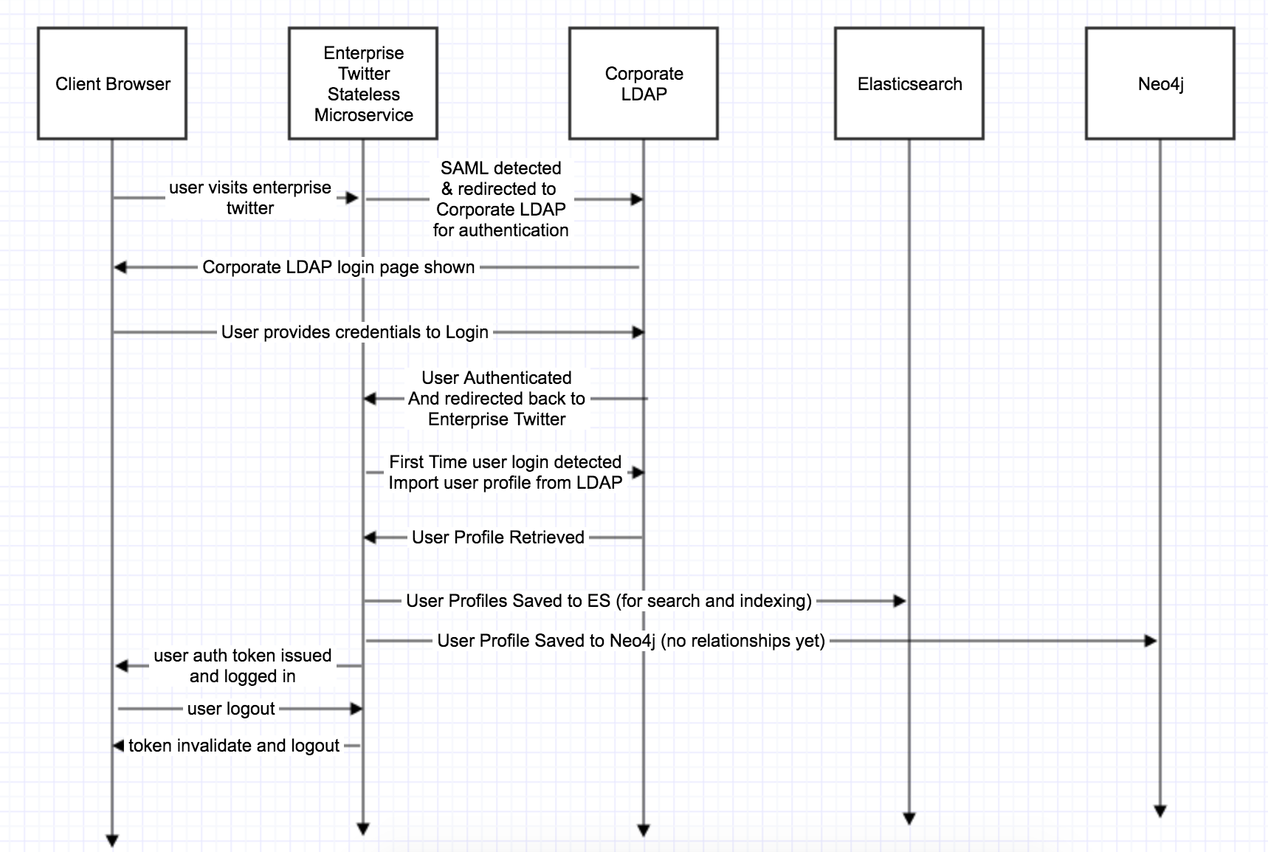
Design Flow (first time user login)

Slide 7
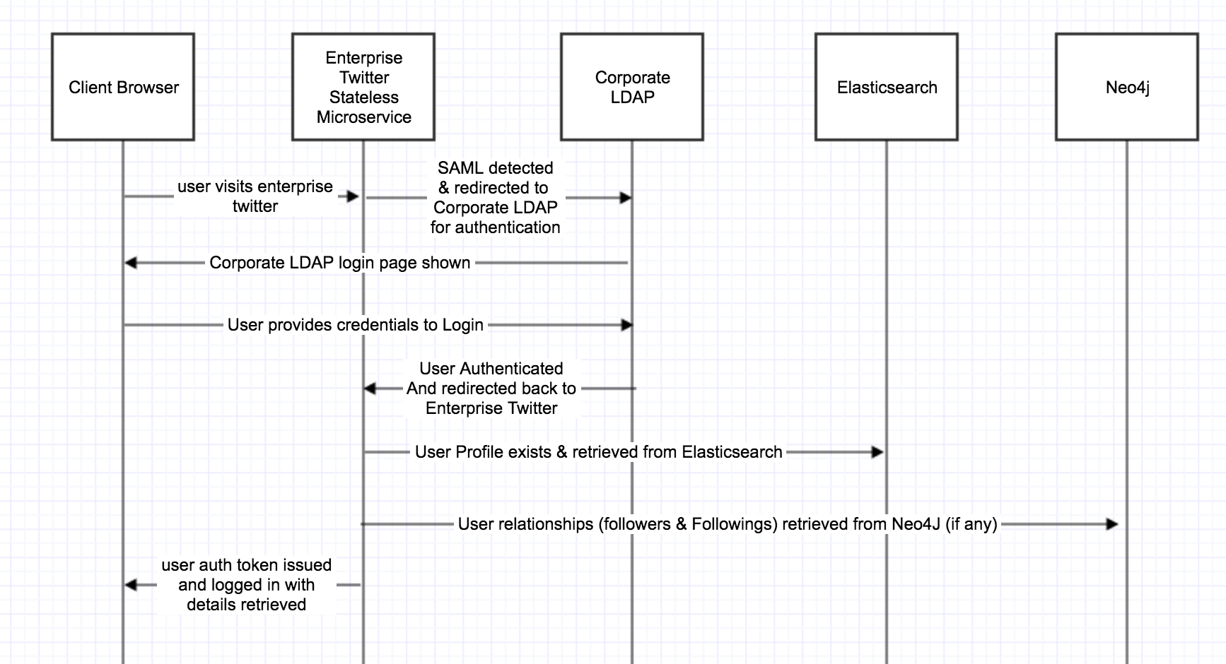
Design Flow (subsequent logins)

Slide 8
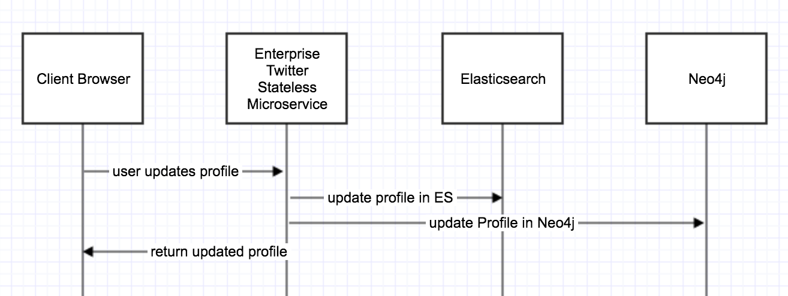
Design flow (user profile update)

Slide 9
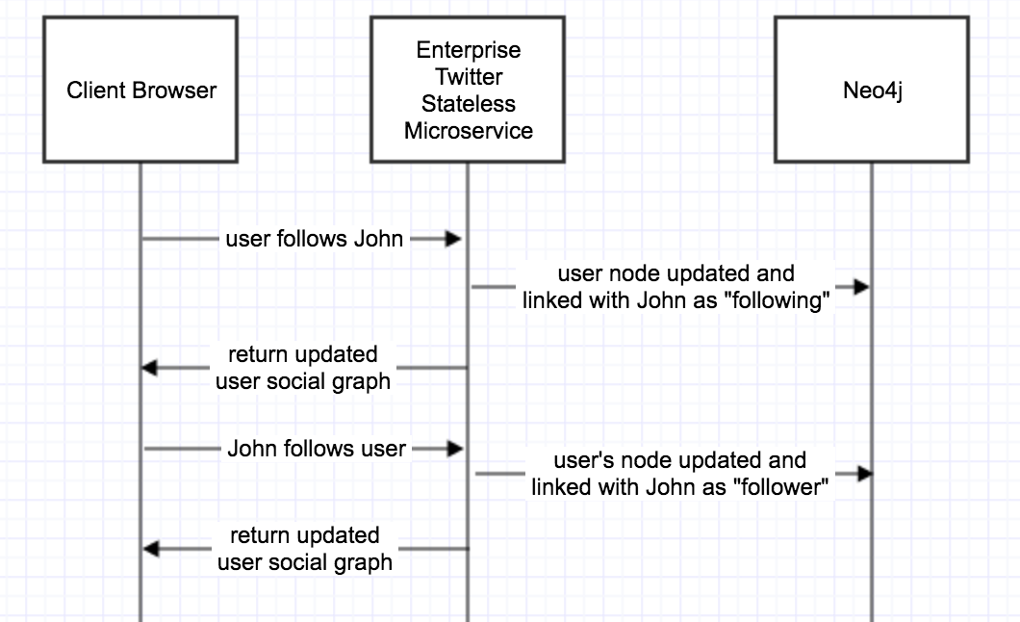
Design flow (user social Graph update)

Slide 10
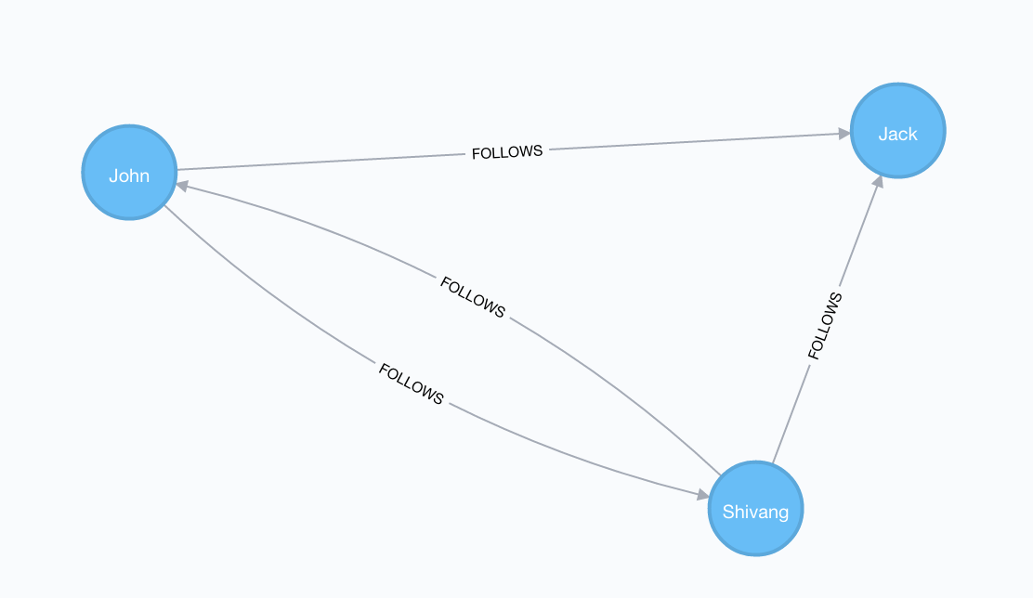
User Social Graph (Neo4J)
Fundamental Graph Problem
Bi-directional “Follows” relationship graph
Create graph: create (Shivang:Employee {name:'Shivang'}), (John:Employee {name: 'John'}), (Jack:Employee {name: 'Jack'}), (Shivang)-[:FOLLOWS]->(John), (Shivang)-[:FOLLOWS]->(Jack), (Shivang)<-[:FOLLOWS]-(John), (John)-[:FOLLOWS]->(Jack)
Query followings: match (n:Employee)-[:FOLLOWS]->(followings) where n.name='Shivang' return n as Shivang, followings
Query followers:
match (followers)-[:FOLLOWS]->(n:Employee) where n.name='Shivang' return n as Shivang, followers

Slide 11
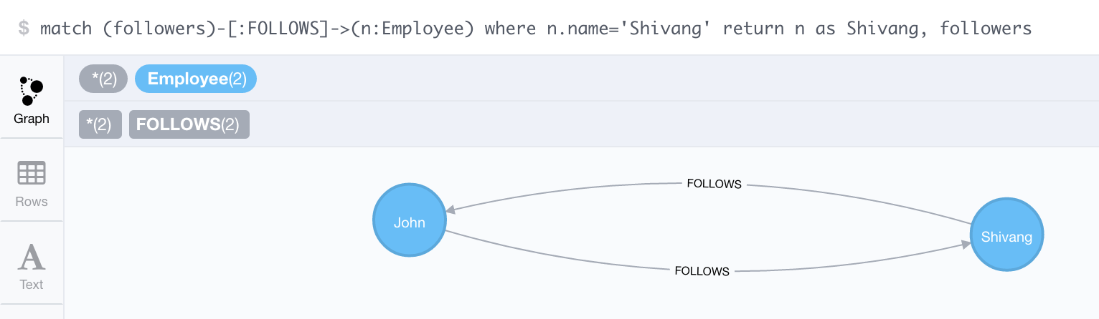
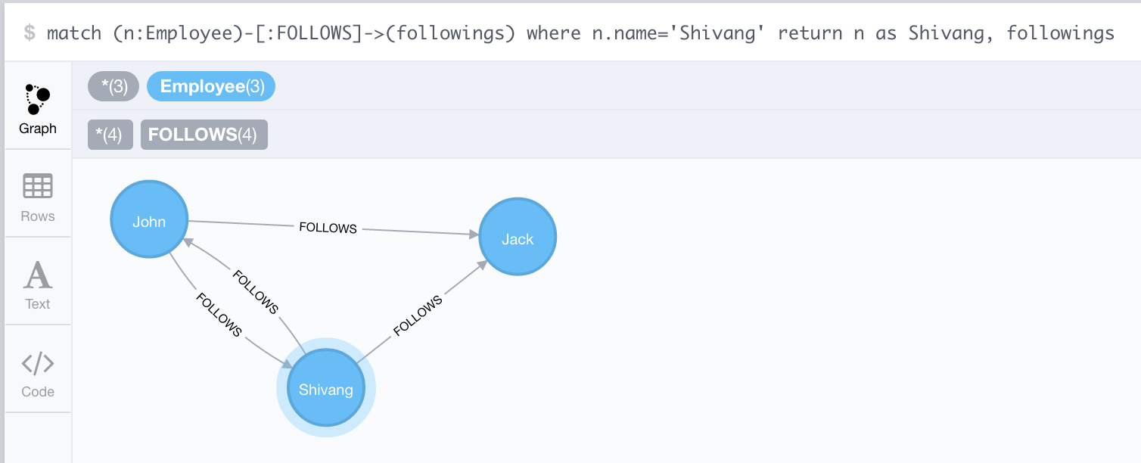

Slide 12
Indexing (Elasticsearch)
3 Indexes -> User, Tweet, AuthTokens
By default, indexing on all attributes
Horizontally scalable architecture
Minimum 2 node cluster
Index archiving and rolling + snapshot backup per index
Extremely high throughput for document search & retrieval

Slide 13
Design (Microservices)
Three tiered architecture
Hystrix protected business layer for resiliency
RxJava + DeferredResult + asynchttpclient for end-to-end non-blocking architecture
Spring MVC for REST APIs
Spring Sleuth for distributed Tracing
Spring Actuator for health check and info endpoints
Spring Security for OAuth2 + SAML
Spring websockets for message broadcasting
Testing Strategy: Spock based Unit + Integration + End-To-End. PactJVM for Contract Tests
Swagger Springfox for documentation

Slide 14
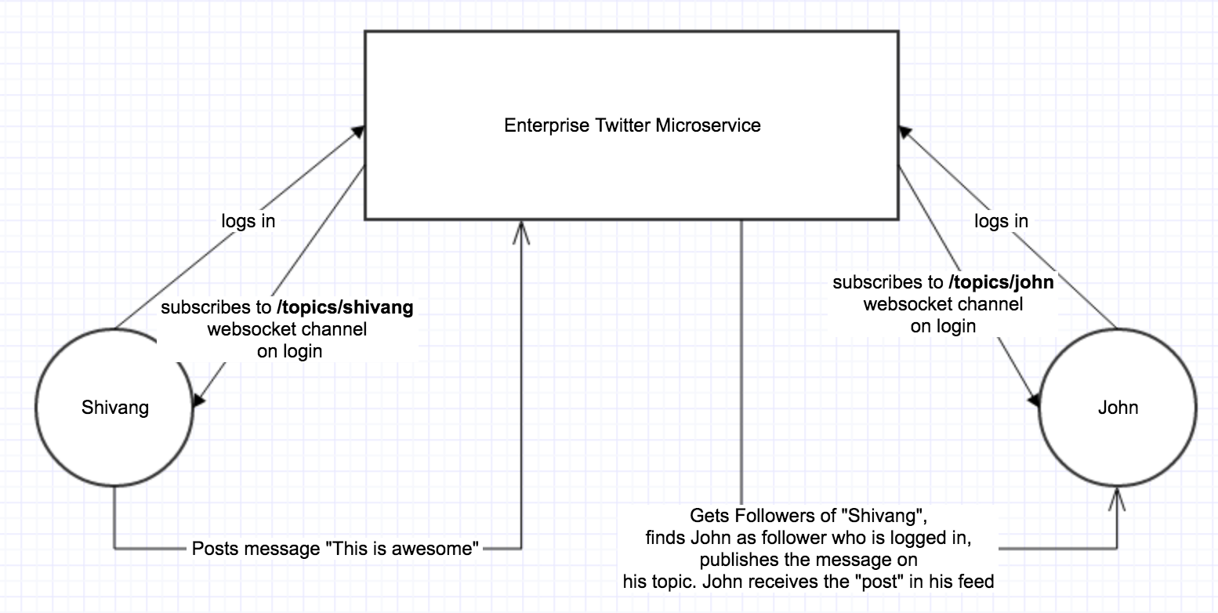
Message Broadcasting

Slide 15
Message Broadcasting (Cont.)
In a distributed environment, as websockets are sticky, long lived TCP connections, A messaging server (Kafka) needs to be used to communicate the broadcasted message across all the application nodes
All application nodes by default are subscribed to a topic on Kafka
When a new post is broadcasted by a user, the handling application node, finds the user’s followers, adds that as the metadata to the message, and publishes it to Kafka
All the subscribed nodes now receive the message on topic. Based on the “followers” metadata, the app node figures out of there are any websocket subscriptions open for 1 ..* “followers” in the list. If so, the original user’s post is than published on their channel

Slide 16
User Feed
Because of the indexing strategy implemented using Elasticsearch, Populating User Feed on user login is as simple as an ES query
{"from":0,"size":10,"query":{"bool":{"must":{"bool":{"should":[{"query_string":{"query":"AVUjCi5fxiqX9fSryYNy","fields":["userId"]}}]}}}},"sort":[{"timeCreatedInMillis":{"order":"desc"}},{"timeCreatedInMillis":{"order":"desc"}}]}
The above query supports pagination as well. Because at the core of Elasticsearch is Lucene based search engine, the performance and throughput is very high

Slide 17
Scaling & Performance
Choice of technologies out-of-the-box provide horizontal scaling & high throughput
As Microservices by default are stateless, and all states are in shared database (including Auth Tokens and corresponding sessions), it’s very easy to have container based deployments and horizontal scalability in Cloud Foundry
Neo4J & Elasticsearch are default horizontally scalable databases
Because the inserts in a graph database is comparatively heavy (add/remove relationships), Neo4j cluster can be divided into READ cluster and WRITE cluster and can be scaled independently depending on the usecase

Slide 18
3rd Party Clients
Opening up the REST APIs Platform to 3rd Party Clients
Vanilla OAuth2.0 authentication & Authorization (client credentials OR JWT)

Slide 19
Continuous Integration & Deployment
Jenkins for Continuous Integration (CI)
Full automated Pipeline based CI with automatic audit trails in Corporate Ticketing System.
Cloud Foundry as Deployment Platform (deployment is comparatively easier for Spring Ecosystem based applications)

Slide 20
Q&A

