Slide 1
Portfolio Building
Flask Basics
Notes:
Hello Everyone, Welcome to portfolio building class. I’ll meet you in everyweek on Wednesday. In this class, at the beginning, we’ll start with hands-ons which you won’t responsible to handle. After a couple of weeks later, we’ll give you projects in every week. They are going to be related with the topics you've learned. We’ll want you to prepare the infrastructure of projects based on requirements. You’ll try to build them by yourself or with your teamates. I strongly recommend you to make an afford them with your teammates. Sometimes, after you dig them up, you couldn’t find the correct way, sometimes you are able to handle with your teammates, or sometimes you solve them by yourself and help another fellow. The first thing that I want to say, please push yourself, while solving projects. Keep digging and don’t give up. The second thing is please open to share your knowledge. As long as you share your knowledge, not only you can repeat it again, but anyone else can learn you useful info. If you explain your knowledge to another fellow, from that moment, you literally belong that one and definetely nail them into your brain. Let me go over, two things are important, please keep eagerly digging up, please open to share your knowledge anyone else. May be these are going to be our motto.
All in all, don’t worry, this is just a learning process. When we give a Project a couple of weeks later, we are going to solve that Project together after a week later. We just want you to get your hands dirty and try to overcome projects.
The main aims of this class to build your impressive Github repo and show you the real life problem --as much as we can-- . Naturally, since your knowledge increases gradually, we’ll start with projects basic ones and climb to top together.
There is one more thing that I want to say, Taking reaction from someone else is going to increase our motivation, please do not hesitate to touch other’s shoulder and give them your supports, If somebody share something in anywhere on slack, please put your emoji or thumbs up and get them smile.

Slide 2
Table of Contents
What is the Framework
What is the Flask
Create Basic Flask App
Notes:
This is our table of contents Guys! At the beginning, we’ll learn fundamentals of frameworks. Obviously, we are not able to go over each framework and this is not our scope. In production environment, we won’t write code as DevOps, however, we have to understant some basics of framework. Because, even though we don’t have any writing code responsibility, we’ll have to be stood up that code on our infrastructure which means when we get any code given by developer, we need to know how to run that code, how to link that code with html pages or how to connect that code with databases. Thats why we’ll show you as DevOps basics of framework. There is one more thing that I want to say, although each code has different systax, when you get the idea behind one of them, others can easly understandable, don’t worry. So, we’ll show you one of the basic framework which name is Python Flask.

Slide 3
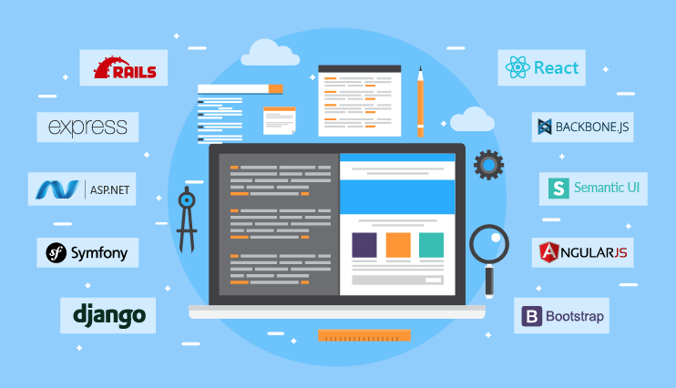
What is Framework
Notes:
Every website has some components working behind like database, user interface, server, browser etc. and if you try to manage them by yourself, you realize that it is very tough job. Thats why they have to be coordinated by single hand. If it doesn’t, they can not talk each other properly. Web framework comes into picture in this point. Basically, a web framework ties up the user interface, database, server, browser and middleware system and streamlines the process flow. In other words, this software framework is essential for development of web applications, web services and dynamic websites as well as static websites. Today we’ll create a static website, and we’ll show you how to create dynamic website later.

Slide 4
Features of Frameworks
Skeleton
Templates
Web Caching
URL Mapping
Security
Notes:
5 main features for frameworks we can talk about
Skeleton generally refers to a quickly set up main columns for a website or app. This is the essential building block of development which allows a developer to quickly put a frame in place to build custom parts on top of it.
As with skeleton, many frameworks provide pre built templates that help us to quick design of a site. Some can have a very basic look with limited functions and some can be innovative designs with unusual features.
Web caching helps store various information to provide faster website loading on the front-end and avoid servers overloading when lots of works are being undertaken in the back-end.
Due to the structured nature of frameworks, it can easily be indexed by search engines which will help with any search engine optimisation (SEO) campaigns you undertake.
Security- Most development frameworks have the necessary requirements to secure website and applications against the most common weaknesses (vulnaribilities). Alse, they are frequently updated to ensure they can defend against the latest attacks. We have to always consider this security problem, while we are working on DevOps as well
https://www.rapid7.com/fundamentals/types-of-attacks/
Malware
Phishing
SQL Injection Attack
Cross-Site Scripting (XSS)
Denial of Service (DoS)
Session Hijacking and Man-in-the-Middle Attacks
Credential Reuse

Slide 5
Advantages of Frameworks
Quick
Open source
Customisable
Support
Notes:
Its Quick. This could be considered the most vital reason why frameworks exist. They eliminate the need to write a lot of repetitive code that you will find being used in many different applications. These include, for example, user-authentication and commenting systems. On average (if you have sufficient knowledge using a certain framework) you can expect to build a project in much less time than would be achieved writing code without a framework. You might think this as writing something on paper. We need pen, paper and table. If we use framework, it puts a paper, pen on the table on behalf of you. But, without framework, you have to cut tree in the forest and produce paper with it, you have to produce table and pencil by yourself as well. It is not only handy for you, but time saving and fast process.
Most of the popular frameworks in many languages are open-source, meaning they are freely available and may be use and modified, normally free of charge and come with unrestricted licences.
These are also easily customizable
Many of the most popular frameworks have good documentation and/or good support. There are large communities of developers out there that will have experienced similar issues SOOO problems can be solved quickly with the help of other web professionals.

Slide 6

What and Why is Flask
Notes:
Flask is a framework which is independent from Phyton.
It is a very easy to learn and simple one.
You can make amazing projects in a very short time with Flask.
Django has a much more difficult and complex structure than Flask. However, you can continue to Django after learning Flask. As I said before, we are not going to learn whole components of Flask. We’ll learn as much as we need.

Slide 7
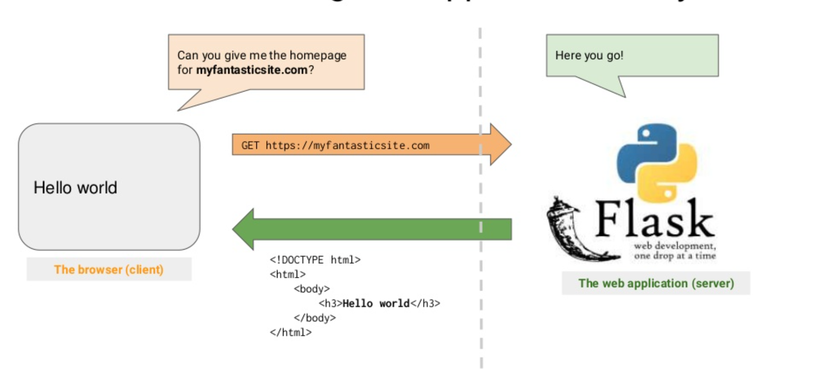
What and Why is Flask
Notes:
so, we can say flask is a micro framework. it is written in Python which enables us to develop web applications. In addition, a basic knowledge of HTML is sufficient for Flask. we are not going to learn whole Flask framework, however, we'll focus on just the basic usage of it.
As a DevOps, as I sadi before, we don’t need to know exactly what the code is, but we need to familiar with framework's structure. Because, even though we won’t read the code or what the code implement exactly, we need to know it’s environment which can be a flask, django, Java etc. If you familiar with one of them, eventhough there are differencies among each other. You can easly get the idea of them and when they give a code, you can easly tie the components of them up.

Slide 8
What and Why is Flask
Flexible
Easy to learn
easy to redirect URLs
Do not need to compile
Notes:
It is flexible
easy learn and use
Redirection of URLs is very understandable and handy
And of course, above all, since python is an interpretable language, it doesn't need to compile, therefore it is the biggest factor that gets the processing time shorter.

Slide 9
Elastic Load Balancing (ELB)
Let's get our hands dirty!
- Creating Basic Flask application
- Creating Flask application with Jinja Template

Slide 10
THANKS!
Any questions?
You can find me at:
Slack: @serdar - instructor
Email: serdar@clarusway.com

Slide 11
Virtual Environment
Notes:
Why Should I Use Virtualenv?
I can just say virtual environment sometimes saves lives. While we were teaching Python in the first lesson, we said that Python is an open source software and has a lot of libraries. Thanks to this, the versions of the libraries are constantly changing. When we uninstall or load a library, sometimes it is not compatible with each other. This can sometimes be a lot of trouble and waste a lot of our time. That's why we need an isolated spot where we can install libraries that we need. Of course these are not going to be affacted our OS system. At the end of the book, virtual environment saves our lives and you should use virtualenv. There is one more thing that I wanna say, on the other hand, we are going to use EC2, while we are working on Project and, we won’t use virtual environment with EC2. Because Ec2 is going to be virgin space and we don’t need to create isolated spot inside it. Today I am gonna show you how to set a virtual environment on your computer and how to install programs that we need. Thus, you are gonna learn how to create a virtual environment and use it.

