Slide 1
Portfolio Building
Flask GET and POST Methods
Notes:
Hi Guys. Before We write a small code to understand where do we need GET and POST methods, We have a small presentation about main idea behind these HTTP methods

Slide 2
Table of Contents
What is HTTP Methods
GET Medhod
POST Method

Slide 3
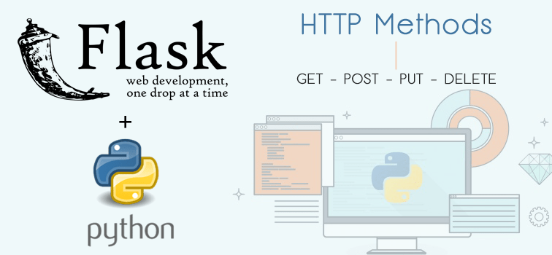
What is HTTP Methods
Notes:
HTTP stands for Hyper Text Transfer Protocol and it is a protocol (rules) that describes how servers and users communicate with each other. When we search for something on google, we send a request to the servers and the server sends a response to us.

Slide 4
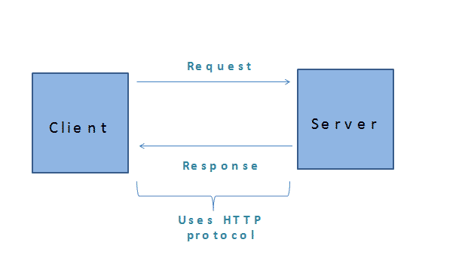
REQUEST RESPONCE PROCESS
Notes:
Lets go over the process together step by step
1. The Client sends the Request
The Request may be for an HTML file located on the server or Request to update the database or It could be asking for a file to download or to Send an e-mail
2. The Server Process the request and prepares a Response.
The Server looks at the Request and performs the requested action. It might get the HTML file or update the Database.
3. The Server sends the Response based on request
4. The Client Receives the Response
If client clicks another hyperlink it initiates another Request Response with this sequence

Slide 5
HTTP Methods
GET
POST
DELETE
HEAD
PUT
Notes:
The HTTP protocol defines the type of requests that can be sent from the client to Server. These are called request methods or Verbs. Some of the Request methods are GET, POST, DELETE, HEAD, PUT
GET is utilized to request data from a specified resource. This is one of the most common HTTP methods.
Important Notice
GET requests can be cached
GET requests remain in the browser history
GET requests can be bookmarked
GET requests should never be used when dealing with sensitive data
GET requests have length restrictions
GET requests are only used to request data (not modify)
2. The POST Method
POST is used to send data to a server to create/update a resource. This is another one of the most common HTTP methods. When you sent an input from any userinterface, you sent a data to the application running on backend. It means you post variables.
POST requests are never cached
It does’t remain in the browser history. You can not see your inputs in your history
It cannot be bookmarked and it has no restrictions on data length. However, browsers can keep your inputs like credentials using their features. But they don’t use POST method to do this.
Let me go over them again, The GET method is used to ask for a specific document - when you click on a hyperlink, GET is being used. GET should probably be used when a URL access will not change the state of a database (by, for example, adding or deleting information) and POST should be used when an access will cause a change.
3. The DELETE Method
The DELETE method -As the name suggests- deletes the specified resource.
4. The HEAD Method
The HEAD method is used to ask only for information about a document, not for the document itself. HEAD is much faster than GET, as a much smaller amount of data is transferred. It's often used by clients who use caching, to see if the document has changed since it was last accessed. If it was not, then the local copy can be reused, otherwise the updated version must be retrieved with a GET.
5. The PUT Method
PUT is used to send data to a server to create/update a resource.
The difference between POST and PUT is that PUT requests are idempotent. That is, calling the same PUT request multiple times will always produce the same result. In contrast, calling a POST request repeatedly have side effects of creating the same resource multiple times.

Slide 6
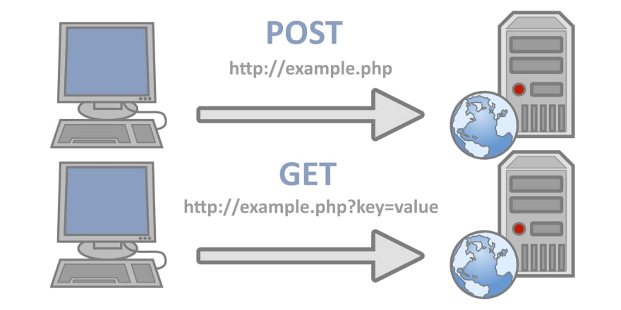
GET & POST METHODS
Notes:
The GET method is used to get data from the server. It sounds very familiar to you because we've always done these things so far. For example, when we open our web page or when we go to any page on the browser, we request an address on the web. In the browser, this request is done with the GET method.
POST method –like I said before-is used to send data to the server. You can send data in unlimited capacity to the server with the POST method. Since the data sent with the POST method is stored in the request body of the HTTP request, it makes the data more secure. However, the POST method is slower than the GET method.
In short, we will use the GET method to get the information from the server and use the POST method to send the information to the server.
Lets go ahead and look at our web-pages. When I hit enter clarusway web-address on browser, the root page returns me right. It means I ask to the server, please GETs the root path’s page. We can say same thing for other paths or subpaths. All those return us with this GET method. You can see, if you click the inspect option, come to the network part. You can see the requests, than if you select the headline, you can see the HTTP methods. As you see methods is GET. If you come to the contac us section, there is a form which asks as different informations for example name, surname, email or etc. When you type you informations and hit the enter button, those infos are accepted as input and they are posted to the server as variable. Why does it return a server, because our application runs on that server. From that point, web-application uses that variables based on your needs. In this example, application took our variables and wrote them on database. Then it returns as a response! What was the response “ your informations successfully added”. Today we’ll focus on how to write a post method in our Flask application
Lets get hands dirty

Slide 7
THANKS!
Any questions?
You can find me at:
@serdar
serdar@clarusway.com

