Slide 1
ANKARA YILDIRIM BEYAZIT UNIVERSITY · CENG410 – DATA MINING
MATERNAL RISK
PREDICTION
Machine Learning Based Classification Analysis
Rümeysa YAVUZKANAT – 21050111081 Emine Sena TOP – 21050111082
2026 / Data Mining Project

Slide 2
Project Overview
Motivation & Objectives
Why Maternal Health?
ML Pipeline
Pregnancy complications remain a leading cause of maternal mortality worldwide
Early risk identification enables preventive treatment & timely intervention
Manual analysis of medical data is error-prone and time-consuming
ML algorithms detect hidden patterns in complex medical datasets
Predictive models support clinical decision-making in real-time
01
EDA
Explore distributions,
correlations & patterns
02
Preprocessing
Handle missing values,
scale & encode features
03
ML Models
Train 5 classification
algorithms
04
Evaluation
Accuracy, ROC-AUC,
F1, CV scores
05
Feature Analysis
Identify key medical
predictors

Slide 3
Dataset Description
Maternal Health Risk Dataset – 1205 Observations
1,205
12
11
1
Observations
Columns
Features
Target Variable
Dataset Features
Feature | Type | Medical Meaning
Age | Continuous | Age of pregnant individual
Systolic BP | Continuous | Systolic blood pressure (mmHg)
Diastolic | Continuous | Diastolic blood pressure (mmHg)
BS | Continuous | Blood sugar level (mmol/L)
Body Temp | Continuous | Body temperature measurement
BMI | Continuous | Body Mass Index
Previous Complications | Binary | Prior pregnancy complications
Preexisting Diabetes | Binary | Diabetes before pregnancy
Gestational Diabetes | Binary | Diabetes during pregnancy
Mental Health | Binary | Mental health condition indicator
Heart Rate | Continuous | Heart rate (bpm)
Risk Level ★ | Target | High Risk (1) / Low Risk (0)

Slide 4
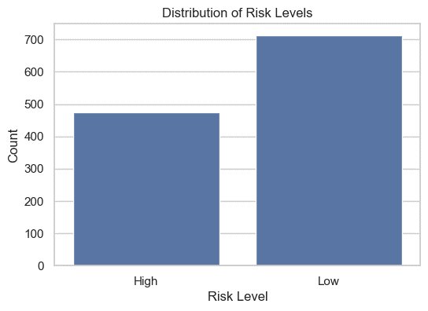
Target Variable
Maternal Risk Level Classification
Target Encoding
Original Label | Encoded Value
Low Risk | 0
High Risk | 1
Binary classification task
Low Risk class: 711 observations (59%)
High Risk class: 470 observations (39%)
Mild class imbalance — manageable for ML

Slide 5
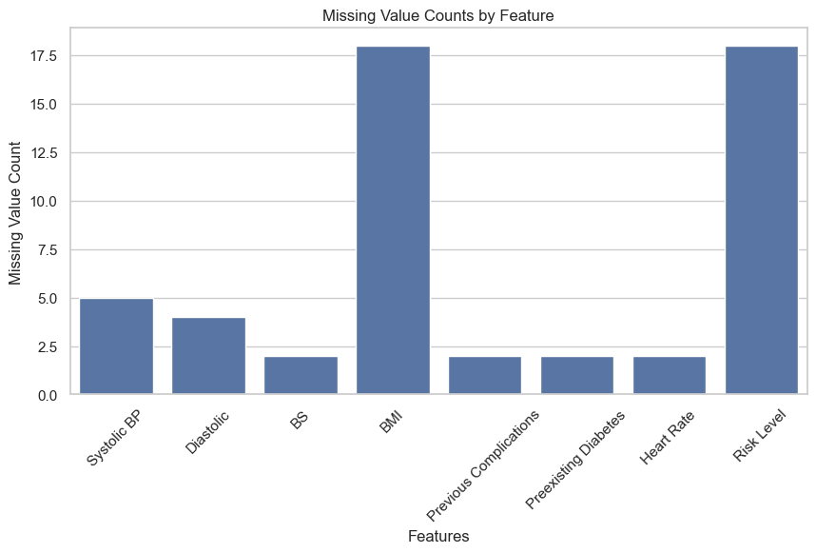
Missing Value Analysis
Identifying & Handling Incomplete Medical Data
Features with Missing Values
BMI
18
Risk Level
18
Systolic BP
5
Diastolic
4
BS / HR / etc.
2 each
Imputation Strategy
Numerical features → Median imputation
Categorical target → Mode imputation
Interpretation
Missing rate is low (~1.5%) — safe to impute
Dataset size preserved (1205 observations)

Slide 6
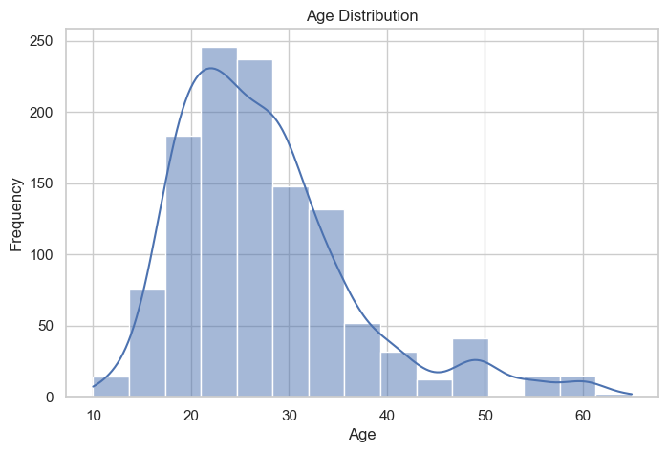
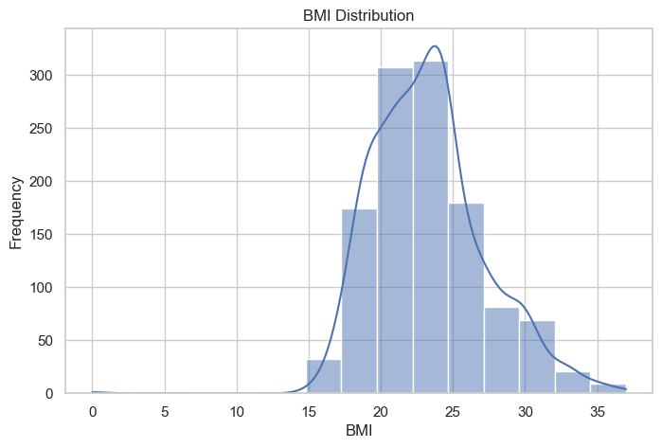
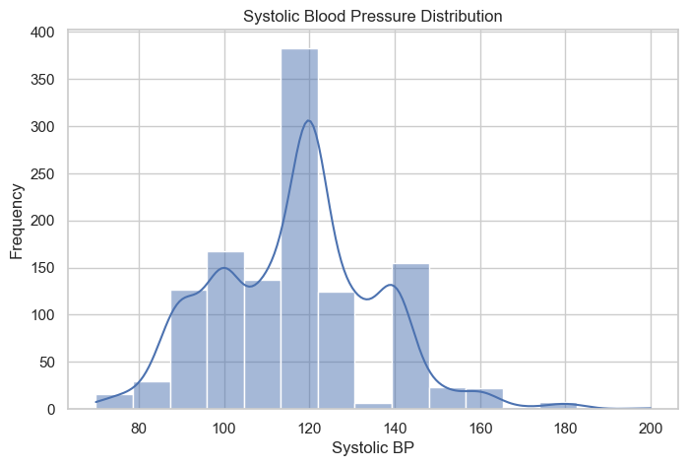
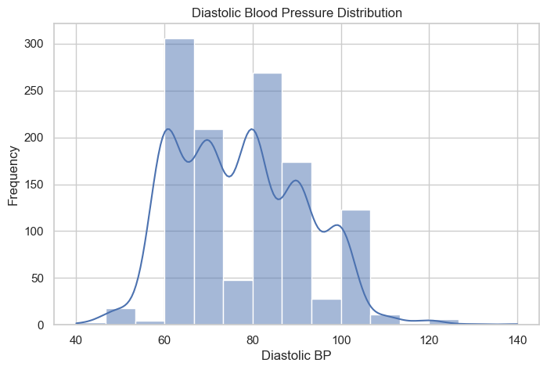
Feature Distribution Analysis
Statistical Distributions of Key Medical Indicators
Age Distribution
BMI Distribution
[INSERT IMAGE: EDA/3 - Age Distribution.png]
Right-skewed; most patients aged 20–35. Reflects typical maternal age range in the dataset.
[INSERT IMAGE: EDA/5 - BMI Distribution.png]
Near-normal; centred ~20–25. High-BMI outliers indicate obesity-related risk.
Systolic BP
Diastolic BP
[INSERT IMAGE: EDA/7 - Systolic Blood Pressure Distribution.png]
Bimodal; peaks at 100 & 120 mmHg. Elevated values signal hypertension risk.
[INSERT IMAGE: EDA/9 - Diastolic Blood Pressure Distribution.png]
Multimodal; centred 60–90 mmHg. Higher outliers may indicate hypertension.

Slide 7
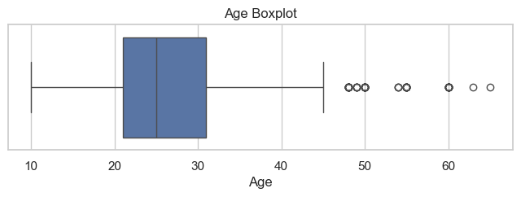
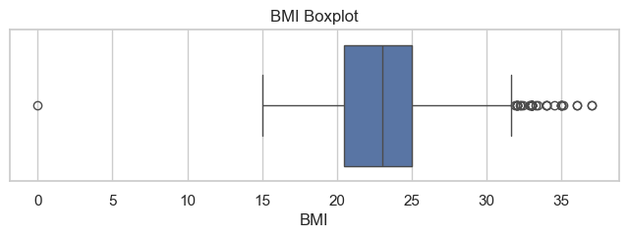
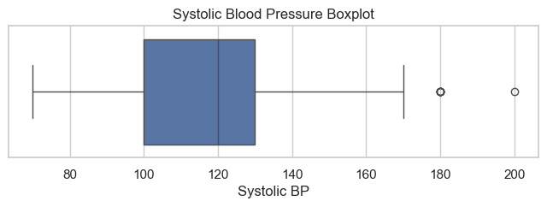
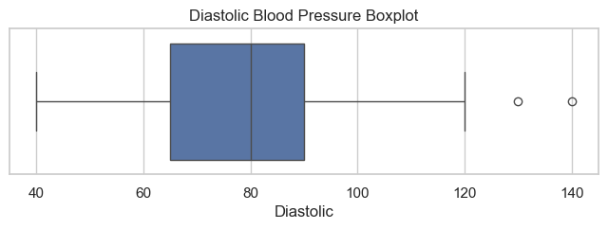
Outlier Analysis
Boxplot-Based Detection of Extreme Medical Values
Outliers detected via IQR method (boxplots) — values beyond Q1 - 1.5×IQR or Q3 + 1.5×IQR
In medical datasets, outliers may represent clinically significant high-risk patients → PRESERVED in preprocessing
Age Boxplot
BMI Boxplot
[INSERT IMAGE: EDA/4 - Age Boxplot.png]
Outliers at 50–65 yrs indicate older maternal patients with elevated risk
[INSERT IMAGE: EDA/6 - BMI Boxplot.png]
High-BMI outliers linked to obesity-related maternal complications
Systolic BP Boxplot
Diastolic BP Boxplot
[INSERT IMAGE: EDA/8 - Systolic Blood Pressure Boxplot.png]
Values >170 mmHg suggest severe hypertension risk conditions
[INSERT IMAGE: EDA/10 - Diastolic Blood Pressure Boxplot.png]
Outliers at 120–140 mmHg may indicate hypertensive disorder

Slide 8
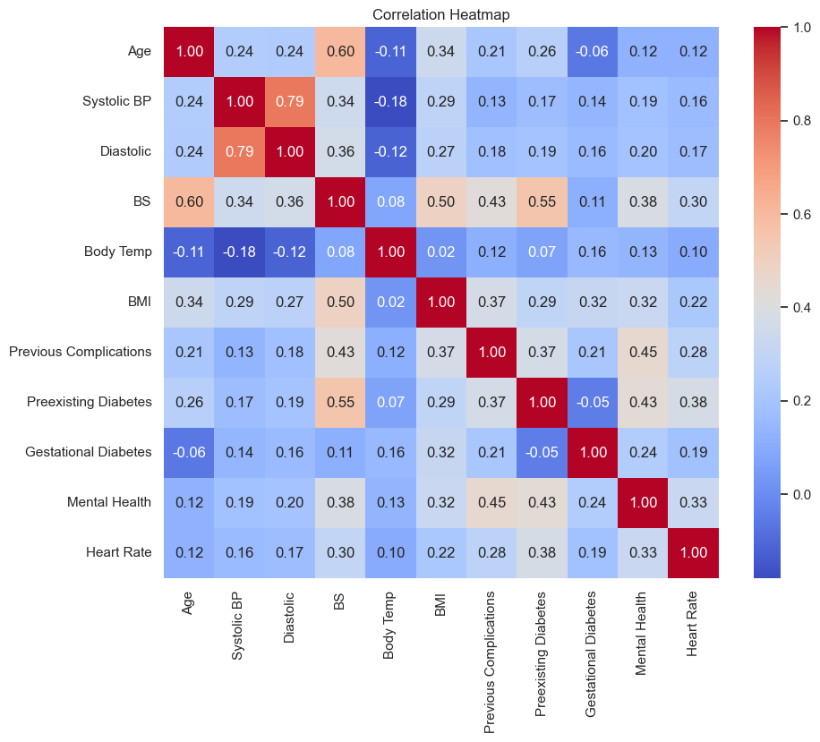

Correlation Analysis
Pearson Correlation Coefficient Between Medical Features
Pearson Correlation Formula
[INSERT IMAGE: EDA/11 - Correlation Heatmap.png]
$$r= \frac{Σ\left[\left(xᵢ−\bar{x}\right)\left(yᵢ−ȳ\right)\right]}{\sqrt{\left(Σ{\left(xᵢ−\bar{x}\right)}^{2}·Σ{\left(yᵢ−ȳ\right)}^{2}\right)}}$$
Key Findings
Systolic ↔ Diastolic BP: r = 0.79 (strong cardiovascular link)
BS ↔ Preexisting Diabetes: r = 0.55 (metabolic relationship)
BS ↔ Age: r = 0.60 (age-related glycemic pattern)
Previous Complications ↔ Mental Health: r = 0.45
Heart Rate ↔ Preexisting Diabetes: r = 0.38
Body Temp shows weakest correlations (r ≈ -0.1 to 0.1)

Slide 9
Preprocessing Pipeline
Preparing the Dataset for Machine Learning
1
2
3
4
Missing Values
Target Encoding
Train-Test Split
Feature Scaling
Median imputation for numerical
Mode imputation for categorical
Low Risk → 0 | High Risk → 1
Binary classification task
80% Training (964 obs)
20% Testing (241 obs)
Stratified | random_state = 42
StandardScaler applied
z = (x − μ) / σ
Essential for KNN, LR, SVM
Why Scaling Matters:
Features with large numerical ranges (e.g. Blood Pressure vs. binary indicators) would dominate distance calculations in KNN and SVM without standardization, causing biased predictions. StandardScaler transforms all features to μ ≈ 0, σ ≈ 1.

Slide 10
Machine Learning Models
Five Supervised Classification Algorithms Compared
Logistic Regression Sigmoid: P(y=1) = 1 / (1 + e⁻ᶻ) where z = w₁x₁ + w₂x₂ + … + wₙxₙ + b
Logistic
Regression
K-Nearest
Neighbors
Support Vector
Machine
Decision
Tree
Random
Forest
Theory
Theory
Theory
Theory
Theory
Sigmoid function maps linear combinations to probabilities
Classifies by majority vote of k nearest neighbors using Euclidean distance
Finds optimal hyperplane maximizing margin between classes
Recursive feature-based splits using Gini Impurity to minimize node impurity
Ensemble of trees with bootstrap sampling + random feature selection, majority vote
Strengths
Strengths
Strengths
Strengths
Strengths
Interpretable, fast, strong baseline
Simple, captures local patterns
High-dim robustness, strong generalization
Interpretable rules, captures nonlinearity
Best accuracy, feature importance, robustness
Why Selected
Why Selected
Why Selected
Why Selected
Why Selected
Effective for binary classification with scaled features
Works well when similar profiles share risk levels
Effective for complex boundaries in medical data
Transparent decision paths for clinical use
Reduces overfitting via ensemble averaging

Slide 11
Model Evaluation Metrics
Comprehensive Performance Assessment Framework
Accuracy
Precision
Recall
(TP + TN) / (TP + TN + FP + FN)
TP / (TP + FP)
TP / (TP + FN)
Overall correct classification rate
Among predicted positives, how many are truly positive
Among actual positives, how many are correctly detected
F1-Score
ROC-AUC
Cross Validation
2 × (Precision × Recall) / (Precision + Recall)
Area Under ROC Curve
CVₘₑₐₙ = (1/k) Σ Scoreᵢ
Harmonic mean balancing precision & recall
Class discrimination: 0.5 = random, > 0.9 = outstanding
5-fold CV; measures generalization to unseen data
Confusion Matrix components: TP = correctly predicted High Risk | TN = correctly predicted Low Risk | FP = Low Risk predicted as High Risk | FN = High Risk predicted as Low Risk (most critical to minimize)

Slide 12
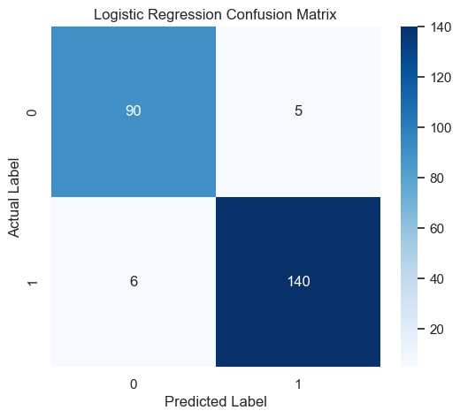
Logistic Regression — Results
95.44%
0.9531
0.97
0.96
0.96
Accuracy
ROC-AUC
Precision
Recall
F1-Score
Confusion Matrix
 | Pred Low (0) | Pred High (1)
Act Low (0) | 90 | 5
Act High (1) | 6 | 140
Strong baseline performance for binary classification
Balanced precision & recall across both classes
Low computational cost — suitable for real-time screening
11 total misclassifications out of 241 test cases

Slide 13
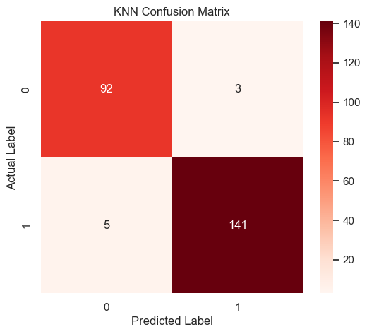
K-Nearest Neighbors — Results
96.68%
0.9671
0.98
0.97
0.97
Accuracy
ROC-AUC
Precision
Recall
F1-Score
Confusion Matrix
 | Pred Low (0) | Pred High (1)
Act Low (0) | 92 | 3
Act High (1) | 5 | 141
Strong neighborhood-based learning performance
High recall — detects most high-risk cases
Only 8 misclassifications out of 241
Feature scaling was critical for accurate distance calculations

Slide 14
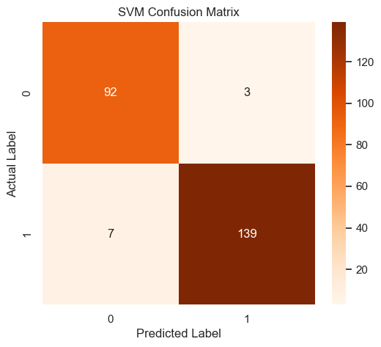
Support Vector Machine — Results
95.85%
0.9602
0.98
0.95
0.97
Accuracy
ROC-AUC
Precision
Recall
F1-Score
Confusion Matrix
 | Pred Low (0) | Pred High (1)
Act Low (0) | 92 | 3
Act High (1) | 7 | 139
Effective decision boundary learning via margin maximization
Strong generalization capability on unseen data
Robust to high-dimensional feature space
10 total misclassifications out of 241 test cases

Slide 15
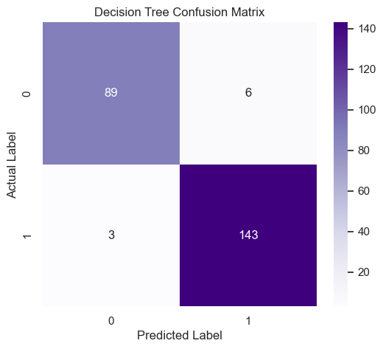
Decision Tree — Results
96.27%
0.9581
0.96
0.98
0.97
Accuracy
ROC-AUC
Precision
Recall
F1-Score
Confusion Matrix
 | Pred Low (0) | Pred High (1)
Act Low (0) | 89 | 6
Act High (1) | 3 | 143
Highest recall (0.98) — minimal missed high-risk cases
Interpretable rule-based classification structure
Decision paths can be directly analyzed clinically
Only 9 total misclassifications

Slide 16
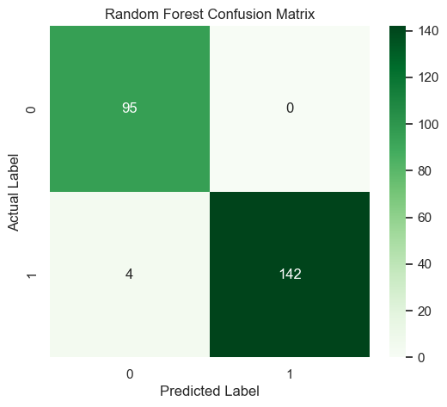
Random Forest — Results
98.34%
0.9863
1.00
0.97
0.99
Accuracy
ROC-AUC
Precision
Recall
F1-Score
Confusion Matrix
 | Pred Low (0) | Pred High (1)
Act Low (0) | 95 | 0
Act High (1) | 4 | 142
★ BEST MODEL — Highest accuracy & ROC-AUC
Zero false positives — perfect Low Risk detection
Ensemble averaging significantly reduces overfitting
Only 4 misclassifications — lowest error rate

Slide 17
Cross Validation Analysis
5-Fold Cross Validation — Model Stability & Generalization
Model | Fold 1 | Fold 2 | Fold 3 | Fold 4 | Fold 5 | CV Mean ★
Random Forest | 0.9793 | 0.9948 | 0.9845 | 0.9896 | 0.9635 | 0.9823
Logistic Regression | 0.9689 | 0.9793 | 0.9689 | 0.9896 | 0.9583 | 0.9730
SVM | 0.9741 | 0.9896 | 0.9637 | 0.9845 | 0.9531 | 0.9730
KNN | 0.9585 | 0.9845 | 0.9689 | 0.9689 | 0.9583 | 0.9678
Decision Tree | 0.9482 | 0.9741 | 0.9689 | 0.9482 | 0.9583 | 0.9595
Cross Validation Insights
Random Forest achieved the highest and most stable CV Mean (0.9823) — strongest generalization
Logistic Regression & SVM tied at CV Mean = 0.9730 — both show excellent stability across folds
Decision Tree shows slightly higher variance — expected behavior for single-tree learning
All models exceeded 0.95 mean — confirming the dataset is highly learnable with strong signal

Slide 18
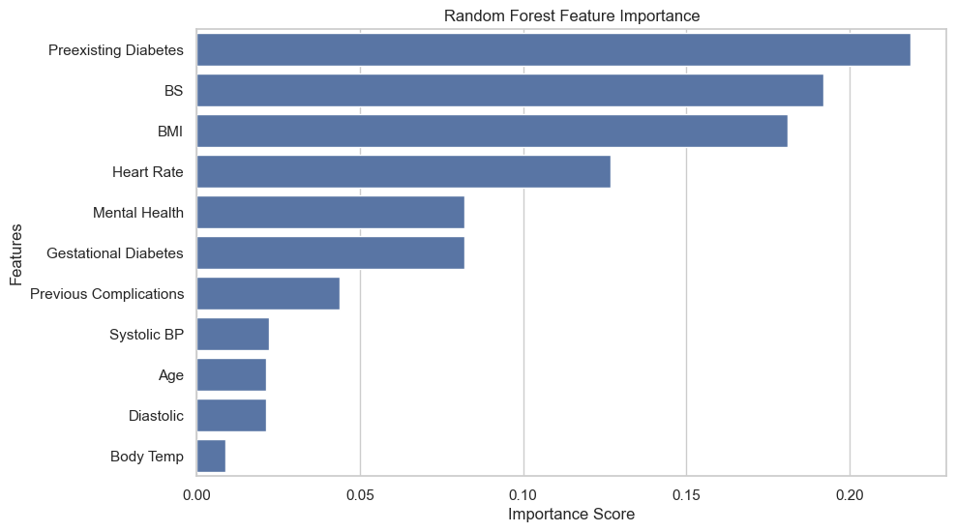
Feature Importance Analysis
Random Forest — Medical Predictor Contribution Ranking
Feature | Importance | Rank
Preexisting Diabetes | 0.2189 | ★ #1
Blood Sugar (BS) | 0.1920 | ★ #2
BMI | 0.1813 | ★ #3
Heart Rate | 0.1268 | #4
Mental Health | 0.0819 | #5
Gestational Diabetes | 0.0813 | #6
Previous Complications | 0.0448 | #7
Systolic BP | 0.0218 | #8
Age | 0.0207 | #9
Diastolic | 0.0205 | #10
Body Temp | 0.0089 | #11

Slide 19
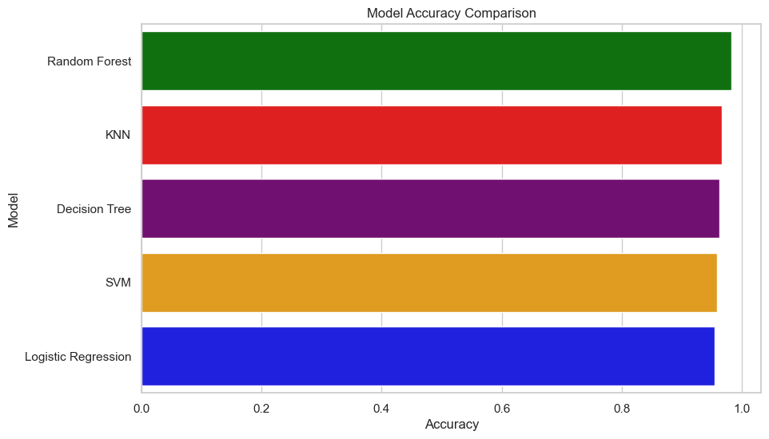
Final Model Comparison
Performance Summary Across All Algorithms
Model | Accuracy | ROC-AUC | CV Mean | Rank
★ Random Forest | 98.34% | 98.63% | 98.23% | #1 BEST
KNN | 96.68% | 96.71% | 96.78% | #2
Decision Tree | 96.27% | 95.81% | 95.95% | #3
SVM | 95.85% | 96.02% | 97.30% | #4
Logistic Regression | 95.44% | 95.31% | 97.30% | #5
★ Best Performing Model: Random Forest
Highest accuracy (98.34%), best ROC-AUC (98.63%), strongest CV Mean (98.23%) — zero false positives for Low Risk class
Ensemble learning advantage: combining 100+ decision trees dramatically reduces variance and overfitting risk

Slide 20
Conclusions
Summary of Findings & Future Directions
Project Achievements
Medical Significance
Final Rankings
Complete ML pipeline from EDA through Feature Importance implemented
5 algorithms compared with comprehensive evaluation metrics
Random Forest achieved 98.34% accuracy & 98.63% ROC-AUC
Top predictors: Preexisting Diabetes, BS, BMI, Heart Rate
All models exceeded 95% accuracy — highly learnable dataset
Cross-validation confirmed stability & generalization capability
Enables early detection of high-risk pregnancies
Supports clinical decision-making
Reduces maternal & fetal mortality
Real-time risk screening potential
1
★ Random Forest
98.34%
2
KNN
96.68%
3
Decision Tree
96.27%
Future Improvements
Deep learning (ANN/CNN)
Larger diverse datasets
Real-time healthcare systems
Explainable AI (SHAP)
Hospital DB integration
Web/API deployment
4
SVM
95.85%
5
Logistic Reg.
95.44%

Slide 21
Thank You
Questions & Discussion
Rümeysa YAVUZKANAT · 21050111081 | Emine Sena TOP · 21050111082
Ankara Yıldırım Beyazıt University · CENG410 – Data Mining · SPRING 2026

