Slide 1
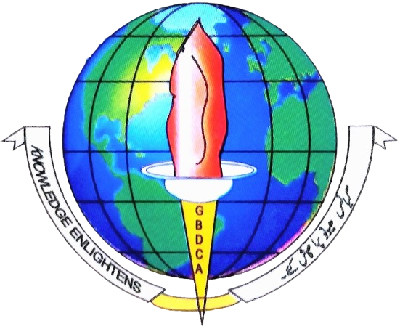
A Robust Pixel-Level Interpretability in
OCT-based Retinal Disease Classification
RESEARCH PROJECT (FYUGP)
PRESENTED BY
UNDER THE SUPERVISION OF
Asgar Rashid (12600-BJB-2021)
Faisal Ahmad Malik (65275-ANG-2022)
Dr. Tawseef Ahmed Teli (Supervisor)
Prof. Ab Qayoom Sofi (Co-Supervisor)
DEPARTMENT OF COMPUTER APPLICATIONS
Shaheed Himayun Muzammil Memorial Govt. Degree College Anantnag
Notes:
Welcome the panel and introduce the project title, your names, and your supervisor. Briefly state that this is an FYUGP research project viva about making AI-based retinal disease detection more transparent and trustworthy for doctors. Keep this to 30 seconds — a warm, confident opening. Transition by saying you'll first walk through some background on the eye and retinal disease before introducing the technical problem.

Slide 2
OVERVIEW
Outline
01
Introduction
06
Proposed Methodology
The eye, retina, retinal disease & diagnosis
Multi-Layer Fused Grad-CAM
02
Optical Coherence Tomography
07
Results & Evaluation
How doctors image the retina
Robustness under SSIM testing
03
Deep Learning + OCT
08
Limitations & Future Work
Automated, accurate — but opaque
What's next
04
Problem Statement
The trust gap, how Grad-CAM works & its limitations
05
Research Gap
Four unresolved gaps in the literature
1
Notes:
Walk through the roadmap briefly: background on the eye and disease, then OCT imaging, then how deep learning is used, the trust problem this creates, the specific research gaps, our proposed method, how we evaluated it, and finally limitations and references. Keep this to about 30-40 seconds — the goal is to give the committee a mental map before diving in.

Slide 3
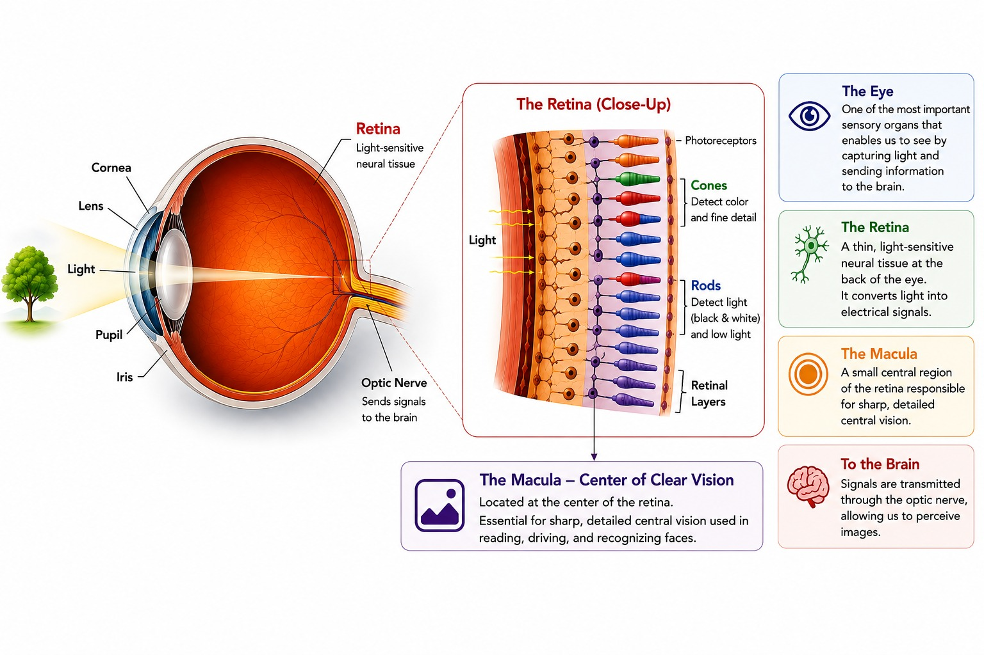
INTRODUCTION
01 · Introduction
The Human Eye & Retina
Human Eye
Eye is an important sensory organ, enables us to see by capturing light from our surroundings.
The retina
A light-sensitive tissue layer located at the back of the eye that converts light into neural signals sent to the brain.
Why is the retina important?
It is the eye's core sensor ; any damage to its structure directly threatens vision.
When disease strikes
Retinal disorders are a leading cause of visual impairment, and can cause irreversible blindness if undetected.
Functional schematic of the human eye
2
Notes:
Ground the audience in basic anatomy before going technical. The retina is the light-sensitive layer at the back of the eye — it's essentially the body's own camera sensor, converting light into neural signals the brain reads as images. Point at the schematic and note the macula, the small central region responsible for sharp vision, since that's where most of the diseases we'll discuss actually occur. Transition by saying that when this tissue is damaged, several distinct diseases can result — which the next slide covers.

Slide 4
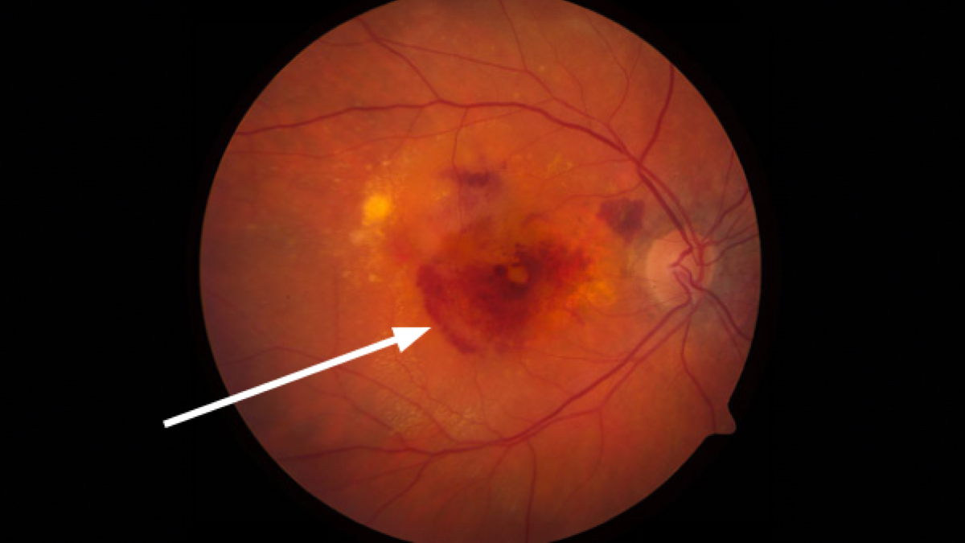
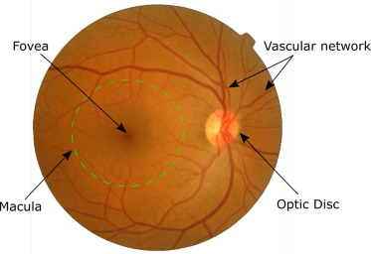
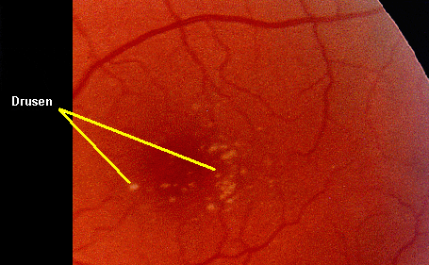
INTRODUCTION
01 · Introduction
Three Retinal Diseases
Representative OCT scans, shown with the disease region highlighted
CNV
DME
DRUSEN
Choroidal Neovascularization
Diabetic Macular Edema
Drusen Deposits
Abnormal new blood vessels grow beneath the retina. These vessels are fragile and may leak blood or fluid, leading to blurred or distorted vision.
Occurs due to diabetes, where damaged retinal blood vessels leak fluid into the macula, causing swelling and reducing central vision.
yellow deposits made of proteins and lipids that accumulate beneath the retina— an early warning sign of macular degeneration.
3
Notes:
Introduce the three pathological classes used throughout this project, alongside NORMAL. For CNV, emphasize abnormal vessel growth and leakage. For DME, connect it to diabetes and macular swelling. For Drusen, frame it as an early AMD warning sign. Mention that these highlighted OCT crops are actual scans from the dataset used later in the study, so the audience already has visual familiarity before the technical sections. Transition into how these scans are actually captured — Optical Coherence Tomography.

Slide 5
DIAGNOSIS
01 · Introduction
Diagnosing Retinal Diseases
Not every imaging technique is suitable.
X-Ray
✕
CT Scan
✕
USG (Ultrasound)
✕
OCT
✓
Are mainly used for bones and dense tissues and cannot visualize the retina in sufficient detail.
Built on X-ray principles ; it is good for bone, but insufficient resolution for retinal layers.
Uses sound waves and is useful for imaging the eye in some situations, but it cannot clearly show the delicate retinal layers.
Uses light instead of radiation or sound ; resolving the retina's micrometer-scale layers directly.
Why not these methods? The retina is only a few hundred micrometers thick. Detecting tiny fluid pockets and deposits requires extremely high-resolution imaging that conventional radiology cannot provide.
Today, OCT is the gold-standard imaging modality for retinal diagnosis worldwide.
4
Notes:
Before introducing OCT properly, briefly explain why the obvious alternatives don't work for the retina. X-ray and CT rely on radiation and are built for dense tissue like bone, not the eye's delicate soft tissue. Ultrasound is safe but too coarse. The unifying reason is scale: the retina is only a few hundred micrometers thick, so diagnosing it needs imaging fine enough to resolve that scale. Land on OCT as the one modality built for exactly this problem, and transition into explaining how OCT itself works on the next slide.

Slide 6
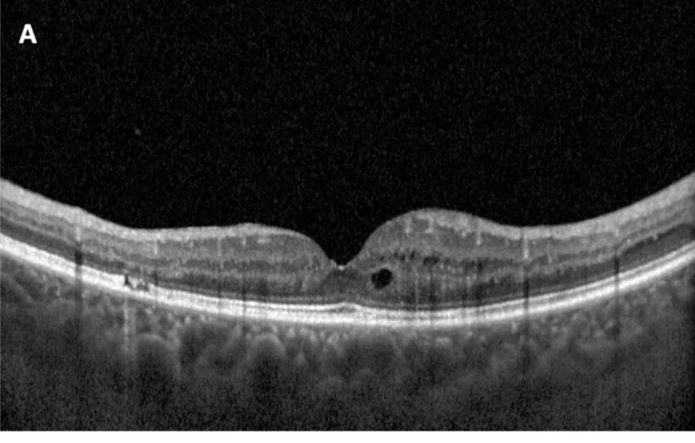
DIAGNOSIS
02 · OCT
Optical Coherence Tomography (OCT)
What it is
A non-invasive imaging technique that captures micrometer-scale, cross-sectional images of the retina's internal layers .
Why doctors use it
It reveals structure beneath the visible surface without surgery, dye, or contact with the eye.
How it aids diagnosis
Using these detailed OCT-Scans doctors can detect retinal diseases much earlier and more accurately.
A real OCT B-scan — a cross-sectional slice of the retina
Today, OCT is the gold-standard imaging modality for retinal diagnosis worldwide.
5
Notes:
Explain OCT in plain terms: think of it like an ultrasound, but using light instead of sound, giving much finer detail. It lets doctors see a cross-section of the retina's layers without touching or cutting the eye. Point to the B-scan image and note the layered structure. Keep this under a minute — the goal is just enough understanding to appreciate why OCT images are the input to the deep learning model discussed next.

Slide 7
AI IN MEDICAL DIAGNOSIS
03 · Deep Learning
Deep Learning + OCT
OCT Scan
CNN
Prediction
Input image
Learns patterns automatically
CNV / DME / DRUSEN / NORMAL
Convolutional Neural Networks (CNNs) learn to recognize disease patterns in OCT images automatically , therefore no hand-crafted rules are required.
96.6% – 99.97%
Yet clinicians still cannot fully trust these predictions.
Classification accuracy achieved across recent CNN-based OCT studies
Why does such an accurate model still remain difficult to trust?
6
Notes:
High classification accuracy might suggest the problem is solved, but it isn't. Walk through the simple pipeline — an OCT scan goes into a CNN, which outputs a prediction — and note that CNNs learn these patterns automatically from data, without being explicitly told what a lesion looks like. Cite the accuracy figures to establish that performance is not the bottleneck. Land deliberately on the closing question, pause briefly, and use it as the hinge into the black-box problem on the next slide.

Slide 8
PROBLEM STATEMENT
04 · Problem
The Black-Box Problem
A CNN can be extremely accurate and still be impossible to interrogate ; it gives an answer, not a reason.
1
2
3
Deep Learning is a
“Black Box”
Doctors Need
Explanations
Explainable AI
(XAI)
The internal reasoning of a CNN is hidden. It predicts a disease class but does not explain which image features drove that decision .
Clinicians are reluctant to act on a prediction they cannot independently verify ; trust requires transparency, not just accuracy.
XAI techniques convert opaque model predictions into visual explanations, highlighting the regions that influenced the decision.
Among all XAI techniques, Grad-CAM remains the most widely used method for explaining CNN-based image classifiers.
7
Notes:
Introduce the black-box problem directly: the CNN outputs a class label, not a reason. Emphasize that clinical trust depends on verifiability, not just accuracy — a doctor won't act on a number alone. Introduce Explainable AI as the general solution category, then narrow to Grad-CAM specifically as the dominant technique in this space, citing its wide adoption in retinal imaging literature. Transition by saying Grad-CAM sounds like the fix, but it comes with real limitations — which the next slide unpacks.

Slide 9


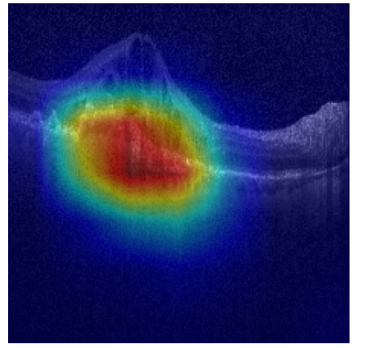
PROBLEM STATEMENT
04 · Problem
Grad-CAM
Among many XAI techniques, Grad-Cam is one of the most widely used methods for explaining CNN-based image classification.
1
2
3
4
Forward Pass
Compute Gradients
Weight & Sum
Generate Heatmap
The OCT image passes through the CNN; the last convolutional layer produces a set of feature maps.
Grad-CAM computes the gradients of the predicted class with respect to each feature map.
Feature maps are combined using their gradient-based importance as weights.
A ReLU activation is applied to keep only the positive contributions, producing heatmap that highlights the Retinal regions that most influenced the model’s prediction.
Importance weight: = average gradient of the class score over feature map k
Heatmap:
The result: a heatmap overlaid on the OCT scan, highlighting the regions that most influenced the model's prediction — this is the explanation Grad-CAM provides.
8
Notes:
Explain the Grad-CAM mechanism itself before critiquing it. Walk through the four steps: the image is processed by the CNN, gradients of the predicted class are computed with respect to the last layer's feature maps, those gradients become importance weights, and a weighted sum passed through a ReLU produces the final heatmap. Keep the formulas on screen but explain them in words rather than reading the notation — the weight is just 'how much this feature map mattered', and the heatmap is a weighted blend of feature maps, keeping only positive influence. Transition by saying this exact mechanism is also the source of Grad-CAM's weaknesses, which the next two slides cover.

Slide 10
05·Research Gap
RESEARCH GAP
From the Systematic Literature Review , three major Research Gaps have been identified:
1
2
RG1
Coarse Heatmaps
Grad-CAM heatmaps are inherently low-resolution: gradients are naturally sparse, and up-sampling small feature maps back to the image size further blurs spatial precision .Since, Standard Grad-CAM is computed exclusively from the network's last convolutional layer, discarding the fine-grained spatial detail present in shallower layers exactly the information needed to trace a lesion's true edges.
A typical Grad-CAM heatmap: broad and diffuse, without tight lesion boundaries.
9
Notes:
Take these two limitations slowly since they're the most visually obvious in the sample heatmap. Coarse resolution comes from sparse gradients and upsampling — explain it as the heatmap being computed at a tiny resolution internally and then stretched up, which necessarily blurs it. Poor localization follows from the same root cause: the heatmap approximates where the model looked, but was never designed to trace an exact pixel boundary. Point to the sample image and note the soft, spread-out red region rather than a tight outline. Transition into the second pair of limitations.

Slide 11
05· Research Gap
RESEARCH GAP
2
RG2
3
RG3
Poor Boundary Localization
Sensitive to Noise
Because a heatmap reflects the model's overall prediction process rather than precise pixel segmentation, it cannot guarantee pixel-level boundary accuracy; a critical shortfall for lesions only a few pixels wide.
Because Grad-CAM relies on gradients, small and realistic input perturbations can introduce spatial noise that shifts the heatmap away from the true lesion, undermining its reliability as a clinical explanation.
A comprehensive solution is needed to fill these gaps.
10
Notes:
These last two limitations explain why simply 'looking harder' at the final layer doesn't fix the problem. Final-layer-only means the network's earliest, most detailed spatial information is thrown away before the heatmap is ever computed. Sensitivity to noise means the explanation itself is not robust — small realistic changes to the image can shift where the heatmap lights up. Land deliberately on the closing statement, pause, and use it as the direct transition into the research gap slide — these four limitations are exactly what the dissertation identifies as unresolved in the literature.

Slide 12
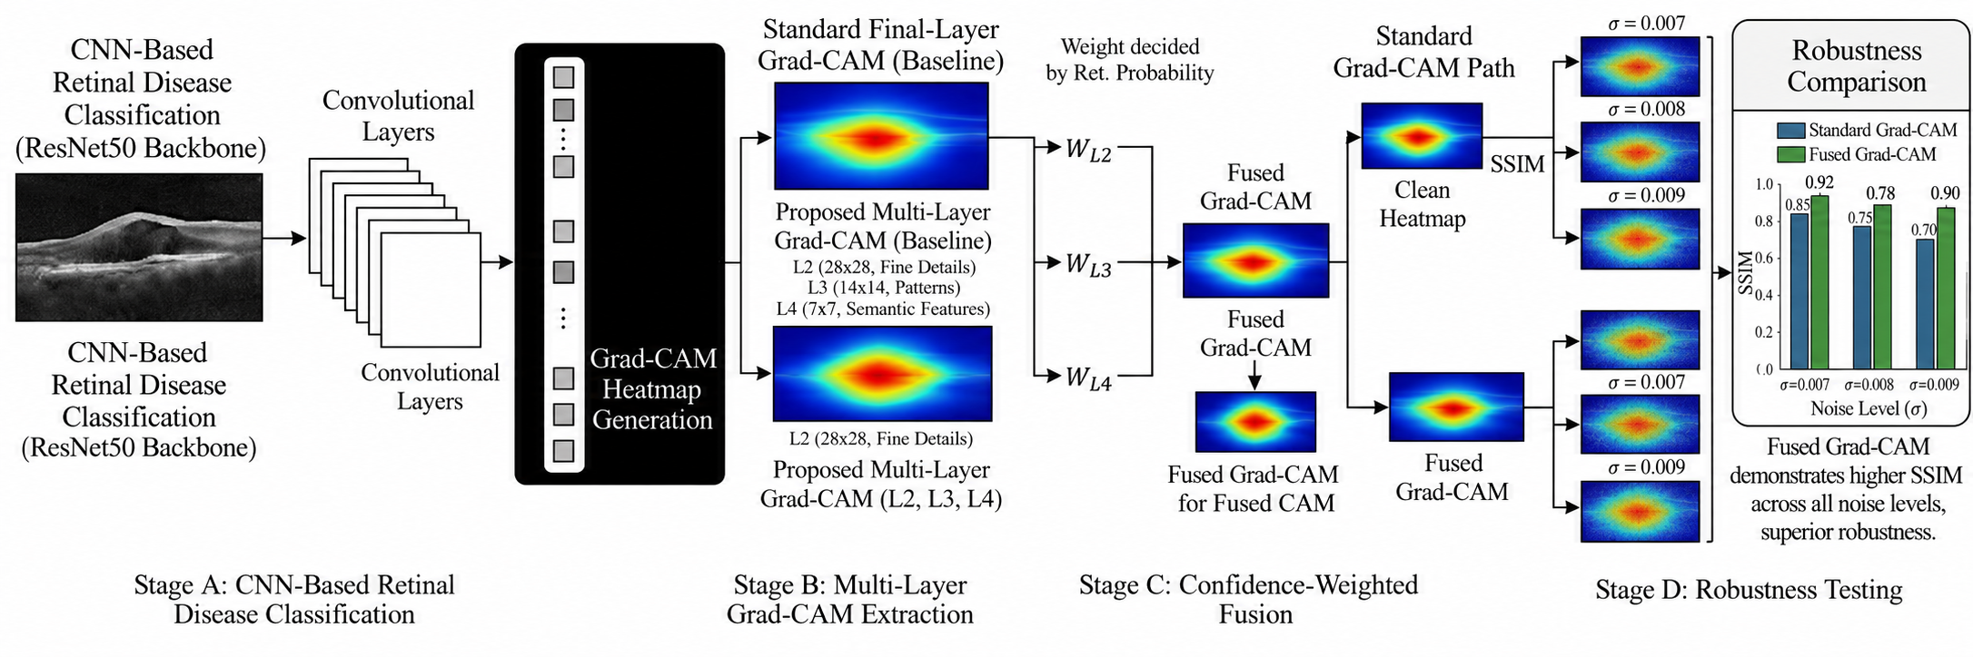
PROPOSED METHODOLOGY
06· Methodology
Multi-Layer Fused Grad-CAM
A four-stage framework that fuses explanations from multiple network depths, weighted by how much each one actually contributes to the prediction.
A Classification
B Multi-Layer Extraction
C Confidence-Weighted Fusion
D Robustness Testing
ResNet50 CNN classifies the OCT scan
Grad-CAM pulled from 3 network depths
Layers combined by evidence strength
Stability verified under noise (SSIM)
\
12
Notes:
This is the core diagram of the entire project, so give it room to breathe. Walk left to right: Stage A classifies the OCT scan with a ResNet50 CNN; Stage B extracts Grad-CAM heatmaps from three different depths in the network rather than just the last layer; Stage C fuses those three maps using confidence-based weights; Stage D tests whether the fused explanation holds up under noise, compared to the standard baseline. Tell the committee you'll now walk through each stage in more depth.

Slide 13
PROPOSED METHODOLOGY
06 · Methodology
Classification & Multi-Layer Extraction
Stage A — CNN Classification
Stage B — Multi-Layer Grad-CAM Extraction
Backbone: ResNet50, pre-trained on ImageNet
Standard Grad-CAM uses only the final layer. This method extracts heatmaps from three depths instead:
Dataset: OCT2017 — CNV, DME, DRUSEN, NORMAL
L2
28 × 28
Fine retinal structures
Images resized to 224×224 and normalized
L3
14 × 14
Achieves ~98% overall classification accuracy
Mid-level structural patterns of retina
L4
7 × 7
A trustworthy, high-accuracy model is the necessary starting point for a meaningful explanation.
High-level semantic features of the disease
Running Grad-CAM at each depth separately produces three layer-specific activation maps.
13
Notes:
Cover the two supporting stages. For classification, keep it brief: a ResNet50 CNN trained on the OCT2017 dataset with four classes, reaching roughly 98% accuracy, which is stable enough to trust as the basis for explanation. For multi-layer extraction, explain why depth matters: shallow layers like L2 keep fine spatial detail, while deeper layers like L4 capture more abstract, semantic information. Standard Grad-CAM only uses the deepest layer, discarding the detail the shallower ones provide — setting up the next slide on how these three maps are combined.

Slide 14

PROPOSED METHODOLOGY
06· Methodology
Confidence-Based Fusion
A simple average would ignore that some layers matter more than others for a given image. Instead, each layer earns its weight empirically.
1
2
3
4
Mask
Re-test
Weight
Fuse
Each layer's heatmap is turned into a mask that blocks out everything it did NOT highlight.
The masked image is passed back through the CNN, and the retained class confidence is recorded.
Layers that preserve high confidence after masking are judged more informative and weighted higher.
The three-layer maps are combined using these confidence-based weights into one fused heatmap.
Fused heatmap:
Wx is the retention score of the Layer x and Lx is the Layer X
Result: an explanation grounded in what the model actually uses — not a uniform, arbitrary blend.
14
Notes:
This is the key technical contribution, so take your time. Walk through the four-step loop: mask the image using each layer's heatmap, re-run the masked image through the classifier, and record how much class confidence survives — that retained confidence becomes the layer's weight. Point to the formula strip and explain in words rather than reading it verbatim: the weight is just each layer's share of the total retained confidence, and the fused heatmap is a weighted blend of the three. Emphasize that this keeps the fusion grounded in evidence rather than a fixed, arbitrary average.

Slide 15
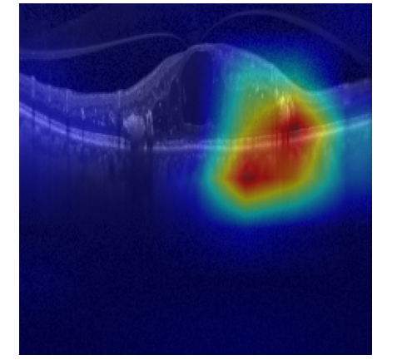
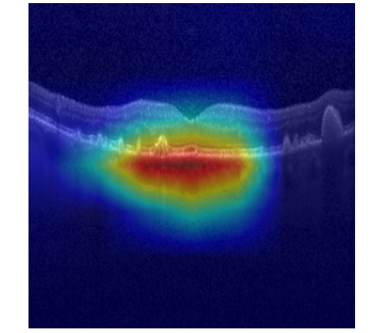
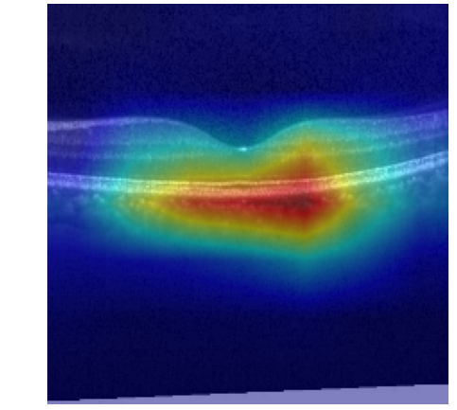
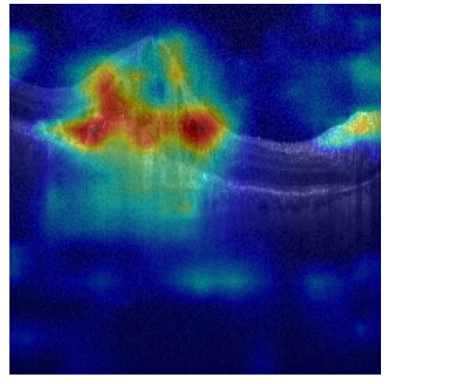
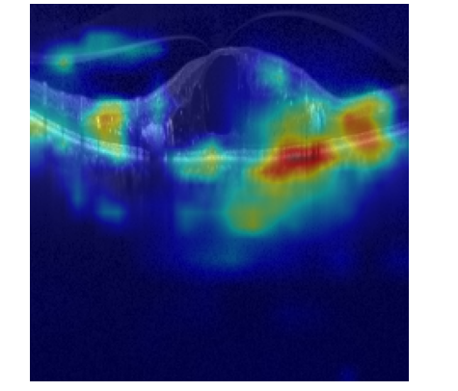
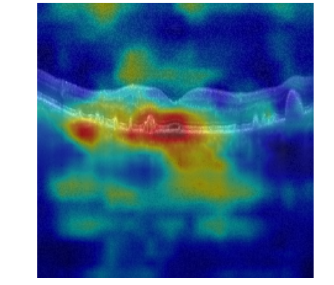
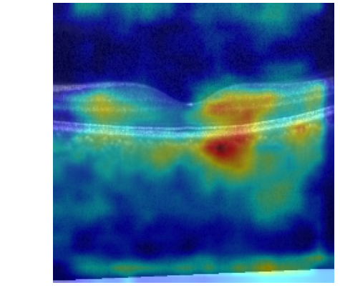
RESULTS & EVALUATION
07 · Results
Testing for Robustness
Why evaluate?
Standard Grad-CAM
A more localized-looking heatmap doesn’t mean it is necessarily stable. The fused method needed to be tested against realistic conditions, not just visual inspection.
SSIM (Structural Similarity Index)
Broad, diffuse activation — spreads beyond the true lesion
Measures how similar two images are. A score near 1.0 means the heatmap barely changed i.e., the explanation is stable.
Multi-Layer Fused Grad-CAM (Proposed)
Method: Gaussian Noise Test
Controlled noise was added to both Standard and Fused heatmaps at three levels — σ = 0.007, 0.008, 0.009 — then compared to the clean version using SSIM, across all four disease classes.
Tighter, more anatomically-focused localization
CNV · DME · DRUSEN · NORMAL
15
Notes:
Explain why evaluation matters: a heatmap that merely looks tighter isn't good enough — it needs to be proven stable under realistic conditions. Introduce SSIM simply as a similarity score between 0 and 1, where closer to 1 means barely any change. Describe the noise test — three controlled noise levels applied to both heatmap types, then compared to the clean version. Then point to the visual comparison: standard Grad-CAM spreads broadly across the scan, while the fused version stays tighter around the actual lesion, across all four classes. Transition into the quantitative results on the next slide.

Slide 16
RESULTS & EVALUATION
07· Results
Robustness Results
σ | Class | Fused | Standard | Gain
0.007 | CNV | 0.9713 | 0.9543 | +0.0170
 | DME | 0.9698 | 0.9502 | +0.0196
 | DRUSEN | 0.9750 | 0.9566 | +0.0184
 | NORMAL | 0.9736 | 0.9579 | +0.0157
0.008 | CNV | 0.9630 | 0.9413 | +0.0217
 | DME | 0.9613 | 0.9349 | +0.0264
 | DRUSEN | 0.9674 | 0.9445 | +0.0229
 | NORMAL | 0.9655 | 0.9470 | +0.0185
0.009 | CNV | 0.9532 | 0.9274 | +0.0258
 | DME | 0.9516 | 0.9195 | +0.0321
 | DRUSEN | 0.9592 | 0.9313 | +0.0279
 | NORMAL | 0.9570 | 0.9337 | +0.0233
Fused Grad-CAM outperforms Standard Grad-CAM at every noise level — and the gap widens as noise increases, showing the fused explanation degrades more slowly.
Table I — Class-wise SSIM robustness under Gaussian noise
\
16
Notes:
Walk through Table I briefly by noise level rather than reading every row: at every sigma, fused SSIM is higher than standard. Then point to the chart, which averages across all four classes for a clearer visual — fused is consistently on top, and importantly the gap between the two bars grows as noise increases, from about 0.018 at the lowest noise level to about 0.027 at the highest. Explain what that means physically: the fused heatmap doesn't just start higher, it degrades more slowly, because if one scale's detail gets corrupted by noise, the other two partially compensate.

Slide 17
LIMITATIONS & FUTURE WORK
08 · Limitations
What's Next
Current Limitations
Future Work
No annotated dataset
Incorporate expert-annotated lesion masks for formal localization validation
There is no pixel-level, expert-labeled ground truth to formally verify localization accuracy.
Pursue clinical validation in collaboration with ophthalmologists
Validation across real world scenarios unavailable
Evaluate on larger, more diverse OCT datasets
SSIM under synthetic noise is a proxy for robustness it does not fully capture real-world acquisition variability across scanners.
17
Notes:
Be candid about limitations — this builds credibility with the panel rather than undermining it. The two honest gaps are the lack of expert-annotated ground truth and the fact that synthetic Gaussian noise is only a proxy for real-world imaging variability across different scanners and protocols. Then pivot to future work with energy: expert annotation partnerships, clinical validation with ophthalmologists, larger and more diverse datasets, and extending the approach to other backbones and to OCTA data. Frame this as a natural next phase, not a weakness.

Slide 18
Thank You
Asgar Rashid · Faisal Ahmad Malik
Department of Computer Applications
SHMM Govt. Degree College Anantnag
Notes:
Thank the committee for their time and open the floor for questions. If you anticipate a question about why SSIM was chosen over other similarity metrics, or about computational cost of the multi-layer approach, have a one-sentence answer ready. Otherwise, let silence sit for a moment after inviting questions rather than filling it — a confident close matters as much as a confident opening.

