Slide 1
SUPPLIER COLLABORATION PORTAL
Agentic AI RFQ Module
An Executive Walkthrough of a Best-in-Class, AI-Powered Sourcing Experience
This deck condenses the full RFQ module blueprint into a one-page summary and a screen-by-screen tour of the six core AI-enabled experiences.
Prepared for Markus Bayer — Accelance | July 2026

Slide 2




Executive Summary
A best-in-class, agentic-AI-powered RFQ module for the Supplier Collaboration Portal — right-sized for mid-market enterprises up to roughly $4B in revenue.
Agentic, not just assisted
Guardrailed autonomy
AI drafts, shortlists, scores, negotiates and reports on its own — the buyer reviews and decides.
Every automated action has a confidence threshold and a financial boundary; anything beyond it comes to you for approval.
Built on your existing data
Right-sized & explainable
Reuses Article, Supplier and Pricing data already in the portal — nothing is entered twice.
Sensible defaults and a visible rationale behind every recommendation, tuned for lean mid-market teams.
This walkthrough covers the six core screens. The full blueprint also includes a 15-feature AI automation catalog, governance & guardrail settings, an 11-row settings table, a complete 10-phase user journey, and ~30 user stories.
Agentic AI RFQ Module — Executive Walkthrough
2

Slide 3
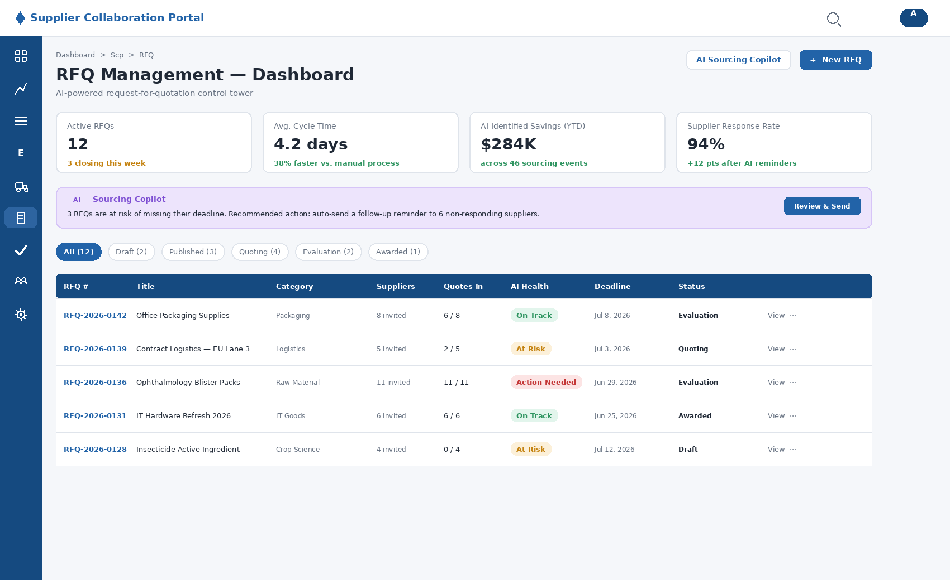
SCREEN 1 OF 6
RFQ Dashboard — Control Tower
A single control tower where AI — not the buyer — notices which RFQs need attention.
Live KPIs and an AI Health score (On Track / At Risk / Action Needed) computed per RFQ, not manually set.
An AI Sourcing Copilot banner proactively flags at-risk RFQs with a one-click fix.
Status filter chips and sortable columns for fast triage across every RFQ in flight.
Agentic AI RFQ Module — Executive Walkthrough
3

Slide 4
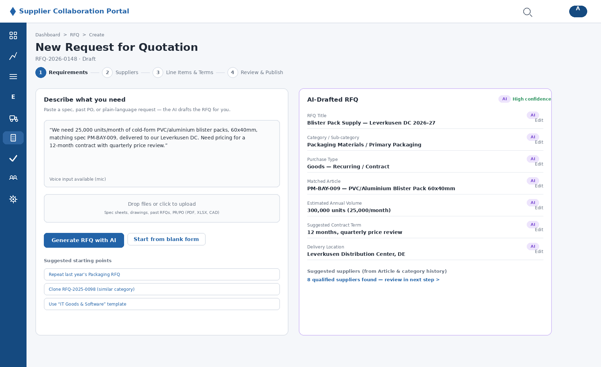
SCREEN 2 OF 6
Create RFQ — AI Requirements Assistant
Turns a pasted spec or a two-sentence request into a structured, ready-to-edit RFQ.
Natural-language and document input, including voice and file upload.
AI drafts every field — title, category, volume, delivery — with a visible confidence score.
One-click category templates, or a blank-form fallback for buyers who prefer it.
Agentic AI RFQ Module — Executive Walkthrough
4

Slide 5
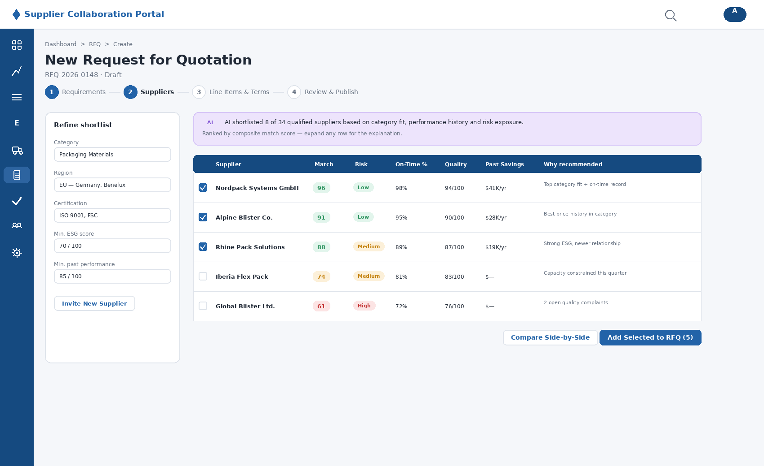
SCREEN 3 OF 6
AI Supplier Shortlisting
Replaces “who do we usually ask?” with a ranked, explainable shortlist from the full qualified pool.
Match score, risk badge, on-time delivery and quality signals for every supplier.
A plain-language “why recommended” rationale on every row, for trust and audit.
Fully overridable shortlist, with one-click invite for a brand-new supplier.
Agentic AI RFQ Module — Executive Walkthrough
5

Slide 6
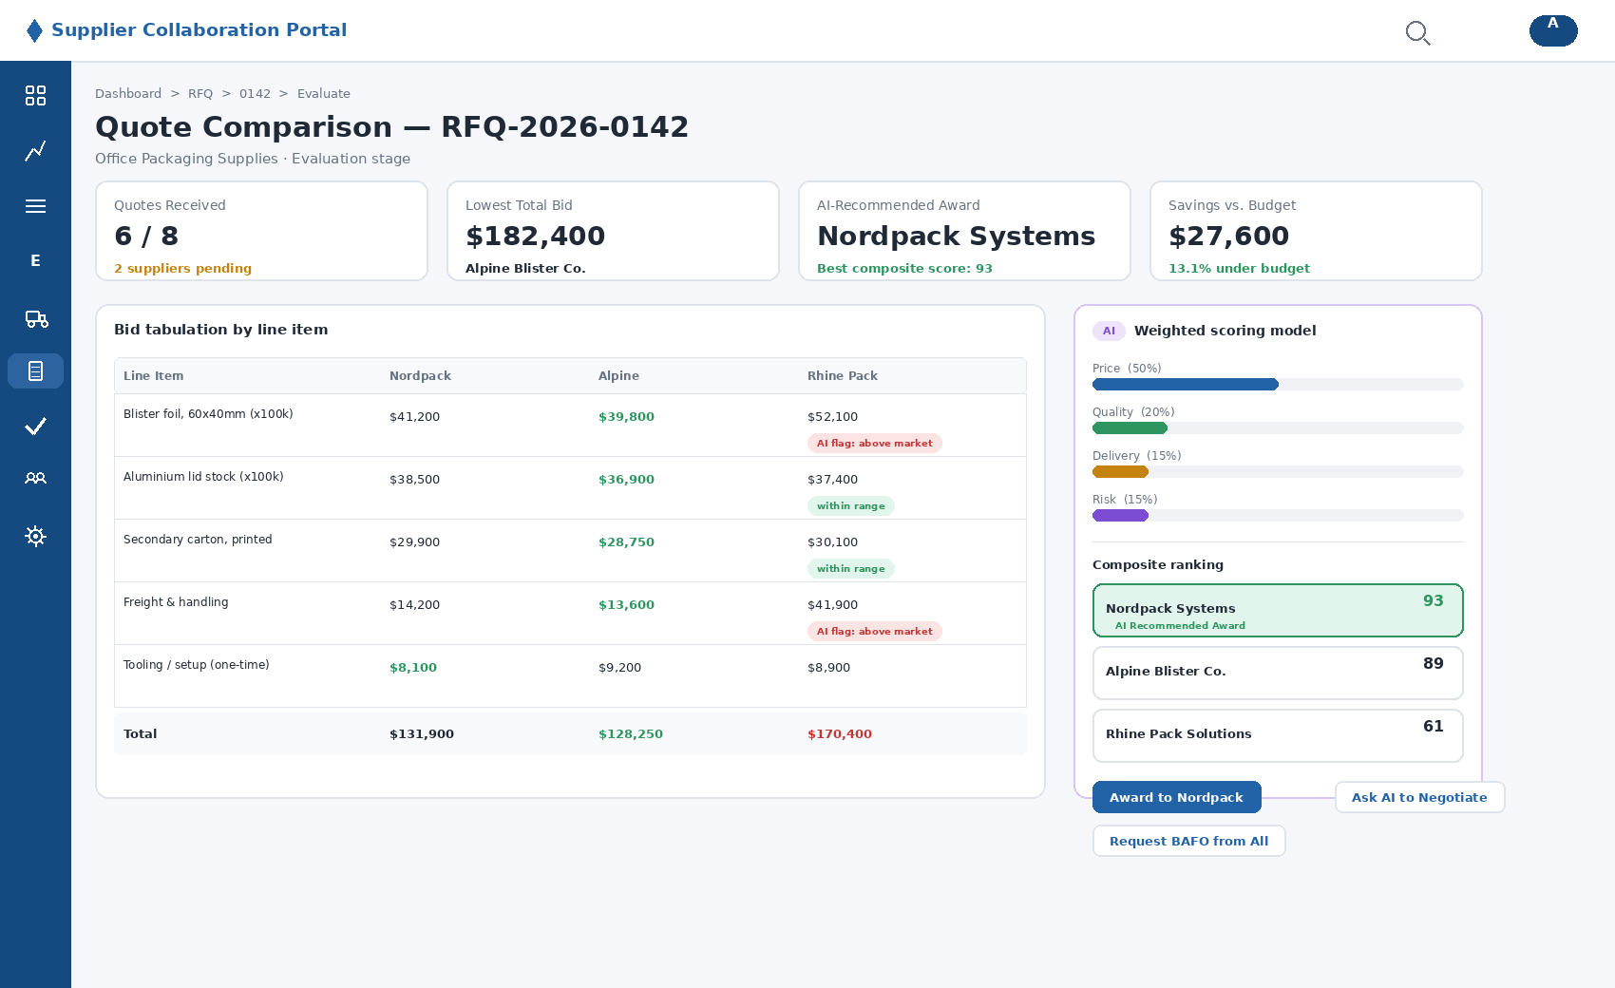
SCREEN 4 OF 6
Quote Comparison & AI Bid Analysis
Turns a pile of incoming quotes into a defensible, ranked recommendation in minutes.
Bid tabulation builds automatically as quotes arrive, with outliers auto-flagged.
A live, adjustable weighted-scoring model re-ranks suppliers as priorities change.
One-click Award, Request BAFO, or hand the next round to the negotiation copilot.
Agentic AI RFQ Module — Executive Walkthrough
6

Slide 7
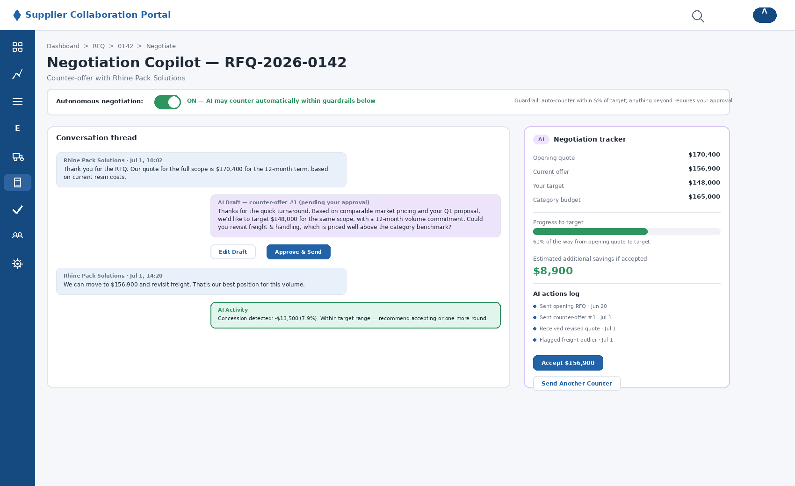
SCREEN 5 OF 6
Negotiation Copilot
The most distinctive capability: an AI agent that negotiates on the buyer’s behalf, inside guardrails the buyer sets.
Guardrailed autonomous counter-offers — auto-send within a bounded range, approval required beyond it.
A live negotiation tracker showing progress toward target and estimated savings.
A complete, auditable log of every AI action taken during the negotiation.
Agentic AI RFQ Module — Executive Walkthrough
7

Slide 8
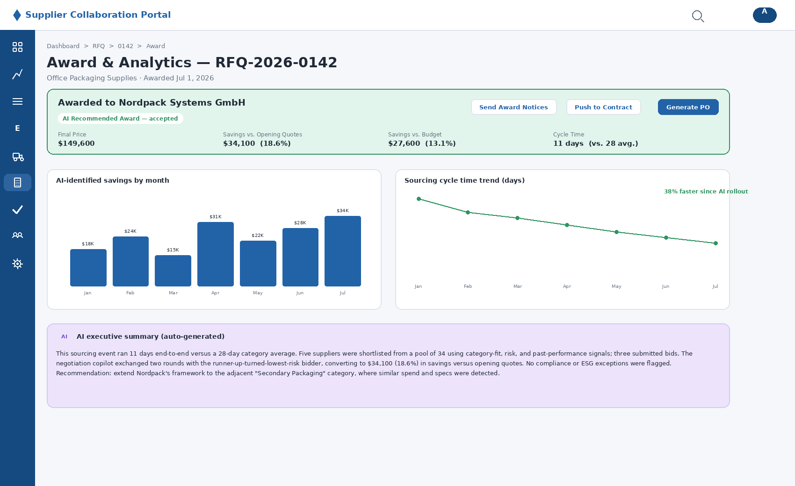
SCREEN 6 OF 6
Award, Contract Handoff & Analytics
Closes the loop from decision to system-of-record action — and makes the savings story visible without a slide deck.
One-click PO generation, contract handoff, and AI-drafted award/regret notices.
Live savings and sourcing-cycle-time trend charts, always up to date.
An auto-generated, plain-language executive summary of what happened and what was saved.
Agentic AI RFQ Module — Executive Walkthrough
8

Slide 9









Beyond RFQ: Building a World-Class Supplier Portal
Nine adjacent modules worth roadmapping once the RFQ module is live.
Contract Lifecycle Management
Supplier Risk, ESG & Sustainability
e-Invoicing & Supply Chain Finance
Turn awarded RFQs into managed agreements with renewal alerts and clause tracking.
Continuous risk, compliance and carbon/ESG monitoring across the supplier base.
Electronic invoicing, payment status and early-payment financing for suppliers.
Supplier Performance & QBRs
Catalog & Punch-out
Collaborative NPI & Design
Ongoing scorecards, trend dashboards and structured quarterly business reviews.
Guided buying for indirect spend categories via supplier catalogs and punch-out.
Joint new-product-introduction workspaces for co-development with key suppliers.
Mobile App & Real-Time Alerts
Integration & API Marketplace
Supplier Diversity & Community
Native mobile access for approvals, quote submission and status alerts on the go.
Pre-built connectors to ERP, CLM and e-signature, plus partner-app marketplace.
Diverse-supplier tracking, community forums and shared best-practice playbooks.
Agentic AI RFQ Module — Executive Walkthrough
9

