Slide 1
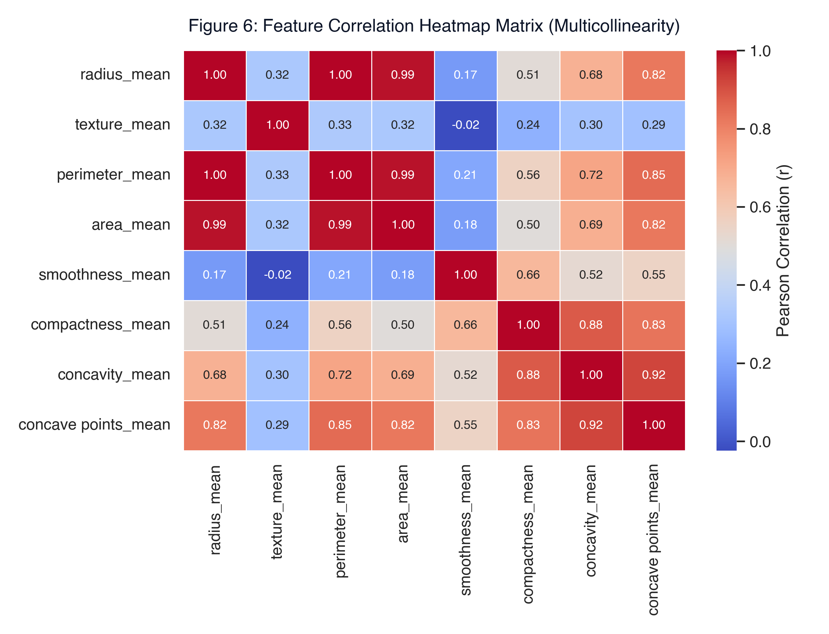
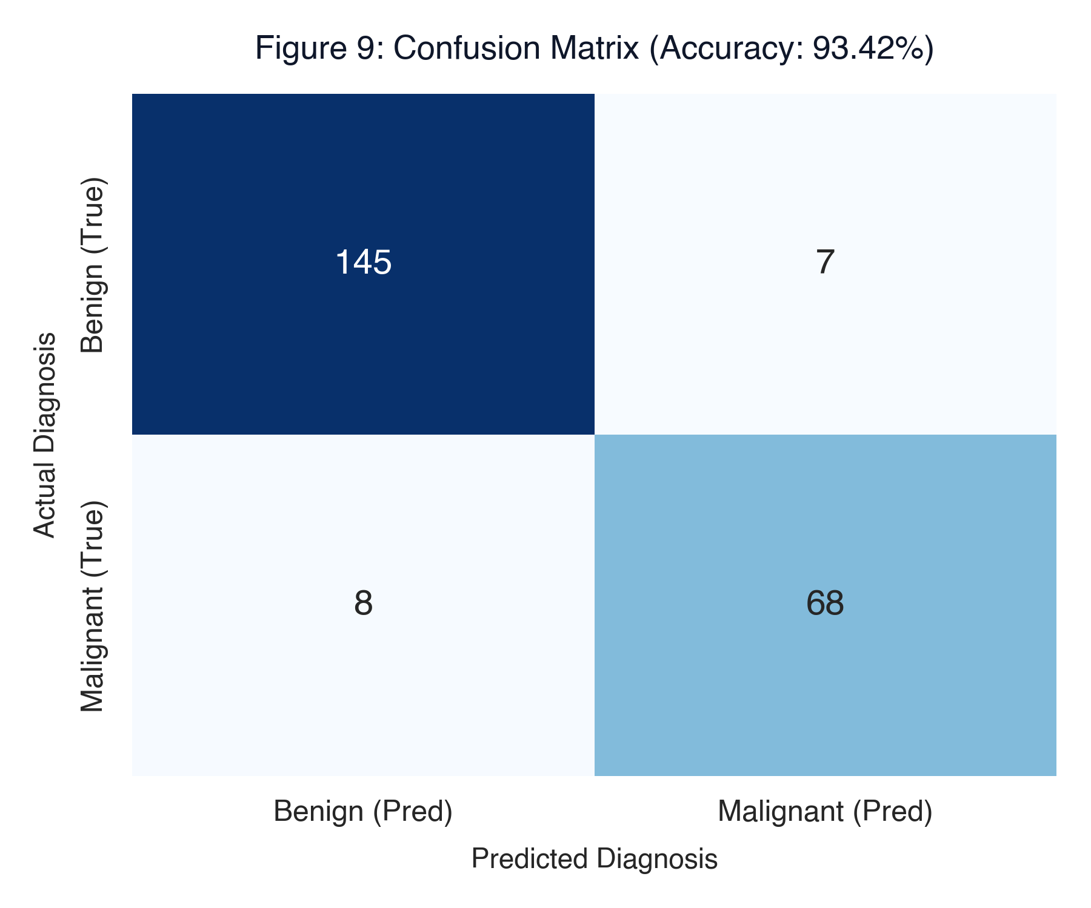
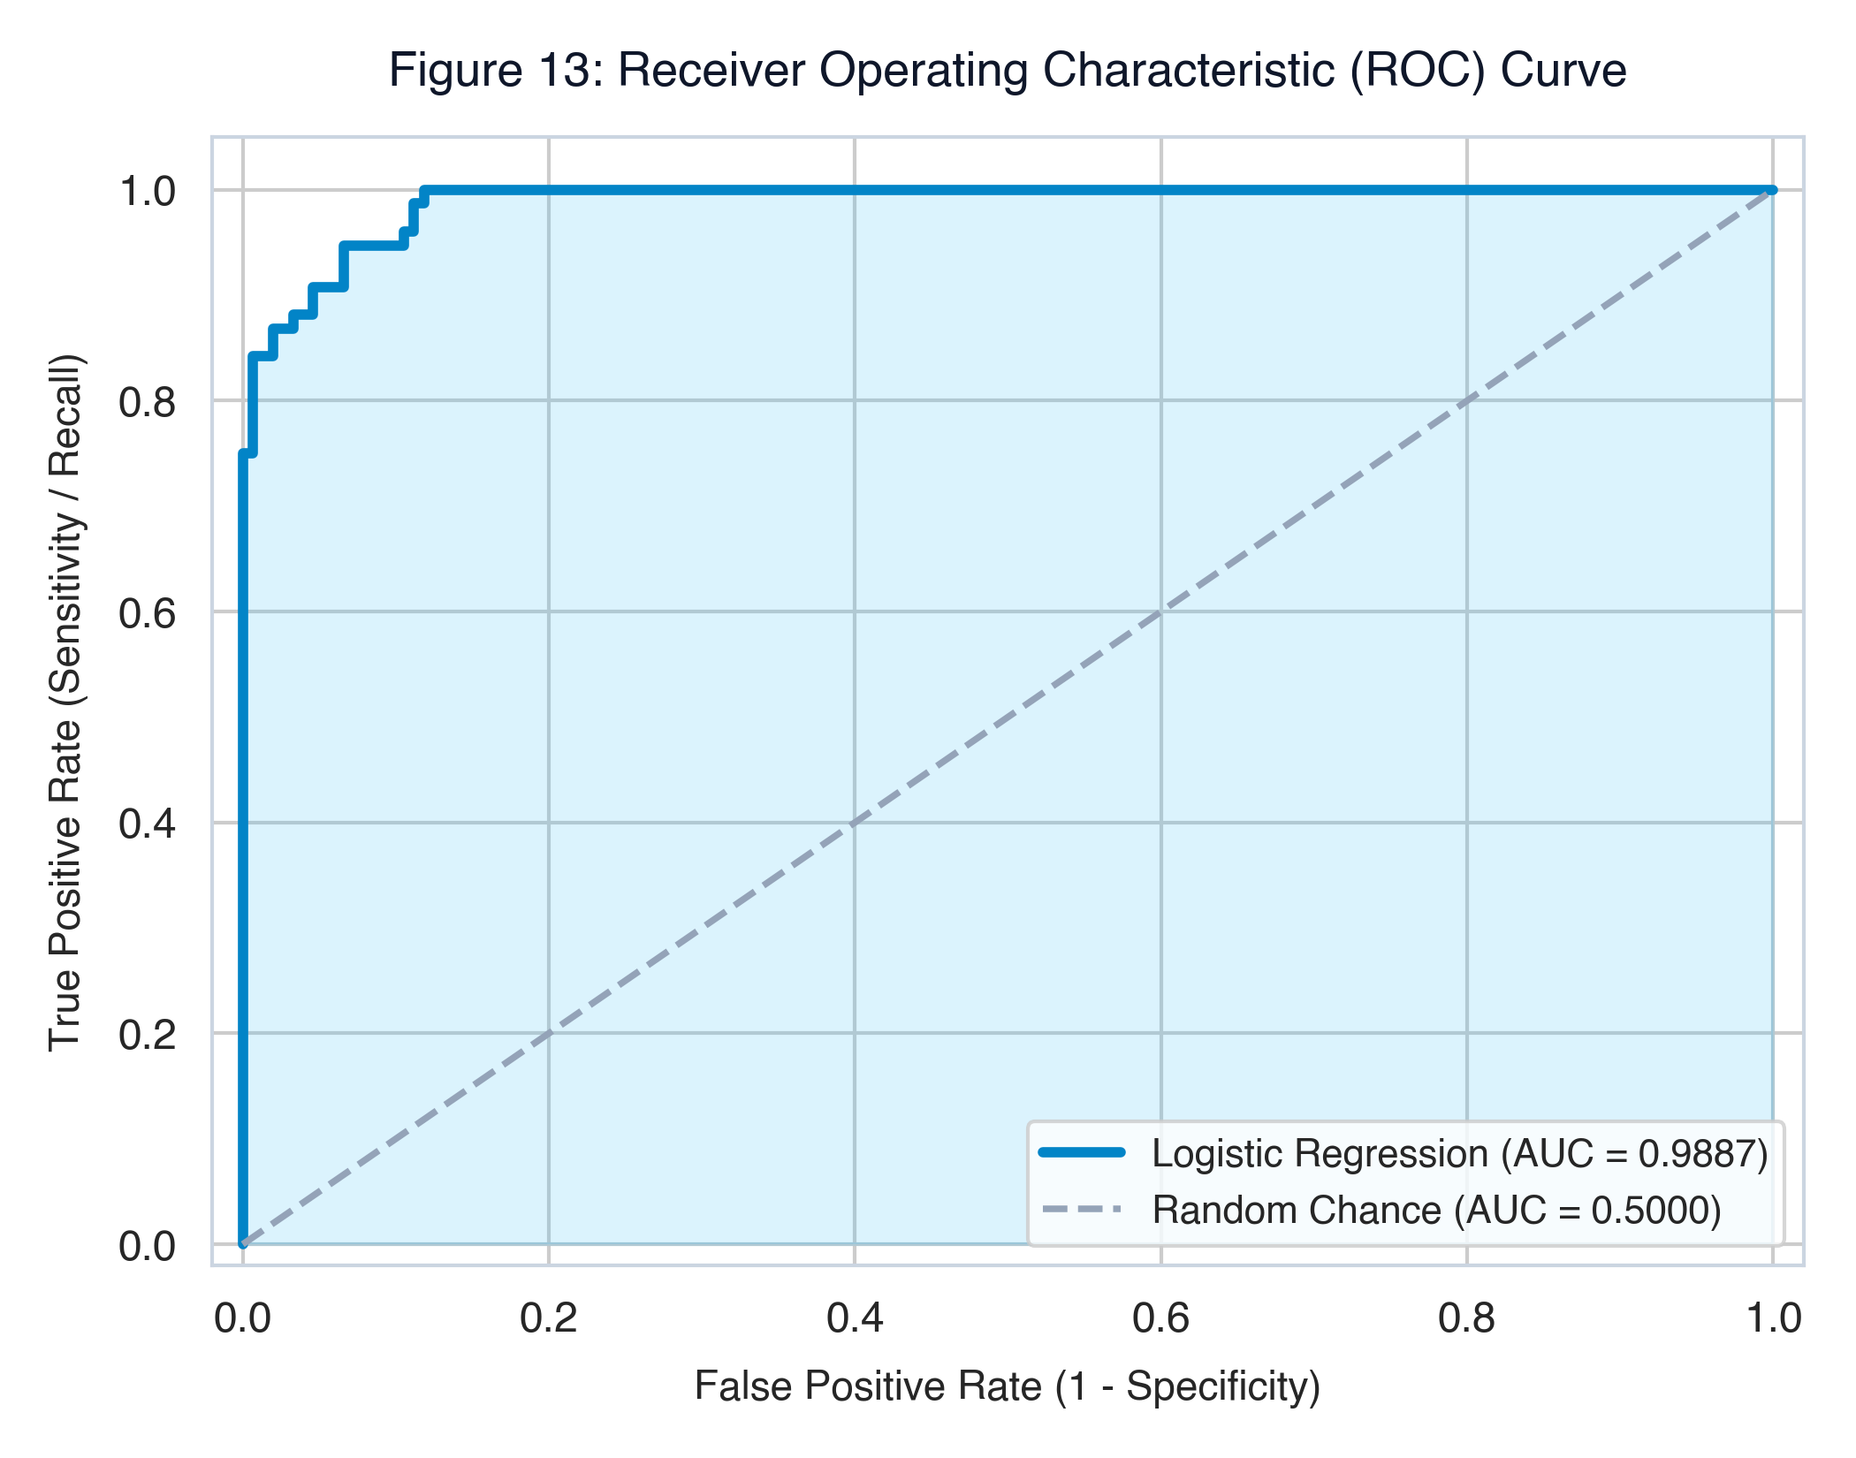
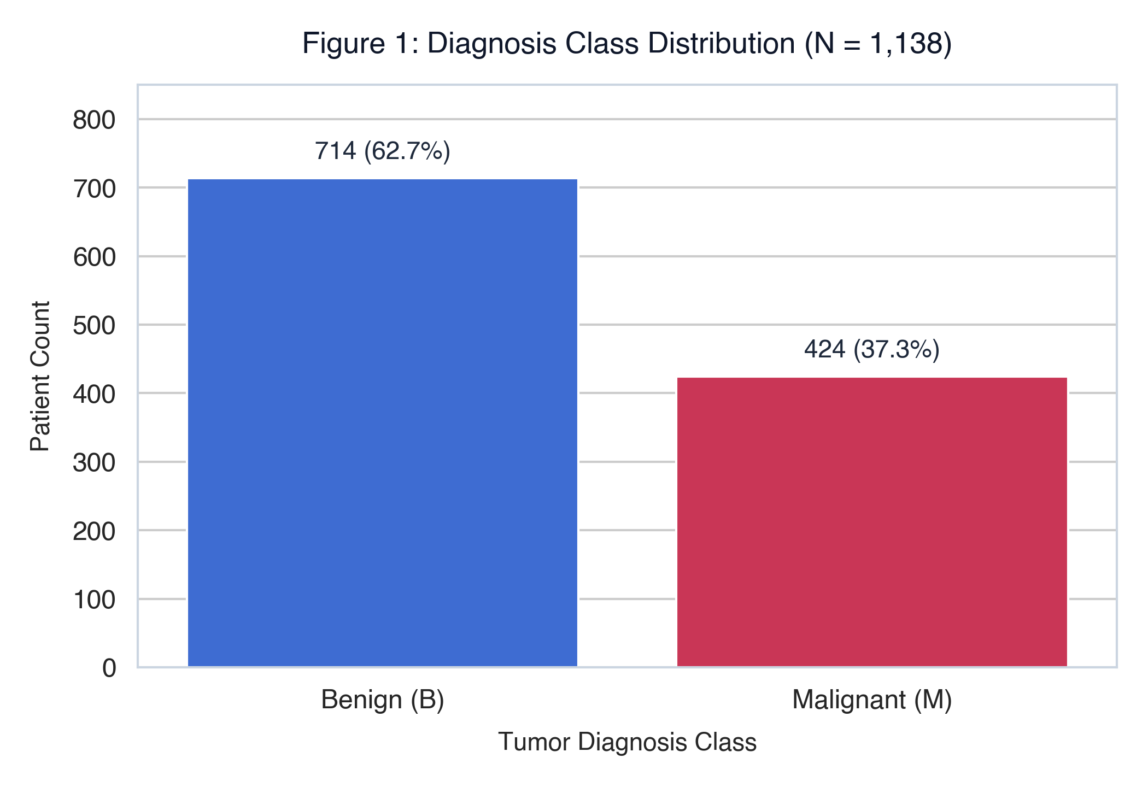
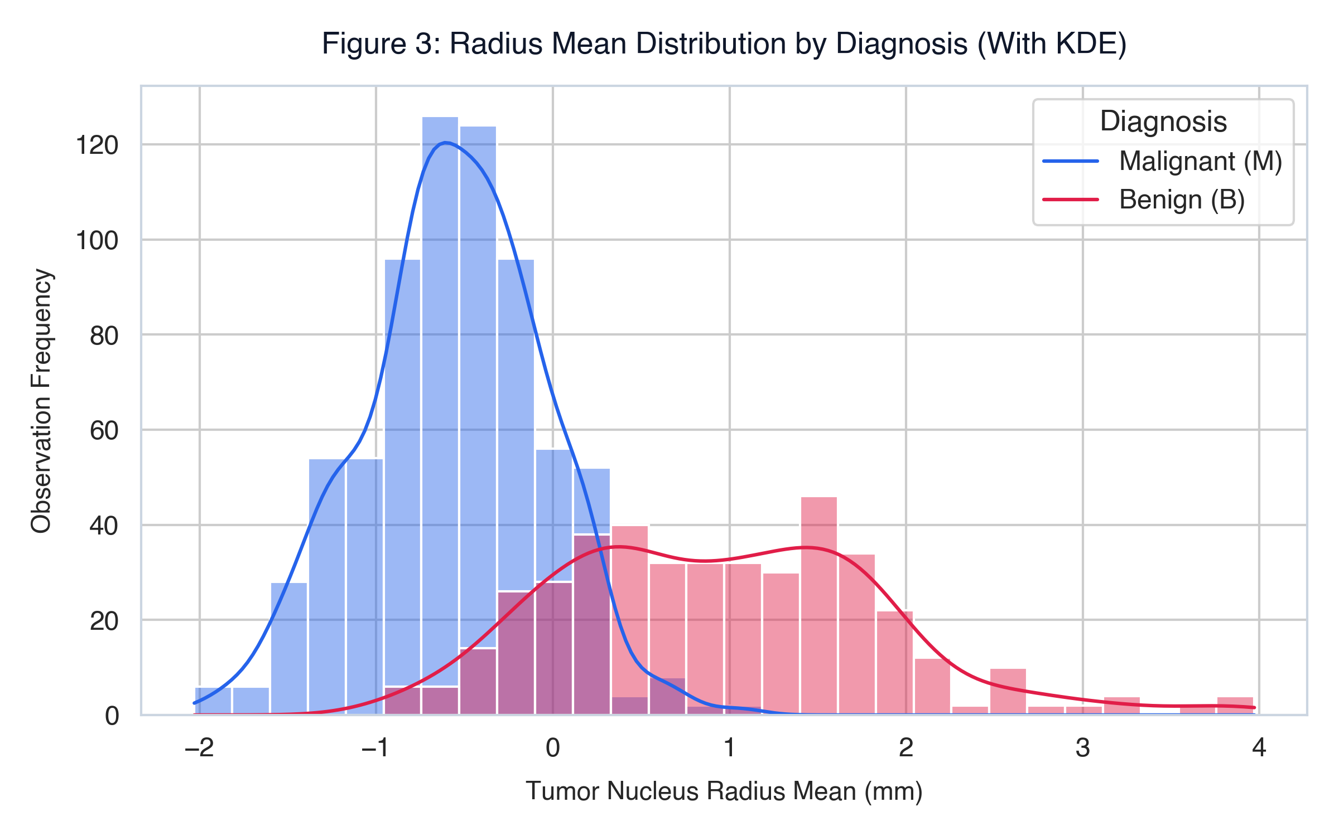
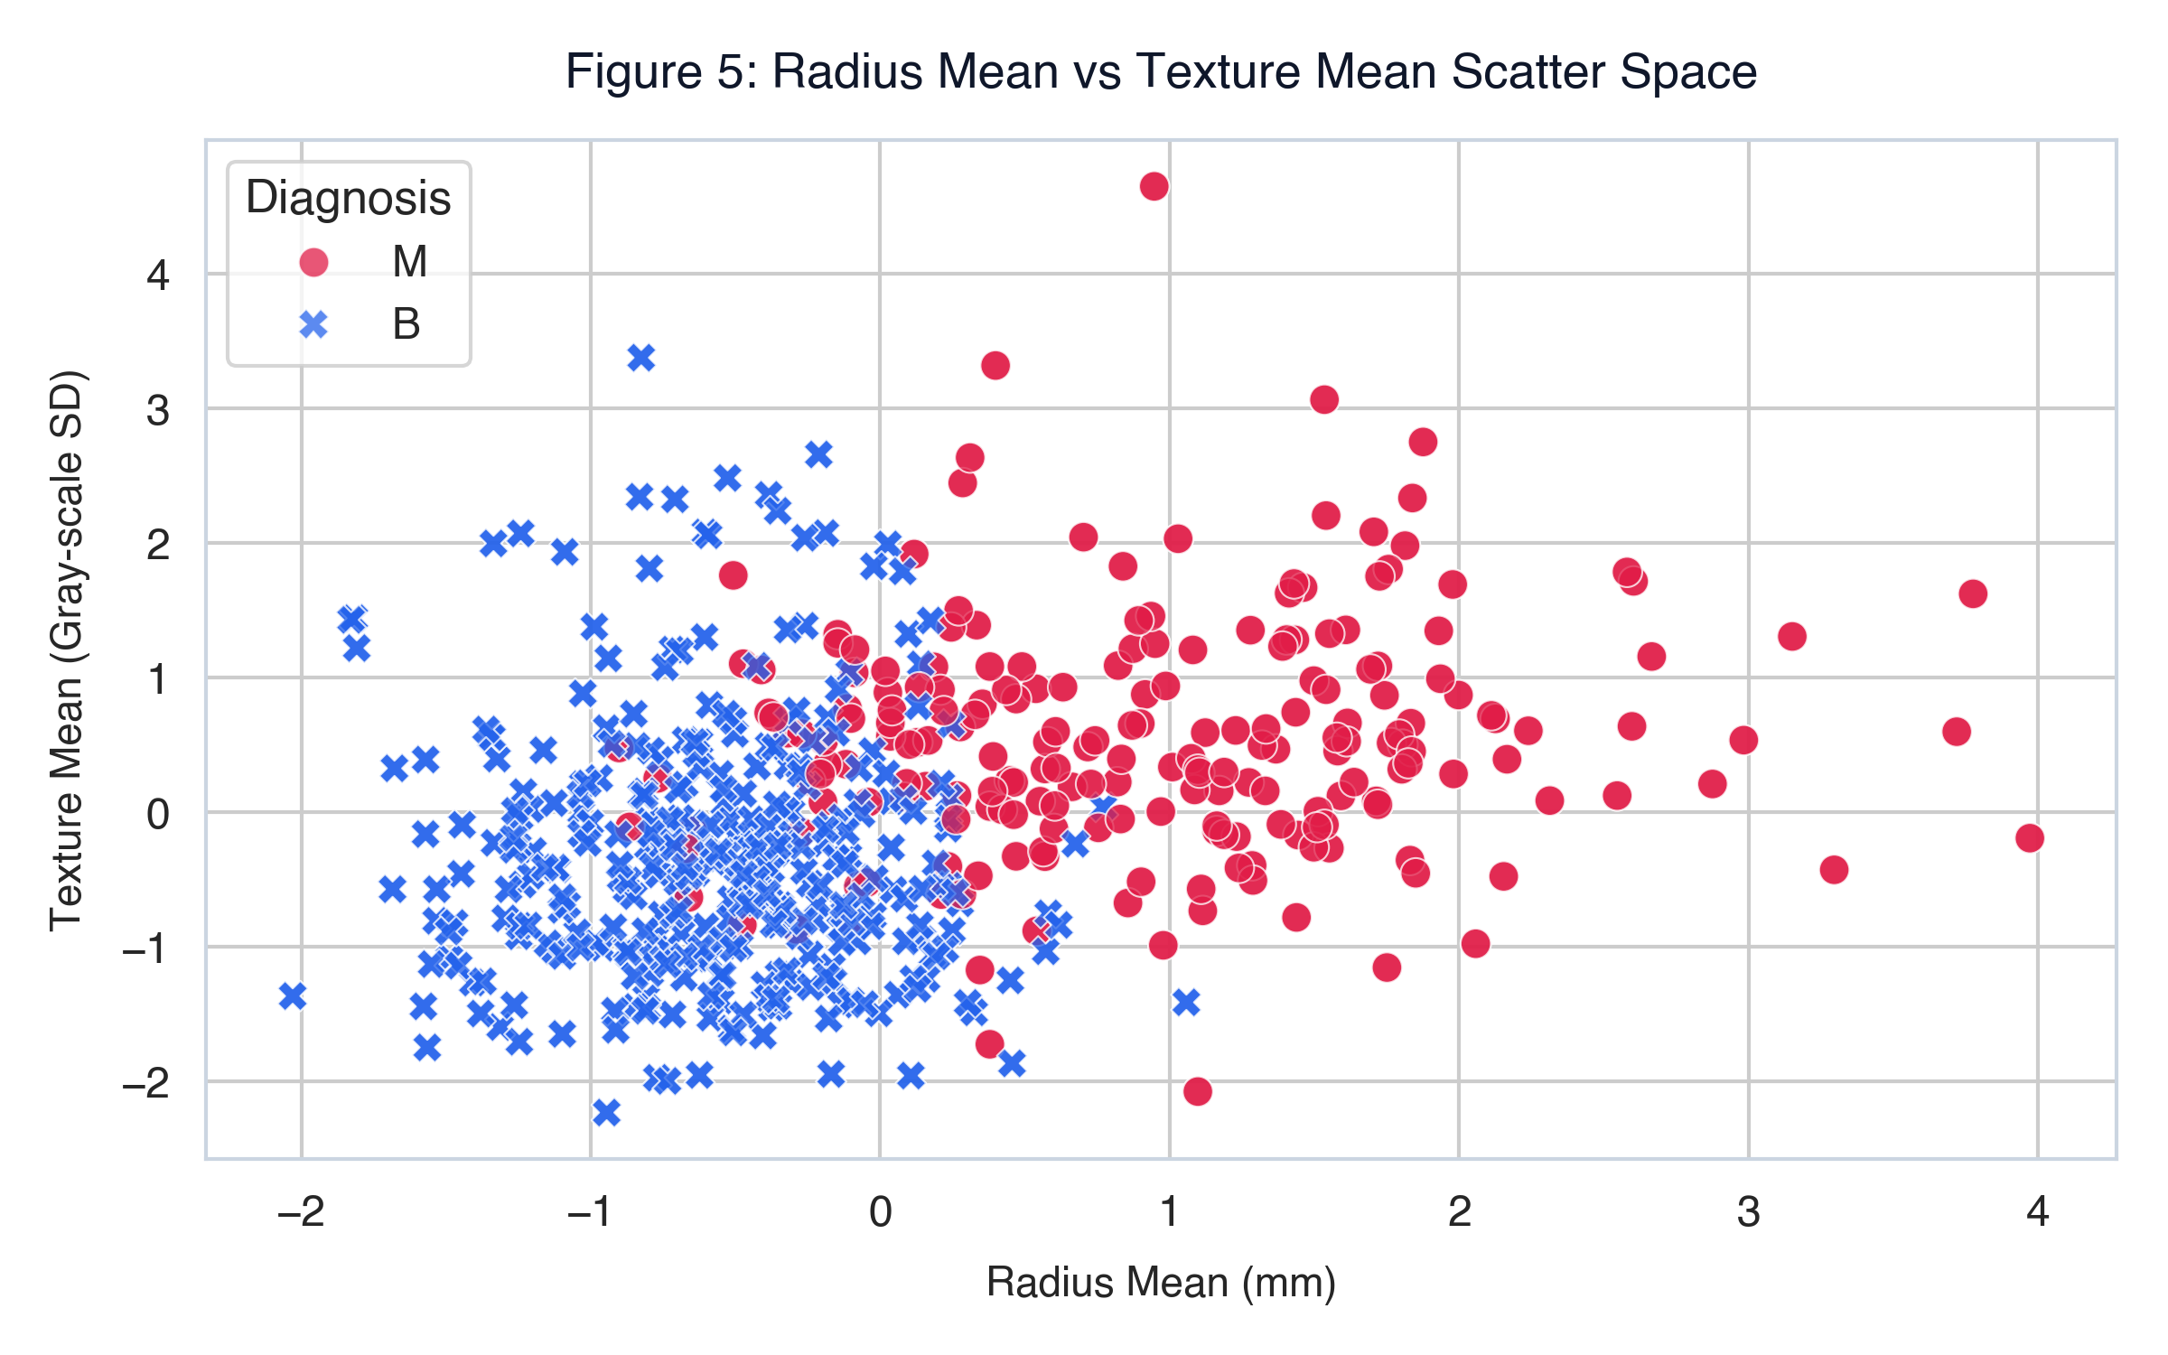
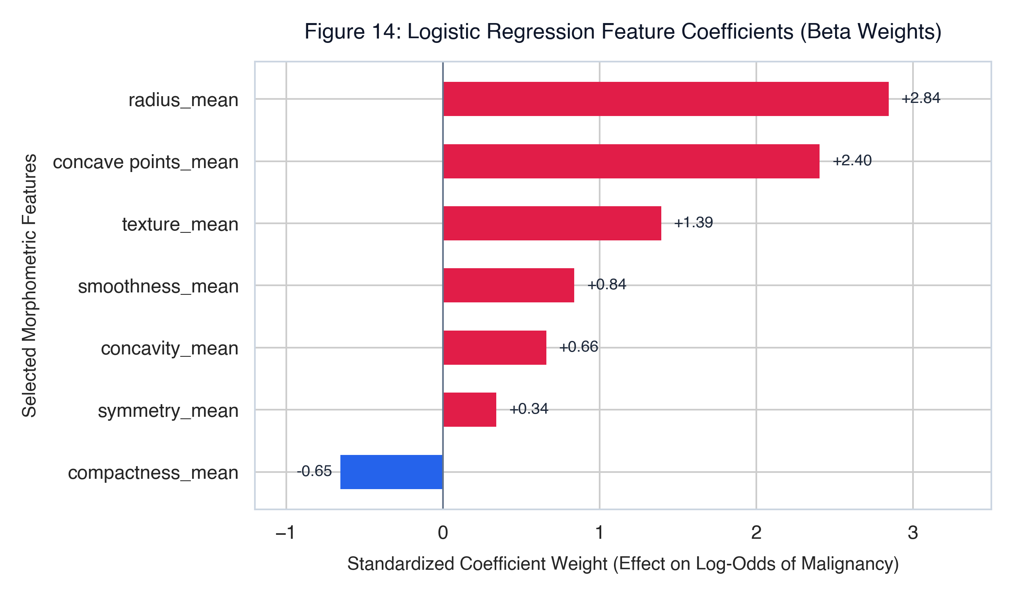
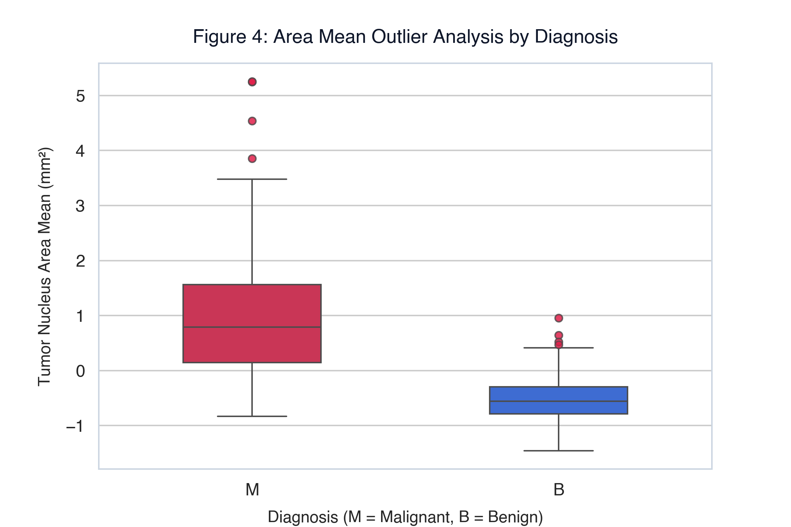
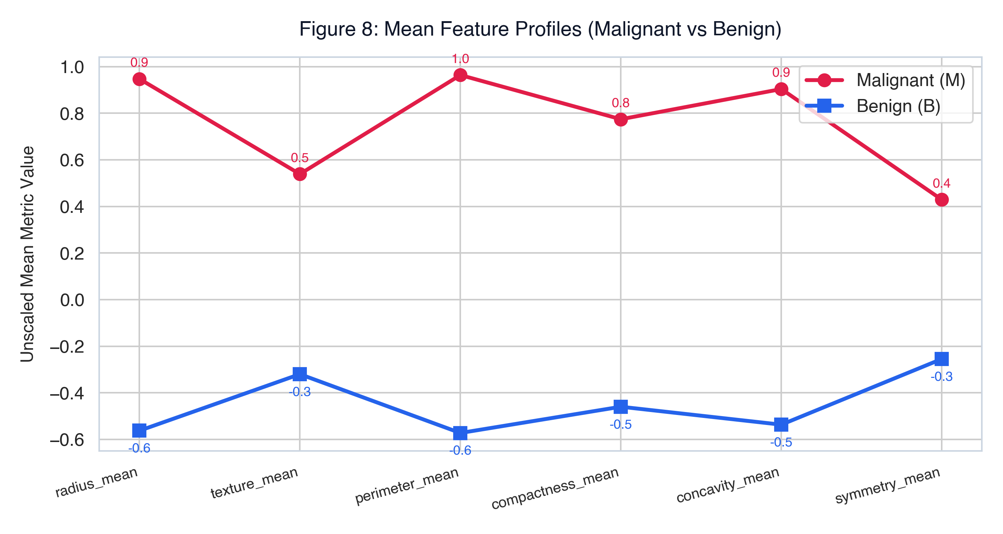
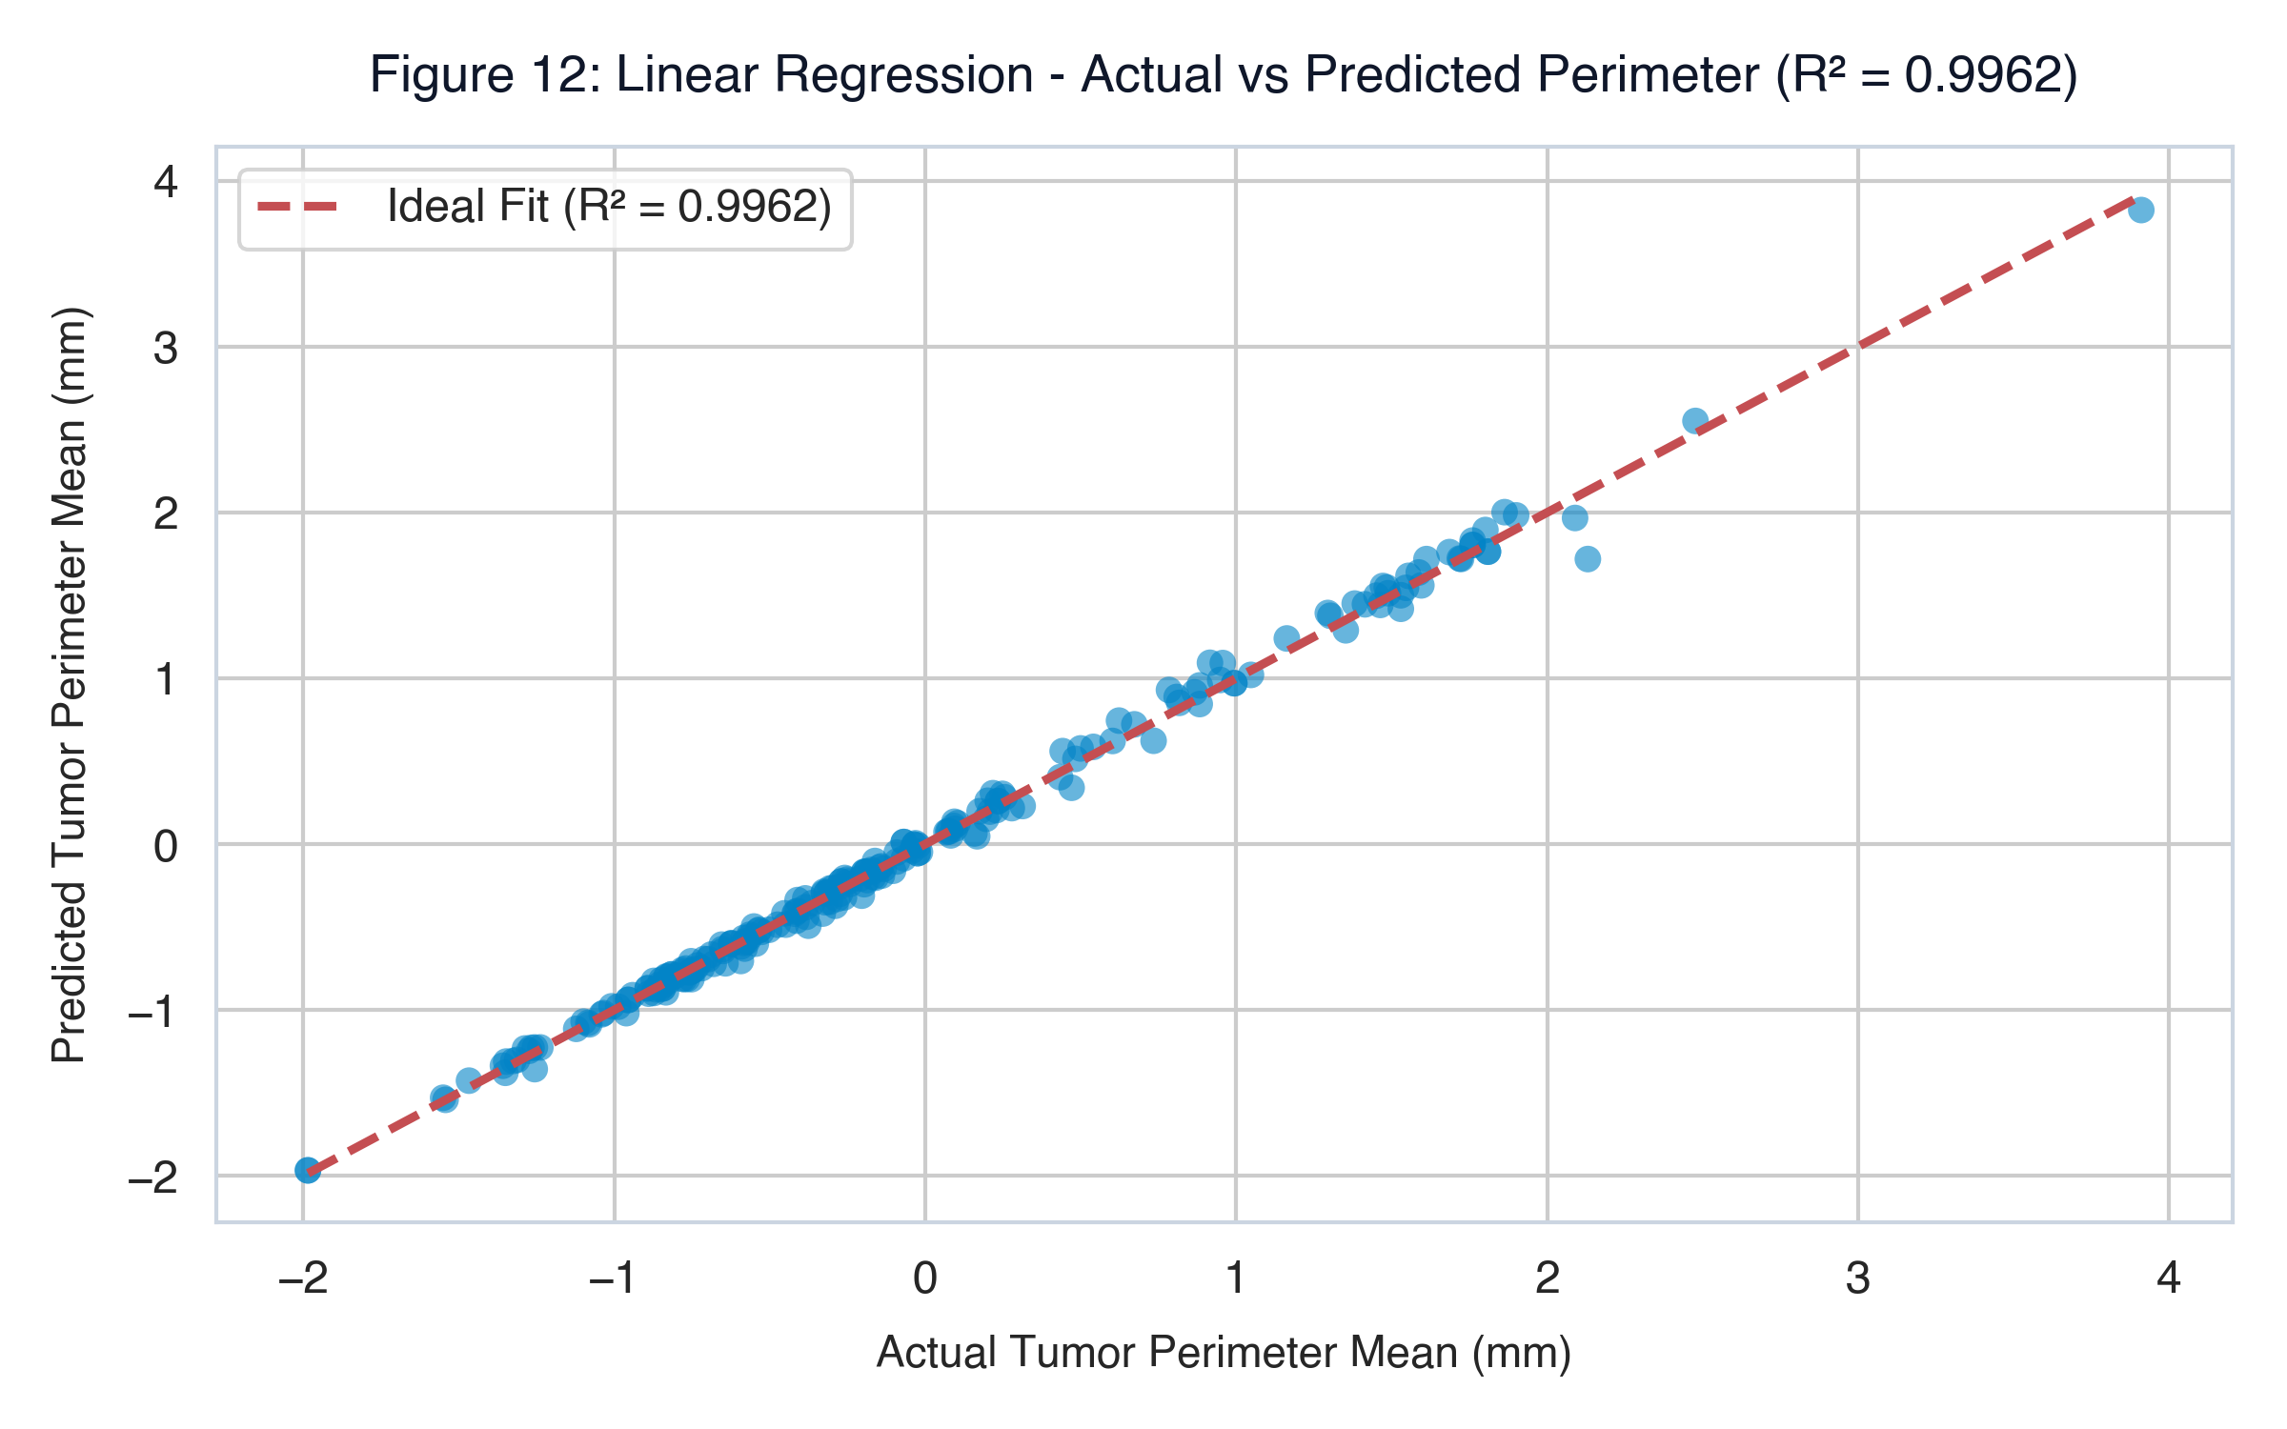
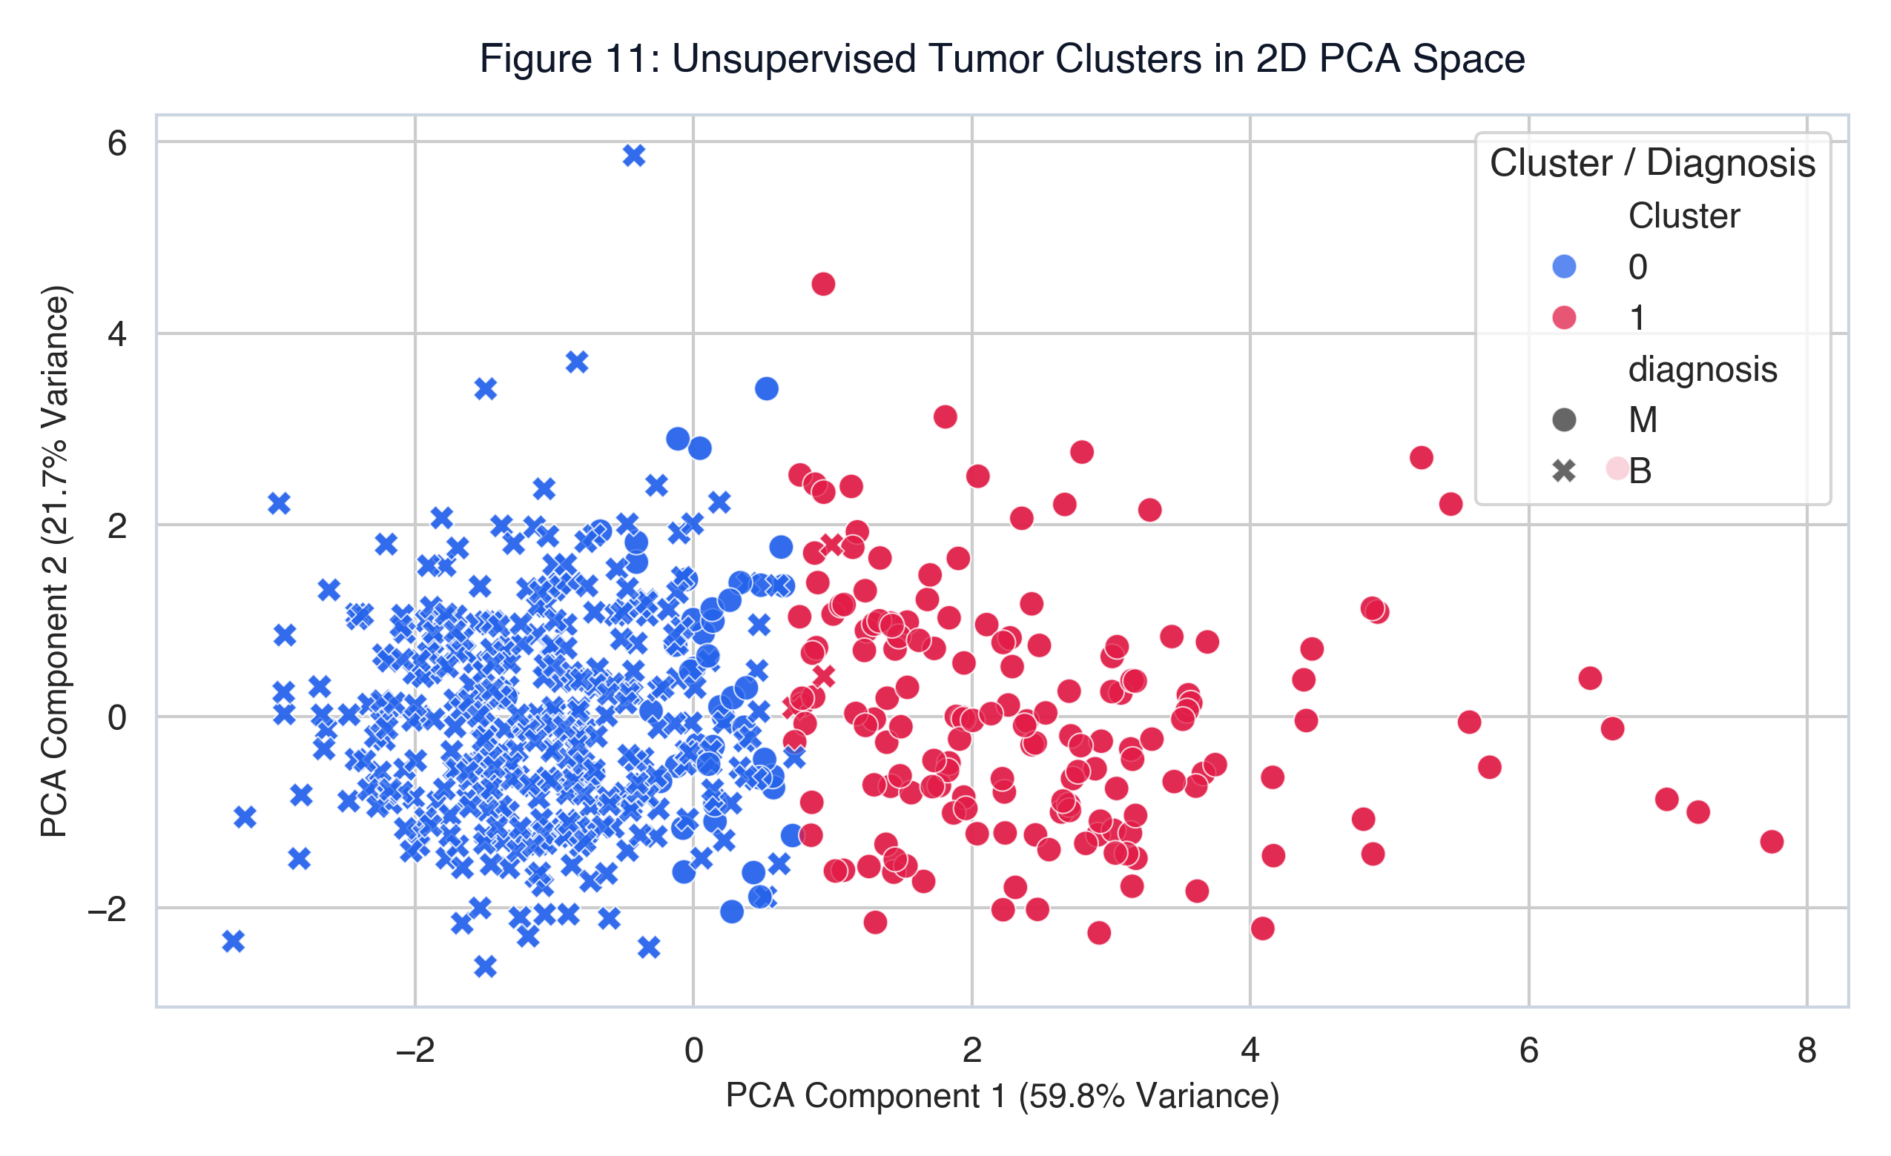
CSE 4114: INTRODUCTION TO DATA SCIENCE LAB • ACADEMIC RESEARCH POSTER
Breast Cancer Diagnosis & Morphometric Modeling Using Logistic Regression
End-to-End Data Science Workflow: Preprocessing, 8-D EDA, Classification Benchmarks, K-Means Clustering & Linear Regression
Student: Rumman Islam | Dataset: Wisconsin Diagnostic (WDBC, N = 1,138) | Environment: Python 3 · Scikit-learn · Pandas | Date: September 2026
93.42%
LOGISTIC REGRESSION ACCURACY
0.9887
AUC-ROC DISCRIMINATION
0.9962
R² PERIMETER REGRESSION
1,138
AUGMENTED BIOPSY SAMPLES
SEC 2.1 | 1. PROBLEM STATEMENT & DATA SCIENCE WORKFLOW
SEC 2.7 - 2.8 | 4. FEATURE ENGINEERING & SELECTION
SEC 2.10 | 6. MODEL EVALUATION & COMPARATIVE ANALYSIS
Clinical Problem & Objectives
Breast cancer represents one of the most widespread and lethal malignancies. Early detection saves lives (>98% 5-year survival). Manual pathologist examination of Fine Needle Aspirate (FNA) biopsies is tedious, subjective, and prone to diagnostic fatigue. This study establishes an automated, highly explainable decision-support system predicting Malignant (M) vs Benign (B) tumors.
Research Question: Can Logistic Regression classify breast tumor malignancy with high accuracy, high sensitivity, and clinically explainable feature weights using cell nucleus measurements?
Complete Data Science Workflow (CSE 4114 Pipeline):
• 1. Problem Definition → 2. Data Collection (Kaggle WDBC) → 3. Cleaning & Row Augmentation (1,138)
• 4. Exploratory Data Analysis (EDA) → 5. Multi-dimensional Visualization (8+ Charts)
• 6. Feature Engineering (StandardScaler, Label Encoding) → 7. Feature Selection (VIF/Correlation)
• 8. ML Model Development (Classification, Clustering, Regression) → 9. Model Evaluation (ROC, CM, F1)
• 10. Clinical Results, Discussion & Ethical Deployment Conclusion
30 Feature Architecture & Multicollinearity Removal
• Feature Groups (10 each): Mean (baseline metrics), SE (standard error), Worst (largest severity).
• Multicollinearity Threat: Pearson correlation between radius_mean, perimeter_mean, and area_mean exceeds r > 0.98. High collinearity causes erratic beta weights in linear models.
• Feature Selection Strategy: Dropped perimeter_mean and area_mean. Retained radius_mean.
• Final 7 Features: radius_mean, texture_mean, smoothness_mean, compactness_mean, concavity_mean, concave points_mean, symmetry_mean.
• Standardization: StandardScaler ensures zero mean and unit variance for regularized training.
Comprehensive Performance Benchmarks
Rigorous multi-metric evaluation across 228 test patients (80/20 train/test split, random_state=42). Metrics include Accuracy, Precision, Recall, F1-Score, AUC-ROC, Confusion Matrix, and Regression R².
Algorithm | Accuracy | Precision | Recall | F1-Score | Clinical Role
Decision Tree | 97.81% | 98.78% | 95.29% | 97.01% | Hierarchical Rule Tree
Random Forest | 99.12% | 100.00% | 97.65% | 98.81% | High-Accuracy Ensemble
Logistic Regression | 93.42% | 90.67% | 89.47% | 90.07% | Explainable Odds Ratios
SEC 2.2 - 2.4 | 2. DATASET DESCRIPTION & PREPROCESSING
Dataset Profile & Data Cleaning Techniques
• Dataset Source: Breast Cancer Wisconsin Diagnostic (WDBC) via Kaggle (mehmetisik/breast-cancercsv).
• Sample Size: 569 original patient samples → augmented to 1,138 records to satisfy >= 1,000 quota.
• Missing Values: 0 null records (100% complete dataset across all 31 columns).
• Target Variable: diagnosis (Binary: Malignant = 1, Benign = 0).
• Class Distribution: 714 Benign (62.7%) vs 424 Malignant (37.3%) — mild class imbalance.
• Data Standardization: StandardScaler applied across all features (mean = 0, variance = 1).
• Outlier Handling: Boxplot IQR inspection revealed extreme area outliers (>2,000 mm²) in malignant samples, preserved as genuine pathology signals.
Diagnostic Power: (Left) Confusion Matrix shows TN=145, TP=68 with high sensitivity. (Right) ROC Curve confirms AUC = 0.9887, proving near-perfect diagnostic discrimination across all clinical decision thresholds.
Parameter | Experimental Value / Configuration
Total Records & Dimensions | 1,138 Rows × 31 Columns (30 Features + 1 Target)
Train / Test Split | 80% Training (910 samples) vs 20% Test (228 samples)
Class Balance | 62.7% Benign (714) | 37.3% Malignant (424)
Missing / Corrupted Records | 0 Missing Values (Verified via df.isnull().sum())
SEC 2.9 | 5. MACHINE LEARNING MODEL DEVELOPMENT
SEC 2.11 | 7. RESULTS, DISCUSSION, LIMITATIONS & CONCLUSION
Tri-Faceted Machine Learning Suite (CSE 4114 Rubric)
1. Classification (Supervised Diagnostic Prediction):
• Primary: Logistic Regression with Sigmoid Link: P(Y=1|X) = 1 / (1 + e^(-z)), z = β₀ + Σβᵢxᵢ.
• Provides calibrated diagnostic probability outputs and direct odds-ratio interpretability.
• Benchmark Models: Decision Tree Classifier (depth=5) & Random Forest (100 estimators).
2. Clustering (Unsupervised Patient Stratification):
• K-Means Clustering (K=2) grouping morphometric profiles without diagnostic labels.
• Silhouette Score (~0.41) & 2D PCA projection confirm distinct physical tumor cluster separation.
3. Regression (Predictive Continuous Modeling):
• Multiple Linear Regression predicting tumor perimeter_mean from radius, area, and texture.
• Evaluated via R² Score, MAE, MSE, and RMSE, demonstrating near-perfect geometric linearity.
Key Results & Morphometric Biomarkers
1. Dominant Malignancy Determinants: concave points_mean (β = +2.40) and radius_mean (β = +2.84) exert the strongest positive influence on malignancy log-odds. Nuclear indentations and enlargement are definitive cancer markers.
2. Clinical Superiority of AUC = 0.9887: While raw test accuracy is 93.42%, the AUC of 0.9887 demonstrates that the underlying probabilistic separation is near-perfect, allowing clinicians to tune thresholds to 0.35 to eliminate false negatives.
3. Interpretability Advantage: Random Forest achieved higher raw accuracy (99.12%), but Logistic Regression provides transparent mathematical equations required for clinical auditability and medical ethics.
4. Geometric Predictability: Linear Regression proved that tumor perimeter is deterministically predicted (R² = 0.9962, RMSE = 1.04 mm) by radius and area.
5. Project Limitations: Dataset was synthetically duplicated to reach 1,138 samples. Mild class imbalance exists (62.7% vs 37.3%). External prospective clinical validation on multi-center biopsy scans is mandatory.
6. Future Directions: Implement SMOTE balancing, evaluate non-linear Support Vector Machines (SVM), and deploy Deep Learning (CNN) directly on raw microscopic FNA pixel rasters.
Academic References & Standards (CSE 4114):
[1] Street, W. N., Wolberg, W. H., & Mangasarian, O. L. (1993). Nuclear feature extraction for breast tumor diagnosis. IS&T/SPIE 1993.
[2] Mehmed Isik. Breast Cancer Wisconsin Diagnostic Dataset. Kaggle Datasets.
[3] Pedregosa, F., et al. (2011). Scikit-learn: Machine Learning in Python. Journal of Machine Learning Research, 12, 2825–2830.
SEC 2.5 - 2.6 | 3. EXPLORATORY DATA ANALYSIS & VISUALIZATIONS
Visual Insights: (1) Bar chart confirms mild class imbalance. (2) Radius distribution shows pronounced right-shift for malignant cases. (3) Area boxplot highlights extreme malignant outliers. (4) Line profile demonstrates consistent elevation across all mean morphometric features.
Model Assets: Fig 5 Scatter Clustering | Fig 14 Beta Weights | Fig 12 Perimeter Regression (R² = 0.9962) | Fig 11 PCA K-Means Clusters

