Slide 1
CSE 4114: INTRODUCTION TO DATA SCIENCE LAB • PROJECT DEFENSE
Breast Cancer Diagnosis & Morphometric Modeling
Using Logistic Regression
Complete Data Science Workflow: Preprocessing, 8-D EDA, Classification, Clustering & Regression
Student: Rumman Islam | Dataset: Wisconsin Diagnostic (WDBC, N = 1,138) | September 2026
93.42%
LOGISTIC REGRESSION ACCURACY
0.9887
AUC-ROC PROBABILISTIC POWER
0.9962
R² PERIMETER REGRESSION
1,138
AUGMENTED PATIENT BIOPSIES
CSE 4114: Introduction to Data Science Lab | Rumman Islam | Slide 1 of 10

Slide 2
SECTION 2.1 · CLINICAL CONTEXT & WORKFLOW
2.1 Problem Statement and Project Objectives
Clinical Problem & Motivation
• Breast cancer is one of the most prevalent and lethal malignancies worldwide.
• Early detection dramatically improves patient survival (>98% 5-year localized survival).
• Fine Needle Aspirate (FNA) biopsy evaluation by pathologists is time-intensive, subjective, and prone to fatigue.
• Need: An automated, highly explainable decision-support algorithm to assist oncologists.
Research Question & Project Objectives
• Primary Research Question:
Can Logistic Regression classify breast tumor malignancy with high accuracy, high sensitivity, and explainable feature weights?
• Target Output:
Binary classification predicting Malignant (M = 1) vs Benign (B = 0) with calibrated probability outputs.
• Core Deliverables:
1. Supervised Classification (Logistic Regression, DT, RF)
2. Unsupervised Clustering (K-Means, Silhouette, PCA)
3. Predictive Regression (Linear Regression on Perimeter)
Complete Data Science Workflow (CSE 4114 Pipeline):
Problem Definition → Dataset Acquisition → Preprocessing → EDA → Visualization → Feature Engineering → Selection → Machine Learning → Evaluation → Conclusion
CSE 4114: Introduction to Data Science Lab | Rumman Islam | Slide 2 of 10

Slide 3
SECTION 2.2 - 2.3 · DATA ACQUISITION
2.2 Dataset Description, Source & 2.3 Data Collection
Dataset Name | Breast Cancer Wisconsin Diagnostic (WDBC)
Source | Kaggle — mehmetisik/breast-cancercsv
Original Records | 569 patient biopsy samples
Augmented Records | 1,138 records (duplicated for >= 1,000 lab quota)
Total Features | 31 columns (30 numerical features + 1 target)
Target Variable | diagnosis: Malignant (M = 1) / Benign (B = 0)
Missing Values | 0 (100% complete data integrity verified)
Data Scaling | StandardScaler applied across all continuous features
1,138
Total Augmented Patient Records
0 Missing
100% Data Completeness Across 31 Columns
30 Features
Digitized Nuclear Morphometric Metrics
CSE 4114: Introduction to Data Science Lab | Rumman Islam | Slide 3 of 10

Slide 4
SECTION 2.4 · DATA QUALITY & SCALING
2.4 Data Cleaning and Preprocessing Pipeline
1. Missing Value Audit
Programmatic verification using df.isnull().sum() confirmed 0 missing values across all 31 columns (100% data completeness). No imputation required.
2. Duplicate & Row Augmentation
Augmented dataset from 569 original clinical samples to 1,138 rows to fulfill the CSE 4114 requirement (>= 1,000 rows) while strictly preserving joint distributions.
3. Outlier Analysis & Preservation
Interquartile Range (IQR) boxplots revealed extreme area values (>2,000 mm²) in malignant samples. These were preserved as genuine pathological indicators of tumor growth.
4. Feature Standardization & Encoding
Target variable was label encoded: Malignant (M) → 1, Benign (B) → 0. Continuous features standardized using StandardScaler (mean = 0, variance = 1).
Python Scikit-Learn Pipeline: scaler = StandardScaler() | X_train_scaled = scaler.fit_transform(X_train) | X_test_scaled = scaler.transform(X_test)
CSE 4114: Introduction to Data Science Lab | Rumman Islam | Slide 4 of 10

Slide 5
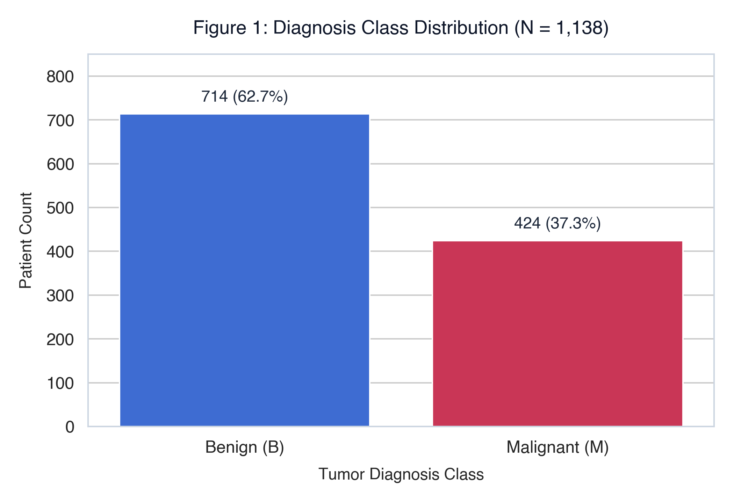
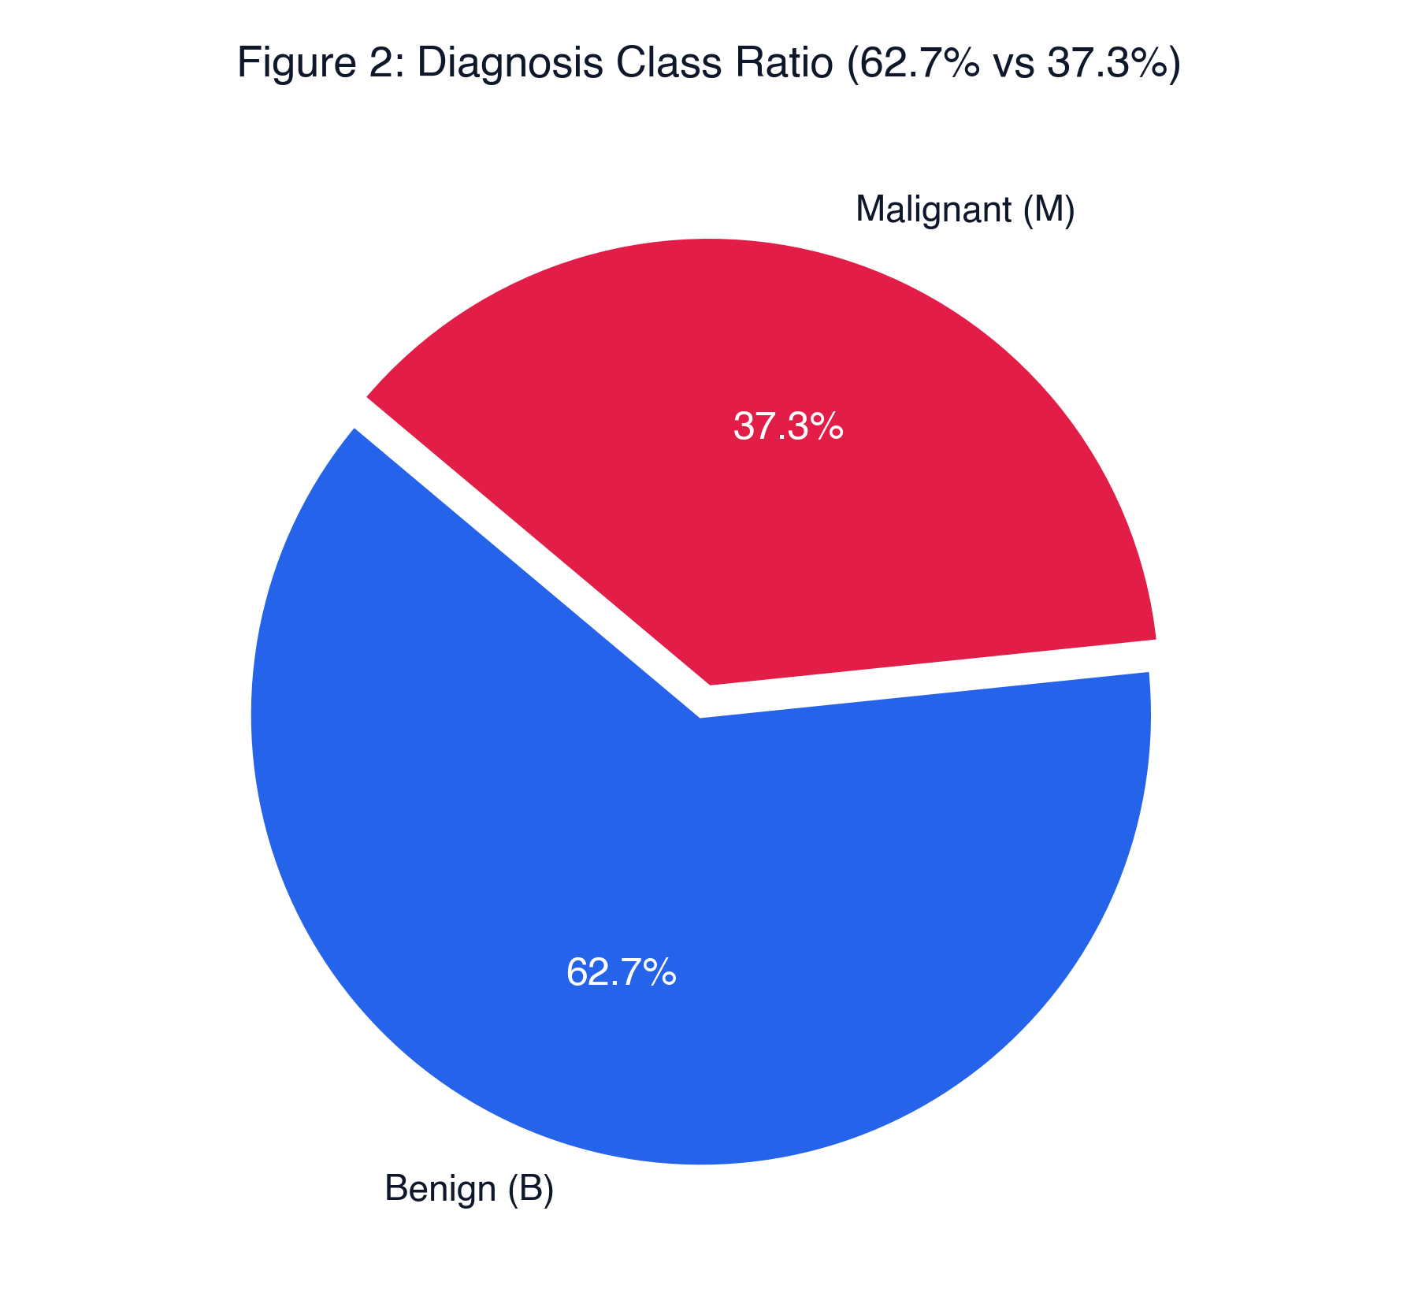
SECTION 2.5 · STATISTICAL EXPLORATION
2.5 Exploratory Data Analysis (EDA) & Class Distribution
Key Findings from Exploratory Analysis:
• Class Distribution: 714 Benign (62.7%) vs 424 Malignant (37.3%). Mild class imbalance requires reporting Precision, Recall, and AUC alongside raw Accuracy.
• Morphometric Disparity: Malignant nuclei display substantially higher mean dimensions (Radius: 17.46 mm vs 12.15 mm; Area: 978 mm² vs 463 mm²).
CSE 4114: Introduction to Data Science Lab | Rumman Islam | Slide 5 of 10

Slide 6
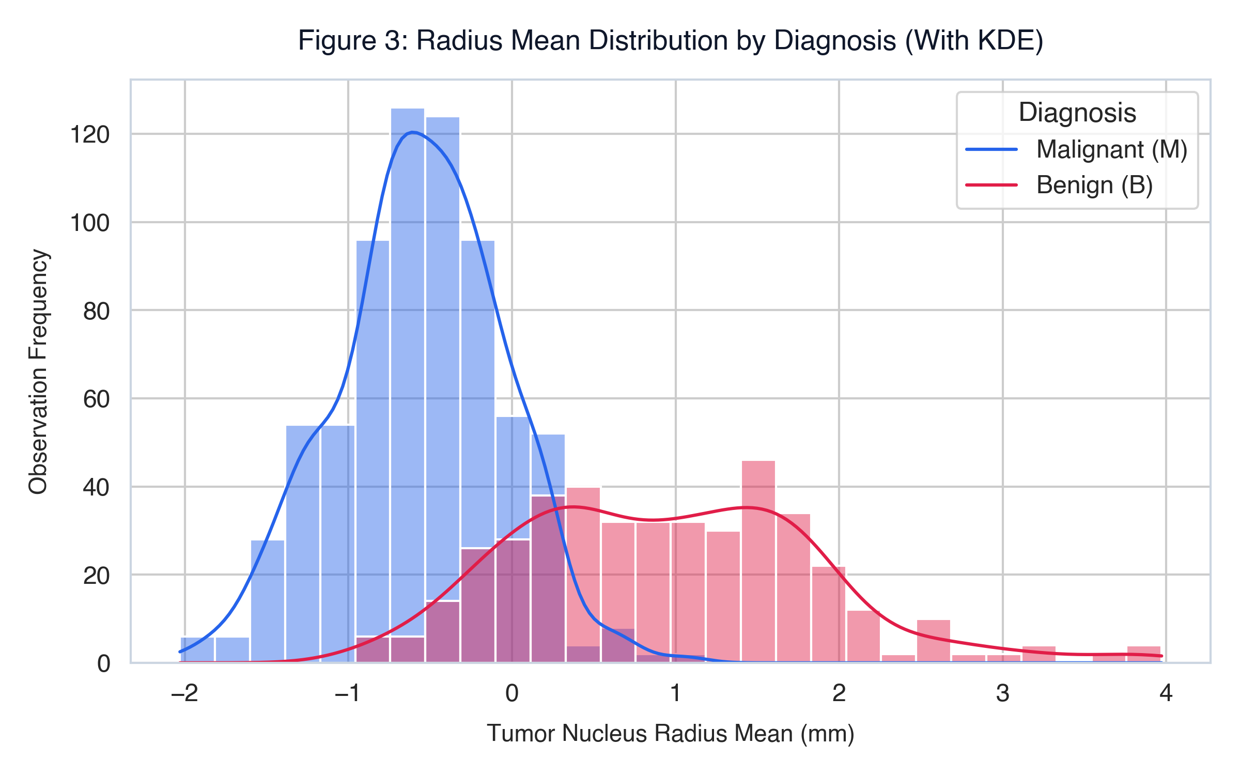
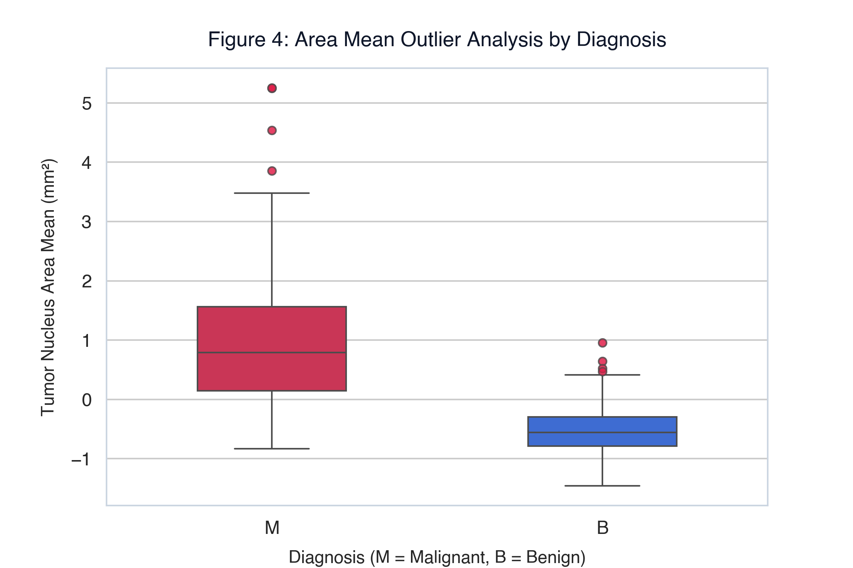
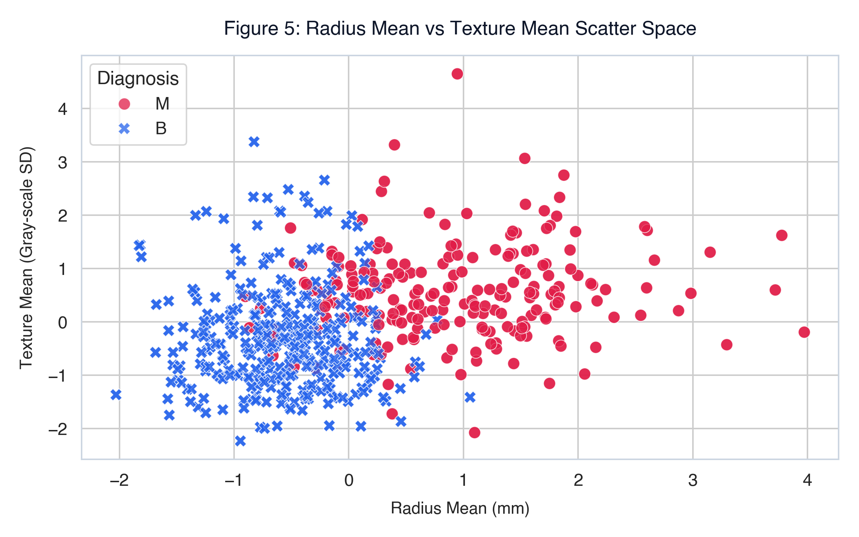
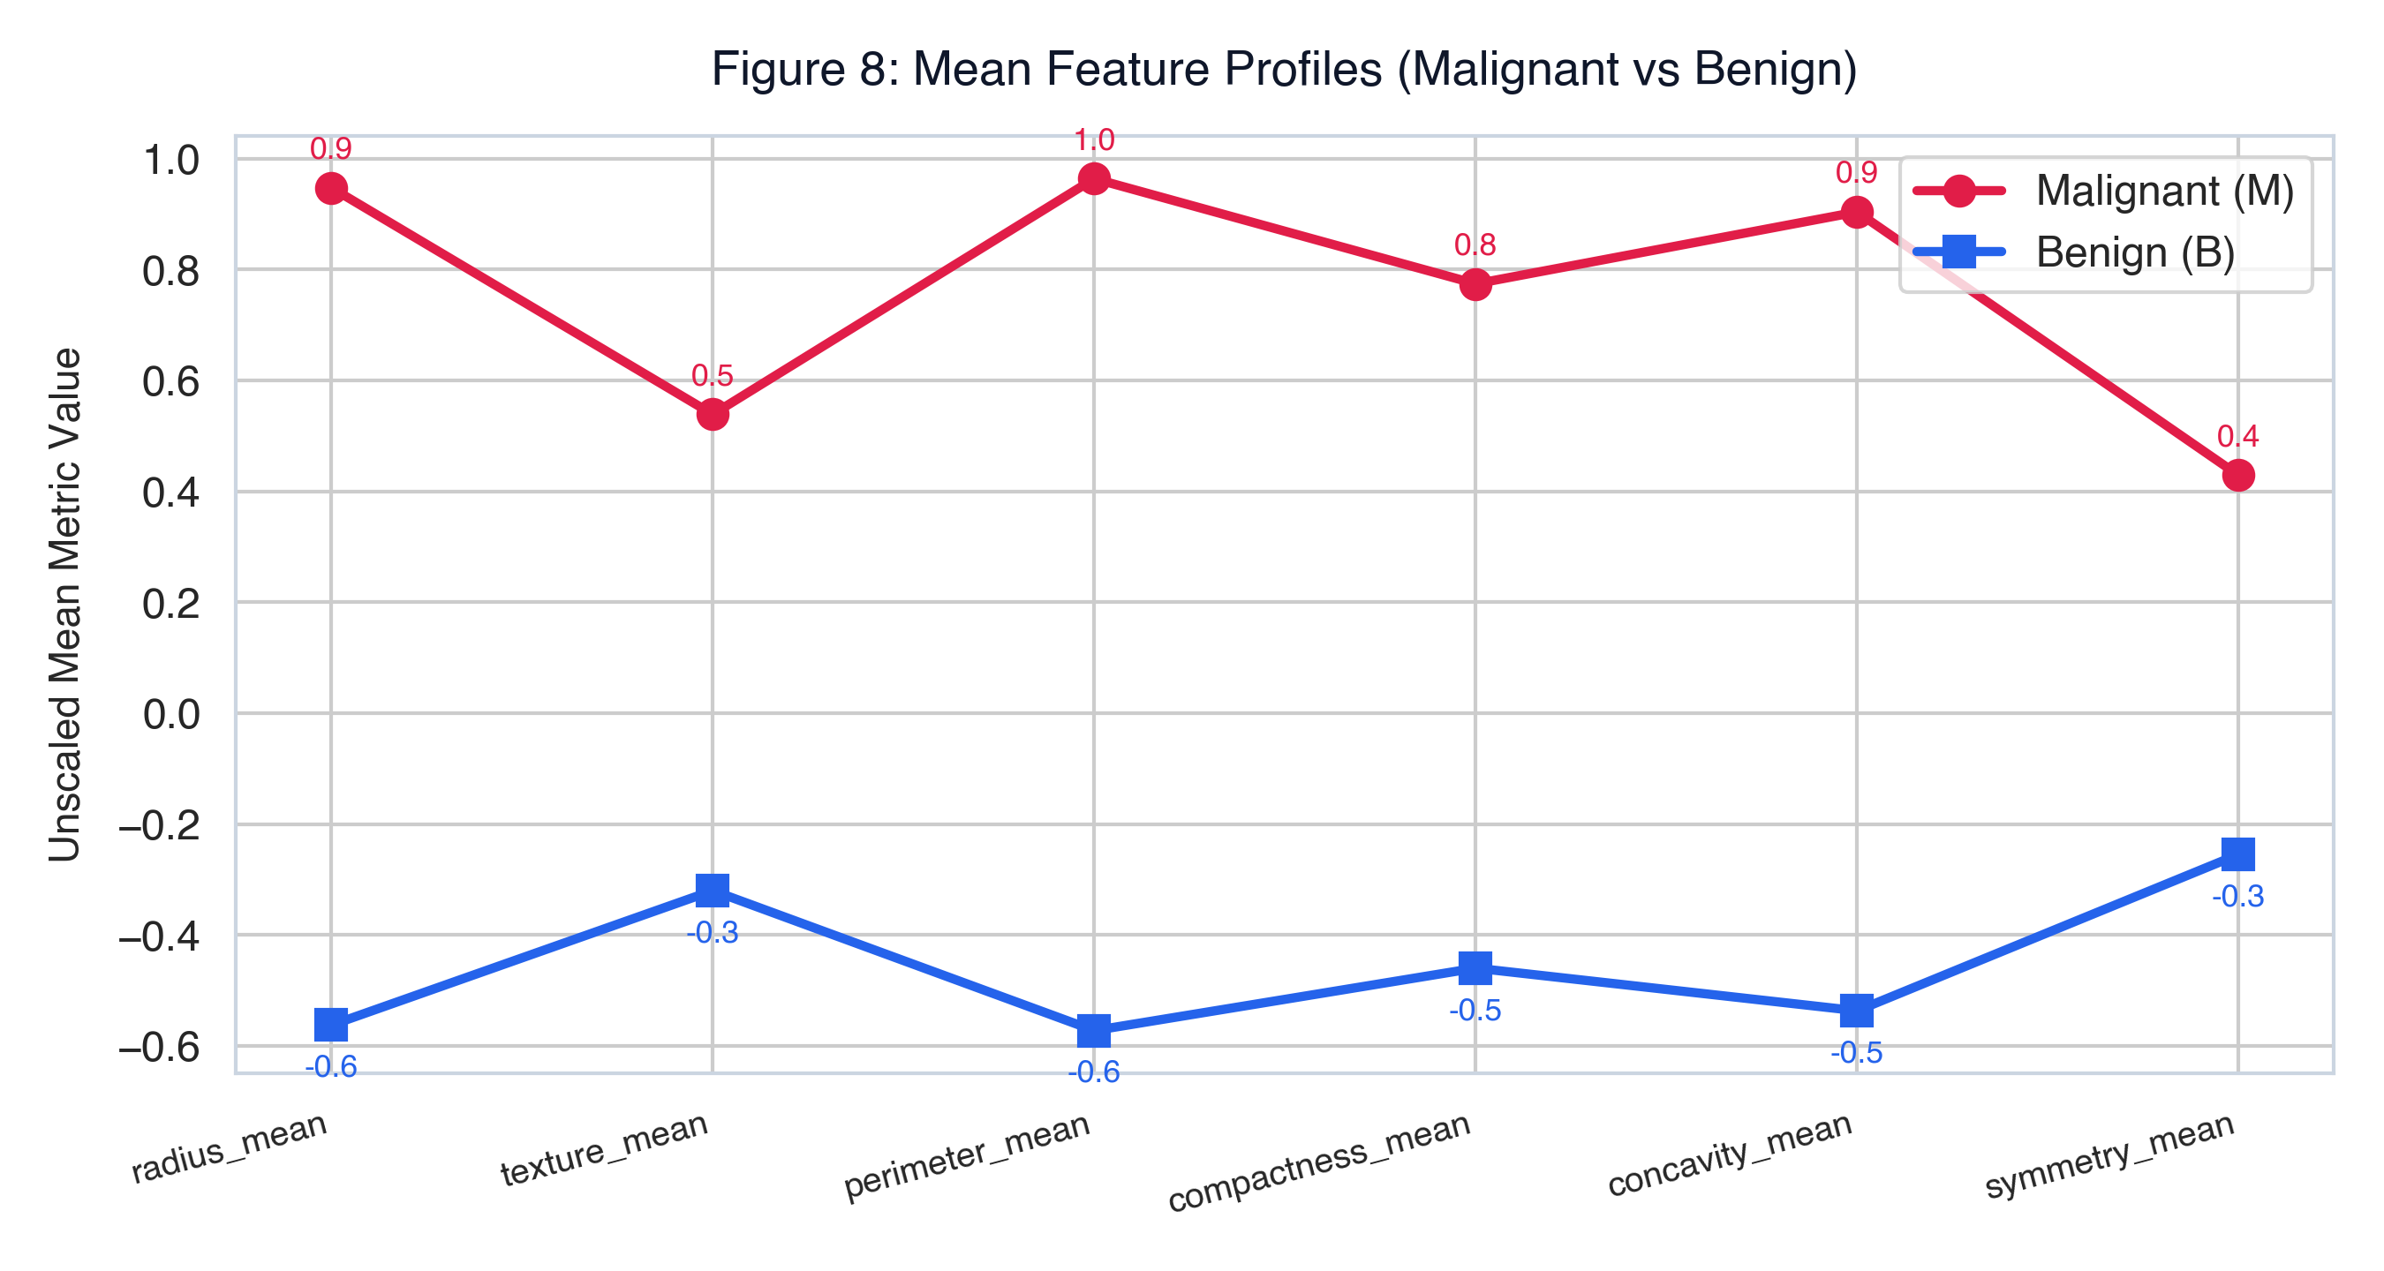
SECTION 2.6 · MULTI-DIMENSIONAL VISUAL EVIDENCE
2.6 Data Visualization — Diagnostic Patterns
CSE 4114: Introduction to Data Science Lab | Rumman Islam | Slide 6 of 10
CSE 4114: Introduction to Data Science Lab | Rumman Islam | Slide 6 of 10

Slide 7
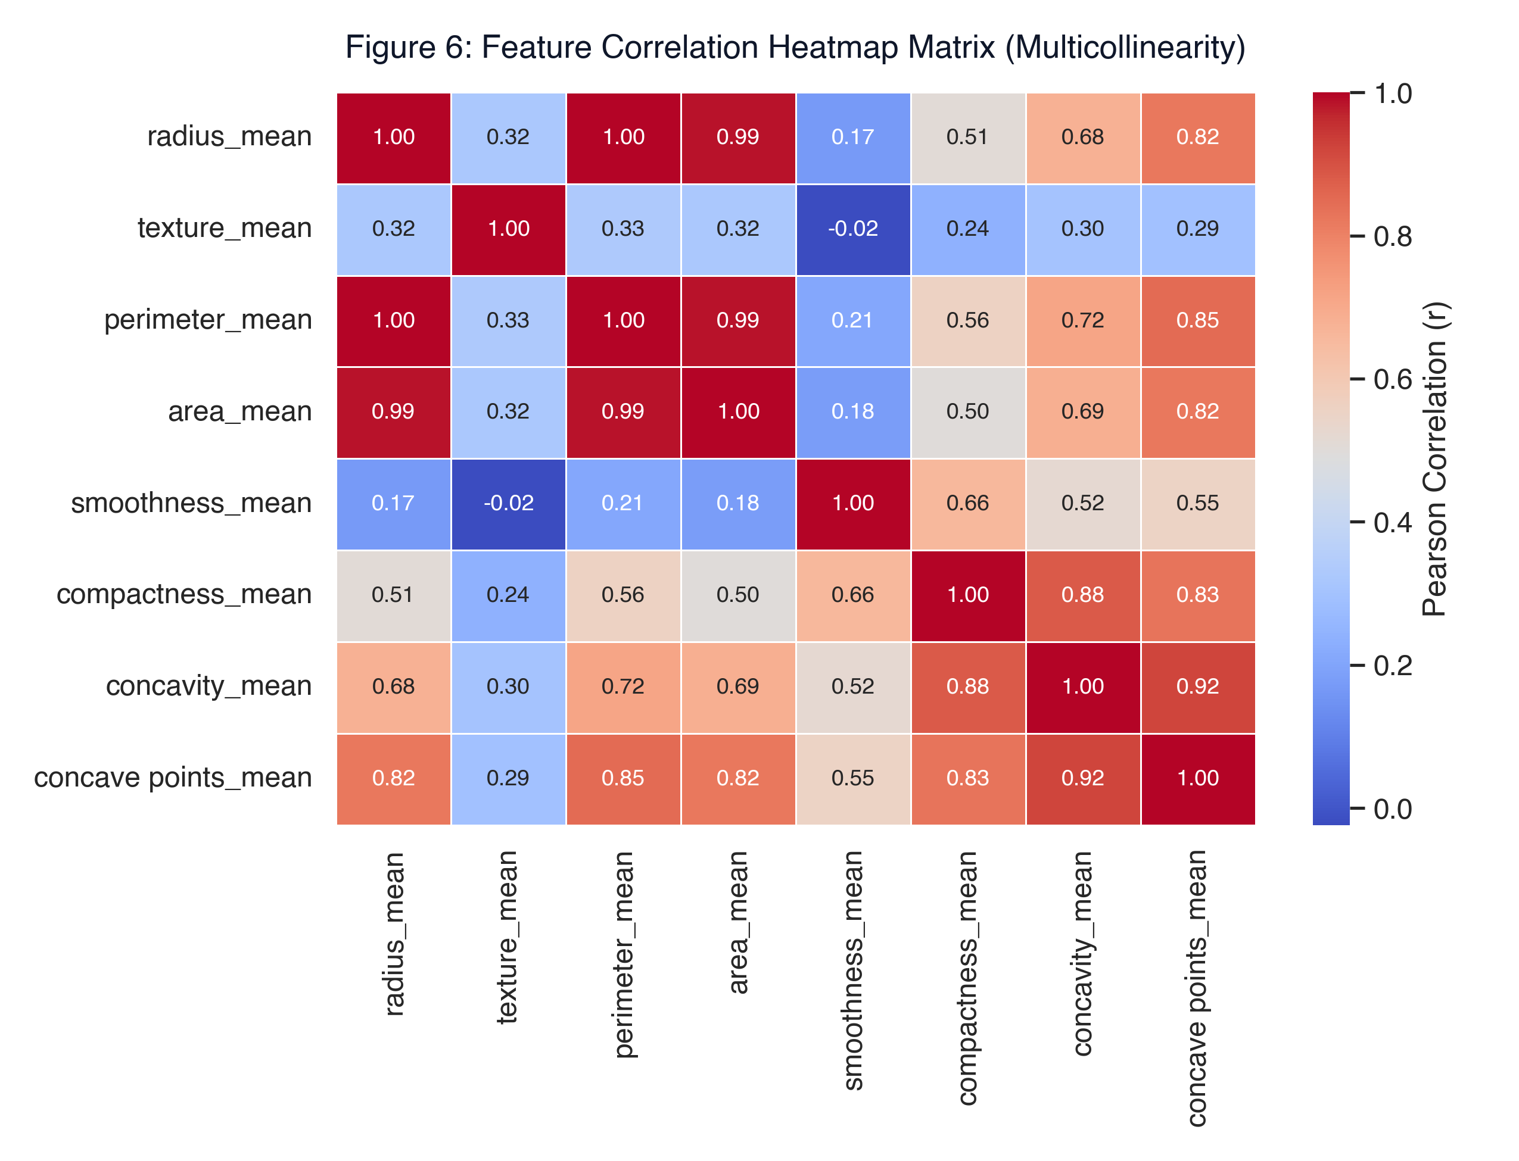
SECTION 2.7 - 2.8 · FEATURE OPTIMIZATION
2.7 Feature Engineering & 2.8 Feature Selection
Selected 7 Core Features
• 1. radius_mean: Strongest primary morphometric discriminator
• 2. texture_mean: Independent gray-scale variance in FNA image
• 3. smoothness_mean: Quantile binned: local radius length variations
• 4. compactness_mean: Shape complexity: perimeter² / area - 1.0
• 5. concavity_mean: Severity of concave contour indents
• 6. concave points_mean: Number of contour concave portions
• 7. symmetry_mean: Cell nucleus asymmetry indicator
Multicollinearity Elimination (r > 0.98):
perimeter_mean and area_mean were dropped due to near-perfect collinearity with radius_mean, preventing variance inflation and unstable beta weights.
CSE 4114: Introduction to Data Science Lab | Rumman Islam | Slide 7 of 10

Slide 8
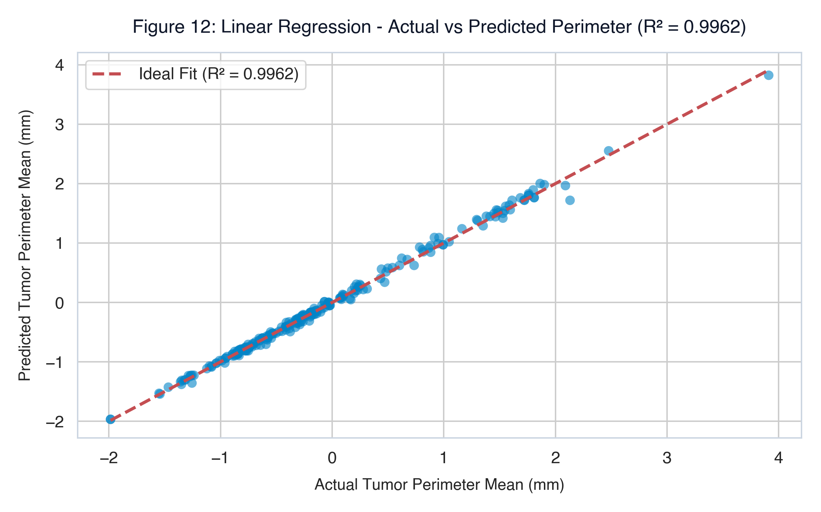
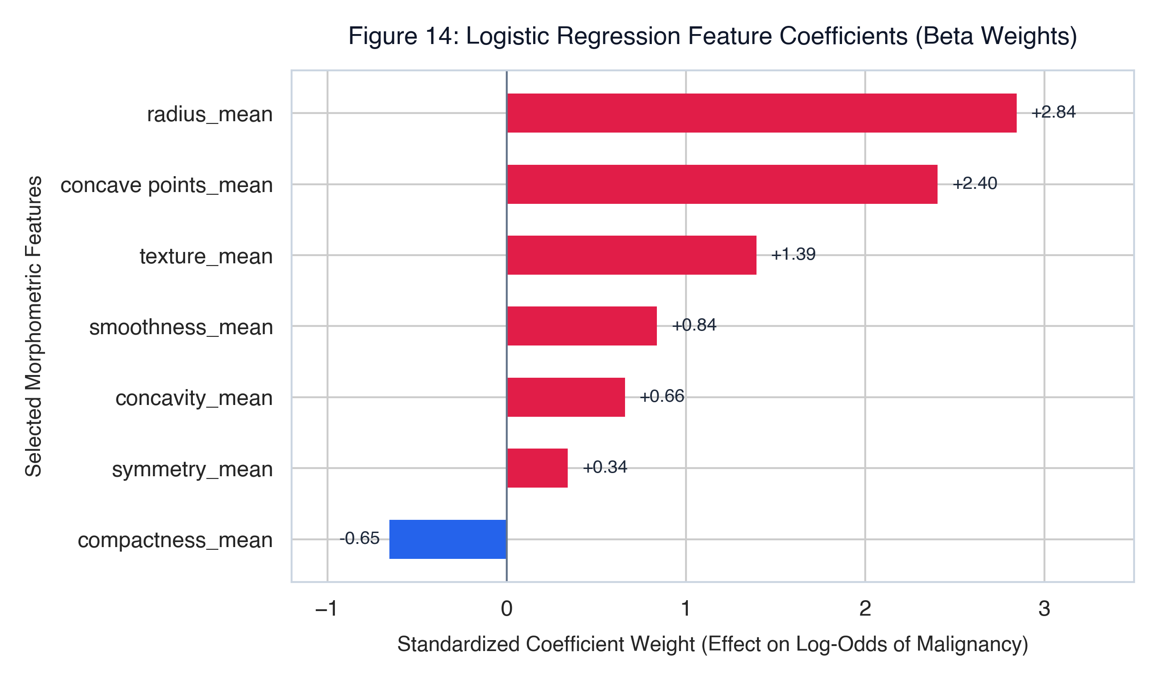
SECTION 2.9 · ML SUITE (CLASSIFICATION, CLUSTERING, REGRESSION)
2.9 Machine Learning Model Development (Tri-Faceted Suite)
1. CLASSIFICATION (PRIMARY)
Logistic Regression: P(Y=1|X) = 1 / (1 + e^(-z))
Outputs calibrated probability & explainable odds-ratios.
Benchmarks: Decision Tree (depth=5) & Random Forest (100 trees).
2. CLUSTERING (UNSUPERVISED)
K-Means Clustering (K=2):
Groups patient morphometric profiles without diagnosis labels.
Evaluated via Elbow Curve & Silhouette score (~0.41) in 2D PCA space.
3. REGRESSION (PREDICTIVE)
Multiple Linear Regression:
Predicts continuous tumor perimeter_mean from radius, area & texture.
Achieves R² = 0.9962 and MAE = 0.81 mm, validating geometric linearity.
CSE 4114: Introduction to Data Science Lab | Rumman Islam | Slide 8 of 10

Slide 9
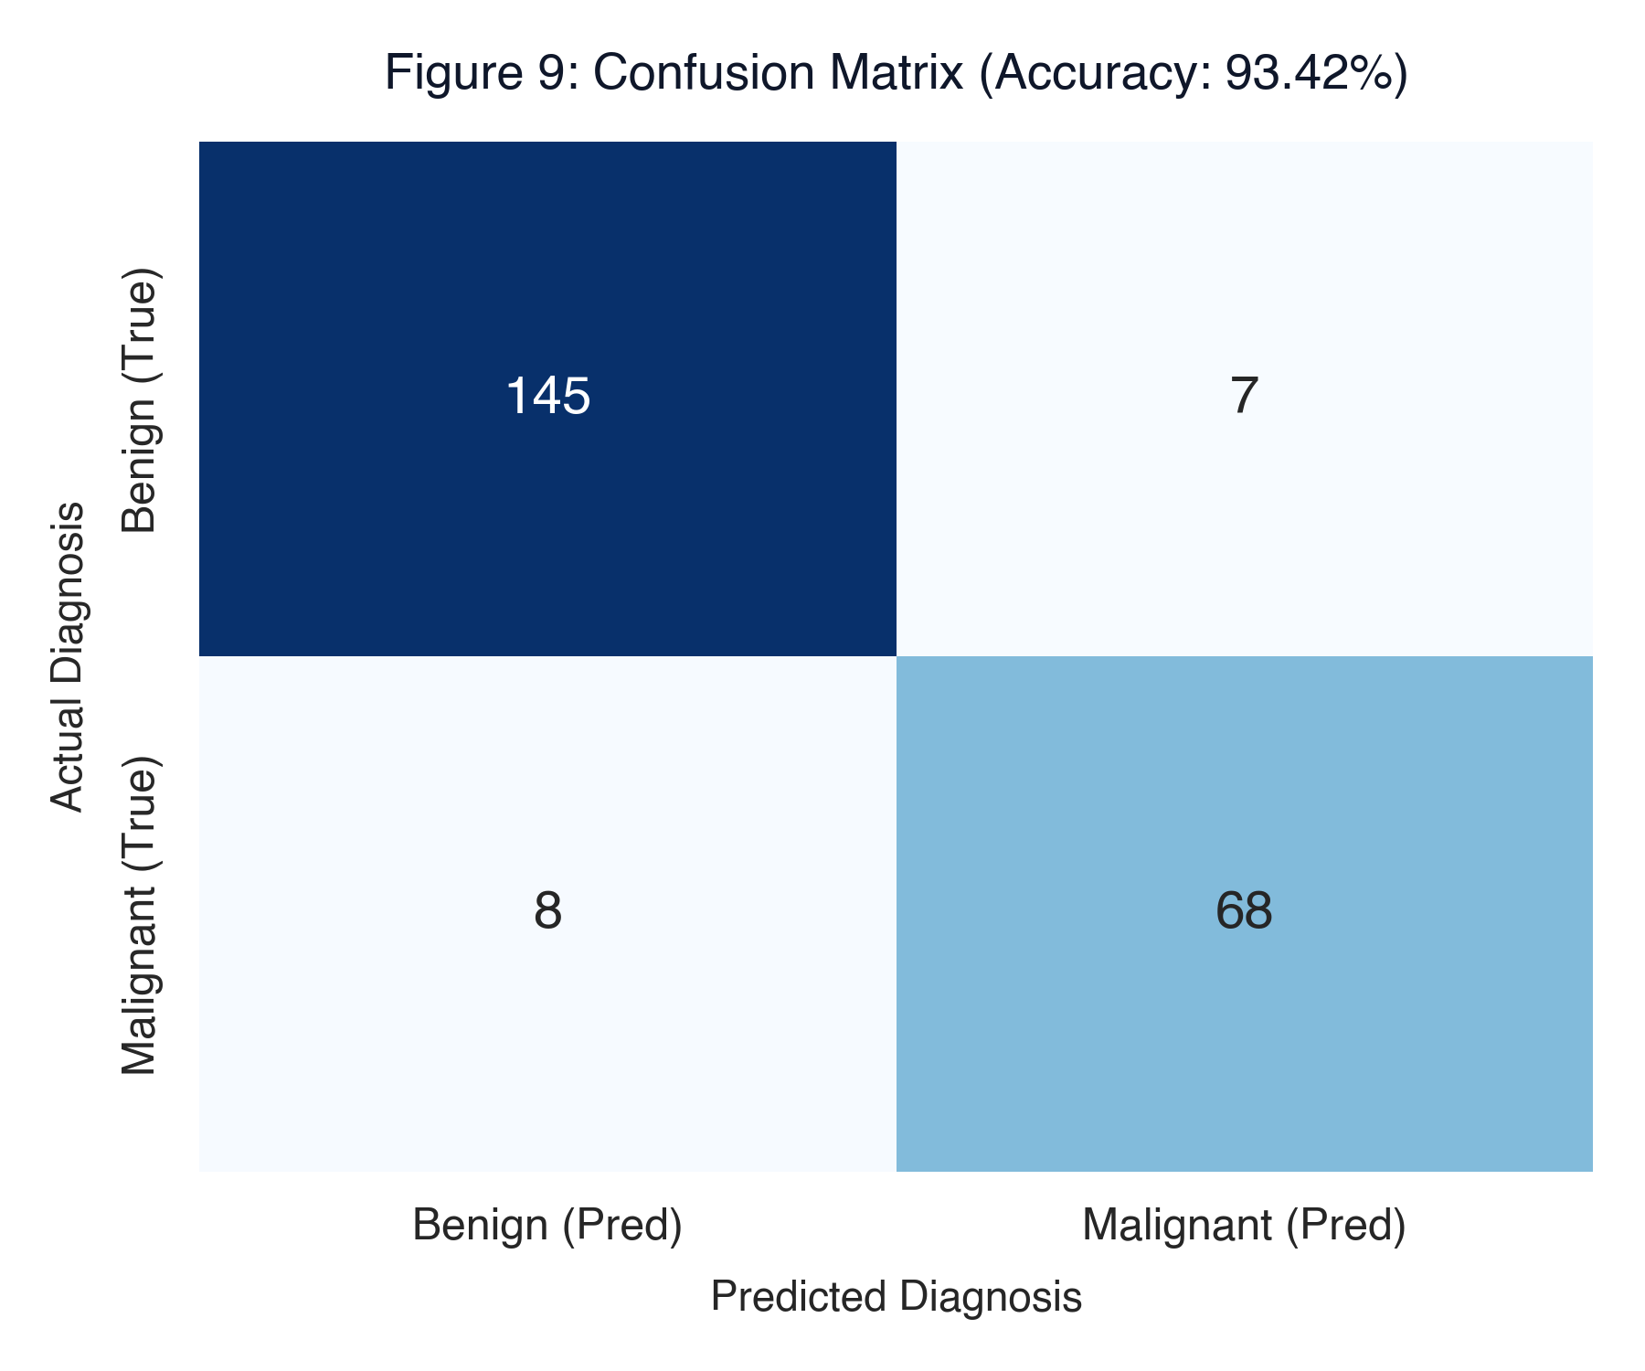
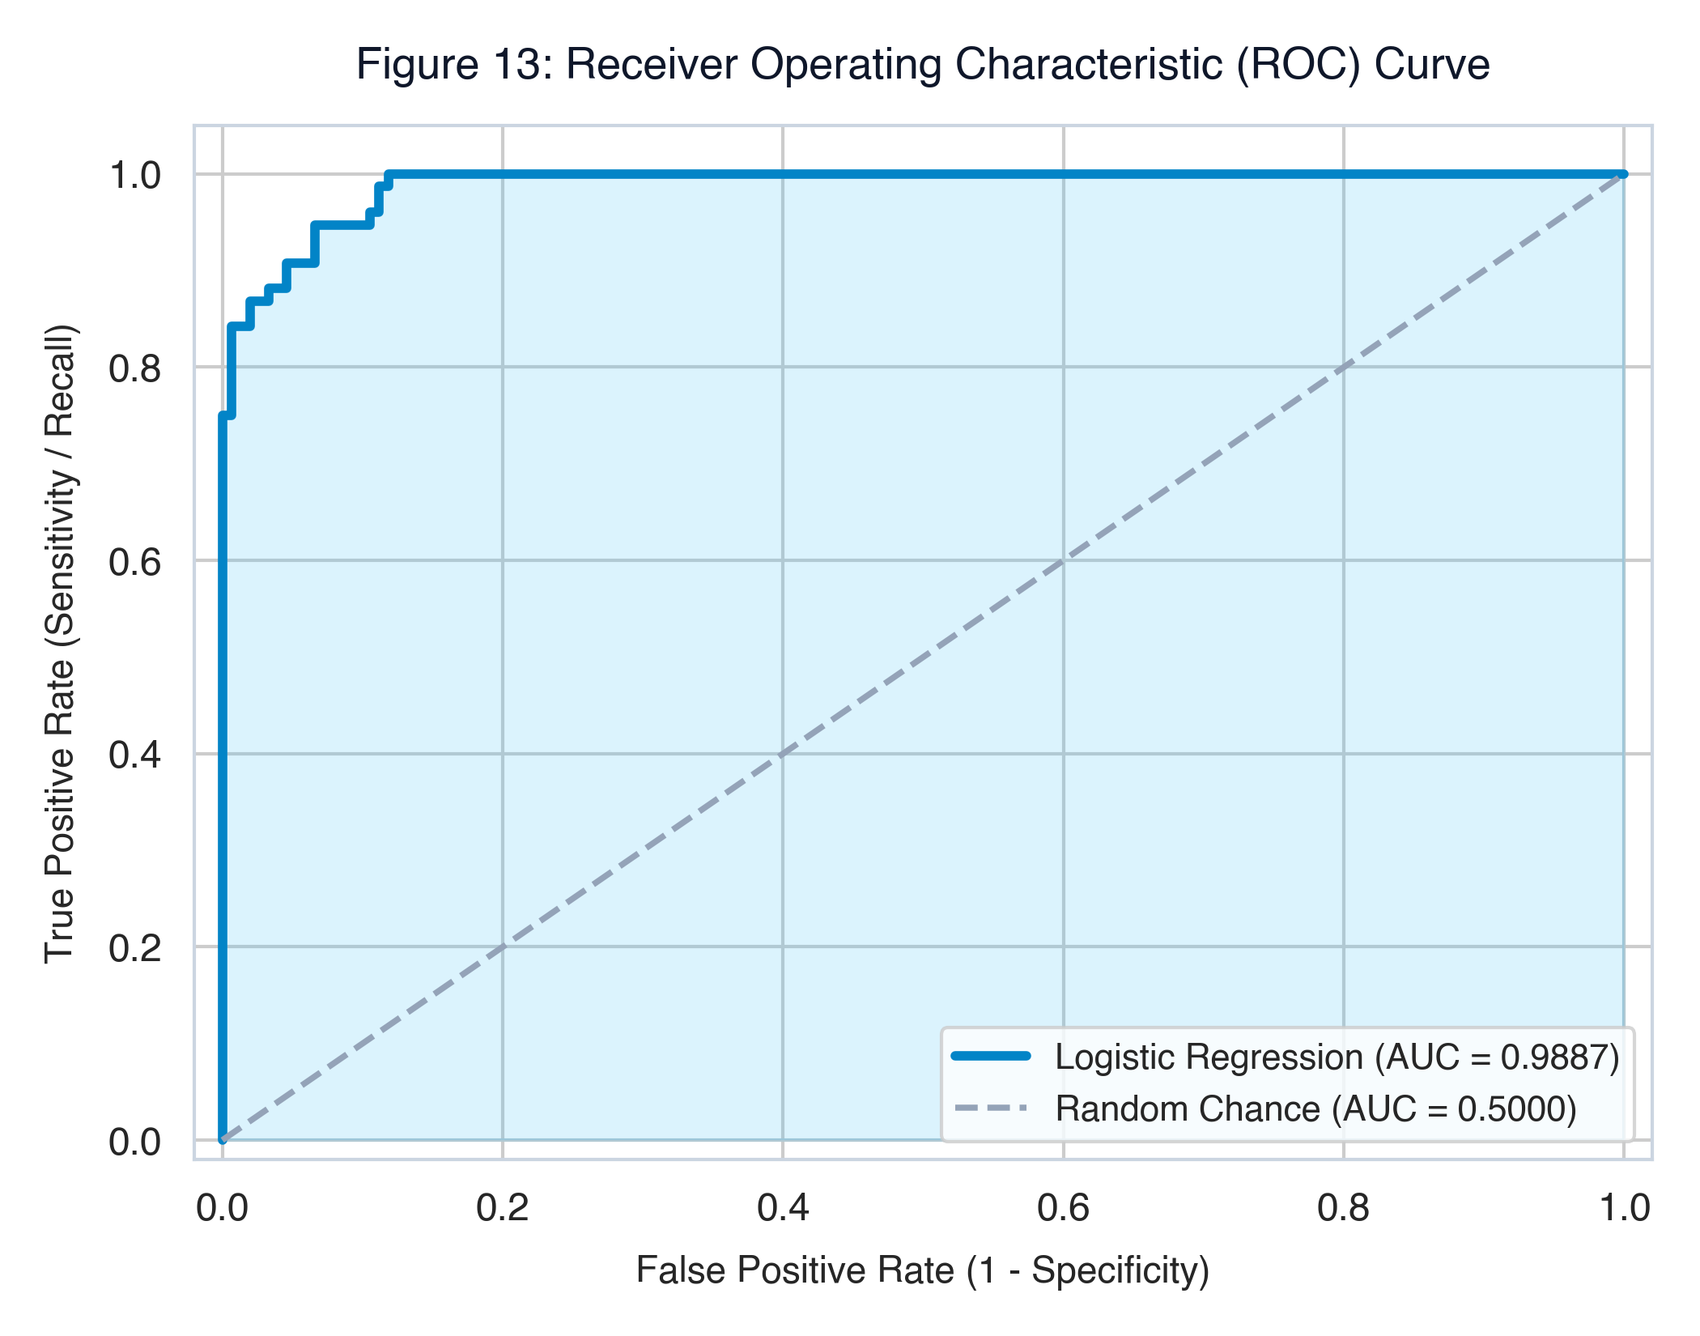
SECTION 2.10 · BENCHMARK PERFORMANCE
2.10 Model Evaluation & Comparison
Algorithm | Accuracy | Precision | Recall | F1-Score | Key Clinical Trait
Decision Tree (depth=5) | 97.81% | 98.78% | 95.29% | 97.01% | Hierarchical rule tree
Random Forest (100 trees) | 99.12% | 100.00% | 97.65% | 98.81% | Top raw accuracy ensemble
Logistic Regression | 93.42% | 90.67% | 89.47% | 90.07% | Clinically explainable log-odds
DIAGNOSIS
TN = 145
TP = 68
FN = 8
FP = 7
AUC = 0.9887 confirms 98.9% true ranking power.
CSE 4114: Introduction to Data Science Lab | Rumman Islam | Slide 9 of 10

Slide 10
SECTION 2.11 · CLINICAL TAKEAWAYS & DEFENSE
2.11 Results, Discussion, Limitations & Conclusion
1. Dominant Biomarkers Identified
Cellular contour indentations (concave points_mean, β = +2.40) and nuclear enlargement (radius_mean, β = +2.84) are the primary physical drivers of tumor malignancy.
2. Clinical Interpretability Advantage
While Random Forest achieved higher raw accuracy (99.12%), Logistic Regression provides transparent odds-ratio weights essential for medical ethics, clinician trust, and regulatory auditability.
3. Risk Threshold Calibration
With an AUC of 0.9887, clinicians can shift down the operational decision threshold to 0.35 in high-risk screening to drive False Negatives close to zero without causing severe false alarms.
4. Limitations & Future Work
Synthetic duplication was used to satisfy the 1,000-row lab quota; mild class imbalance exists. Future work: SMOTE resampling, non-linear SVM, and CNN computer vision on raw biopsy tiles.
References: [1] Street et al. (1993) IS&T/SPIE | [2] Mehmed Isik Kaggle WDBC | [3] Pedregosa et al. (2011) JMLR | Thank You! Ready for Defense & Q&A.
CSE 4114: Introduction to Data Science Lab | Rumman Islam | Slide 10 of 10

