Slide 1

1
CHAPTER
INTRODUCTION
Slides by James Tam
Department of Computer Science,
University of Calgary
February 22, 2013

Slide 2
Chapter Goals
To learn about computers and programming
To create, compile and run your first Python program
To recognize compile-time and run-time errors
To describe an algorithm with pseudocode
In this chapter, you will learn how to write and run your first Python program. You will also learn how to diagnose and fix programming errors, and how to use pseudocode to describe an algorithm.

Slide 3

Contents
Computer Programs
The Anatomy of a Computer
The Python Programming Language
Becoming Familiar with your Programming Environment
Analyzing Your First Program
Errors
Problem Solving:
Algorithm Design

Slide 4
1.1 Computer Programs
A Computer Program is a sequence of instructions and decisions
Computers execute very basic instructions in rapid succession
Programming is the act of designing and implementing computer programs

Slide 5
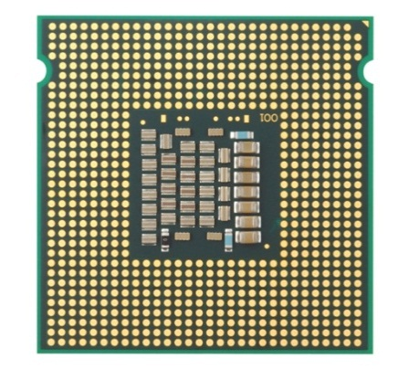
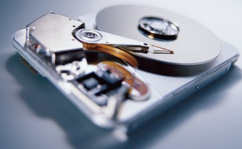
1.2 The Anatomy of a Computer
The central processing unit (CPU) performs program control (e.g. fetching data) and data processing (e.g. performing calculations)
Storage devices include memory (RAM) and secondary storage
Hard disk
Flash drives
CD/DVD drives
Input/output devices allow the user to interact with the computer
Mouse, keyboard, printer, screen…

Slide 6
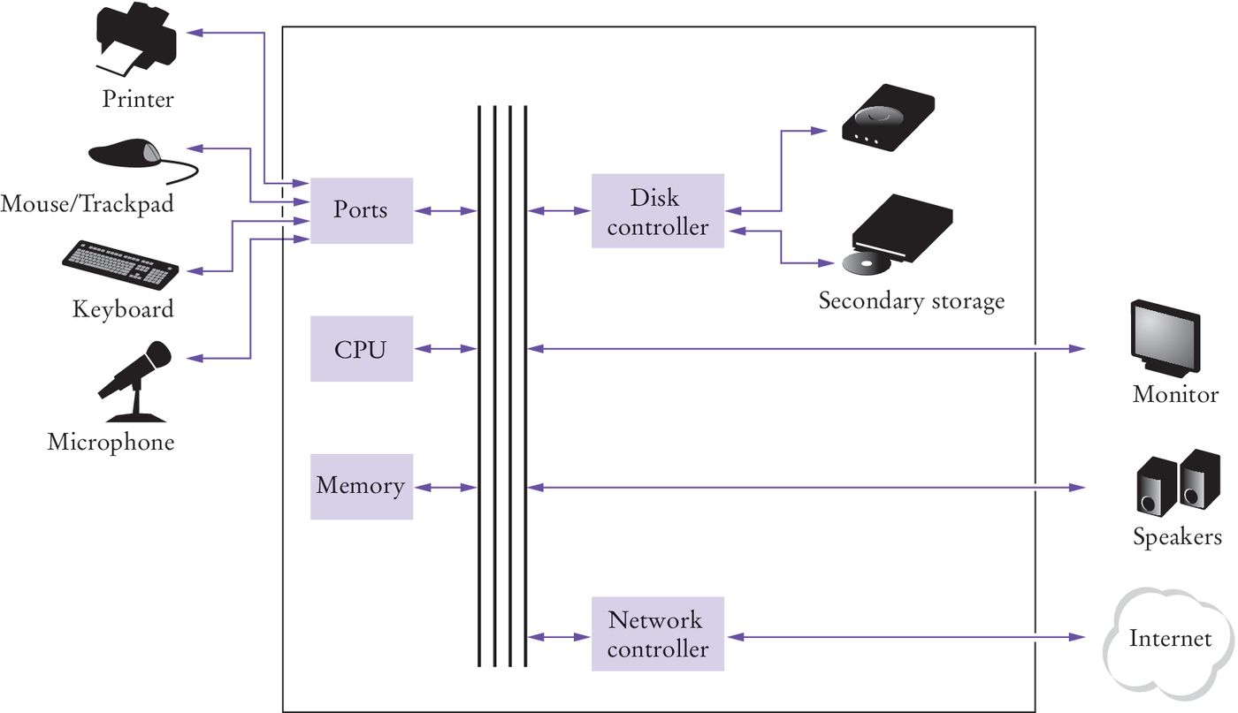
Schematic design of a PC

Slide 7
When you‘run’ a program
Program instructions and data (such as text, numbers, audio, or video) are stored on the hard disk, on a compact disk (or DVD), or elsewhere on the network.
When a program is started, it is brought into memory, where the CPU can read it.
The CPU runs the program one instruction at a time. The program may react to user input.
As directed by these instructions and the user, the CPU reads data, modifies it, and writes it back to memory, the screen, or secondary storage.

Slide 8
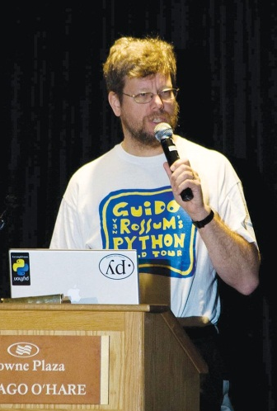
1.3 The Python Language
In the early 1990’s, Guido van Rossum designed what would become the Python programming language
Van Rossum was dissatisfied with the languages available
They were optimized to write large programs that executed quickly
He needed a language that could not only be used to create programs quickly but also make them easy to modify
It was designed to have a much simpler and cleaner syntax than other popular languages such as Java, C and C++ (making it easier to learn)

Slide 9
1.4 Programming Environment
There are two ways of creating a computer program
Using an Integrated Development Environment (IDE)
Using a text editor (such as WordPad)
Your instructor will suggest one to start with

Slide 10
IDE components
The source code editor can help programming by:
Listing line numbers of code
Color lines of code (comments, text…)
Auto-indent source code
Output window
Debugger

Slide 11
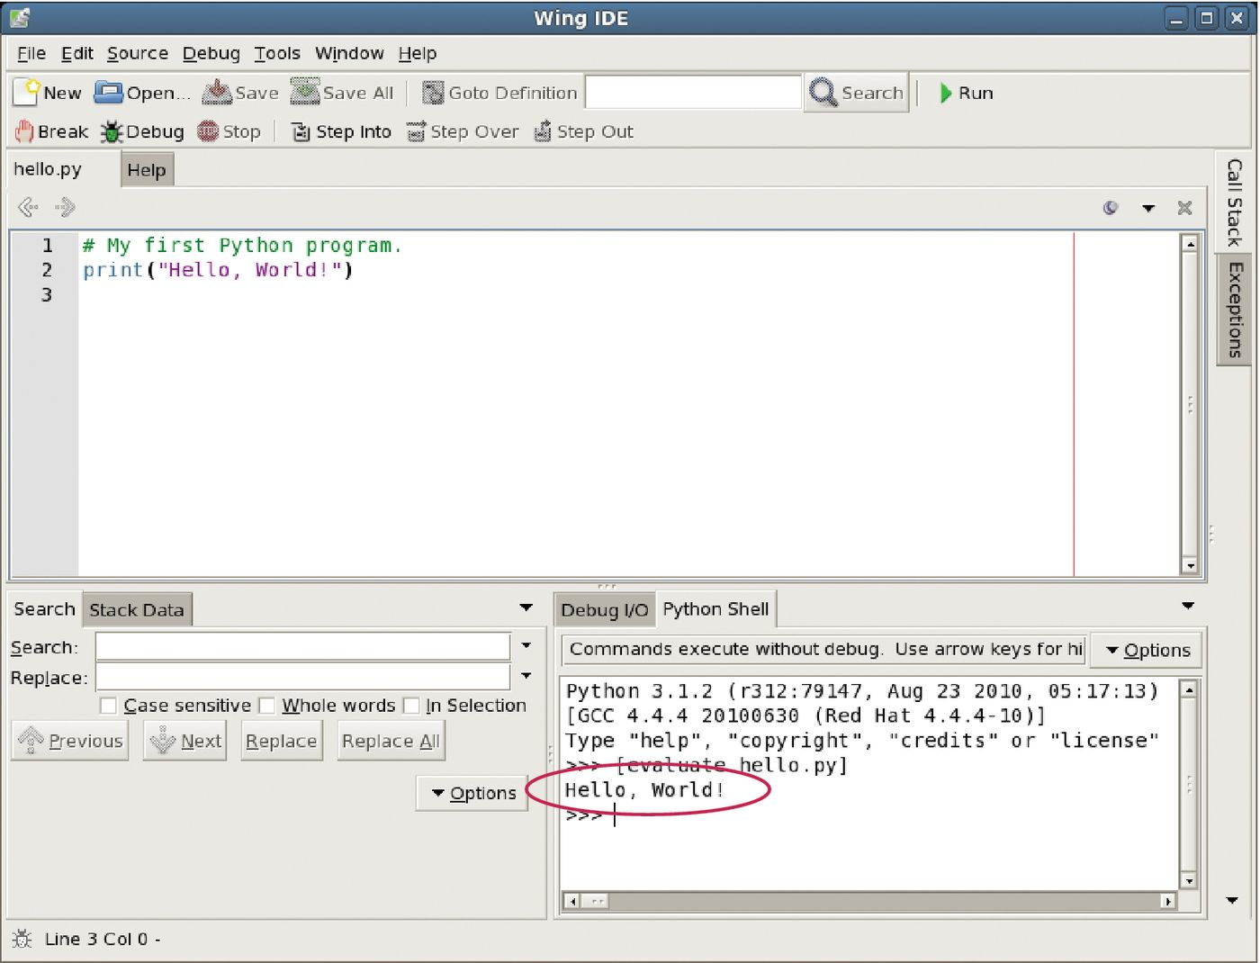
An example IDE
Debugging tool
Editor
Output

Slide 12
Your first program
Traditional ‘Hello World’ program in Python
We will examine this program in the next section
Typing the program into your IDE would be good practice!
Be careful of spelling e.g., ‘print’ vs. ‘primt’
PyTHon iS CaSe SeNsItiVe.

Slide 13
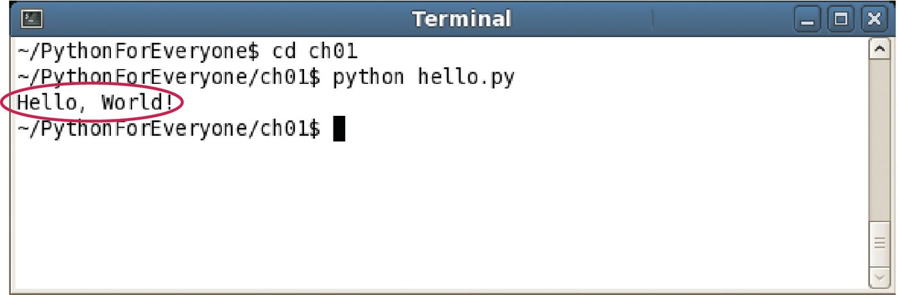
Text editor programming
You can also use a simple text editor such as Notepad or WordPad to write your source code
Once saved as Hello.py, you can use a console window to:
Compile the program
Run the program
Output
Compile/execute

Slide 14
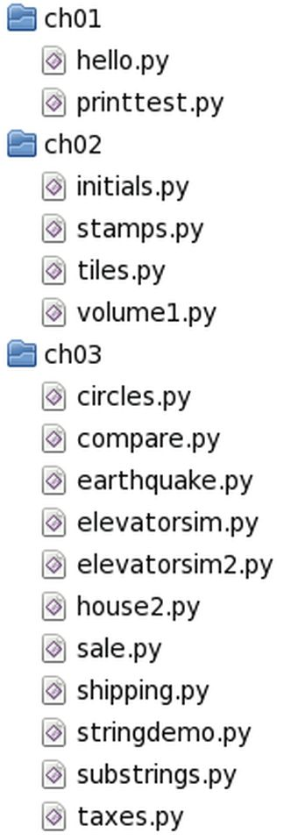

Organize your work
Your ‘source code’ is stored in .py files
Create one folder per program
Can be many .py files
Be sure you know where your IDE stores your files!
Backup your work!
Backup your work to a Flash Drive, external hard drive, or network drive that is backed up nightly.

Slide 15
Python interactive mode
Like other languages you can write/save a complete Python program in a file and let the interpreter execute the instructions all at once.
Alternatively you can run instructions one at a time using interactive mode.
It allows quick ‘test programs’ to be written.
(Interactive mode can be started on computers where Python is installed by typing ‘python’ at the console window).

Slide 16
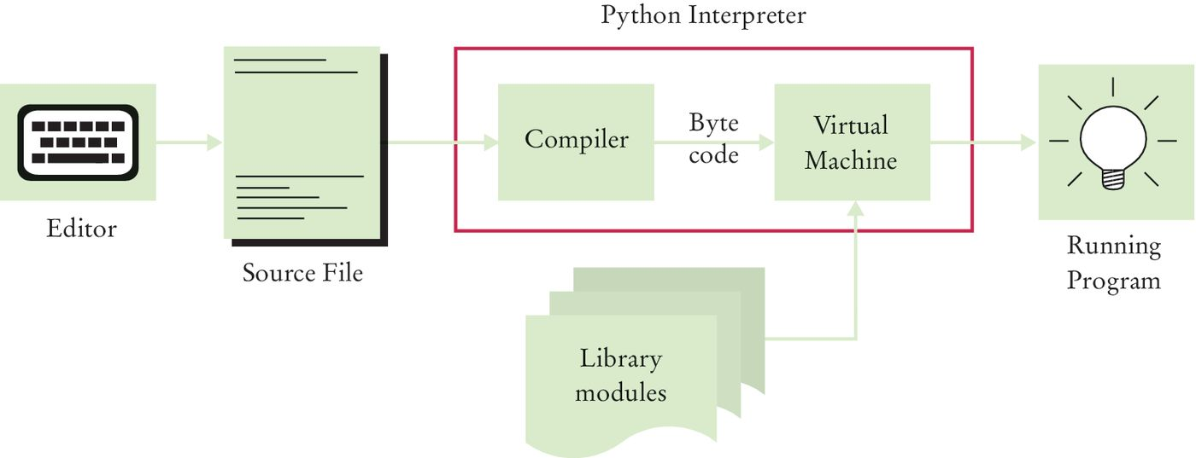
Source code to running program
The compiler generates byte code instructions (simple instructions for the Virtual machine)
The Virtual machine is a program that is similar to the CPU of your computer
Any necessary libraries (e.g. for drawing graphics) are automatically located and included by the virtual machine

Slide 17

1.5 Analyzing Your First Program
A Python program contains one or more lines of instructions (statements) that will be translated and executed by the interpreter
1: The first line is a comment (not a statement but instead it provides descriptive information about the program to programmers).
2: The second line contains a statement that prints a line of text onscreen “Hello, World!”

Slide 18
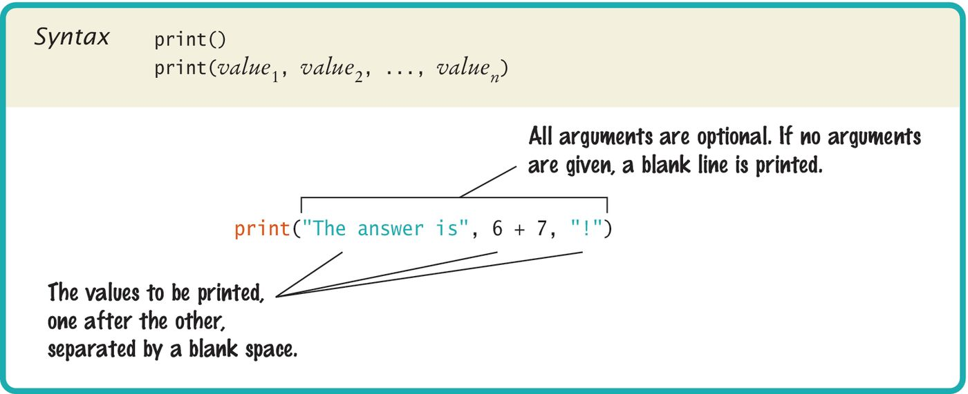
Syntax 1.1: Python Programs
Using the Python ‘print()’ function.
A function is a collection of programming instructions that carry out a particular task (in this case to print a value onscreen).
It’s code that somebody else wrote for you!

Slide 19
Syntax 1.1: Python Functions
To use, or call, a function in Python you need to specify:
The name of the function that you want to use (in the previous example the name was print)
Any values (arguments) needed by the function to carry out its task (in this case, “Hello World!”). Arguments are enclosed in parentheses and multiple arguments are separated with commas.

Slide 20

1.6 Errors
The Two Categories of Errors:
1) Compile-time Errors
Syntax Errors
Spelling, capitalization, punctuation
Ordering of statements, matching of parenthesis, quotes…
No executable program is created by the compiler
Correct first error listed, then compile again. Repeat until all errors are fixed
2) Run-time Errors
Logic Errors
Program runs, but produces unintended results
Program may ‘crash’

Slide 21
Syntax errors
What happens if you
Misspell a word: Print("Hello World!")
Leave out quotes print(Hello World!)
Mismatch quotes print("Hello World!')
Don’t match brackets print('Hello'
Try it to see what error messages are generated

Slide 22
Logic errors
What happens if you
Divide by zero print(1/0)
Misspell output print("Hello, Word!")
Forget to output Remove line 2
Programs will compile and run
The output may not be as expected

Slide 23
1.7 Problem Solving: Algorithm Design
Algorithms are simply plans
Detailed plans that describe the steps to solve a specific problem
You already know quite a few
Calculate the area of a circle
Find the length of the hypotenuse of a triangle
Some problems are more complex and require more steps
Calculate PI to 100 decimal places
Calculate the trajectory of a missile

Slide 24
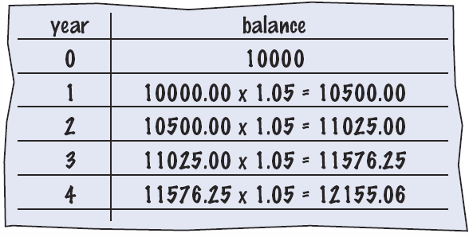
Text problem to algorithm
Given the problem:
You put $10,000 into a bank account that earns 5 percent interest per year. How many years does it take for the account balance to be double the original?
How would you solve it?
Manual method
Make a table
Add lines until done
Use a spreadsheet!
Write a formula
Per line, based on line above

Slide 25
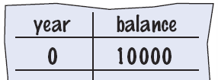
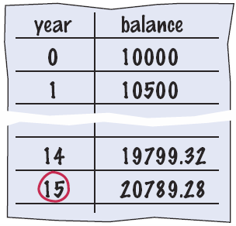
Text problem to algorithm steps
You put $10,000 into a bank account that earns 5 percent interest per year. How many years does it take for the account balance to be double the original?
Break it into steps
Start with a year value of 0 and a balance of $10,000
Repeat the following while the balance is less than $20,000
Add 1 to the year value
Multiply the balance by 1.05
(5% increase)
Report the final year value as the answer

Slide 26
Text problem to pseudocode
Pseudocode
Half-way between natural language and a programming language
Modified Steps
Set the year value of 0
Set the balance to $10,000
While the balance is less than $20,000
Add 1 to the year value
Multiply the balance by 1.05
Report the final year value as the answer
This can be translated into Python fairly easily
Pseudocode is an informal description of a sequence of steps for solving a problem

Slide 27
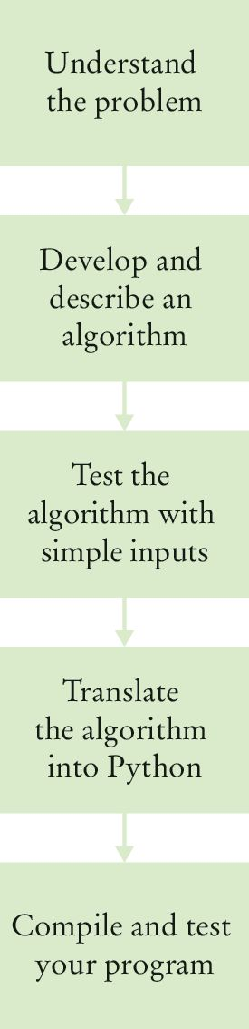
Algorithm defined
An algorithm describes a sequence of steps that is:
Unambiguous
Do not require ‘assumptions’
Uses precise instructions
Executable
Can be carried out in practice
Terminating
Will eventually come to an end

Slide 28
Steps: algorithm to pseudocode
You have the choice of buying two cars. One is more fuel efficient than the other, but also more expensive. You know the price and fuel efficiency (in miles per gallon, mpg) of both cars. You plan to keep the car for ten years. Which car is the better deal?
Determine the inputs and outputs
From the problem statement:
price1, price2, mpg1, mpg2…
Break down the problem into smaller tasks
‘Calculate total cost’ for each car
Describe each subtask as pseudocode
total cost = purchase price + operating cost
Test your pseudocode with example input

Slide 29
Summary: computer basics
Computers execute very basic instructions in rapid succession.
A computer program is a sequence of instructions and decisions.
Programming is the act of designing and implementing computer programs.
The central processing unit (CPU) performs program control and data processing.
Storage devices include memory and secondary storage.

Slide 30
Summary: python
Python was designed in a way that makes it easier to learn than other programming languages such as Java, C and C++.
This was done by giving it a much simpler and cleaner syntax.
Set aside some time to become familiar with the programming environment that you will use for your class work.
An editor is a program for entering and modifying text, such as a Python program.

Slide 31
Summary: python
Python is case sensitive. You must be careful about distinguishing between upper and lowercase letters.
The Python compiler translates source code into byte code instructions that can be executed by the Virtual machine.
A function is called by specifying the name and its parameters.
A string is a sequence of characters enclosed in quotation marks.

Slide 32
Summary: errors and pseudocode
A compile-time error is a violation of the programming language rules that is detected by the compiler.
A run-time error causes a program to take an action that the programmer did not intend.
Pseudocode is an informal description of a sequence of steps for solving a problem.
An algorithm for solving a problem is a sequence of steps that is unambiguous, executable, and terminating.

