Slide 1
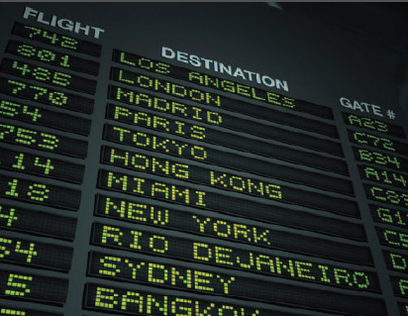
2
CHAPTER
FUNDAMENTAL DATA TYPES
Slides by James Tam
Department of Computer Science,
University of Calgary
April 12, 2013

Slide 2
Chapter Goals (1)
To declare and initialize variables and constants
To understand the properties and limitations of integers and floating-point numbers
To appreciate the importance of comments and good code layout
To write arithmetic expressions and assignment statements

Slide 3
Chapter Goals (2)
To create programs that read, and process inputs, and display the results
To learn how to use Python strings
To create simple graphics programs using basic shapes and text

Slide 4

Contents
Variables
Arithmetic
Input and Output
Problem Solving:
First Do It By Hand
Strings
Graphics
Numbers and character strings (such as the ones in this display board) are important data types in any Python program. In this chapter, you will learn how to work with numbers and text, and how to write simple programs that perform useful tasks with them.

Slide 5
2.1 Variables
Most computer programs hold temporary values in named storage locations
Programmers name them for easy access
There are many different types of storage to hold different things
You ‘define’ a variable by telling the compiler:
What name you will use to refer to it
What is the initial value to be stored in it

Slide 6
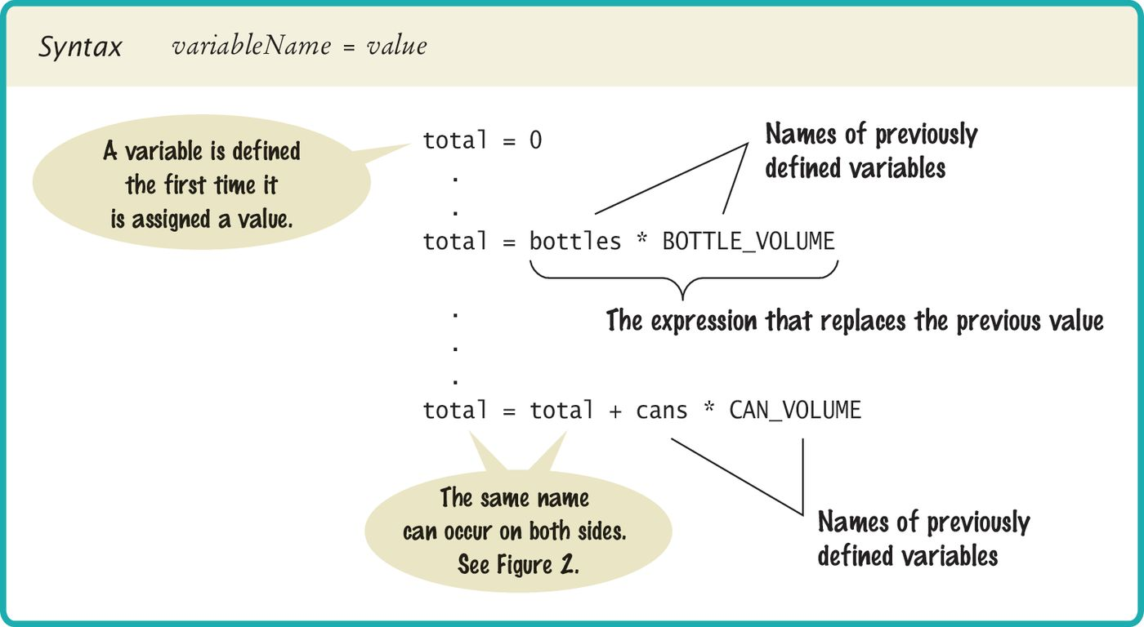
Syntax 2.1: Variable Definition
To define a variable, you must specify an initial value.
See Slide #17 for the effect of referring to a variable twice

Slide 7
The assignment statement
Use the ‘assignment statement’ (with an '=' ) to place a new value into a variable
cansPerPack = 6 # define & initialize
Beware: The = sign is NOT used for comparison:
It copies the value on the right side into the variable on the left side
You will learn about the comparison operator in the next chapter

Slide 8
Assignment syntax
The value on the right of the '=' sign is assigned to the variable on the left

Slide 9
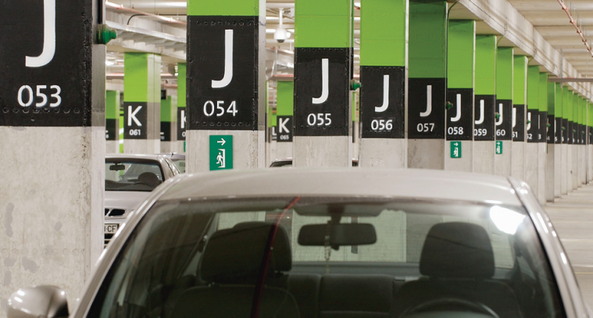
Variables and contents
Each variable has an identifier (name) and contents
In Python you must set the contents of a variable when you define it
cansPerPack = 6
Imagine a parking space in a parking garage
Identifier: J053
Contents: Bob’s Chevy
cansPerPack
6
A variable is a storage location with a name

Slide 10
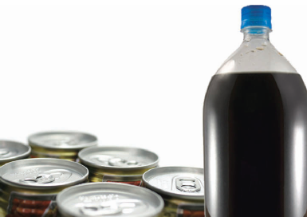
An example: soda deal
Soft drinks are sold in cans and bottles. A store offers a six-pack of 12-ounce cans for the same price as a two-liter bottle. Which should you buy? (12 fluid ounces equal approximately 0.355 liters.)
List of variables: Type of Number
Number of cans per pack Whole number
Ounces per can Whole number
Ounces per bottle Number with fraction

Slide 11
Why different types? (1)
There are three different types of data that we will use in this chapter:
1) A whole number (no fractional part) 7 (integer)
2) A number with a fraction part 8.88 (float)
3) A sequence of characters "Bob" (string)
The type of information currently stored by a variable is indicated by whatever is to the right of the equals sign (cansPerPack is an integer while canVolume is a float).
cansPerPack = 6
canVolume = 12.0

Slide 12
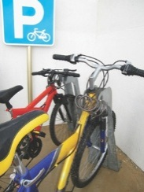
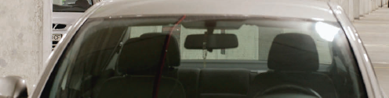
Why different types? (2)
Back to the garage analogy, parking spaces may be meant for different types of vehicles
Bicycle
Motorcycle
Full Size
Electric Vehicle

Slide 13
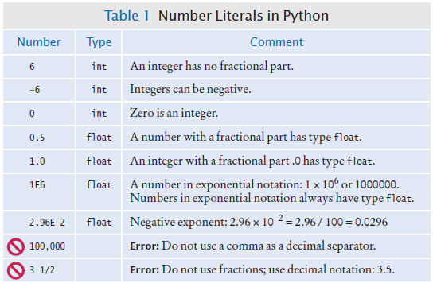
Table 1: Number Literals in Python
Sometimes when you just type a number, the compiler has to ‘guess’ what type it is

Slide 14
Floating-point numbers
Python stores numbers with fractional parts as ‘floating point’ numbers.
They are stored in four parts
Sign
Mantissa
Radix
Exponent
Parts of a floating point number -5:
Sign | Mantissa | Radix ^{exponent}
-1 | 5 | 10 ⁰

Slide 15
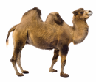
Naming variables
Name should describe the purpose
‘canVolume’ is better than ‘cv’
Use These Simple Rules
1) Variable names must start with a letter or the
underscore ( _ ) character
Continue with letters (upper or lower case), digits or the underscore
2) You cannot use other symbols (? or %...) and spaces are not permitted
3) Separate words with ‘camelCase’ notation
Use upper case letters to signify word boundaries
4) Don’t use ‘reserved’ Python words (see Appendix C)

Slide 16
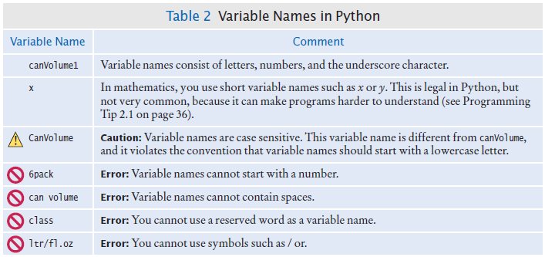
Table 2: Variable Names in Python
Legal and illegal variable names

Slide 17
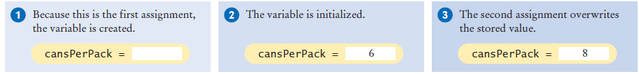
Updating a variable (1)
If an existing variable is assigned a new value, that value replaces the previous contents of the variable.
For example:
cansPerPack = 6
cansPerPack = 8

Slide 18
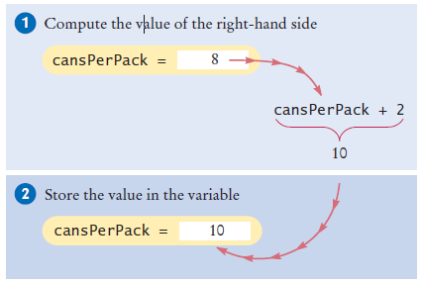
Updating a variable (2)
Executing the Assignment:
cansPerPack = cansPerPack + 2
Step by Step:
Calculate the right hand side of the assignment. Find the value of cansPerPack, and add 2 to it.
Store the result in the variable named on the left side of the assignment operator (cansPerPack in this case)

Slide 19
Programming Tip 2.1: Descriptive Variable Names
Choose descriptive variable names
Which variable name is more self descriptive?
canVolume = 0.35
cv = 0.355
This is particularly important when programs are written by more than one person.

Slide 20
Extra programming tip: constants
In Python it’s a variable whose value should not be changed after it’s assigned an initial value.
BOTTLE_VOLUME = 2.0
It is good style to use named constants to explain numerical values to be used in calculations
Which is clearer?
totalVolume = bottles * 2
totalVolume = bottles * BOTTLE_VOLUME
A programmer reading the first statement may not understand the significance of the 2
Also, if the constant is used in multiple places and needs to be changed, only the initialization changes

Slide 21
Constants: naming & style
It is customary to use all UPPER_CASE letters for constants to distinguish them from variables.
BOTTLE_VOLUME = 2 # Constant
MAX_SIZE = 100 # Constant
taxRate = 5 # Variable

Slide 22

Python comments
Use comments at the beginning of each program, and to clarify details of the code
Use comments to
add explanations for
humans who read
your code. The
compiler ignores
comments.

Slide 23
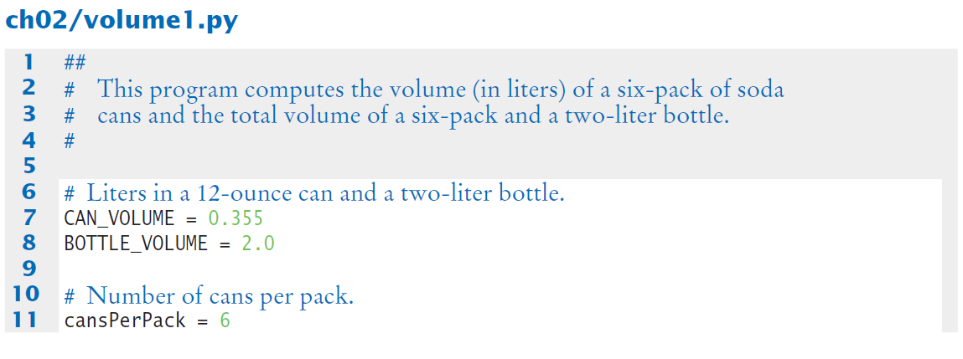
Python comment example

Slide 24

Common Error 2.1
Undefined Variables
You must define a variable before you use it: (i.e. somewhere above the code before you use the variable)
canVolume = 12 * literPerOunce # ??
literPerOunce = 0.0296

Slide 25
Common Error 2.2
Roundoff Errors
Floating point values are not exact
This is a limitation of binary values (no fractions):
price = 4.35
quantity = 100
total = price * quantity
# Should be 100 * 4.35 = 435.00
print(total) # Prints 434.99999999999999
You can deal with roundoff errors by rounding to the nearest integer (see Section 2.2.4) or by displaying a fixed number of digits after the decimal separator (see Section 2.5.3).

Slide 26
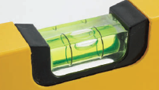
Common Error 2.3
Unbalanced Parentheses
Consider the expression
((a + b) * t / 2 * (1 - t)
What is wrong with it?
Now consider this expression.
(a + b) * t) / (2 * (1 - t)
This expression has three ( and three ), but it still is not correct.

Slide 27
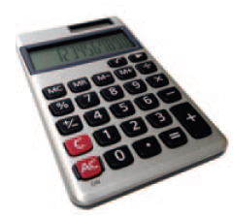


2.2 Arithmetic (1)
Python supports all of the same basic math as a calculator:
Addition +
Subtraction -
You write your expressions a bit differently though.. Algebra Python
Multiplication *
Division /

Slide 28
2.2 Arithmetic (2)
Precedence is similar to Algebra:
PEMDAS
Parenthesis, Exponent, Multiply/Divide, Add/Subtract

Slide 29
Mixing numeric types
If you mix integer and floating-point values in an arithmetic expression, the result is a floating-point value.
7 + 4.0 # Yields the floating value 11.0

Slide 30
Floor division
When you divide two integers with the / operator, you get a floating-point value. For example,
7 / 4
yields 1.75
We can also perform floor division using the // operator. (It computes the quotient and discards the fractional part, no rounding).
7 // 4
evaluates to 1 because 7 divided by 4 is 1.75 with a fractional part of 0.75, which is discarded.

Slide 31
Calculating a remainder
If you are interested in the remainder of dividing two integers, use the % operator (called modulus):
remainder = 7 % 4
The value of remainder will be 3
Sometimes called modulo divide

Slide 32
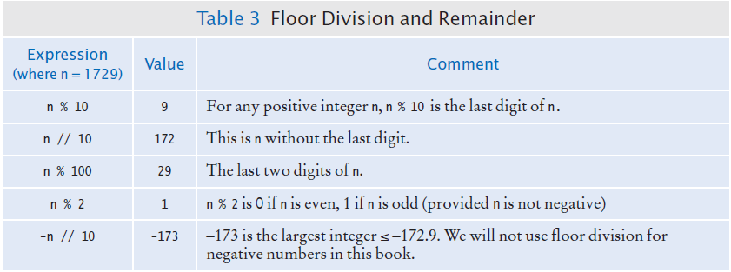
Table 3: Integer Division and Remainder Examples
Handy to use for making change:
pennies = 1729
dollars = pennies / 100 # 17
cents = pennies % 100 # 29

Slide 33
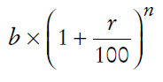
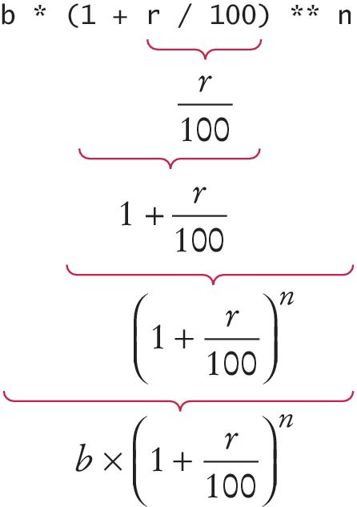
Powers and roots
In Python, there’s no symbols for power and roots
Becomes:
b * ((1 + r / 100) ** n)
Analyzing the expression:
In Python:
The single star * is used to calculate a product
Double stars ** are used to calculate an exponent

Slide 34
Calling functions
Recall that a function is a collection of programming instructions that carry out a particular task.
The print() function can display information, but there are many other functions available in Python.

Slide 35
Calling functions that return a value
Most functions return a value. That is, when the function completes its task, it passes a value back to the point where the function was called.
For example:
The call abs(-173) returns the value 173.
The value returned by a function can be stored in a variable:
distance = abs(x)

Slide 36
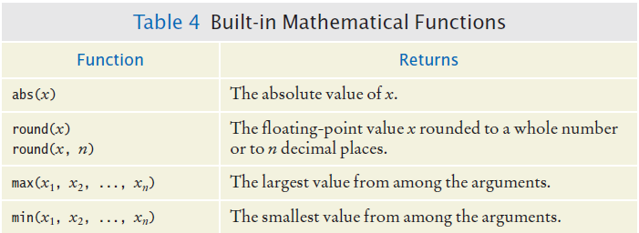
Table 4: Built in Mathematical Functions

Slide 37
Python libraries (modules)
A standard library is a library that is considered part of the language and must be included with any Python system.
Python’s standard library is organized into modules. Related functions and data types are grouped into the same module. Functions defined in a module must be explicitly loaded into your program before they can be used.

Slide 38
Using functions from the math module
For example, to use the sqrt() function, which computes the square root of its argument:
# First include this statement at the top of your
# program file.
from math import sqrt
# Then you can simply call the function as
y = sqrt(x)

Slide 39
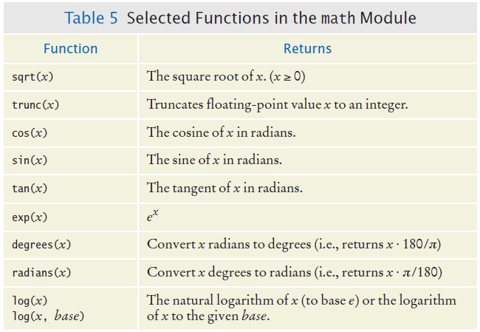
Table 5: Functions from the Math Module

Slide 40
Floating-point to integer conversion
You can use the function: int() and float() to convert between integer and floating point values:
balance = total + tax # balance: float
dollars = int (balance) # dollars: integer
You lose the fractional part of the floating-point value (no rounding occurs)

Slide 41
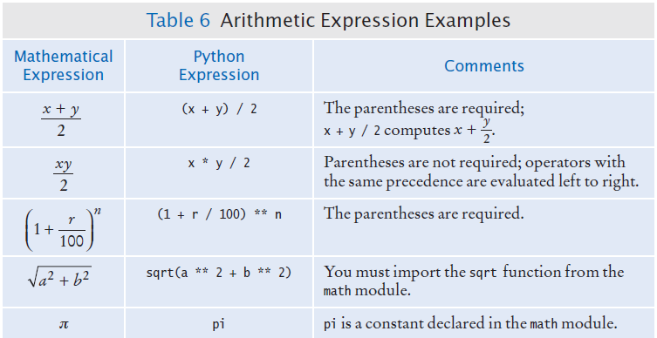
Table 6: Arithmetic Expressions

Slide 42
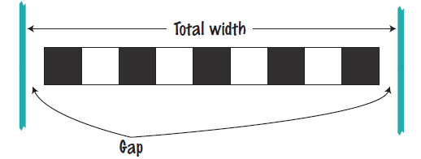
2.3 Problem Solving: First by Hand
A very important step for developing an algorithm is to first carry out the computations by hand. Example Problem:
A row of black and white tiles needs to be placed along a wall. For aesthetic reasons, the architect has specified that the first and last tile shall be black.
Your task is to compute the number of tiles needed and the gap at each end, given the space available and the width of each tile.

Slide 43

Start with example values
Givens
Total width: 100 inches
Tile width: 5 inches
Test your values
Let’s see… 100/5 = 20, perfect! 20 tiles. No gap.
But wait… BW…BW “…first and last tile shall be black.”
Look more carefully at the problem….
Start with one black, then some number of WB pairs
Observation: each pair is 2x width of 1 tile
In our example, 2 x 5 = 10 inches

Slide 44
Keep applying your solution
Total width: 100 inches
Tile width: 5 inches
Calculate total width of all tiles
One black tile: 5”
9 pairs of BWs: 90”
Total tile width: 95”
Calculate gaps (one on each end)
100 – 95 = 5” total gap
5” gap / 2 = 2.5” at each end

Slide 45
Now devise an algorithm
Use your example to see how you calculated values
How many pairs?
Note: must be a whole number
Integer part of:
(total width – tile width) / 2 x tile width
How many tiles?
1 + 2 x the number of pairs
Gap at each end
(total width – number of tiles x tile width) / 2

Slide 46
2.4 Strings
In Python, string literals are specified by enclosing a sequence of characters within a matching pair of either single or double quotes.
print("This is a string.", 'So is this.')
By allowing both types of delimiters, Python makes it easy to include an apostrophe or quotation mark within a string.
message = 'He said "Hello"'

Slide 47
String length
The number of characters in a string is called the length of the string. (For example, the length of "Harry" is 5).
You can compute the length of a string using Python’s len() function:
length = len("World!") # length is 6
A string of length 0 is called the empty string. It contains no characters and is written as "" or ''.

Slide 48
String concatenation (+): 1
You can ‘add’ one String onto the end of another
fName = "Harry"
lName = "Morgan"
name = fname + lname # HarryMorgan
You wanted a space in between?
name = fname + " " + lname # Harry Morgan
To concatenate a numeric variable to a String:
a = "Agent"
n = 7
bond = a + str(n) # Agent7

Slide 49
String concatenation (+): 2
Displaying Strings and numerics inside print():
total = 123
print("The total is ", total)

Slide 50
String repetition (*)
You can also produce a string that is the result of repeating a string multiple times.
Suppose you need to print a dashed line.
Instead of specifying a literal string with 50 dashes, you can use the * operator to create a string that is comprised of the string "-" repeated 50 times.
dashes = "-" * 50
results in the string
"-------------------------------------------------"

Slide 51
Converting Numbers to Strings
Use the str() function to convert between numbers and strings.
Examples:
balance = 888.88
dollars = 888
balanceAsString = str(balance)
dollarsAsString = str(dollars)
Conversely, to turn a string containing a number into a numerical value, use the int() and float() functions:
id = int("1729")
price = float("17.29")
This conversion is important when the strings come from user input.

Slide 52

Strings and Characters
Strings are sequences of characters
Unicode characters to be exact
Characters have numeric values
See the ASCII code chart in Appendix A
For example, the letter ‘H’ has a value of 72 if it were a number

Slide 53
Copying a character from a String
Each char inside a String has an index number:
The first char is index zero (0)
The [] operator returns a char at a given index inside a String:
name = "Harry"
start = name[0]
last = name[4]
0 | 1 | 2 | 3 | 4 | 5 | 6 | 7 | 8 | 9
c | h | a | r | s |  | h | e | r | e
0 | 1 | 2 | 3 | 4
H | a | r | r | y

Slide 54
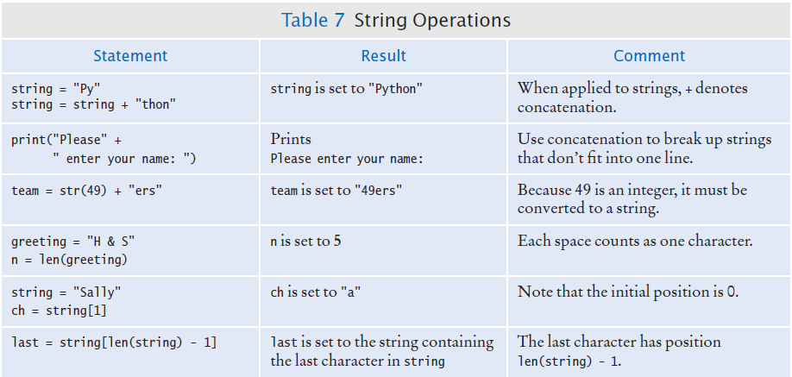
Table 7: String Operations

Slide 55
Methods
In computer programming, an object is a software entity that represents a value with certain behavior.
The value can be simple, such as a string, or complex, like a graphical window or data file.
The behavior of an object is given through its methods.
But unlike a function, which is a standalone operation, a method can only be applied to an object of the type for which it was defined. For example, you can apply the upper() method to any string, like this:
name = "John Smith"
# Sets uppercaseName to "JOHN SMITH"
uppercaseName = name.upper()

Slide 56
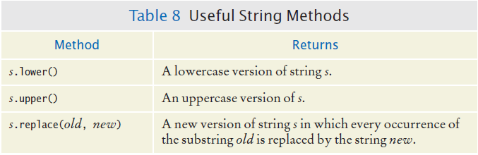
Table 8: Some Useful String Methods

Slide 57
Special Topic 2.5: String Escape Sequences
How would you print a double quote?
Preface the " with a \ inside the double quoted String
print("He said \"Hello\"")
OK, then how do you print a backslash?
Preface the \ with another \!
System.out.print("“C:\\Temp\\Secret.txt“")
Special characters inside Strings
Output a newline with a ‘\n’
print("*\n**\n***\n")
*
**
***

Slide 58
2.5 Input and Output
You can read a String from the console with the input() function:
name = input("Please enter your name")
Converting a String variable to a number can be used if numeric (rather than string input) is needed
age = int(input("Please enter age: "))
The above is equivalent to doing it two steps (getting the input and then converting it to a number):
aString = input("Please enter age: ") # String input
age = int(aString) # Converted to
# int

Slide 59
Formatted output
Outputting floating point values can look strange:
Price per liter: 1.21997
To control the output appearance of numeric variables, use formatted output tools such as:
print("Price per liter %.2f" %(price))
Price per liter: 1.22
print("Price per liter %10.2f" %(price))
Price per liter: 1.22
The %10.2f is called a format specifier
2 spaces
10 spaces

Slide 60
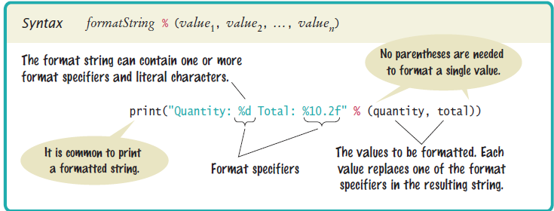
Syntax: formatting strings

Slide 61
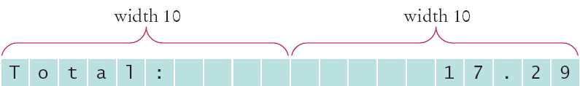
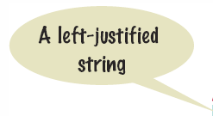

Format flag examples
Left Justify a String:
print("%-10s" %("Total:"))
Right justify a number with two decimal places
print("%10.2f" %(price))
And you can print multiple values:
print("%-10s%10.2f" %("Total: ", price))

Slide 62
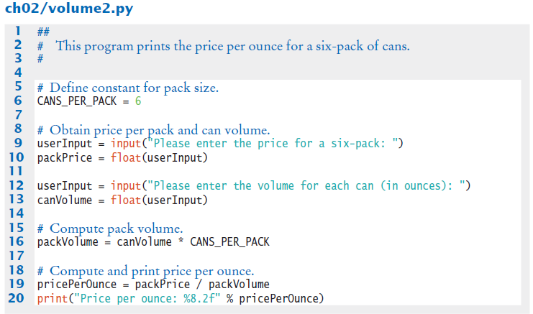
Volume2.py

Slide 63
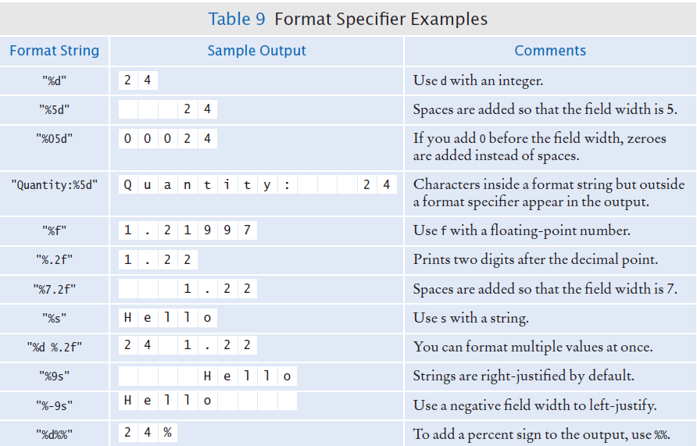
Table 9: Format Specifier Examples

Slide 64
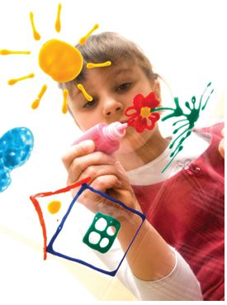
2.6 Drawing Simple Graphics
To help you create simple drawings, we have included a graphics module with the book that is a simplified version of Python’s more complex library module. The module code and usage instructions are available with the source code for the book on its companion web site.

Slide 65
Using the graphics module (1)
To create a graphical application using the graphics module, carry out the following at the top of your program:
from graphics import GraphicsWindow
Create a graphics window (640 x 480 pixels):
win = GraphicsWindow(640, 480)
Access the canvas contained in the graphics window:
canvas = win.canvas()

Slide 66
Using the graphics module (2)
Create your drawing.
canvas.drawRect(15, 10, 20, 30)
Have the program wait for the user to close the window (by clicking the close button). Without this statement, the program would terminate immediately and the graphics window would disappear, leaving no time for you to see your drawing.
win.wait()

Slide 67
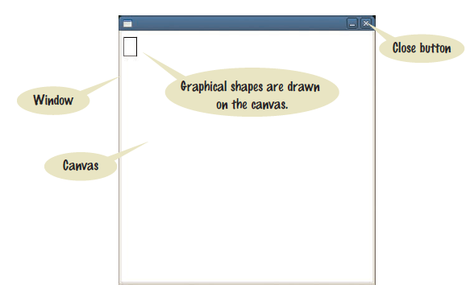
A graphics window

Slide 68
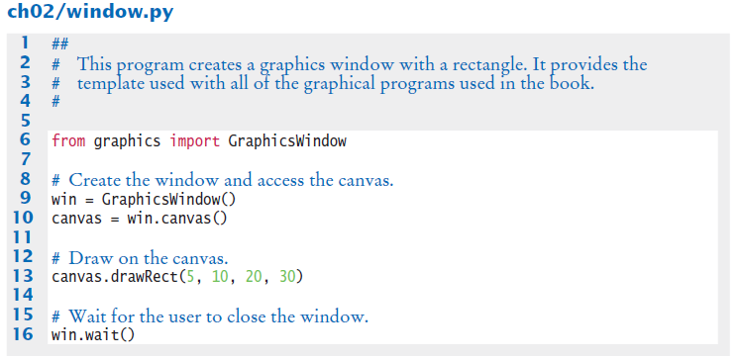
A complete drawing example

Slide 69
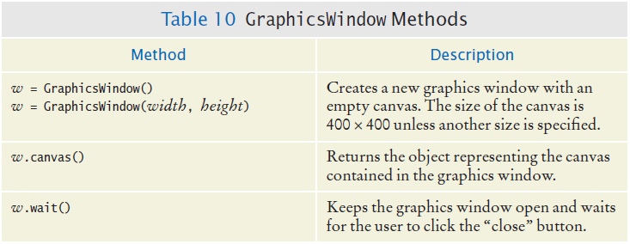
Table 10: GraphicsWindow Methods

Slide 70
Drawing shapes
Basic shapes have 4 properties: x coordinate, y coordinate, width and height.
Example:
canvas.drawRect(15, 10, 20, 30)
This statement draws a rectangle with the upper top left corner at point (15,10) in the window with a height of 20 and a width of 30.
Common shapes that can be drawn include: rectangles, squares, circles and ovals.

Slide 71
Drawing lines
Lines require 4 slightly different properties than drawing shapes:
Point 1(x coordinate, y coordinate)
Point 2(x coordinate, y coordinate)

Slide 72
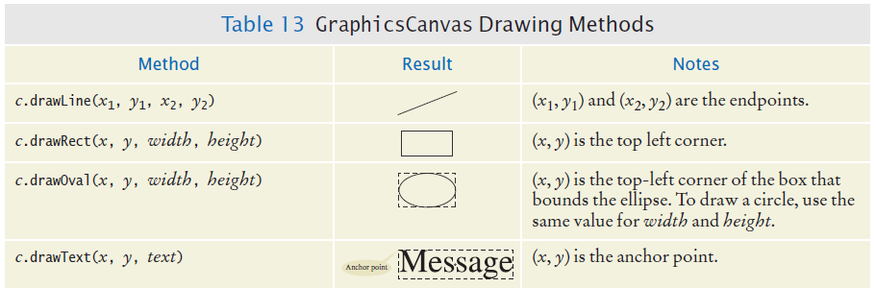
Table 13: Common Shapes, Lines and Text

Slide 73
The canvas and shapes can be colored
If you use the default setting (not changing the fill or outline), shapes are outlined in black and there is no fill color.
The fill color and outline can be set to different colors with the method calls:
setFill(<color name>)
OR
setFill(<red level>, <green level>, <blue level>)
setOutline(<color name>)
OR
setOutline(<red level>, <green level>, <blue level>)

Slide 74

Example of setting color
The following statements draw a rectangle that is outlined in black and filled with green.
canvas.setOutline("black")
canvas.setFill(0, 255, 0)
canvas.drawRect(10, 20, 100, 50)

Slide 75
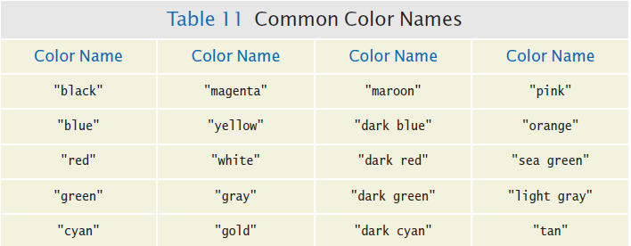
Table 11: Common Color Names

Slide 76
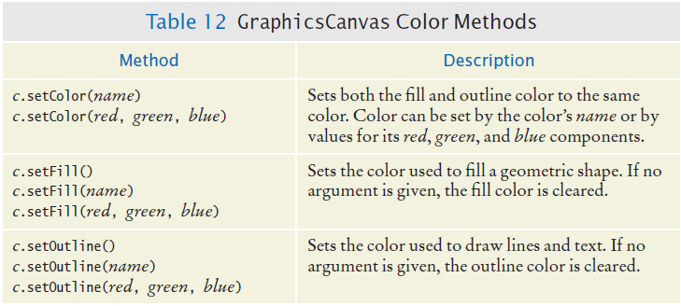
Table 12: GraphicsCanvas Color Methods

Slide 77
Summary: variables
A variable is a storage location with a name.
When defining a variable, you must specify an initial value.
By convention, variable names should start with a lower case letter.
An assignment statement stores a new value in a variable, replacing the previously stored value.

Slide 78
Summary: operators
The assignment operator = does not denote mathematical equality.
Variables whose initial value should not change are typically capitalized by convention.
The / operator performs a division yielding a value that may have a fractional value.
The // operator performs a division, the remainder is discarded.
The % operator computes the remainder of a floor division.

Slide 79
Summary: python overview
The Python library declares many mathematical functions, such as sqrt() and abs()
You can convert between integers, floats and strings using the respective functions: int(), float(), str()
Python libraries are grouped into modules. Use the import statement to use methods from a module.
Use the input() function to read keyboard input in a console window.

Slide 80
Summary: python overview
Use the format specifiers to specify how values should be formatted.

Slide 81
Summary: Strings
Strings are sequences of characters.
The len() function yields the number of characters in a String.
Use the + operator to concatenate Strings; that is, to put them together to yield a longer String.
In order to perform a concatenation, the + operator requires both arguments to be strings. Numbers must be converted to strings using the str() function.
String index numbers are counted starting with 0.

Slide 82
Summary: Strings
Use the [ ] operator to extract the elements of a String.

Slide 83
Summary: graphics
Graphical shapes (such as squares, rectangles, circles, ovals), or lines and text can be drawn using the graphics module.
The color of graphical objects can be set with the setOutline() and setFill() methods.

