Slide 1

3
CHAPTER
DECISIONS
Slides by James Tam
Department of Computer Science,
University of Calgary
April 23, 2013

Slide 2
Chapter goals
To implement decisions using the if statement
To compare integers, floating-point numbers, and Strings
To write statements using the Boolean data type
To develop strategies for testing your programs
To for validate user input
In this chapter, you will learn how to program simple and complex decisions. You will apply what you learn to the task of checking user input.

Slide 3

Contents
The if Statement
Relational Operators
Nested Branches
Multiple Alternatives
Problem Solving: Flowcharts
Problem Solving: Test Cases
Boolean Variables and Operators
Analyzing Strings
Application: Input Validation

Slide 4
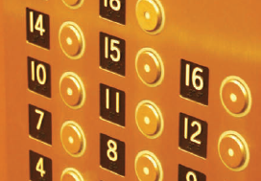
3.1 The if Statement
A computer program often needs to make decisions based on input, or circumstances
For example, buildings often ‘skip’ the 13th floor, and elevators should too
The 14th floor is really the 13th floor
So every floor above 12 is really ‘floor - 1’
If floor > 12, Actual floor = floor - 1
The two keywords of the if statement are:
if
else
The if statement allows a program to carry out different actions depending on the nature of the data to be processed.

Slide 5
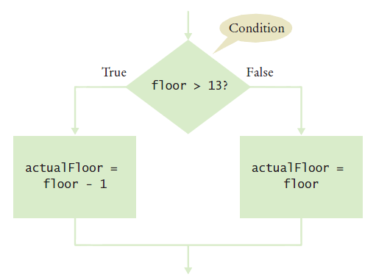
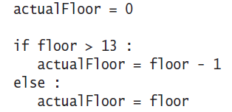
Flowchart of the if statement
One of the two branches is executed once
True (if) branch or False (else) branch

Slide 6
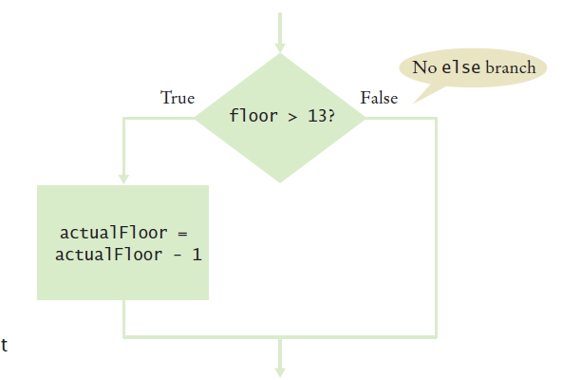
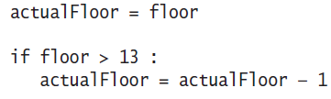
Flowchart with only true branch
An if statement may not need a ‘False’ (else) branch

Slide 7
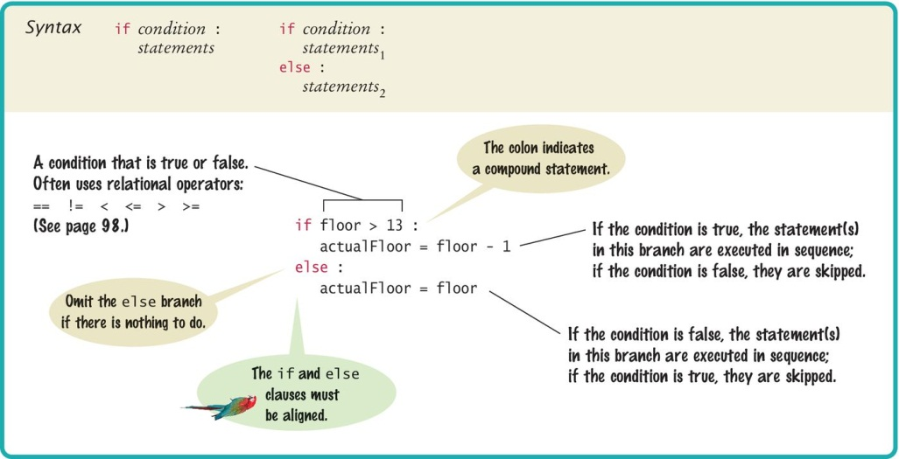
Syntax 3.1: The if Statement

Slide 8
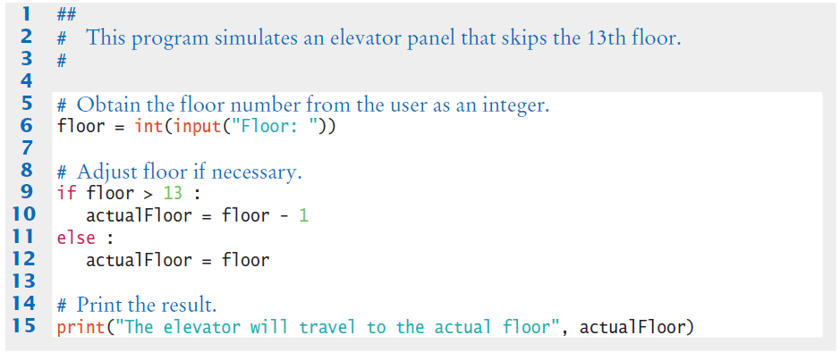
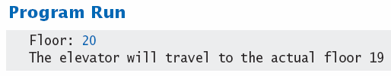
Elevatorsim.py

Slide 9
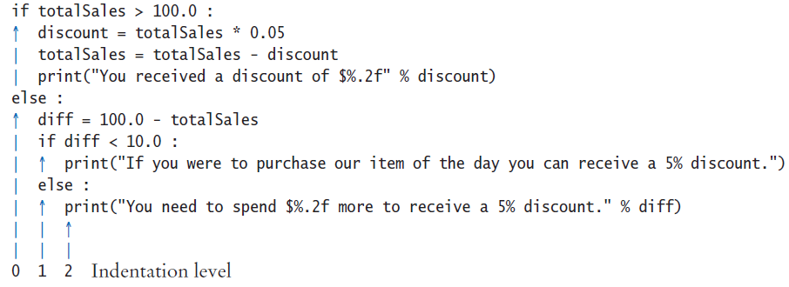
Tips on indenting blocks
Use spaces instead of tabs to indent a consistent number of spaces
This is referred to as ‘block- structured’ code. Indenting consistently is not only syntactically required in Python, it also makes code much easier for humans to follow.

Slide 10

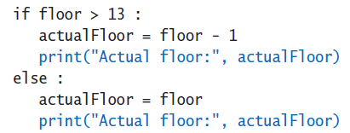
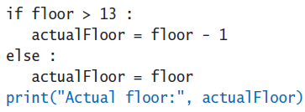
Common Error 3.1
Avoid duplication in branches
If the same code is duplicated in each branch then move it out of the if statement.

Slide 11
The conditional operator
A ‘shortcut’ you may find in existing code
It is not used in this book
The shortcut notation can be used anywhere that a value is expected
True branch
Condition
False branch

Slide 12
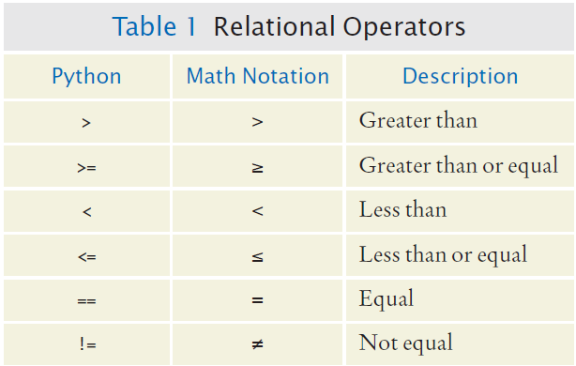
3.2 Relational Operators
Every if statement has a condition
Usually compares two values with an operator
if floor > 13 :
..
if floor >= 13 : ..
if floor < 13 : ..
if floor <= 13 :
..
if floor == 13 : ..
Beware!

Slide 13
Assignment vs. equality testing
Assignment: makes something true.
Equality testing: checks if something is true.
floor = 13
if floor == 13 :

Slide 14
Comparing strings
Checking if two strings are equal
Checking if two strings are not equal
if name1 == name2 :
print("The strings are identical")
if name1 != name2 :
print("The strings are not identical")

Slide 15
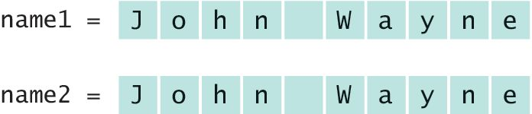
Checking for string equality (1)
For two strings to be equal, they must be of the same length and contain the same sequence of characters:

Slide 16
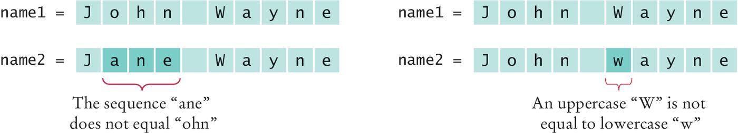
Checking for string equality (2)
If even one character is different, the two strings will not be equal:

Slide 17
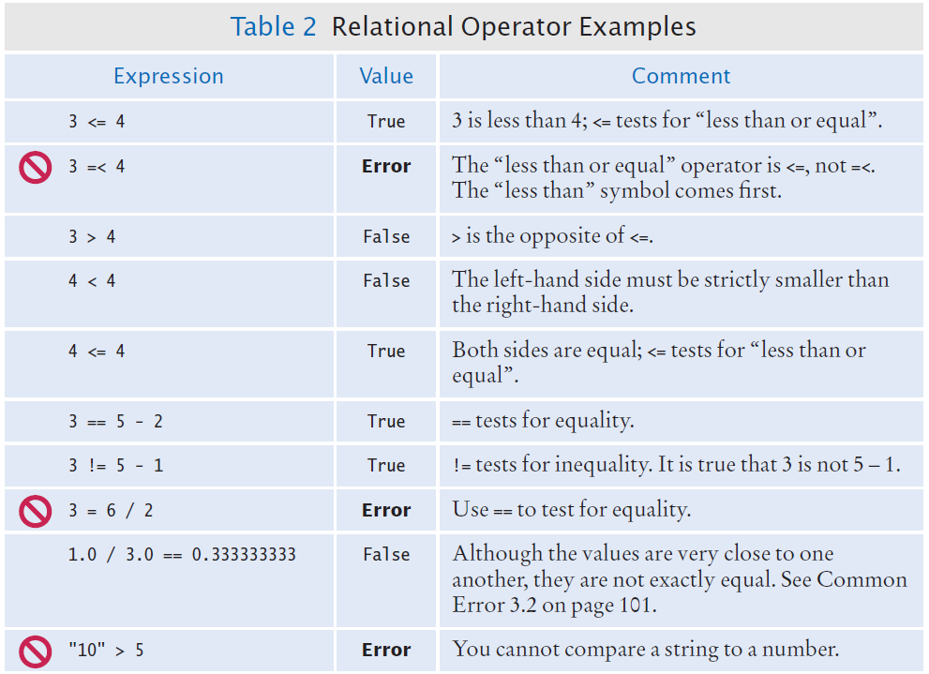
Relational Operator Examples (1)

Slide 18
Relational Operator Examples (2)

Slide 19

Common Error 3.2 (1)
Floating-point numbers have only a limited precision, and calculations can introduce roundoff errors.
You must take these inevitable roundoffs into account when comparing floating point numbers.

Slide 20
Common Error 3.2 (2)
For example, the following code multiplies the square root of 2 by itself.
Ideally, we expect to get the answer 2:
r = math.sqrt(2.0)
if r * r == 2.0 :
print("sqrt(2.0) squared is 2.0")
else :
print("sqrt(2.0) squared is not 2.0 but", r * r)
Output:
sqrt(2.0) squared is not 2.0 but 2.0000000000000004

Slide 21

The use of EPSILON
Use a very small value to compare the difference if floating-point values are ‘close enough’
The magnitude of their difference should be less than some threshold
Mathematically, we would write that x and y are close enough if:
EPSILON = 1E-14
r = math.sqrt(2.0)
if abs(r * r - 2.0) < EPSILON :
print("sqrt(2.0) squared is approximately 2.0")

Slide 22
Lexicographical order
To compare Strings in ‘dictionary’ order:
string1 < string2
Notes
All UPPERCASE letters come before lowercase
‘space’ comes before all other printable characters
Digits (0-9) come before all letters
See Appendix A for the Basic Latin (ASCII) Subset of Unicode

Slide 23
Operator precedence
The comparison operators have lower precedence than arithmetic operators
Calculations are done before the comparison
Normally your calculations are on the ‘right side’ of the comparison or assignment operator
Calculations
actualFloor = floor + 1
if floor > height + 1 :

Slide 24


Implementing an if statement (1)
Decide on a branching condition
Write pseudocode for the true branch
Write pseudocode for the false branch

Slide 25


Implementing an if statement (2)
Double-check relational operators
Test values below, at, and above the comparison (127, 128, 129)
Remove duplication
Test both branches

Slide 26
Implementing an if statement (3)
Write the code in Python

Slide 27
Implemented example
The university bookstore has a Kilobyte Day sale every October 24, giving an 8 percent discount on all computer accessory purchases if the price is less than $128, and a 16 percent discount if the price is at least $128.
if originalPrice < 128 :
discountRate = 0.92
else :
discountRate = 0.84
discountedPrice = discountRate * originalPrice

Slide 28
3.3 Nested Branches
You can nest an if inside either branch of an if statement.
Simple example: Ordering drinks
Ask the customer for their drink order
if customer orders wine
Ask customer for ID
if customer’s age is 21 or over
Serve wine
Else
Politely explain the law to the customer
Else
Serve customers a non-alcoholic drink

Slide 29
Flowchart of a Nested if
Ask for order
Nested if-else inside true branch of an if statement.
Three paths
Wine?
True
Check ID
False
>= 21?
True
Serve wine
Serve non-alcoholic drink
False
Read law
Done

Slide 30
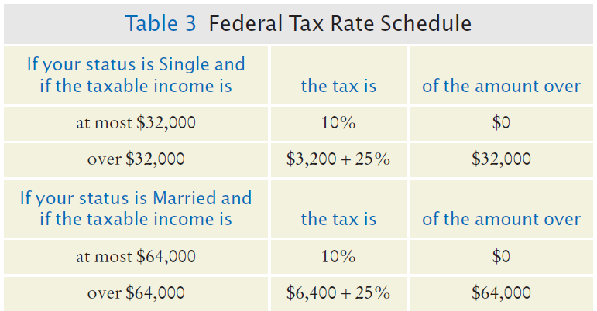
Tax example: nested ifs
Four outcomes (branches)
Single
<= 32000
> 32000
Married
<= 64000
> 64000

Slide 31
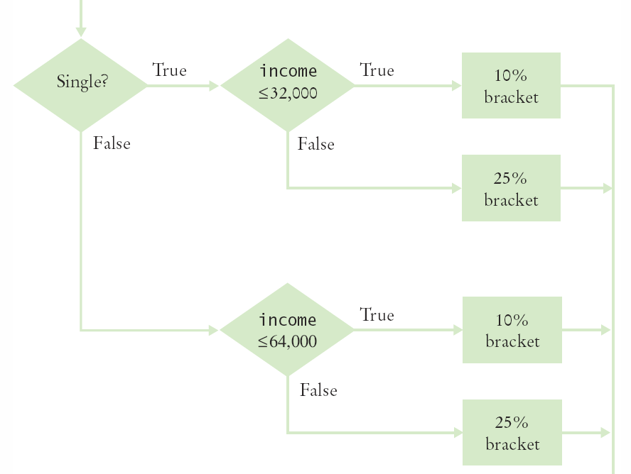
Flowchart for tax example
Four branches

Slide 32
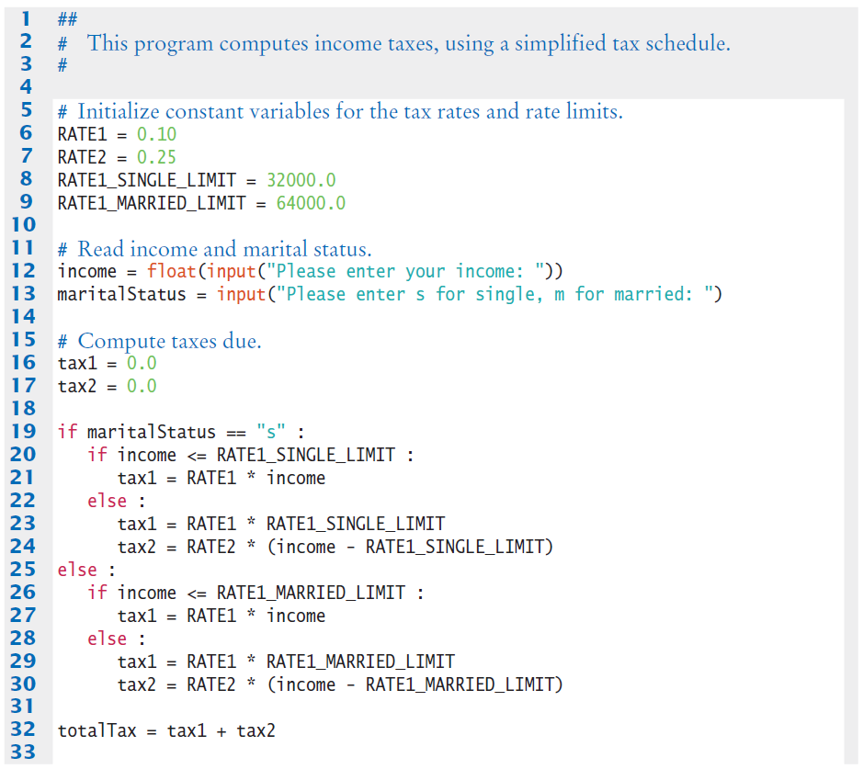
Taxes.py (1)

Slide 33
Taxes.py (2)
The ‘True’ branch (Single)
Two branches within this branch

Slide 34
Taxes.py (3)
The ‘False’ branch (not single)

Slide 35


Hand-tracing
Hand-tracing helps you understand whether a program works correctly
Create a table of key variables
Use pencil and paper to track their values
Works with pseudocode or code
Track location with a marker such as a
paper clip
Use example input values that:
You know what the correct outcome should be
Will test each branch of your code

Slide 36
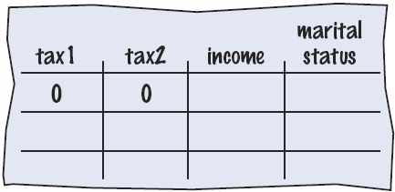
Hand-tracing tax example (1)
Setup
Table of variables
Initial values

Slide 37
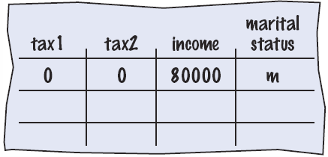
Hand-tracing tax example (2)
Input variables
From user
Update table
Because marital status is not “s” we skip to the else on line 25

Slide 38
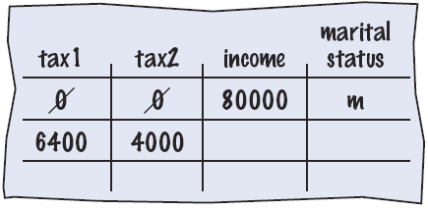
Hand-tracing tax example (3)
Because income is not <= 64000, we move to the else clause on line 28
Update variables on lines 29 and 30
Use constants

Slide 39
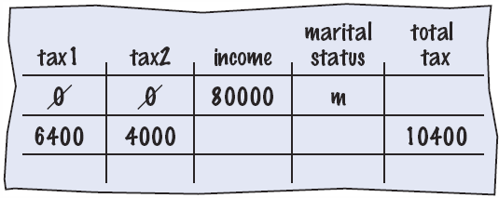
Hand-tracing tax example (4)
Output
Calculate
As expected?

Slide 40
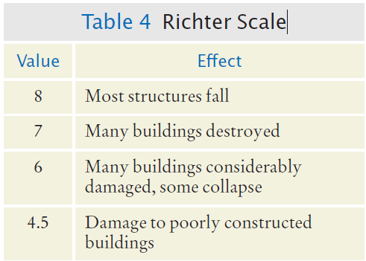
3.4 Multiple Alternatives
What if you have more than two branches?
Count the branches for the following earthquake effect example:
8 (or greater)
7 to 7.99
6 to 6.99
4.5 to 5.99
Less than 4.5
When using multiple if statements, test general conditions after more specific conditions.

Slide 41
Flowchart of multiway branching
True
>= 8.0?
Most Structures Fall
False
>= 7.0?
True
Many Buildings Destroyed
False
>= 6.0?
True
Many buildings considerably damaged, some collapse
False
>= 4.5?
True
Damage to poorly constructed buildings
False
No destruction of buildings

Slide 42
if, elif multiway branching
if richter >= 8.0 : # Handle the ‘special case’ first
print("Most structures fall")
elif richter >= 7.0 :
print("Many buildings destroyed")
elif richter >= 6.0 :
print("Many buildings damaged, some collapse")
elif richter >= 4.5 :
print("Damage to poorly constructed buildings")
else : # so that the‘general case’ can be handled last
print("No destruction of buildings")

Slide 43
What is wrong with this code?
if richter >= 8.0 :
print("Most structures fall")
if richter >= 7.0 :
print("Many buildings destroyed")
if richter >= 6.0 :
print("Many buildings damaged, some collapse")
if richter >= 4.5 :
print("Damage to poorly constructed buildings")

Slide 44
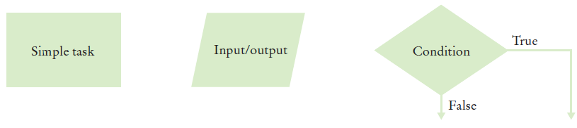
3.5 Problem Solving: Flowcharts
You have seen a few basic flowcharts
A flowchart shows the structure of decisions and tasks to solve a problem
Basic flowchart elements:
Connect them with arrows
But never point an arrow
inside another branch!
Each branch of a decision can contain tasks and further decisions.

Slide 45
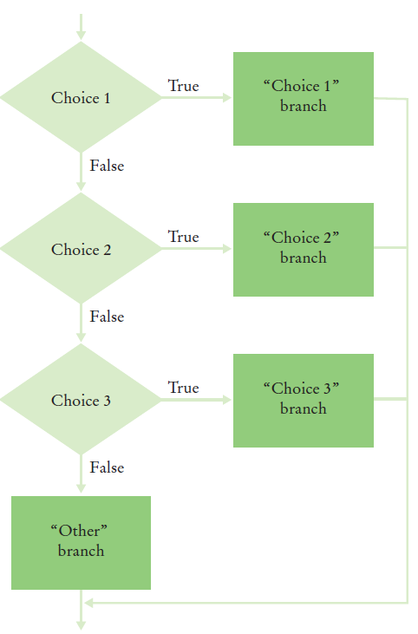
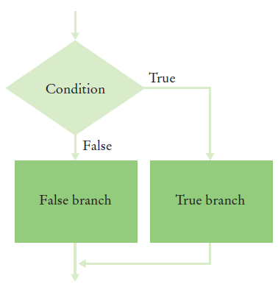
Conditional flowcharts
Two Outcomes
Multiple Outcomes

Slide 46
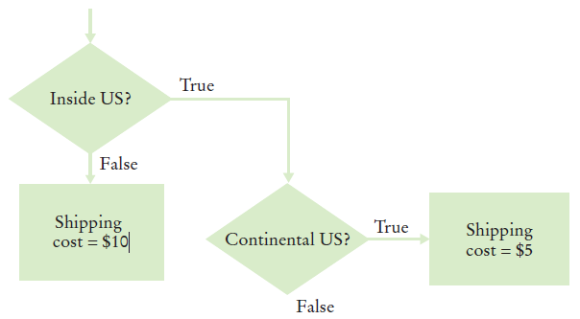
Shipping cost flowchart
Shipping costs are $5 inside the United States, except that to Hawaii and Alaska they are $10. International shipping costs are also $10.
Three Branches:
International
Branch
Hawaii/Alaska
Branch
Lower 48
Branch

Slide 47
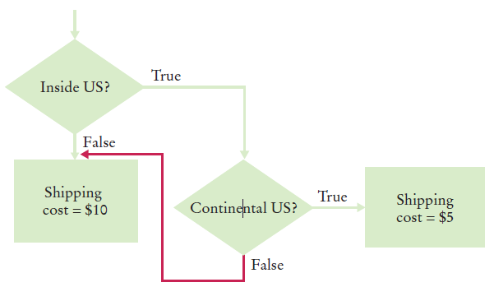
Don’t connect branches!
Shipping costs are $5 inside the United States, except that to Hawaii and Alaska they are $10. International shipping costs are also $10.
Don’t do this!
International
Branch
Hawaii/Alaska
Branch
Lower 48
Branch

Slide 48
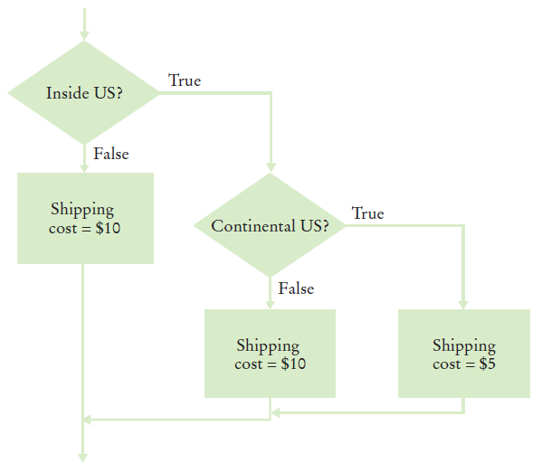
Shipping cost flowchart
Shipping costs are $5 inside the United States, except that to Hawaii and Alaska they are $10. International shipping costs are also $10.
Completed:

Slide 49
3.6 Problem Solving: Test Cases
Aim for complete coverage of all decision points:
There are two possibilities for the marital status and two tax brackets for each status, yielding four test cases
Test a handful of boundary conditions, such as an income that is at the boundary between two tax brackets, and a zero income
If you are responsible for error checking (which is discussed in Section 3.9), also test an invalid input, such as a negative income
Each branch of your code should be covered with a test case

Slide 50
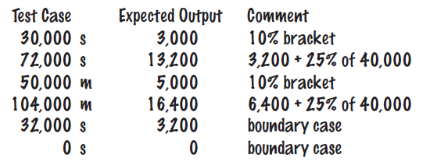
Choosing test cases
Choose input values that:
Test boundary cases and 0 values
Test each branch
A boundary case is a value that is tested in the code.

Slide 51

3.7 Boolean Variables
Boolean Variables
A Boolean variable is often called a flag because it can be either up (true) or down (false)
boolean is a Python data type
failed = True
Can be either True or False
Boolean Operators: and, or
They combine multiple conditions

Slide 52
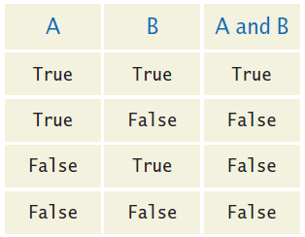
Combined conditions: and
Combining two conditions is often used in range checking
Is a value between two other values?
Both sides of the and must be true for the result to be true
if temp > 0 and temp < 100 :
print("Liquid")

Slide 53
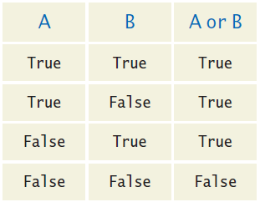
Combined conditions: or
If only one of two conditions need to be true
Use a compound conditional with an or:
If either is true
The result is true
if temp <= 0 or temp >= 100 :
print("Not liquid")

Slide 54
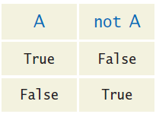
The not operator: not
If you need to invert a boolean variable or comparison, precede it with not
If using not, try to use simpler logic:
if not attending or grade < 60 :
print("Drop?")
if attending and not(grade < 60) :
print("Stay")
if attending and grade >= 60 :
print("Stay")

Slide 55
The not operator: inequality !
A slightly different operator is used for the not when checking for inequality rather than negation.
Example inequality:
The password that the user entered is not equal to the password on file.
if userPassword != filePassword :

Slide 56
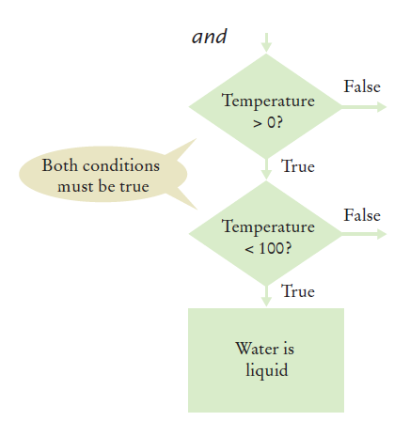
and flowchart
if temp > 0 and temp < 100 :
print("Liquid")
This is often called ‘range checking’
Used to validate that input is between two values

Slide 57
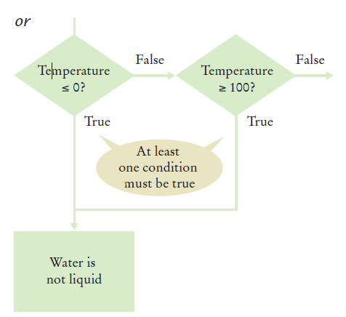
or flowchart
Another form of ‘range checking’
Checks if value is outside a range
if temp <= 0 or temp >= 100 :
print("Not Liquid")

Slide 58
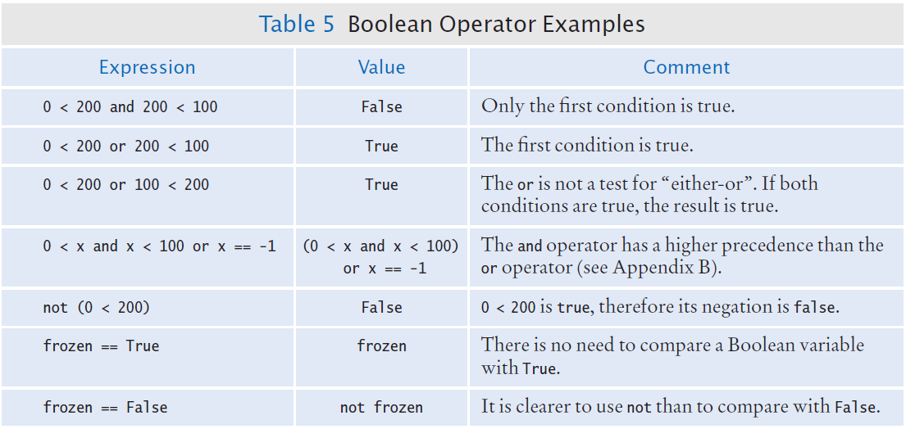
Boolean Operator Examples

Slide 59

Common Error 3.3
Confusing and and or Conditions
It is a surprisingly common error to confuse and and or conditions.
A value lies between 0 and 100 if it is at least 0 and at most 100.
It lies outside that range if it is less than 0 or greater than 100.
There is no golden rule; you just have to think carefully.

Slide 60
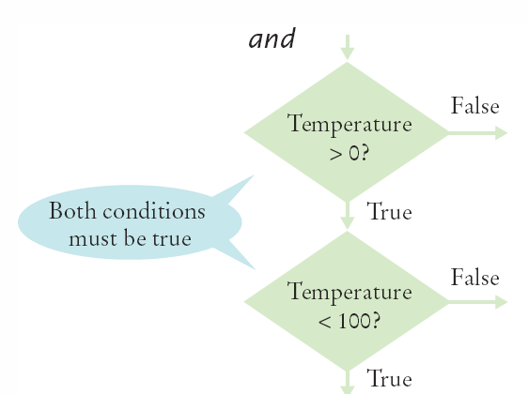
Short-circuit evaluation: and
Combined conditions are evaluated from left to right
If the left half of an and condition is false, why look further?
A useful example:
if temp > 0 and temp < 100 :
print("Liquid")
Done!
if quantity > 0 and (price / quantity) < 10 :

Slide 61
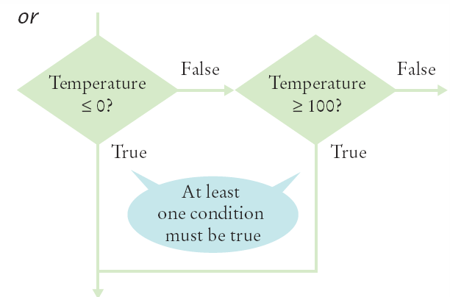
Short-circuit evaluation: or
If the left half of the or is true, why look further?
Python doesn’t!
Don’t do these second:
Assignment
Output
if temp <= 0 or temp >= 100 :
print("Not Liquid")
Done!

Slide 62
De Morgan’s law
De Morgan’s law tells you how to negate and and or conditions:
not(A and B) is the same as notA or notB
not(A or B) is the same as notA and notB
Example: Shipping is higher to AK and HI
To simplify conditions with negations of and or or expressions, it’s a good idea to apply De Morgan’s law to move the negations to the innermost level.
if (country != "USA"
and state != "AK"
and state != "HI") :
shippingCharge = 20.00
if not(country=="USA"
or state=="AK"
or state=="HI") : shippingCharge = 20.00

Slide 63
3.8 Analyzing Strings
Sometimes it’s necessary to analyze or ask certain questions about a particular string.
Sometimes it is necessary to determine if a string contains a given substring. That is, one string contains an exact match of another string.
Given this code segment,
name = "John Wayne"
the expression
"Way" in name
yields True because the substring "Way" occurs within the string stored in variable name.

Slide 64
Substring: suffixes
For example, suppose you are given the name of a file and need to ensure that it has the correct extension
if filename.endswith(".html") :
print("This is an HTML file.")
The endswith() string method is applied to the string stored in filename and returns True if the string ends with the substring ".html" and False otherwise.

Slide 65
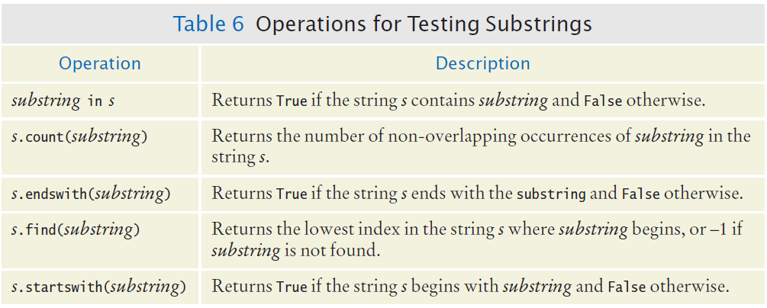
Operations for Testing Substrings

Slide 66
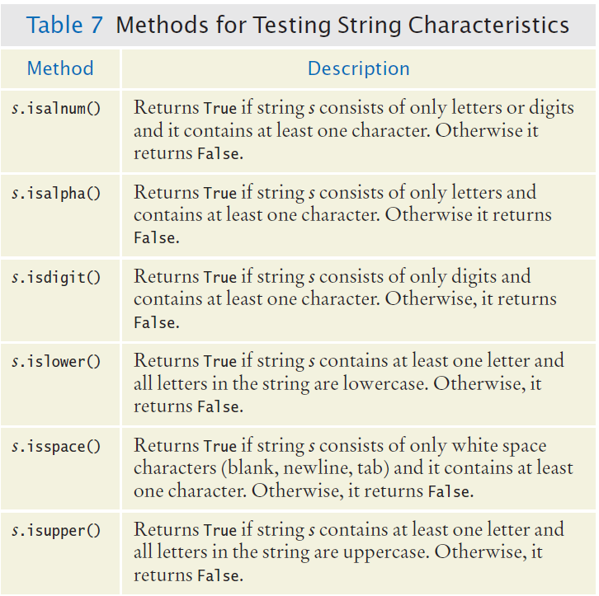
Methods: Testing String Characteristics (1)

Slide 67
Methods for Testing String Characteristics (2)

Slide 68
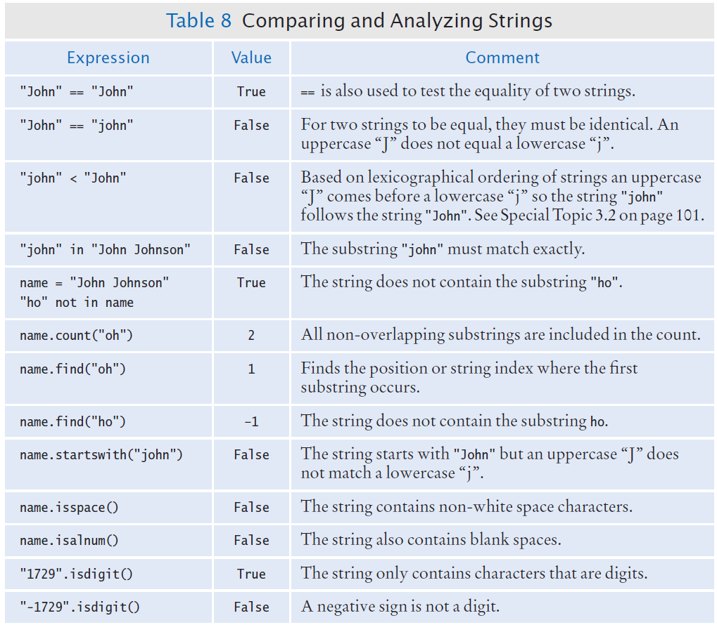
Comparing and Analyzing Strings (1)

Slide 69
Comparing and Analyzing Strings (2)

Slide 70
3.9 Input Validation (1)
Accepting user input is dangerous
Consider the Elevator program:
Assume that the elevator panel has buttons labeled 1 through 20 (but not 13).

Slide 71
Input Validation (2)
The following are illegal inputs:
The number 13
Zero or a negative number
A number larger than 20
An input that is not a sequence of digits, such as five:
Python’s exception mechanism is needed to help verify integer and floating point values (Chapter 7).
if floor == 13 :
print("Error: There is no thirteenth floor.")
if floor <= 0 or floor > 20 :
print("Error: The floor must be between 1 and 20.")

Slide 72
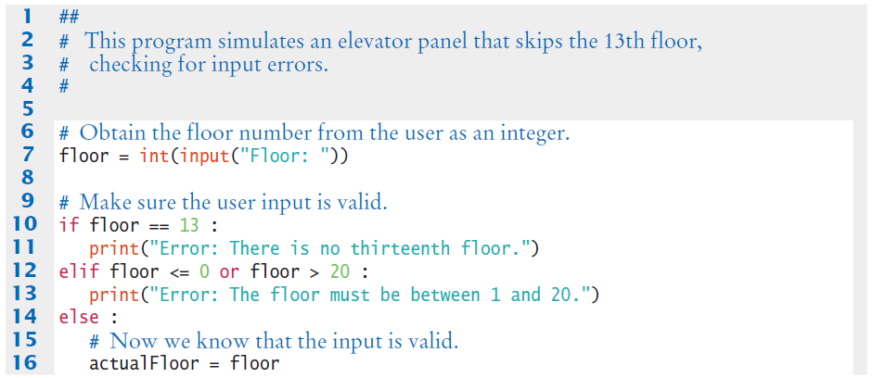
Elevatorsim2.py
Input value range checking

Slide 73

Elevatorsim2.py

Slide 74
Summary: if statement
The if statement allows a program to carry out different actions depending on the nature of the data to be processed.
Relational operators ( < <= > >= == != ) are used to compare numbers and Strings.
Strings are compared in lexicographic order.
Multiple if statements can be combined to evaluate complex decisions.
When using multiple if statements, test general conditions after more specific conditions.

Slide 75
Summary: flowcharts and testing (1)
When a decision statement is contained inside the branch of another decision statement, the statements are nested.
Nested decisions are required for problems that have two levels of decision making.
Flow charts are made up of elements for tasks, input/output, and decisions.
Each branch of a decision can contain tasks and further decisions.
Never point an arrow inside another branch.

Slide 76
Summary: flowcharts and testing (2)
Each branch of your program should be covered by a test case.
It is a good idea to design test cases before implementing a program.

Slide 77
Summary: Boolean
The type boolean has two values, true and false.
Python has two Boolean operators that combine conditions: and and or.
To invert a condition, use the not operator. When checking for equality use the ! operator.
The and and or operators are computed lazily: As soon as the truth value is determined, no further conditions are evaluated.
De Morgan’s law tells you how to negate and and or conditions.

