Slide 1

4
CHAPTER
LOOPS
Slides by James Tam
Department of Computer Science,
University of Calgary
April 26, 2013

Slide 2
Chapter Goals
To implement while and for loops
To hand-trace the execution of a program
To become familiar with common loop algorithms
To understand nested loops
To implement programs that read and process data sets
To use a computer for simulations
In this chapter, you will learn about loop statements in Python, as well as techniques for writing programs that simulate activities in the real world.

Slide 3
Contents
The while loop
Problem Solving: Hand-Tracing
Application: Processing Sentinels
Problem Solving: Storyboards
Common Loop Algorithms
The for loop
Nested Loops
Processing Strings
Application: Random Numbers and Simulations

Slide 4
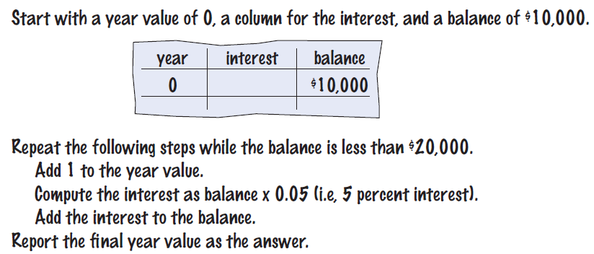

4.1 The while Loop
Examples of loop applications
Calculating compound interest
Simulations, event driven programs…
Compound interest algorithm (Chapter 1)
Steps

Slide 5
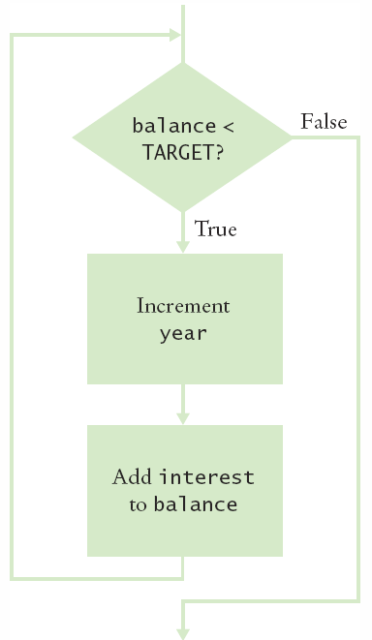
Planning the while loop
A loop executes instructions
repeatedly while a condition is True.
while balance < TARGET :
year = year + 1
interest = balance * RATE/100
balance = balance + interest

Slide 6
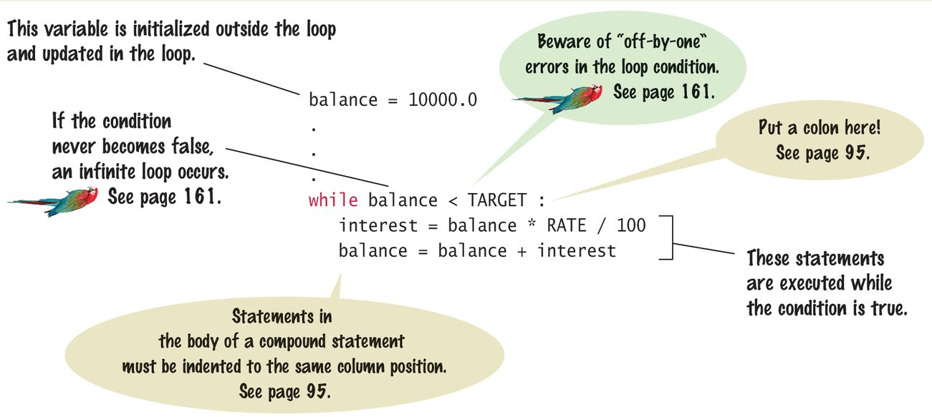
Syntax 4.1: while Statement

Slide 7
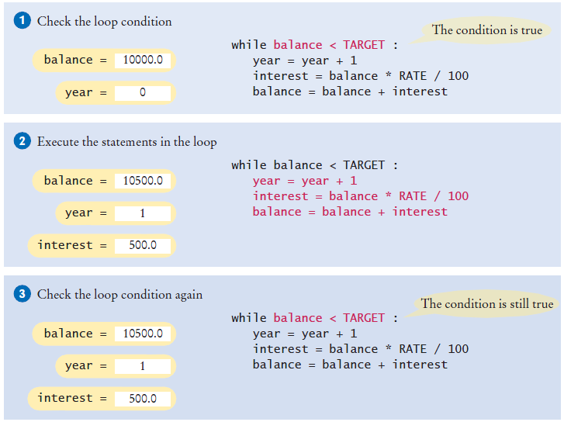
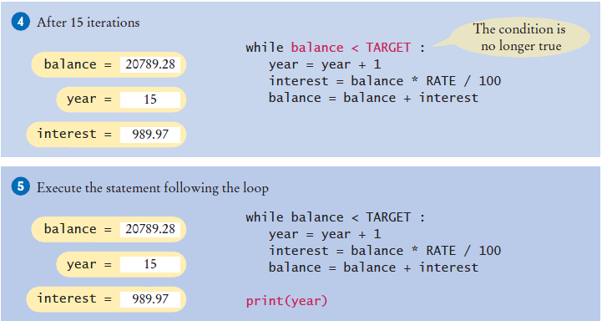
Execution of the loop

Slide 8
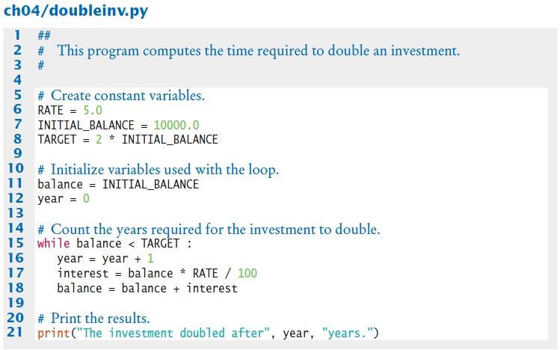

Doubleinv.py
Declare and initialize a variable outside of the loop to count years
Increment the years variable each time through

Slide 9
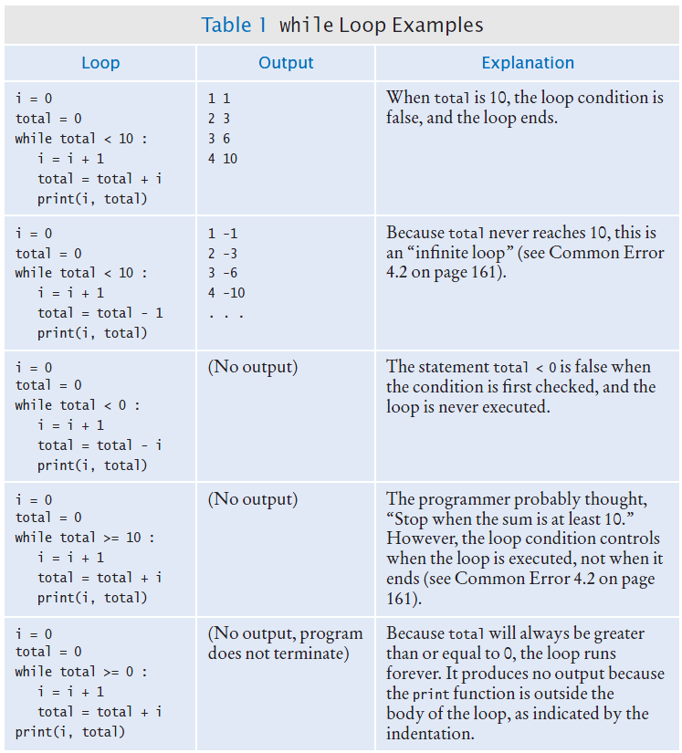
while loop examples (1)

Slide 10
while loop examples (2)

Slide 11

Common Error 4.1
Don’t think “Are we there yet?”
The loop body will only execute if the test condition is True.
“Are we there yet?” should continue if False
If bal should grow until it reaches TARGET
Which version will execute the loop body?
while bal < TARGET :
year = year + 1
interest = bal * RATE
bal = bal + interest
while bal <= TARGET :
year = year + 1
interest = bal * RATE
bal = bal + interest

Slide 12
Common Error 4.2
Infinite Loops
The loop body will execute until the test condition becomes False.
What if you forget to update the test variable?
bal is the test variable (TARGET doesn’t change)
You will loop forever! (or until you stop the program)
while bal < TARGET :
year = year + 1
interest = bal * RATE
bal = bal + interest

Slide 13
Common Error 4.3
Off-by-One Errors
A ‘counter’ variable is often used in the test condition
Your counter can start at 0 or 1, but programmers often start a counter at 0
If I want to paint all 5 fingers, when I am done?
Start at 0, use < Start at 1, use <=
0, 1, 2, 3, 4 1, 2, 3, 4, 5
finger = 0
FINGERS = 5
while finger < FINGERS :
# paint finger
finger = finger + 1
finger = 1
FINGERS = 5
while finger <= FINGERS :
# paint finger
finger = finger + 1

Slide 14
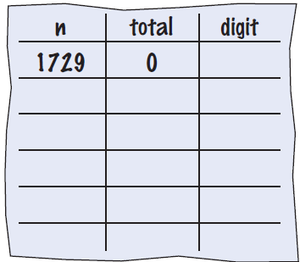
4.2: Hand-Tracing
Example: Calculate the sum of digits (1+7+2+9)
Make columns for key variables (n, total, digit)
Examine the code and number the steps
Set variables to state before loop begins

Slide 15
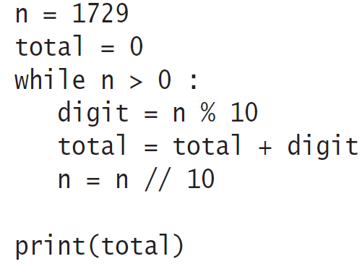
Tracing sum of digits
Start executing loop body statements changing variable values on a new line
Cross out values in previous line

Slide 16
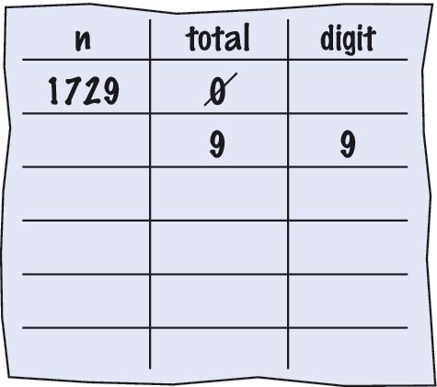
Tracing sum of digits
Continue executing loop statements changing variables
1729 / 10 leaves 172 (no remainder)

Slide 17
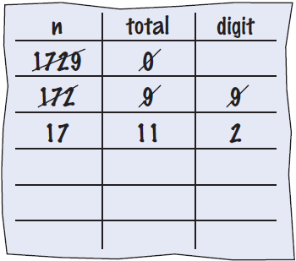
Tracing sum of digits
Test condition. If True, execute loop again
Variable n is 172, Is 172 > 0?, True!
Make a new line for the second time through and update variables

Slide 18
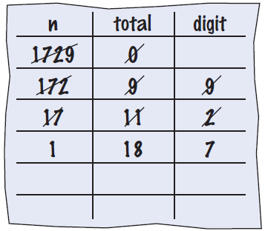
Tracing sum of digits
Third time through
Variable n is 17 which is still greater than 0
Execute loop statements and update variables

Slide 19
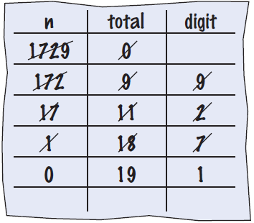
Tracing sum of digits
Fourth loop iteration:
Variable n is 1 at start of loop. 1 > 0? True
Executes loop and changes variable n to 0 (1/10 = 0)

Slide 20
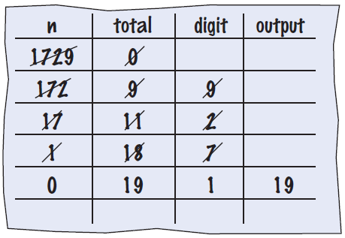
Tracing sum of digits
Because n is 0, the expression(n > 0) is False
Loop body is not executed
Jumps to next statement after the loop body
Finally prints the sum!

Slide 21
Summary of the while loop
while loops are very commonly used
Initialize variables before you test
The condition is tested BEFORE the loop body
This is called pre-test
The condition often uses a counter variable
Something inside the loop should change one of the variables used in the test
Watch out for infinite loops!

Slide 22
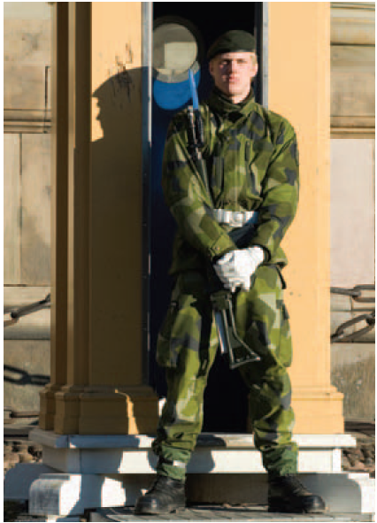
4.3 Processing Sentinel Values
Sentinel values are often used:
When you don’t know how many items are in a list, use a ‘special’ character or value to signal no more items.
For numeric input of positive numbers, it is common to use the value -1:
salary = 0.0
while salary >= 0 :
salary = float(input())
if salary >= 0.0 :
total = total + salary
count = count + 1
A sentinel value denotes the end of a data set, but it is not part of the data.

Slide 23
Averaging a set of values
Declare and initialize a ‘total’ variable to 0
Declare and initialize a ‘count’ variable to 0
Declare and initialize a ‘salary’ variable to 0
Prompt user with instructions
Loop until sentinel value is entered
Save entered value to input variable (‘salary’)
If salary is not -1 or less (sentinel value)
Add salary variable to total variable
Add 1 to count variable
Make sure you have at least one entry before you divide!
Divide total by count and output. Done!

Slide 24
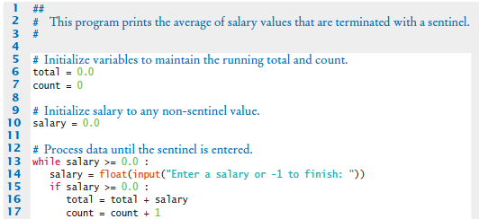
Sentinel.py (1)
Outside the while loop: declare and initialize variables to use
Since salary is initialized to 0, the while loop statements will execute at least once
Input new salary and compare to sentinel
Update running total and count (to calculate the average later)

Slide 25

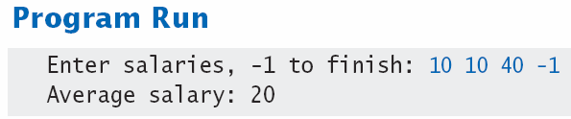
Sentinel.py (2)
Prevent divide by 0
Calculate and output the average salary using the total and count variables

Slide 26
Priming read
Some programmers don’t like the “trick” of initializing the input variable with a value other than a sentinel.
An alternative is to change the variable with a read before the loop.
# Set salary to a value to ensure that the loop
# executes at least once.
salary = 0.0
while salary >= 0 :
salary = float(input("Enter a salary or -1 to finish: "))
while salary >= 0 :

Slide 27
Modification read
It is an input operation at the bottom of the loop is used to obtain the next input.
# Priming read
salary = float(input("Enter a salary or -1 to finish: "))
while salary >= 0.0 :
total = total + salary
count = count + 1
# Modification read
salary = float(input("Enter a salary or -1 to finish:
"))

Slide 28
Boolean variables and sentinels
A boolean variable can be used to control a loop
Sometimes called a ‘flag’ variable
done = False
while not done :
value = float(input("Enter a salary or -1 to finish: "))
if value < 0.0:
done = True
else :
# Process value
Initialize done so that the loop will execute
Set done ‘flag’ to True if sentinel value is found

Slide 29
4.4 Storyboards
One useful problem solving technique is the use of storyboards to model user interaction. It can help answer:
What information does the user provide, and in which order?
What information will your program display, and in which format?
What should happen when there is an error?
When does the program quit?
A storyboard consists of annotated sketches for each step in an action
sequence.

Slide 30
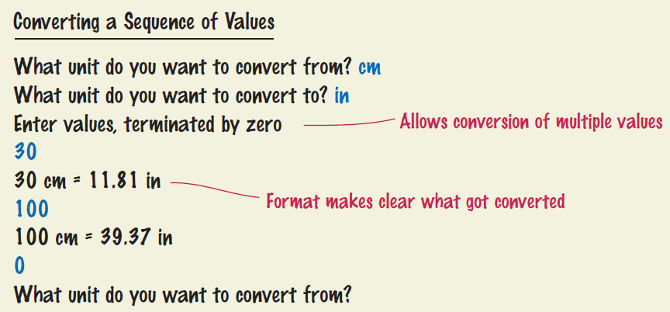
Storyboard example
Goal: Converting a sequence of values
Will require a loop and some variables
Handle one conversion each time through the loop

Slide 31
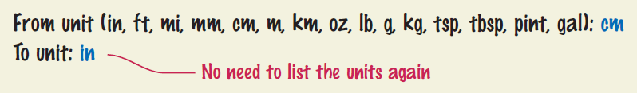
What can go wrong?
Unknown unit types
How do you spell centimeters and inches?
What other conversions are available?
Solution:
Show a list of the acceptable unit types

Slide 32
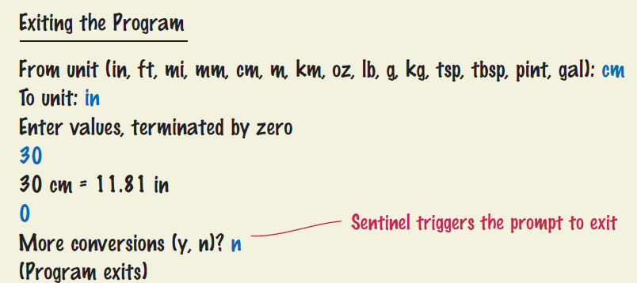
What else can go wrong?
How does the user quit the program?
Storyboards help you plan a program
Knowing the flow helps you structure your code

Slide 33
4.5 Common Loop Algorithms
1: Sum and Average Value
2: Counting Matches
3: Prompting until a Match Is Found
4: Maximum and Minimum
5: Comparing Adjacent Values

Slide 34
Sum and average examples
total = 0.0
inputStr = input("Enter value: ")
while inputStr != "" :
value = float(inputStr)
total = total + value
inputStr = input("Enter value: ")
Sum of Values
Initialize total to 0
Use while loop with sentinel
total = 0.0
count = 0
inputStr = input("Enter value: ")
while inputStr != "" :
value = float(inputStr)
total = total + value
count = count + 1
inputStr = input("Enter value: ")
if count > 0 :
average = total / count
else :
average = 0.0
Average of Values
First total the values
Initialize count to 0
Increment per input
Check for count 0
Before divide!

Slide 35
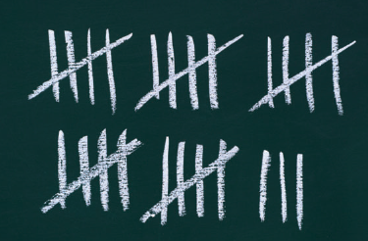
Counting matches
negatives = 0
inputStr = input("Enter value: ")
while inputStr != "“ :
value = int(inputStr)
if value < 0 :
negatives = negatives + 1
inputStr = input("Enter value: ")
print("There were", negatives, "negative values.")
Counting Matches
Initialize negatives to 0
Use a while loop
Add to negatives per match

Slide 36
Prompt until a match is found
valid = False
while not valid :
value = int(input("Please enter a positive value < 100: "))
if value > 0 and value < 100 :
valid = True
else :
print("Invalid input.")
Initialize boolean flag to False
Test sentinel in while loop
Get input, and compare to range
If input is in range, change flag to True
Loop will stop executing

Slide 37
Maximum and minimum
largest = int(input("Enter a value: "))
inputStr = input("Enter a value: ")
while inputStr != "“ :
value = int(inputStr)
if value > largest :
largest = value
inputStr = input("Enter a value: ")
smallest = int(input("Enter a value: "))
inputStr = input("Enter a value: ")
while inputStr != "“ :
value = int(inputStr)
if value < smallest :
smallest = value
inputStr = input("Enter a value: ")
Get first input value
This is the largest (or smallest) that you have seen so far!
Loop while you have a valid number (non-sentinel)
Get another input value
Compare new input to largest (or smallest)
Update largest (or smallest) if necessary

Slide 38
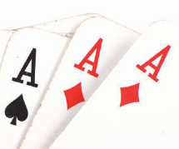
Comparing adjacent values
value = int(input("Enter a value: "))
inputStr = input("Enter a value: ")
while inputStr != "“ :
previous = value
value = int(inputStr)
if value == previous :
print("Duplicate input")
inputStr = input("Enter a value: ")
Get first input value
Use while to determine if there are more to check
Copy input to previous variable
Get next value into input variable
Compare input to previous, and output if same

Slide 39
4.6 The for Loop (1)
Uses of a for loop:
The for loop can be used to iterate over the contents of any container, which is an object that contains or stores a collection of elements (a string is a container that stores the collection of characters in the string).
Note an important difference between the while loop and the for loop. In the while loop, the index variable i is assigned 0, 1, and so on. In the for loop, the element variable is assigned stateName[0], stateName[1], and so on.
stateName = "Virginia"
i = 0
while i < len(stateName) :
letter = stateName[i]
print(letter)
i = i + 1
while version
stateName = "Virginia"
for letter in stateName :
print(letter)
for version

Slide 40
4.6 The for Loop (2)
Uses of a for loop:
A for loop can also be used as a count-controlled loop that iterates over a range of integer values.
i = 1
while i < 10 :
print(i)
i = i + 1
for i in range(1, 10) :
print(i)
while version
for version

Slide 41
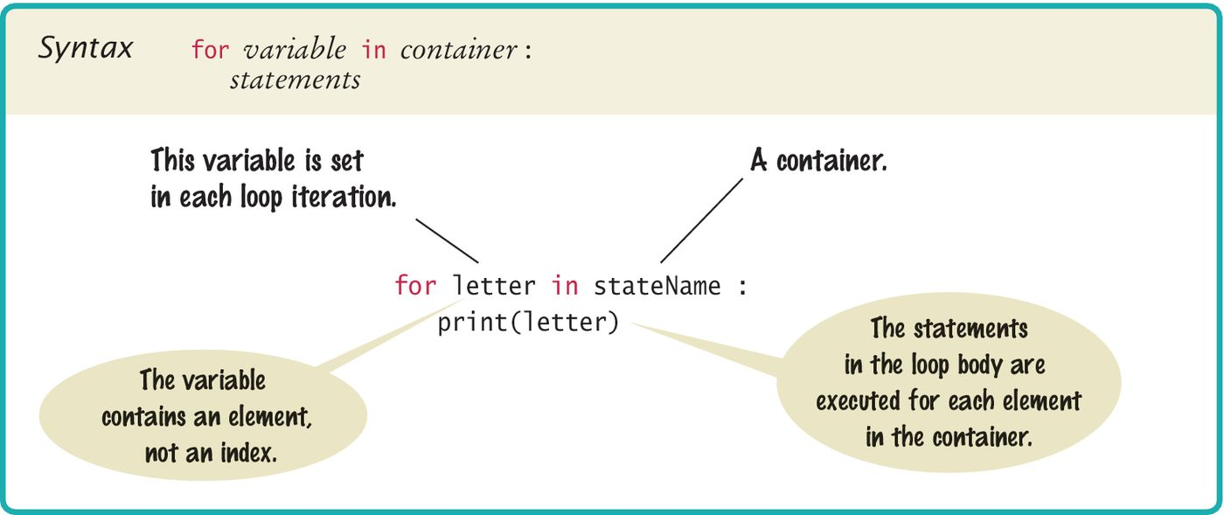
Syntax 4.2: for Statement
Using a for loop to iterate over the contents of a container, an element at a time.

Slide 42
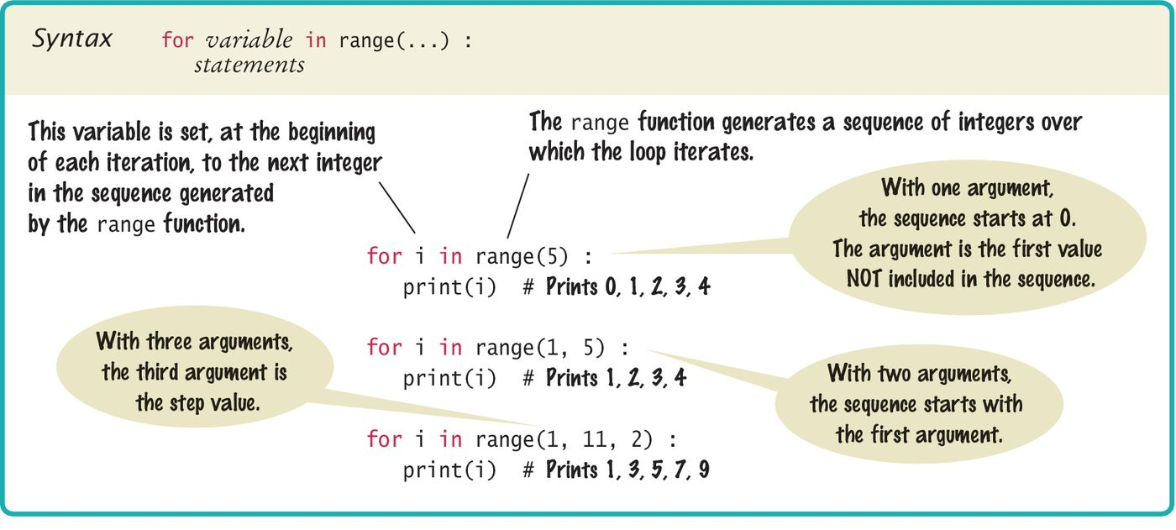
Syntax 4.3: for Statement
Using a for loop as a count-controlled loop to iterate over a range of integer values using the range function for generating a sequence of integers that can be used with the for loop.

Slide 43
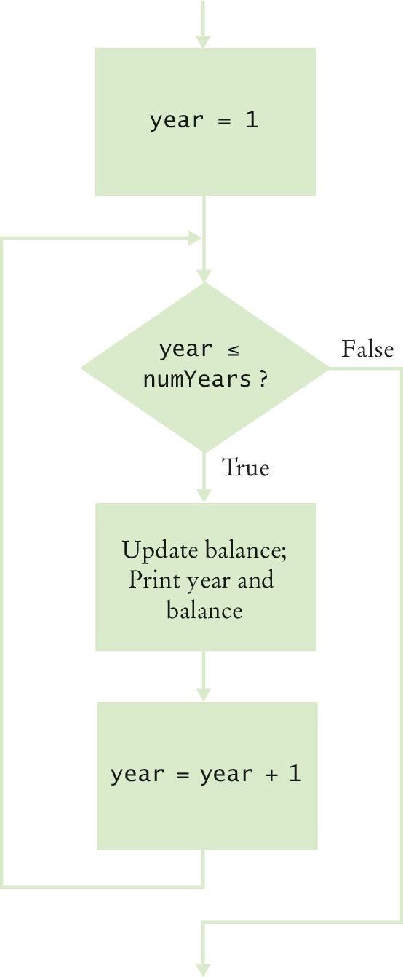
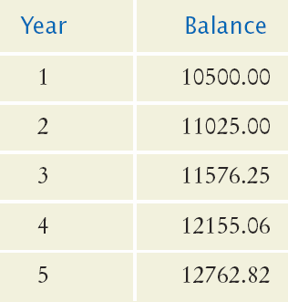
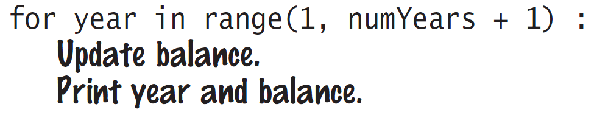
Planning a for loop
Print the balance at the end of each year for a number of years

Slide 44
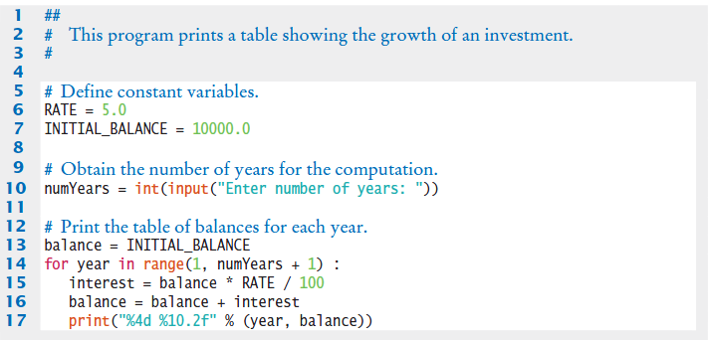
Investment.py
Setup variables
Get input
Loop
Calc
Output

Slide 45
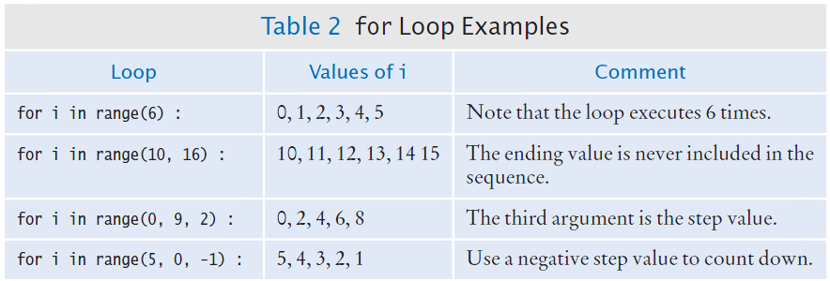
Good examples of for loops
Keep it simple!

Slide 46

Programming Tip 4.1 (1)
Finding the correct lower and upper bounds for a loop can be confusing.
Should you start at 0 or at 1?
Should you use <= b or < b as a termination condition?
Counting is easier for loops with asymmetric bounds.
The following loops are executed b - a times.
int i = a
while i < b :
. . .
i = i + 1
for i in range(a, b) :
. . .

Slide 47
Programming Tip 4.1 (2)
The loop with symmetric bounds, is executed b - a + 1 times.
That “+1” is the source of many programming errors.
i = a
while i <= b :
. . .
i = i + 1
# For this version of the loop the ‘+1’ is very noticeable!
for year in range(1, numYears + 1) :

Slide 48
Summary of the for loop
for loops are very commonly used
The for loop can be used to iterate over the contents of any container, which is an object that contains or stores a collection of elements (a string is a container that stores the collection of characters in the string).
A for loop can also be used as a count-controlled loop that iterates over a range of integer values.

Slide 49
Steps to writing a loop
Planning:
Decide what work to do inside the loop
Specify the loop condition
Determine loop type
Setup variables before the first loop
Process results when the loop is finished
Trace the loop with typical examples
Coding:
Implement the loop in Python

Slide 50
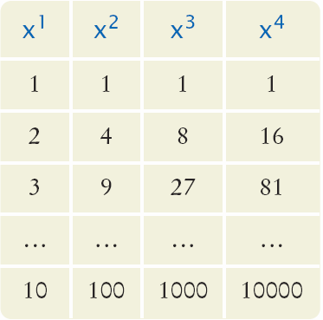
4.7 Nested Loops
How would you print a table with rows and columns?
Print top line (header)
Use a for loop
Print table body…
How many rows?
How many columns?
Loop per row
Loop per column

Slide 51
Flowchart of a nested loop
x = 1
x <= 10?
True
n= 1
Inner Loop
False
n <= 4?
True
Print x^{n}
False
n = n + 1
Print new line
x = x + 1
Done

Slide 52
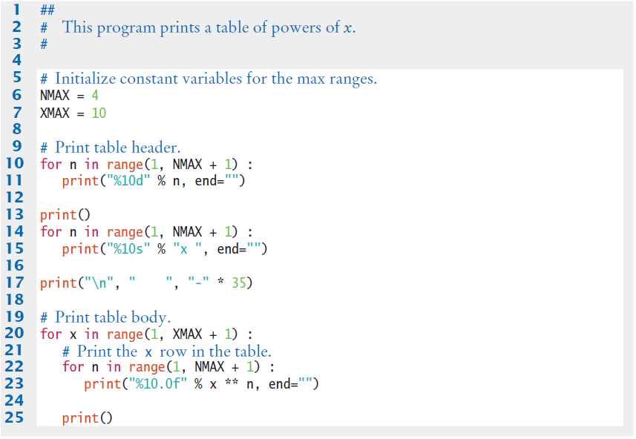
Powertable.py
Body of outer loop
Body of inner loop

Slide 53
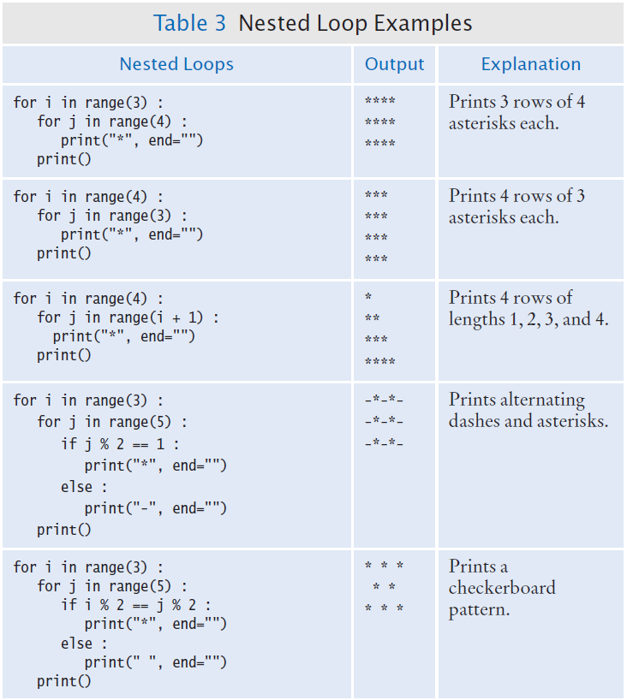
Nested Loop Examples (1)

Slide 54
Nested Loop Examples (2)

Slide 55
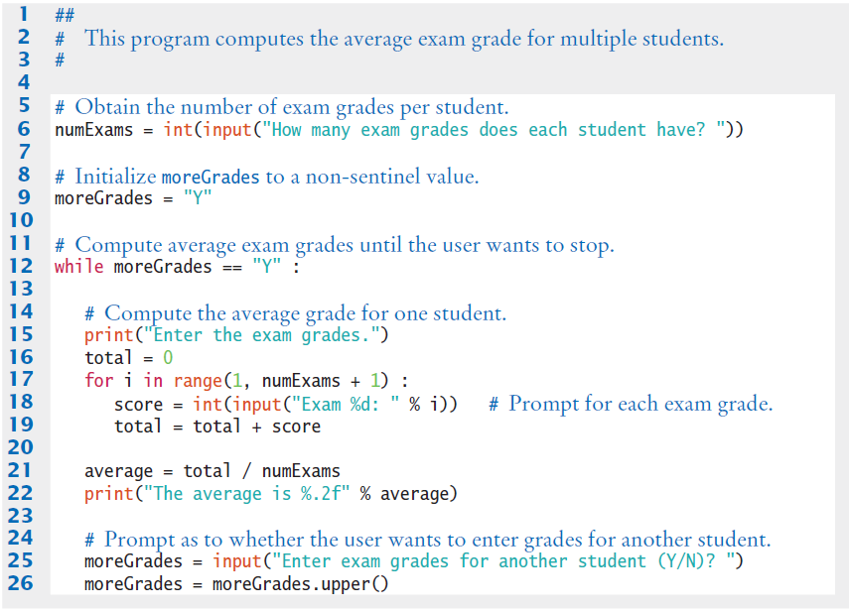
Examaverages.py (1)

Slide 56
Examaverages.py (2)

Slide 57
4.8 Processing Strings
A common use of loops is to process or evaluate strings.
For example, you may need to count the number of occurrences of one or more characters in a string or verify that the contents of a string meet certain criteria.

Slide 58
String processing examples
Counting Matches
Finding All Matches
Finding the First or Last Match
Validating a String
Building a New String

Slide 59
Counting matches
Suppose you need to count the number of uppercase letters contained in a string.
Sometimes, you need to count the number of occurrences of multiple characters within a string.
uppercase = 0
for char in string :
if char.isupper() :
uppercase = uppercase + 1
vowels = 0
for char in word :
if char.lower() in "aeiou" :
vowels = vowels + 1

Slide 60
Finding all matches
Print the position of each uppercase letter in a sentence.
sentence = input("Enter a sentence: ")
for i in range(len(sentence)) :
if sentence[i].isupper() :
print(i)

Slide 61
Finding the first match
Here is a loop that finds the position of the first digit in a string.
found = False
position = 0
while not found and position < len(string) :
if string[position].isdigit() :
found = True
else :
position = position + 1
if found :
print("First digit occurs at position", position)
else :
print("The string does not contain a digit.")

Slide 62
Finding the last match
Here is a loop that finds the position of the last digit in the string.
found = False
position = len(string) - 1
while not found and position >= 0 :
if string[position].isdigit() :
found = True
else :
position = position - 1

Slide 63
Validating a string (1)
In the United States, telephone numbers consist of three parts––area code exchange, and line number––which are commonly specified in the form (###)###-####.

Slide 64
Validating a string (2)
We can examine a string to ensure that it contains a correctly formatted phone number.
valid = True
position = 0
while valid and position < len(string) :
if ((position == 0 and string[position] != "(")
or (position == 4 and string[position] != ")")
or (position == 8 and string[position] != "-")
or not string[position].isdigit() :
valid = False
else :
position = position + 1

Slide 65
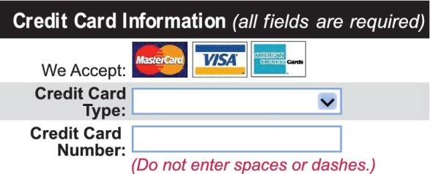
Building a new string (1)
One of the minor annoyances of online shopping is that many web sites require you to enter a credit card without spaces or dashes, which makes double-checking the number rather tedious.
How hard can it be to remove dashes or spaces from a string?

Slide 66
Building a new string (2)
The contents of a string cannot be changed.
But nothing prevents us from building a new string.
Here is a loop that builds a new string containing a credit card number with spaces and dashes removed:
userInput = input("Enter a credit card number: ")
creditCardNumber = ""
for char in userInput :
if char != " " and char != "-" :
creditCardNumber = creditCardNumber + char

Slide 67
4.9 Random Numbers/Simulations
Games often use random numbers to make things interesting
Rolling Dice
Spinning a wheel
Pick a card
A simulation usually involves looping through a sequence of events
Days
Events

Slide 68

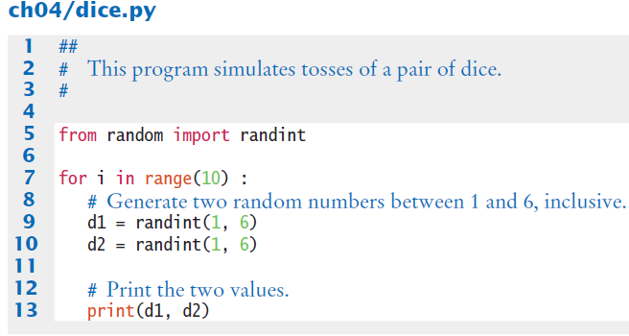
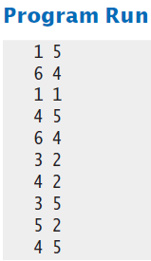
Simulating die tosses
Goal:
Get a random integer between 1 and 6

Slide 69
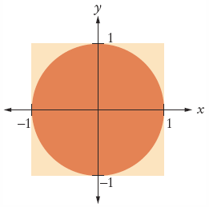
The Monte Carlo method
Used to find approximate solutions to problems that cannot be precisely solved
Example: Approximate PI using the relative areas of a circle inside a square
Uses simple arithmetic
Hits are inside circle
Tries are total number of tries
Ratio is 4 x Hits / Tries

Slide 70

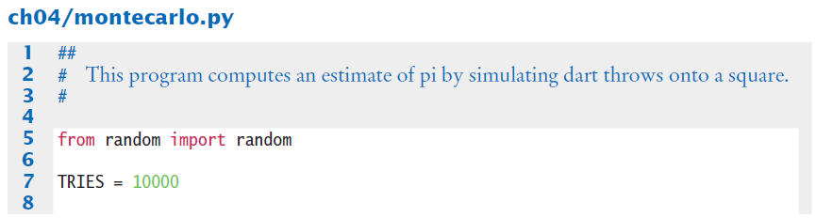
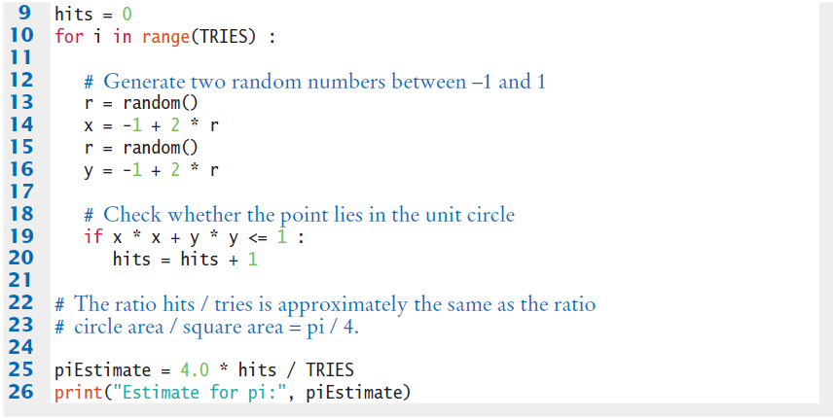
Montecarlo.py

Slide 71
Summary: types of loops
There are two types of loops:
while Loops
for Loops
while loops are very commonly used (general purpose)
Uses of the for loop:
The for loop can be used to iterate over the contents of any container.
A for loop can also be used as a count-controlled loop that iterates over a range of integer values.

Slide 72
Summary
Each loop requires the following steps:
Initialization (setup variables to start looping)
Condition (test if we should execute loop body)
Update (change something each time through)
A loop executes instructions repeatedly while a condition is True.
An off-by-one error is a common error when programming loops.
Think through simple test cases to avoid this type of error.

Slide 73
Summary
A sentinel value denotes the end of a data set, but it is not part of the data.
You can use a boolean variable to control a loop.
Set the variable to True before entering the loop, then set it to False to leave the loop.
When the body of a loop contains another loop, the loops are nested.
A typical use of nested loops is printing a table with rows and columns.
Loops can be used in conjunction with many string processing tasks

Slide 74
Summary
In a simulation, you use the computer to simulate an activity.
You can introduce randomness by calling the random number generator.

