Slide 1
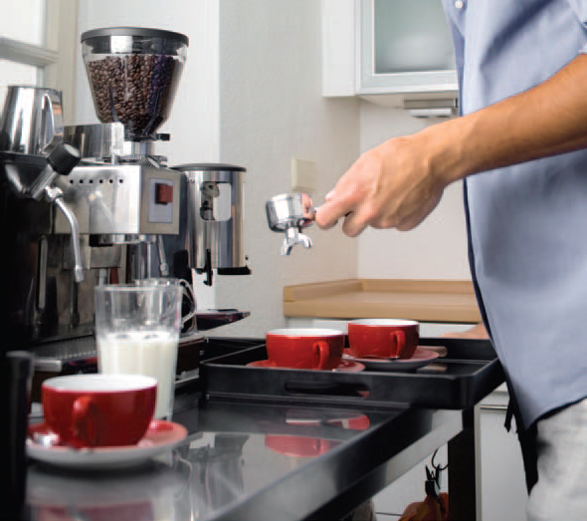
5
CHAPTER
FUNCTIONS
Slides by James Tam
Department of Computer Science,
University of Calgary
April 24, 2013

Slide 2
Chapter Goals
To be able to implement functions
To become familiar with the concept of parameter passing
To develop strategies for decomposing complex tasks into simpler ones
To be able to determine the scope of a variable
To learn how to think recursively (optional)
In this chapter, you will learn how to design and implement your own functions. Using the process of stepwise refinement, you will be able to break up complex tasks into sets of cooperating functions.

Slide 3
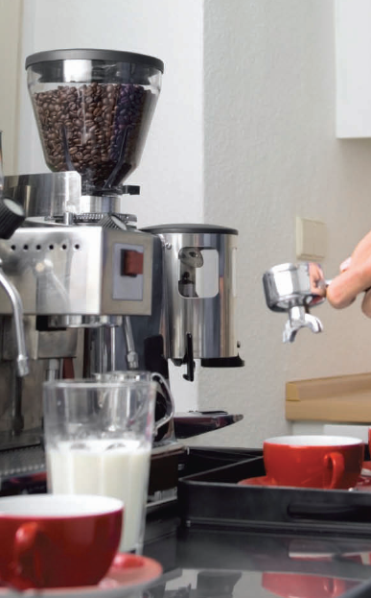
Contents
Functions as Black Boxes
Implementing and Testing Functions
Parameter Passing
Return Values
Functions without Return Values
Problem Solving:
Reusable Functions
Stepwise Refinement
Variable Scope
Recursive functions (optional)

Slide 4
5.1 Functions as Black Boxes
A function is a sequence of instructions with a name.
For example, the round function, which was introduced in Chapter 2, contains instructions to round a floating-point value to a specified number of decimal places.

Slide 5
Calling Functions (1)
You call a function in order to execute its instructions.
price = round(6.8275, 2) # Sets result to 6.83
By using the expression round(6.8275, 2), your program calls the round function, asking it to round 6.8275 to two decimal digits.

Slide 6
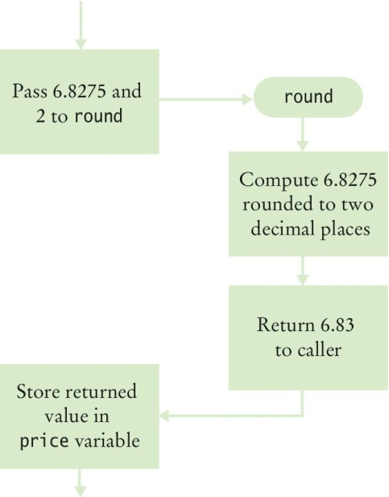
Calling Functions (2)
The round function returns its result back to where the function was called and your program resumes execution.

Slide 7
Function Arguments (1)
When another function calls the round function, it provides “inputs”, such as the values 6.8275 and 2 in the call round(6.8275, 2).
These values are called the arguments of the function call.
Note that they are not necessarily inputs provided by a human user.
They are simply the values for which we want the function to compute a result.

Slide 8
Function Arguments (2)
Functions can receive multiple arguments or it is also possible to have functions with no arguments.

Slide 9
Function Return Values (1)
The “output” that the round function computes is called the return value.
Functions return only one value.
The return value of a function is returned to the point in your program where the function was called.
price = round(6.8275, 2)
When the round function returns its result, the return value is stored in the variable ‘price’. statement)

Slide 10
Function Return Values (2)
Do not confuse returning a value with producing program output which is produced when using a print() statement.

Slide 11
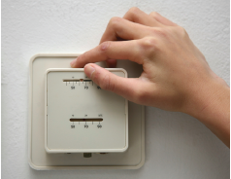
Black Box Analogy
A thermostat is a ‘black box’
Set a desired temperature
Turns on heater/AC as required
You don’t have to know how it really works!
How does it know the current temp?
What signals/commands does it send to the heater or A/C?
Use functions like ‘black boxes’
Pass the function what it needs to do its job
Receive the answer

Slide 12
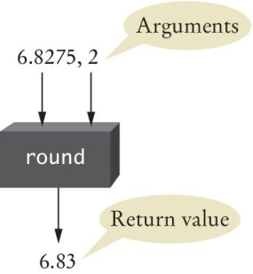
The round Function As A Black Box (1)
You pass the round function its necessary arguments (6.8275 & 2) and it produces its result (6.83).

Slide 13
The round Function As A Black Box (2)
You may wonder how the round function performs its job.
As a user of the function, you don’t need to know how the function is implemented. You just need to know the specification of the function: If you provide arguments x and n, the function returns x rounded to n decimal digits.

Slide 14
Designing Your Own Functions As Black Boxes
When you design your own functions, you will want to make them appear as black boxes to other programmers.
Even if you are the only person working on a program, making each function into a black box pays off: there are fewer details that you need to keep in mind.

Slide 15
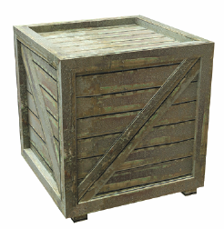
5.2 Implementing And Testing Functions
A function to calculate the volume of a cube
What does it need to do its job?
What does it answer with?
When writing (‘defining’) this function:
Pick a name for the function (cubeVolume).
Declare a variable for each incoming argument
(sideLength) (called parameter variables)
Put all this information together along with the def keyword to form the first line of the function’s definition:
This line is called the header of the function.
def cubeVolume(sideLength):

Slide 16
Testing a Function
If you run a program containing just the function definition, then nothing happens.
After all, nobody is calling the function.
In order to test the function, your program should contain
The definition of the function.
Statements that call the function and print the result.

Slide 17
Calling/Testing The Cube Function
Implementing the function (function definition)
def cubeVolume(sideLength) :
volume = sideLength ** 3
return volume
Calling/testing the function
result1 = cubeVolume(2)
result2 = cubeVolume(10)
print("A cube with side length 2 has volume", result1)
print("A cube with side length 10 has volume", result2)

Slide 18
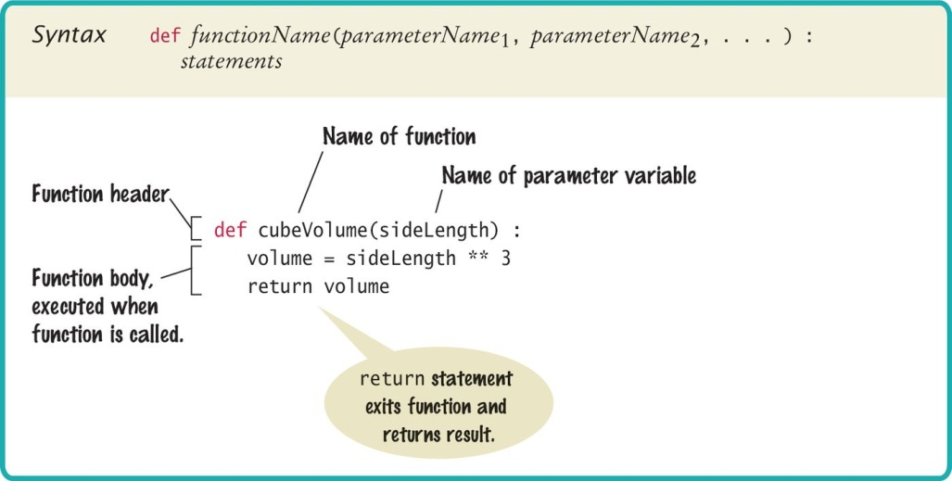
Syntax 5.1: Function Definition

Slide 19
Programming Tip 5.1: Function Comments
Whenever you write a function, you should comment its behavior.
Comments are for human readers, not compilers.
## Computes the volume of a cube.
# @param sideLength the length of a side of the cube
# @return the volume of the cube
#
def cubeVolume(sideLength) :
volume = sideLength ** 3
return volume
Function comments explain the purpose of the function, the meaning of the parameter variables and the return value, as well as any special requirements.

Slide 20
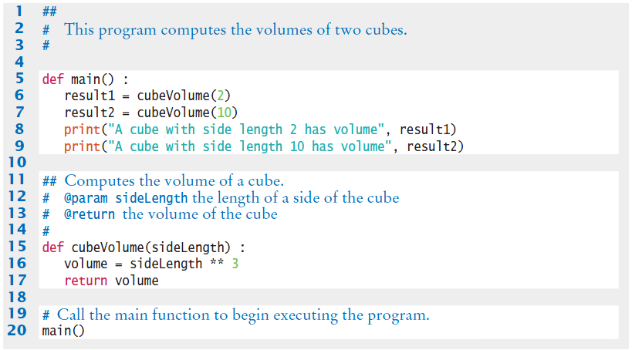

Cubes.py With Documentation

Slide 21
The main Function
When defining and using functions in Python, it is good programming practice to place all statements into functions, and to specify one function as the starting point.
Any legal name can be used for the starting point, but we chose ‘main’ since it is the required function name used by other common languages.
Of course, we must have one statement in the program that calls the main function.

Slide 22
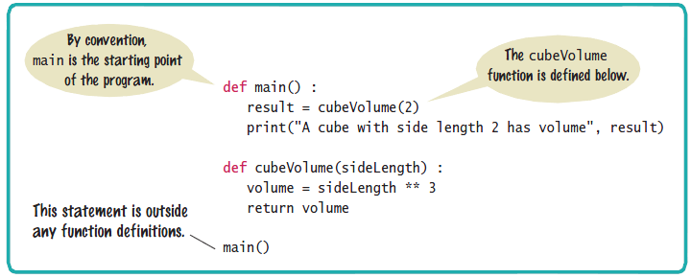
Syntax 5.2: The main Function

Slide 23
Using Functions: Order (1)
It is important that you define any function before you call it.
For example, the following will produce a compile-time error:
print(cubeVolume(10))
def cubeVolume(sideLength) :
volume = sideLength ** 3
return volume
The compiler does not know that the cubeVolume function will be defined later in the program.

Slide 24
Using Functions: Order (2)
However, a function can be called from within another function before the former has been defined. The following is perfectly legal:
def main() :
result = cubeVolume(2)
print("A cube with side length 2 has volume",
result)
def cubeVolume(sideLength) :
volume = sideLength ** 3
return volume
main()

Slide 25
5.3 Parameter Passing
Parameter variables receive the argument values supplied in the function call
The argument value may be:
The contents of a variable
A ‘literal’ value (2)
aka. ‘actual parameter’ or argument
The parameter variable is:
Declared in the called function
Initialized with the value of the argument value
Used as a variable inside the called function
aka. ‘formal parameter’
Calling function
Argument value
out
Parameter variable
in
Called function

Slide 26




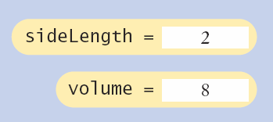
Parameter Passing Steps
result1 = cubeVolume(2)
def cubeVolume(sideLength):
volume = sideLength * 3
return volume

Slide 27

Common Error 5.1
Trying to modify parameter variables
A copy of the argument values is passed
Called function (addTax) can modify local copy (price)
But not original
in calling function
total
total = 10
addTax(total, 7.5);
copy
total
10.0
def addTax(price, rate):
tax = price * rate / 100
# No effect outside the function
price = price + tax
return tax;
price
10.75

Slide 28
Programming Tip 5.2
Do not modify parameter variables
Many programmers find this practice confusing.
def totalCents(dollars, cents) :
cents = dollars * 100 + cents # Modifies parameter variable.
return cents
To avoid the confusion, simply introduce a separate variable:
def totalCents(dollars, cents) :
result = dollars * 100 + cents
return result

Slide 29
5.4 Return Values
Functions can (optionally) return one value
Add a return statement that returns a value
A return statement does two things:
Immediately terminates the function
Passes the return value back to the calling function
def cubeVolume (sideLength):
volume = sideLength * 3
return volume
The return value may be a value, a variable or a calculation
return statement

Slide 30
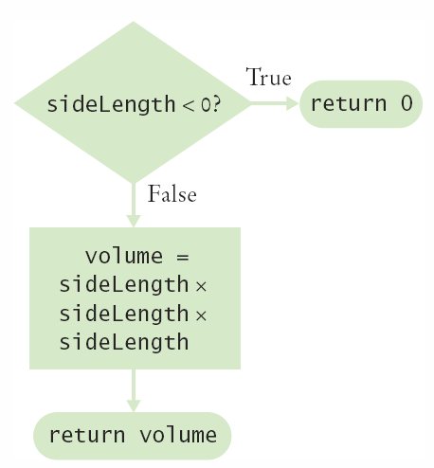
Multiple return Statements (1)
A function can use multiple return statements
But every branch must have a return statement
def cubeVolume(sideLength):
if (sideLength < 0):
return 0
return sideLength * 3

Slide 31
Multiple return Statements (2)
Alternative to multiple returns (e.g., one for each branch):
You can avoid multiple returns by storing the function result in a variable that you return in the last statement of the function.
For example:
def cubeVolume(sideLength) :
if sideLength >= 0:
volume = sideLength ** 3
else :
volume = 0
return volume

Slide 32
Make Sure A Return Catches All Cases (1)
Missing return Statement
Make sure all conditions are handled
In this case, sideLength could be equal to 0
No return statement for this condition
The compiler will not complain if any branch has no return statement
It may result in a run-time error because Python returns the special value None when you forget to return a value.
def cubeVolume(sideLength) :
if sideLength >= 0 :
return sideLength ** 3
# Error—no return value if sideLength < 0

Slide 33
Make Sure A Return Catches All Cases (2)
A correct implementation:
def cubeVolume(sideLength) :
if sideLength >= 0
return sideLength ** 3
else :
return 0

Slide 34
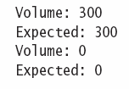
Implementing a function: Steps
Describe what the function should do.
Determine the function’s “inputs”.
Determine the types of parameter values and the return value.
Write pseudocode for obtaining the desired result.
Implement the function body.
Test your function.
Design test cases and code
def pyramidVolume(height, baseLength) :
baseArea = baseLength * baseLength
return height * baseArea / 3

Slide 35

5.5 functions Without Return Values
functions are not required to return a value
No return statement is required
The function can generate output though!
...
boxString("Hello")
...
def boxString(contents) :
n = len(contents) :
print("-" * (n + 2))
print("!" + contents + "!")
print("-" * (n + 2))

Slide 36
Using return Without a Value
You can use the return statement without a value
The function will terminate immediately!
def boxString(contents) :
n = len(contents)
if n == 0 :
return # Return immediately
print("-" * (n + 2))
print("!" + contents + "!")
print("-" * (n + 2))

Slide 37
5.6 Problem Solving: Reusable functions
Find Repetitive Code
May have different values but same logic
hours = int(input("Enter a value between 0 and 23: "))
while hours < 0 or hours > 23 :
print("Error: value out of range.")
hours = int(input("Enter a value between 0 and 23: "))
minutes = int(input("Enter a value between 0 and 59: "))
while minutes < 0 or minutes > 59 :
print("Error: value out of range.")
minutes = int(input("Enter a value between 0 and 59: "))
0 - 23
0 - 59

Slide 38
Write a ‘Parameterized’ function
## Prompts a user to enter a value up to a given maximum until the user provides
# a valid input.
# @param high an integer indicating the largest allowable input
# @return the integer value provided by the user (between 0 and high, inclusive)
#
def readIntUpTo(high) :
value = int(input("Enter a value between 0 and " + str(high) + ": "))
while value < 0 or value > high :
print("Error: value out of range.")
value = int(input("Enter a value between 0 and " + str(high) + ": "))
return value
23 or 59
8

Slide 39
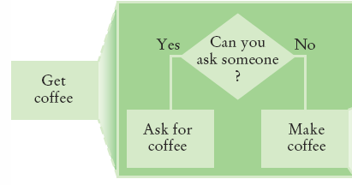
5.7 Problem Solving
Stepwise Refinement
To solve a difficult task, break it down into simpler tasks
Then keep breaking down the simpler tasks into even simpler ones, until you are left with tasks that you know how to solve

Slide 40
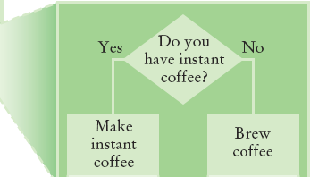
Get Coffee
If you must make coffee, there are two ways:
Make Instant Coffee
Brew Coffee

Slide 41
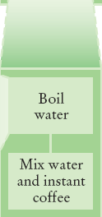
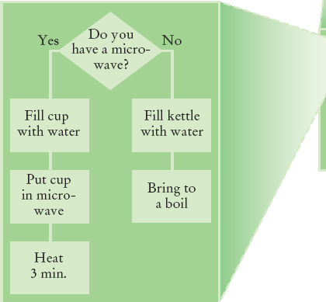
Instant Coffee
Two ways to boil water
1) Use Microwave
2) Use Kettle on Stove

Slide 42
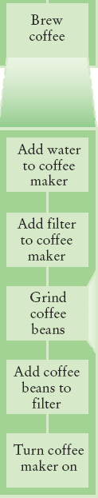
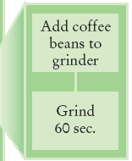
Brew Coffee
Assumes coffee maker
Add water
Add filter
Grind Coffee
Add beans to grinder
Grind 60 seconds
Fill filter with ground coffee
Turn coffee maker on
Steps are easily done

Slide 43
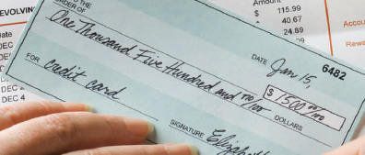
Stepwise Refinement Example
When printing a check, it is customary to write the check amount both as a number (“$274.15”) and as a text string (“two hundred seventy four dollars and 15 cents”). Write a program to turn a number into a text string.
Wow, sounds difficult!
Break it down
Let’s take the dollar part (274) and come up with a plan
Take an Integer from 0 – 999
Return a String
Still pretty hard…

Slide 44
Stepwise Refinement Example
Take it digit by digit (2, 7, 4) – left to right
Handle the first digit (hundreds)
If empty, we’re done with hundreds
Get first digit (Integer from 1 – 9)
Get digit name (“one”, “two ”, “three”…)
Add the word “ hundred”
Sounds easy!
Second digit (tens)
Get second digit (Integer from 0 – 9)
If 0, we are done with tens… handle third digit
If 1, … may be eleven, twelve.. Teens… Not easy!
Let’s look at each possibility left (1x-9x)…

Slide 45
Stepwise Refinement Example
If second digit is a 0
Get third digit (Integer from 0 – 9)
Get digit name (“”, “one”, “two”…) … Same as before?
Sounds easy!
If second digit is a 1
Get third digit (Integer from 0 – 9)
Return a String (“ten”, “eleven”, “twelve”…)
If second digit is a 2-9
Start with string “twenty”, “thirty”, “forty”…
Get third digit (Integer from 0 – 9)
Get digit name (“”, “one”, “two”…) … Same as before
Sounds easy!

Slide 46
Name the Sub-Tasks
digitName
Takes an Integer from 0 – 9
Return a String (“”, “one”, “two”…)
tensName (second digit >= 20)
Takes an Integer from 0 – 9
Return a String (“twenty”, “thirty”…) plus
digitName(third digit)
teenName
Takes an Integer from 0 – 9
Return a String (“ten”, “eleven”…)

Slide 47
Write Pseudocode
part = number (The part that still needs to be converted)
name = "" (The name of the number)
If part >= 100
name = name of hundreds in part + " hundred"
Remove hundreds from part.
If part >= 20
Append tensName(part) to name.
Remove tens from part.
Else if part >= 10
Append teenName(part) to name.
part = 0
If (part > 0)
Append digitName(part) to name.
Identify functions that we can use (or re-use!) to do the work.

Slide 48
Plan The functions
Decide on name, parameter(s) and types and return type
def intName (number):
Turns a number into its English name.
Returns a String that is the English description of a number (e.g., “seven hundred twenty nine”)
def digitName (digit):
Return a String (“”, “one”, “two”…)
def tensName (number):
Return a String (“twenty”, “thirty”…) plus
Return from digitName(thirdDigit)
def teenName (number):
Return a String (“ten”, “eleven”…)

Slide 49

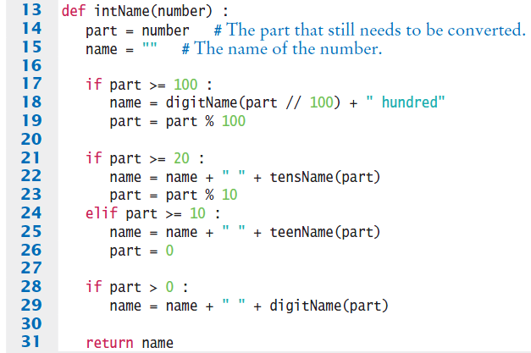
Convert to Python: intName function
main calls intName
Does all the work
Returns a String
Uses functions:
tensName
teenName
digitName

Slide 50
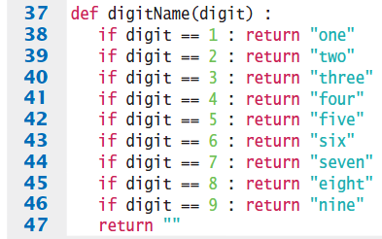
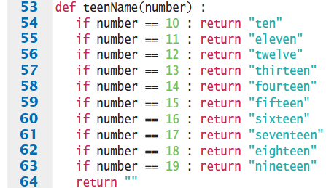
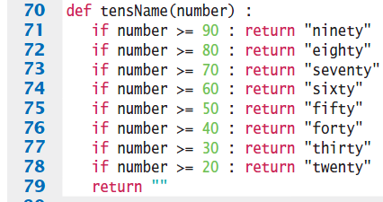

digitName, teenName, tensName

Slide 51
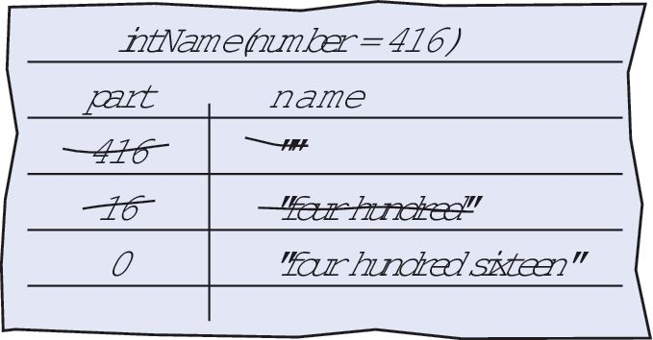

Programming Tips
Keep functions short
If more than one screen, break into ‘sub’ functions
Trace your functions
One line for each step
Columns for key variables
Use Stubs as you write larger programs
Unfinished functions that return a ‘dummy’ value
def digitName(digit):
return "mumble"

Slide 52
5.8 Variable Scope
The scope of a variable is the part of the program in which
it is visible.
Variables can be declared:
Inside a function
Known as ‘local variables’
Only available inside this function
Parameter variables are like local variables
Outside of a function
Sometimes called ‘global scope’
Can be used (and changed) by code in any function
How do you choose?

Slide 53
Examples of Scope
sum, square & i are local variables in main
def main() :
sum = 0
for i in range(11) :
square = i * i
sum = sum + square
print(square, sum)
sum
i
square
The scope of a variable is the part of the program in which
it is visible.

Slide 54
Local Variables of functions
Variables declared inside one function are not visible to other functions
sideLength is local to main
Using it outside main will cause a compiler error
def main():
sideLength = 10
result = cubeVolume()
print(result)
def cubeVolume():
return sideLength * sideLength * sideLength # ERROR

Slide 55
Re-using Names for Local Variables
Variables declared inside one function are not visible to other functions
result is local to square and result is local to main
They are two different variables and do not overlap
def square(n):
result = n * n
return result
def main():
result = square(3) + square(4)
print(result)
result
result

Slide 56
Global Variables
They are variables that are defined outside functions.
A global variable is visible to all functions that are defined after it.
However, any function that wishes to use a global variable must include a global declaration.

Slide 57
Example Use of a Global Variable
If you omit the global declaration, then the balance variable inside the withdraw function is considered a local variable.
balance = 10000 # A global variable
def withdraw(amount) :
# This function intends to access the
# global ‘balance’ variable
global balance
if balance >= amount :
balance = balance - amount

Slide 58

Programming Tip 5.6
There are a few cases where global variables are required (such as pi defined in the math module), but they are quite rare.
Programs with global variables are difficult to maintain and extend because you can no longer view each function as a “black box” that simply receives arguments and returns a result.
Instead of using global variables, use function parameter variables and return values to transfer information from one part of a program to another.

Slide 59
5.9 Recursive functions (Optional)
A recursive function is a function that calls itself
A recursive computation solves a problem by using the solution of the same problem with simpler inputs
For a recursion to terminate, there must be special cases for the simplest inputs

Slide 60
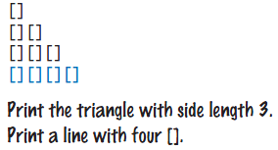
Recursive Triangle Example
def printTriangle(sideLength) :
if sideLength < 1 : return
printTriangle(sideLength - 1)
print("[]" * sideLength)
Special Case
Recursive Call
The function will call itself (and not output anything) until sideLength becomes < 1
It will then use the return statement and each of the previous iterations will print their results
1, 2, 3 then 4

Slide 61
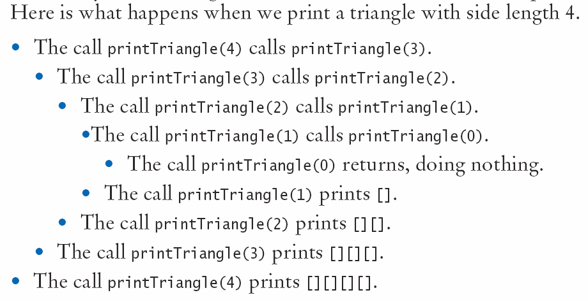
Recursive Calls and Returns

Slide 62
Summary: functions
A function is a named sequence of instructions.
Arguments are supplied when a function is called.
The return value is the result that the function computes.
When declaring a function, you provide a name for the function and a variable for each argument.
Function comments explain the purpose of the function, the meaning of the parameters and return value, as well as any special requirements.
Parameter variables hold the arguments supplied in the function call.

Slide 63
Summary: function Returns
The return statement terminates a function call and yields the function result.
Complete computations that can be reused into functions.
Use the process of stepwise refinement to decompose complex tasks into simpler ones.
When you discover that you need a function, write a description of the parameter variables and return values.
A function may require simpler functions to carry out its work.

Slide 64
Summary: Scope
The scope of a variable is the part of the program in which it is visible.
Two local or parameter variables can have the same name, provided that their scopes do not overlap.
You can use the same variable name within different functions since their scope does not overlap.
Local variables declared inside one function are not visible to code inside other functions

Slide 65
Summary: Recursion
A recursive computation solves a problem by using the solution of the same problem with simpler inputs.
For recursion to terminate, there must be special cases for the simplest inputs.
The key to finding a recursive solution is reducing the input to a simpler input for the same problem.
When designing a recursive solution, do not worry about multiple nested calls. Simply focus on reducing a problem to a slightly simpler one.

