Slide 1

6
CHAPTER
Lists
Slides by James Tam
Department of Computer Science,
University of Calgary
May 9, 2013

Slide 2
Chapter Goals
To collect elements using lists
To use the for loop for traversing lists
To learn common algorithms for processing lists
To use lists with functions
To work with tables of data
In this chapter, you will learn about lists and common algorithms for processing them.

Slide 3

Contents
Basic properties of lists
List operations
Common list algorithms
Using lists with functions
Problem solving: Adapting algorithms
Problem solving: Discovering algorithms by manipulating physical objects
Tables

Slide 4

6.1 Lists
A Computer Program often needs to store a sequence of values and then process them
For example, if you had this sequence of values, how many variables would you need?
input1, input2, input3….
Lists to the rescue!
An List collects sequences of values.

Slide 5
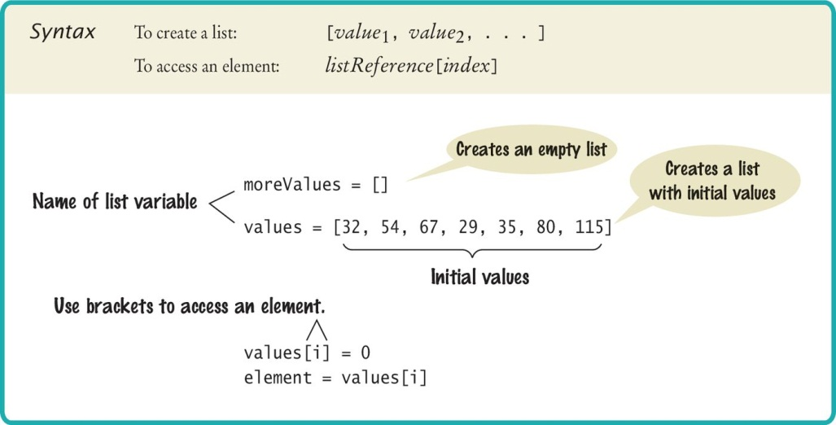
Creating a List
Specify a list variable with the subscript operator []

Slide 6
Accessing List Elements
A list is a sequence of elements, each of which has an integer position or index.
To access a list element, you specify which index you want to use. That is done with the subscript operator in the same way that you access individual characters in a string.
Accessing list elements
Replacing list elements
print(values[5])
values[5] = 87

Slide 7
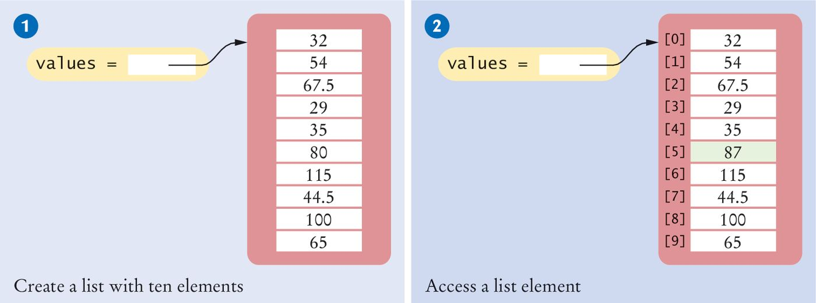
Creating Lists/Accessing Elements
# 1: Creating a list
values = [32, 54, 67.5, 29, 35, 80, 115, 44.5, 100, 65]
# 2: Accessing a list element
values[5] = 87

Slide 8
Lists Vs. Strings (1)
Both lists and strings are sequences, and the [] operator can be used to access an element in any sequence.
There are two differences between lists and strings:
Lists can hold values of any type, whereas strings are sequences of characters.
Moreover:
strings are immutable— you cannot change the characters in the sequence.
Lists are mutable.

Slide 9
Lists Vs. Strings (2)
Lists are mutable (continued)
As you just saw in a previous example result of the operation:
values[5] = 87
…the element at index 5 is filled with 87

Slide 10
Lists Vs. Strings (3)
As with strings, list indexes start at 0. That is, the legal elements for the values list are
values[0], the first element
values[1], the second element
values[2], the third element
values[3], the fourth element
values[4], the fifth element
. . .
values[9], the tenth element

Slide 11
List Boundaries
You have to be careful that the index stays within the valid range.
Attempting to access an element whose index is not within the valid index range is called an out-of-range error or a bounds error. When an out-of-range error occurs at run time, it causes a run-time exception.
Here is a very common bounds error (10 element list):
values[10] = number

Slide 12
Determining List Length
You can use the len() function to obtain the length of the list; that is, the number of elements:
The following code ensures that you only access the list when the index variable i is within the legal bounds:
numElements = len(values)
if 0 <= i and i < len(values) :
values[i] = number

Slide 13
Using The Square Brackets
Note that there are two distinct uses of the square brackets. When the square brackets immediately follow a variable name, they are treated as the subscript operator:
When the square brackets do not a follow a variable name, they create a list:
values[4]
values = [4]

Slide 14
Traversing Lists
There are two fundamental ways of visiting all elements of a list:
You can loop over the index values and look up each element.
You can loop over the elements themselves.

Slide 15
Loop Over the Index Values
Given the values list that contains 10 elements, we will want to set a variable, say i, to 0, 1, 2, and so on, up to 9.
# First version (list index used)
for i in range(10) :
print(i, values[i])
# Better version (list index used)
for i in range(len(values)) :
print(i, values[i])
# Third version: index values not needed (traverse
# list elements)
for element in values :
print(element)

Slide 16

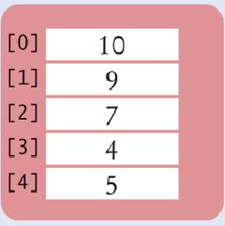
List References
Make sure you see the difference between the:
List variable: The named ‘alias’ to the list
List contents: Memory where the values are stored
values = [32, 54, 67.5, 29, 35, 80, 115, 44.5, 100, 65]
List variable
List contents
Reference
A list variable contains a reference to the list contents. The reference is the location of the list contents (in memory).
Values

Slide 17
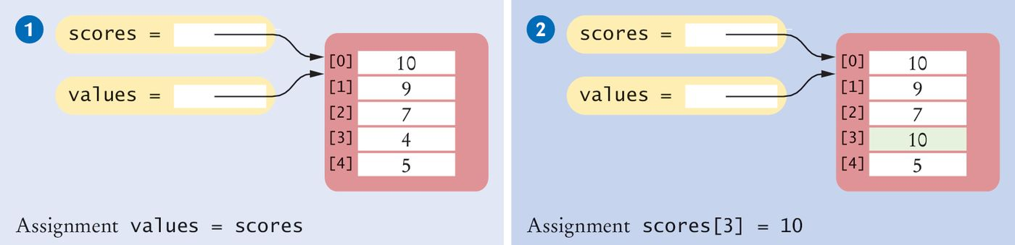
List Aliases
When you copy a list variable into another, both variables refer to the same list.
The second variable is an alias for the first because both variables reference the same list.
scores = [10, 9, 7, 4, 5]
values = scores # Copying list reference
List contents
A list variable specifies the location of a list. Copying the reference yields a second reference to the same list.
References

Slide 18
Modifying Aliased Lists
You can modify the list through either of the variables:
scores[3] = 10
print(values[3]) # Prints 10

Slide 19

Common Error 6.1
Out-of-Range Errors:
Perhaps the most common error in using lists is accessing a nonexistent element.
If your program accesses a list through an out-of-range index, the program will generate an exception at run time.
values = [2.3, 4.5, 7.2, 1.0, 12.2, 9.0, 15.2, 0.5]
values[8] = 5.4
# Error––values has 8 elements,
# and the index can range from 0 to 7

Slide 20
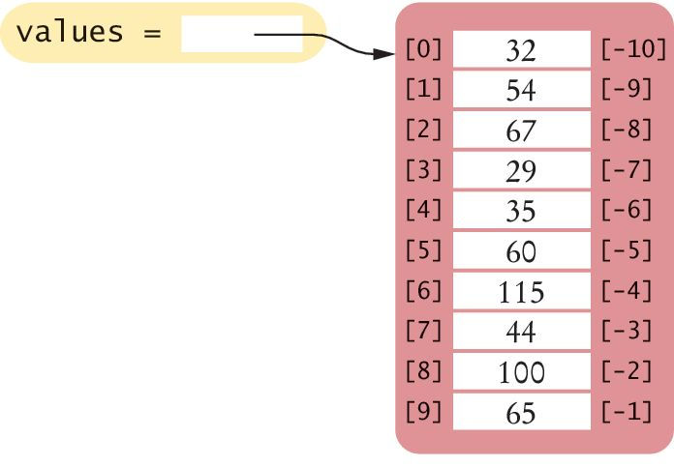
Reverse Subscripts
In Python, unlike other languages, uses negative subscripts to provide access to the list elements in reverse order.
For example, a subscript of –1 provides access to the last element in the list:
Similarly, values[-2] is the second-to-last element.
last = values[-1]
print("The last element in the list is", last)

Slide 21
6.2 List Operations
Appending Elements
Inserting an Element
Finding an Element
Removing an Element
Concatenation
Equality / Inequality Testing
Sum, Maximum, Minimum, and Sorting
Copying Lists

Slide 22
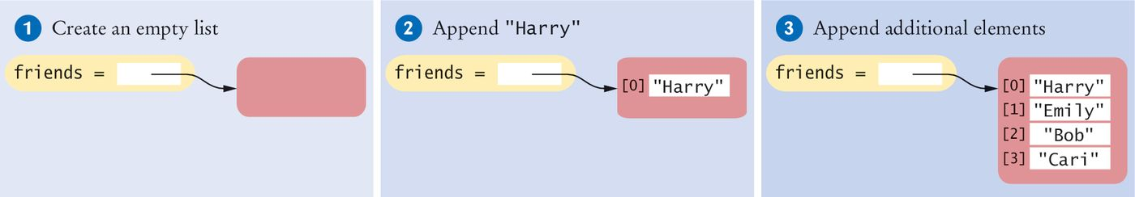
Appending Elements
Sometimes we may not know the values that will be contained in the list when it’s created.
In this case, we can create an empty list and add elements to the end as needed.
#1
friends = []
#2
friends.append("Harry")
#3
friends.append("Emily")
friends.append("Bob")
friends.append("Cari")

Slide 23
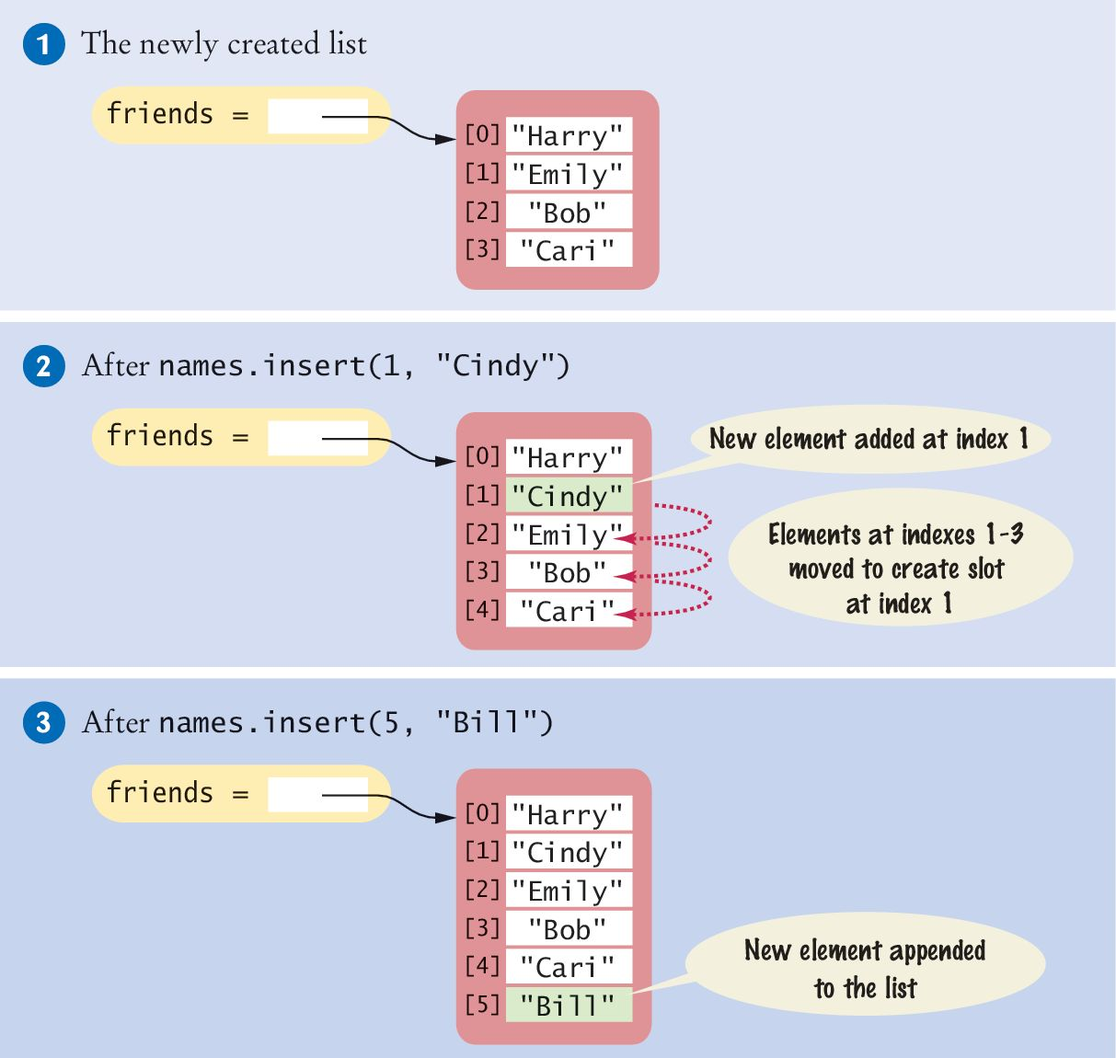
Inserting an Element
Sometimes the order in which elements are added to a list is important.
A new element has to be inserted at a specific position in the list.
#1
friends = ["Harry", "Emily", "Bob", "Cari"]
#2
friends.insert(1, "Cindy")

Slide 24
Finding an Element
If you simply want to know whether an element is present in a list, use the in operator:
Often, you want to know the position at which an element occurs.
The index() method yields the index of the first match.
if "Cindy" in friends :
print("She's a friend")
friends = ["Harry", "Emily", "Bob", "Cari", "Emily"]
n = friends.index("Emily") # Sets n to 1

Slide 25
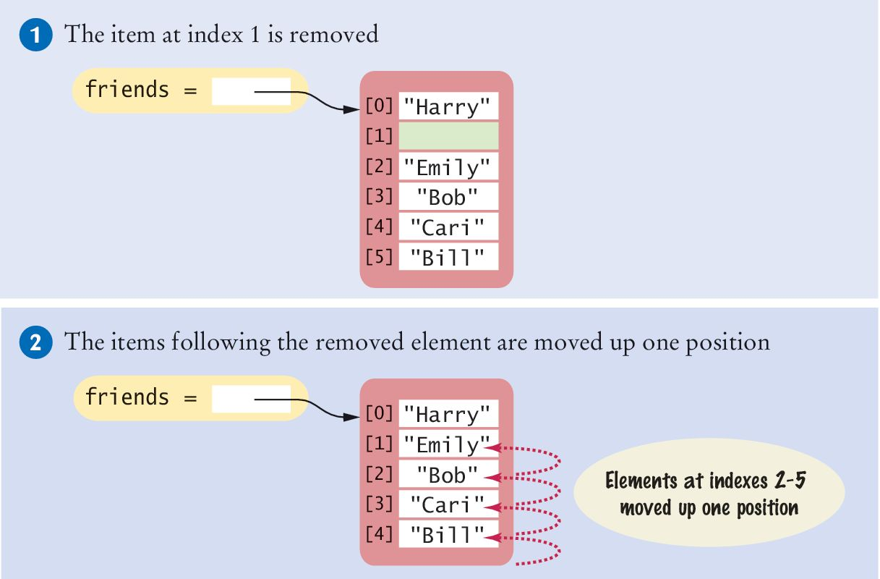
Removing an Element
The pop() method removes the element at a given position.
All of the elements following the removed element are moved up one position to close the gap.
The size of the list is reduced by 1
friends = ["Harry", "Cindy", "Emily", "Bob", "Cari",
"Bill"]
friends.pop(1)

Slide 26
Concatenation
The concatenation of two lists is a new list that contains the elements of the first list, followed by the elements of the second.
Two lists can be concatenated by using the plus (+) operator:
myFriends = ["Fritz", "Cindy"]
yourFriends = ["Lee", "Pat", "Phuong"]
ourFriends = myFriends + yourFriends
# Sets ourFriends to ["Fritz", "Cindy", "Lee", "Pat", "Phuong"]

Slide 27
Equality / Inequality Testing
You can use the == operator to compare whether two lists have the same elements, in the same order.
The opposite of == is !=.
[1, 4, 9] == [1, 4, 9] # True
[1, 4, 9 ] == [4, 1, 9] # False.
[1, 4, 9] != [4, 9] # True.

Slide 28
Sum, Maximum, Minimum
If you have a list of numbers, the sum() function yields the sum of all values in the list.
For a list of numbers or strings, the max() and min() functions return the largest and smallest value:
sum([1, 4, 9, 16]) # Yields 30
max([1, 16, 9, 4]) # Yields 16
min("Fred", "Ann", "Sue") # Yields "Ann"

Slide 29
Sorting
The sort() method sorts a list of numbers or strings.
values = [1, 16, 9, 4]
values.sort() # Now values is [1, 4 , 9, 16]

Slide 30
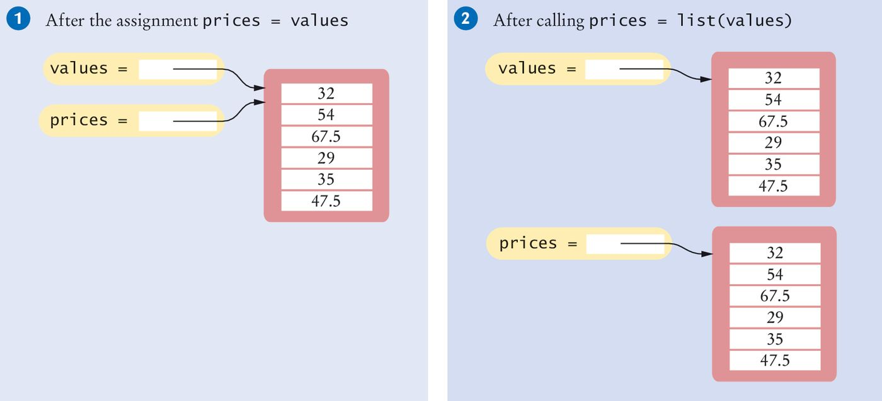
Copying Lists (1)
As discussed, list variables do not themselves hold list elements.
They hold a reference to the actual list.
If you copy the reference, you get another reference to the same list:
prices = values

Slide 31
Copying Lists (2)
Sometimes, you want to make a copy of a list; that is, a new list that has the same elements in the same order as a given list.
Use the list() function:
prices = list(values)

Slide 32
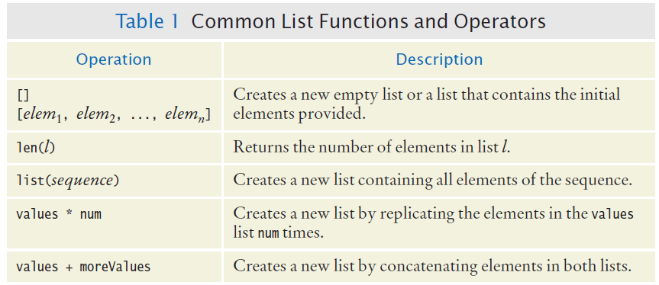
Common List Functions And Operators (1)

Slide 33
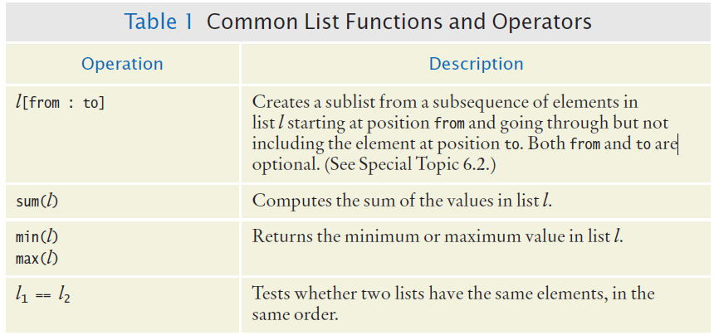
Common List Functions And Operators (2)

Slide 34
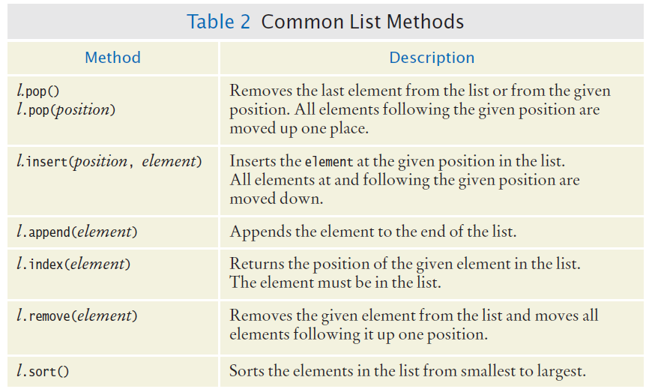
Common List Methods

Slide 35
List Slicing
Sometimes you want to look at a part of a list.
The arguments for the slice operator are the first index to include in the slice, followed by the first index to exclude.
Example: You are interested in the temperatures only for the third quarter, with index values 6, 7, and 8.
temperatures = [18, 21, 24, 28, 33, 39, 40, 39, 36, 30, 22, 18]
secondQuarter = temperatures[6 : 9]
Slices work with all sequences (strings), not just lists.

Slide 36
6.3 Common List Algorithms
Filling a List
Combining List Elements
Element Separators
Maximum and Minimum
Linear Search
Collecting and Counting Matches
Removing Matches
Swapping Elements
Reading Input

Slide 37
Filling a List
This loop creates and fills a list with squares (0, 1, 4, 9, 16, ...).
values = []
for i in range(n) :
values.append(i * i)

Slide 38
Combining List Elements
Here is how to compute a sum of numbers:
To concatenate strings, you only need to change the initial value:
result = 0.0
for element in values :
result = result + element
result = ""
for element in names :
result = result + element

Slide 39
Element Separators (1)
When you display the elements of a list, you usually want to separate them, often with commas or vertical lines, like this:
Harry, Emily, Bob

Slide 40
Element Separators (2)
Add the separator before each element (there’s one fewer separator than there are numbers) in the sequence except the initial one (with index 0), like this:
for i in range(len(names)) :
if i > 0 :
result = result + ", "
result = result + names[i]

Slide 41
Element Separators (3)
If you want to print values without adding them to a string:
for i in range(len(values)) :
if i > 0 :
print(" | ", end="")
print(values[i], end="")
print()

Slide 42
Maximum and Minimum
Here is the implementation of the max algorithm (already covered in Chapter 4, this one is just specific to a list):
largest = values[0]
for i in range(1, len(values)) :
if values[i] > largest :
largest = values[i]

Slide 43
Linear Search
Finding the first value that is > 100. You need to visit all elements until you have found a match or you have come to the end of the list:
limit = 100
pos = 0
found = False
while pos < len(values) and not found :
if values[pos] > limit :
found = True
else :
pos = pos + 1
if found :
print("Found at position:", pos)
else :
print("Not found")
A linear search
inspects elements
in sequence until a
match is found.

Slide 44
Collecting and Counting Matches
Collecting all matches
Counting matches
limit = 100
result = []
for element in values :
if (element > limit) :
result.append(element)
limit = 100
counter = 0
for element in values :
if (element > limit) :
counter = counter + 1

Slide 45
Removing Matches
Remove all elements that match a particular condition.
Example: remove all strings of length < 4 from a list.
i = 0
while i < len(words) :
word = words[i]
if len(word) < 4 :
words.pop(i)
else :
i = i + 1

Slide 46

Swapping Elements (1)
For example, you can sort a list by repeatedly swapping elements that are not in order.
Swap the elements at positions i and j of a list values.
We’d like to set values[i] to values[j]. But that overwrites the value that is currently stored in values[i], so we want to save that first:
Before moving a new value into a location (say blue) copy blue’s value elsewhere and then move black’s value into blue. Then move the temporary value (originally in blue) into black.

Slide 47
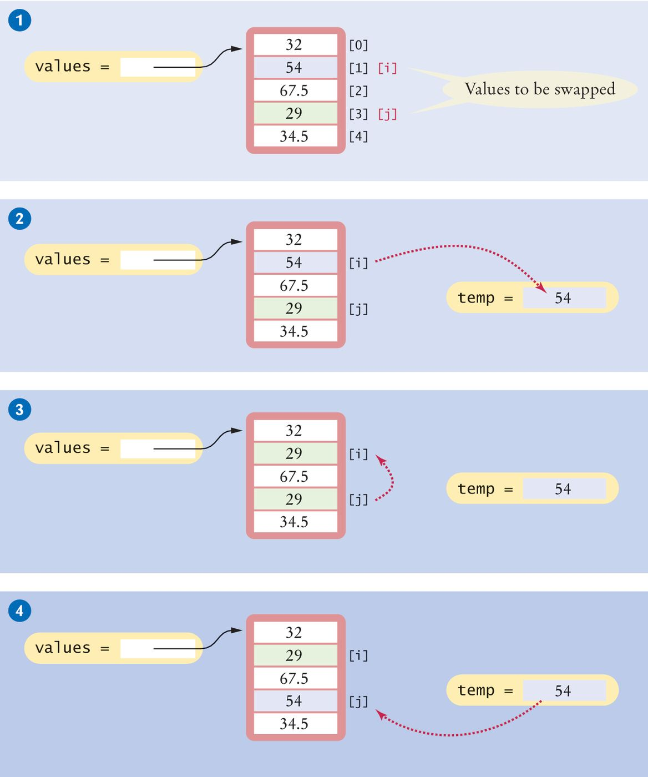
Swapping Elements (2)
Swapping elements [1] and [3]
This sets up the scenario for the actual code that will follows.

Slide 48
Swapping Elements (3)
# Step 2
temp = values[i]
# Step 3
values[i] = values[j]

Slide 49
Swapping Elements (4)
# Step 4
# temp contains values[i]
values[j] = temp

Slide 50
Reading Input
It is very common to read input from a user and store it in a list for later processing.
values = []
print("Please enter values, Q to quit:")
userInput = input("")
while userInput.upper() != "Q" :
values.append(float(userInput))
userInput = input("")
Program execution
Please enter values, Q to quit:
32
29
67.5
Q

Slide 51
6.4: Using Lists With Functions
A function can accept a list as an argument.
The following function visits the list elements, but it does not modify them.
def sum(values) :
total = 0
for element in values :
total = total + element
return total

Slide 52
Modifying List Elements
The following function multiplies all elements of a list by a given factor:
def multiply(values, factor) :
for i in range(len(values)) :
values[i] = values[i] * factor

Slide 53
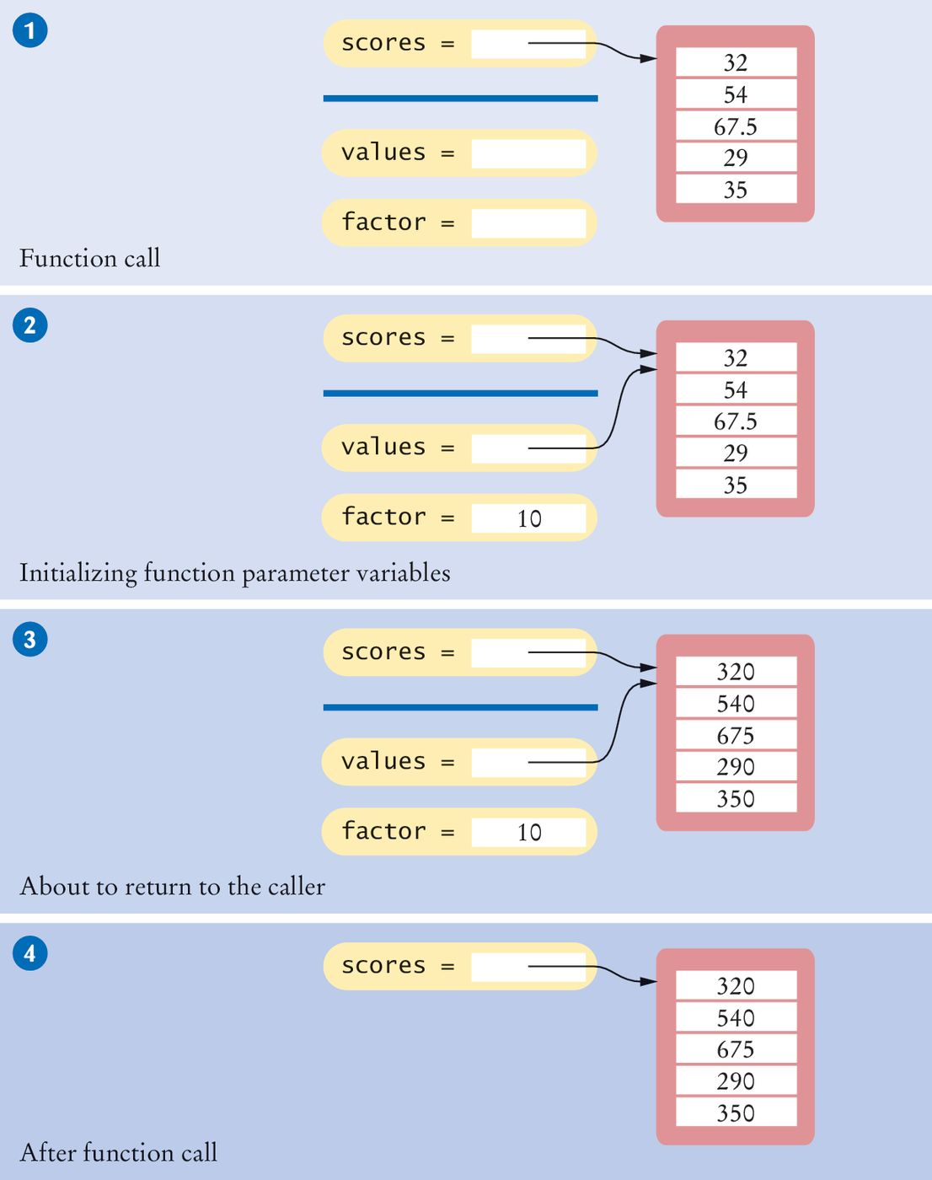
Example: Step 1
The parameter variables values and factor are created.

Slide 54
Example: Step 2
The parameter variables are initialized with the arguments that are passed in the call.
In our case, values is set to scores and factor is set to 10.
Note that values and scores are references to the same list.
# Function call
multiply(scores, 10)

Slide 55
Example: Step 3
The function multiplies all list elements by 10.
def multiply(values, factor) :
for i in range(len(values)) :
values[i] = values[i] * factor

Slide 56
Example: Step 4
The function returns. Its parameter variables are removed.
However, scores still refers to the list with the modified elements.

Slide 57
Returning Lists From Functions
Simply build up the result in the function and return it.
In this example, the squares() function returns a list of squares from 0² up to (n – 1)²:
def squares(n) :
result = []
for i in range(n) :
result.append(i * i)
return result

Slide 58
Call By: Value Vs. Reference
Call by value:
When the contents of a variable that was passed to a function can never be changed by that function.
Call by reference:
Function can change the arguments of a method call.
A Python method can mutate the contents of a list when it receives an reference to it (see the “Modifying List Elements” slides and Figure 8 in the text).

Slide 59
Tuples
Similar to a list, but once created, its contents cannot be modified (immutable version of a list).
A tuple is created by specifying its contents as a comma-separated sequence. You can enclose the sequence in parentheses:
If you prefer, you can omit the parentheses:
triple = (5, 10, 15)
triple = 5, 10, 15

Slide 60
Returning Multiple Values
It is common practice in Python, however, to use tuples to return multiple values.
# Function definition
def readDate() :
print("Enter a date:")
month = int(input(" month: "))
day = int(input(" day: "))
year = int(input(" year: "))
return (month, day, year) # Returns a tuple.
# Function call: assign entire value to a tuple
date = readDate()
# Function call: use tuple assignment:
(month, day, year) = readDate()

Slide 61
6.5 Problem Solving:
Adapting Algorithms
Consider this example problem: You are given the quiz scores of a student. You are to compute the final quiz score, which is the sum of all scores after dropping the lowest one.
For example, if the scores are
8 7 8.5 9.5 7 5 10
then the final score is 50.

Slide 62

Adapting a Solution
What steps will we need?
Find the minimum.
Remove it from the list.
Calculate the sum.
What tools do we know?
Finding the minimum value (Section 6.3.4)
Removing matches (Section 6.3.7)
Calculating the sum (Section 6.4)
But wait… We need to find the POSITION of the minimum value, not the value itself..
Hmmm. Time to adapt

Slide 63


Planning a Solution
Refined Steps:
Find the minimum value.
Find it’s position.
Remove it from the list.
Calculate the sum.
Let’s try it
Find the position of the minimum:
At position 5
Remove it from the list
Calculate the sum

Slide 64
Adapting the code
Adapt smallest value to smallest position:
Original algorithm
smallest = values[0]
for i in range(1, len(values)) :
if values[i] < smallest :
smallest = values[i]
Adapted algorithm
smallestPosition = 0
for i in range(1, len(values)) :
if values[i] < values[smallestPosition] :
smallestPosition = i

Slide 65



6.6: Problem Solving
Discovering Algorithms by
Manipulating Physical Objects
Consider this example problem: You are given a list whose size is an even number, and you are to switch the first and the second half.
For example, if the list contains the eight numbers
Rearrange it to:

Slide 66

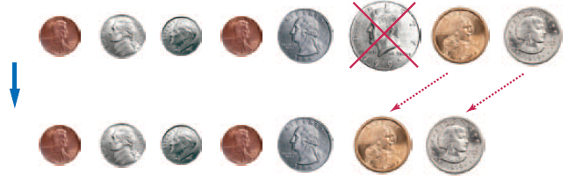
Manipulating Objects
One useful technique for discovering an algorithm is to manipulate physical objects
Start by lining up some objects to denote an array
Coins, playing cards, or small toys are good choices
Visualize removing one object

Slide 67
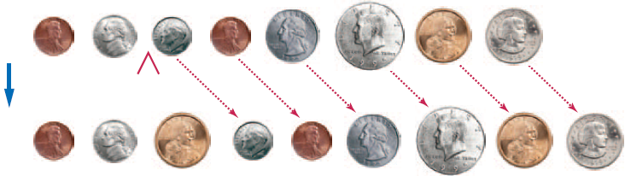
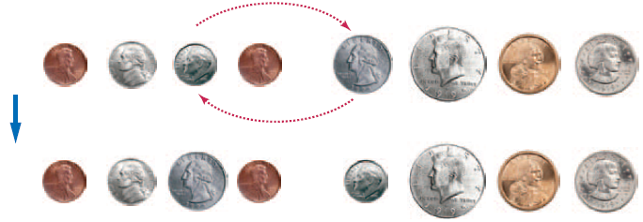
Manipulating Objects
Visualize inserting one object
How about swapping two coins?

Slide 68
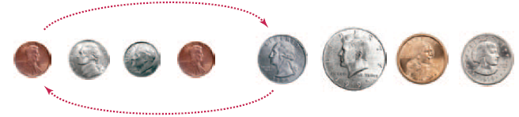
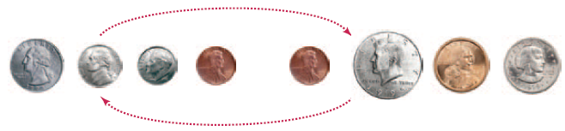
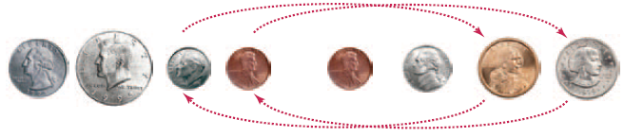
Manipulating Objects
Back to our original problem. Which tool(s) to use?
How about swapping two coins? Four times?

Slide 69
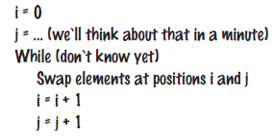
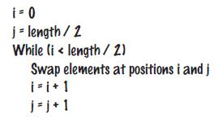
Develop an Algorithm
Pick two locations (indexes) for the first swap and start a loop
How can j be set to handle any number of items?
… if size is 8, j is index 4…
And when do we stop our loop?...
i
j
(size / 2)
Also (size / 2)

Slide 70
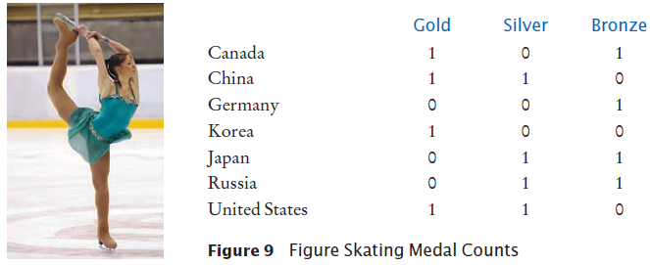
6.7 Tables
Lists can be used to store data in two dimensions (2D) like a spreadsheet
Rows and Columns
Also known as a ‘matrix’

Slide 71
Creating Tables (1)
Here is the code for creating a table that contains 7 rows and 3 columns, which is suitable for holding our medal count data:
COUNTRIES = 7
MEDALS = 3
counts = [
[ 1, 0, 1 ],
[ 1, 1, 0 ],
[ 0, 0, 1 ],
[ 1, 0, 0 ],
[ 0, 1, 1 ],
[ 0, 1, 1 ],
[ 1, 1, 0 ]
]

Slide 72
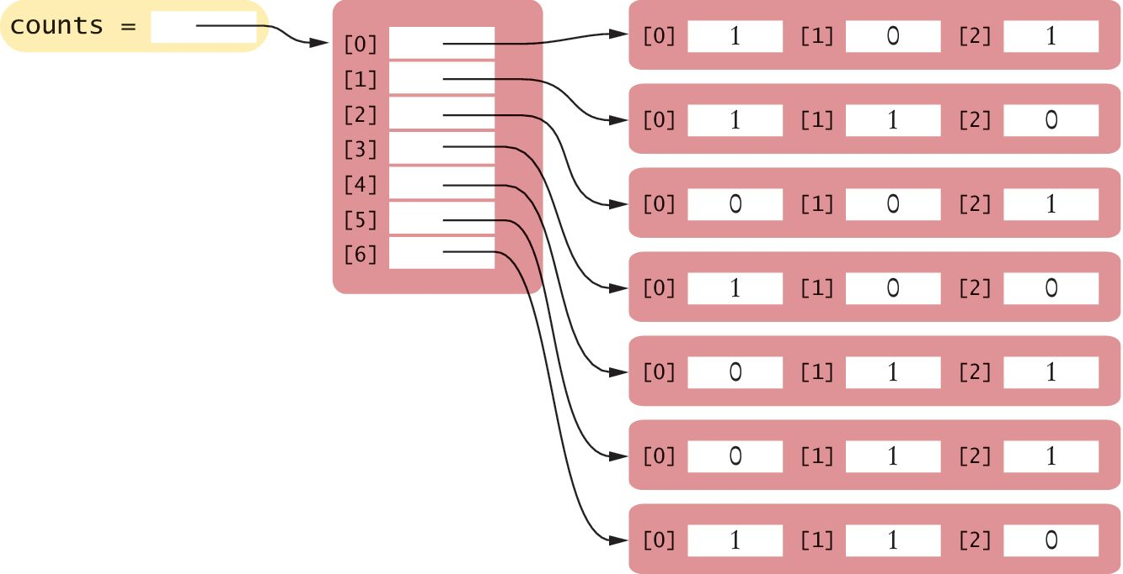
Creating Tables (2)
This creates a list in which each element is itself another list:

Slide 73
Creating Tables (3)
Sometimes, you may need to create a table with a size that is too large to initialize with literal values.
First, create a list that will be used to store the individual rows.
table = []

Slide 74
Creating Tables (4)
Then create a new list using replication (with the number of columns as the size) for each row in the table and append it to the list of rows:
The result is a table that consists of 5 rows and 20 columns.
ROWS = 5
COLUMNS = 20
for i in range(ROWS) :
row = [0] * COLUMNS
table.append(row)

Slide 75
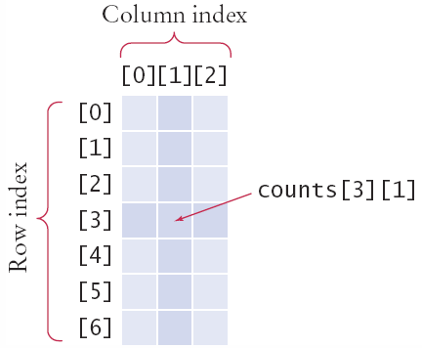
Accessing Elements
Use two index values:
Row then Column
To print
Use nested for loops
Outer row(i) , inner column(j) :
medalCount = counts[3][1]
for i in range(COUNTRIES):
# Process the ith row
for j in range(MEDALS) :
# Process the jth column in the ith row
print("%8d" % counts[i][j], end="")
print() # Start a new line at the end of the row

Slide 76
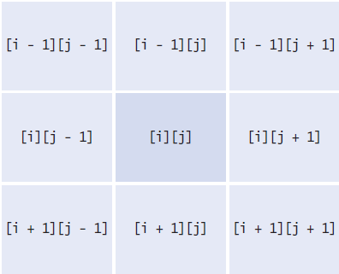
Locating Neighboring Elements
Some programs that work with two-dimensional lists need to locate the elements that are adjacent to an element
This task is particularly common in games
You are at loc i, j
Watch out for edges!
No negative indexes!
Not off the ‘board’

Slide 77
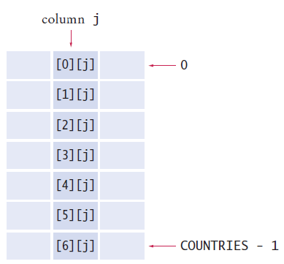
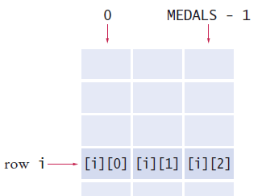
Adding Rows and Columns
Rows (x) Columns (y)
total = 0
for j in range(MEDALS):
total = total + counts[i][j]
total = 0
for i in range(MEDALS):
total = total + counts[i][j]

Slide 78
Using Tables With Functions
When you pass a table to a function, you will want to recover the dimensions of the table. If values is a table, then:
len(values) is the number of rows.
len(values[0]) is the number of columns.
For example, the following function computes the sum of all elements in a table:
def sum(values) :
total = 0
for i in range(len(values)) :
for j in range(len(values[0])) :
total = total + values[i][j]
return total

Slide 79
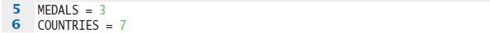
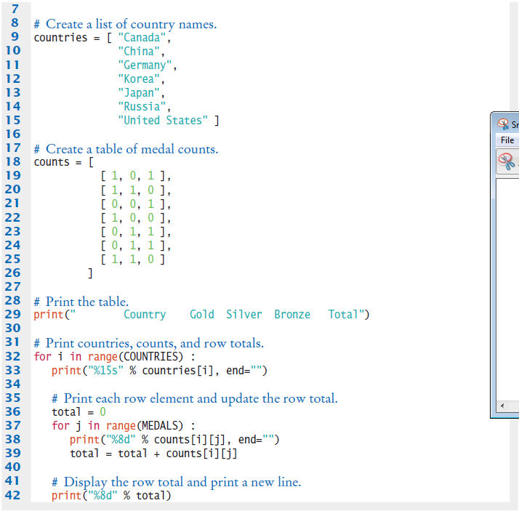
Tables And Functions: Medals.py (1)

Slide 80
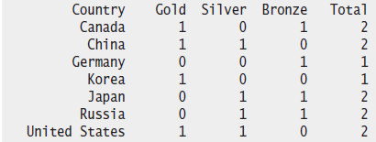
Tables And Functions: Medals.py (2)
Program execution

Slide 81
Summary: Lists
A list is a container that stores a sequence of values.
Each individual element in a list is accessed by an integer index i, using the notation list[i].
A list index must be at least zero and less than the number of elements in the list.
An out-of-range error, which occurs if you supply an invalid list index, can cause your program to terminate.
You can iterate over the index values or the elements of a list.

Slide 82
Summary: Lists
A list reference specifies the location of a list. Copying the reference yields a second reference to the same list.
A linear search inspects elements in sequence until a match is found.
Use a temporary variable when swapping elements.
Lists can occur as function parameters and return values.

Slide 83
Summary: Lists
When calling a function with a list argument, the function receives a list reference, not a copy of the list.
A tuple is created as a comma-separated sequence enclosed in parentheses.
By combining fundamental algorithms, you can solve complex programming tasks.
You should be familiar with the implementation of fundamental algorithms so that you can adapt them.
Discover algorithms by manipulating physical objects.

Slide 84
Summary: Lists
Use a two-dimensional list to store tabular data.
Individual elements in a two-dimensional list are accessed by using two index values, table[i][j]

Slide 85
Built-In Operations For Lists
Use the insert() method to insert a new element at any position in a list.
The in operator tests whether an element is contained in a list.
Use the pop() method to remove an element from any position in a list.
Use the remove() method to remove an element from a list by value.
Two lists can be concatenated using the plus (+) operator.
Use the list() function to copy lists.

Slide 86
Built-In Operations For Lists
Use the slice operator (:) to extract a sublist or substrings.

