Slide 1
Projects Ideas
Submitted by:
18101018- Rumman Ahmed Prodhan
18101017- Muhammad Bin Mujib
18101025- Tanveer Ahamed Rabby

Slide 2
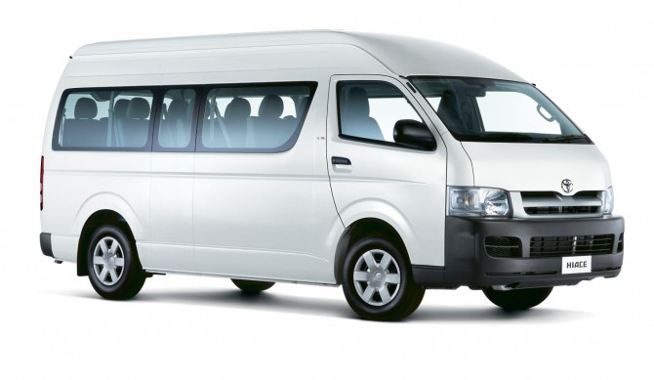
Affordable Ride Sharing Service (Microbus)
A ride sharing service that everyone can afford

Slide 3
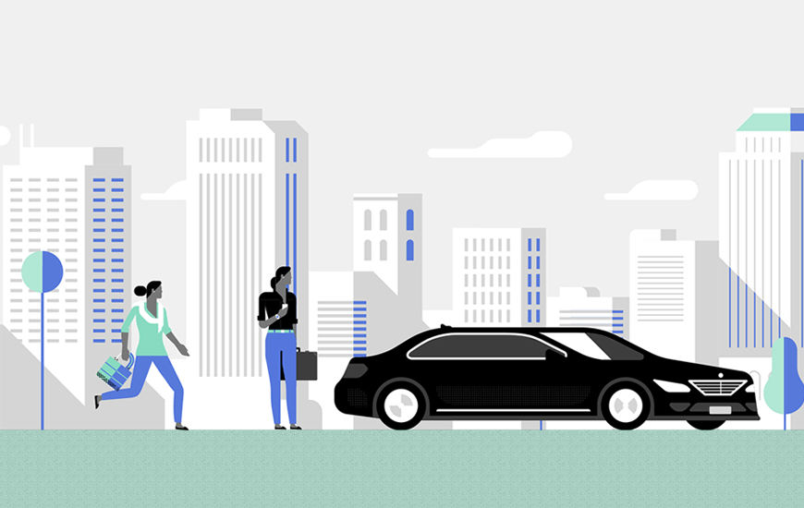
Statement
Many people don’t want the hassle of public transportation and can’t afford their own vehicle and the available ride sharing services is too expensive for them. So our ride sharing service will fill the gap for those people. Our service will be cheaper than other ride sharing services and a lot more hassle free compared to public transportation.

Slide 4

Features of the System
Book your seat in advance.
Pay via cash, card or mobile banking.
Money back guarantee if the ride don’t arrive by the given approximate time.
Book ride for others.
App for android and ios
Full surveillance camera for passenger security
Monitoring live location

Slide 5
Updated Features
Seat cancelation system
Special features for girls and disable people
Add a complaint/user rating services
Details information about driver and vehicle
Details information about route and traffic

Slide 6

Requirement Analyses
For our better development we have started a survey among the people. We asked them some questions that would help us to analyze the system requirements . We are glad that about more than 40 people have responded to us.
We just divided our questions into one section:
Customer(user)
And we asked two different type of questions
Close ended
Open ended

Slide 7
Open ended Question
Where do you live? (present)
On which route you want to use our service? (e.g. Mirpur 1 to Farmgate)
How much are you willing to pay for our service compared to other ride sharing services? (e.g. 5% cheaper)
Do you want to suggest us something that we might add?

Slide 8
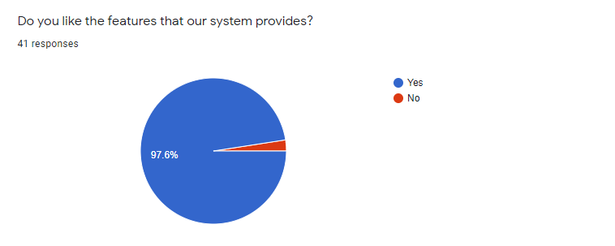
People’s responses

Slide 9
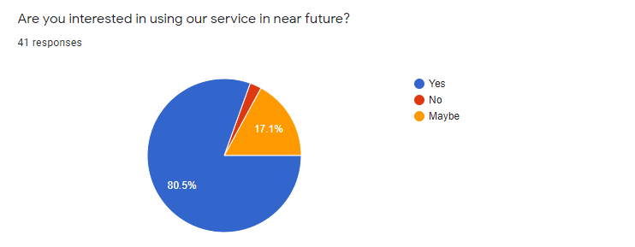

Slide 10
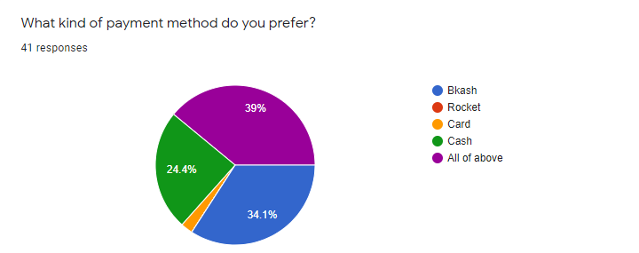

Slide 11
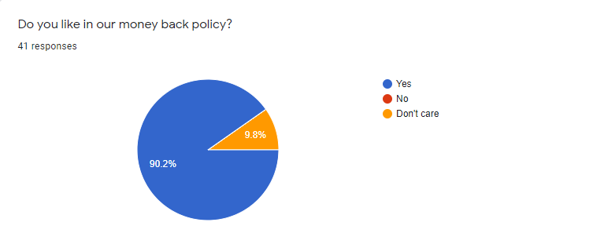

Slide 12
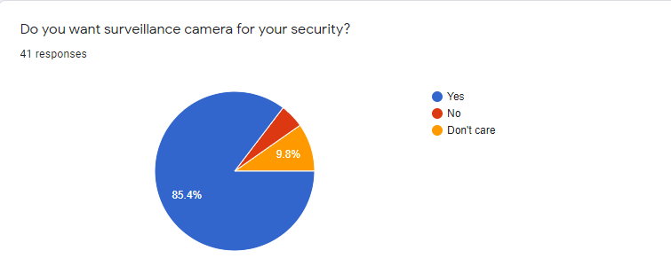

Slide 13
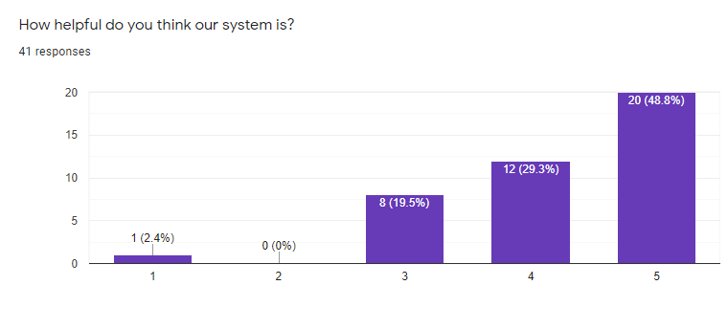

Slide 14
Close Ended Question
Do you like the features that our system provides?
Are you interested in using our service in near future?
What kind of payment method do you prefer?
Do you like in our money back policy?
Do you want surveillance camera for your security?
How helpful do you think our system is?

Slide 15
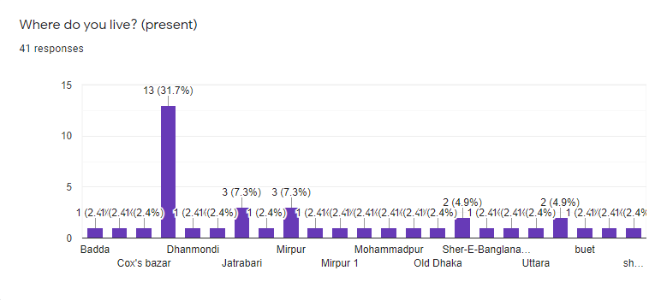

Slide 16
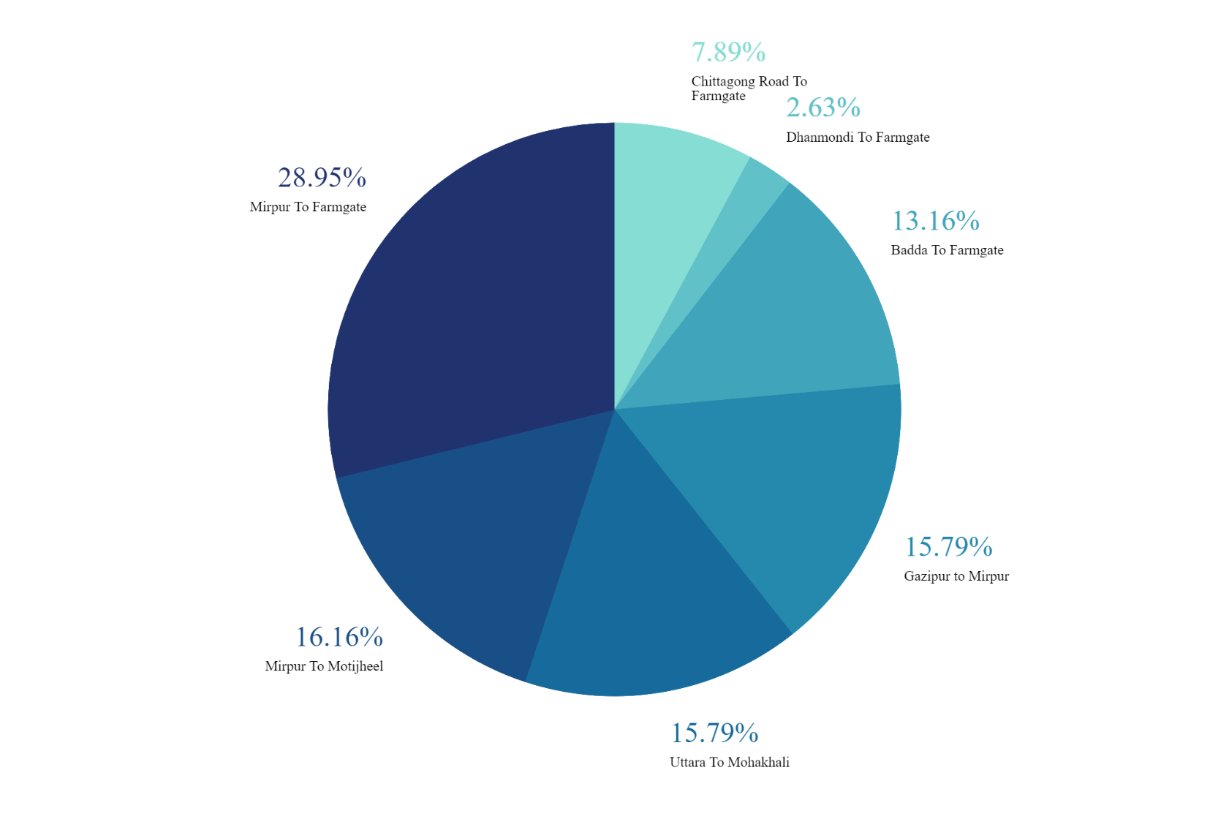
On which route you want to use our service? (e.g. Mirpur 1 to Farmgate)
41 responses

Slide 17
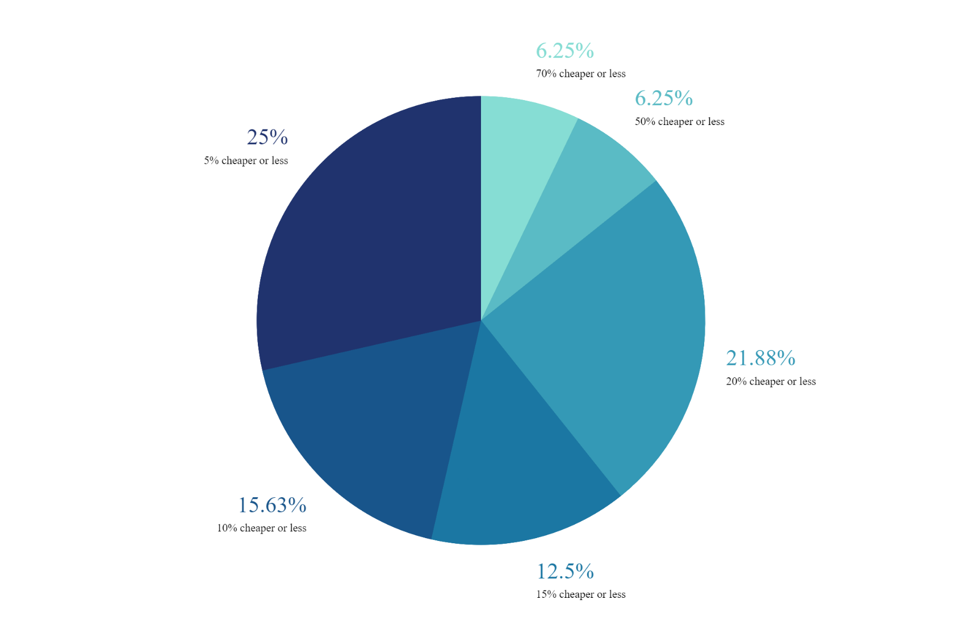
How much are you willing to pay for our service compared to other ride sharing services? (e.g. 5% cheaper)
41 responses

Slide 18
After analysis we discovered that:
We will add seat cancelation system
We will add special facilities for girls
We will add separate arraignments for disable people
We will maintain vehicle schedule
We will make sure the vehicle in clean
We will make sure proper safety of our passengers

Slide 19
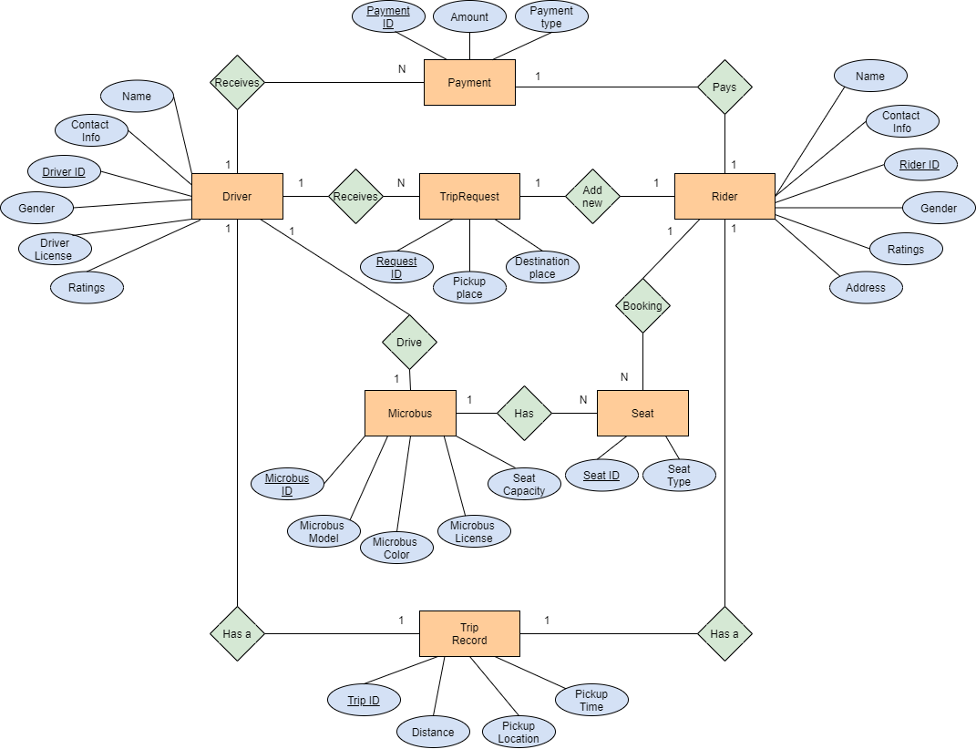
ER Diagram

Slide 20
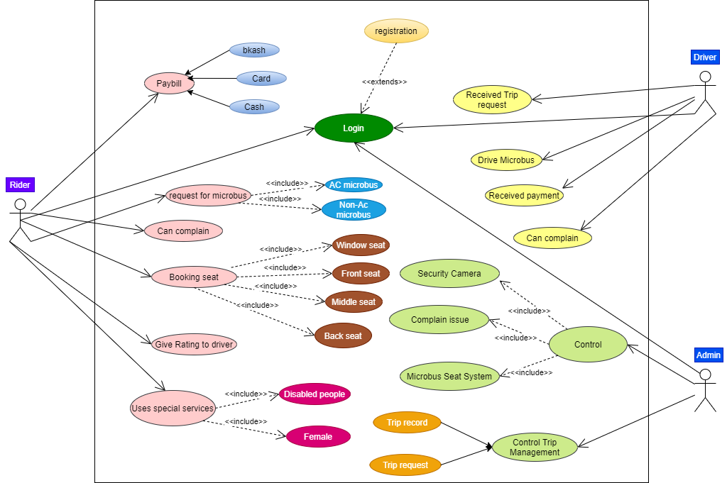
Use Case Diagram

Slide 21


