Slide 1
Netflix
Movies & TV Shows
Data Analysis Project using Python, Pandas & Matplotlib
8,807
12
6,126
2,664
Total Titles
Columns
Movies
TV Shows

Slide 2
Step 1 — Dataset
Dataset Info:
File:
netflix_movie_tvshow.csv
Source:
Kaggle
Rows:
8,807
Columns:
12
Load command:
pd.read_csv('netflix_movie_tvshow.csv')

Slide 3
Step 2 — Data Exploration
df.shape
→ 8807 rows × 12 columns
df.columns
→ show_id, type, title, director, cast, country, date_added, release_year, rating, duration, listed_in, description
df.dtypes
→ release_year → int64, rest → object (string)
df.info()
→ 12 columns, mixed dtypes, shows memory usage
df.head(10)
→ First 10 rows of the dataset
df.tail(10)
→ Last 10 rows of the dataset
df.describe()
→ Statistical summary of release_year column

Slide 4
Step 3 — Data Cleaning
Missing Values Found:
How We Cleaned:
Column | Missing
director | 2,634
cast | 825
country | 831
date_added | 10
rating | 4
duration | 3
fillna('Unknown')
director - can't guess name
fillna('Not Available')
cast - can't guess cast
fillna('Not Specified')
country - can't guess origin
dropna(['rating'])
only 4 rows - safe to drop
dropna(['duration'])
only 3 rows - safe to drop
dropna(['date_added'])
only 10 rows - safe to drop

Slide 5
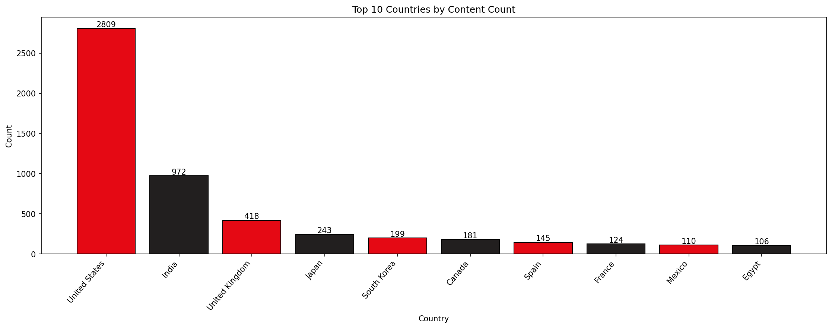
Visualization 1 — Top 10 Countries by Content Count
Observation: United States has the highest count with 2,809 titles. Egypt has the lowest with 106 titles only.

Slide 6
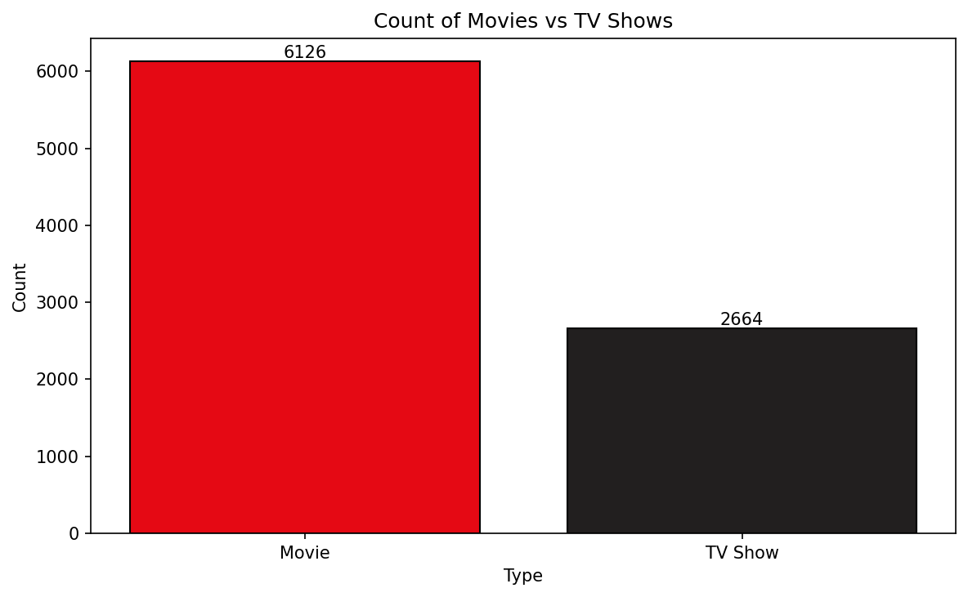
Visualization 2 — Movies vs TV Shows
6,126
Movies (69.7%)
2,664
TV Shows (30.3%)
Observation: Netflix has significantly more Movies (6,126) than TV Shows (2,664). Movies make up ~70% of total content.

Slide 7
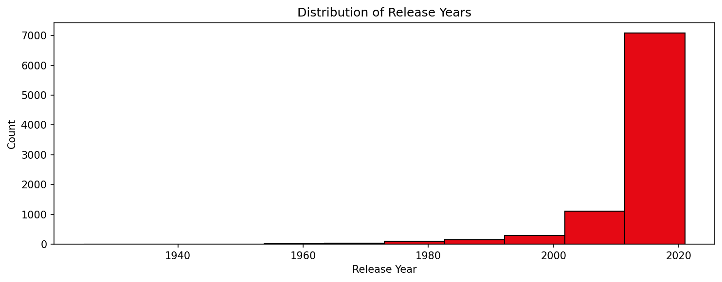
Visualization 3 — Distribution of Release Years
Observation: Most content on Netflix is from recent years. Very little content is available from old years like 1940 or 1960.

Slide 8
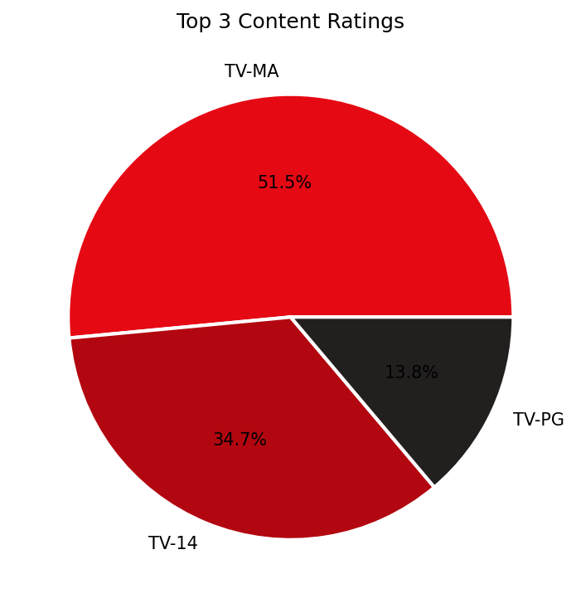
Visualization 4 — Top 3 Content Ratings
TV-MA — 51.5%
Mature audiences (18+)
TV-14 — 34.7%
Ages 14 and above
TV-PG — 13.8%
Parental guidance
Observation: TV-MA is the most common rating with over 50% of content. Netflix mostly has content made for adults.

Slide 9
Conclusion
🎬 Content Type
🌍 Top Country
Netflix has 6,126 Movies vs 2,664 TV Shows — Movies make up ~70%
USA dominates with 2,809 titles. India is 2nd with 972 titles
🔞 Top Rating
📅 Recent Content
TV-MA covers 51.5% — Netflix is primarily for adult audiences
Most titles are from after 2015 — Netflix prefers modern content
🧹 Data Cleaning
🐼 Tools Used
2,634 director values filled with 'Unknown'. 17 rows dropped safely
Python, Pandas, NumPy, Matplotlib, Seaborn

Slide 10
Thank You
Netflix Movies & TV Shows — Pandas Data Analysis Project
Tools: Python | Pandas | NumPy | Matplotlib | Seaborn
Dataset: netflix_movie_tvshow.csv
Institute: Cybrom Technology, Bhopal

