Slide 1
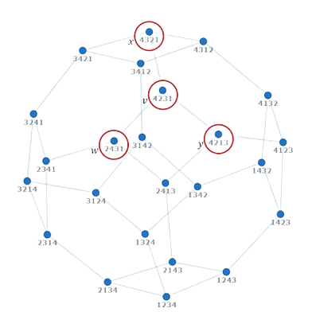
A parallel algorithm for constructing multiple independent spanning trees in bubble-sort networks
M Rumman qadir 22i-1204
Awais ahmed 22i-1225
Ahmed asif 22i-1299

Slide 2
Agenda
Motivation & Background
Problem Statement
Prior Work & Gap Analysis
Key Contributions
Algorithm Overview
Example on B₄
Theoretical Results
Our Parallelization Plan

Slide 3
Motivation & Background
Reliable broadcasting and fault‑tolerance require multiple disjoint paths.
Independent Spanning Trees (ISTs): rooted trees sharing no internal nodes or edges.
Bubble‑Sort Network Bₙ:
Nodes = all permutations of {1…n}.
Edges = adjacent‐swap connections (image: B₄ diagram).

Slide 4

Goal
Construct the maximum (n–1) ISTs in Bₙ in parallel.

Slide 5

Challenge
Previous IST algorithms for Bₙ were recursive and not parallelizable.

Slide 6
Prior work
Kao et al. (2019): amortized constant‐time parent finding via recursion.
IST construction for other networks (e.g., hypercubes, star graphs) already exists.
Most prior algorithms use recursive strategies with poor parallelism.
Few efforts addressed real-time or scalable IST computation in Bₙ.

Slide 7
Properties
Algorithm 1: non‑recursive parent finder, O(1) per vertex per tree.
Optimal total work: O(n.n!) with matching Ω(n.n!) lower bound.
Proofs: spanning‐tree correctness, pairwise independence.
Height bound: ≤ D(Bₙ)+(n–1) = n(n+1)/2–1.

Slide 8
Algorithm OvervieW
Preprocessing (per v):
Compute inverse array inv[ ], position of rightmost misplaced symbol r(v).
Parent(v,t,n): Six rules based on vₙ and tree index t → single adjacent swap.
FindPosition(v, t):
Swap(v,x): use inv[x] to swap in O(1).

Slide 9
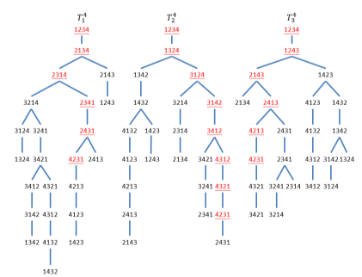

Slide 10
Theoretical Results
IMPACT FACTOR | MEASUREMENT
Correctness (Theorem 1) | each Tₙᵗ is a spanning tree; disjoint paths guarantee independence.
Complexity | O(1) per parent ⇒ O(n·n!) total, asymptotically optimal.
Height (Theorem 2) | ≤ D(Bₙ)+(n–1) = n(n+1)/2–1.

Slide 11
Our Parallelization Plan
MPI (inter-node): distribute permutations evenly across ranks.
OpenMP (intra-node): parallel for over local vertices for inv[ ], r(v), Parent calls.
METIS:
Build small proxy graph.
Partition into p parts.
Map prefix‐based full vertices to ranks for balanced load.

Slide 12
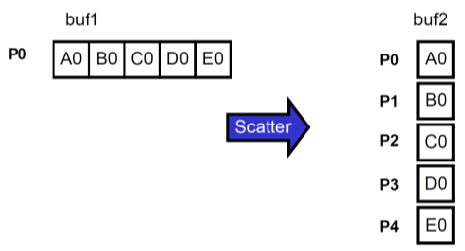
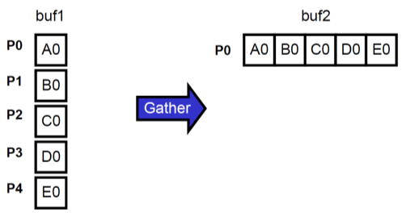
MPI Parallelization:
MPI_Scatter: distribute contiguous blocks of permutations to each rank (MPI_Scatter)
MPI_Bcast: broadcast global parameters (n, tree count) to all ranks (MPI_Bcast)
MPI_Gather: collect computed parent pointers or aggregate metrics (MPI_Gather)

Slide 13
Openmp Parallelization:
Leverage multithreading within each MPI rank to process permutations concurrently.
Use parallel for directives to distribute vertices across threads.
Exploit shared memory: threads access common data (inverse maps, parent pointers).
No synchronization needed—each thread works on distinct data, avoiding locks.
Maximizes node‑level performance by fully utilizing all CPU cores.

Slide 14
THANK YOU
Kao et al. (2023), Information Sciences.
PDC Project Spec.
Questions?

