Slide 1
protection of e-commerce website from sql injection
1. Rumnaz khan (151014063)
2. Zarin Tasnim Momo (151014008)
3. Prapti iffat (151014052)
4. Zakaria Hossain (151014071)

Slide 2
Aims
To create an E-commerce website with a secure database.
Put forth a method to analyze and detect the malicious code to find out and prevent the attack.
Prevent various SQL injection attacks based on efficient attack detection strategies.

Slide 3
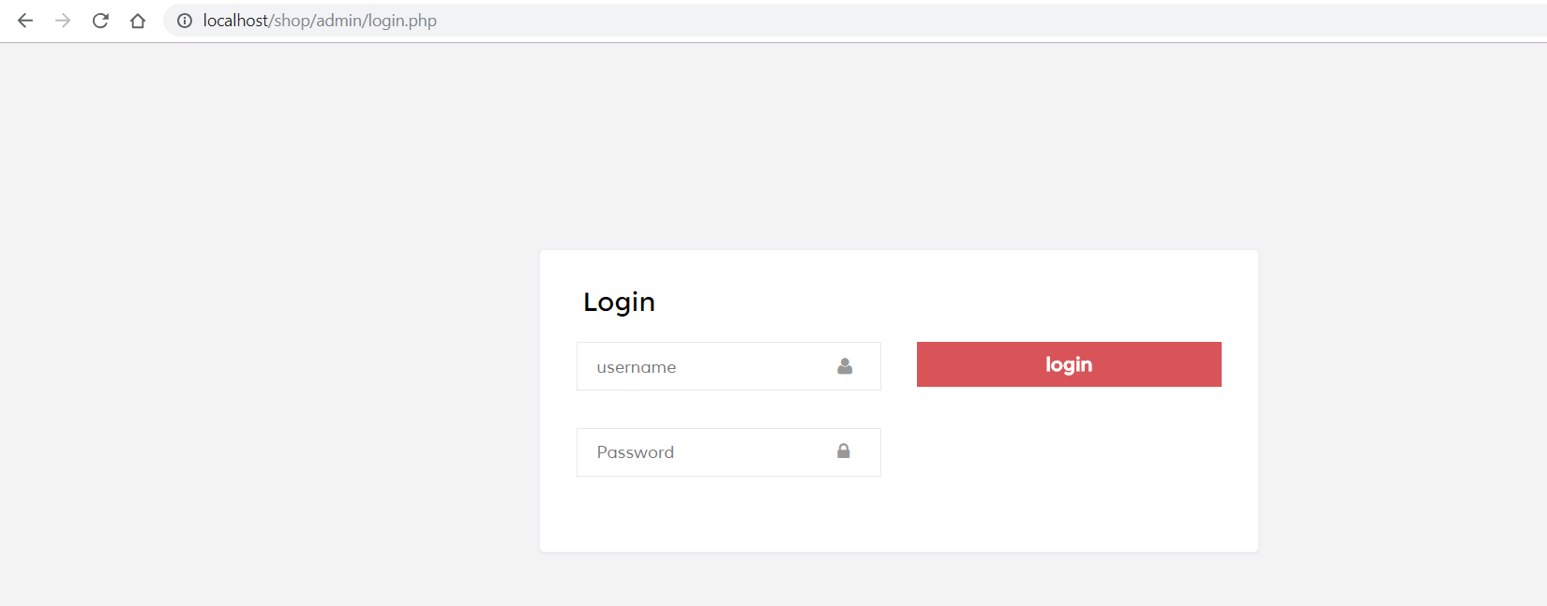
Work progress
Admin login:

Slide 4
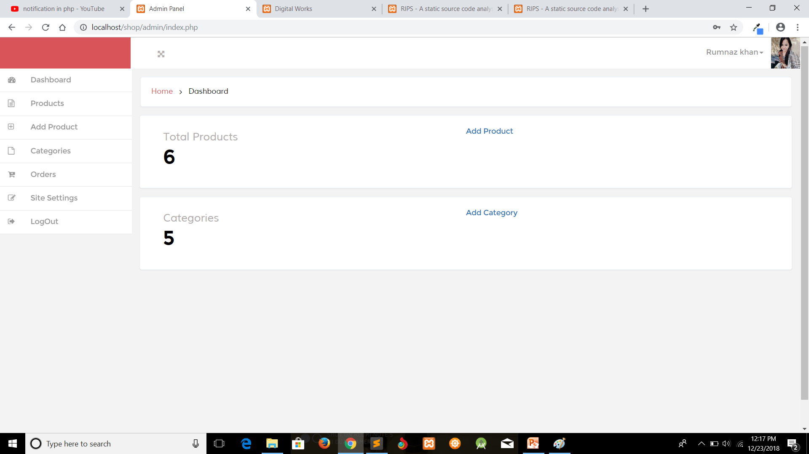
Admin panel

Slide 5
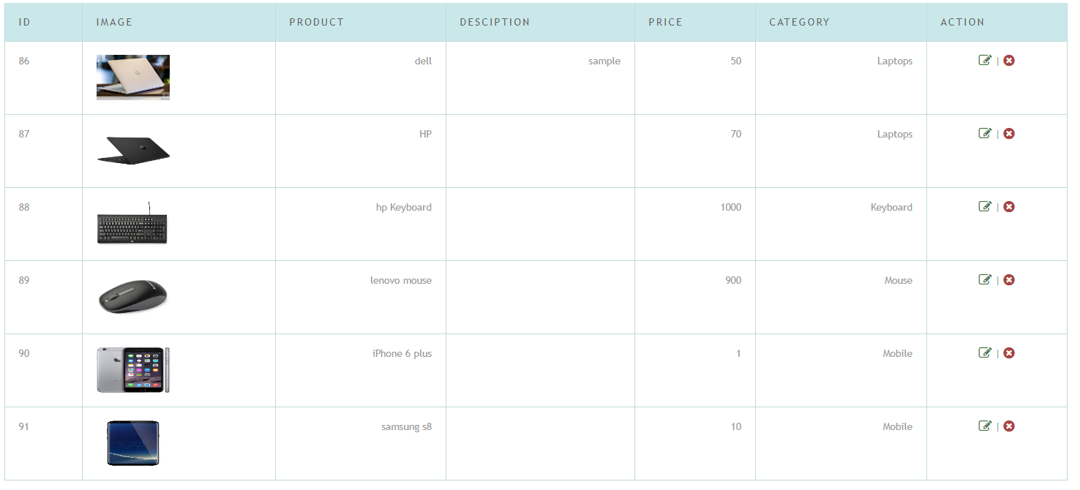
Products:

Slide 6
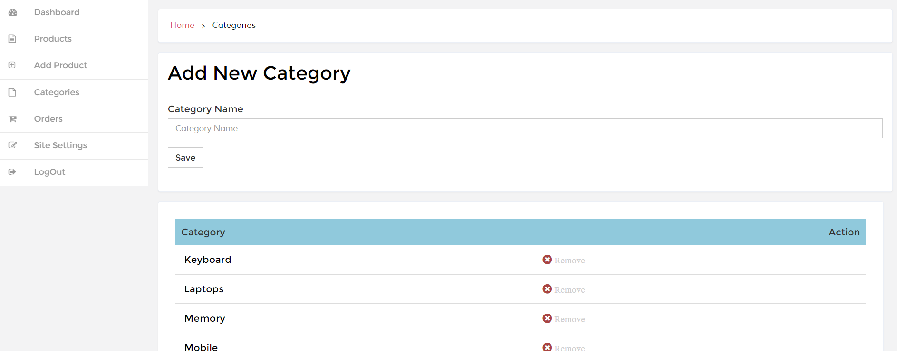
brand list and category list
Category:

Slide 7
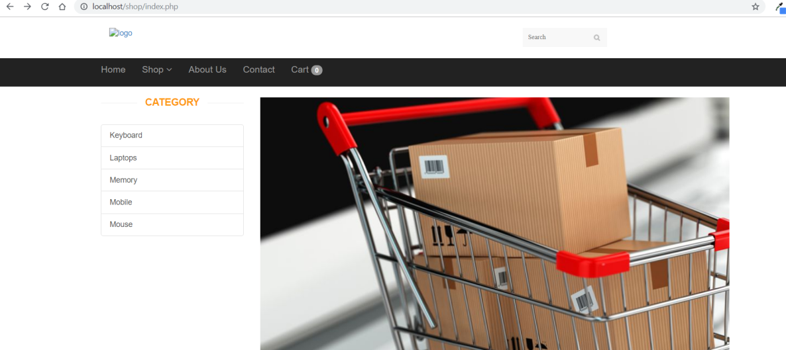
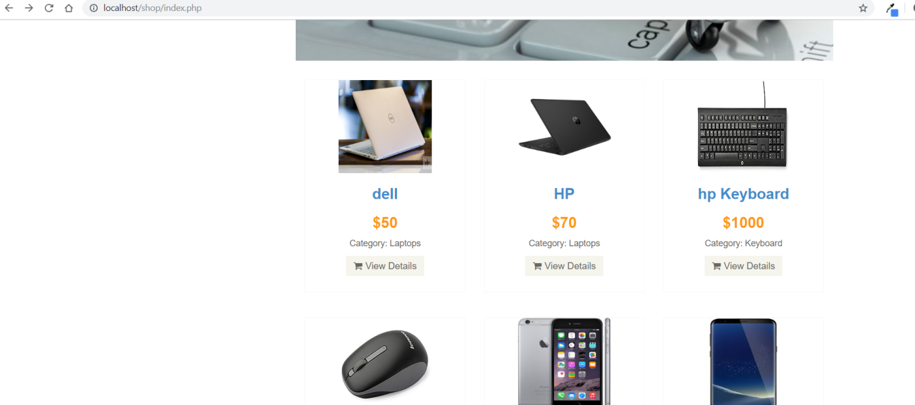
Home page

Slide 8
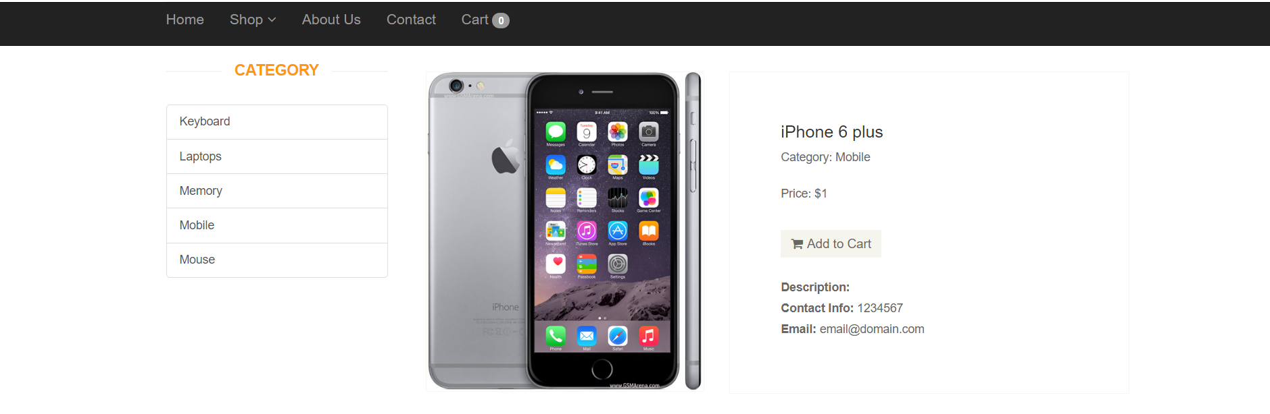
View details:

Slide 9
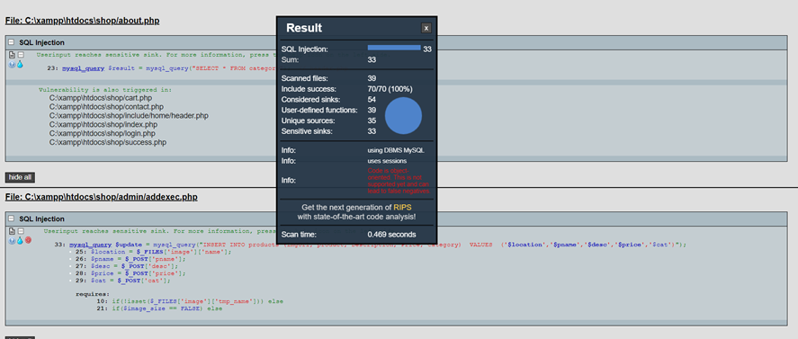
Sql injection prevention

Slide 10
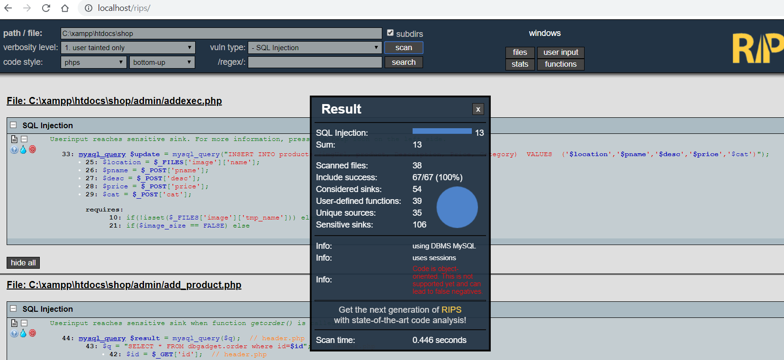

Slide 11
Running works
Sql injection prevention using prepared statements.
Creating Notification if someone is trying to inject SQL injection.

