Slide 1
Chapter 4: Threads & Concurrency

Slide 2
Outline
Overview
Multicore Programming
Multithreading Models
Thread Libraries
Implicit Threading
Threading Issues
Operating System Examples

Slide 3
Motivation
Most modern applications are multithreaded
Threads run within application
Multiple tasks with the application can be implemented by separate threads
Update display
Fetch data
Spell checking
Answer a network request
Process creation is heavy-weight while thread creation is light-weight
Can simplify code, increase efficiency
Kernels are generally multithreaded

Slide 4
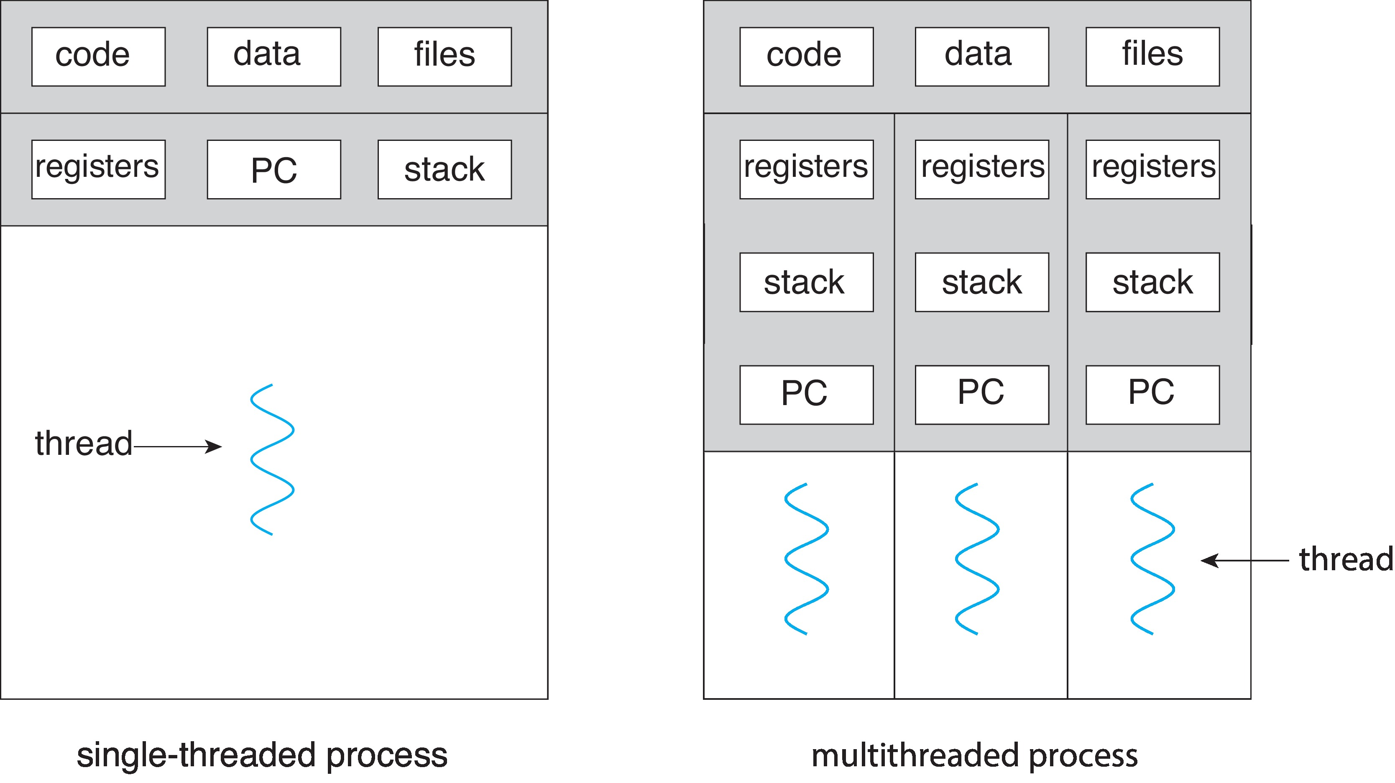
Single and Multithreaded Processes

Slide 5
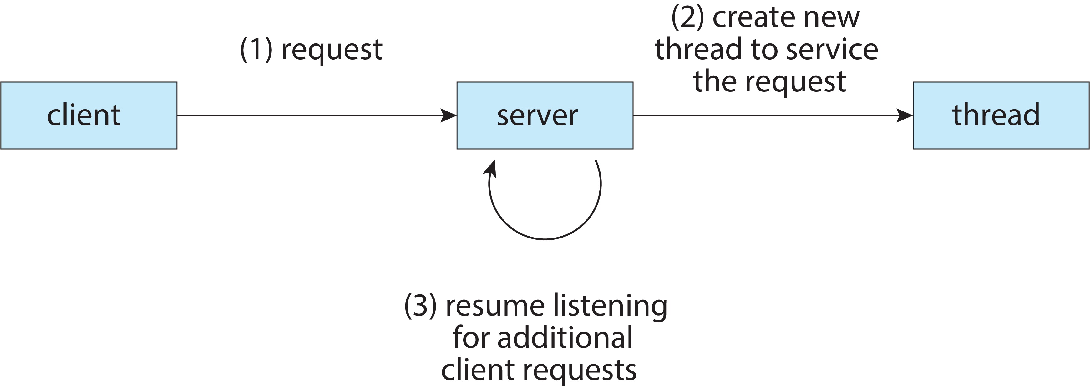
Multithreaded Server Architecture

Slide 6
Benefits
Responsiveness – may allow continued execution if part of process is blocked, especially important for user interfaces
Resource Sharing – threads share resources of process, easier than shared memory or message passing
Economy – cheaper than process creation, thread switching lower overhead than context switching
Scalability – process can take advantage of multicore architectures

Slide 7
Multicore Programming
Multicore or multiprocessor systems putting pressure on programmers, challenges include:
Dividing activities
Balance
Data splitting
Data dependency
Testing and debugging
Parallelism implies a system can perform more than one task simultaneously
Concurrency supports more than one task making progress
Single processor / core, scheduler providing concurrency

Slide 8
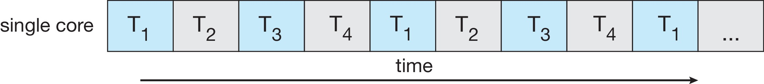
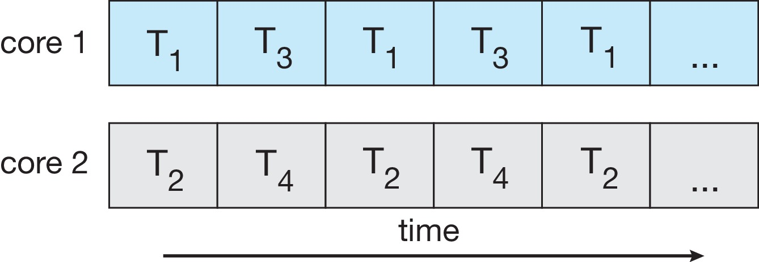
Concurrency vs. Parallelism
Concurrent execution on single-core system:
Parallelism on a multi-core system:

Slide 9
Multicore Programming
Types of parallelism
Data parallelism – distributes subsets of the same data across multiple cores, same operation on each
Task parallelism – distributing threads across cores, each thread performing unique operation

Slide 10
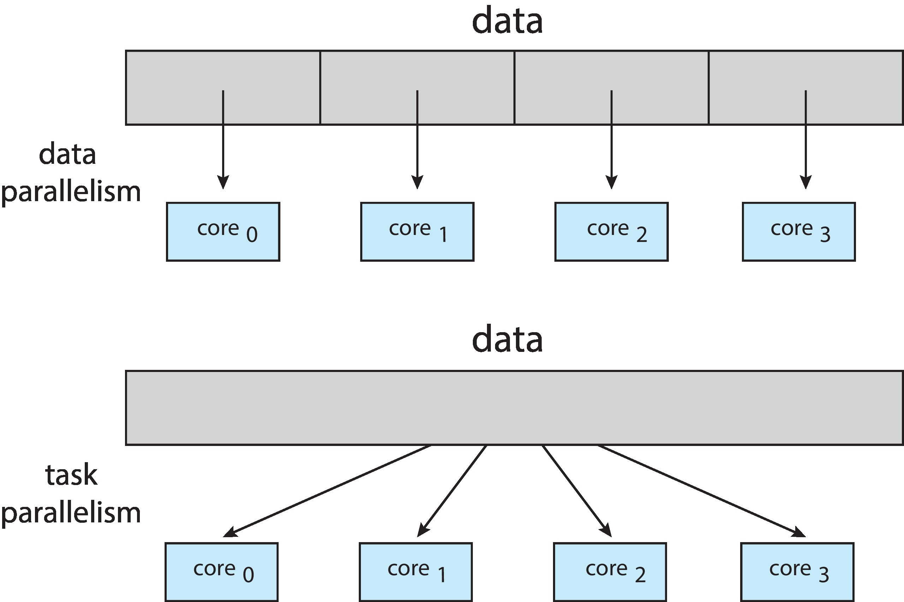
Data and Task Parallelism

Slide 11
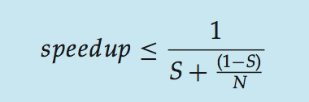
Amdahl’s Law
Identifies performance gains from adding additional cores to an application that has both serial and parallel components
S is serial portion
N processing cores
That is, if application is 75% parallel / 25% serial, moving from 1 to 2 cores results in speedup of 1.6 times
As N approaches infinity, speedup approaches 1 / S

Slide 12
User Threads and Kernel Threads
User threads - management done by user-level threads library
Three primary thread libraries:
POSIX Pthreads
Windows threads
Java threads
Kernel threads - Supported by the Kernel
Examples – virtually all general -purpose operating systems, including:
Windows
Linux
Mac OS X
iOS
Android

Slide 13
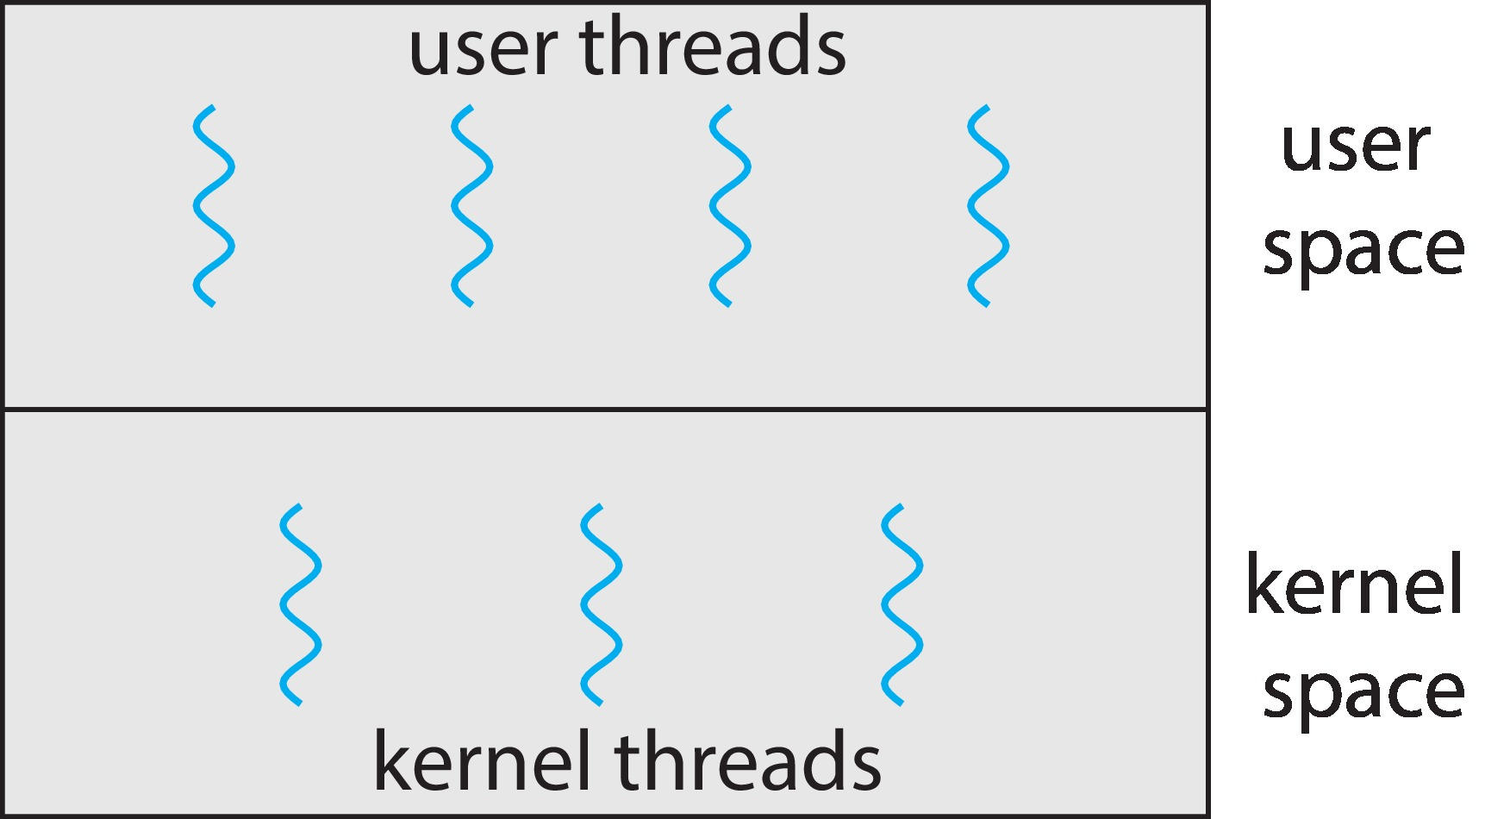
User and Kernel Threads

Slide 14
Multithreading Models
Many-to-One
One-to-One
Many-to-Many

Slide 15
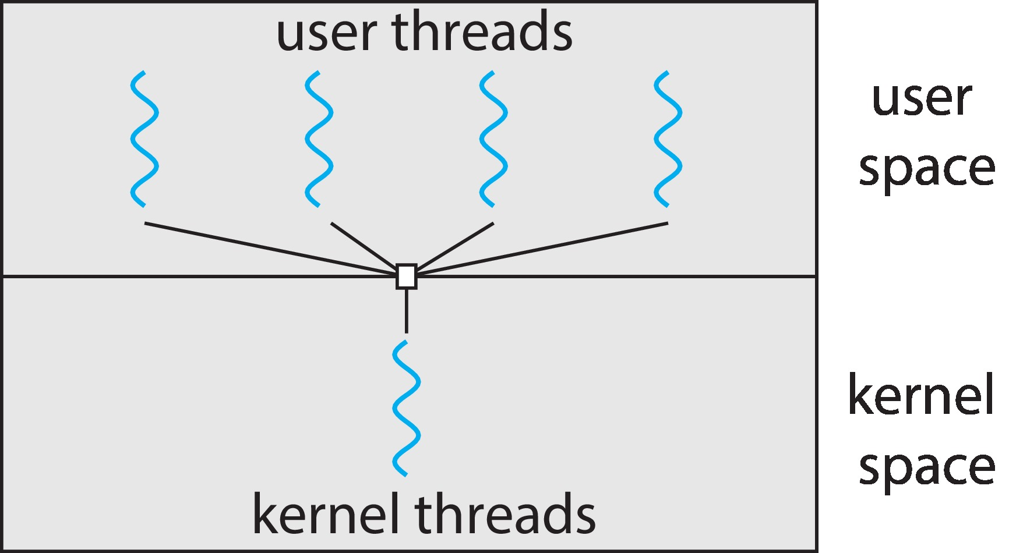
Many-to-One
Many user-level threads mapped to single kernel thread
One thread blocking causes all to block
Multiple threads may not run in parallel on multicore system because only one may be in kernel at a time
Few systems currently use this model
Examples:
Solaris Green Threads
GNU Portable Threads

Slide 16
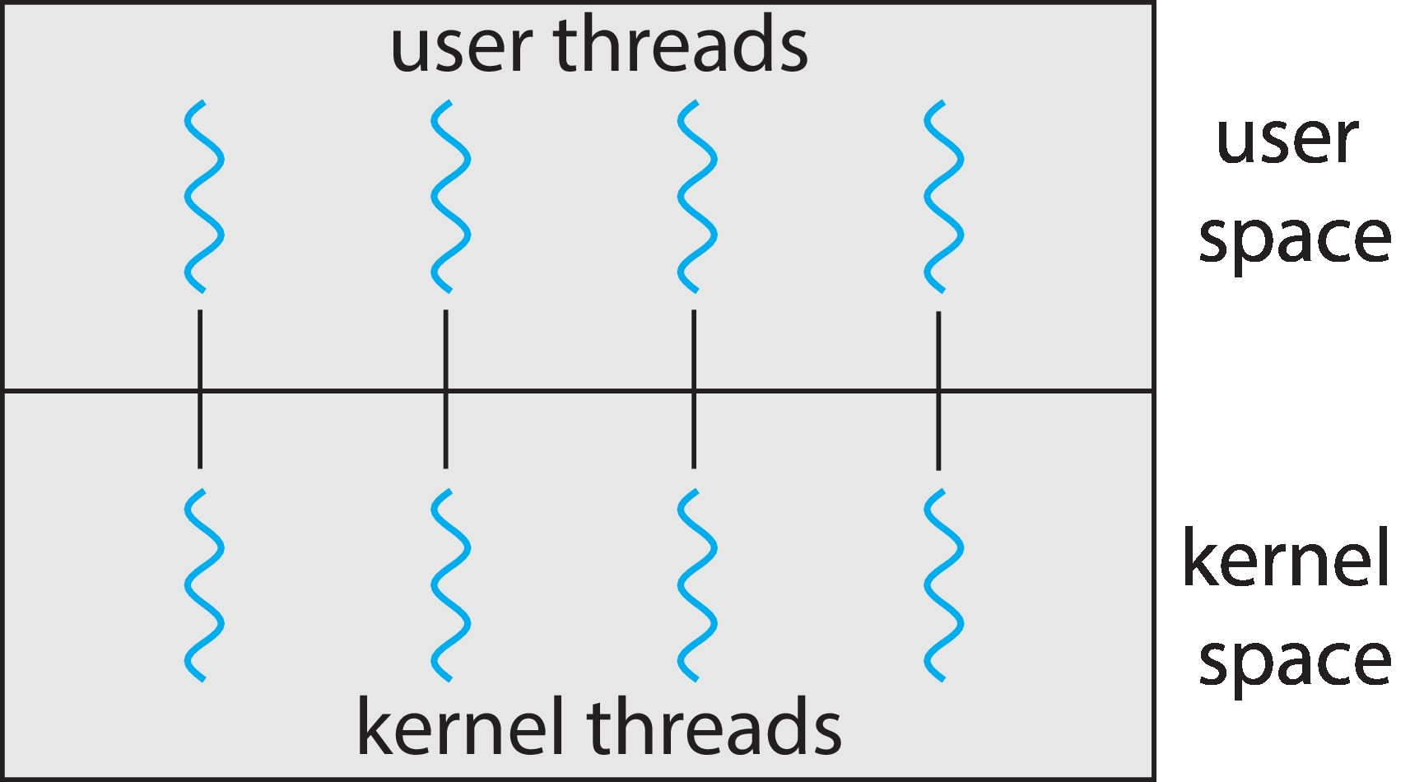
One-to-One
Each user-level thread maps to kernel thread
Creating a user-level thread creates a kernel thread
More concurrency than many-to-one
Number of threads per process sometimes restricted due to overhead
Examples
Windows
Linux

Slide 17
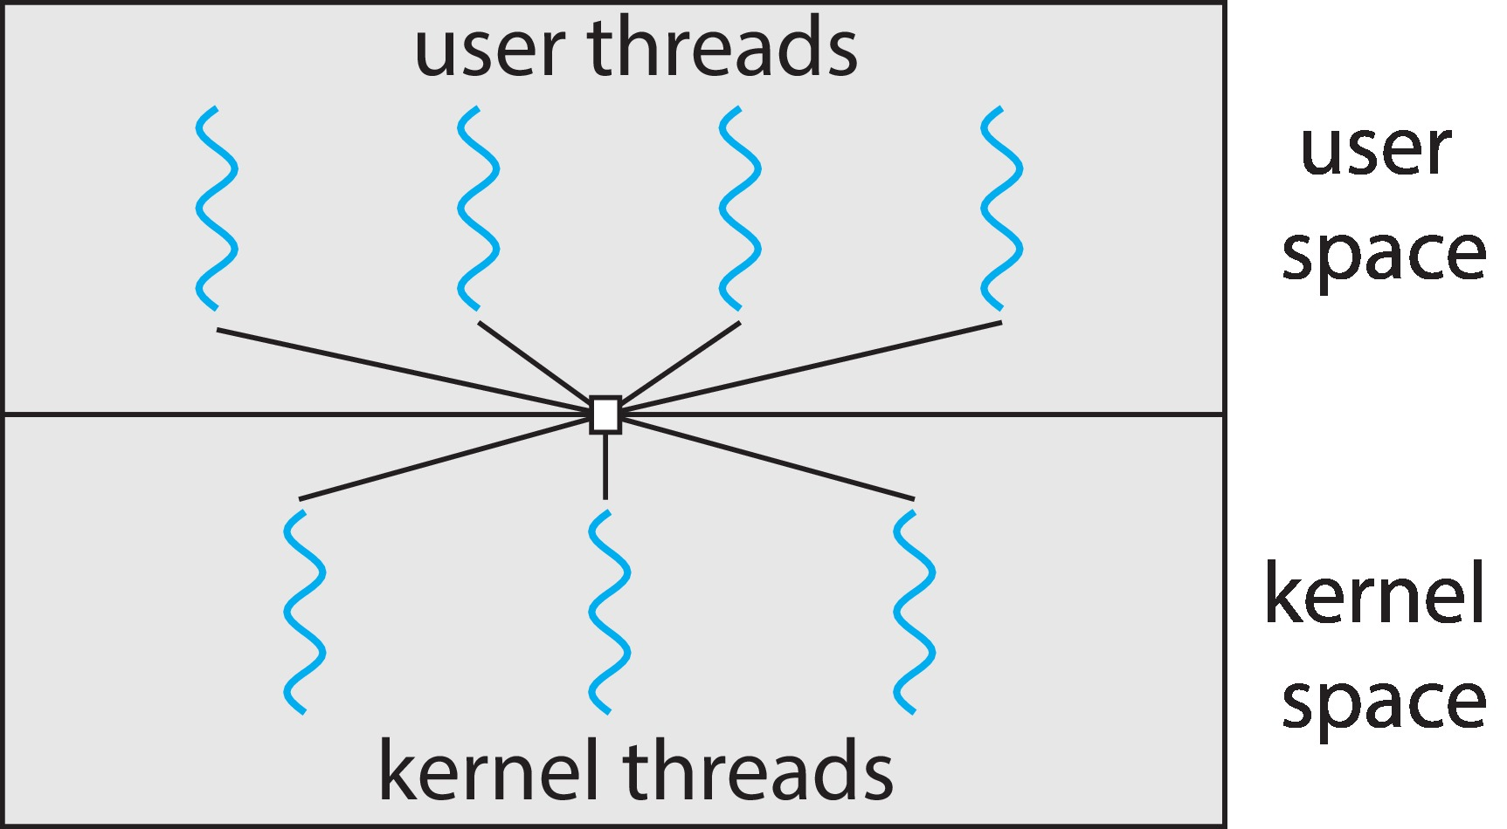
Many-to-Many Model
Allows many user level threads to be mapped to many kernel threads
Allows the operating system to create a sufficient number of kernel threads
Windows with the ThreadFiber package
Otherwise not very common

Slide 18
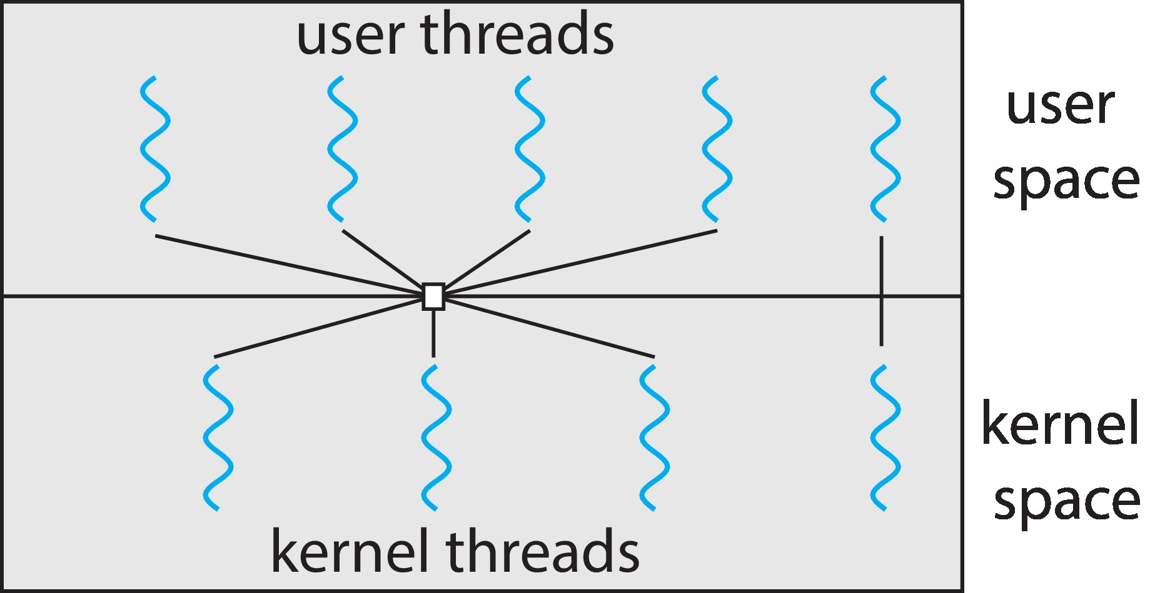
Two-level Model
Similar to M:M, except that it allows a user thread to be bound to kernel thread

Slide 19
Thread Libraries
Thread library provides programmer with API for creating and managing threads
Two primary ways of implementing
Library entirely in user space
Kernel-level library supported by the OS

Slide 20
Pthreads
May be provided either as user-level or kernel-level
A POSIX standard (IEEE 1003.1c) API for thread creation and synchronization
Specification, not implementation
API specifies behavior of the thread library, implementation is up to development of the library
Common in UNIX operating systems (Linux & Mac OS X)

Slide 21
Implicit Threading
Growing in popularity as numbers of threads increase, program correctness more difficult with explicit threads
Creation and management of threads done by compilers and run-time libraries rather than programmers
Five methods explored
Thread Pools
Fork-Join
OpenMP
Grand Central Dispatch
Intel Threading Building Blocks

Slide 22
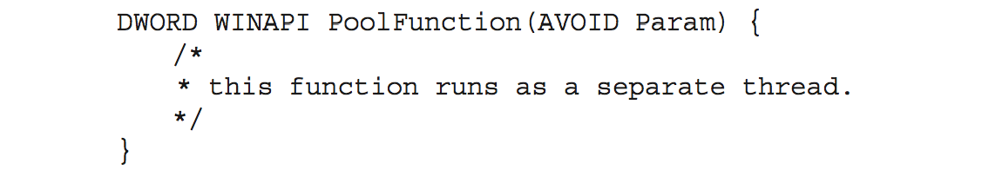
Thread Pools
Create a number of threads in a pool where they await work
Advantages:
Usually slightly faster to service a request with an existing thread than create a new thread
Allows the number of threads in the application(s) to be bound to the size of the pool
Separating task to be performed from mechanics of creating task allows different strategies for running task
i.e.,Tasks could be scheduled to run periodically
Windows API supports thread pools:

Slide 23
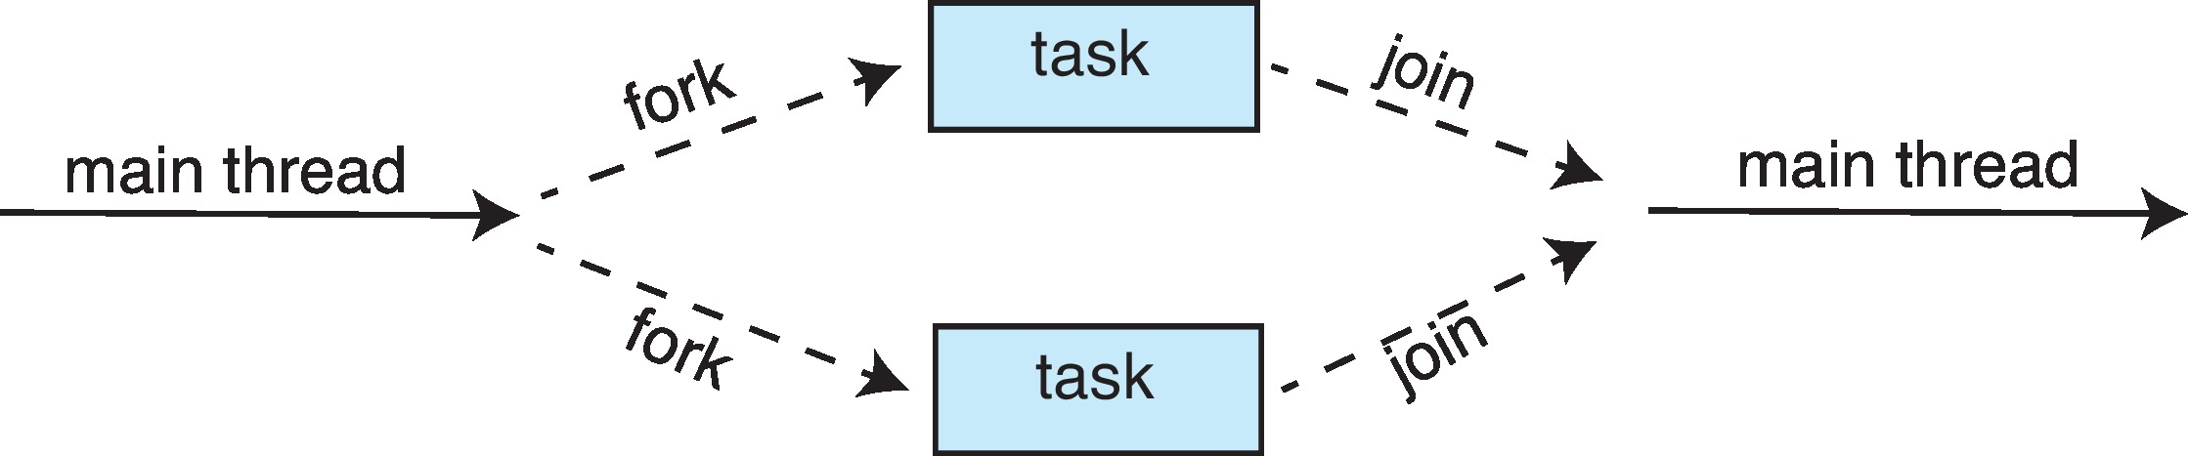
Fork-Join Parallelism
Multiple threads (tasks) are forked, and then joined.

Slide 24
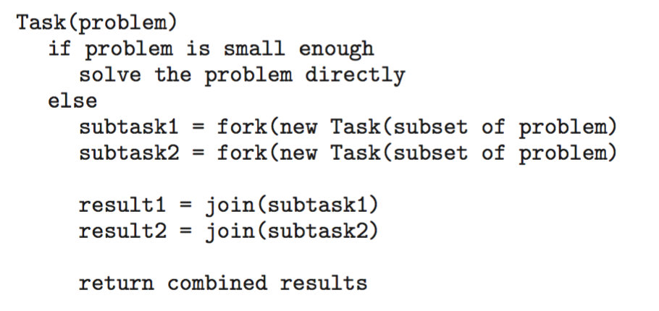
Fork-Join Parallelism
General algorithm for fork-join strategy:

Slide 25
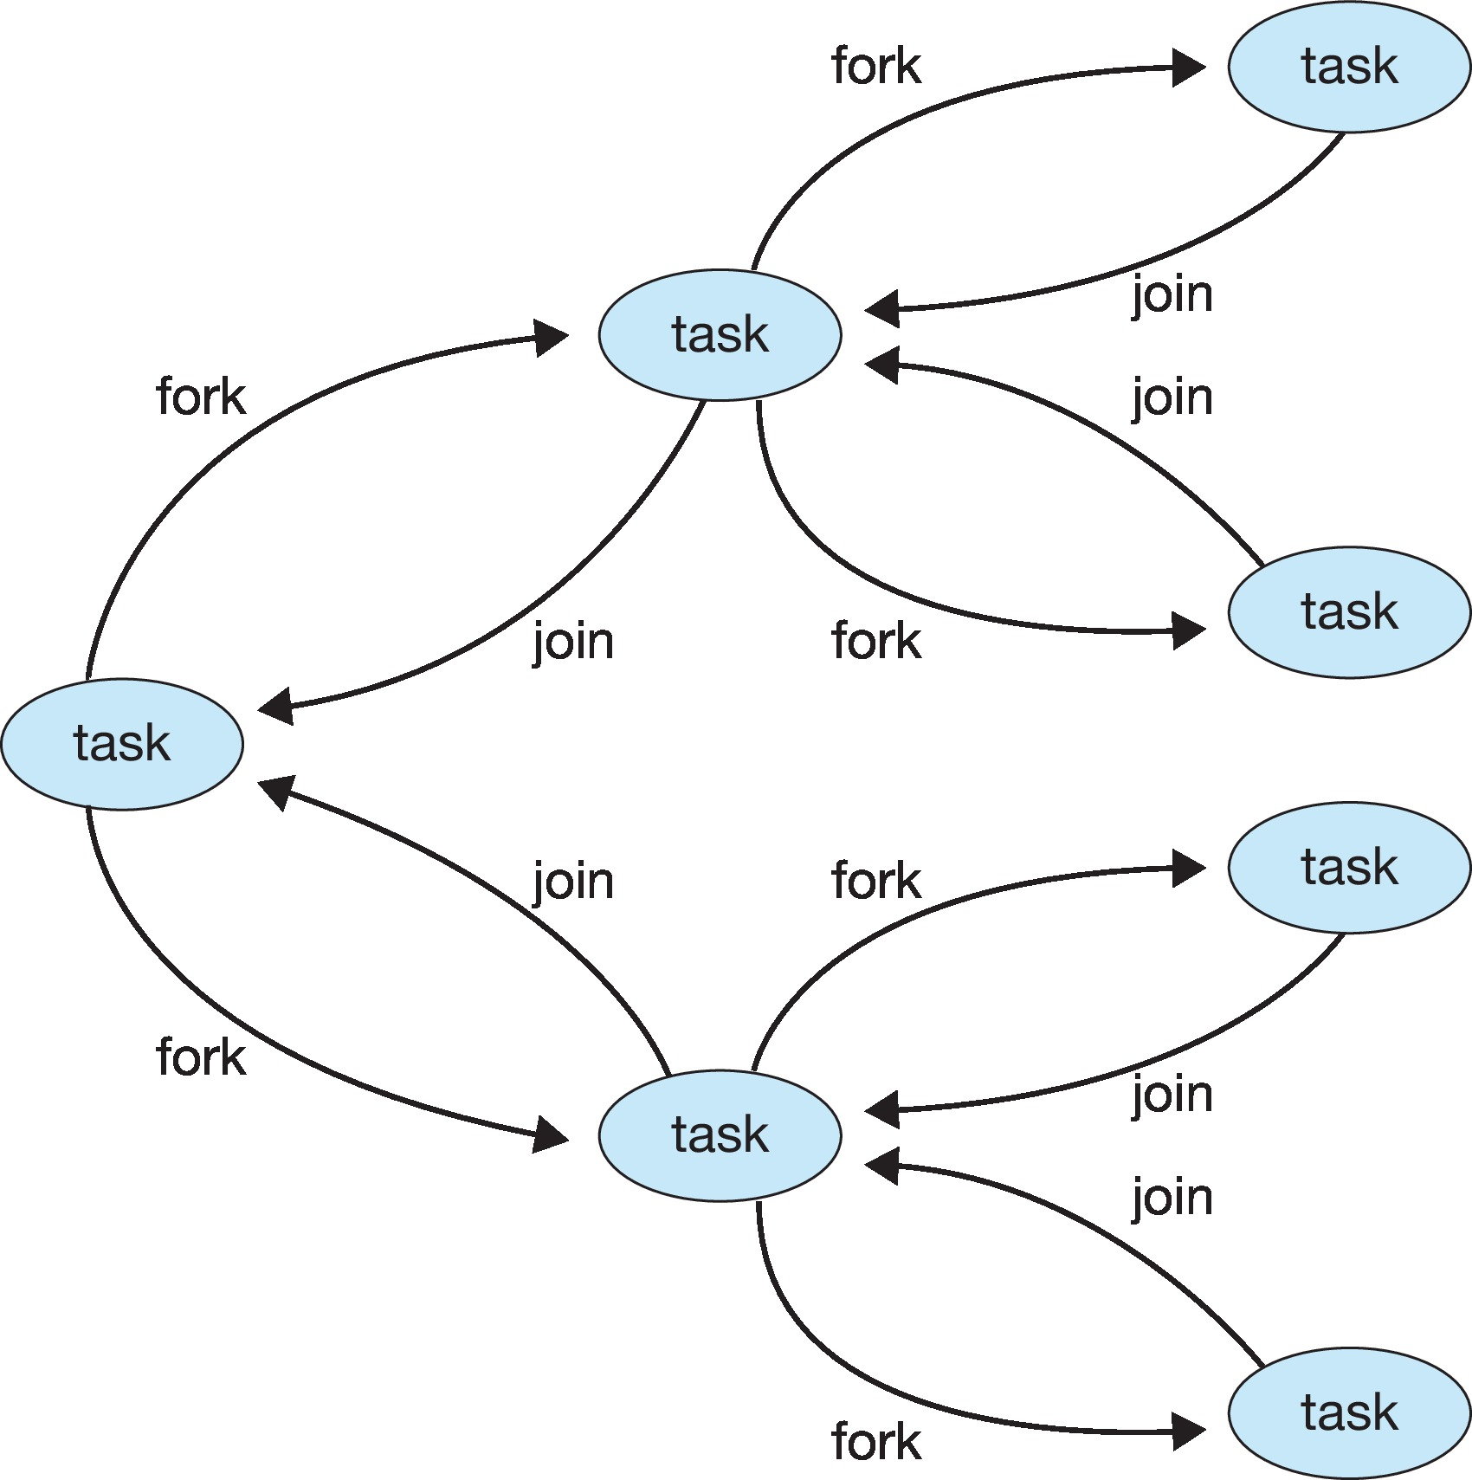
Fork-Join Parallelism

Slide 26
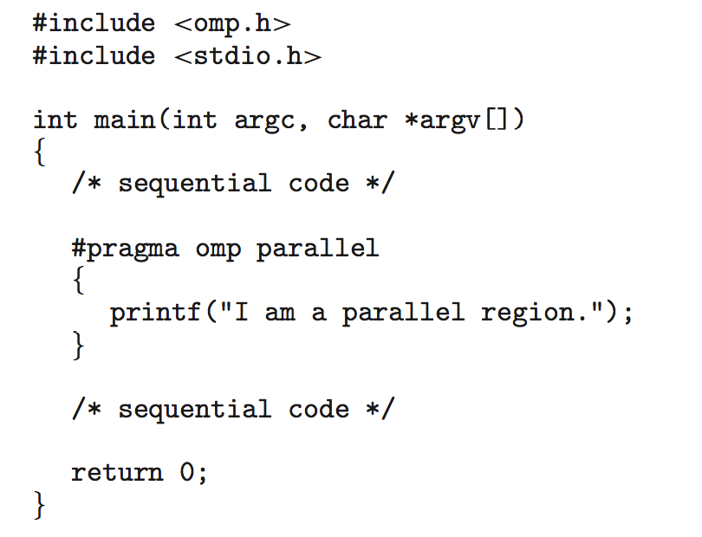
OpenMP
Set of compiler directives and an API for C, C++, FORTRAN
Provides support for parallel programming in shared-memory environments
Identifies parallel regions – blocks of code that can run in parallel
#pragma omp parallel
Create as many threads as there are cores

Slide 27
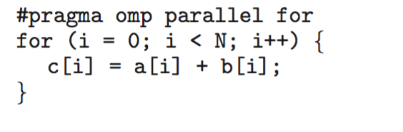
Run the for loop in parallel

Slide 28
Grand Central Dispatch
Apple technology for macOS and iOS operating systems
Extensions to C, C++ and Objective-C languages, API, and run-time library
Allows identification of parallel sections
Manages most of the details of threading
Block is in “^{ }” : ˆ{ printf("I am a block"); }
Blocks placed in dispatch queue
Assigned to available thread in thread pool when removed from queue

Slide 29
Grand Central Dispatch
Two types of dispatch queues:
serial – blocks removed in FIFO order, queue is per process, called main queue
Programmers can create additional serial queues within program
concurrent – removed in FIFO order but several may be removed at a time
Four system wide queues divided by quality of service:
QOS_CLASS_USER_INTERACTIVE
QOS_CLASS_USER_INITIATED
QOS_CLASS_USER_UTILITY
QOS_CLASS_USER_BACKGROUND

Slide 30
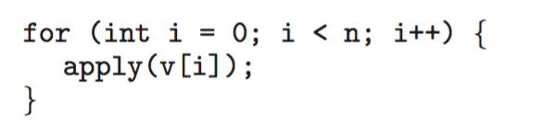
Intel Threading Building Blocks (TBB)
Template library for designing parallel C++ programs
A serial version of a simple for loop
The same for loop written using TBB with parallel_for statement:

Slide 31
Threading Issues
Semantics of fork() and exec() system calls
Signal handling
Synchronous and asynchronous
Thread cancellation of target thread
Asynchronous or deferred
Thread-local storage
Scheduler Activations

Slide 32
Semantics of fork() and exec()
Does fork()duplicate only the calling thread or all threads?
Some UNIXes have two versions of fork
exec() usually works as normal – replace the running process including all threads

Slide 33
Signal Handling
Signals are used in UNIX systems to notify a process that a particular event has occurred.
A signal handler is used to process signals
Signal is generated by particular event
Signal is delivered to a process
Signal is handled by one of two signal handlers:
default
user-defined
Every signal has default handler that kernel runs when handling signal
User-defined signal handler can override default
For single-threaded, signal delivered to process

Slide 34
Signal Handling (Cont.)
Where should a signal be delivered for multi-threaded?
Deliver the signal to the thread to which the signal applies
Deliver the signal to every thread in the process
Deliver the signal to certain threads in the process
Assign a specific thread to receive all signals for the process

Slide 35
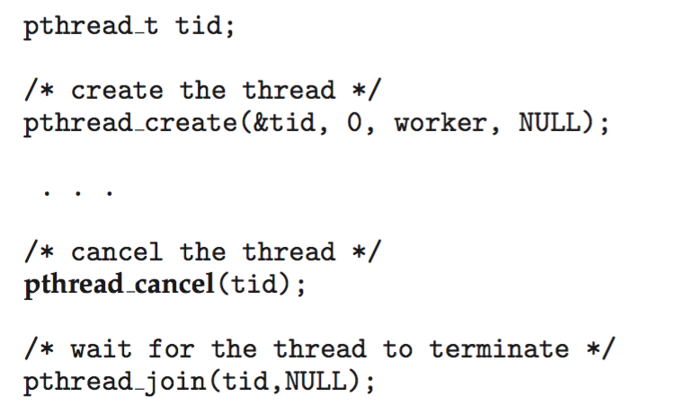
Thread Cancellation
Terminating a thread before it has finished
Thread to be canceled is target thread
Two general approaches:
Asynchronous cancellation terminates the target thread immediately
Deferred cancellation allows the target thread to periodically check if it should be cancelled
Pthread code to create and cancel a thread:

Slide 36
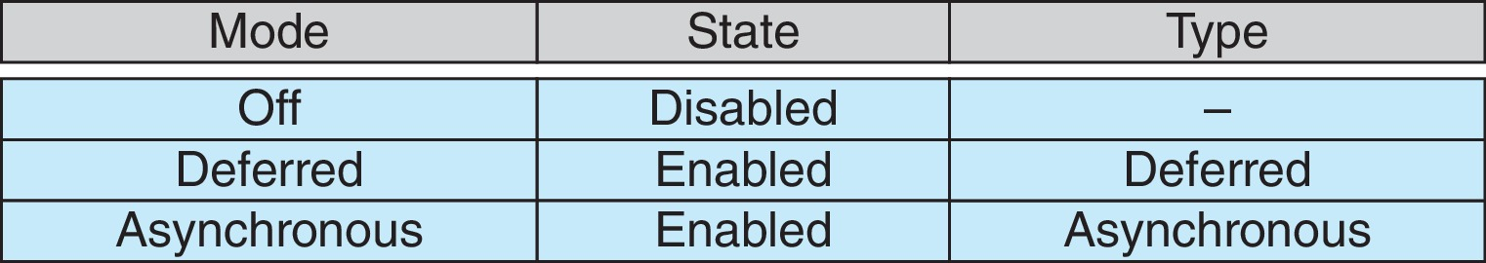
Thread Cancellation (Cont.)
Invoking thread cancellation requests cancellation, but actual cancellation depends on thread state
If thread has cancellation disabled, cancellation remains pending until thread enables it
Default type is deferred
Cancellation only occurs when thread reaches cancellation point
i.e., pthread_testcancel()
Then cleanup handler is invoked
On Linux systems, thread cancellation is handled through signals

Slide 37
Thread-Local Storage
Thread-local storage (TLS) allows each thread to have its own copy of data
Useful when you do not have control over the thread creation process (i.e., when using a thread pool)
Different from local variables
Local variables visible only during single function invocation
TLS visible across function invocations
Similar to static data
TLS is unique to each thread

Slide 38
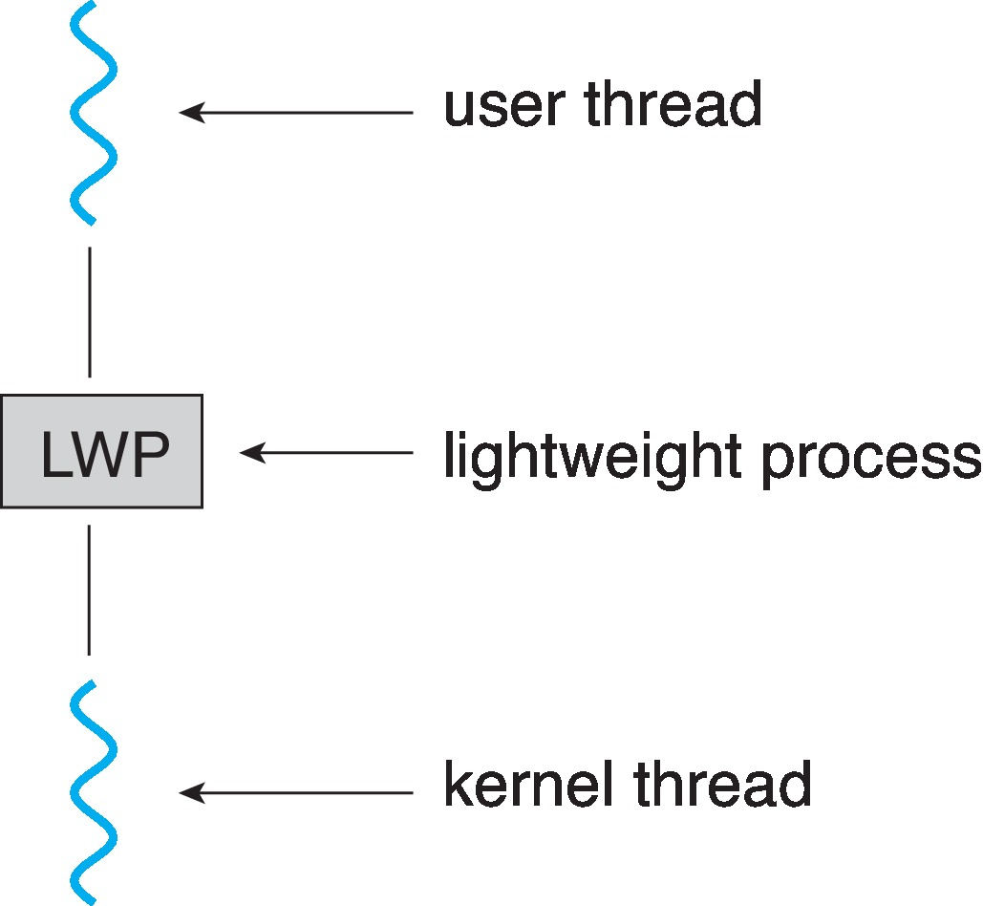
Scheduler Activations
Both M:M and Two-level models require communication to maintain the appropriate number of kernel threads allocated to the application
Typically use an intermediate data structure between user and kernel threads – lightweight process (LWP)
Appears to be a virtual processor on which process can schedule user thread to run
Each LWP attached to kernel thread
How many LWPs to create?
Scheduler activations provide upcalls - a communication mechanism from the kernel to the upcall handler in the thread library
This communication allows an application to maintain the correct number kernel threads

Slide 39
Operating System Examples
Windows Threads
Linux Threads
Notes:
39

Slide 40
Windows Threads
Windows API – primary API for Windows applications
Implements the one-to-one mapping, kernel-level
Each thread contains
A thread id
Register set representing state of processor
Separate user and kernel stacks for when thread runs in user mode or kernel mode
Private data storage area used by run-time libraries and dynamic link libraries (DLLs)
The register set, stacks, and private storage area are known as the context of the thread

Slide 41
Windows Threads (Cont.)
The primary data structures of a thread include:
ETHREAD (executive thread block) – includes pointer to process to which thread belongs and to KTHREAD, in kernel space
KTHREAD (kernel thread block) – scheduling and synchronization info, kernel-mode stack, pointer to TEB, in kernel space
TEB (thread environment block) – thread id, user-mode stack, thread-local storage, in user space

Slide 42
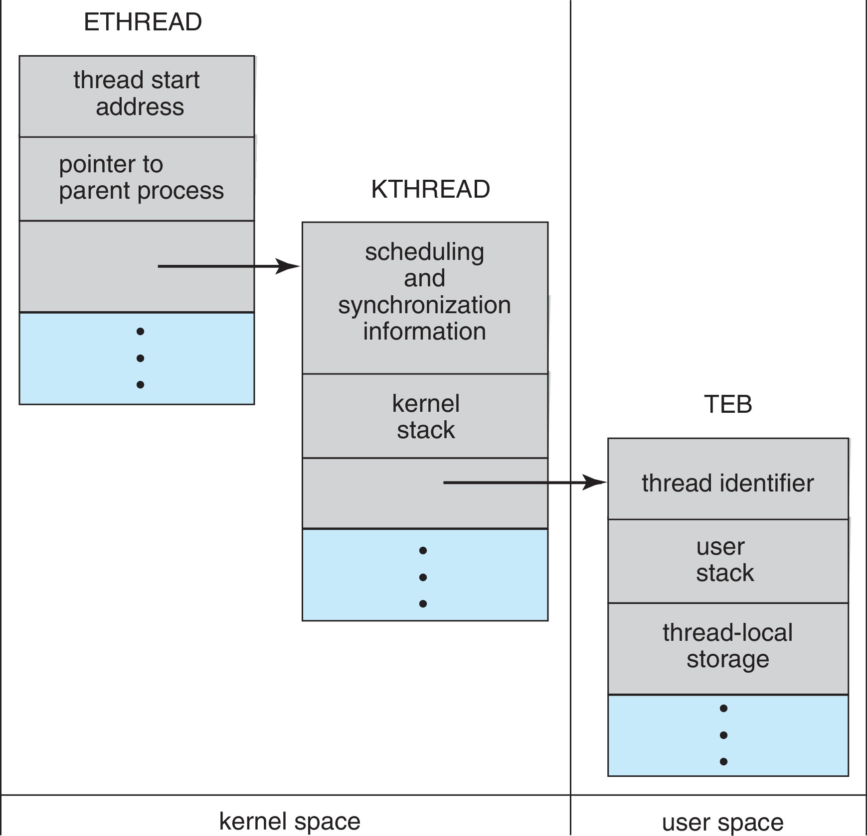
Windows Threads Data Structures

Slide 43
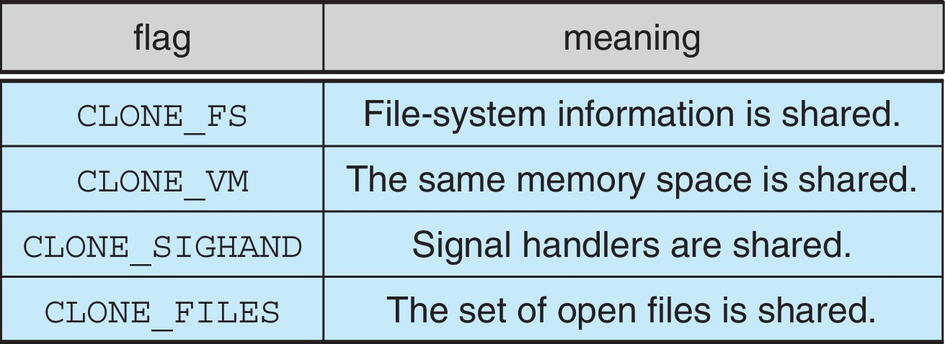
Linux Threads
Linux refers to them as tasks rather than threads
Thread creation is done through clone() system call
clone() allows a child task to share the address space of the parent task (process)
Flags control behavior
struct task_struct points to process data structures (shared or unique)

Slide 44
End of Chapter 4

