Slide 1
CDMerge: Semantically Sound Merging of Class Diagrams for Software Component Integration
Achim Lindt, Bernhard Rumpe, Max Stachon, Sebastian Stüber
Software Engineering
RWTH Aachen
https://se-rwth.de/

Slide 2

Merging Class Diagrams: Motivation
Principle of Software Engineering: Divide and Conquer
division of systems into submodules with high cohesion / low coupling
Now we want to apply this principle to models, as well:
Model each submodule independently.
Utilize model-composition to:
check for compatibility,
generate system-model on demand.
Use-case: MaCoCo (large CD for university information system)
Notes:
Open-worls semantic

Slide 3
Merging Operator for Class Diagrams ⊕ : CD $×$ CD → CD
The merged CD reflects precisely all information of its parts.
Nothing is omitted and nothing added.
Conflicting information prevents a merge.
All systems S implementing (A ⊕ B) also implement A and B correctly!
A
B
A ⊕ B
⊕_{CD}
=
Notes:
Open-worls semantic

Slide 4
Merging Class Diagrams: Example
CD Management
CD Teaching
Employee
Association
Name
int salary
Cardinality
not specified
1
*
⊕_{CD}
Professor
Lecture
attendance
Student
1..*
lecturer
holds
Professor
Lecture
String name
String mail
int credits
long matrNr
lecturer
holds
String mail
int courseID
Roles
Employee
CD University
int salary
=
Professor
1
1..*
Lecture
*
String name
String mail
attendance
Student
lecturer
holds
int credits
int courseID
long matrNr

Slide 5


Formal Aspects of Merging Class Diagrams
CD
Object Structures
Class Diagrams describe objects and their links:
Semantics of one CD is the set of all valid object structures
$sem:CD →℘(OS)$
CDMerge operator
input: two models A and B
output: merged model A ⊕ B
such that $sem\left(A⊕ B\right)⊆ sem(A) ∩ sem(B)$
$sem$
A
B
sem(A)
sem(B)
Notes:
XXX laterdo Die benutzen mathematischen Symbole sind inkompatibel und auch noch im Falschen Font:
Das ist anzupassen in diesem Kapitel. Idealerweise an die ISE-Vorlesungsnorm
→ Es bietet sich an, das bei der Umsetzung ins neue Format mit zu erledigen (bedarf aber einer Rücksprache)

Slide 6



Closed-World vs Open-World Semantics
Closed-world semantics ($sem_{cw}$):
Only explicitly modelled elements are allowed.
Does not consider merging as intersection of semantics.
Open-world semantics ($sem_{ow}$) $\hat{=}$ underspecification
If something is not explicitly modelled, it is still allowed.
Useful for model evolution analysis and model composition.
OD
CD A
$$∉sem_{cw}\left(A\right)$$
Employee
*
Task
tony: Manager
todo
name = „Tony Smith“
$$∈sem_{ow}\left(A\right)$$
managedBy
managedBy
1
Manager

Slide 7
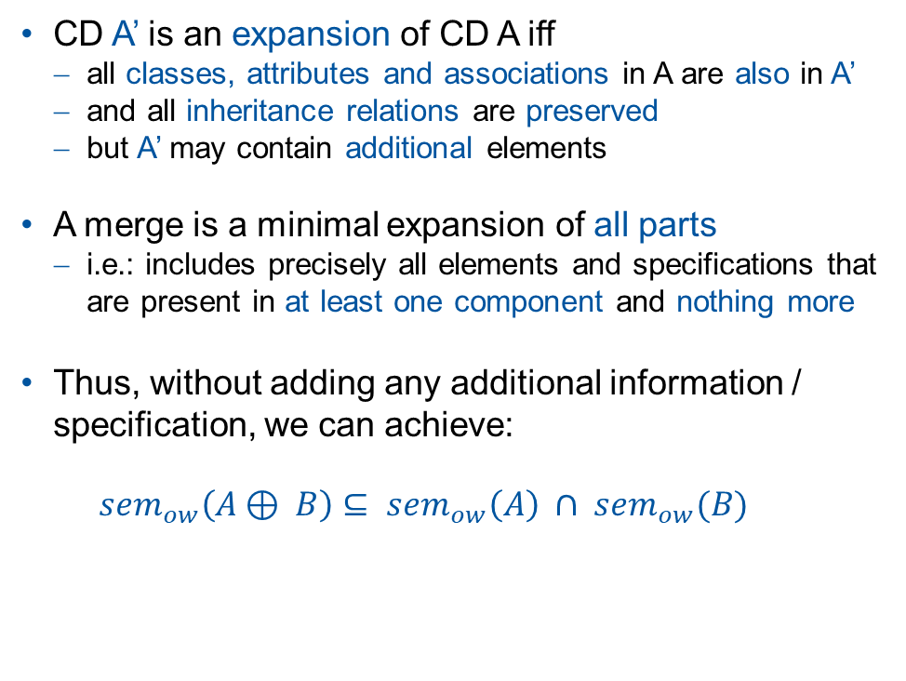
A Merge of CDs is a Minimal Expansion!
CD A
CD A’ is an expansion of CD A iff
all classes, attributes and associations in A are also in A’
and all inheritance relations are preserved
but A’ may contain additional elements
A merge is a minimal expansion of all parts
i.e.: includes precisely all elements and specifications that are present in at least one component and nothing more
Thus, without adding any additional information / specification, we can achieve:
$$sem_{ow}\left(A⊕ B\right)⊆ sem_{ow}\left(A\right) ∩ sem_{ow}(B)$$
Employee
*
Task
todo
managedBy
1
Manager
A’ expands A
CD A’
Employee
Task
String name
1..*
*
Date deadline
todo
1
Manager
managedBy

Slide 8
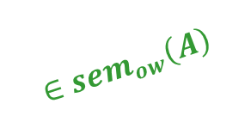
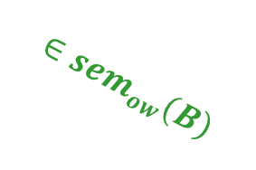
Why can we not achieve: $sem_{ow}\left(A⊕ B\right)= sem_{ow}\left(A\right) ∩ sem_{ow}(B)$?
CD A
Employee
1..*
Task
todo
managedBy
1
OD
$$∈sem_{ow}\left(A\right)$$
Manager
tony:Manager
CD B
$$∈sem_{ow}\left(B\right)$$
Employee
todo
Task
Manager

Slide 9


Why can we not achieve: $sem_{ow}\left(A⊕ B\right)= sem_{ow}\left(A\right) ∩ sem_{ow}(B)$?
CD $A⊕B$
OD
1..*
Task
Employee
todo
$$∉sem_{cw}\left(A⊕B\right)$$
tony:Manager
managedBy
1
Manager

Slide 10
How is CDMerge implemented?
First, identify matching elements.
Match classes by name.
Match attributes by class and name.
Match association by classes, association name, and role-names.
Next, merge matching elements if possible and add them to a fresh CD.
Merge attributes iff types are compatible.
Merge classes iff attributes and inheritance can be merged.
Merge associations iff match is unambiguous and cardinalities are compatible.
Finally, all unmatched elements from the input-CDs are added, as well.

Slide 11
Example: Class Merging
Class may occur in both diagrams
Attributes are collected together
Person
CD A
Person
CD B
Person
CD C
String name
String email
int birthdate
⊕_{CD}
String name
int id
=
String name
String email
int birthdate
int id
fits
sem(A)
sem(B)
OK

Slide 12
Example: Class Merging
Class may occur in both diagrams
Attributes are collected together
If types conflict: merge error (as failure)
No “smart” repairs
Person
CD A
Person
CD B
Person
CD C
String name
String email
int birthdate
⊕_{CD}
String name
int id
Date birthdate
=
String name
String email
int birthdate
Date birthdate
int id
Error

Slide 13
Example: Inheritance Merging
Person
CD A
Person
CD B
Person
CD C
String name
⊕_{CD}
String name
=
String name
attribute pull-up
to superclass
Employee
Professor
Employee
double salary
int empNo
int empNo
String phone
double salary
int empNo
Professor
Semantics of Inheritance Arrow:
Professor is subclass of Person,
not necessarily direct subclass
Professor
boolean tenured
boolean tenured
String phone
OK

Slide 14
Example: Conflicts in Inheritance Merging
No circular inheritance hierarchy
CD A
CD B
CD C
Lecturer
Professor
Professor
⊕_{CD}
=
Professor
Lecturer
Lecturer
Error

Slide 15
Example: Association Merging
CD A
Person
employment
Contract
String name
*
int salary
workContract
⊕_{CD}
CD B
Person
1
Contract
String name
contractor
workContract
int salary
=
CD C
Person
*
employment
1
Contract
String name
int salary
contractor
workContract
OK

Slide 16
Example: Ambiguous Matching of Association
No ambiguous matching of associations
CD A
ambiguous matching roles
Person
0..1
Contract
String name
*
int salary
employee
workContract
CD B
employment
Person
employee
Contract
String name
contracts
int salary
workContract
Error

Slide 17
Example: Mismatching Cardinalities
Do we allow intersection of cardinality?
Acceptable according to formal semantics,
BUT a cardinality may be considered a writing promise for the implementation!
e.g., adding arbitrary many workContracts to a Person.
CD A
Person
1..*
employment
0..1
Contract
String name
int salary
workContract
CD B
Person
employment
Contract
String name
1..4
*
int salary
workContract
Error
Notes:
Writing promises erklären

Slide 18
Example: Association and Inheritance Conflict
Roles are reading and writing promises (getLecturer / setLecturer):
Association targets cannot be changed:
→ No merging of these associations
CD A
CD B
Lecturer
Lecturer
1
holds
*
Course
⊕_{CD}
lecturer
1
holds
*
Professor
Course
Professor
lecturer
1
holds
*
CD C
Lecturer
Course
ambiguous role: Course.lecturer
lecturer
=
*
Professor
1
holds
Error
lecturer

Slide 19
Next Step: Merging and Code Generation
Ideal: merge is compatible with code generation
i.e. code generation and handwritten code on sub-diagrams can be reused
Modular, incremental generation:
late binding for handwritten code
reuse of pre-generated/compiled submodules as black-box
gen.
Java
«gen»
bind/link
CD1
data1
classes1
Module 1
compile
Java
«gen»
CD2
data2
classes2
Module 2
depends on
compose
⊕
Java
«hc»
extensions2
ext.2
CD M
Java
«gen»
data M
classesM
System
depends on
Java
«hc»
extensionsM
ext.M

Slide 20
Conclusion
Goal: Divide and Conquer
Apply this principle to data models by developing a merge operator for CDs.
Result: CDMerge
semantically sound merging of CDs
integrated into cd4analysis (github.com/MontiCore/cd4analysis)
Case study: MaCoCo
large CD for university information system
decomposition by hand into 4 component-CDs
automatic merge by CDMerge
Next Step: Merging and Code Generation
modular, incremental generation
component integration

