Slide 1
Implementing a Simple REST Service
Getting started
Defining a simple REST service

Slide 2
1. Getting Started
Spring Boot web applications
The role of REST services
REST services in Spring MVC
Supporting JSON and XML
Defining a model class
Demo package: demo.restservices

Slide 3
Spring Boot Web Applications
To create a web app, add the Spring Web dependency:
Alternatively, add the Spring Reactive Web dependency
Good if you have very high load or a continuous stream of data
<dependency>
<groupId>org.springframework.boot</groupId>
<artifactId>spring-boot-starter-web</artifactId>
</dependency>
We'll do this
pom.xml
<dependency>
<groupId>org.springframework.boot</groupId>
<artifactId>spring-boot-starter-webflux</artifactId>
</dependency>
pom.xml

Slide 4
The Role of REST Services
A REST service is an endpoint in a web application
Has methods that are mapped to URLs
Easily accessible by clients over HTTP(S)
Consume/return data, typically JSON (or XML)
The role of REST services in a full-stack application:
Callable from UI, e.g. from a React web UI
Provides a façade to back-end data/functionality

Slide 5
REST Services in Spring MVC
This is how REST services work in Spring MVC:
HTTP request
aMethod
HTTP response
DispatcherServlet
bean created by Spring Boot
Controller bean
implemented by you
Other beans
e.g. repositories
Spring Boot application

Slide 6
Supporting JSON and XML
REST controller methods receive/return Java objects
Spring Boot automatically creates a JSON serializer bean, to convert Java objects to/from JSON
If you also want to support XML serialization, you must add the following dependency in your POM file:
<dependency>
<groupId>com.fasterxml.jackson.dataformat</groupId>
<artifactId>jackson-dataformat-xml</artifactId>
</dependency>
pom.xml

Slide 7
Defining a Model Class
We'll use the following POJO class in our REST services:
The JSON/XML serializers will convert Product objects to/from JSON or XML automatically, as appropriate
public class Product {
private long id;
private String description;
private double price;
// Plus constructors, getters/setters, etc …
}
Product.java

Slide 8
2. Defining a Simple REST Service
How to define a REST controller
Example REST controller
Pinging the simple REST controller
A better approach
Mapping path variables
Mapping request parameters
Demo package: demo.restservices

Slide 9
How to Define a REST Controller
Define a class and annotate with:
@Controller (or @RestController)
@RequestMapping (optional base URL)
@CrossOrigin (optional CORS support)
Define methods annotated with one of the following:
@GetMapping, @PostMapping, @PutMapping, @DeleteMapping,@RequestMapping
For each method, also specify the path (URL) and data-types

Slide 10
Example REST Controller
Here's a simple REST controller
The method returns a product collection:
@RestController
@RequestMapping("/simple")
@CrossOrigin
public class SimpleController {
private Map<Long, Product> catalog = new HashMap<>();
…
@GetMapping(
value="/productsV1",
produces={"application/json","application/xml"}
)
public Collection<Product> getProductsV1() {
return catalog.values();
}
…
}
SimpleController.java

Slide 11
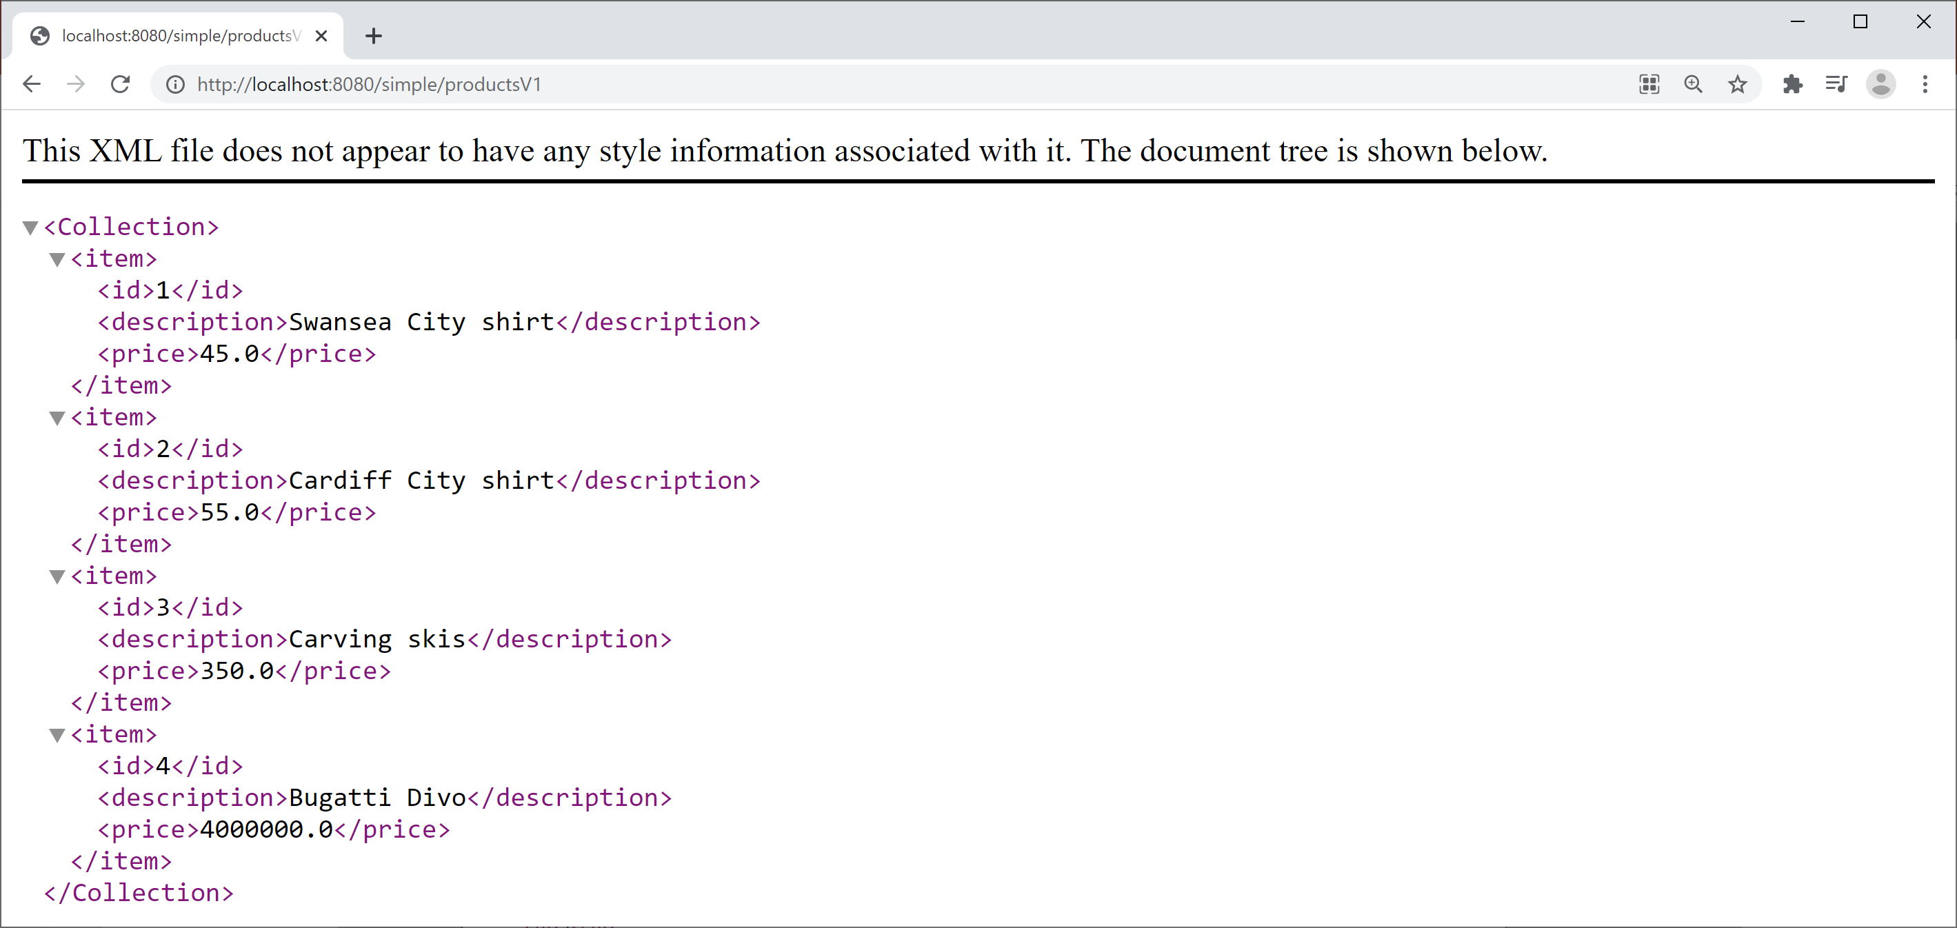
Pinging the Simple REST Controller
Run the Spring Boot app, then browse to:
http://localhost:8080/simple/productsV1

Slide 12
A Better Approach
So far, we return a Collection<Product>
This populates the HTTP response body
But it doesn't set the HTTP headers or status code
A better approach is to return ResponseEntity<T>
Gives control over entire HTTP response body
We can set HTTP headers and status code:
@GetMapping(
value="/productsV2",
produces={"application/json","application/xml"}
)
public ResponseEntity<Collection<Product>> getProductsV2() {
return ResponseEntity.ok().body(catalog.values());
}
SimpleController.java

Slide 13
Mapping Path Variables
You can map parts of the path to variables
In the path, define {…} placeholder(s)
In the method, annotate param with @PathVariable
@GetMapping(
value="/products/{id}",
produces={"application/json","application/xml"}
)
public ResponseEntity<Product> getProductById(@PathVariable long id) {
Product p = catalog.get(id);
if (p == null)
return ResponseEntity.notFound().build();
else
return ResponseEntity.ok().body(p);
}
SimpleController.java
http://localhost:8080/simple/products/1

Slide 14
Mapping Request Parameters
You can map HTTP request parameter(s)
In the path, optionally provide parameter(s) after ?
In the method, annotate param with @RequestParam
@GetMapping(
value="/products",
produces={"application/json","application/xml"})
public ResponseEntity<Collection<Product>> getProductsMoreThan(
@RequestParam(value="min", required=false, defaultValue="0.0") double min) {
Collection<Product> products = catalog.values()
.stream()
.filter(p -> p.getPrice() > min)
.collect(Collectors.toList());
return ResponseEntity.ok().body(products);
}
SimpleController.java
http://localhost:8080/simple/products?min=100

Slide 15
Summary
Getting started
Defining a simple REST service

Slide 16

Exercise
Add the following endpoints to the REST controller:
GET /count Returns the count of products
GET /averagePrice?min=xxx&max=yyy Returns the average price (in an optional range)

