Slide 1
Implementing a Full REST Service
Setting the scene
Defining a full REST service

Slide 2
1. Setting the Scene
Overview
Example REST controller
Using Swagger to expose the REST API
Using the Swagger UI
Demo package: demo.restservices

Slide 3
Overview
So far, we've seen how to GET data from a REST service:
Here's how to support the other HTTP verbs:
@GetMapping(value= … )
@PostMapping(value= … )
@PutMapping(value= … )
@DeleteMapping(value= … )

Slide 4
Example REST Controller
Here's the example REST controller for our example:
Note:
We've defined a repository bean to manage data persistence
See ProductRepository.java for details
@RestController
@RequestMapping("/full")
@CrossOrigin
public class FullController {
@Autowired
private ProductRepository repository;
// Full CRUD API, see following slides
…
}
FullController.java

Slide 5
Using Swagger to Expose the REST API (1 of 3)
We'll use Swagger to help us test our REST API
Swagger is an open-source project
Enables you to document your REST API
What does Swagger do?
Exposes metadata about your REST controller classes and paths
Enables you to test GET, POST, PUT, DELETE endpoints
For full details about Swagger, see:
https://swagger.io/

Slide 6
Using Swagger to Expose the REST API (2 of 3)
To use Swagger in a Spring Boot application, add the following dependencies to your POM file:
<dependency>
<groupId>io.springfox</groupId>
<artifactId>springfox-boot-starter</artifactId>
<version>3.0.0</version>
</dependency>
<dependency>
<groupId>io.springfox</groupId>
<artifactId>springfox-swagger-ui</artifactId>
<version>3.0.0</version>
</dependency>
pom.xml

Slide 7
Using Swagger to Expose the REST API (3 of 3)
You must also configure Swagger so it knows what controllers and paths to expose:
import org.springframework.context.annotation.Bean;
import org.springframework.context.annotation.Configuration;
import springfox.documentation.builders.PathSelectors;
import springfox.documentation.builders.RequestHandlerSelectors;
import springfox.documentation.spi.DocumentationType;
import springfox.documentation.spring.web.plugins.Docket;
@Configuration
public class SwaggerConfiguration {
@Bean
public Docket api() {
return new Docket(DocumentationType.SWAGGER_2)
.select()
.apis(RequestHandlerSelectors.any())
.paths(PathSelectors.any())
.build();
}
}
SwaggerConfiguration.java

Slide 8
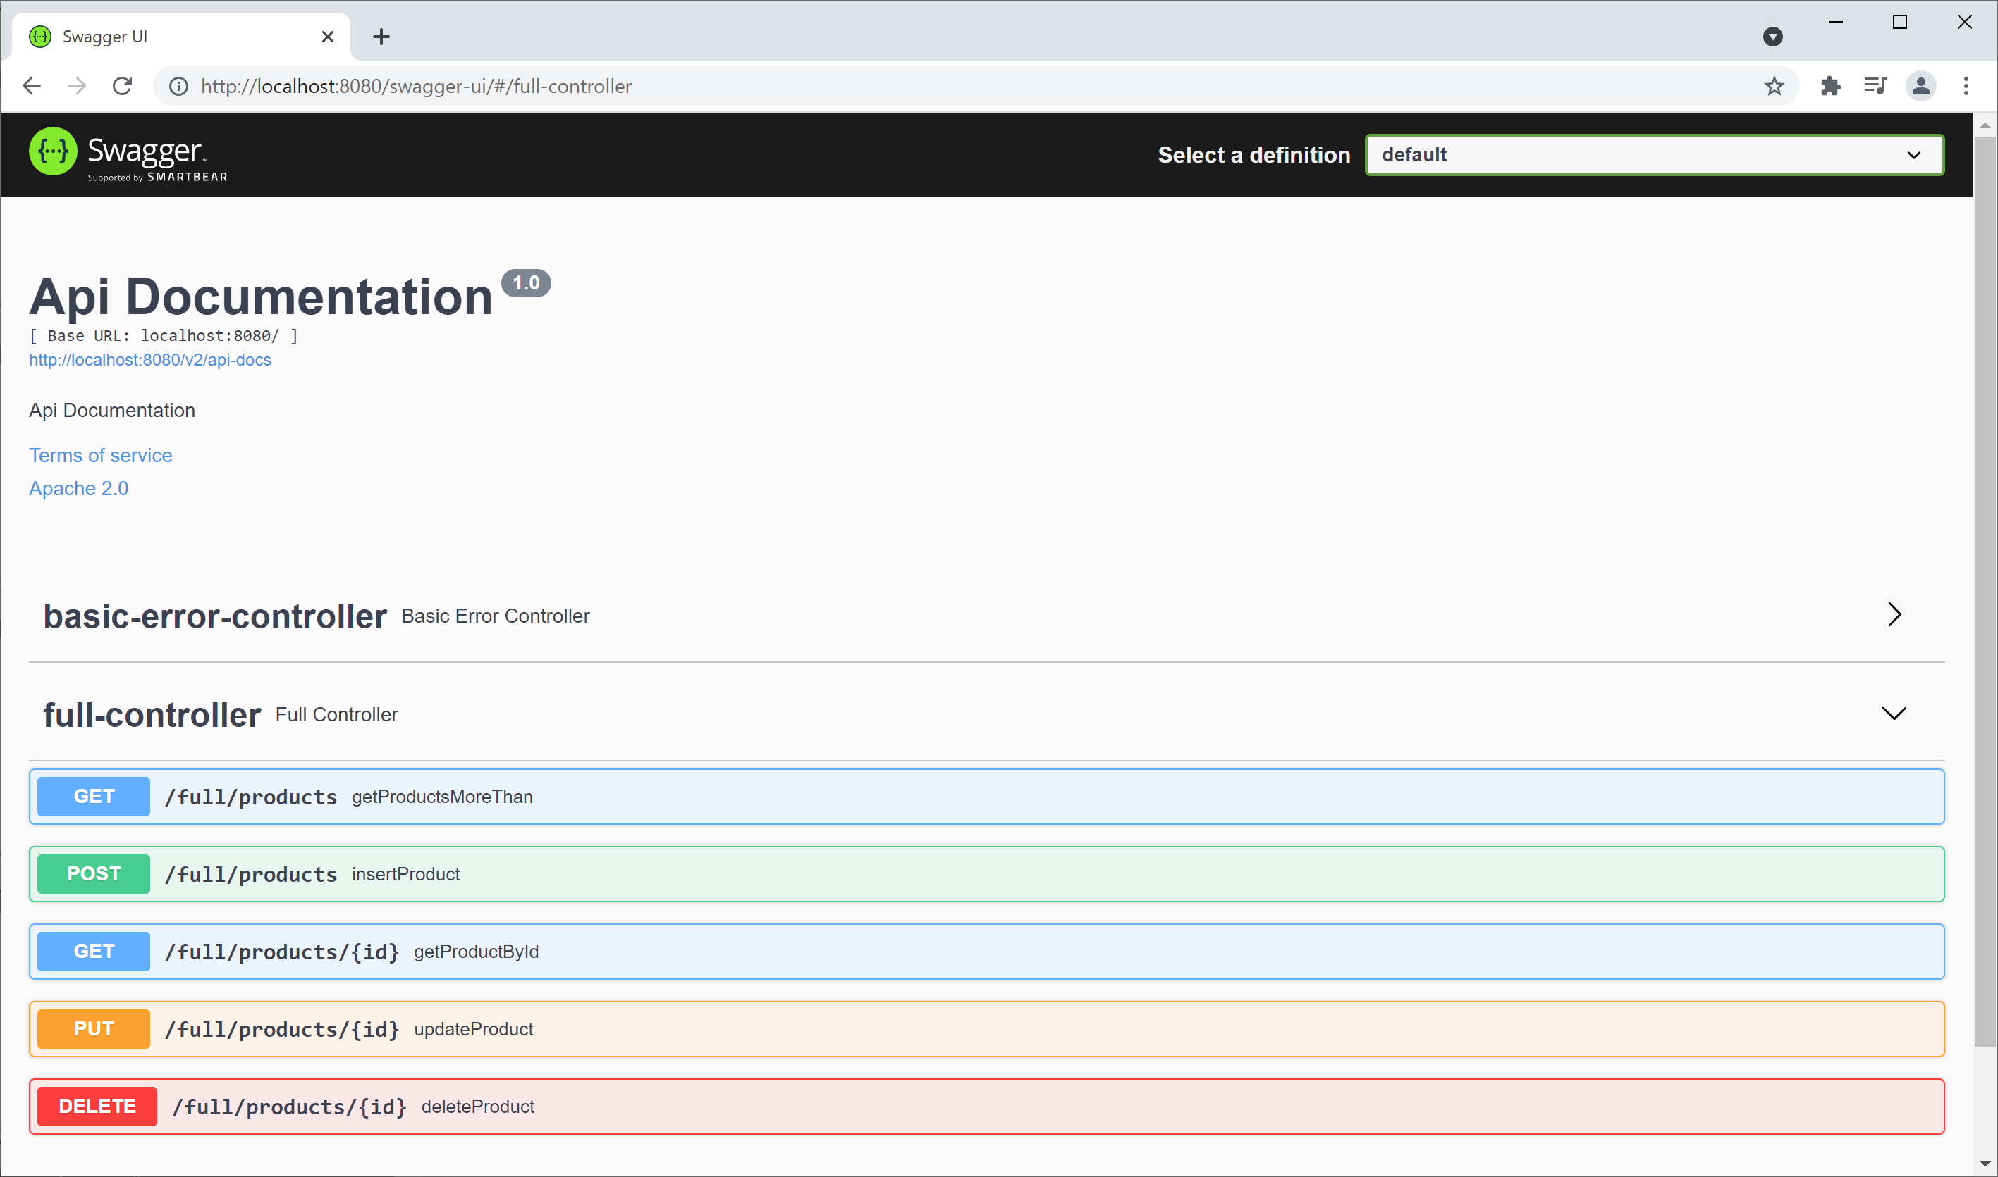
Using the Swagger UI
Run your Spring Boot app and browse to:
http://localhost:8080/swagger-ui/

Slide 9
2. Defining a Full REST Service
Implementing a POST method
Implementing a PUT method
Implementing a DELETE method

Slide 10
Implementing a POST Method
A POST method typically inserts a resource:
Client passes object in HTTP request body
Service returns enriched object after insertion
Service also returns status code 201, plus a LOCATION header
@PostMapping(
value="/products",
consumes={"application/json","application/xml"},
produces={"application/json","application/xml"})
public ResponseEntity<Product> insertProduct(@RequestBody Product product) {
repository.insert(product);
URI uri = URI.create("/full/products/" + product.getId());
return ResponseEntity.created(uri).body(product);
}
FullController.java

Slide 11
Implementing a PUT Method
A PUT method typically updates an existing resource:
Client passes id in URL
Client also passes an object in request body
Service returns status code 200 or 404
@PutMapping(value="/products/{id}", consumes={"application/json","application/xml"})
public ResponseEntity<Void> updateProduct(@PathVariable long id,
@RequestBody Product product) {
if (!repository.update(product))
return ResponseEntity.notFound().build();
else
return ResponseEntity.ok().build();
}
FullController.java

Slide 12
Implementing a DELETE Method
A DELETE method typically deletes an existing resource:
Client passes id in URL
Service returns status code 200 or 404
@DeleteMapping("/products/{id}")
public ResponseEntity<Void> deleteProduct(@PathVariable long id) {
if (!repository.delete(id))
return ResponseEntity.notFound().build();
else
return ResponseEntity.ok().build();
}
FullController.java

Slide 13
Summary
Setting the scene
Defining a full REST service

Slide 14

Exercise
Add the following endpoint to the REST controller:
PUT /products/1/increasePriceBy/10.99 Increases price of specified product by specified amount

