Slide 1
Messaging with Kafka
Overview of messaging using Kafka
Using Kafka in a Spring Boot application

Slide 2
1. Overview of Messaging using Kafka
What is Kafka?
Kafka in industry
Installing Kafka
A few words about Zookeeper
Tweak the Kafka and Zookeeper config files
Starting Zookeeper and Kafka

Slide 3
What is Kafka?
Apache Kafka is a distributed message broker
Kafka runs as a cluster of broker nodes
Primary goal is high throughput, idea for cloud-scale architectures
Uses a pub/sub messaging architecture
Subscriber
Publisher
Broker
Subscriber
Publisher
Broker
Subscriber
Publisher
Kafka broker cluster
Subscriber

Slide 4
Kafka in Industry
Kafka is widely used by major players in industry
LinkedIn
Twitter
Netflix
Airbnb
Goldman Sachs
PayPal
Coursera
Hotels.com
Etc.

Slide 5
Installing Kafka
In Windows…
Go to https://kafka.apache.org/downloads.html
Download and unzip the latest binary distribution, e.g. kafka_2.12-2.8.1.tgz
In macOS:
Install Homebrew (if not already installed)
Then run the following command:
brew install kafka

Slide 6
A Few Words about Zookeeper
Apache Kafka uses Apache Zookeeper to coordinate cluster info
Zookeeper is a distributed hierarchical key-value store
Provides a naming service for large distributed systems
The Kafka download already includes Zookeeper
So you don’t need to download Zookeeper separately
You just need to run Zookeeper first, then you can run Kafka…

Slide 7
Tweak the Kafka and Zookeeper Config Files
You must edit the Kafka and Zookeeper configuration files
Set the data log directories appropriately for your environment
Edit the Kafka configuration file, located here:
<Kafka_Home>/config/server.properties
Edit the Zookeeper configuration file, located here:
<Kafka_Home>/config/zookeeper.properties
log.dirs=C:/temp/kafka-logs
server.properties
dataDir=C:/temp/zookeeper
zookeeper.properties

Slide 8
Starting Zookeeper and Kafka on Windows
To start Zookeeper on Windows:
Open a Command Prompt window
In the Kafka installation directory, run the following command:
To start Kafka on Windows:
Open another Command Prompt window
In the Kafka installation directory, run the following command:
bin\windows\zookeeper-server-start.bat config\zookeeper.properties
bin\windows\kafka-server-start.bat config\server.properties

Slide 9
Starting Zookeeper and Kafka on macOS
To start Zookeeper and Kafka on macOS:
Open a new Terminal window
In the Kafka installation directory, run the following commands:
zookeeper-server-start /usr/local/etc/kafka/zookeeper.properties &
kafka-server-start /usr/local/etc/kafka/server.properties

Slide 10
2. Using Kafka in a Spring Boot Application
Spring Boot dependency for Kafka
Configuring application properties
Sending messages to a topic
Consuming messages from a topic
Example REST API to publish messages
Pinging the REST API
Demo package: demo.kafka.simple

Slide 11
Spring Boot Dependency for Kafka
To use Kafka in a Spring Boot application, add the following dependency in your pom file:
<dependency>
<groupId>org.springframework.kafka</groupId>
<artifactId>spring-kafka</artifactId>
</dependency>
pom.xml

Slide 12
Configuring Application Properties
You can tell Kafka to create topics dynamically
This enables your application to send/receive from a topic, without you having to create the topic first
To enable Kafka to create topics dynamically, define the following application property:
spring.kafka.listener.missing-topics-fatal=false
application.properties

Slide 13
Sending Messages to a Topic
To send messages to a topic:
Autowire a KafkaTemplate<K,V> bean
Call send(topicName,key,value)
Note that Kafka messages are key-value pairs ☺
@Service
public class MyPublisher {
private static final String TOPIC_NAME = "mytopic";
@Autowired
private KafkaTemplate<String,String> kafkaTemplate;
public void sendMessage(String key, String value){
this.kafkaTemplate.send(TOPIC_NAME, key, value);
}
}
MyPublisher.java

Slide 14
Consuming Messages from a Topic (1 of 2)
To consume messages from a topic, define a method and annotate it with:
@KafkaListener(topics,groupId)
You can define multiple listeners for the same topic
One listener in each group will receive the message
Listener methods receive the message value
Can also receive message header metadata, e.g. key, timestamp

Slide 15
Consuming Messages from a Topic (2 of 2)
Example consumer in our demo app:
@Service
public class MyConsumer {
@KafkaListener(topics = "mytopic", groupId="group1")
public void group1ConsumerA(
@Header(KafkaHeaders.RECEIVED_MESSAGE_KEY) String key,
@Header(KafkaHeaders.RECEIVED_TOPIC) String topic,
@Header(KafkaHeaders.RECEIVED_TIMESTAMP) String timestamp,
String value) {
// Process the message here…
}
}
MyConsumer.java

Slide 16
Example REST API to Publish Messages
The demo app has a REST controller
Allows users to publish messages to a topic
@RestController
@RequestMapping("/mykafka")
@CrossOrigin
public class MyRestController {
@Autowired
private MyPublisher publisher;
@GetMapping("/publish")
public String publish(@RequestParam("value") String value) {
for (int i = 1; i <= 5; i++) {
this.publisher.sendMessage("key" + i, value);
}
return "Published 5 messages, keys: 1-5, value: " + value;
}
}
MyRestController.java

Slide 17
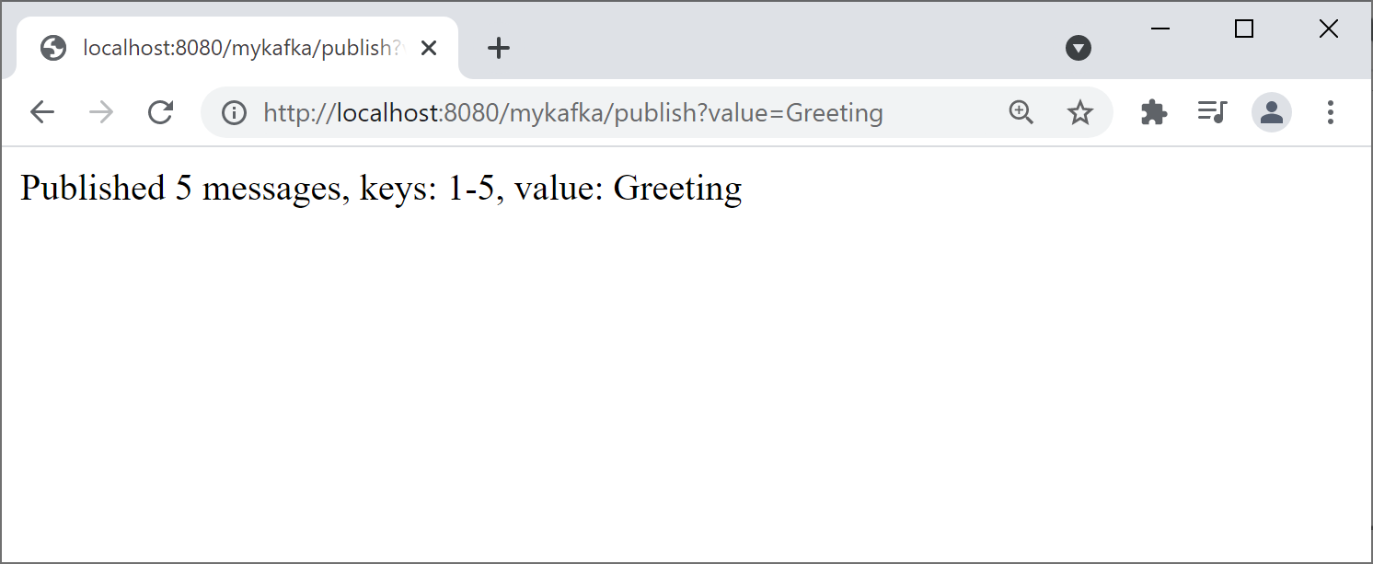
Pinging the REST API
You can ping the REST API as follows:
http://localhost:8080/mykafka/publish?value=Greeting

Slide 18
Summary
Overview of Kafka
Using Kafka in a Spring Boot application

Slide 19

Exercise
The simple example we've just shown sends messages with the following data types:
Key: String
Value: String
Kafka lets you send any data types as keys/values
You must configure KafkaTemplate
Specify how to serialize/deserialize objects
See: demo.kafka.customobjects
Demo package: demo.kafka.customobjects

