Slide 1
mlflow
with
run:ai

Slide 2
mlflow overview

Slide 3


What is needed for mlflow to run?
1) A Database to store information related to experiment runs
2) An Artifacts folder to store objects related to the runs
Database
Artifacts folder

Slide 4
How does mlflow work?
1) First we start the server with a CLI command
running either of these commands will automatically create a database in the local directory, if one doesn’t exist.
mlflow ui
(or)
mlflow server
we can also choose to specify the location of the database, and artifact folder, as well as the host IP, and port.
mlflow server \
--backend-store-uri=sqlite:///abs/path/to/db/mlflow.db \
--default-artifact-root=/abs/path/to/artifacts \
--host=0.0.0.0 \
--port=5000

Slide 5
How does mlflow work?
2) call mlflow commands within the python script
you’ll want to import mlflow, then set the tracking uri so that mlflow will save everything to the database and artifact folder.
Then you’ll want to start your run, and at the end, you’ll want to end the run.
import mlflow
mlflow.set_tracking_uri(‘0.0.0.0:5000’)
mlflow.start_run()
“””
your code here
“””
mlflow.end_run()

Slide 6
mlflow with run:ai

Slide 7
What is needed for mlflow to run on run:ai?
1) A persistent directory to keep
mlflow database
mlflow artifacts folder
2) A docker image with the following installed
mlflow
jupyterlab*
jupyter-server-proxy*
*needed in order to access the mlflow UI

Slide 8
creating persistent directory

Slide 9
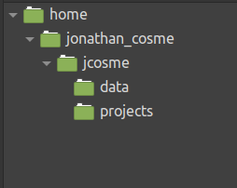
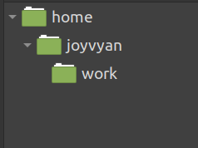
Before we start
We need to create an ‘mlflow’ folder on our NFS.
This is what our NFS folder structure looks like now
This is the default folder structure for our jupyter lab image

Slide 10
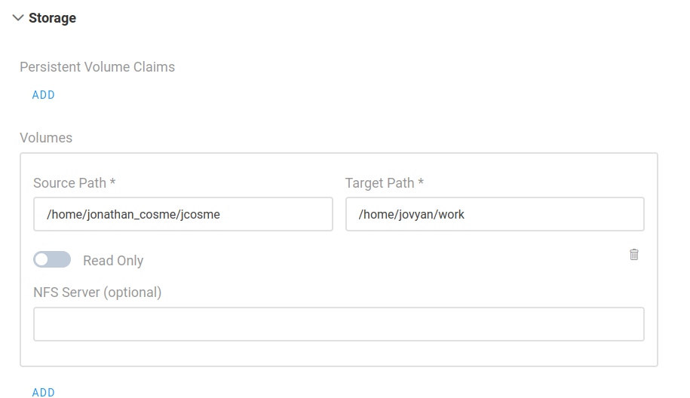
Before we start
We need to create an ‘mlflow’ folder on our NFS.
For our example:
Whenever we create a job on run:ai, we must always mount our NFS to the default jupyter work directory
our NFS folder
default jupyter work directory (this is always the same)

Slide 11
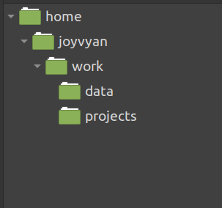
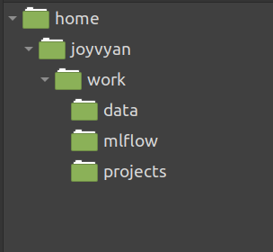
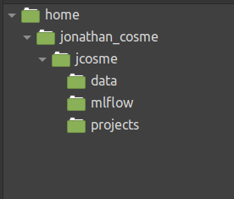
Before we start
We need to create an ‘mlflow’ folder on our NFS.
1. After we mount our NFS volume,
our work directory will look like this:
2. Using Jupyter Lab, we create an ‘mlflow’ folder within the work directory:
3. This will cause our NFS directory to automatically look like this:

Slide 12
docker image

Slide 13
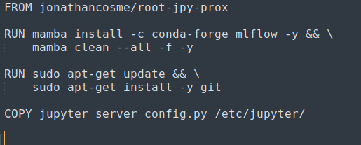
Docker used in our example
The docker image we will use is:
jonathancosme/mlflow-ui
This is what is in the dockerfile:
notebook with jupyter-server-proxy already installed
install mlflow
install git (needed by mlflow)
copy new config file, with mlflow UI access configured

Slide 14
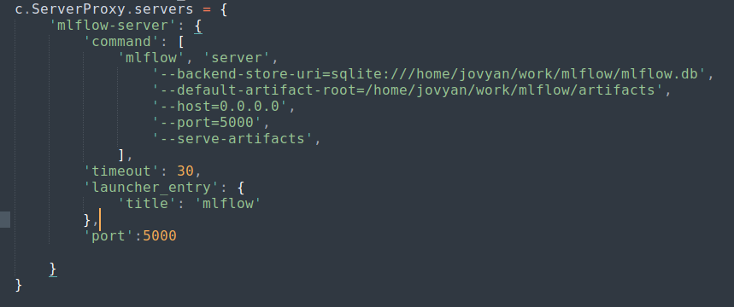
Docker used in our example
The docker image we will use is:
jonathancosme/mlflow-ui
in order to access the mlflow UI, we need to add this entry to the jupyter_server_config.py file, and replace the existing file in the image
we specify our database and artifact folder locations (this is why we must always mount our NFS directory to the default jupyter work directory)
we must make sure to start the server on this IP and port
This tells jupyter to forward port 5000 to the URL

Slide 15
Accessing the mlflow UI

Slide 16
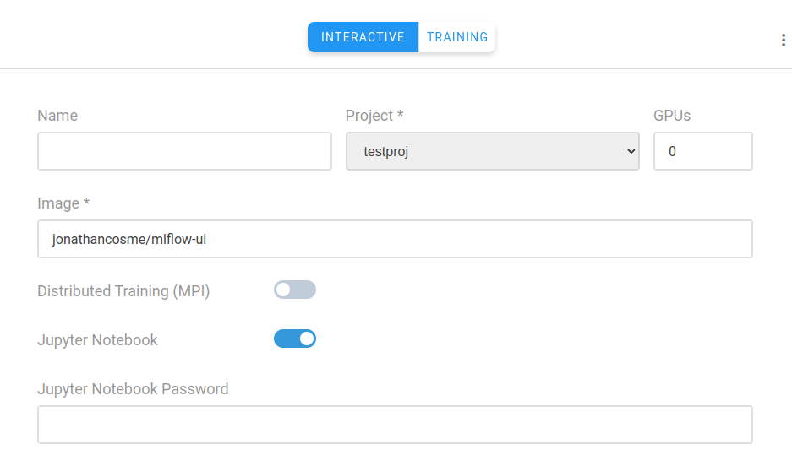
Access mlflow UI
Create a jupyter interactive job with:
image jonathancosme/mlflow-iu
mounted NFS folder (with ‘mlflow’ folder) in default jupyter work directory
default jupyter work directory (this is always the same)
NFS folder

Slide 17
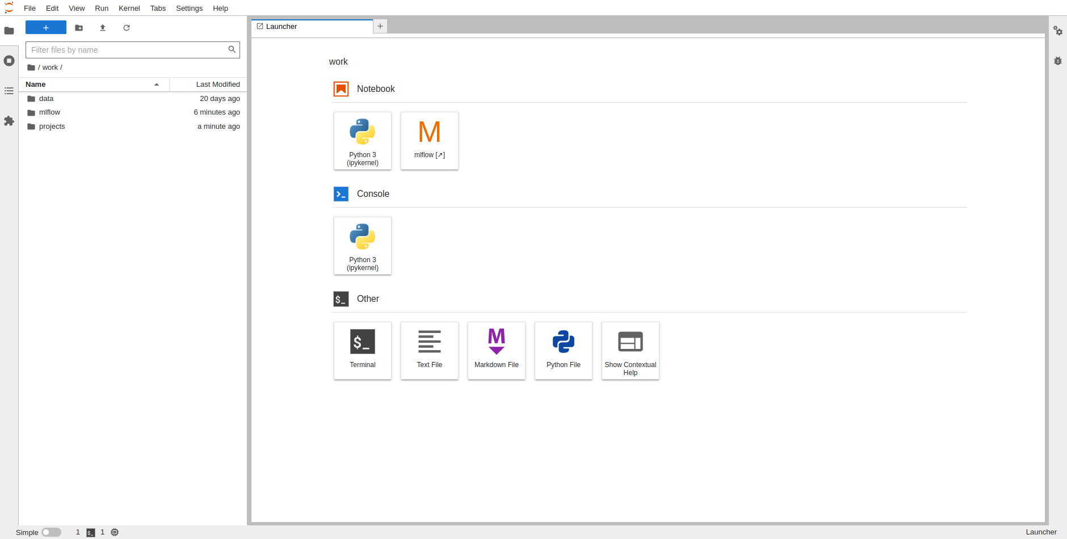
Access mlflow UI
1) make sure ‘mlflow’ folder exists inside ‘work’ directory
2) select ‘mlflow’ on launcher

Slide 18
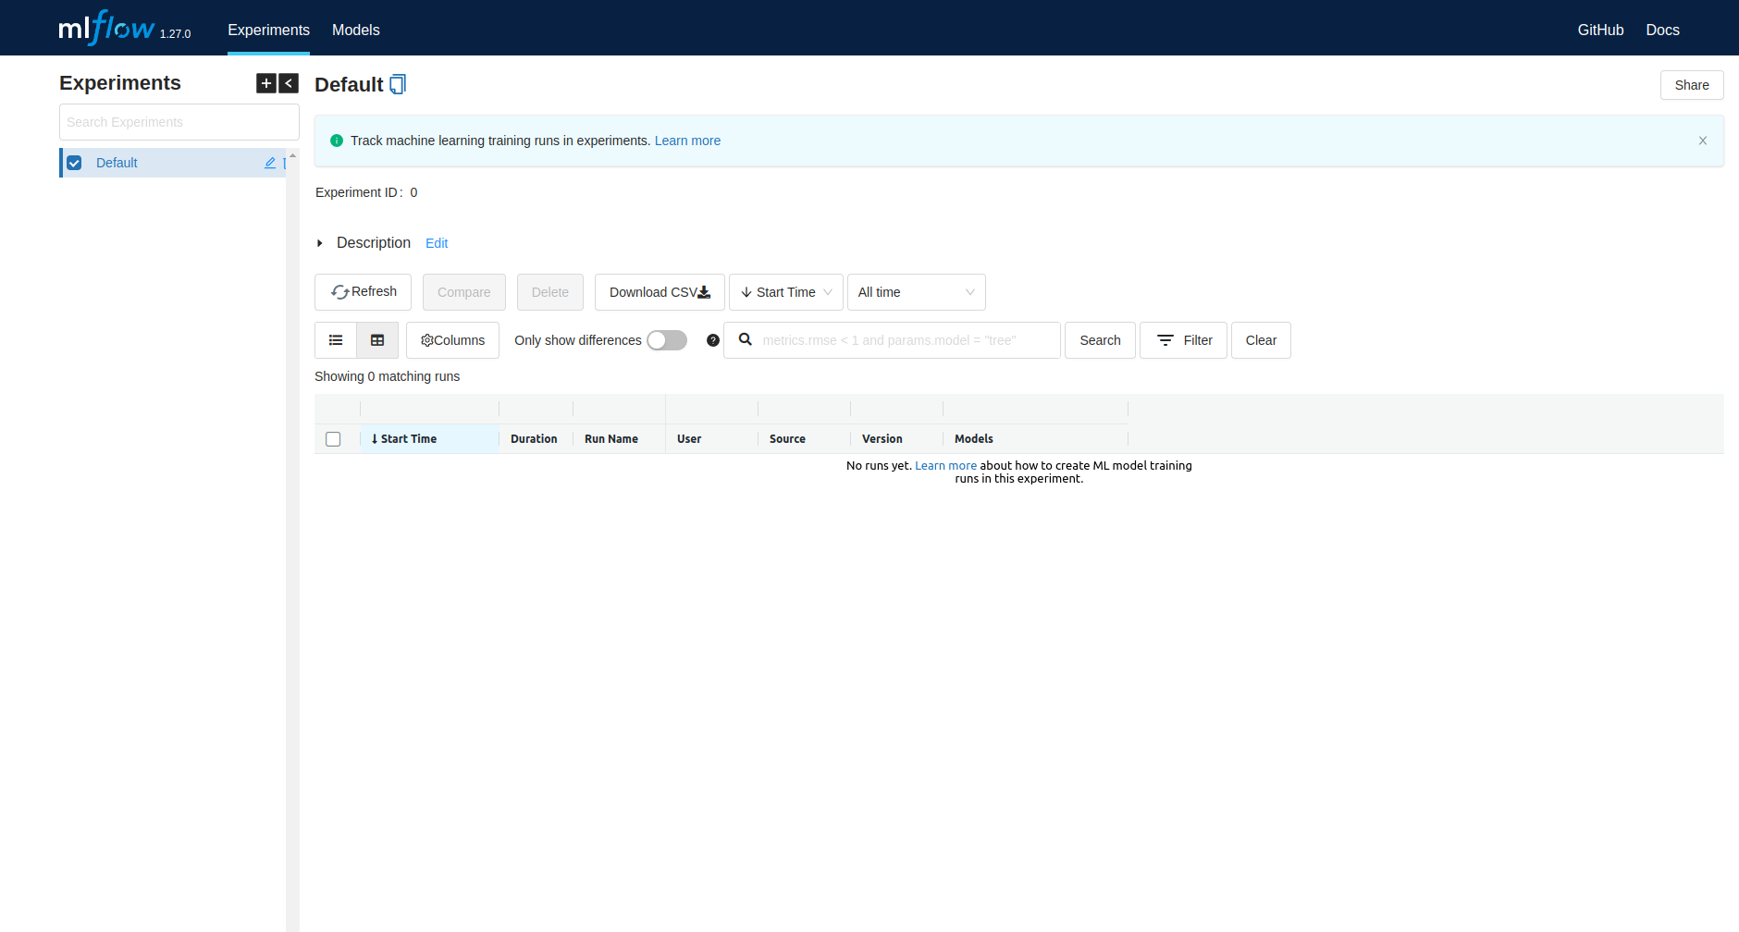
Access mlflow UI
A new tab should appear with the mlflow UI

Slide 19
running mlflow experiments with run:ai

Slide 20
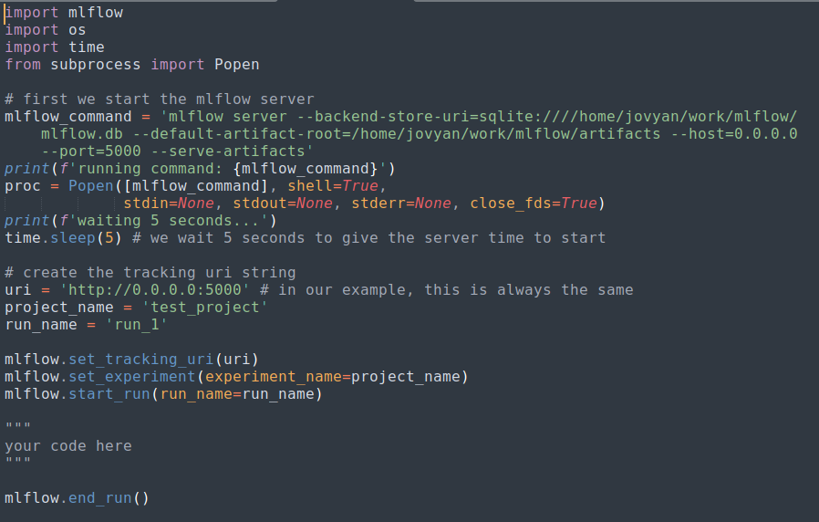
Python scripts
in your script, you should first launch the mlflow server
Then be sure to set the tracking uri

Slide 21
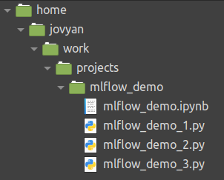
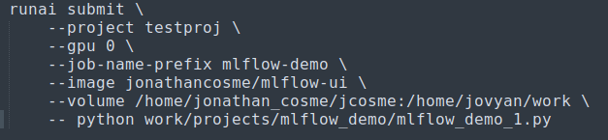
CLI submission
Our example scrips are located here:
make sure you use the mlflow-ui docker image
so our CLI command would look like this:
make sure you mount the NFS to the work directory
The code to run the job must specify the python script with relative location

Slide 22
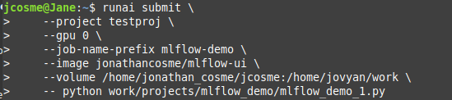
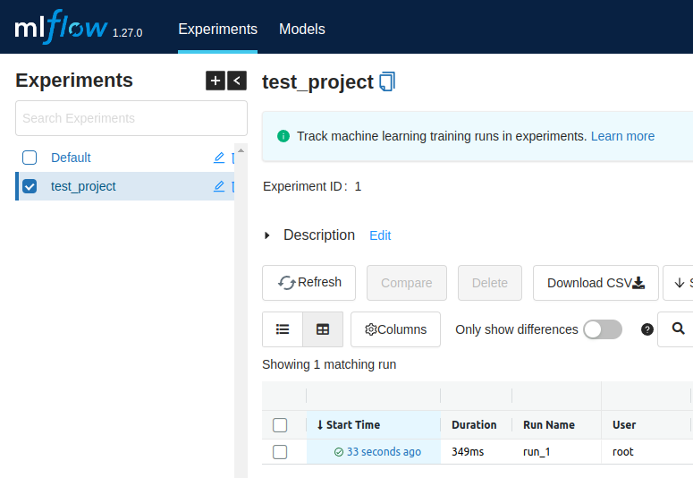
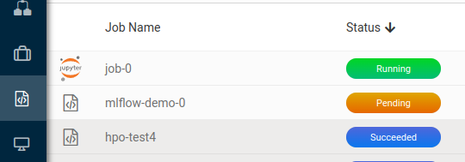
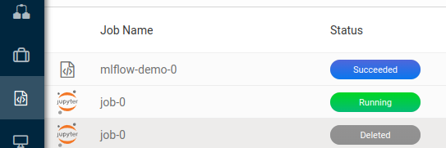
Example job submission
1) submit CLI command
4) refresh mlflow UI to see updates
2) a new job should appear
3) wait for job to finish

Slide 23
Thank you!

