Slide 1
mlflow
with
run:ai

Slide 2
mlflow overview

Slide 3
What is needed for mlflow to run?

Slide 4

What is needed for mlflow to run?
1) A Database to store information related to experiment runs
Database

Slide 5

What is needed for mlflow to run?
1) A Database to store information related to experiment runs
2) An Artifacts folder to store objects related to the runs
Database
Artifacts folder

Slide 6
How does mlflow work?

Slide 7
How does mlflow work?
1) First we start the server with a CLI command

Slide 8
How does mlflow work?
1) First we start the server with a CLI command
running either of these commands will automatically create a database in the local directory, if one doesn’t exist.
mlflow ui
(or)
mlflow server

Slide 9
How does mlflow work?
1) First we start the server with a CLI command
running either of these commands will automatically create a database in the local directory, if one doesn’t exist.
mlflow ui
(or)
mlflow server
we can also choose to specify the location of the database, and artifact folder, as well as the host IP, and port.
mlflow server \
--backend-store-uri=sqlite:///abs/path/to/db/mlflow.db \
--default-artifact-root=/abs/path/to/artifacts \
--host=0.0.0.0 \
--port=5000

Slide 10
How does mlflow work?

Slide 11
How does mlflow work?
2) call mlflow commands within the python script

Slide 12
How does mlflow work?
2) call mlflow commands within the python script
you’ll want to import mlflow, then set the tracking uri so that mlflow will save everything to the database and artifact folder.
Then you’ll want to start your run, and at the end, you’ll want to end the run.
import mlflow
mlflow.set_tracking_uri(‘0.0.0.0:5000’)
mlflow.start_run()
“””
your code here
“””
mlflow.end_run()

Slide 13
mlflow with run:ai

Slide 14
What is needed for mlflow to run on run:ai?

Slide 15
What is needed for mlflow to run on run:ai?
1) A persistent directory to keep
mlflow database
mlflow artifacts folder

Slide 16
What is needed for mlflow to run on run:ai?
1) A persistent directory to keep
mlflow database
mlflow artifacts folder
2) A docker image with the following installed
mlflow
jupyterlab*
jupyter-server-proxy*
*needed in order to access the mlflow UI

Slide 17
creating persistent directory

Slide 18
Before we start
We need to create an ‘mlflow’ folder on our NFS.

Slide 19
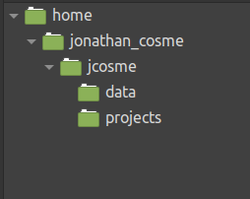
Before we start
We need to create an ‘mlflow’ folder on our NFS.
This is what our NFS folder structure looks like now

Slide 20
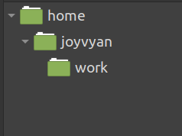
Before we start
We need to create an ‘mlflow’ folder on our NFS.
This is what our NFS folder structure looks like now
This is the default folder structure for our jupyter lab image

Slide 21
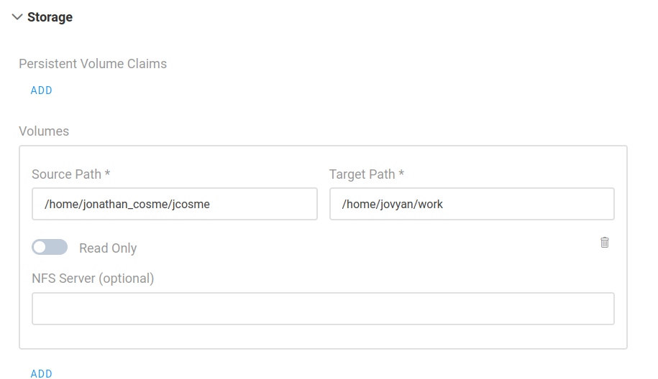
Before we start
We need to create an ‘mlflow’ folder on our NFS.
For our example:
Whenever we create a job on run:ai, we must always mount our NFS to the default jupyter work directory
our NFS folder
default jupyter work directory (this is always the same)

Slide 22
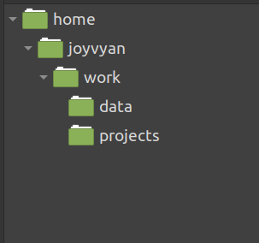
Before we start
We need to create an ‘mlflow’ folder on our NFS.
1. After we mount our NFS volume,
our work directory will look like this:

Slide 23
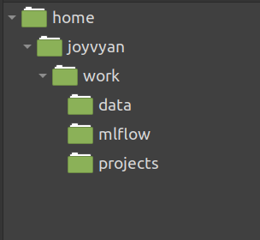
Before we start
We need to create an ‘mlflow’ folder on our NFS.
1. After we mount our NFS volume,
our work directory will look like this:
2. Using Jupyter Lab, we create an ‘mlflow’ folder within the work directory:

Slide 24
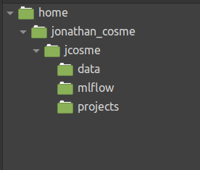
Before we start
We need to create an ‘mlflow’ folder on our NFS.
1. After we mount our NFS volume,
our work directory will look like this:
2. Using Jupyter Lab, we create an ‘mlflow’ folder within the work directory:
3. This will cause our NFS directory to automatically look like this:

Slide 25
docker image

Slide 26
Docker used in our example

Slide 27
Docker used in our example
The docker image we will use is:
jonathancosme/mlflow-ui

Slide 28
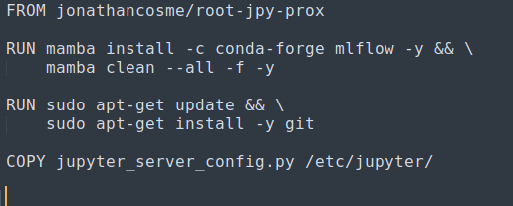
Docker used in our example
The docker image we will use is:
jonathancosme/mlflow-ui
This is what is in the dockerfile:

Slide 29
Docker used in our example
The docker image we will use is:
jonathancosme/mlflow-ui
This is what is in the dockerfile:
notebook with jupyter-server-proxy already installed

Slide 30
Docker used in our example
The docker image we will use is:
jonathancosme/mlflow-ui
This is what is in the dockerfile:
notebook with jupyter-server-proxy already installed
install mlflow

Slide 31
Docker used in our example
The docker image we will use is:
jonathancosme/mlflow-ui
This is what is in the dockerfile:
notebook with jupyter-server-proxy already installed
install mlflow
install git (needed by mlflow)

Slide 32
Docker used in our example
The docker image we will use is:
jonathancosme/mlflow-ui
This is what is in the dockerfile:
notebook with jupyter-server-proxy already installed
install mlflow
install git (needed by mlflow)
copy new config file, with mlflow UI access configured

Slide 33
Docker used in our example
The docker image we will use is:
jonathancosme/mlflow-ui

Slide 34
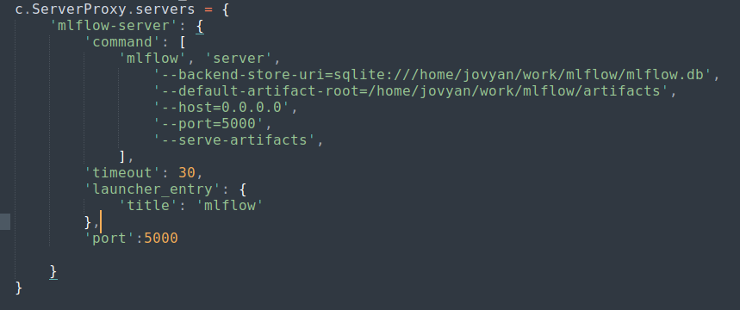
Docker used in our example
The docker image we will use is:
jonathancosme/mlflow-ui
in order to access the mlflow UI, we need to add this entry to the jupyter_server_config.py file, and replace the existing file in the image

Slide 35
Docker used in our example
The docker image we will use is:
jonathancosme/mlflow-ui
in order to access the mlflow UI, we need to add this entry to the jupyter_server_config.py file, and replace the existing file in the image
we specify our database and artifact folder locations (this is why we must always mount our NFS directory to the default jupyter work directory)

Slide 36
Docker used in our example
The docker image we will use is:
jonathancosme/mlflow-ui
in order to access the mlflow UI, we need to add this entry to the jupyter_server_config.py file, and replace the existing file in the image
we specify our database and artifact folder locations (this is why we must always mount our NFS directory to the default jupyter work directory)
we must make sure to start the server on this IP and port

Slide 37
Docker used in our example
The docker image we will use is:
jonathancosme/mlflow-ui
in order to access the mlflow UI, we need to add this entry to the jupyter_server_config.py file, and replace the existing file in the image
we specify our database and artifact folder locations (this is why we must always mount our NFS directory to the default jupyter work directory)
we must make sure to start the server on this IP and port
This tells jupyter to forward port 5000 to the URL

Slide 38
Accessing the mlflow UI

Slide 39
Access mlflow UI
Create a jupyter interactive job with:

Slide 40
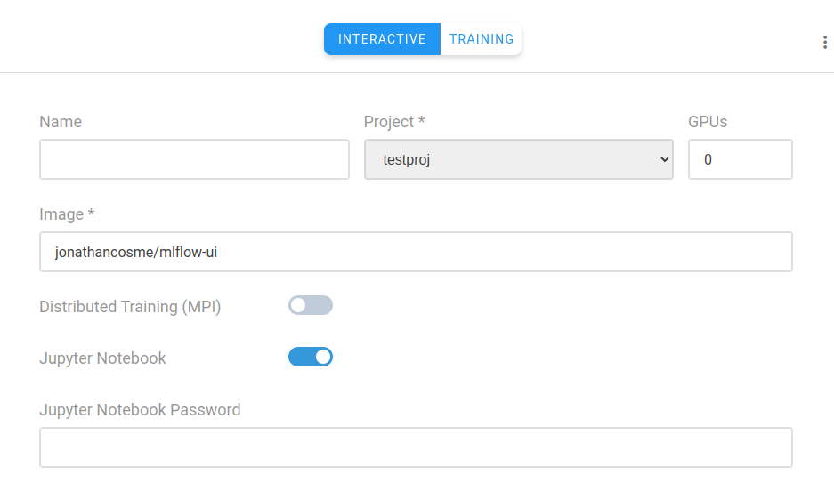
Access mlflow UI
Create a jupyter interactive job with:
image jonathancosme/mlflow-iu

Slide 41
Access mlflow UI
Create a jupyter interactive job with:
image jonathancosme/mlflow-iu
mounted NFS folder (with ‘mlflow’ folder) in default jupyter work directory
default jupyter work directory (this is always the same)
NFS folder

Slide 42
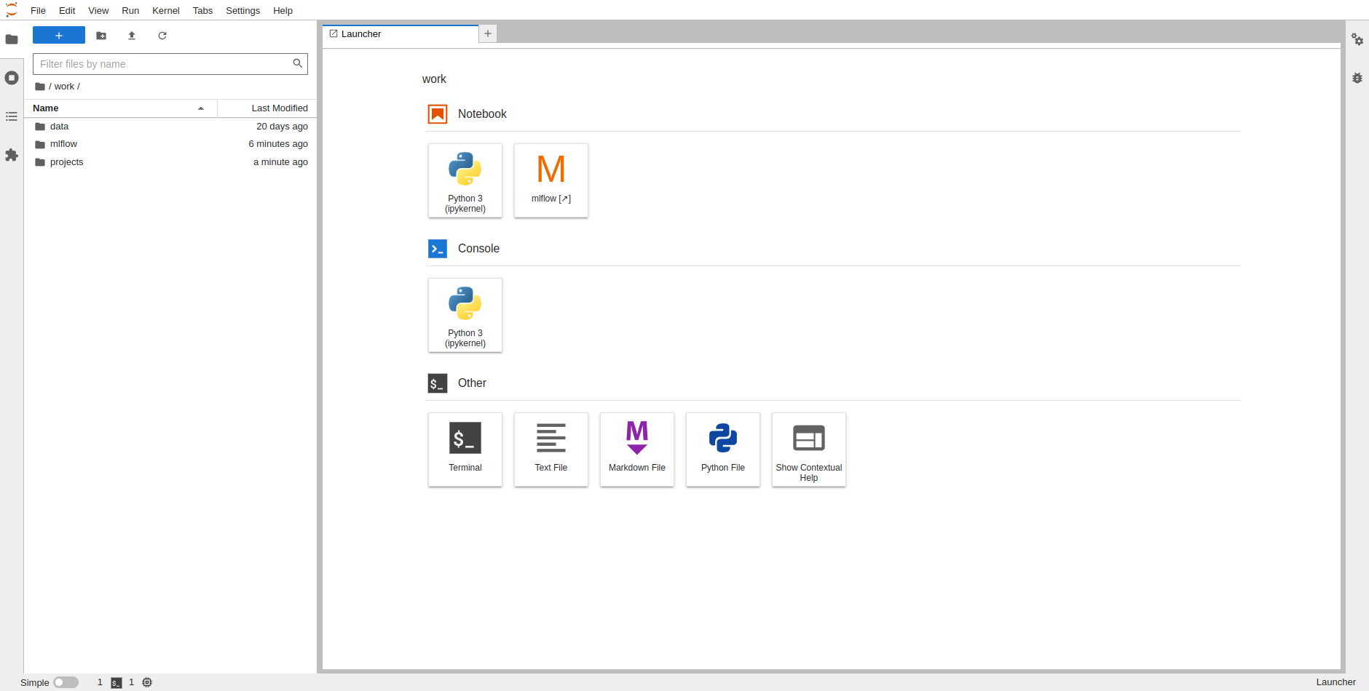
Access mlflow UI
1) make sure ‘mlflow’ folder exists inside ‘work’ directory

Slide 43
Access mlflow UI
1) make sure ‘mlflow’ folder exists inside ‘work’ directory
2) select ‘mlflow’ on launcher

Slide 44
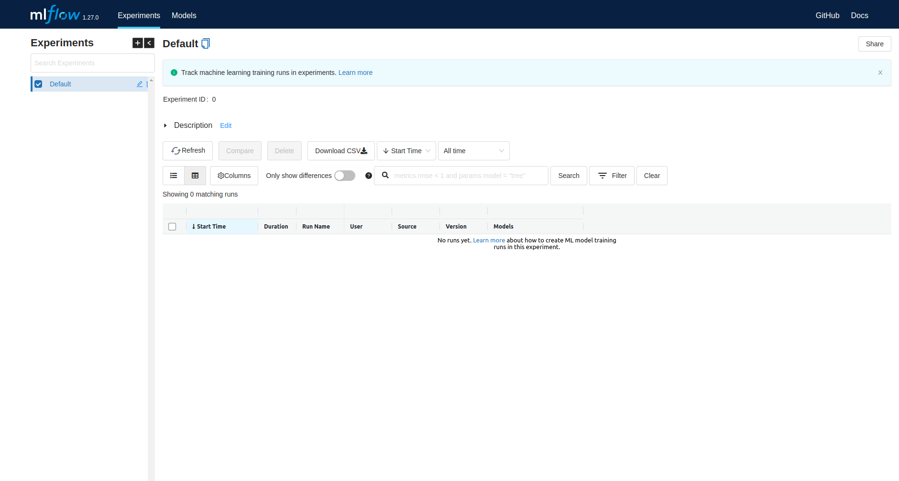
Access mlflow UI
A new tab should appear with the mlflow UI

Slide 45
running mlflow experiments with run:ai

Slide 46
Python scripts

Slide 47
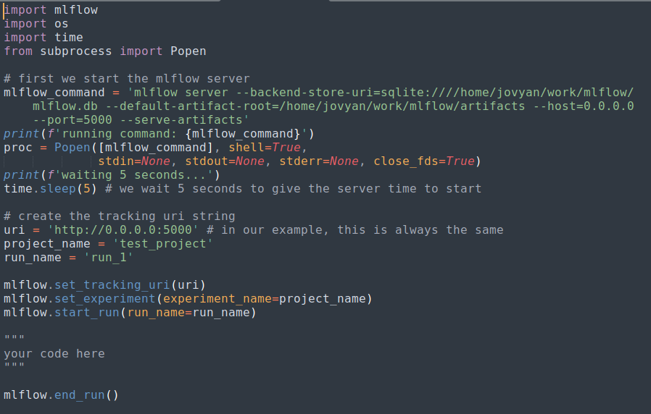
Python scripts

Slide 48
Python scripts
in your script, you should first launch the mlflow server

Slide 49
Python scripts
in your script, you should first launch the mlflow server
Then be sure to set the tracking uri

Slide 50
CLI submission

Slide 51
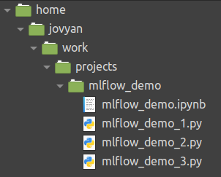
CLI submission
Our example scrips are located here:

Slide 52
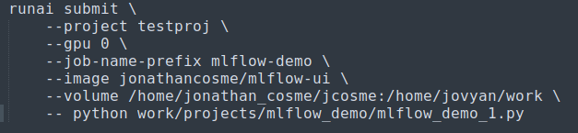
CLI submission
Our example scrips are located here:
so our CLI command would look like this:

Slide 53
CLI submission
Our example scrips are located here:
make sure you use the mlflow-ui docker image
so our CLI command would look like this:

Slide 54
CLI submission
Our example scrips are located here:
make sure you use the mlflow-ui docker image
so our CLI command would look like this:
make sure you mount the NFS to the work directory

Slide 55
CLI submission
Our example scrips are located here:
make sure you use the mlflow-ui docker image
so our CLI command would look like this:
make sure you mount the NFS to the work directory
The code to run the job must specify the python script with relative location

Slide 56
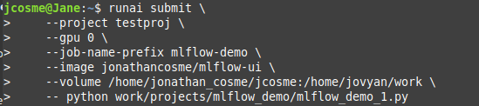
Example job submission
1) submit CLI command

Slide 57
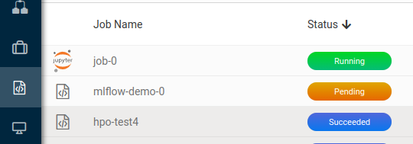
Example job submission
1) submit CLI command
2) a new job should appear

Slide 58
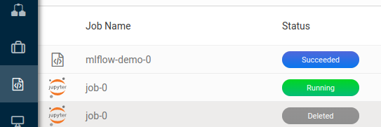
Example job submission
1) submit CLI command
2) a new job should appear
3) wait for job to finish

Slide 59
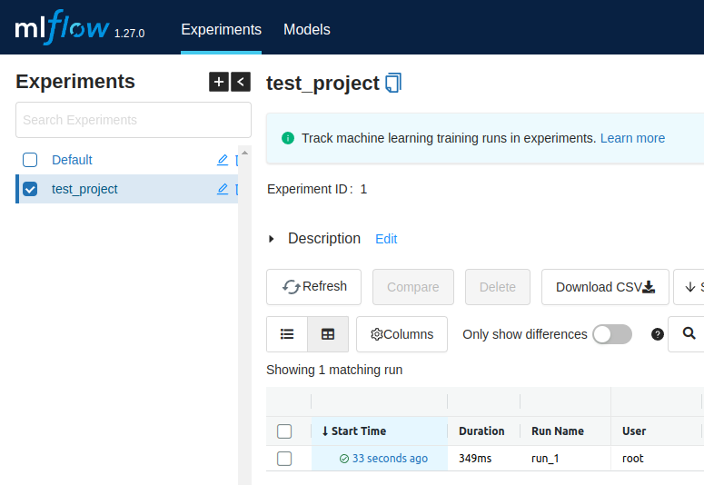
Example job submission
1) submit CLI command
4) refresh mlflow UI to see updates
2) a new job should appear
3) wait for job to finish

Slide 60
Thank you!

