Slide 1
Tensorboard
with
run:ai
(using ResNet examples)

Slide 2
Tensorboard overview

Slide 3

What is needed for Tensorboard to run?
1) A logs folder to store objects related to the runs
Logs folder

Slide 4
How does Tensorboard work?
1) To view the Tensorboard UI, we start the server with a CLI command
You must specify the location of the logs folder with the logdir argument. You can also set the host IP and port.
tensorboard \
--logdir=/abs/path/to/logs_folder \
--host=0.0.0.0 \
--port=6006

Slide 5
How does Tensorboard work?
2) In order to write records to the Tensorboard folder, create a Tensorboard callback in our script, and pass it to a model
import tensorflow as tf
tb_dir = "/abs/path/to/logs_folder"
“””
code to build and compile your model
“””
tensorboard_callback = tf.keras.callbacks.TensorBoard(
log_dir=tb_dir)
history = model.fit(train_ds,
epochs=5,
callbacks=[tensorboard_callback])
Note:
It is not necessary to start the Tensorboard server in order to write records.
Starting the server is only needed to view the UI.

Slide 6
Tensorboard with run:ai

Slide 7
What is needed for Tensorboard to run on run:ai?
1) A persistent directory to keep
Tensorboard logs folder
2) A docker image with the following installed
Tensorboard
jupyterlab*
jupyter-server-proxy*
*needed to access the Tensorboard UI
3) A docker image with the following installed
Tensorflow**
Keras**
**needed in order train Tensorflow models (ResNet in our example)

Slide 8
Creating persistent directory

Slide 9
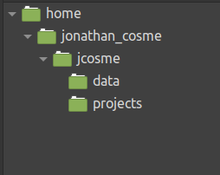
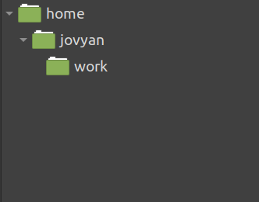
Before we start
We need to create a ‘tensorboard_logs’ folder on our NFS.
This is what our NFS folder structure looks like now
This is the default folder structure for our jupyter lab image

Slide 10
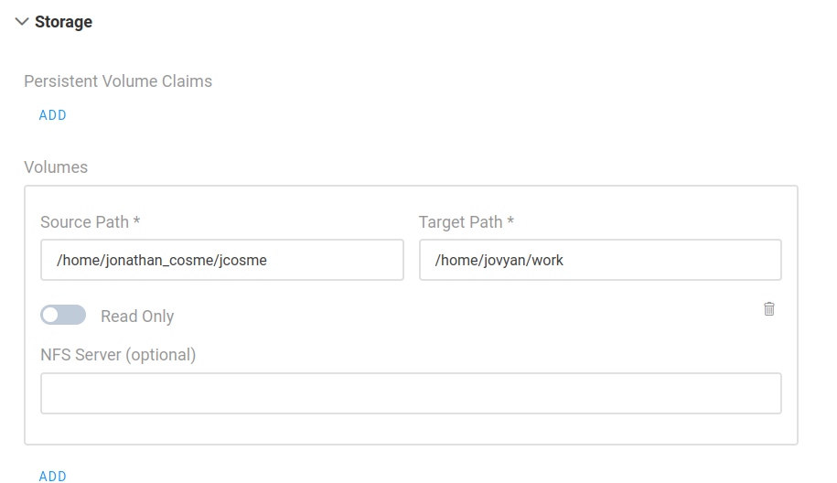
Before we start
We need to create an ‘tensorboard_logs’ folder on our NFS.
For our example:
Whenever we create a job on run:ai, we must always mount our NFS to the default jupyter work directory
our NFS folder
default jupyter work directory (this is always the same)

Slide 11
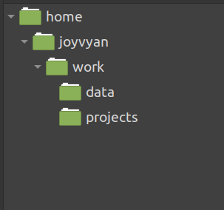
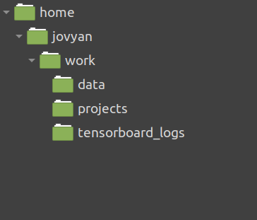
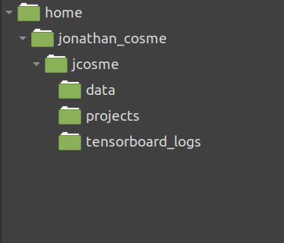
Before we start
We need to create an ‘tensorboard_logs’ folder on our NFS.
1. After we mount our NFS volume,
our work directory will look like this:
2. Using Jupyter Lab, we create an ‘tensorboard_logs’ folder within the work directory:
3. This will cause our NFS directory to automatically look like this:

Slide 12
Docker images

Slide 13
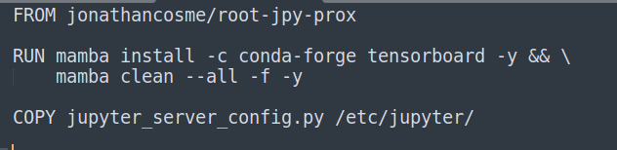
First docker image used in our example
The docker image we will use to access the UI is:
jonathancosme/tensorboard-ui
This is what is in the dockerfile:
notebook with jupyter-server-proxy already installed
install Tensorboard
copy new config file, with Tensorboard UI access configured

Slide 14
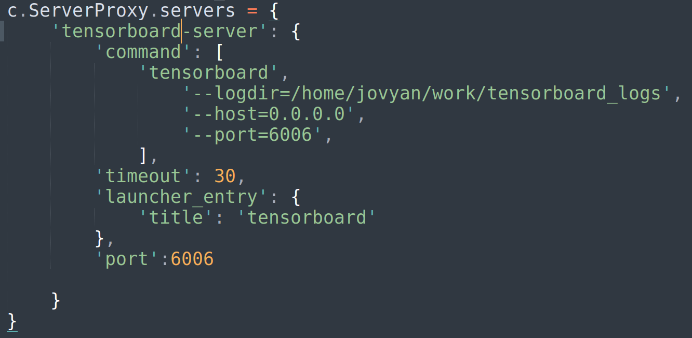
First docker image used in our example
The docker image we will use to access the UI is:
jonathancosme/tensorboard-ui
In order to access the Tensorboard UI, we need to add this entry to the jupyter_server_config.py file, and replace the existing file in the image
we specify our Tensorboard logs folder locations (this is why we must always mount our NFS directory to the default jupyter work directory)
we must make sure to start the server on this IP and port
This tells jupyter to forward port 6006 to the URL

Slide 15
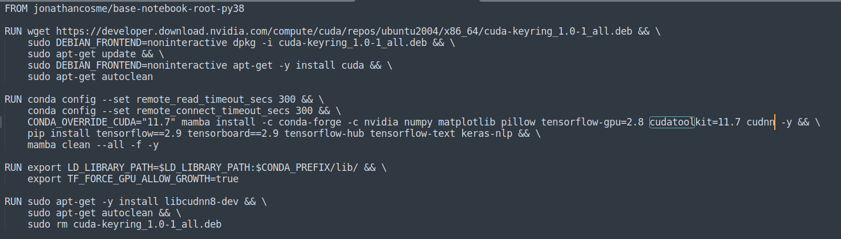
Second docker image used in our example
The docker image we will use to train a Tensorflow ResNet model is:
jonathancosme/keras-nb
This is what is in the dockerfile:
notebook with root privileges and python 3.8
install cudatoolkit 11.7
Install Tensorflow
set environment variable needed for Tensorflow to run

Slide 16
Accessing the Tensorboard UI

Slide 17
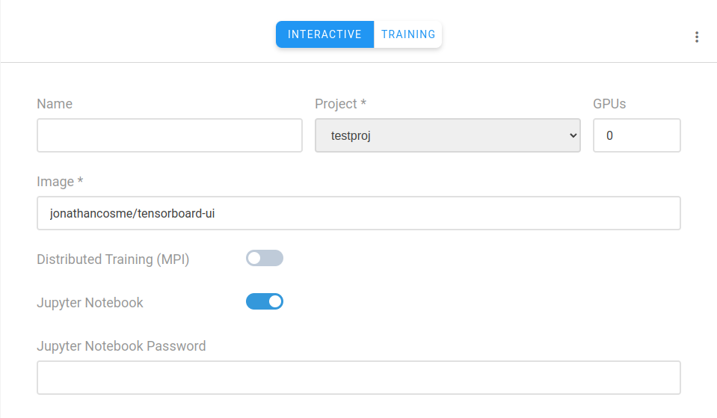
Access Tensorboard UI
Create a jupyter interactive job with:
image jonathancosme/tensorboard-iu
mounted NFS folder (with ‘tensorboard_logs’ folder) in default jupyter work directory
default jupyter work directory (this is always the same)
NFS folder

Slide 18
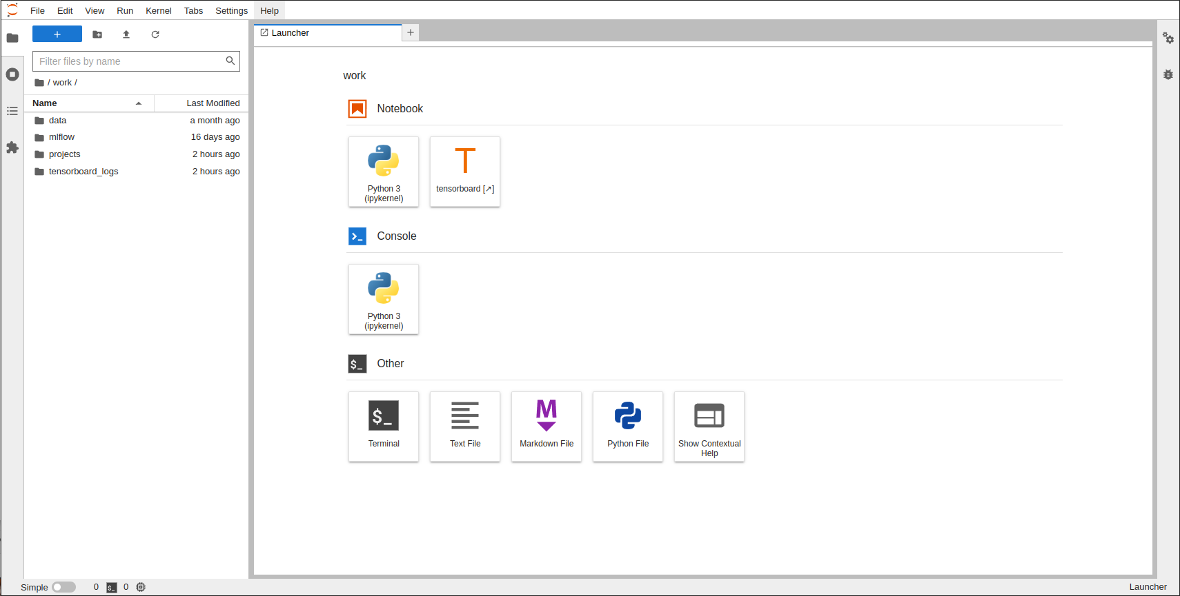
Access Tensorboard UI
2) select ‘tensorboard’ on launcher
1) make sure ‘tensorboard_logs’ folder exists inside ‘work’ directory

Slide 19
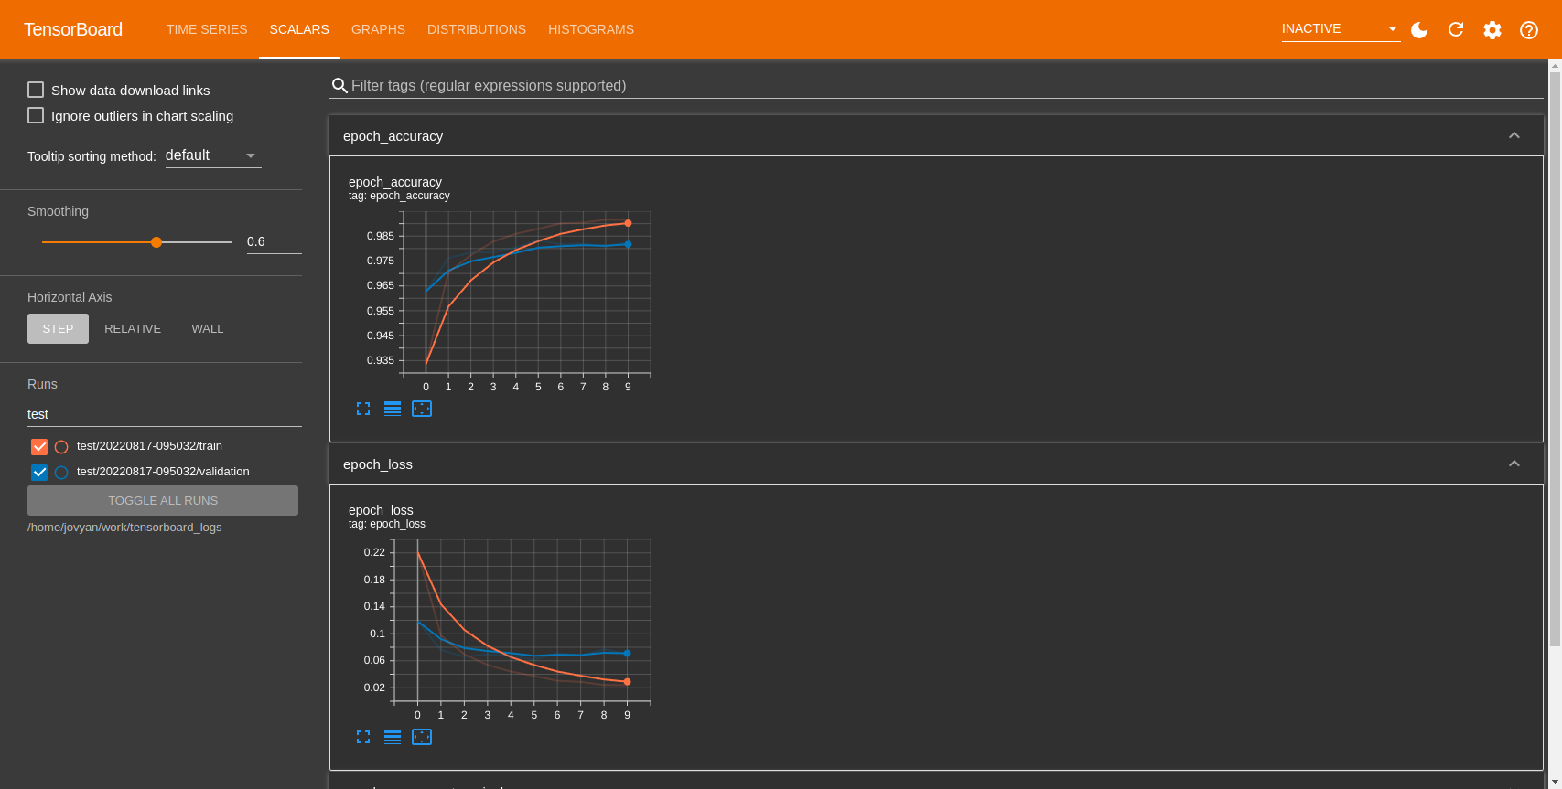
Access Tensorflow UI
A new tab should appear with the Tensorflow UI

Slide 20
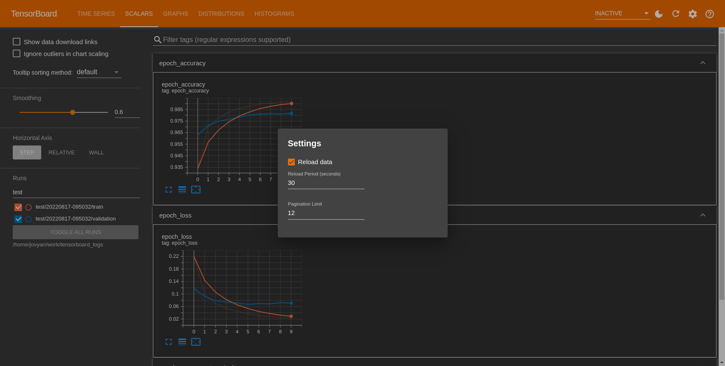
Access Tensorflow UI
Select ‘Reload data’ under settings.
1)
2)

Slide 21
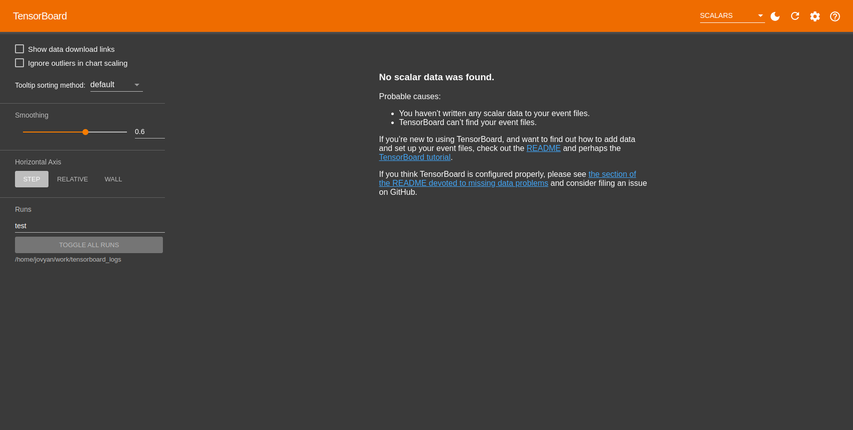
Access Tensorflow UI
Note:
The first time you access the UI, there will be no data available

Slide 22
running Tensorflow ResNet experiments with run:ai

Slide 23

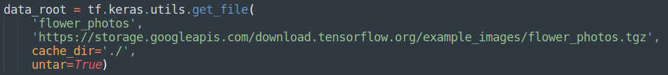
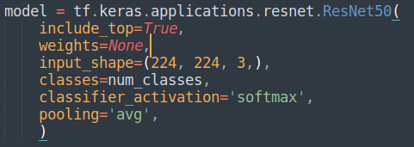
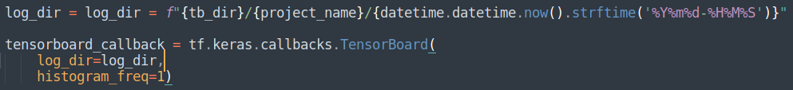
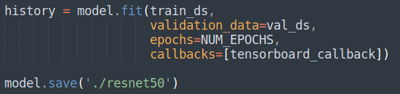
Python scripts (ResNet50 example)
Set the absolute path of the logs folder, and set a project name.
Load the flowers dataset from Tensorflow
Load the ResNet architecture directly from Tensorflow
Create a subdirectory in our tensorboard_logs folder, using project_name, then create another subfolder using the date and time
Pass in the callback, fit and save the model

Slide 24
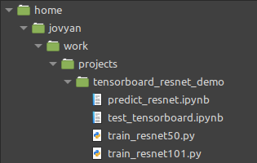
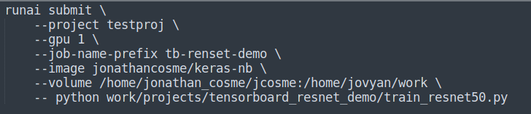
CLI submission
Our example scrips are located here:
make sure you use the keras-nb docker image
so our CLI command would look like this:
make sure you mount the NFS to the work directory
The code to run the job must specify the python script with relative location

Slide 25
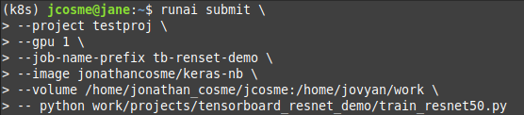
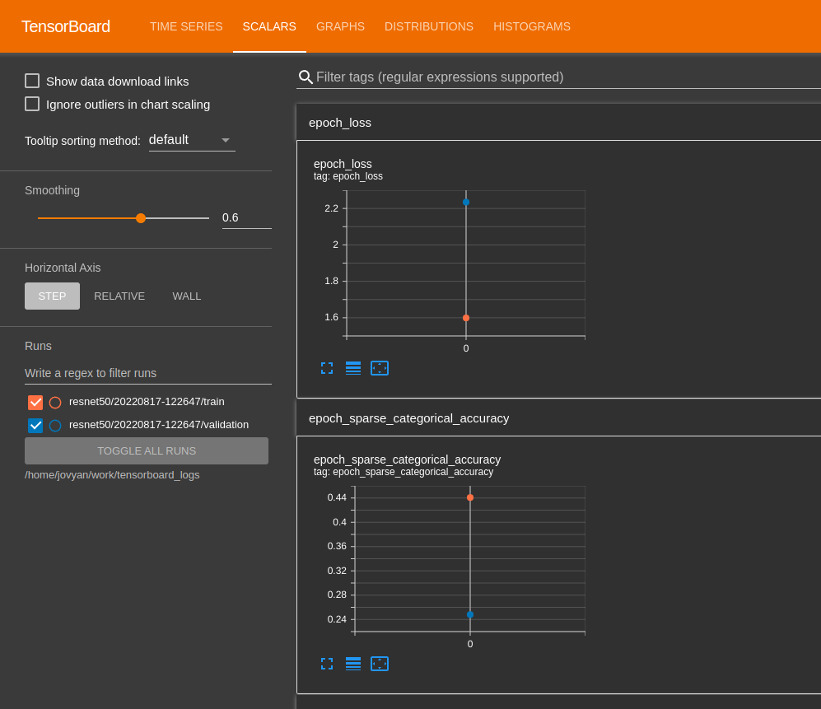
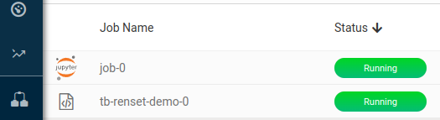
Example job submission
1) submit CLI command
3) The Tensorboard UI will refresh periodically
2) a new job should appear

Slide 26


Example job submission
ResNet50
/home/jovyan/work/tensorboard_logs
tensorboard-ui
ResNet101

Slide 27
Thank you!

