Slide 1
Tensorboard
with
run:ai
(using ResNet examples)

Slide 2
Tensorboard overview

Slide 3
What is needed for Tensorboard to run?

Slide 4

What is needed for Tensorboard to run?
A logs folder to store objects related to the runs
Logs folder

Slide 5
How does Tensorboard work?

Slide 6
How does Tensorboard work?
1) To view the Tensorboard UI, we start the server with a CLI command

Slide 7
How does Tensorboard work?
1) To view the Tensorboard UI, we start the server with a CLI command
You must specify the location of the logs folder with the logdir argument. You can also set the host IP and port.
tensorboard \
--logdir=/abs/path/to/logs_folder \
--host=0.0.0.0 \
--port=6006

Slide 8
How does Tensorboard work?

Slide 9
How does Tensorboard work?
2) In order to write records to the Tensorboard folder, create a Tensorboard callback in our script, and pass it to a model

Slide 10
How does Tensorboard work?
2) In order to write records to the Tensorboard folder, create a Tensorboard callback in our script, and pass it to a model
import tensorflow as tf
tb_dir = "/abs/path/to/logs_folder"
“””
code to build and compile your model
“””
tensorboard_callback = tf.keras.callbacks.TensorBoard(
log_dir=tb_dir)
history = model.fit(train_ds,
epochs=5,
callbacks=[tensorboard_callback])

Slide 11
How does Tensorboard work?
2) In order to write records to the Tensorboard folder, create a Tensorboard callback in our script, and pass it to a model
import tensorflow as tf
tb_dir = "/abs/path/to/logs_folder"
“””
code to build and compile your model
“””
tensorboard_callback = tf.keras.callbacks.TensorBoard(
log_dir=tb_dir)
history = model.fit(train_ds,
epochs=5,
callbacks=[tensorboard_callback])
Note:
It is not necessary to start the Tensorboard server in order to write records.
Starting the server is only needed to view the UI.

Slide 12
Tensorboard with run:ai

Slide 13
What is needed for Tensorboard to run on run:ai?

Slide 14
What is needed for Tensorboard to run on run:ai?
1) A persistent directory to keep
Tensorboard logs folder

Slide 15
What is needed for Tensorboard to run on run:ai?
1) A persistent directory to keep
Tensorboard logs folder
2) A docker image with the following installed
Tensorboard
jupyterlab*
jupyter-server-proxy*
*needed to access the Tensorboard UI

Slide 16
What is needed for Tensorboard to run on run:ai?
1) A persistent directory to keep
Tensorboard logs folder
2) A docker image with the following installed
Tensorboard
jupyterlab*
jupyter-server-proxy*
*needed to access the Tensorboard UI
3) A docker image with the following installed
Tensorflow**
Keras**
**needed in order train Tensorflow models (ResNet in our example)

Slide 17
Creating persistent directory

Slide 18
Before we start
We need to create a ‘tensorboard_logs’ folder on our NFS.

Slide 19
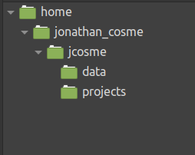
Before we start
We need to create a ‘tensorboard_logs’ folder on our NFS.
This is what our NFS folder structure looks like now

Slide 20
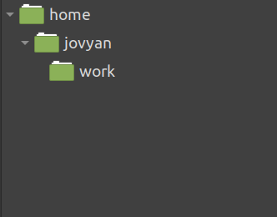
Before we start
We need to create a ‘tensorboard_logs’ folder on our NFS.
This is what our NFS folder structure looks like now
This is the default folder structure for our jupyter lab image

Slide 21
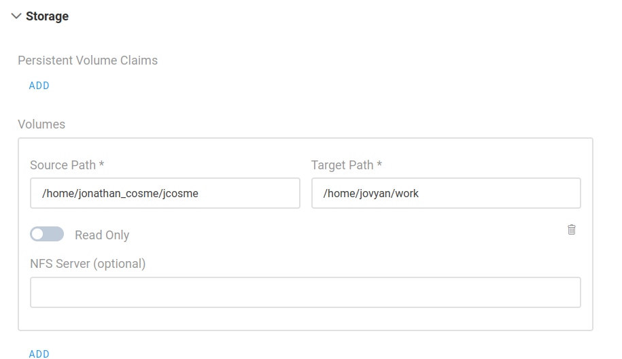
Before we start
We need to create an ‘tensorboard_logs’ folder on our NFS.
For our example:
Whenever we create a job on run:ai, we must always mount our NFS to the default jupyter work directory
our NFS folder
default jupyter work directory (this is always the same)

Slide 22
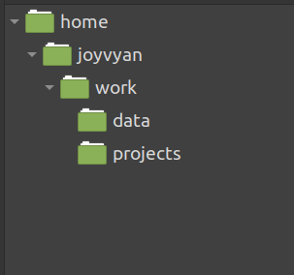
Before we start
We need to create an ‘tensorboard_logs’ folder on our NFS.
1. After we mount our NFS volume,
our work directory will look like this:

Slide 23
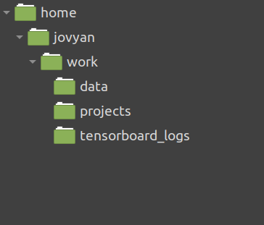
Before we start
We need to create an ‘tensorboard_logs’ folder on our NFS.
1. After we mount our NFS volume,
our work directory will look like this:
2. Using Jupyter Lab, we create an ‘tensorboard_logs’ folder within the work directory:

Slide 24
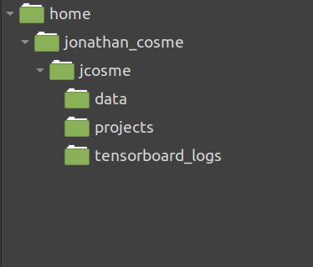
Before we start
We need to create an ‘tensorboard_logs’ folder on our NFS.
1. After we mount our NFS volume,
our work directory will look like this:
2. Using Jupyter Lab, we create an ‘tensorboard_logs’ folder within the work directory:
3. This will cause our NFS directory to automatically look like this:

Slide 25
Docker images

Slide 26
First docker image used in our example

Slide 27
First docker image used in our example
The docker image we will use to access the UI is:
jonathancosme/tensorboard-ui

Slide 28
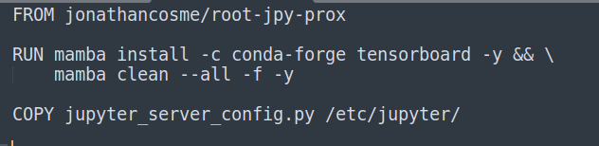
First docker image used in our example
The docker image we will use to access the UI is:
jonathancosme/tensorboard-ui
This is what is in the dockerfile:

Slide 29
First docker image used in our example
The docker image we will use to access the UI is:
jonathancosme/tensorboard-ui
This is what is in the dockerfile:
notebook with jupyter-server-proxy already installed

Slide 30
First docker image used in our example
The docker image we will use to access the UI is:
jonathancosme/tensorboard-ui
This is what is in the dockerfile:
notebook with jupyter-server-proxy already installed
install Tensorboard

Slide 31
First docker image used in our example
The docker image we will use to access the UI is:
jonathancosme/tensorboard-ui
This is what is in the dockerfile:
notebook with jupyter-server-proxy already installed
install Tensorboard
copy new config file, with Tensorboard UI access configured

Slide 32
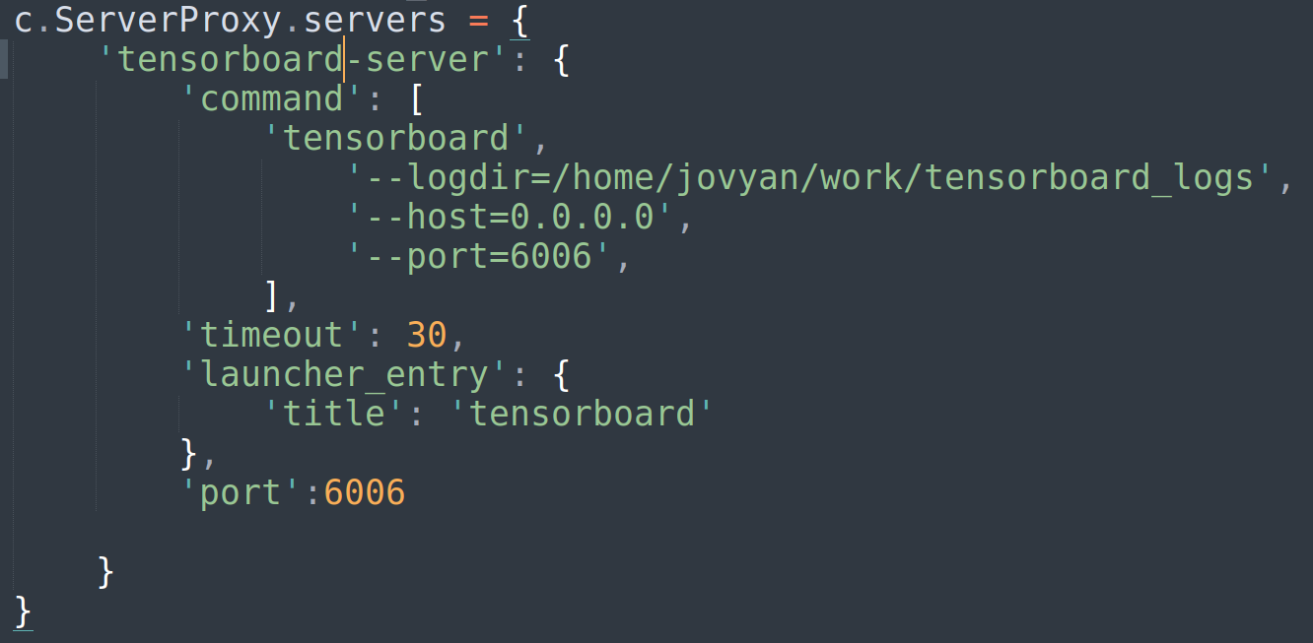
First docker image used in our example
The docker image we will use to access the UI is:
jonathancosme/tensorboard-ui
In order to access the Tensorboard UI, we need to add this entry to the jupyter_server_config.py file, and replace the existing file in the image

Slide 33
First docker image used in our example
The docker image we will use to access the UI is:
jonathancosme/tensorboard-ui
In order to access the Tensorboard UI, we need to add this entry to the jupyter_server_config.py file, and replace the existing file in the image
we specify our Tensorboard logs folder locations (this is why we must always mount our NFS directory to the default jupyter work directory)

Slide 34
First docker image used in our example
The docker image we will use to access the UI is:
jonathancosme/tensorboard-ui
In order to access the Tensorboard UI, we need to add this entry to the jupyter_server_config.py file, and replace the existing file in the image
we specify our Tensorboard logs folder locations (this is why we must always mount our NFS directory to the default jupyter work directory)
we must make sure to start the server on this IP and port

Slide 35
First docker image used in our example
The docker image we will use to access the UI is:
jonathancosme/tensorboard-ui
In order to access the Tensorboard UI, we need to add this entry to the jupyter_server_config.py file, and replace the existing file in the image
we specify our Tensorboard logs folder locations (this is why we must always mount our NFS directory to the default jupyter work directory)
we must make sure to start the server on this IP and port
This tells jupyter to forward port 6006 to the URL

Slide 36
Second docker image used in our example

Slide 37
Second docker image used in our example
The docker image we will use to train a Tensorflow ResNet model is:
jonathancosme/keras-nb

Slide 38
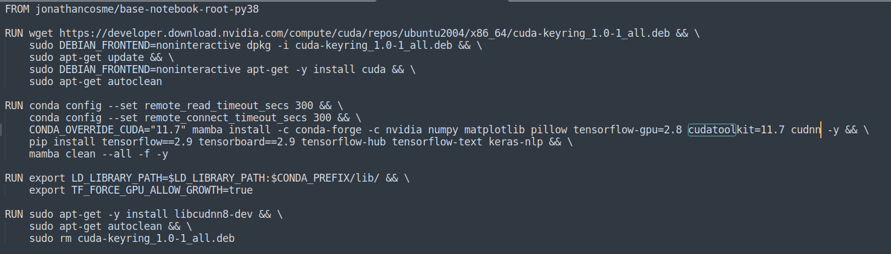
Second docker image used in our example
The docker image we will use to train a Tensorflow ResNet model is:
jonathancosme/keras-nb
This is what is in the dockerfile:

Slide 39
Second docker image used in our example
The docker image we will use to train a Tensorflow ResNet model is:
jonathancosme/keras-nb
This is what is in the dockerfile:
notebook with root privileges and python 3.8

Slide 40
Second docker image used in our example
The docker image we will use to train a Tensorflow ResNet model is:
jonathancosme/keras-nb
This is what is in the dockerfile:
notebook with root privileges and python 3.8
install cudatoolkit 11.7

Slide 41
Second docker image used in our example
The docker image we will use to train a Tensorflow ResNet model is:
jonathancosme/keras-nb
This is what is in the dockerfile:
notebook with root privileges and python 3.8
install cudatoolkit 11.7
Install Tensorflow

Slide 42
Second docker image used in our example
The docker image we will use to train a Tensorflow ResNet model is:
jonathancosme/keras-nb
This is what is in the dockerfile:
notebook with root privileges and python 3.8
install cudatoolkit 11.7
Install Tensorflow
set environment variable needed for Tensorflow to run

Slide 43
Accessing the Tensorboard UI

Slide 44
Access Tensorboard UI
Create a jupyter interactive job with:

Slide 45
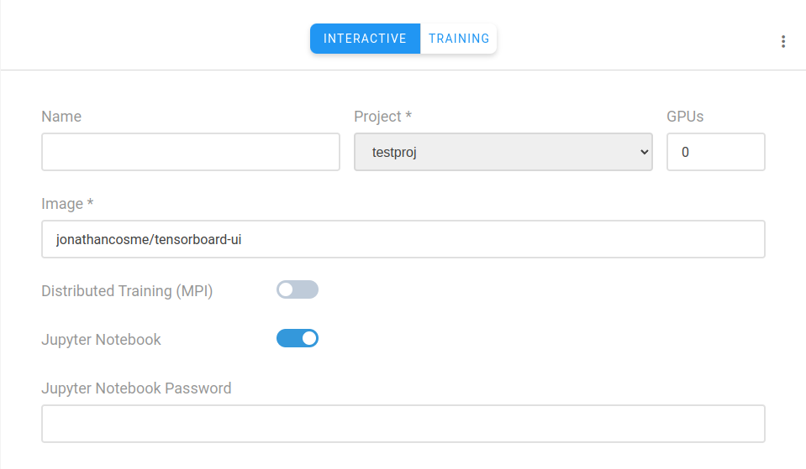
Access Tensorboard UI
Create a jupyter interactive job with:
image jonathancosme/tensorboard-iu

Slide 46
Access Tensorboard UI
Create a jupyter interactive job with:
image jonathancosme/tensorboard-iu
mounted NFS folder (with ‘tensorboard_logs’ folder) in default jupyter work directory
default jupyter work directory (this is always the same)
NFS folder

Slide 47
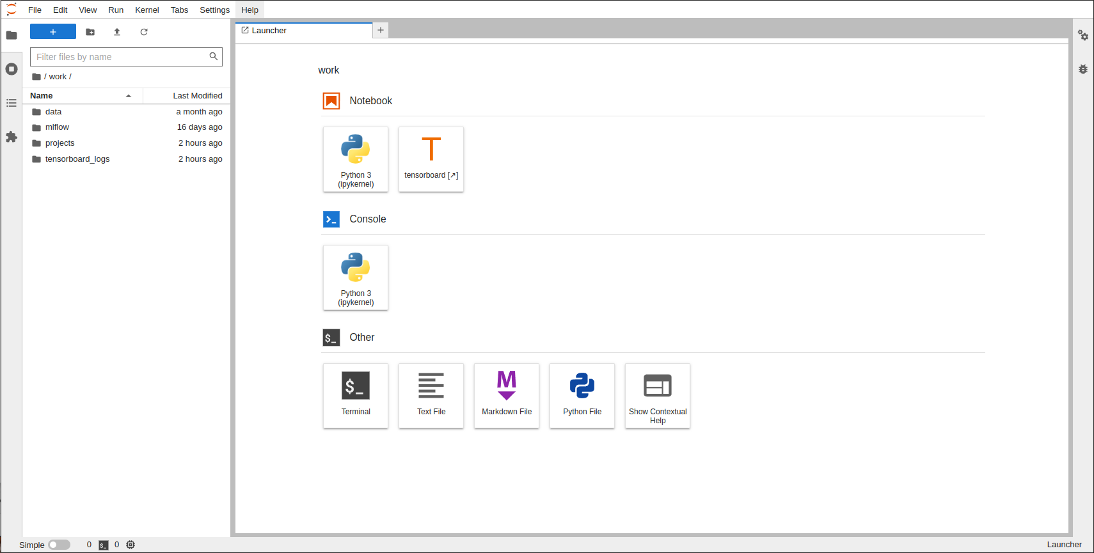
Access Tensorboard UI
1) make sure ‘tensorboard_logs’ folder exists inside ‘work’ directory

Slide 48
Access Tensorboard UI
2) select ‘tensorboard’ on launcher
1) make sure ‘tensorboard_logs’ folder exists inside ‘work’ directory

Slide 49
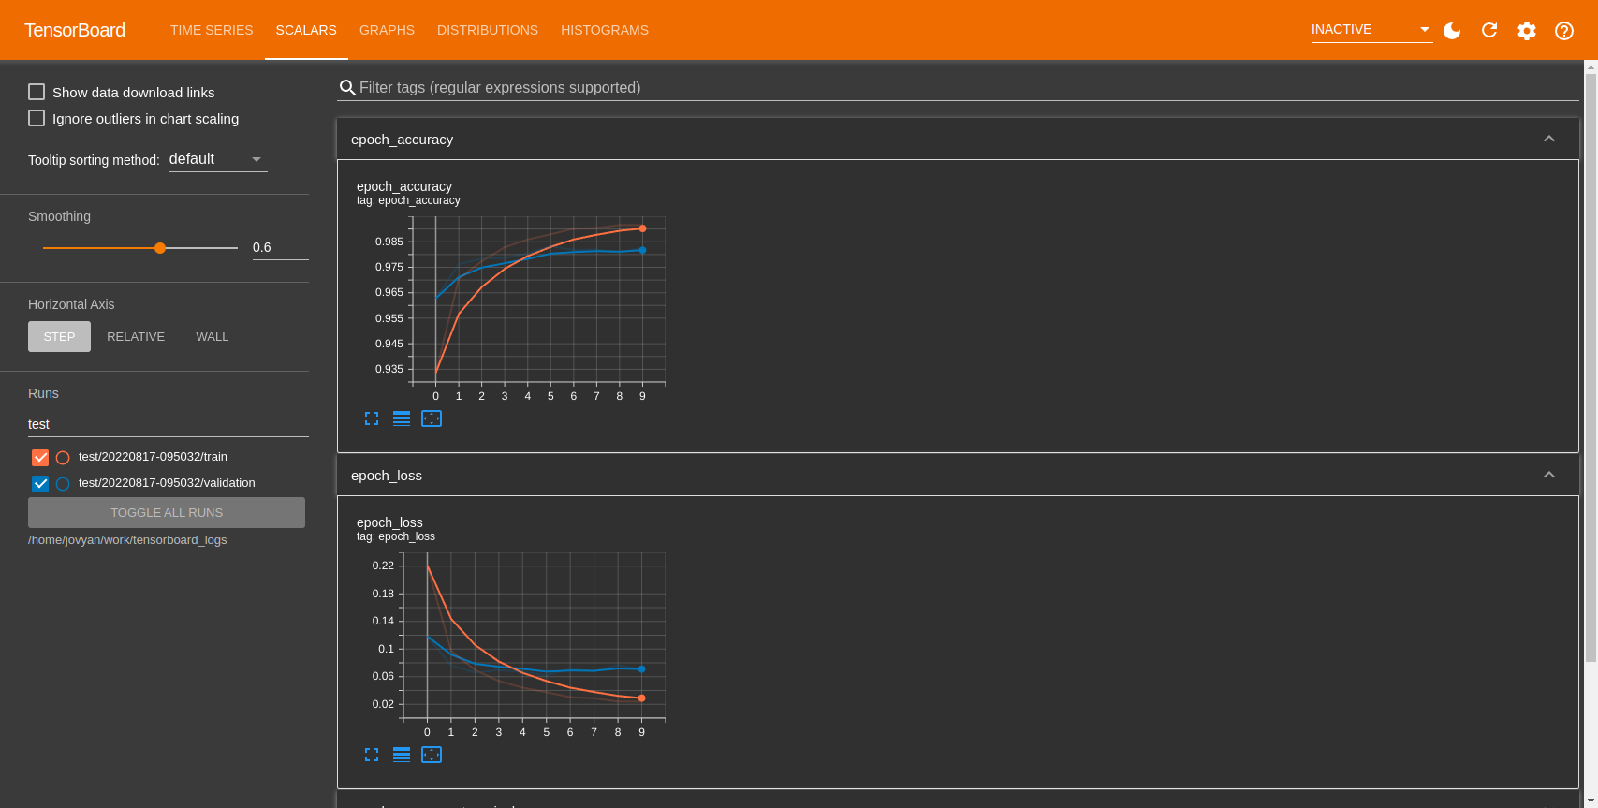
Access Tensorflow UI
A new tab should appear with the Tensorflow UI

Slide 50
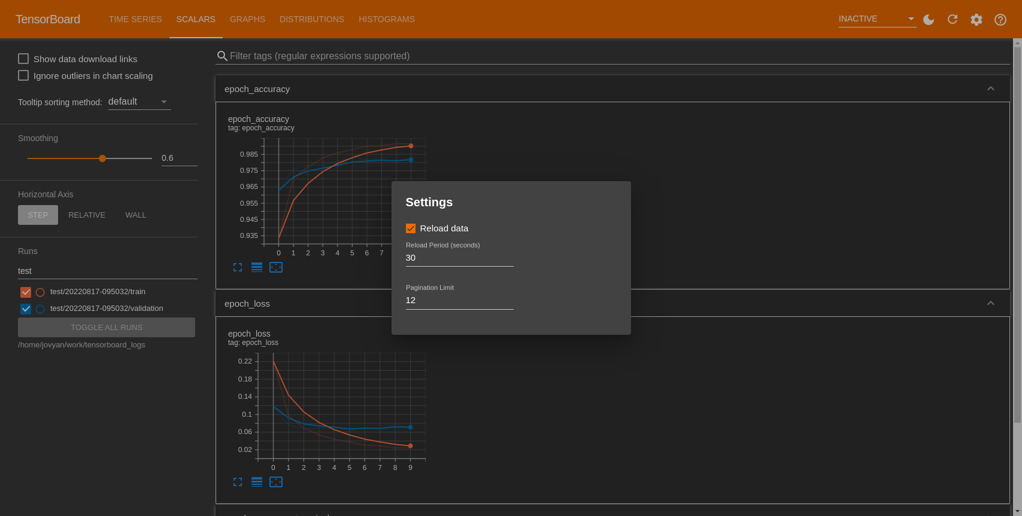
Access Tensorflow UI
Select ‘Reload data’ under settings.
1)
2)

Slide 51
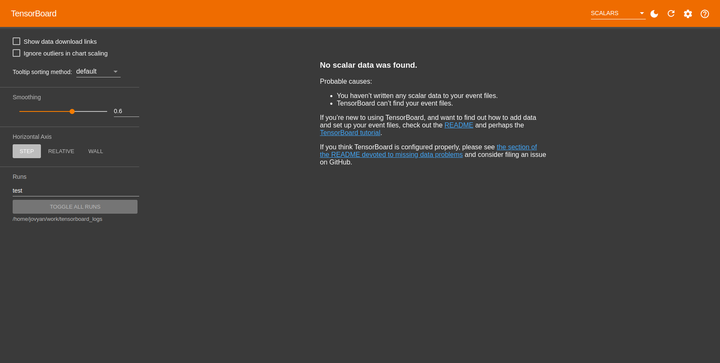
Access Tensorflow UI
Note:
The first time you access the UI, there will be no data available

Slide 52
running Tensorflow ResNet experiments with run:ai

Slide 53
Python scripts (ResNet50 example)

Slide 54

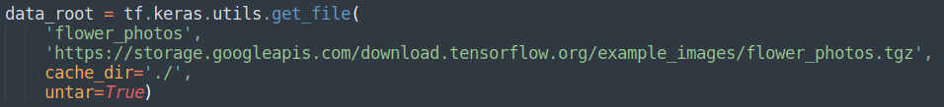
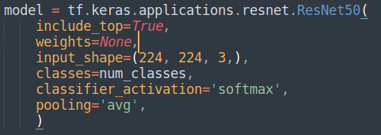
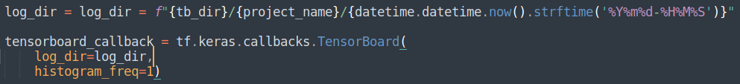
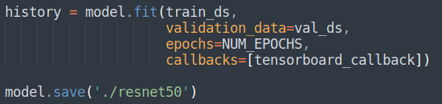
Python scripts (ResNet50 example)

Slide 55
Python scripts (ResNet50 example)
Set the absolute path of the logs folder, and set a project name.

Slide 56
Python scripts (ResNet50 example)
Set the absolute path of the logs folder, and set a project name.
Load the flowers dataset from Tensorflow

Slide 57
Python scripts (ResNet50 example)
Set the absolute path of the logs folder, and set a project name.
Load the flowers dataset from Tensorflow
Load the ResNet architecture directly from Tensorflow

Slide 58
Python scripts (ResNet50 example)
Set the absolute path of the logs folder, and set a project name.
Load the flowers dataset from Tensorflow
Load the ResNet architecture directly from Tensorflow
Create a subdirectory in our tensorboard_logs folder, using project_name, then create another subfolder using the date and time

Slide 59
Python scripts (ResNet50 example)
Set the absolute path of the logs folder, and set a project name.
Load the flowers dataset from Tensorflow
Load the ResNet architecture directly from Tensorflow
Create a subdirectory in our tensorboard_logs folder, using project_name, then create another subfolder using the date and time
Pass in the callback, fit and save the model

Slide 60
CLI submission

Slide 61
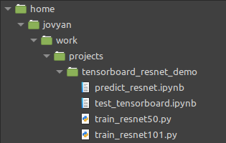
CLI submission
Our example scrips are located here:

Slide 62
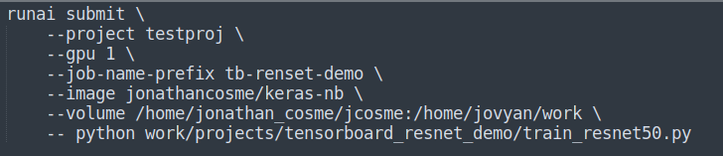
CLI submission
Our example scrips are located here:
so our CLI command would look like this:

Slide 63
CLI submission
Our example scrips are located here:
make sure you use the keras-nb docker image
so our CLI command would look like this:

Slide 64
CLI submission
Our example scrips are located here:
make sure you use the keras-nb docker image
so our CLI command would look like this:
make sure you mount the NFS to the work directory

Slide 65
CLI submission
Our example scrips are located here:
make sure you use the keras-nb docker image
so our CLI command would look like this:
make sure you mount the NFS to the work directory
The code to run the job must specify the python script with relative location

Slide 66
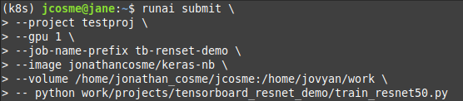
Example job submission
1) submit CLI command

Slide 67
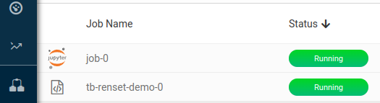
Example job submission
1) submit CLI command
2) a new job should appear

Slide 68
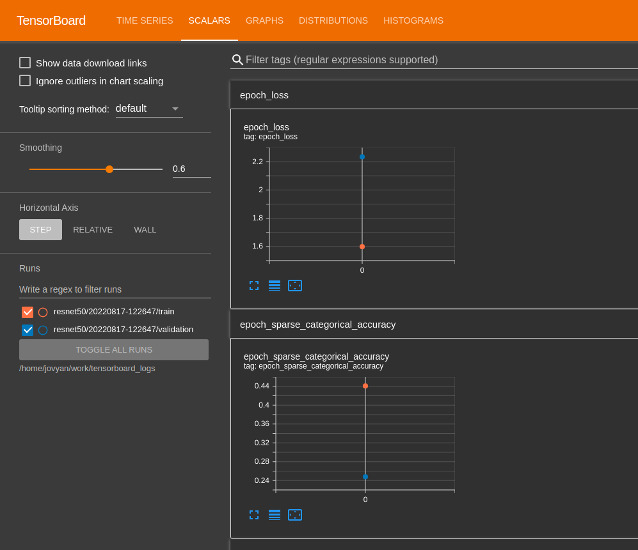
Example job submission
1) submit CLI command
3) The Tensorboard UI will refresh periodically
2) a new job should appear

Slide 69


Example job submission
ResNet50
/home/jovyan/work/tensorboard_logs
tensorboard-ui
ResNet101

Slide 70
Thank you!

