Slide 1
Supply chain Performance Overview – atliq mart
Monitoring OT, IF, OTIF, and Fulfillment KPIs Across Cities

Slide 2
Key Performance Indicators (KPI) Summary
Over all On-Time Delivery (OT%) is 59.03%, significantly below the target of 86.09%, indicating major delays in deliveries.
In-Full Delivery (IF%) stands at 52.78%, falling short of the 76.51% target, highlighting issues in order completeness and fulfillment.
OTIF (On-Time In-Full) is critically low at 29.02%, compared to the 65.91% target, showing combined inefficiencies in both timeliness and completeness.
LIFR% (Line-Item Fill Rate) at 65.96% indicates moderate fulfillment efficiency but still leaves room for improvement.
VOFR% (Volume Fill Rate) is high at 96.59%, suggesting overall volume delivery is strong despite issues in timing and completeness.

Slide 3
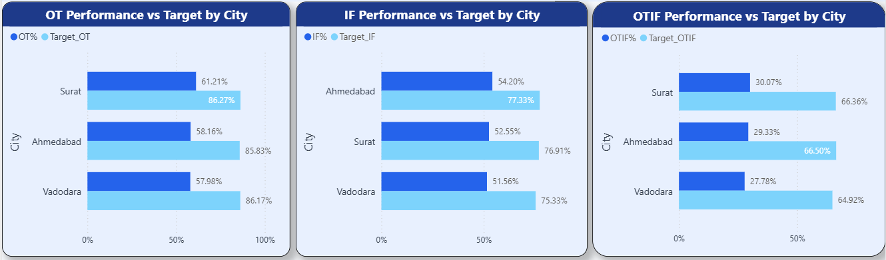
City-wise Performance vs Target Analysis
All cities are underperforming vs targets, with Vadodara showing the lowest performance across OT, IF, and OTIF

Slide 4
Performance Gap Insights & Action Plan
INSIGHTS
All cities (Surat, Ahmedabad, Vadodara) are significantly underperforming against targets across OT, IF, and OTIF, indicating a system-wide supply chain issue.
OT% is ~57–61% vs target ~85%, showing consistent delays in delivery timelines.
IF% is below target across all cities (~51.5%-54%), highlighting gaps in inventory availability and order fulfillment.
OTIF% is critically low (~27–30%), reflecting combined inefficiencies in both timeliness and completeness.
Vadodara is the worst-performing city, consistently showing the lowest performance across all KPIs, the larger gap in Vadodara suggests additional localized operational inefficiencies.
SOLUTIONS
Improve demand forecasting and inventory planning to reduce stock shortages and improve IF%.
Optimize delivery routes and scheduling to minimize delays and improve OT%.
Conduct a deep-dive analysis for Vadodara operations (warehouse, dispatch, last-mile delivery).
Implement real-time tracking and monitoring systems for faster issue resolution.
Align teams around OTIF as the primary KPI to improve end-to-end performance.
Vadodara requires immediate operational focus, while overall improvements are needed across the entire supply chain.

Slide 5
Operational performance and delivery insights
Identifying Underperforming Stores, Delivery Failures, and Service Gaps

Slide 6
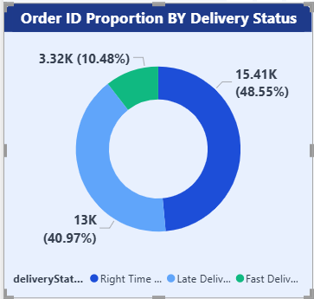
Order proportion by delivery status
Around 59% of orders are delivered on or before time

Slide 7
Delivery status insights and action plan
INSIGHTS
Only 48.5% of orders are delivered on time, indicating room for improvement.
Around 41% of orders are delayed, reflecting inefficiencies in delivery operations
Fast deliveries account for only around 10.5% indicating lack of operational efficiency.
The late delivery rates are almost similar for all the cities(38.8%-42%) with Vadodara and Ahmedabad performing slightly worse, indicating system-wide issues rather than city-specific issues.
SOLUTIONS
The business should look for the optimization of delivery routes to reduce transit time and delays.
Improve warehouse and dispatch efficiency to minimize processing delays.
Increase the delivery workforce in underperforming areas specially in Vadodara and Ahmedabad to make the delivery process efficient.
Implement real-time tracking and monitoring to quickly address the delay reason.

Slide 8
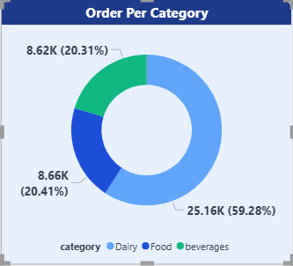
Order proportion per category
Most of the orders contain the Dairy category products

Slide 9
Product Category Insights and Solutions
INSIGHTS
Dairy products account for around 59.3% of total orders, indicating high demand in the market.
The order rates are almost similar for the Food and Beverages(~20.5%), which has significantly lower demand as compared to the Dairy.
Lower contribution of Food and Beverages indicates growth potential.
The order distribution is highly skewed towards Dairy indicating single category demand in the market.
SOLUTIONS
Ensure strong inventory for Dairy products to prevent stockout and meet high demand.
Promote discounts and offers for Food and Beverages products to increase their shares in the market.
Introduce bundle-products(Food and Beverages) to boost cross-category sales.
Expand product variety in Food and Beverages to attract more customers.

Slide 10
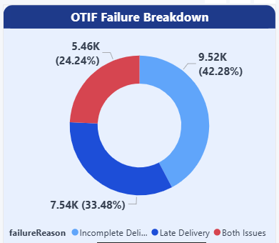
OTIF(On-time In-full) failure breakdown
Incomplete deliveries impact the most in the failure of OTIF

Slide 11
OTIF failure insights and solutions
INSIGHTS
Incomplete deliveries are the primary issue (~42.3%), contributing the highest share of OTIF failures, indicating the issues in inventory and order fulfillment.
Late deliveries account for around 33.5% indicating a significant concern in OTIF failures, indicating the issues in the delivery process.
Around 24.2% of failures are due to both late and incomplete deliveries, reflecting combined operational inefficiencies.
SOLUTIONS
Ensure adequate inventory levels to prevent stockout of products to reduce incomplete deliveries.
Optimize operational inefficiency specially in routes, warehouses and workforce to reduce delivery delays.
Implement real-time monitoring systems to quickly identify and resolve delivery issues

Slide 12
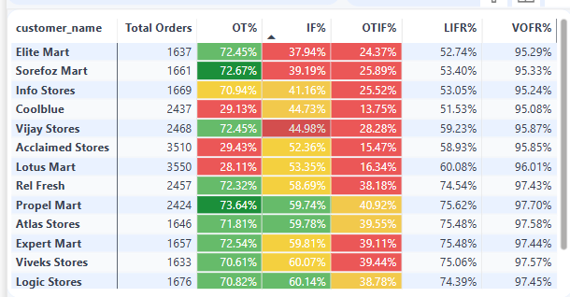
Customer performance breakdown
Coolblue, Acclaimed Stores, and Lotus Mart show the lowest performance in On-Time Delivery, while Elite Mart, Sorefoz Mart, and Vijay Stores underperform in terms of complete deliveries.

Slide 13
Customer performance insights and solutions
INSIGHTS
Coolblue, Acclaimed Stores, and Lotus Mart have the lowest On-Time Delivery rates (~29%), highlighting operational inefficiencies.
Elite Mart, Sorefoz Mart, and Vijay Stores have the lowest In-Full Delivery Rates (~38%-45%), indicating inventory management inefficiencies.
Sorefoz Mart and Lotus Mart have the lowest In-Full Delivery rates in Ahmedabad (~17%–24%), whereas they perform significantly better (~60%–68%) in other cities, indicating inventory management inefficiencies in Ahmedabad for these customers.
Info Stores and Acclaimed Stores have the lowest In-Full Delivery rates in Surat (~19%–22.5%), whereas they perform significantly better (~63%–67%) in other cities, indicating inventory management inefficiencies in Surat for these customers.
Elite Mart, Vijay Stores, and Coolblue have the lowest In-Full Delivery rates in Vadodara (~16.5%–22.25%). In contrast, Elite Mart and Vijay Stores perform at average levels (~58%) in other cities, while Coolblue achieves its best performance in Ahmedabad (~67.2%), highlighting inventory management inefficiencies in Vadodara for these Customers.
SOLUTIONS
The business should focus on improving operational efficiency by optimizing delivery routes, workforce management, and dispatch processes to reduce delivery delays for Coolblue, Acclaimed Stores and Lotus Mart customers.
The business should optimize inventory planning and stock allocation in different cities for Elite Mart, Sorefoz Mart, and Vijay Stores to improve In-Full delivery performances.
The business should ensure adequate inventory levels across Ahmedabad (Sorefoz Mart, Lotus Mart), Surat (Info Stores, Acclaimed Stores), and Vadodara (Elite Mart, Vijay Stores, Coolblue) to minimize stockouts of products, improve In-Full Delivery, and enhance customer satisfaction.

