Slide 1
CI\CD with apps
for
EPAM DevOps course
Kazan
May, 2022
Telegram: @runalsh or @ilnursh
Github: github.com/runalsh
Site (trap!) runalsh.ru
FB: fb.com/runalsh
VK: vk.com/runalsh
Ilnur Shaidullin

Slide 2
Task and reqiurements
Selected tools and technologies
Infrastructure
Push action example
Versioning
Containerization
Alarm
Monitoring
Logs
Applications
Autoscaling
Load balancing
Pricing and coasts

Slide 3
TASK
Variant 7.
Using API https://www.metaweather.com/api/ get data about weather in Moscow for current month and
store it into your DB:
id, weather_state_name, wind_direction_compass, created, applicable_date, min_temp, max_temp, the_temp.
Output the data by date (the date is set) in form of a table and sort them by created in ascending order.

Slide 4
SELECTED TOOLS
Function | Selected | Why? | comment
Source code management | Github
CI/CD runner | Github Action (Selfhosted) | Full compatible with selected CSM | Your can choose between selfhosted and cloudhosted solution. Both realized.
Cloud | AWS | AWS – most popular and have many options and services GCP – simpler interface, powerful, less outdated services, cheaper and faster than AWS | This project began at Google Cloud but after ending trial period and new sanctions was migrated to AWS
Apps language | Python | I like it
SC tests | Pytest, Pylint, | Pytest - functional test, pylint – checks for errors in code
Quality check | Sonarqube Bandit (optional) | Detecting bugs, quality inspection | Bandit disabled, but you can always enable it
Database | AWS RDS (postgresql)

Slide 5
Function | Selected | Why? | comment
IaC solution | Terraform | Described in task requirements
Orchestration | Kubernetes – AWS EKS, Helm | Described in task requirements
Scalability | Kubernetes (HPA) | Described in task requirements
Artifact repository | AWS ECR | Build-in AWS repository
Monitoring | AWS CloudWatch |  | I didnt used Grafana or full ELK (EFK) stack for this project because it required one more powerful instance (except Grafana) and its not cheap. Grafana added as optional
Alarm | AWS SNS / Telegram/ Email
Logging | AWS CloudWatch | Logs store and view

Slide 6



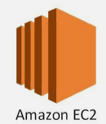







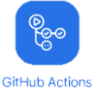



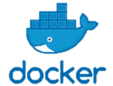



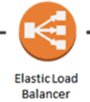
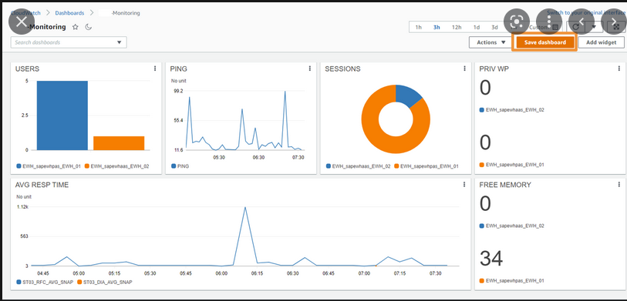

INFRASTRUCTURE
Developers
Team
Developing | Tests | Storage | Deployment | Operating | Monitoring
 | Continuous integration |  | Continuous Delivery
GitHub
Runner
TFstate
DEV
PROD
U
S
E
R
S
cluster
runner
alert
Monitoring
Team

Slide 7
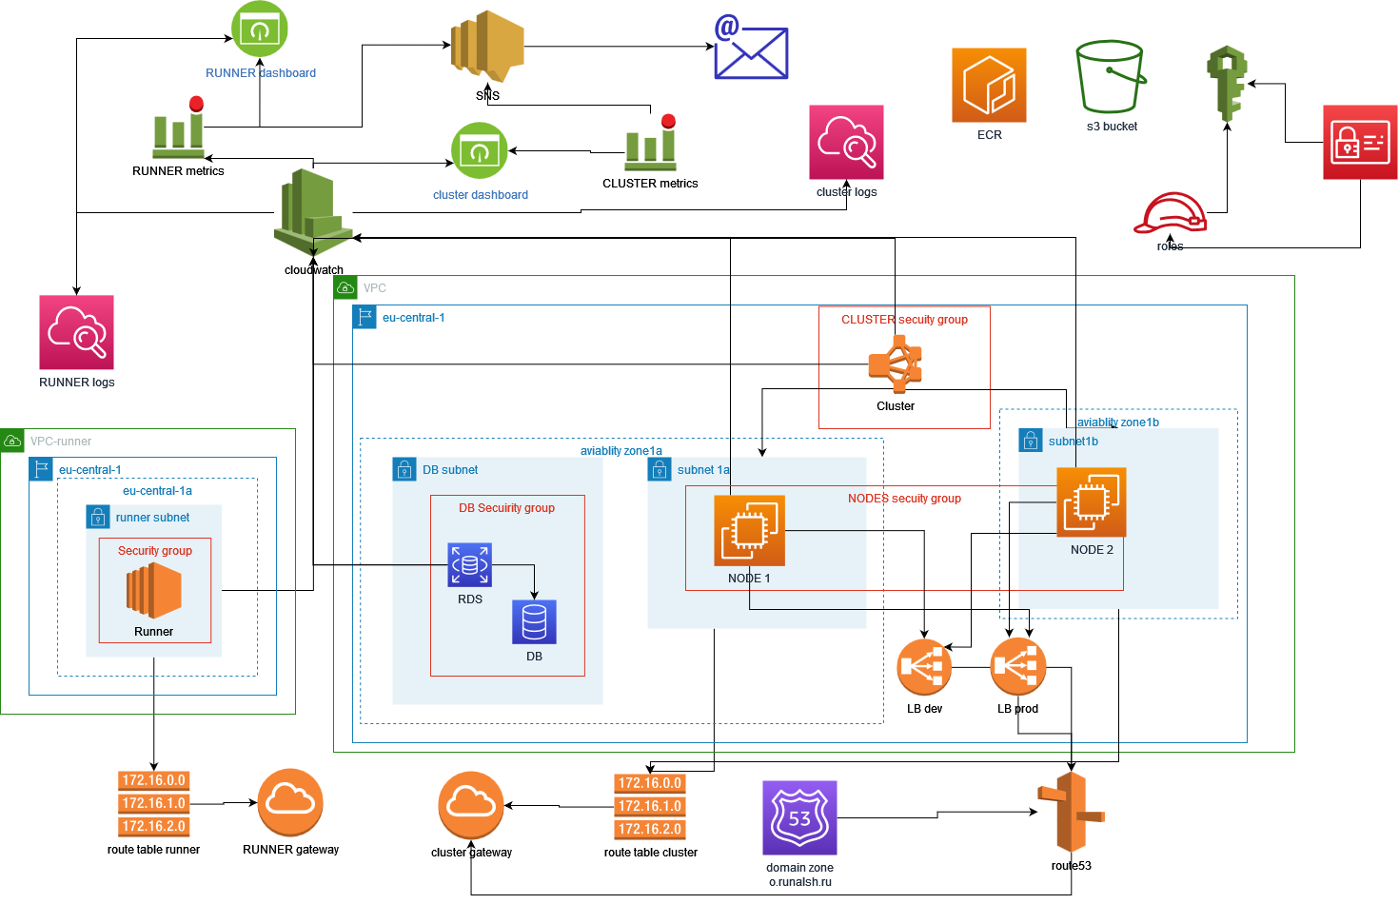
нарисовать с сабнетами и тд

Slide 8
PUSH ACTION
Delete
DEV
DEV
DEV
More than 5 images?
Runner
Tests
Build images
Push images to ECR
yes
Push
PROD
PROD
PROD
Helm
Cluster
PROD ns
DEV ns
S53 route
wealth
LB PROD
Backend
Backend
Frontend
Frontend
Autoscaling
Autoscaling
LB DEV

Slide 9
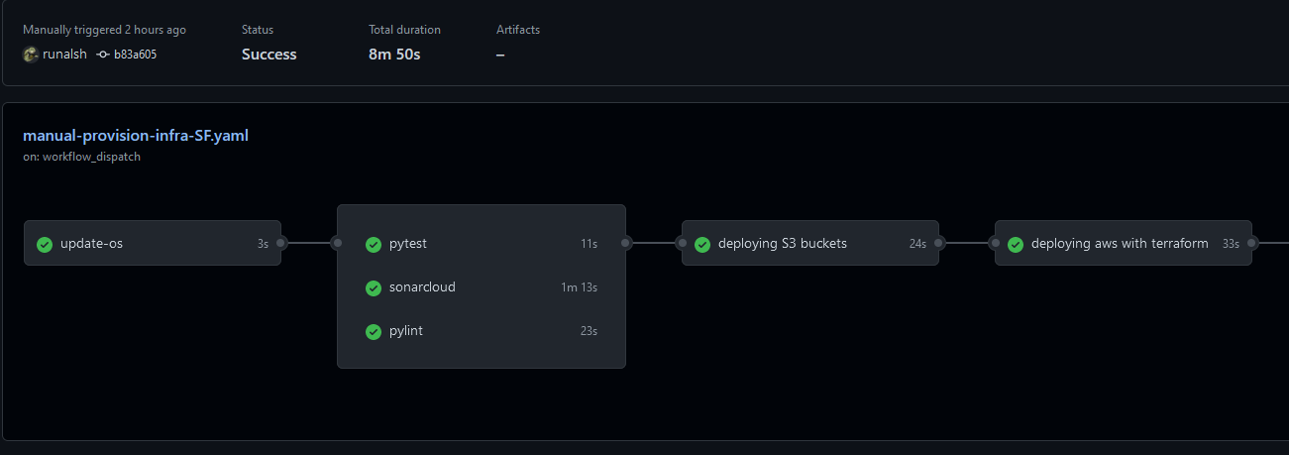
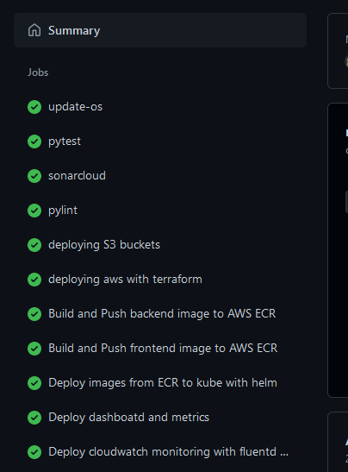
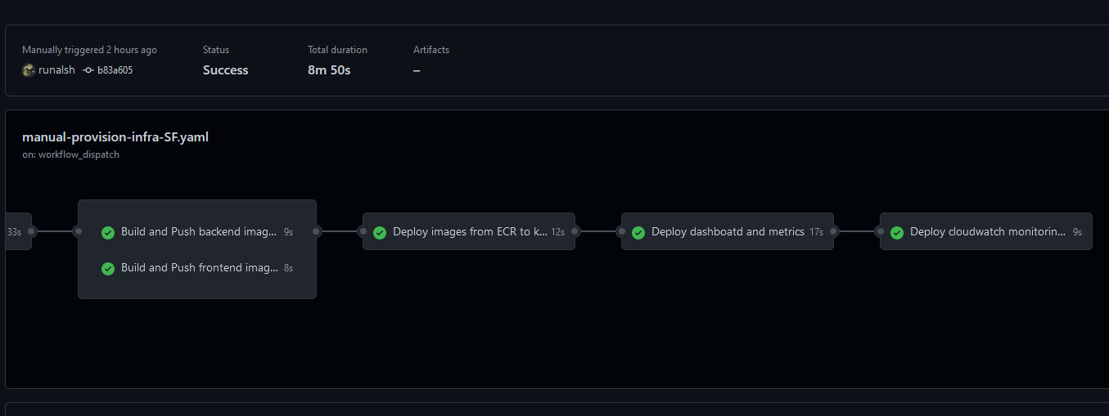
PUSH ACTION

Slide 10

VERSIONING
PROD
DEV
1 cluster – 2 namespace DEV and PROD.
1 DB for both space.
Why?

Slide 11
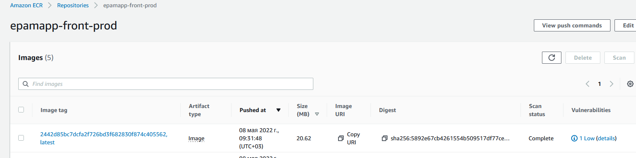
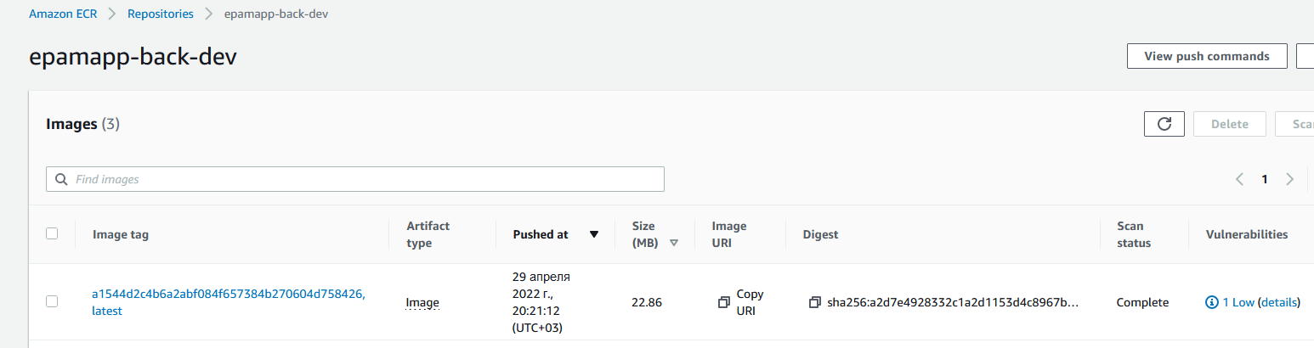
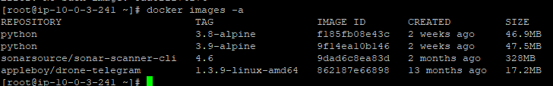
CONTAINERIZATION
For smaller size of application
images I using multistage building
in Docker.
Just 23 Mb for backend and 21 Mb
for frontend.
As builder used Python Alpine.
After each building on selfhosted
GH runner local registry cleaning
for save space EXCEPT original
Images like sonarcloud, python
for save network bandwidth

Slide 12
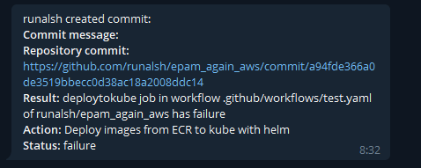

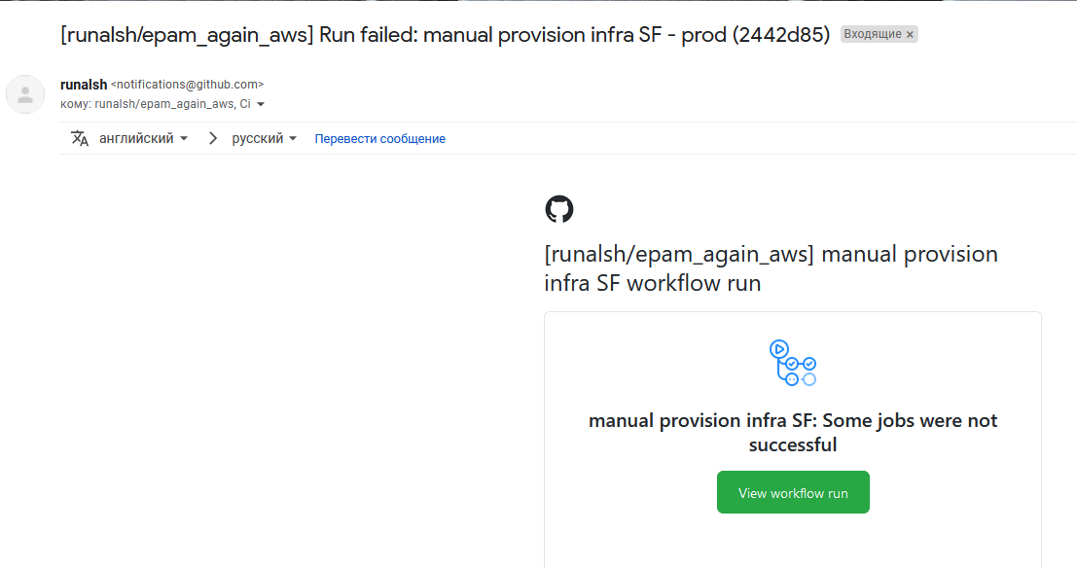

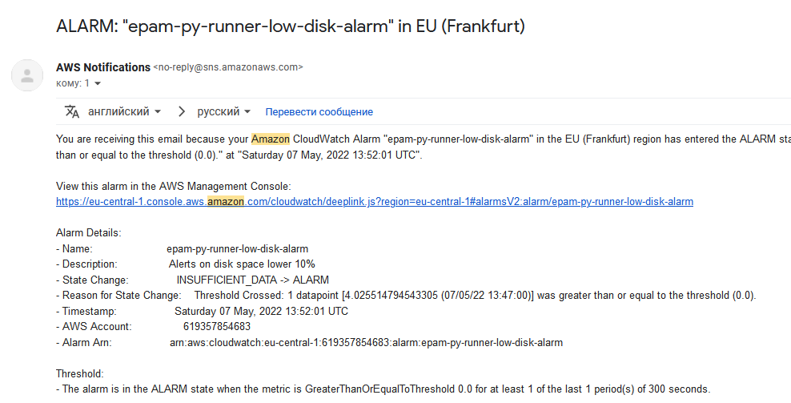

ALARM
Github Runner
Action failure
Alerts on state of runner and cluster:
mem usage
cpu usage
disk usage

Slide 13
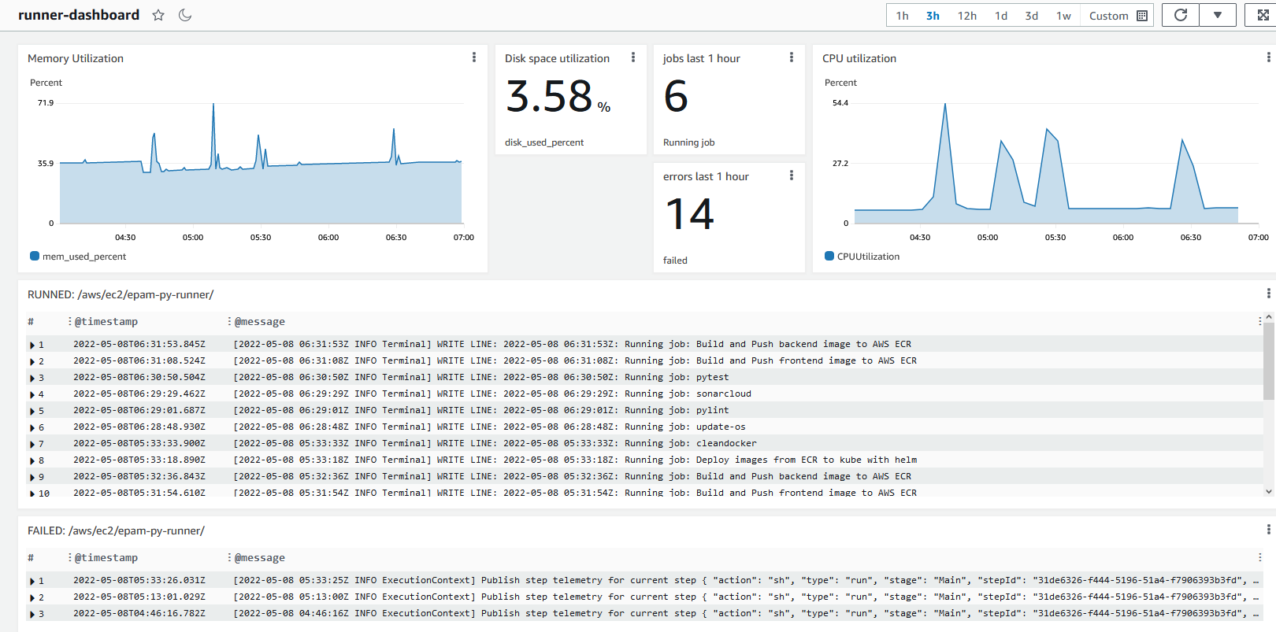
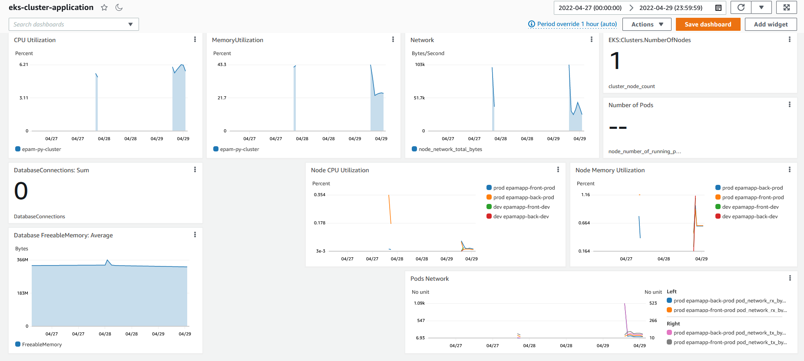
MONITORING
Github Action
Selfhosted runner
Dashboard:
Disk usage
Memory usage
Cpu usage
Logs from started jobs and count number
Logs from failed jobs and count number
Cluster dashboard:
Disk
Cpu
Memory
network
Number of pod
Number of nodes
RDS free space and connection number

Slide 14
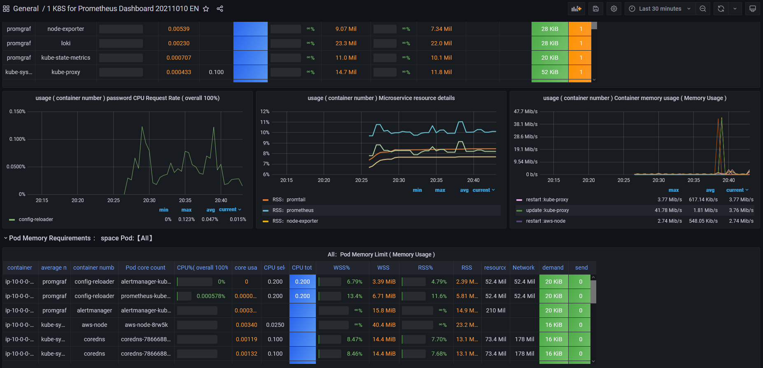
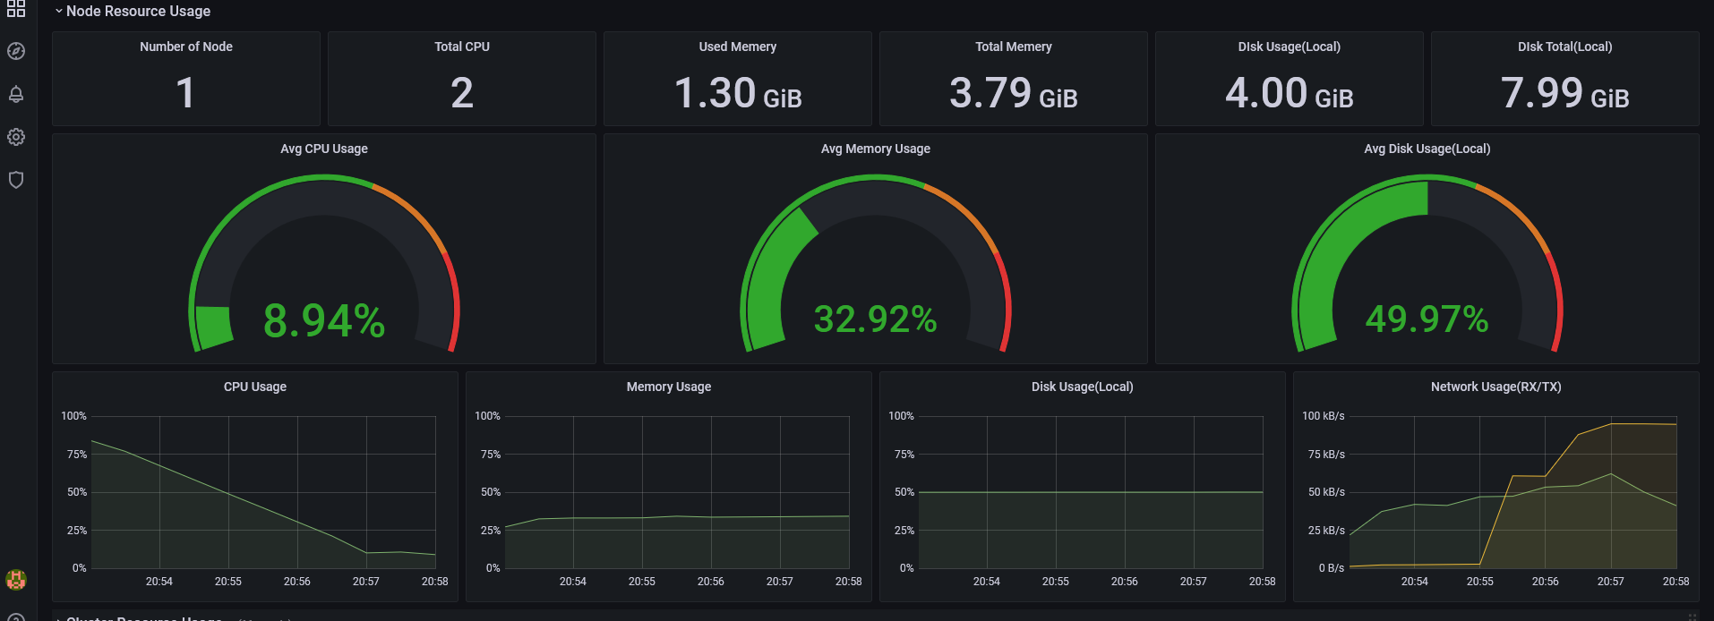
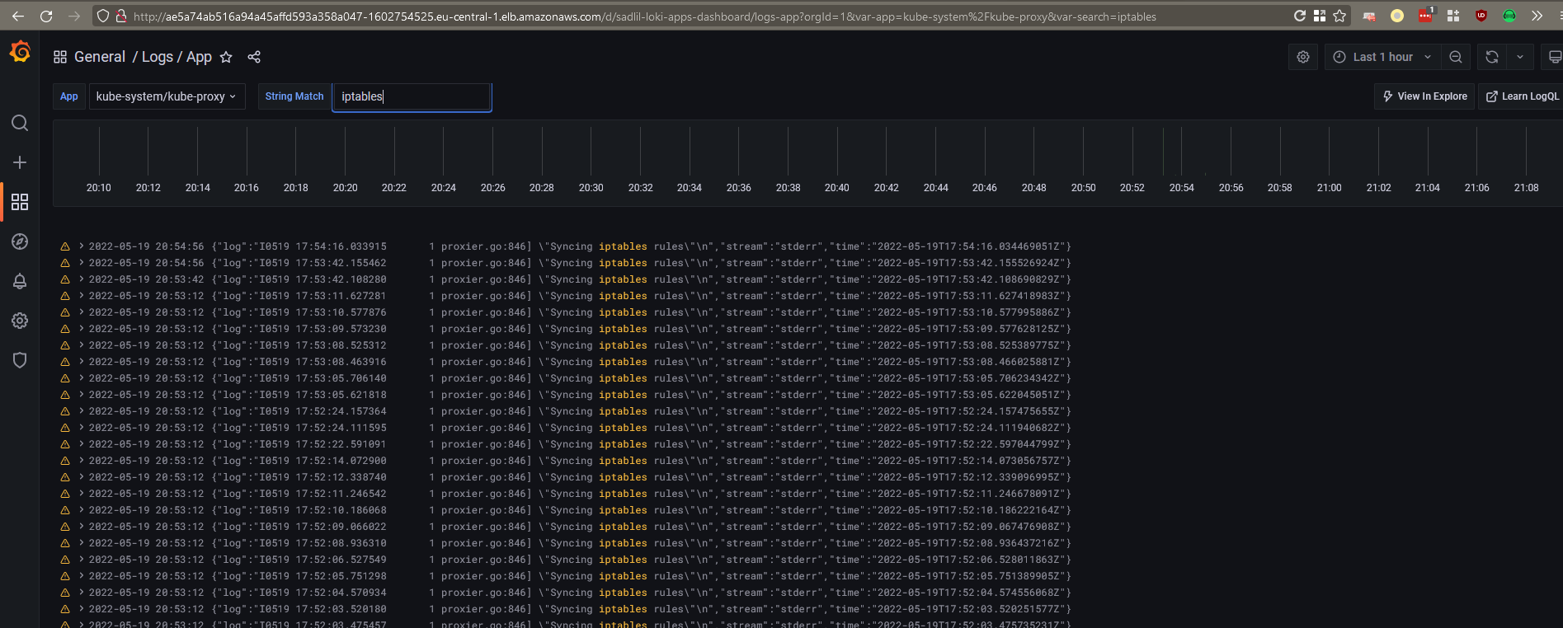
MONITORING (GRAFANA opt)
Node exporter > Prometheus > Grafana
Loki > Grafana
(but only from kubernetes cluster)
But I choosed AWS Cloudwatch and P-G-L added as optional.
Why?

Slide 15
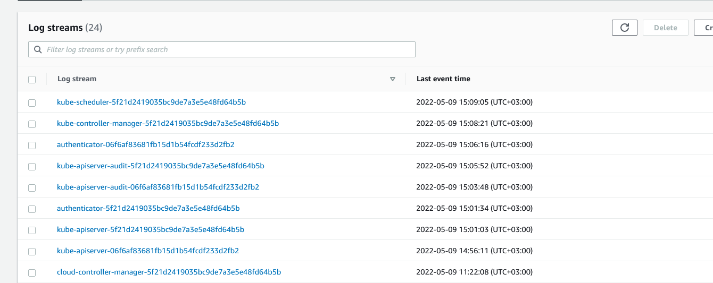
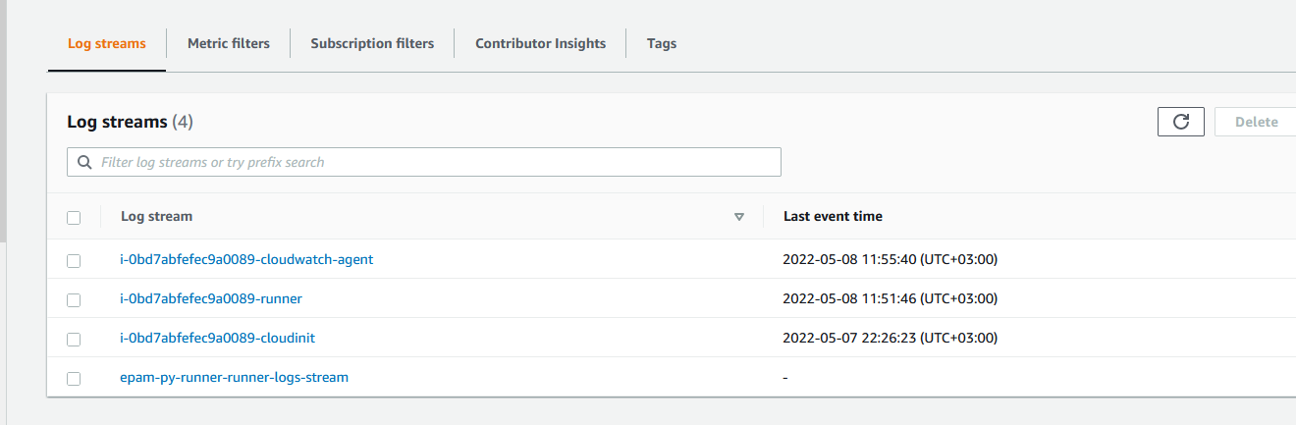
LOGS
Cluster logs:
pods
applications
Runner logs:
Github runner
Cloudwatch agent
Cloudinit agent

Slide 16
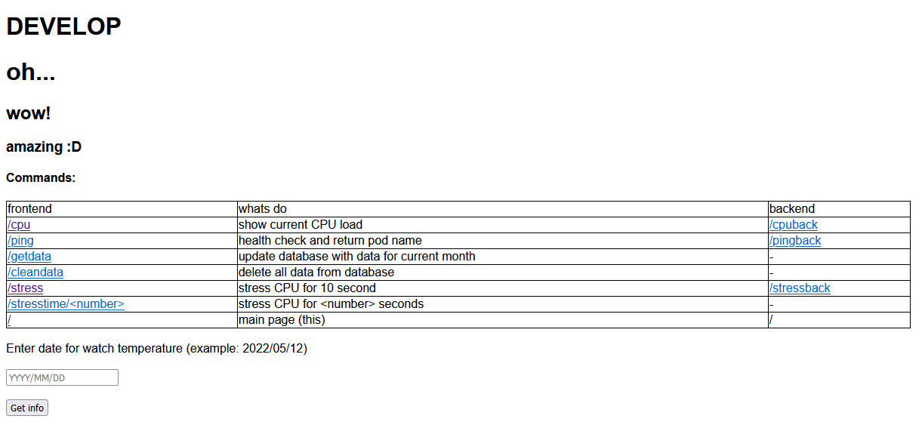
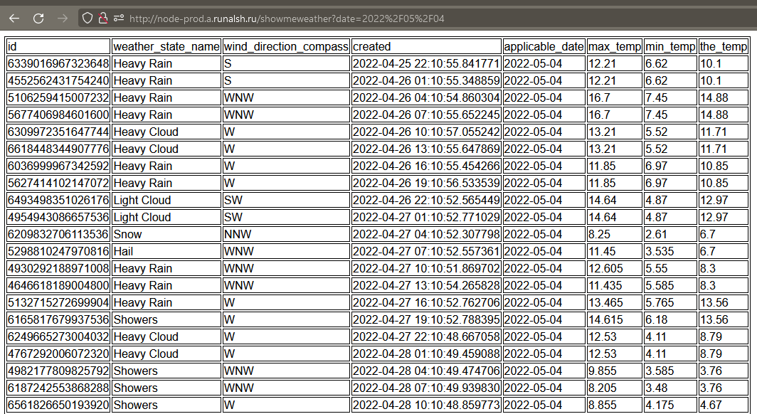
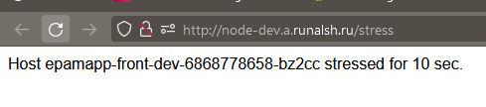

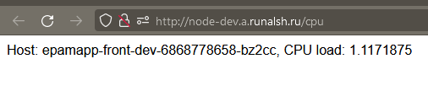
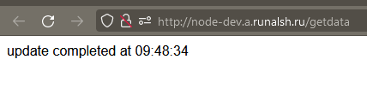
APPLICATION

Slide 17


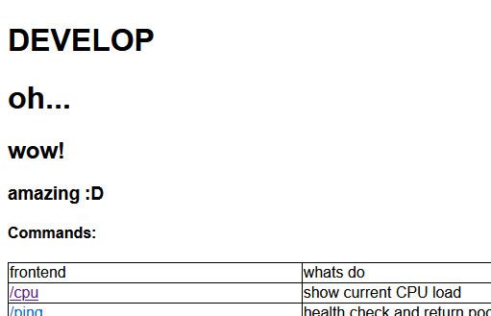
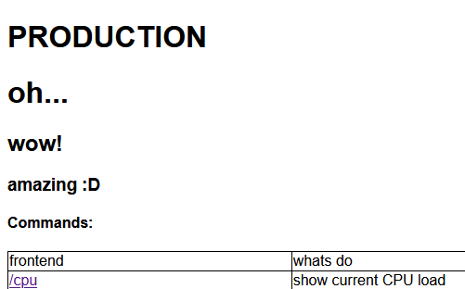
APPLICATIONs
PRODUCTION
DEVELOP
Frontend
Backend
Backend
Frontend
DATABASE
http://node-prod.a.runalsh.ru/
http://node-dev.a.runalsh.ru/
Route 53
Weighted
(80/20)
http://lb.a.runalsh.ru/
Prod - 80%
Dev -20%

Slide 18
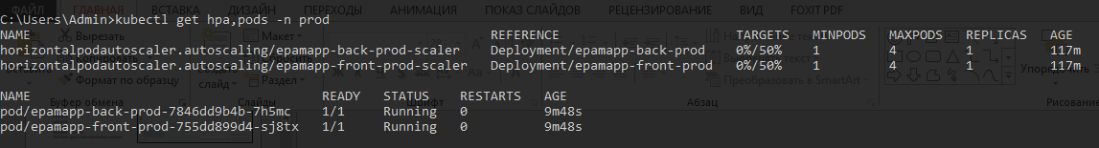
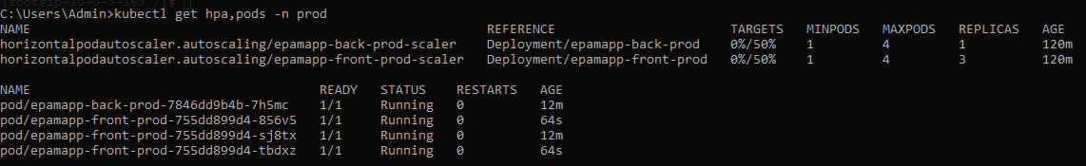
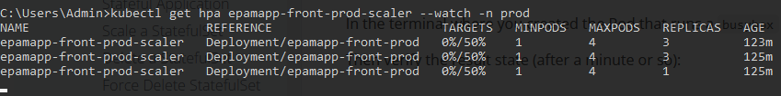
AUTOSCALING
1) We have 1 replicas
2) Run stress several times
for frontend app
3) After stop load and
idling 2 minutes
replica count goes to 1

Slide 19
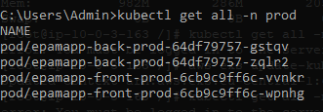
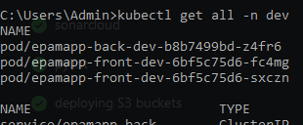
LOAD BALANCING
For verify load balancing between pods and check traffic route rule between PROD and DEV by wealth
we run curl command and grab some statistic.
watch -n 0.1 curl -s lb.a.runalsh.ru/ping >> wow
We have 2 replicas for frontend
on dev and prod. 80% of traffic sent to
prod and 20% to dev by s53 traffic policy.
Check statistic:
grep -o -i prod-6cb9c9ff6c-vvnkr wow | wc -l | grep -o -i prod-6cb9c9ff6c-wpnhg wow | wc -l | grep -o -i dev-6bf5c75d6-fc4mg wow | wc -l | grep -o -i dev-6bf5c75d6-sxczn wow | wc -l
Production |  | Develop
150 | 83 | 35 | 51
233 (73%) |  | 86 (27%)

Slide 20
PRICING
 | Version 1 SCM – Github | Version 2 Version 1+ Runner – Github Action Cloud (2000 min\mounth) | Version 3 Version2 + Cluster – ECS (EC2 mode) | Yandex cloud as Variant 1 | Google Cloud as variant 1
 | AWS |  |  | YaC | GCP
Runner (EC2) t2.micro | 11 | 0 | 0 | 16 | 6
Cluster - 1 | 73 | 73 | 0 | 0 | 0
Cluster 2 node(t3a.small) | 34 | 34 | 34 | 130 | 16
RDS PostgreSQL(db.t3.micro) | 17 | 17 | 17 | 90 | 25
Route 53 1 domain zone | 1 | 1 | 1 | 7 | 1
S3 storage - 1 GB | 0,02 | 0,02 | 0,02 | 10 | 0.01
ECR - 1 Gb | 1 | 1 | 1 | 10 | 0,1
SNS – 1000 | 0,05 | 0,05 | 0,05 | - | 0,1
Cloudwatch 2 dashboard, 1 gb logs | 3 | 3 | 3 | - | 0,5
Total per mount ($) | 140,07 | 129,07 | 56,07 | 256 | 48,7
Per year ($) | 1680,84 | 1548,84 | 672,84 | 3072 | 584,4

Slide 21
QA

