Slide 1
Newspaper <<Kazan Times>>
How we build infrastructure
Monitoring the state of the system
Storing and collecting logs
Alerting
We using backups too!
How we attacked by competitors
Tg: @ilnursh @runalsh

Slide 2
Topology of network
Intra4 192.168.40.0/24
eth3
eth1
ROUTER
Dnsmasq
Grafana
Prometheus
Sshfs
ELK
Elasticsearch
Logstash
Kibana
eth2
eth1
eth0
External 192.168.1.0/24
eth0
Intra1 192.168.10.0/24
Intra2 192.168.20.0/24
eth1
eth3
eth1
WEB
Nginx
Python script
Sshfs
DB
PostgreSQL
Pgadmin
Mdraid+Lvm
Bash Script 1
Bash Script 2
LVM
MDraid
eth0
eth0
Management 10.0.2.0/24

Slide 3
Firewall Section
ROUTER
ELK
Dnsmasq : 53
5601 : Kibana
SSH : 22
5044 : Logstash
Grafana : 3000
22 : SSH
External 192.168.1.0/24
5432 : PostgreSQL
DB
WEB
Nginx : 80,443
5050 : Pgadmin
SSH : 22
22 : SSH
25 : Exim
Management 10.0.2.0/24

Slide 4
How we apply firewall rules
ROUTER
Grafana from Management
Forward WEB-ELK, WEB-DB
DNS
Universal rules
SSH Management
Ping (icmp)
Loopback
Established conns
Closing rules
Drop incoming
Drop forward
Allow output
WEB
Nginx
Nginx for Extranet
DB
Pgadmin for Management
PostgreSQL for WEB
SSH for ROUTER and WEB
ELK
Logstash from WEB
Kibana from Mnagament
On next 3 slides you will see many
Non interesting text with rules.
Just skip it ☺

Slide 5
Latency test
For simulate latency we will use tc (Traffic Control ) utility from iproute packet.
At first lets check latency between WEB and DB from WEB
root@bullseye:~# ping db.runalsh.local
PING db.runalsh.local (192.168.20.2) 56(84) bytes of data.
64 bytes from db.runalsh.local (192.168.20.2): icmp_seq=25 ttl=63 time=1.37 ms
64 bytes from db.runalsh.local (192.168.20.2): icmp_seq=27 ttl=63 time=0.907 ms
Now add latency 97 ms to eth1 (intranet between WEB and Router)
tc qdisc add dev eth1 root netem delay 97ms
Check ping now
root@bullseye:~# ping db.runalsh.local
PING db.runalsh.local (192.168.20.2) 56(84) bytes of data.
64 bytes from db.runalsh.local (192.168.20.2): icmp_seq=1 ttl=63 time=98.7 ms
64 bytes from db.runalsh.local (192.168.20.2): icmp_seq=2 ttl=63 time=98.9 ms
As we can see to our ~1 ms added 97 ms.

Slide 6
Router
A router is a switching device for networks which is able to route network packets
Lets check it.
root@bullseye:~# ping -R web.runalsh.local
PING web.runalsh.local (192.168.10.2) 56(124) bytes of data.
64 bytes from web.runalsh.local (192.168.10.2): icmp_seq=1 ttl=63 time=1.4 ms
RR: db.runalsh.local (192.168.20.2)
router.runalsh.local (192.168.10.3)
web.runalsh.local (192.168.10.2)
web.runalsh.local (192.168.10.2)
router.runalsh.local (192.168.20.3)
db.runalsh.local (192.168.20.2)
64 bytes from web.runalsh.local (192.168.10.2): icmp_seq=2 ttl=63 time=0.79 ms (same route)
64 bytes from web.runalsh.local (192.168.10.2): icmp_seq=3 ttl=63 time=0.91 ms (same route)
As you can see packets from DB through router go to WEB and go back with same route.

Slide 7
For check of correctly working router iptables rules and count of packet drop we will simulate forward traffic from
two subnets which not accepted. For example from DB to ELK.
Check dropped packet count at first.
root@router:~# iptables –nvL …
Chain FORWARD (policy DROP 72 packets, 4320 bytes)
Now try to set up unaccepted connection. From DB to ELK
root@db:~# telnet elk.runalsh.local 5601
Trying 192.168.40.2...
telnet: Unable to connect to remote host: Connection timed out
Repeat few times.
Check count again
root@router:~# iptables -nvL
….
Chain FORWARD (policy DROP 80 packets, 4800 bytes)
Its working, fantastic! ☺

Slide 8
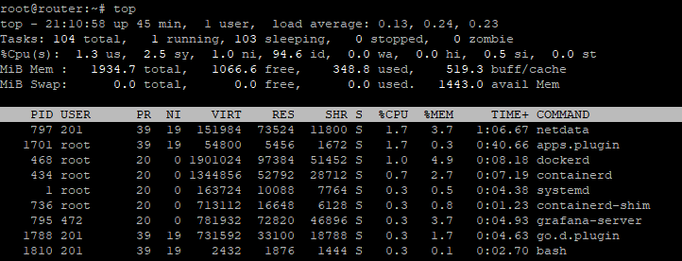
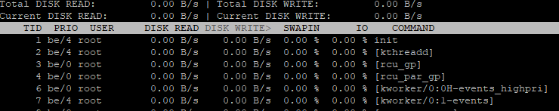
iostat
Monitoring - Section 1
How we can check resource utilization?
CPU
root@router:~# top
Button “p” will sort by proc usage - %CPU
MEMORY
Also here we see memory usage (%MEM)
and can sort by them with pressing “m”
button. Also here we get information about
total memory and free.
But if need more detailed information can
use “free” command.
DISK I\O
For check disk utilization we can use iostat.
It will be helpful to detect cause of problems

Slide 9
ELK stack
For this project im used Elasticksearch cluster for accounting logs from WEB server with using
Filebeat module. Its collect information from logs of Nging and system and sent to Logstash on ELK.
WEB
Filebeat: Nginx System
Logstash
Elasticksearch
Kibana
Logstash – collecting and parsing logs
Kibana – visualize data that saved in Elasticksearch index
Elasticksearch – search, analyze data
Filebeat – agent for data extracting and sending
Steps to setup Kibana index pattern
Go to Managment section press “create index pattern”, enter “filebeat-*” and go to next step,
as time field choose “@timetable”.

Slide 10
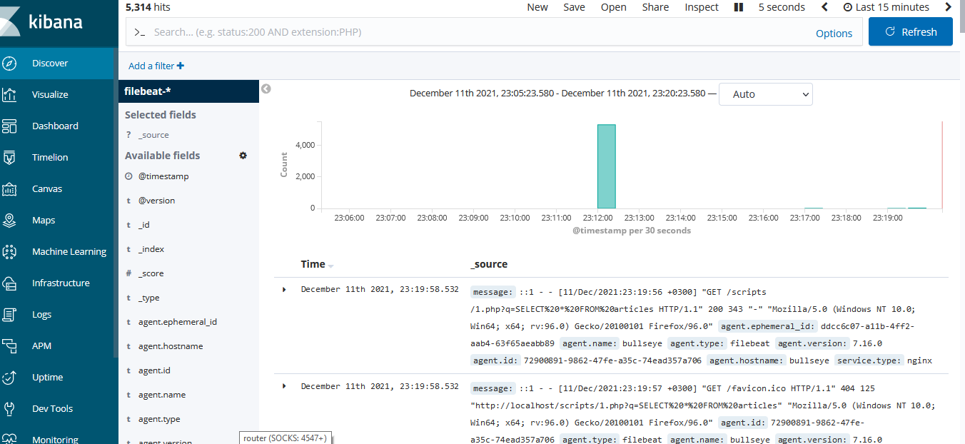
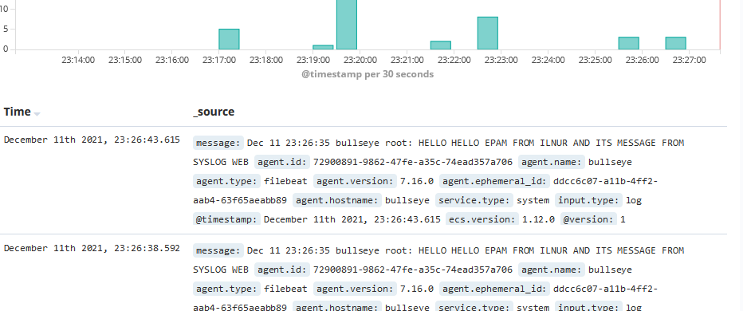
Lets make some logs and on WEB run
curl http://localhost/scripts/1.php?q=
SELECT%20*%20FROM%20articles
As you can see – our request form
Nginxcome to Logstash and ELK.
Now lets test syslog.
On WEB bash write
logger HELLO HELLO
EPAM FROM ILNUR AND ITS MESSAGE
FROM SYSLOG WEB
We saw this message in Kibana, cheers ☺

Slide 11

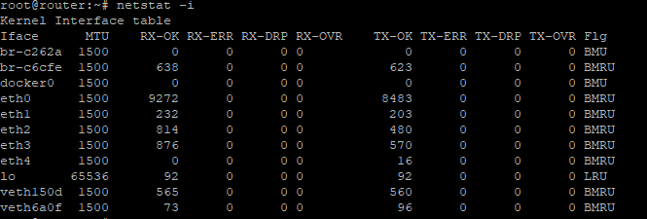
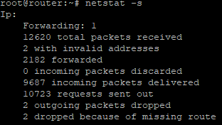
Monitoring - Section 2
Now we focused for network data checking on Router.
Established TCP session
netstat -ant | grep ESTABLISHED
Packet counters (IN/OUT/DROPPED/ERRORs)
We can get full information with
cat /proc/net/dev but more friendly
netstat –I
Or ifconfig give us information for each
interface
Packets forwarded/routed
netstat –s command display
information for each protocol

Slide 12
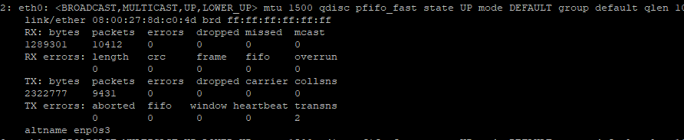
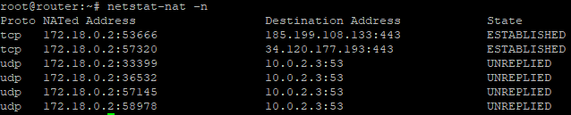
Utilization: multicast broadcast
unicast
ip -s link show
show information for each
interface
NAT sessions
To display list of all
nat connections
netstat-nat -s
Grafana + Pometheus
For visiualizate some metrics from router we used Promehteus and Grafana as visualizer.
To get some information also installed node_exporter and netdata.
Netdata
NodeExporter
Prometheus
Grafana

Slide 13
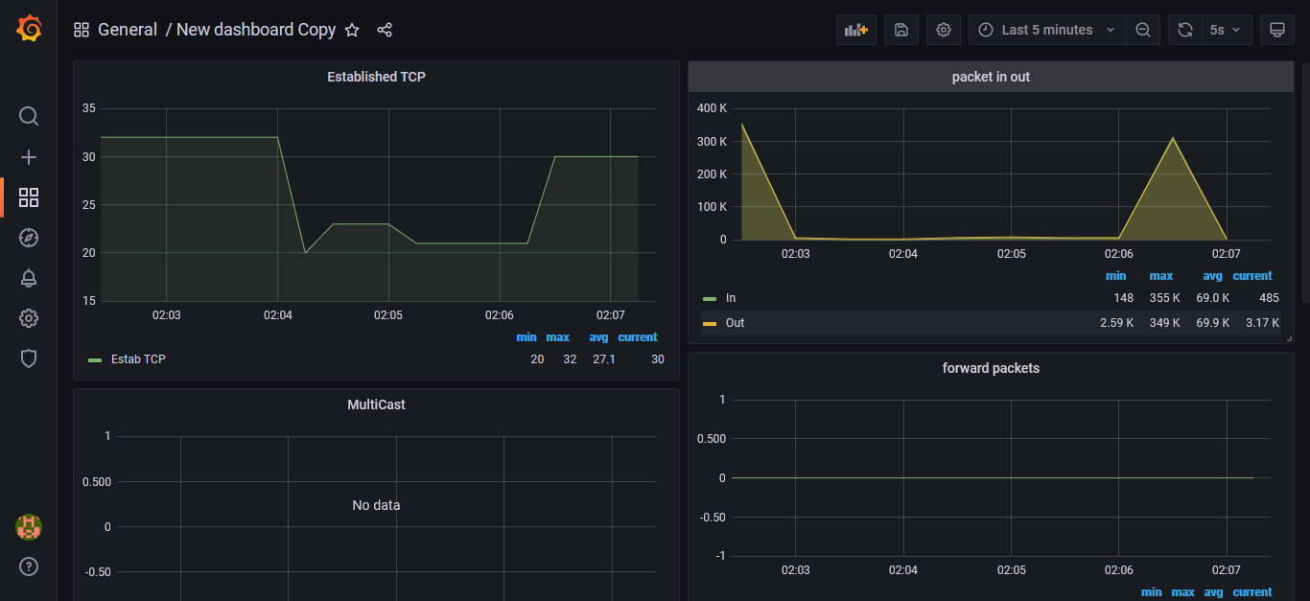
Grafana + Pometheus
You can easy add new dashboards from big collection https://grafana.com/grafana/dashboards/

Slide 14
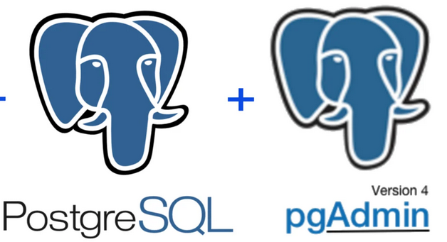
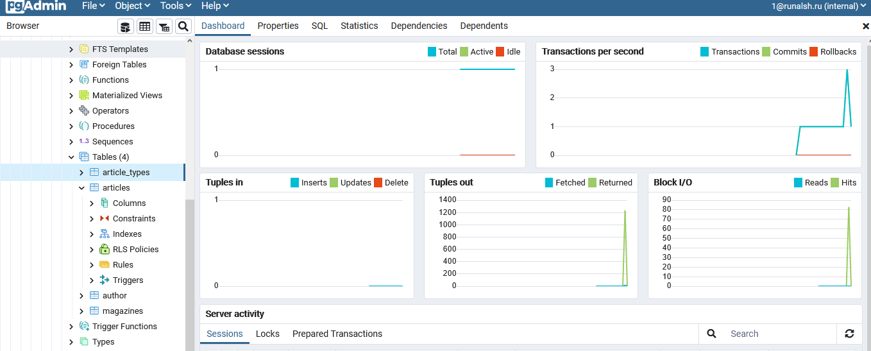
Database section
For this project I choosed PostgreSQL db as base.
Why?
Opensource
Object relative
Light
Easy integration with other tools and languages
Also for GUI installed PGAdmin as service
Also according to requirements we have 2 storage LVM and Mdraid with RAID1 scheme.
Files from /local/files available from ROUTER and WEB via sshfs.

Slide 15
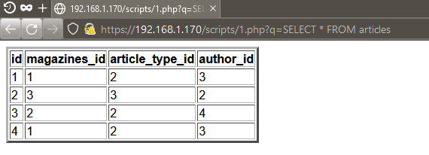
WEB section
As web server using Nginx with php-fpm and python
modules. For PostgreSQL integration added psycopg2
and pdo_pgsql.
WEB server have connection to Extranet
For direct query to DB we can and parameters after q=
Example - https://192.168.1.170/scripts/1.php?q=SELECT%20*%20FROM%20articles
Please don’t write here something like DATABASE DROP ☺

Slide 16
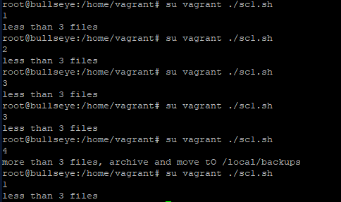
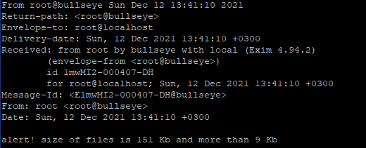
Scripts section
Bash script 1 - sc1.sh
Located on DB server.
Receive information from database
and save to /local/files directory.
If more than 3 files compress and
move to /local/backups
Get information from DB
How many files in /local/files
Archive and move to
/local/backups
Less or equal 3
More 3
Script 1 – sc1.sh
Script 2 – sc2.sh

Slide 17
Bash script 2 – sc2.sh
Sent alert to root user under certain conditions. Alerts can be read from /var/mail/mail
Has configuration in /etc/sc2.cfg and you can modify parametres:
files_number – if number of files in /local/backups more than files_number will run script
obiem - if total size of files in /local/backups more than X Kb will run script
Running as service with pid file check
Less or equal than obiem
Less or equal than
files_number
init
Check number of files
Check size
Send alert to root user
More than obiem
More than
files_number
Send alert to root user

Slide 18
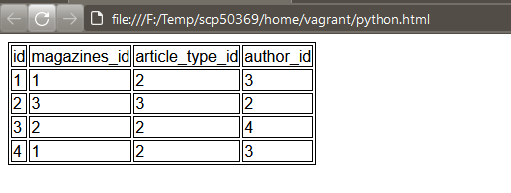
Python script - 1.py
Receive information from articles table from DB and print it as html page to /home/vagrant/python.html
Located on WEB in /local/scripts
Running with cron every 1 minute

Slide 19
MITM section
Hacker attacked our ROUTER and get root privileges throw some 0day exp. He is interested to modify
requests between WEB and DB and drop tables on DB. For this he redirected packets from DB to port 80
on WEB and modified request
WEB
ROUTER
Simple forward
DB
Configuration before invasion
WEB
ROUTER
DB
Configuration for MITM
Hacker, :80
He installed mitmproxy tool and made redirect SELECT%20id%20FROM%20 to DROP%20TABLE%20
mitmproxy --mode transparent --showhost --ssl-insecure --map-remote "|SELECT%20id%20FROM%20|
DROP%20TABLE%20“

Slide 20
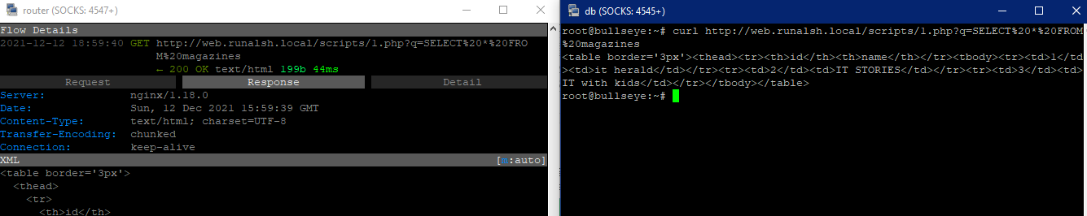
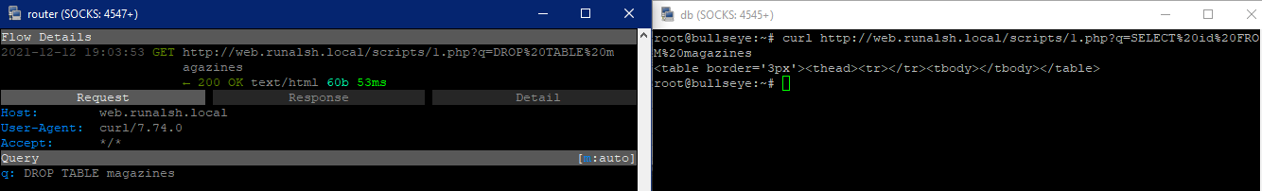
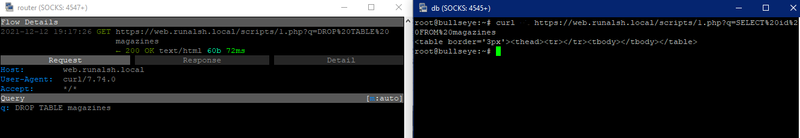
HTTP capture
HTTP modify
HTTPS modify
Administrator enabled https, disabled http, restored table from file.
But hacker added mitm cert to trusted on DB and dropped table againg ☺

Slide 21
QA section
Why host machine Vagrant? Why not docker etc
Im using Windows 10 1809 build and it don’t support Docker host and WSL. Vagrant in virtual box mode. I hate
Windows 10 builds > 1900 because its have many problems with old programs and some unsupported drivers
2. Why so much commands in vagrantfile, why don’t use external .sh file for deploy?
For deployment easier to see all command in configurations in one file. If I will open notepad+ with 100500 tabs its
much more difficult to understand problems. Of course I can extract as separated sh files.
3 Why so much operation like “cp /vagrant/Desktop/web/nginx_default /home/vagrant/ &&
sudo cp /home/vagrant/nginx_default /etc/nginx/sites-available/default”. Why y don’t copy files directly from host to final location in instance ?
At first, copy from windows host to linux fs break chmod and chown and by default made as root user. But my project
made for minimal priveleges of used commands.
Second, if I made some mistakes in conf files I will find it in /home/vagrant directory wihout browsing many dirs in instance.
4. what the hell with adding ssh keys in vagrantfile ?
Yes, Im using one key for all instances. Vagrant on each provision generate new keys, I can copy it, generate priv keys…
But for educational deployment I think it acceptable

Slide 22
5. Can we run you vagrant config?
Yeah, just put vagrantfile in you location , change home directory /vagrant/Desktop/ to your and put dirs there
6. Scripts/files?
Will be here https://github.com/runalsh/for_epam
Anything else?

