Slide 1
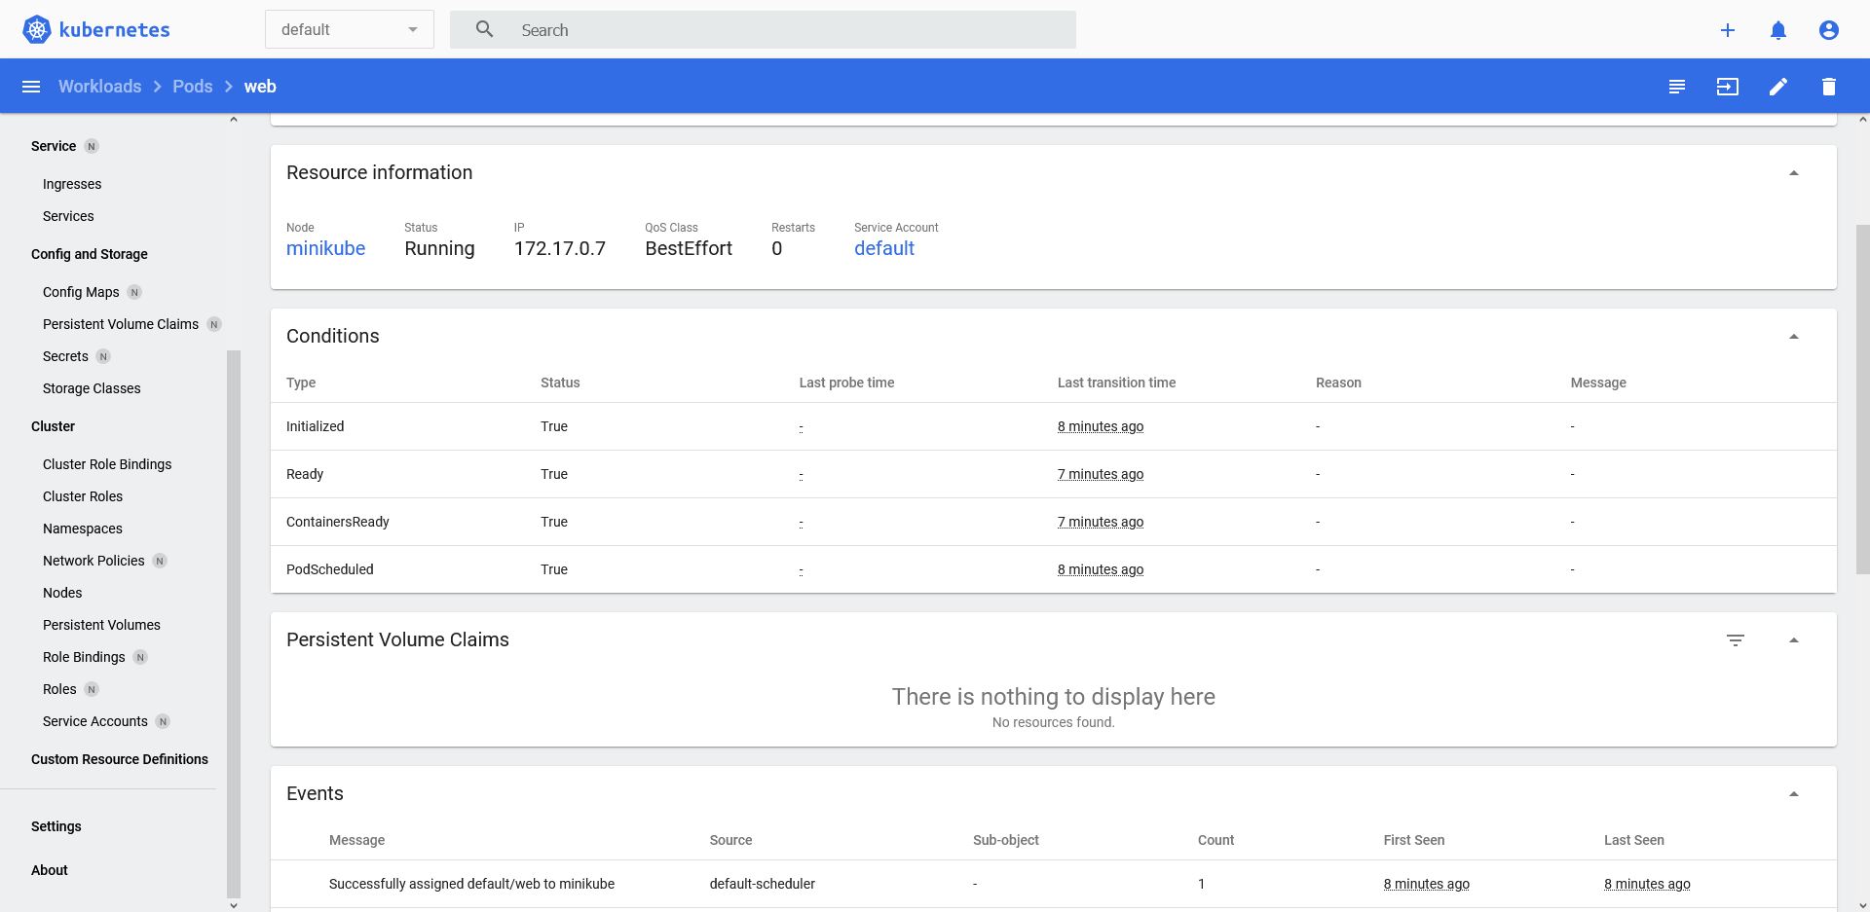

Slide 2
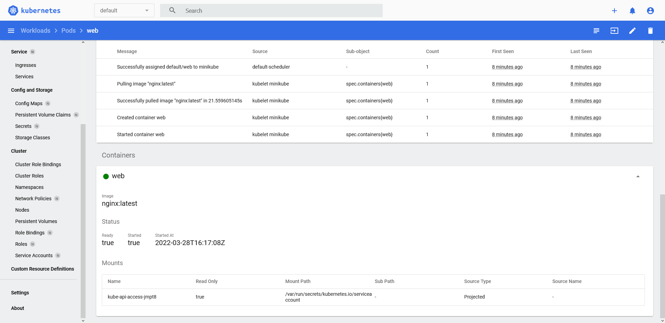

Slide 3
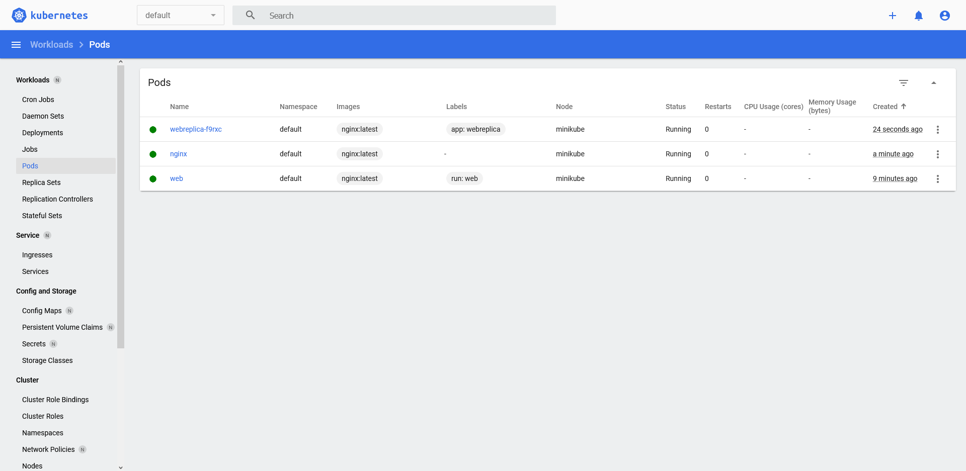
1 replica – original rs.yaml from git

Slide 4
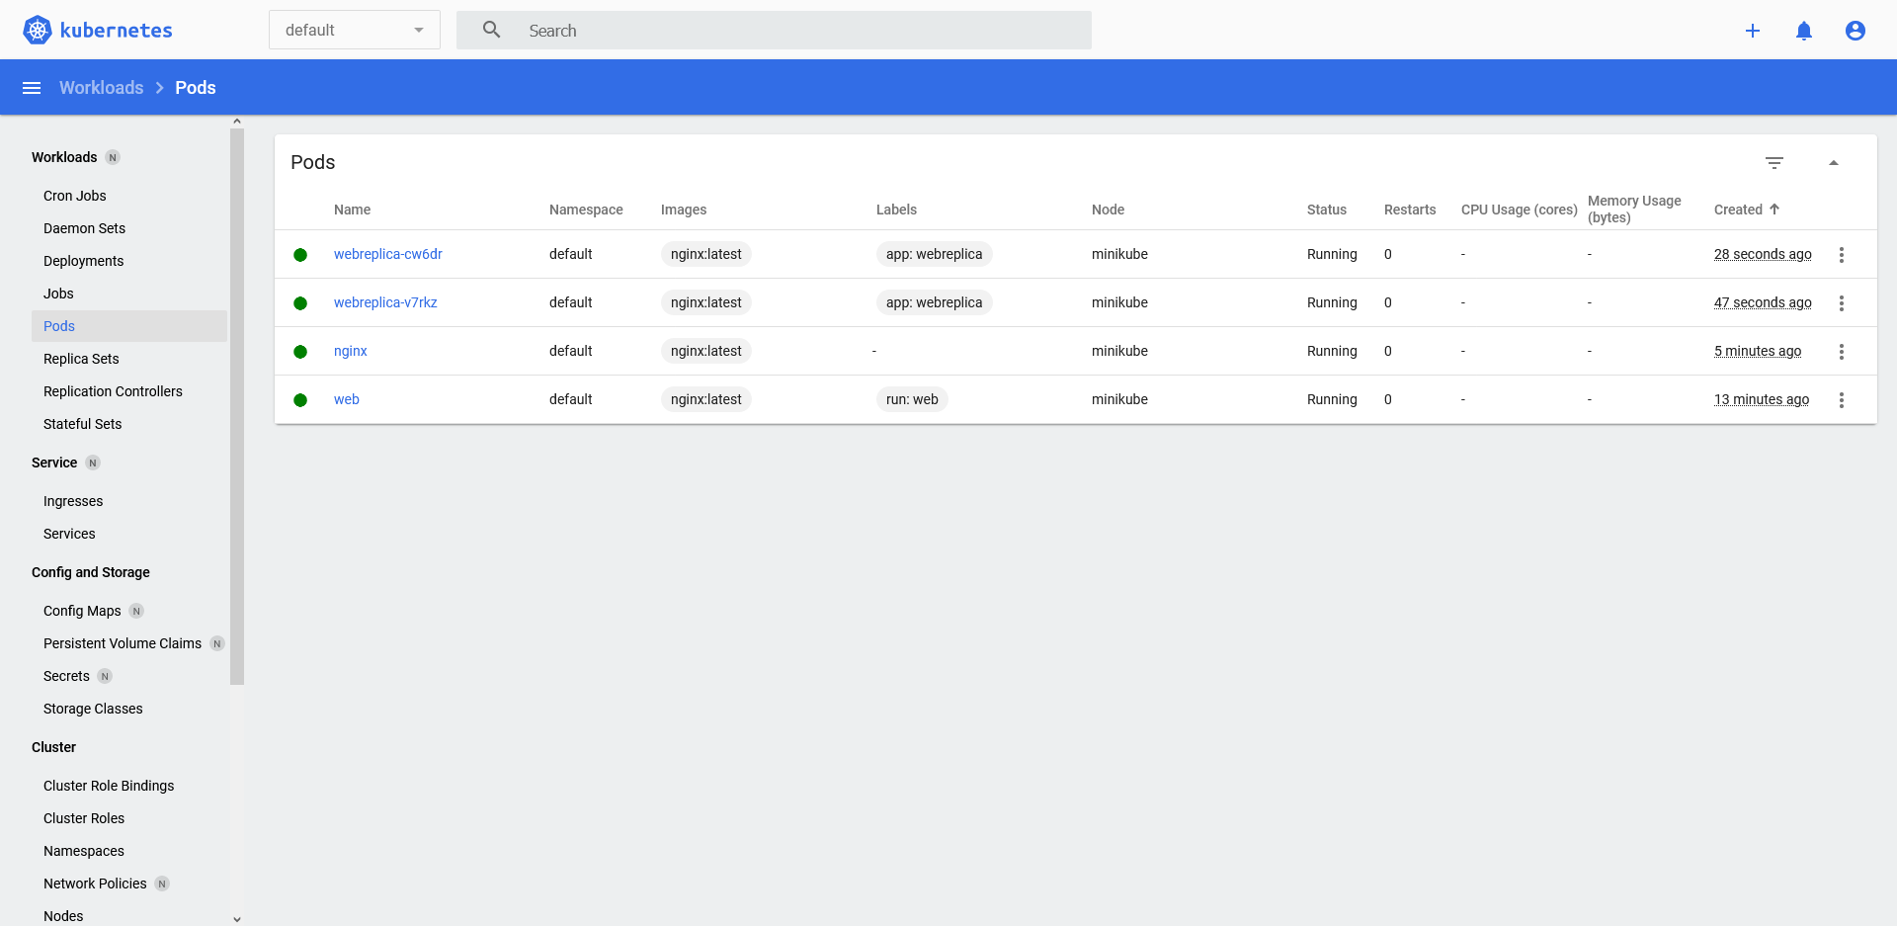
2 replica – scale rs.yaml

Slide 5
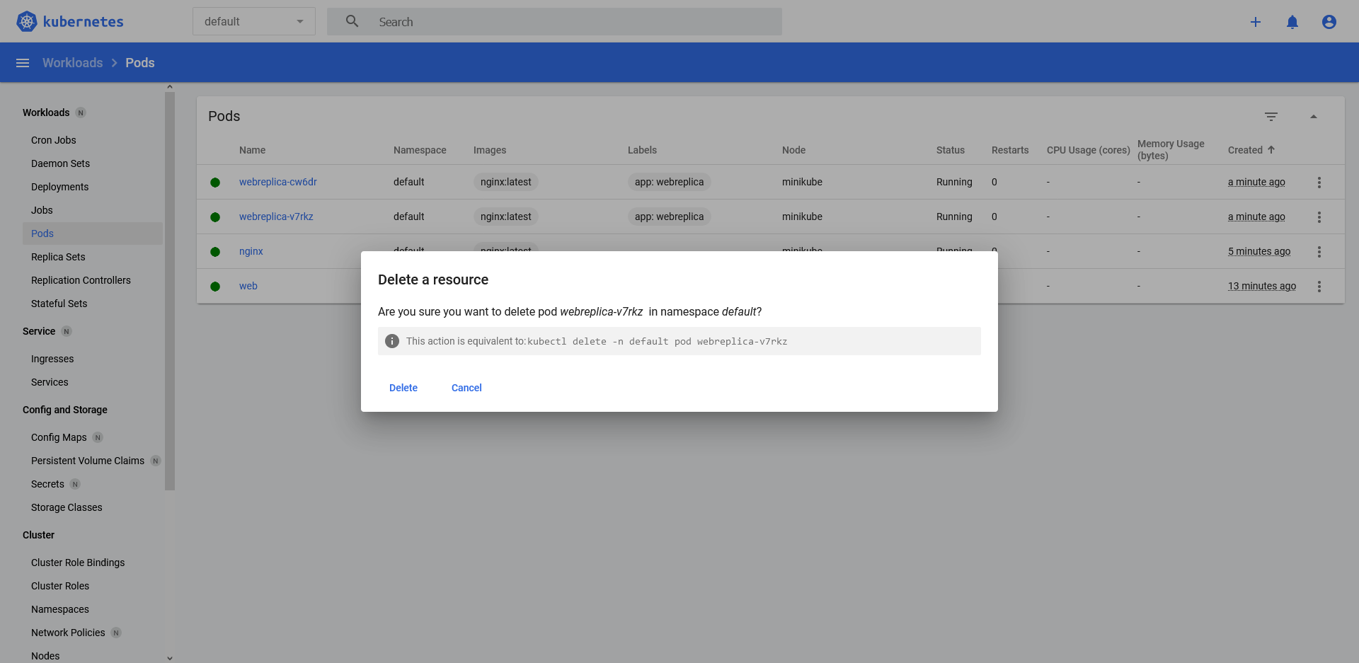
Delete 1 replica – created new

Slide 6
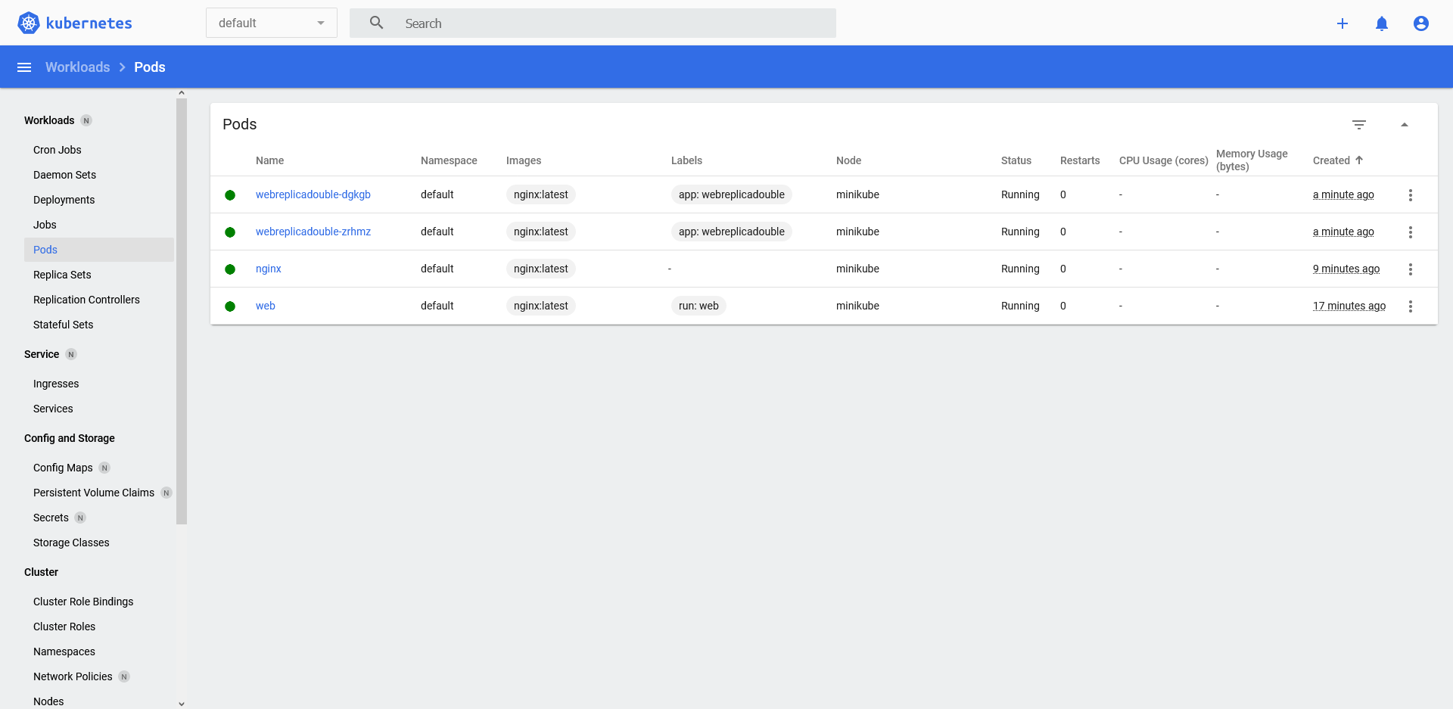
2 replica – my own rs.yaml

