Slide 1
DATA VISUALISATION Foreign Exchange Rate Per Dollar
TEAM ID: 8 Bismeet, Dhaval, Sumant

Slide 2
INTRODUCTION
Data visualization refers to presenting data in a graphical or pictorial form, such as a pie chart. Visualizations allow audiences to recognize patterns more quickly. Interactive displays enable decision-makers to drill down through the layers of detail. This changes perspectives so that users can review the facts behind the analysis.

Slide 3
OBJECTIVE
The task was to create a dashboard using any tool or technology to show it graphically—simple and self-understanding presentation by displaying trends and all information.
The dataset was provided in the form of a CSV file.

Slide 4
INSIGHTS USED
Growth/ fall of a given currency w.r.t the US dollar over the years
Time-series analysis of exchange rates of different currencies using individual plots of the dataset.
Maximum/minimum exchange rate at present
Impact of global recession (2008) on all the given currencies and which one stood out on top via combine plot of the dataset
Developing economies(fixed/floating exchange rates) via heat-map plot
Combining all the data in the form of a website.

Slide 5
TOOLS USED
Packages:
pandas
numpy
matplotlib.pyplot
geopandas
seaborn
Dashboard:
Built using HTML5 and CSS3

Slide 6
WORKING
The home page show the heat map of the World median exchange range for the given countries and comparison of exchange rate of different counties for the years 2001-2019.
The webpage for each country shows the foreign exchange rate trends with respect to US dollar from 2001 to 2019.
The code has been explained in the .ipynb file.

Slide 7
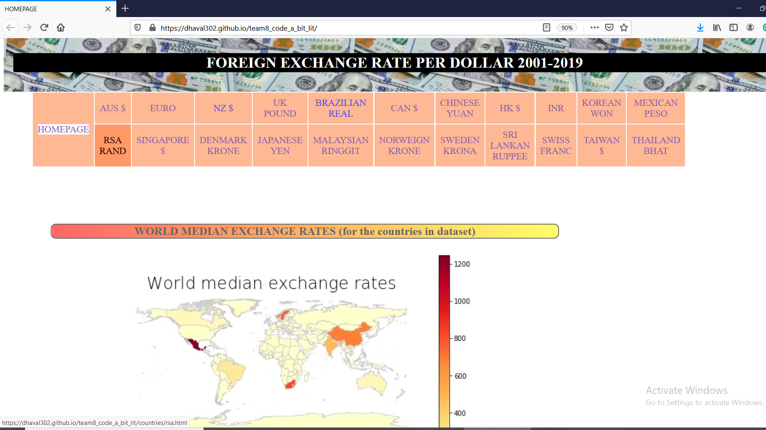
Home Page

Slide 8
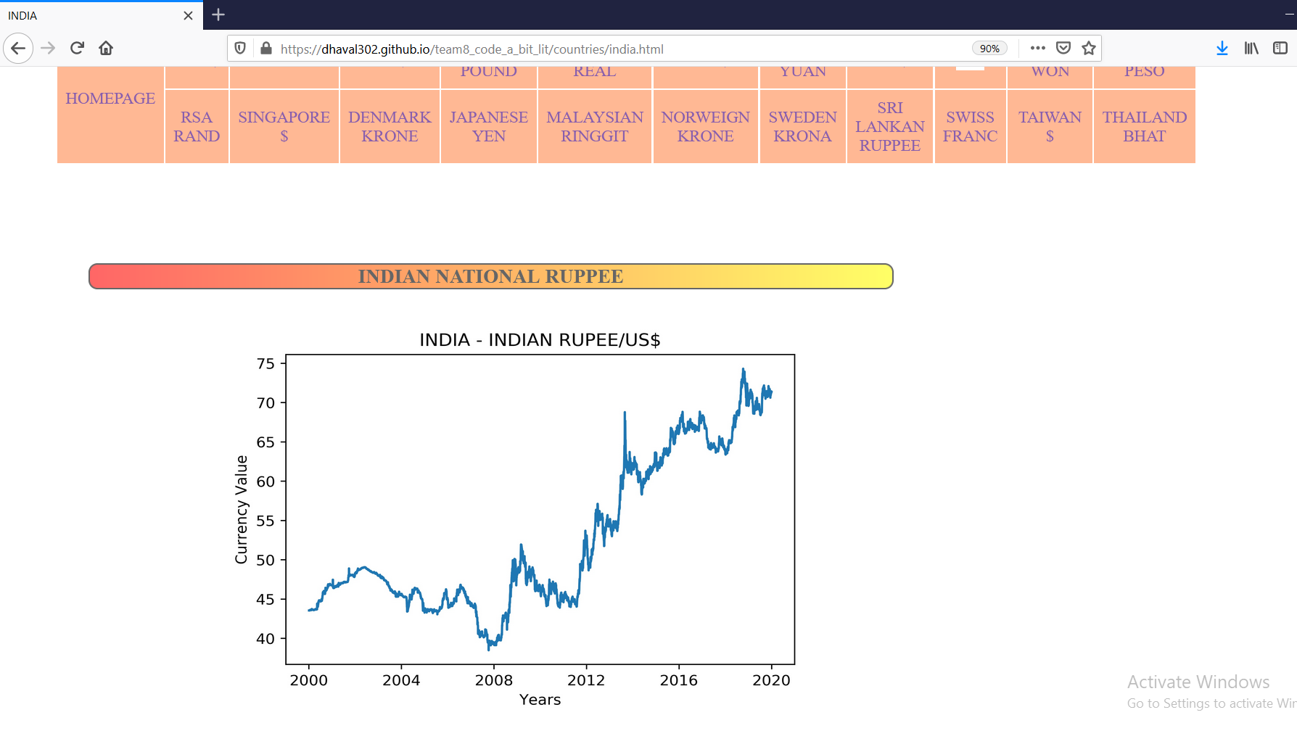
Web pages of the given countries showing the trend from 2001 to 2019

Slide 9
Links:
.ipynb file:
https://github.com/runawaybon/CODE_A_BIT_LIT_PEC2020
Website Link:
https://dhaval302.github.io/team8_code_a_bit_lit/index.html
Website repository:
https://github.com/Dhaval302/team8_code_a_bit_lit

