Slide 1


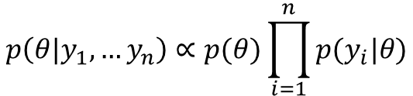
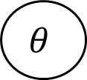

Stan pseudo-code:
data{
int<lower=0> n;
real y[n];
}
parameters{
real theta;
}
model{
theta ~ p();
for( i in 1 : n ) {
y[i] ~ p(theta);
}
}
$$θ$$
$$y_{1}$$
$$y_{2}$$
…
$$y_{n}$$
Posterior density
$$p\left(θ|y_{1},…y_{n}\right)∝p(θ)\prod_{i=1}^{n}{p(y_{i}|θ)}$$

Slide 2
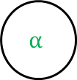























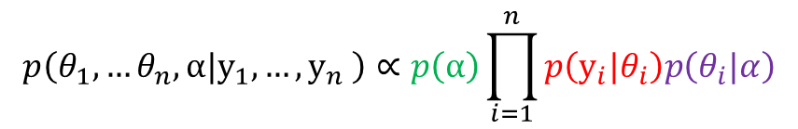




a)
b)
$$α$$
c)
$$γ$$
$$α$$
$$α$$
$$μ_{1}$$
…
$$μ_{m}$$
$$θ_{1}$$
$$θ_{2}$$
…
$$θ_{n}$$
$$θ_{1,1}$$
…
$$θ_{1,n}$$
…
$$θ_{m,1}$$
…
$$θ_{m,n }$$
$$σ_{1}$$
$$μ_{1}$$
…
$$σ_{n}$$
$$μ_{n}$$
$$x_{1}$$
$$x_{n}$$
$$y_{1}$$
$$y_{2}$$
$$y_{n}$$
$$y_{1,1}$$
$$y_{1, n}$$
$$y_{m,1}$$
$$y_{m, n}$$
$$y_{1}$$
$$y_{n}$$
$$p\left(θ_{1},…θ_{n},α|y_{1},…,y_{n} \right)∝p\left(α\right)\prod_{i=1}^{n}{p\left(y_{i}|θ_{i}\right)p\left(θ_{i}|α\right)}$$
a)
$$p\left(μ_{1},…,μ_{n},θ_{1,1},…,θ_{m,n_{m}},α|y_{1,1},…,y_{m,n }\right)∝p\left(α\right)\prod_{j=1}^{m}{p(μ_{j}|α)\prod_{i=1}^{n}{p\left(y_{j,i}|θ_{j,i}\right)p\left(θ_{j,i}|μ_{j}\right)}}$$
b)
$$p\left(μ_{1},…,μ_{n},σ_{1},…,σ_{n},α,γ|x_{1},…,x_{n},y_{1,1},…,y_{m,n }\right)∝p\left(α\right)p(γ)\prod_{i=1}^{n}{p(μ_{j}|α,x_{i})p(σ_{j}|γ,x_{i})p\left(y_{i}|μ_{i},σ_{i}\right)}$$
c)

Slide 3
a)
b)
$$α$$
c)
$$γ$$
$$α$$
$$α$$
$$μ_{1}$$
…
$$μ_{m}$$
$$θ_{1}$$
$$θ_{2}$$
…
$$θ_{n}$$
$$θ_{1,1}$$
…
$$θ_{1,n}$$
…
$$θ_{m,1}$$
…
$$θ_{m,n }$$
$$σ_{1}$$
$$μ_{1}$$
…
$$σ_{n}$$
$$μ_{n}$$
$$x_{1}$$
$$x_{n}$$
$$y_{1}$$
$$y_{2}$$
$$y_{n}$$
$$y_{1,1}$$
$$y_{1, n}$$
$$y_{m,1}$$
$$y_{m, n}$$
$$y_{1}$$
$$y_{n}$$

Slide 4

a)
$$α$$
Stan pseudo-code:
data{
int<lower=0> n;
real y[n];
}
parameters{
real theta[n];
real alpha;}
model{
alpha ~ p();
for( i in 1 : n ) {
theta[i] ~ p(alpha);
y[i] ~ p(theta[i]);
}
}
$$θ_{1}$$
$$θ_{2}$$
…
$$θ_{n}$$
$$y_{1}$$
$$y_{2}$$
$$y_{n}$$
$$p\left(θ_{1},…θ_{n},α|y_{1},…,y_{n}\right)∝p\left(α\right)\prod_{i=1}^{n}{p\left(y_{i}|θ_{i}\right)p\left(θ_{i}|α\right)}$$

Slide 5





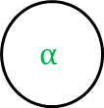





Stan pseudo-code:
data{
int<lower=0> n;
int<lower=0> m;
real y[m,n];
}
parameters{
real theta[m,n];
real alpha;
real mu[m];
}
model{
alpha ~ p();
for( i in 1 : m ) {
mu[i] ~ p(alpha)
for( j in 1 : n ) {
theta[i,j] ~ p(mu[i]);
y[i,j] ~ p(theta[i,j]);
}
}
b)
$$α$$
$$μ_{1}$$
…
$$μ_{m}$$
$$θ_{1,1}$$
…
$$θ_{1,n}$$
…
$$θ_{m,1}$$
…
$$θ_{m,n }$$
$$y_{1,1}$$
$$y_{1, n}$$
$$y_{m,1}$$
$$y_{m, n}$$
$$p\left(μ_{1},…,μ_{n},θ_{1,1},…,θ_{m,n_{m}},α|y_{1,1},…,y_{m,n_{m}}\right)∝p\left(α\right)\prod_{j=1}^{m}{p(μ_{j}|α)\prod_{i=1}^{n_{j}}{p\left(y_{j,i}|θ_{j,i}\right)p\left(θ_{j,i}|μ_{j}\right)}}$$

Slide 6










Stan pseudo-code:
data{
int<lower=0> n;
real y[n];
real x[n];
}
parameters{
real sigma[n];
real mu[n];
real alpha;
real gamma;
}
model{
alpha ~ p();
gamma ~ p();
for( i in 1 : n ) {
mu[i] ~ p(alpha,x[i])
sigma[i] ~ p(gamma,x[i])
y[i] ~ p(mu[i], sigma[i]);
}
}
c)
$$γ$$
$$α$$
$$σ_{1}$$
$$x_{1}$$
$$μ_{1}$$
…
$$σ_{n}$$
$$x_{n}$$
$$μ_{n}$$
$$y_{1}$$
$$y_{n}$$
$$p\left(μ_{1},…,μ_{n},σ_{1},…,σ_{n},α,γ|x_{1},…,x_{n},y_{1},…,y_{n }\right)∝p\left(α\right)p(γ)\prod_{i=1}^{n}{p(μ_{i}|α,x_{i})p(σ_{i}|γ,x_{i})p\left(y_{i}|μ_{i},σ_{i}\right)}$$

Slide 7











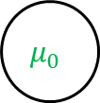


Stan pseudo-code:
data{
int<lower=0> n;
int<lower=0> J;
real y[n,J];
real nu1;
real nu2;
real s2_1;
real s2_2;
}
parameters{
real mu[J];
real sigma[J];
real mu0;
real phi;
}
model{
mu0 ~p();
phi ~ p(nu1, s2_1) ;
for( j in 1 : J ) {
mu[j] ~ p(mu0, phi);
sigma[j] ~ p(nu2,s2_2);
for( i in 1 : n ) {
y[i,j] ~ p(mu[j],sigma[j]);
}
}
Note. These are not needed for full points, since they are different from the given examples.
$$ν_{1}$$
$$s_{1}^{2}$$
$$μ_{0}$$
$$φ$$
$$ν_{2}$$
$$s_{2}^{2}$$
$$μ_{1}$$
$$σ_{1}$$
…
$$μ_{J}$$
$$σ_{J}$$
…
…
…
$$y_{1,1}$$
$$y_{n,1}$$
$$y_{1,J}$$
$$y_{n,J}$$

