Slide 1
Feature Selection Competition

Slide 2
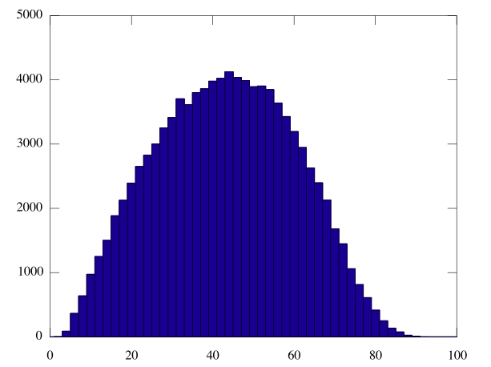
100,000 randomly selected 10-element feature sets

Slide 3
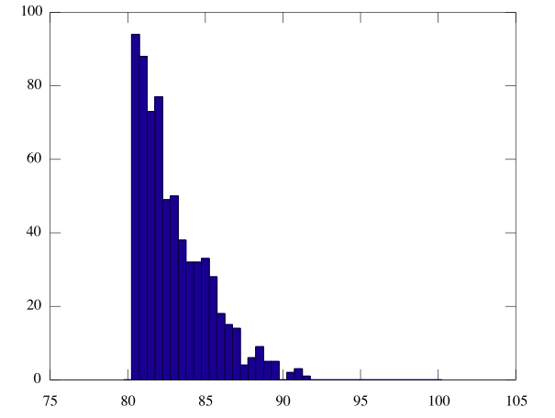
100,000 randomly selected 10-element feature sets
Close up showing only sets scoring > 80%.
Notice, very unlikely to randomly select > 90%

Slide 4
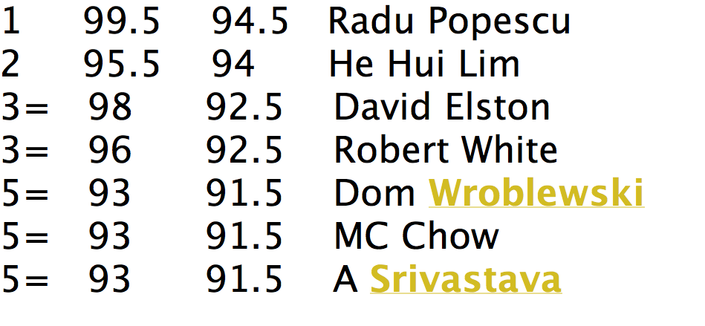
Results

Slide 5
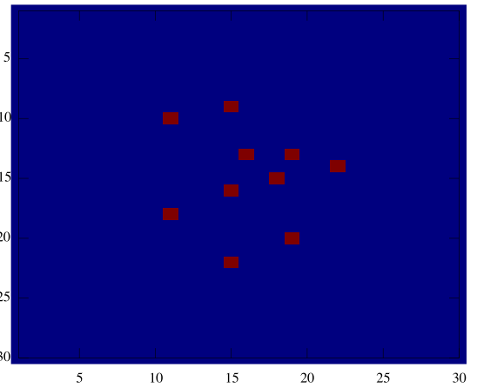
Winning Features
[310 318 429 436 442 463 525 553 560 644]

Slide 6
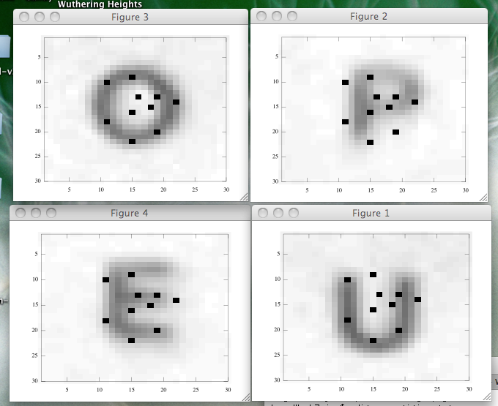
Winning Features

