Slide 1
Feature Selection Challenge 2011

Slide 2
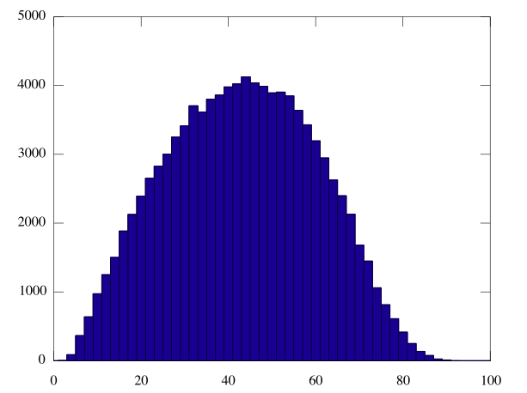
100,000 randomly selected 10-element feature sets

Slide 3
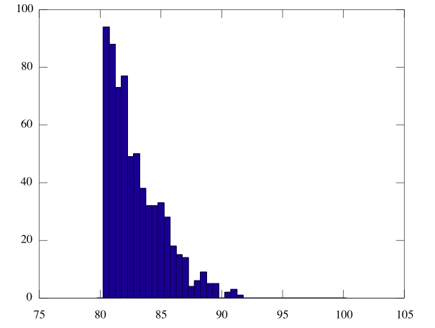
100,000 randomly selected 10-element feature sets
Close up showing only sets scoring > 80%.
Notice, very unlikely to randomly select > 90%

Slide 4
Results
3rd 88.0 81.5 T Archer
2nd 94.0 89.5 Domonic Ellam
1st 99.5 93.0 Mike Goddard, Callum Cox
and Matt Raymond
95.5 94.0 He Hui Lim (2010-2011)
99.5 94.5 Radu Popescu (2010-2011)

Slide 5
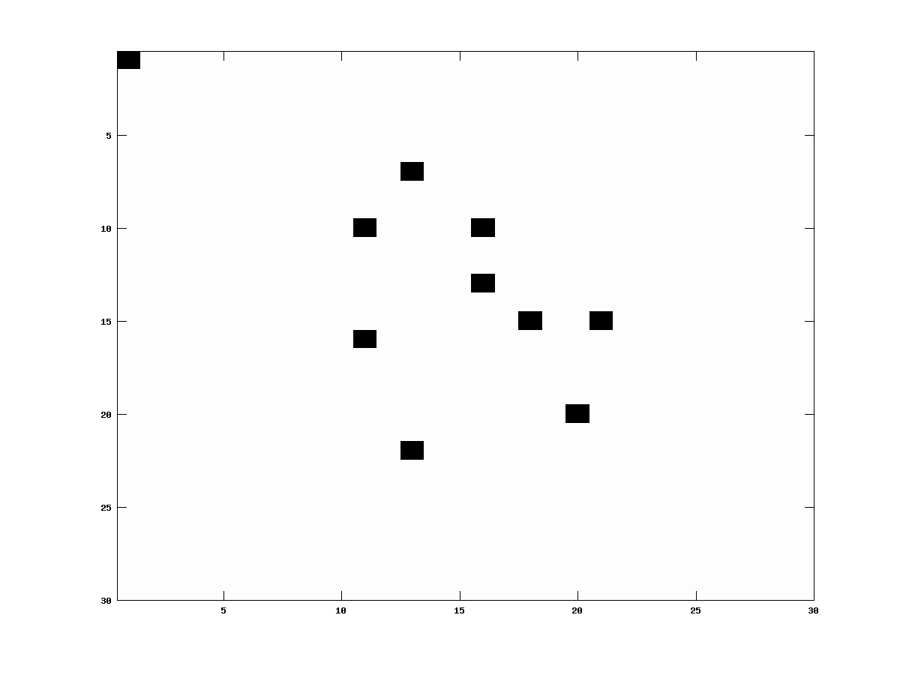
Winning Features
[1 310 316 367 382 460 463 525 590 615]
[310 318 429 436 442 463 525 553 560 644] (2010)

Slide 6
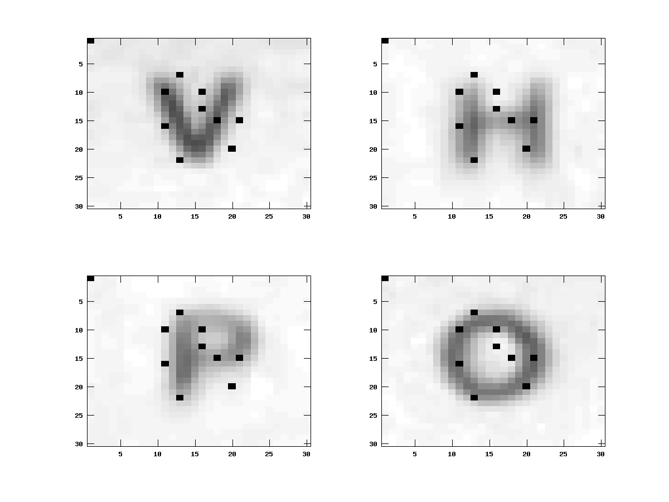
Winning Features

Slide 7
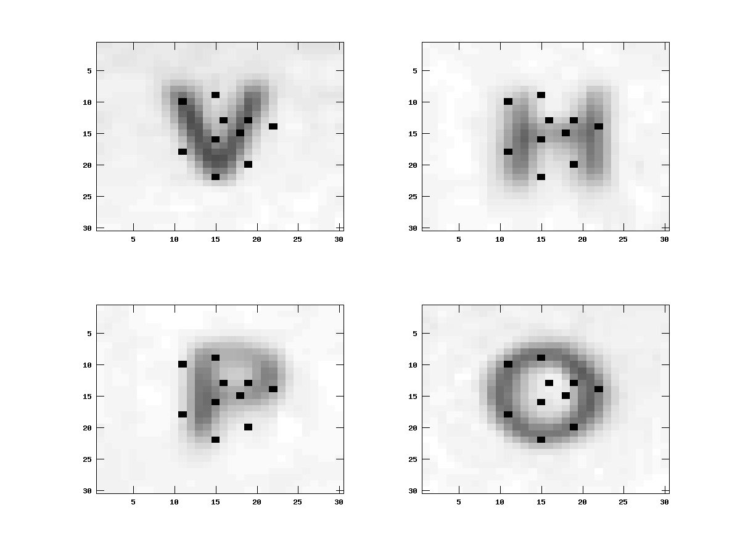
Winning Features (2010)

