Slide 1
Feature Selection Challenge 2012

Slide 2
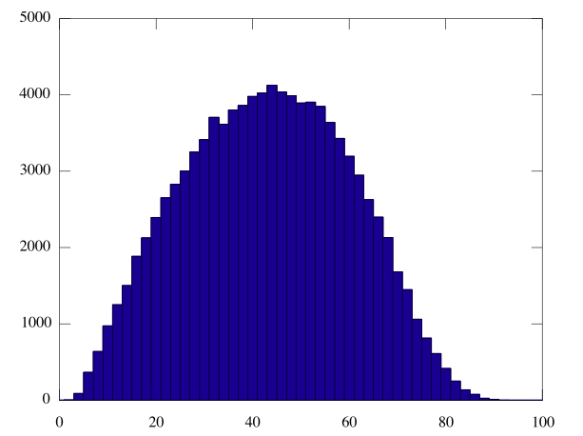
100,000 randomly selected 10-element feature sets

Slide 3
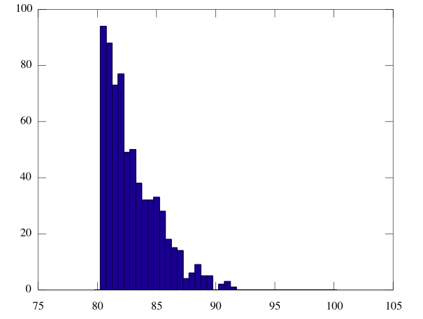
100,000 randomly selected 10-element feature sets
Close up showing only sets scoring > 80%.
Notice, very unlikely to randomly select > 90%

Slide 4
Leader Board
Position | Devel | Test | Year | Name
 | 95.0 | 92.0 | 2012 | Luke Heavens + Ben Carr
 | 96.0 | 92.0 | 2012 | Smith, Paterson, Dewhirst + White
 | 96.5 | 91.0 | 2012 | Florin-Christian Gavrila
 | 98.0 | 95.5 | 2012 | Josh Keegan

Slide 5
Leader Board
Position | Devel | Test | Year | Name
1st | 98.0 | 95.5 | 2012 | Josh Keegan
2nd= | 95.0 | 92.0 | 2012 | Luke Heavens + Ben Carr
2nd= | 96.0 | 92.0 | 2012 | Smith, Paterson, Dewhirst + White
4th | 96.5 | 91.0 | 2012 | Florin-Christian Gavrila

Slide 6
Leader Board
Position | Devel | Test | Year | Name
1st | 98.0 | 95.5 | 2012 | Keegan
2nd | 99.5 | 94.5 | 2010 | Popescu
3rd | 95.5 | 94.0 | 2010 | Lim
4th | 99.5 | 93.0 | 2011 | Goddard, Cox and Raymond
5th | 98.0 | 92.5 | 2010 | Elston
6th | 96.0 | 92.5 | 2010 | White

Slide 7
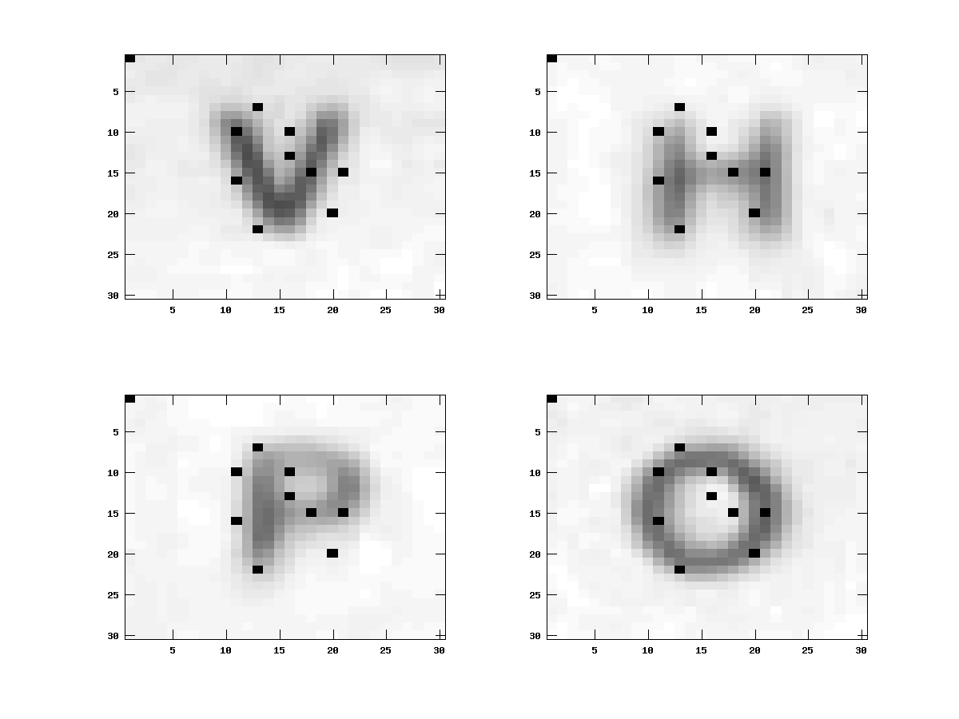
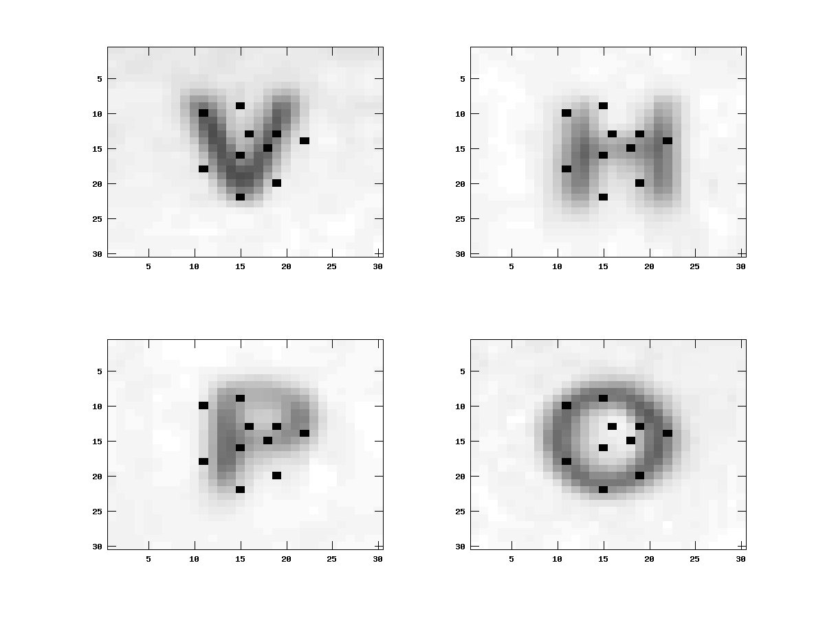
Winning Features (2010)

Slide 8

Winning Features (2012)

