Slide 1
Project Report
Machine Learning for Computer Vision
Hanying Zhang

Slide 2
Executive Summary
In this project the Vision Transformer(ViT) paper is studied and implemented.
An experiment is also carried out to test the performance of the model on a new dataset.
The positional embedding and attention matrix are also studied.

Slide 3
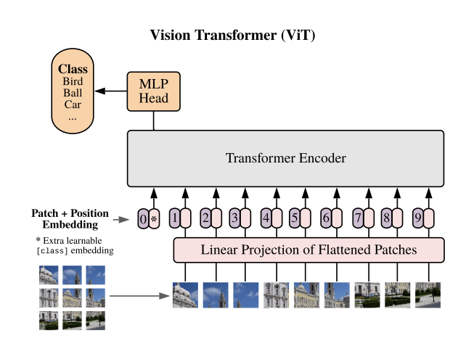
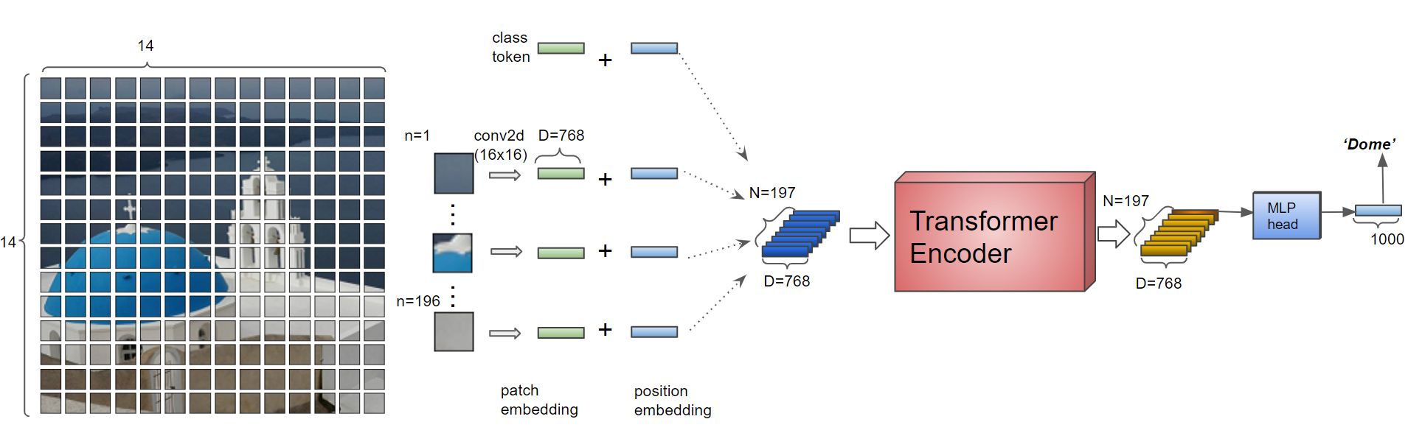
ViT – Vision Transormer

Slide 4
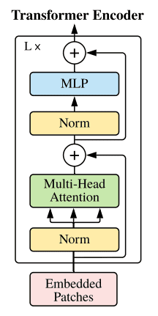
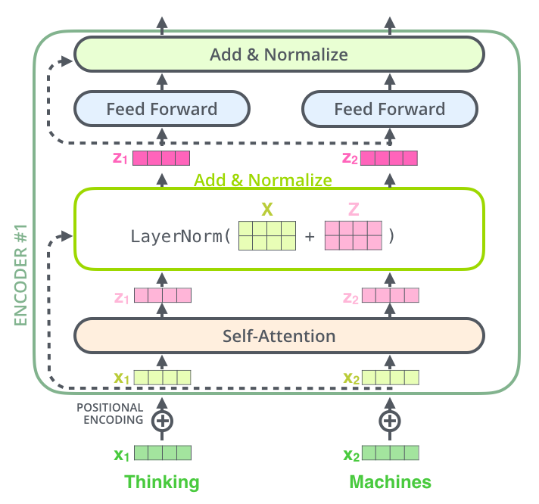
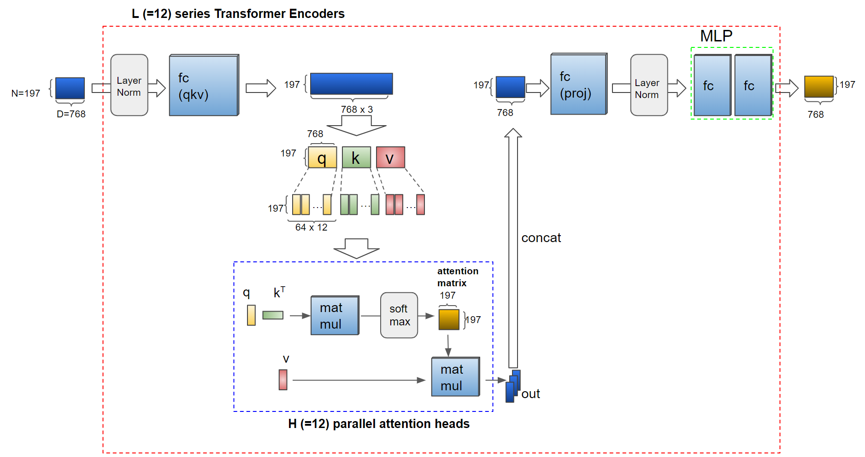
Transformer in ViT

Slide 5

Classification – Dataset
A dogs vs. cats competition that is still accepts test submissions
The dataset is slightly different from the competition on Kaggle
Train set: 20k images
Validation set: 2k images
Test set: 2k images

Slide 6
Classification – Fine Tune
Pre-trained model: jx_vit_base_p16_224-80ecf9dd.pth
Replace the head with one FC layer, the weight is [2,768] where 768 is the dim of the output of Transformer
First experiment: All weights in the model except for the ones in the head is fixed
Fine Tune: All weights in the model are trainable
Settings
5 epochs
Batch size: 16
Optimizer: Adam
Learning rate: 0.0001
CosineAnneallingLR decay

Slide 7

Classification – Results
Test Accuracy:
96.5% before Fine Tune
98.65% after Fine Tune
obvious that the accuracy becomes better after fine-tune
Training with more epochs and bigger learning rates are also explored, but these parameters failed to give better results

Slide 8
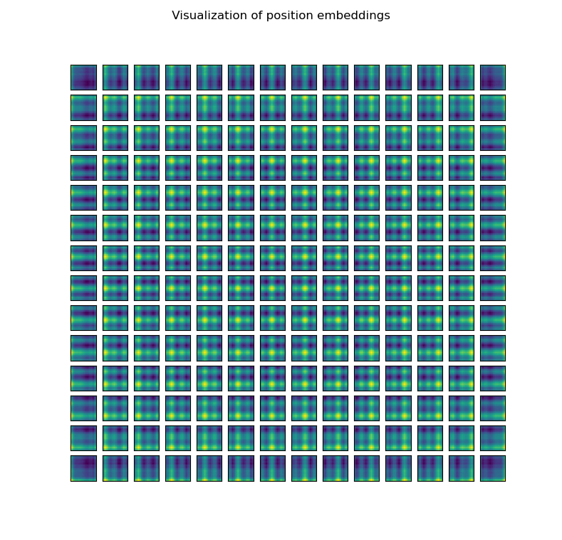
Visualization – Positional Embedding
Several variations of position embedding methods were tried in the original paper
No positional embedding
1D positional embedding
2D positional embedding
Relative positional embedding
The latter 3 ones give similar performance
Visualize the 1D positional embedding for explanation - computing the cosine similarity between the i-th embedding and all the embeddings(except for the class_token one)
we can see that each patch of the image has the embedding correctly representing the positions in the image. Thus we can say that 1D positional embedding is enough for this model.

Slide 9
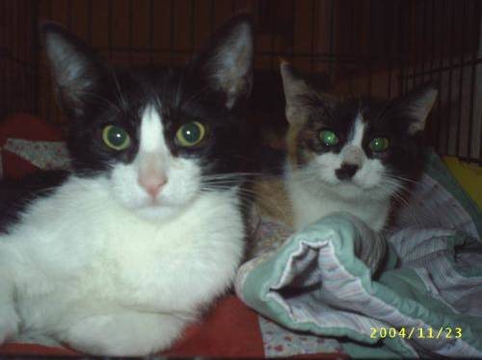
Visualization – Attention Matrix
The attention matrix, i.e., matmul(Q,K^T)/_(sqrt(D_K))
To see how the attention mechanism works
One image from the test set which contains two objects is selected to show the attentions

Slide 10
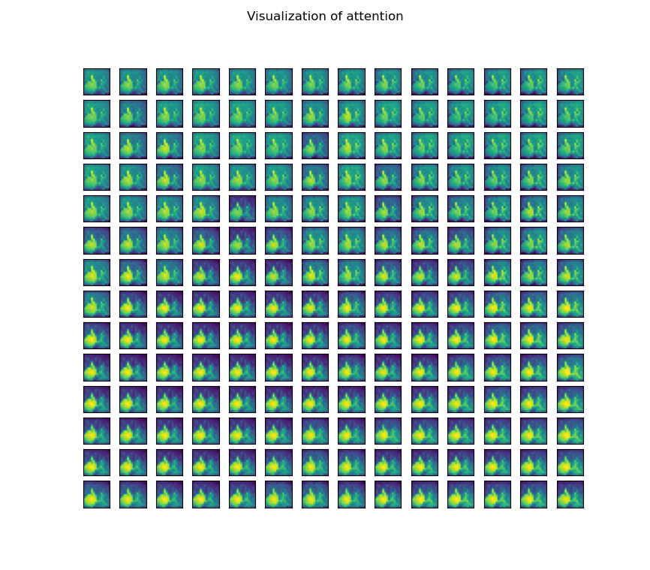
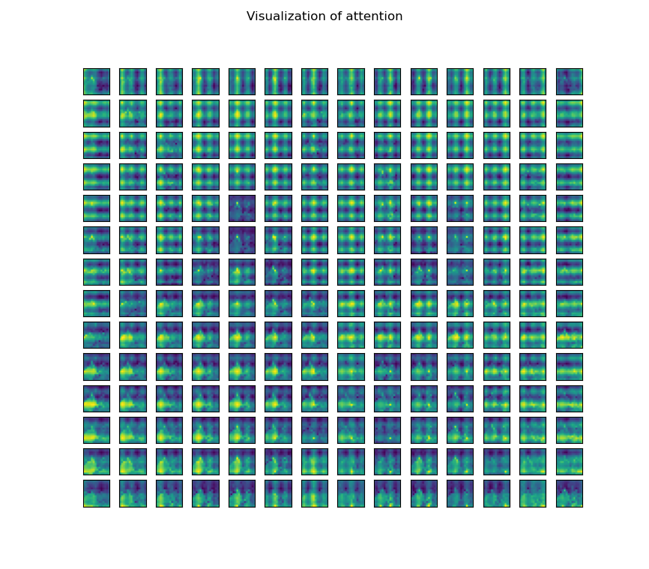
Visualization – Attention Matrix

Slide 11
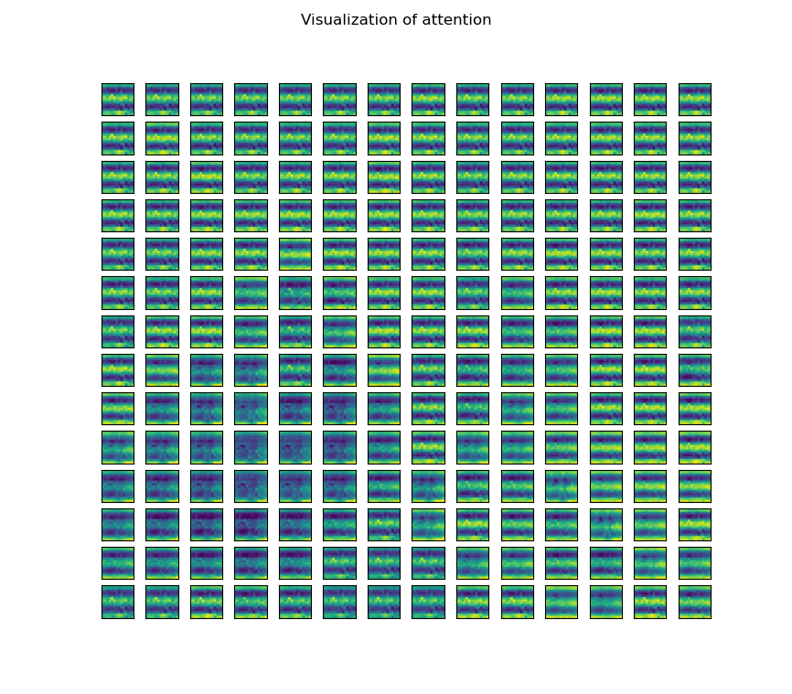
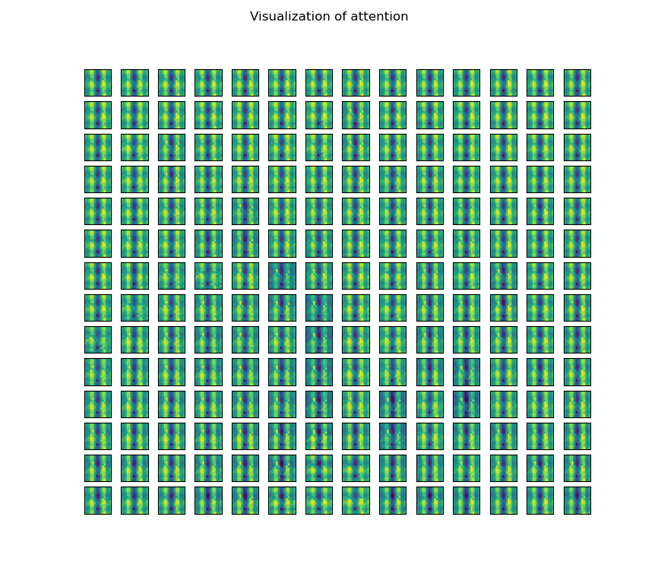
Visualization – Attention Matrix

Slide 12
Thank you for your ATTENTION.

