Slide 1
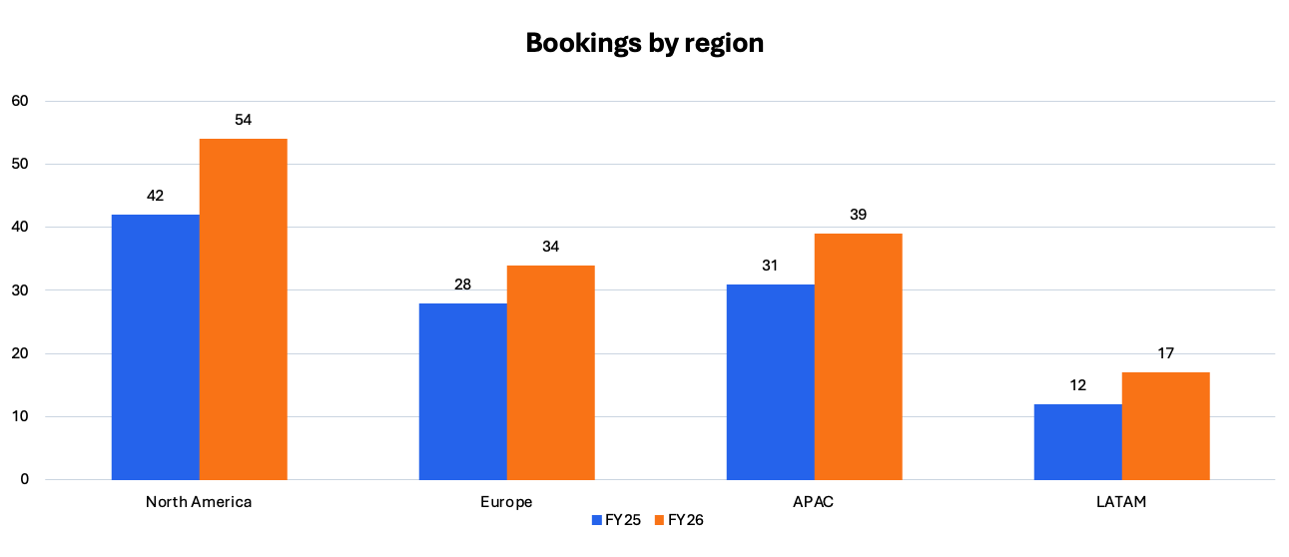
Quarterly bookings expanded in every region

