Slide 1
CONFIDENTIAL
Digital Commerce
Transformation
Strategic Assessment & Implementation Roadmap
Prepared for Meridian Retail Group | February 2026
Strategy & Operations Practice

Slide 2
Agenda
Four workstreams structured around a hypothesis-driven approach
01
Situation Assessment
Slides 3-8
Current state, customer segments, digital maturity, competitive position
02
Opportunity Analysis
Slides 9-13
Revenue by channel, customer journey, SKU demand, cross-sell potential
03
Strategic Recommendation
Slides 14-19
Options assessment, roadmap, technology, organization design
04
Financial Case
Slides 20-25
Investment, projections, sensitivity, risk mitigation, next steps
Meridian Retail Group | Digital Commerce Transformation | Confidential

Slide 3
SECTION 01
Situation Assessment
Understanding Meridian's current position, customer base, and competitive landscape

Slide 4
Executive Summary
Three key findings point to a $140M addressable revenue opportunity
FINDING 1
Online penetration at 8% vs. 23% industry average
Meridian's digital channel lags peers by 15pp, representing significant untapped demand from existing customer base and new digital-native segments.
REVENUE OPPORTUNITY
$140M
3-year addressable gap
FINDING 2
$140M addressable revenue gap identified
Bottom-up analysis of SKU-level demand, cross-sell uplift, and category expansion yields a conservative $140M incremental revenue opportunity over 3 years.
$12.0M
Total Investment
340% expected ROI
FINDING 3
18-month payback on $12M platform investment
Phased investment approach mitigates risk while accelerating time-to-value through iterative releases and early revenue capture from high-margin digital channels.
18 mo.
Payback Period
Phased approach
Source: Management interviews, industry benchmarks (Forrester 2025), internal analysis

Slide 5
Current State Assessment
Revenue concentration in physical retail creates vulnerability to digital disruption
Key Challenges
Declining Foot Traffic
Same-store visits down 12% YoY; suburban malls underperforming
Legacy Technology
20-year-old POS system; no unified inventory; manual fulfillment
Customer Data Gaps
No single customer view; CRM covers only 34% of transactions
Talent Deficit
Zero in-house digital product or engineering capability
Margin Pressure
Occupancy costs rising 3% annually; digital margin 2x physical
E-commerce at 8% of revenue vs. 23% industry average = 15pp gap
Source: Meridian FY2025 10-K, management data room, Euromonitor

Slide 6
Customer Segmentation Analysis
Four distinct segments with differentiated digital propensity and lifetime value
Digital Natives
Omnichannel Shoppers
Traditional Loyalists
Occasional Browsers
18-34 yrs
25-50 yrs
45-65 yrs
All ages
LTV
$820
LTV
$1,450
LTV
$2,100
LTV
$320
Revenue %
42%
Revenue %
31%
Revenue %
18%
Revenue %
9%
Digital Propensity
High
Digital Propensity
High
Digital Propensity
Medium
Digital Propensity
Low
Key Insight
73% of Digital Natives and Omnichannel Shoppers express willingness to increase spend through a quality e-commerce experience. Combined, these segments represent $68M in addressable annual online revenue.
Traditional Loyalists show 2.6x higher LTV — converting even 15% to omnichannel would yield $9.5M incremental annual revenue.
Source: Customer survey (n=4,200), transaction data analysis, third-party panel data

Slide 7
Digital Maturity Scorecard
Meridian scores 2.1/5.0 across six critical digital capability dimensions
Dimension | Meridian | Industry | Best | Gap
E-Commerce | 1.5 | 3.8 | 4.8 | -2.3
Data & Analytics | 2.0 | 3.5 | 4.5 | -1.5
Supply Chain | 2.5 | 3.2 | 4.2 | -0.7
Customer Exp. | 1.8 | 4.0 | 4.7 | -2.2
Technology | 2.0 | 3.6 | 4.6 | -1.6
Org & Talent | 2.8 | 3.4 | 4.3 | -0.6
Overall | 2.1 | 3.6 | 4.5 | -1.5
Largest gaps in E-Commerce Platform (-2.3) and Customer Experience (-2.2) — priority investment areas
Source: Digital Maturity Assessment Framework (McKinsey DMI), management self-assessment, peer benchmarking

Slide 8
Competitive Landscape Analysis
Meridian significantly trails peers across all digital commerce dimensions
Company | Revenue | Digital % | YoY Growth | Mobile % | NPS | CSAT | Delivery | Position
Nordstrom | $14.9B | 38% | +18% | 62% | 72 | 4.2 | 2-day | Leader
Macy's | $23.1B | 33% | +15% | 58% | 65 | 3.9 | 2-day | Leader
Kohl's | $16.6B | 28% | +12% | 51% | 58 | 3.7 | 3-day | Challenger
Dillard's | $6.8B | 15% | +8% | 38% | 52 | 3.5 | 5-day | Follower
JCPenney | $7.6B | 22% | +10% | 44% | 48 | 3.4 | 4-day | Follower
Meridian | $3.6B | 8% | +2% | 22% | 38 | 3.1 | 7-day | Laggard
Meridian ranks last in digital penetration (8%) — 25pp below peer median of 33%
NPS of 38 is 24 points below peer average — primary driver is poor online experience
7-day delivery vs. 2-day peer standard creates 3.5x higher cart abandonment rate
Source: Company filings, eMarketer (2025), Forrester Digital Maturity Index, J.D. Power

Slide 9
SECTION 02
Opportunity Analysis
Quantifying the revenue opportunity across channels, customer journeys, and product categories

Slide 10
Revenue Opportunity by Channel
E-commerce platform expected to capture $140M in incremental revenue within 3 years
Channel Economics
Direct Web
68% margin
Highest margin, owned channel
Marketplace
42% margin
Volume driver, lower margin
Mobile App
71% margin
Best engagement, highest LTV
Social Commerce
38% margin
Emerging, brand-building
B2B Portal
55% margin
Enterprise client focus
Year 1: $48M
Year 2: $96M
Year 3: $148M
Source: Internal financial model, comparable company benchmarks, management estimates

Slide 11
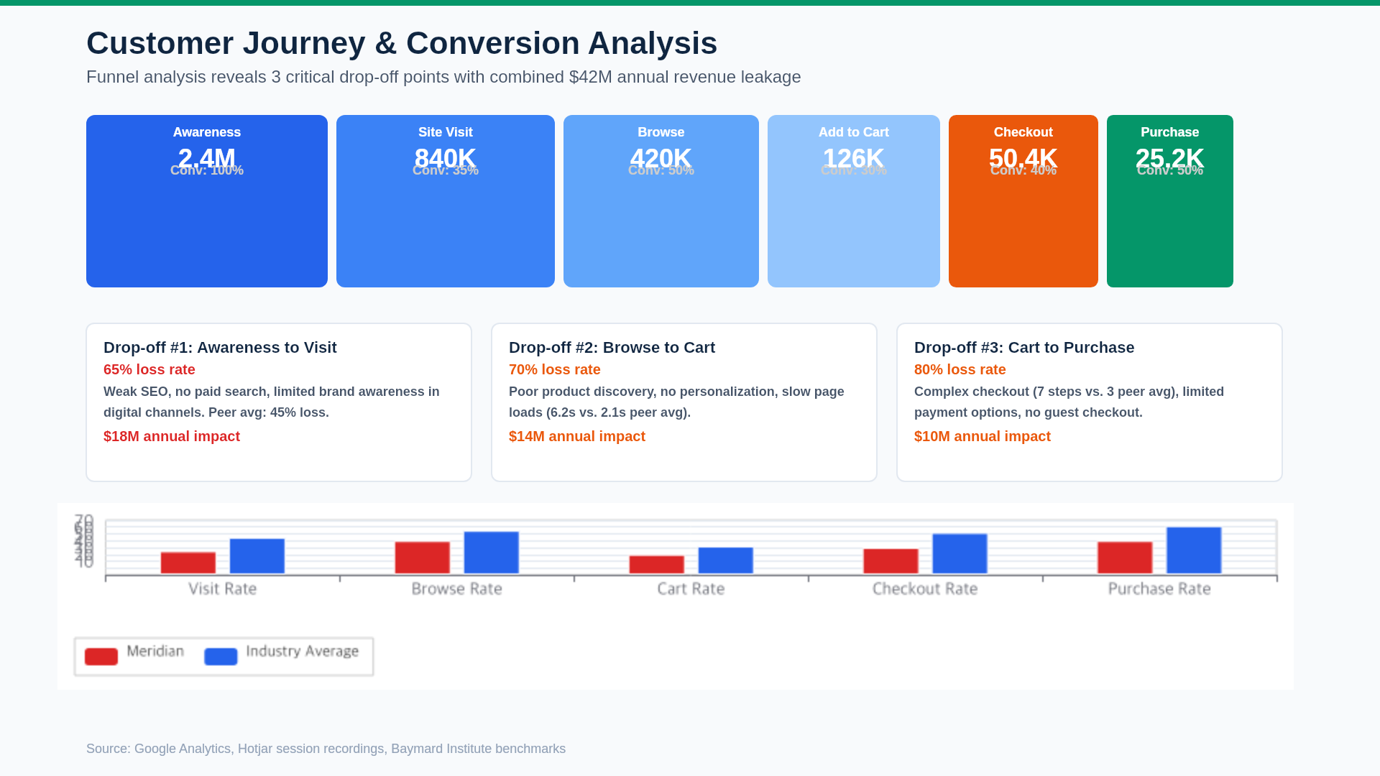

Slide 12
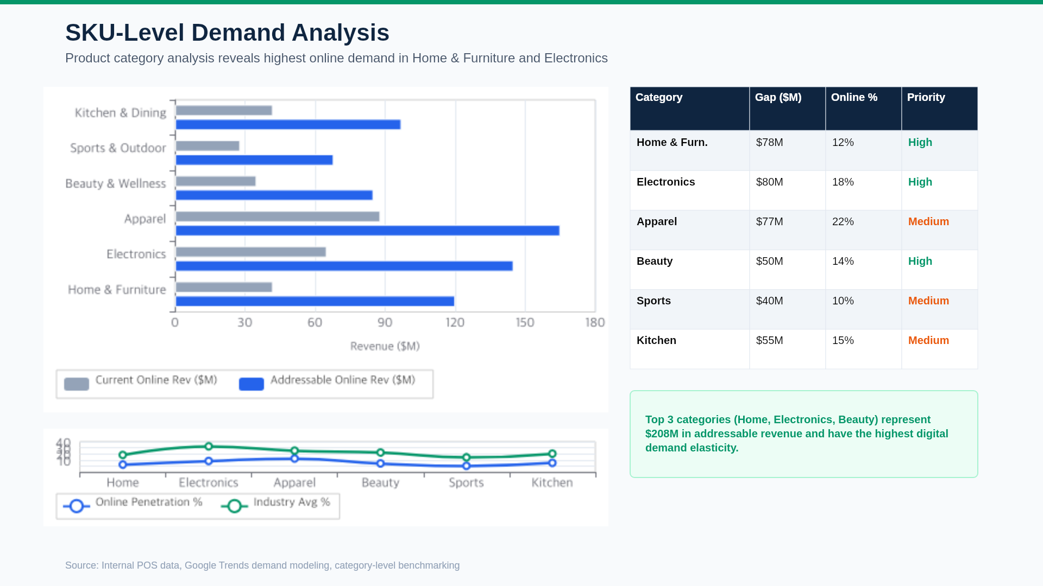

Slide 13
Cross-sell & Upsell Potential
Personalization engine could drive 18-24% increase in average order value
$127
Current AOV
vs. $168 peer avg
+24%
AOV Uplift Target
With personalization
$22M
Annual Revenue Impact
From AOV increase alone
2.1x
Cross-sell Ratio
vs. 3.4x industry avg
Personalization Strategy
Collaborative Filtering
$8.4M
"Customers who bought X also bought Y" — drives 35% of Amazon revenue
Dynamic Bundling
$6.2M
AI-powered bundle creation based on basket analysis and margin optimization
Behavioral Triggers
$4.1M
Browse abandonment, wishlist reminders, price drop alerts via email/push
Loyalty Tiering
$3.5M
Spend-based tiers with exclusive access, early drops, and personalized offers
Source: Basket analysis (18 months data), McKinsey Personalization Index, peer case studies

Slide 14
SECTION 03
Strategic Recommendation
Defining the optimal path forward: strategy, roadmap, technology, and organization

Slide 15
Strategic Options Assessment
Three options evaluated on NPV, risk, speed-to-market, and organizational readiness
OPTION A: BUILD
OPTION B: PLATFORM+
OPTION C: OUTSOURCE
Custom-built e-commerce platform on microservices architecture
Composable platform (Shopify Plus + headless CMS) with custom integrations
Fully managed marketplace solution via third-party operator
Full control & differentiation
18-24 month build time
Higher ongoing cost ($4M/yr)
Significant talent risk
Best long-term flexibility
6-month time to MVP
Balanced cost ($2.1M/yr)
Lower execution risk
Proven at scale (peers)
Extensible architecture
Fastest launch (3 months)
Lowest upfront cost ($1.2M/yr)
Limited customization
Revenue share drag (12-18%)
No data ownership
NPV (3yr)
$42M
NPV (3yr)
$68M
NPV (3yr)
$28M
Risk
High
Risk
Medium
Risk
Low
RECOMMENDED
Option B delivers highest risk-adjusted NPV ($68M) with 6-month time to first revenue
Source: Vendor evaluations, comparable implementations, internal financial modeling

Slide 16
Recommended Strategy: Composable Commerce Platform
Phased approach balances speed-to-market with long-term flexibility and data ownership
Platform Foundation
Shopify Plus headless with custom React storefront and composable microservices
Data-Led Growth
CDP integration, real-time personalization, ML-driven product recommendations
Omnichannel Integration
Unified inventory, BOPIS, ship-from-store, and same-day delivery capabilities
Org Transformation
Dedicated digital BU with product, engineering, data science, and growth teams
Strategic Rationale
Success Metrics (18-month targets)
Speed-to-market: MVP in 6 months captures $18M Year 1 revenue that Build option would miss entirely
Data ownership: Unlike Outsource, Meridian retains full customer data and analytics capability
Cost efficiency: $2.1M/yr run rate vs. $4M (Build) while maintaining 90% of customization capability
Proven model: Nordstrom, Allbirds, and Glossier all use composable architecture at comparable scale
Risk mitigation: Phased rollout allows course correction; no big-bang deployment risk
Metric | Current | Target | Delta
Online Revenue | $300M | $440M | +47%
Digital Penetration | 8% | 14% | +6pp
Conversion Rate | 1.1% | 2.8% | +1.7pp
Average Order Value | $127 | $158 | +24%
NPS | 38 | 58 | +20
Source: Vendor evaluation scorecards, comparable case studies, financial model v3.2

Slide 17
Implementation Roadmap
Three-phase approach delivers incremental value while managing execution risk
PHASE 1: FOUNDATION
PHASE 2: LAUNCH & GROW
PHASE 3: SCALE
Months 0-6 | $3.2M
Months 6-12 | $5.1M
Months 12-18 | $3.7M
Platform selection & procurement
Core team hiring (12 FTEs)
Data migration & API architecture
Payment gateway integration
Fulfillment partner onboarding
QA environment & CI/CD setup
Full catalog (5,000+ SKUs)
Digital marketing ramp ($1.2M)
Marketplace integration
Mobile app launch (iOS + Android)
Customer analytics platform
A/B testing infrastructure
B2B portal launch
Social commerce integration
International expansion (CA, UK)
Advanced personalization (ML)
Same-day/BOPIS fulfillment
Loyalty program 2.0
MVP: Top 500 SKUs Live
Target: $48M Run Rate
Target: $140M+ Run Rate
Total Investment: $12.0M
Expected ROI: 340% over 3 years
Break-even: Month 18
Source: Project plan v2.1, vendor SOWs, HR capacity model

Slide 18
Technology Architecture
Composable, API-first architecture enables rapid iteration and future extensibility
PRESENTATION LAYER
React Storefront
Next.js SSR, headless CMS
Mobile Apps
React Native, shared components
POS Integration
In-store kiosks, clienteling
Marketplace Feeds
Amazon, eBay, Google Shopping
API GATEWAY | GraphQL Federation | Rate Limiting | Auth (OAuth 2.0 + OIDC)
COMMERCE SERVICES
Shopify Plus
Catalog, cart, checkout
OMS
Order routing, fulfillment
Search & Discovery
Algolia, faceted search
Personalization
CDP + ML recommendations
DATA PLATFORM | Snowflake DWH | Segment CDP | dbt Transforms | Looker BI
INFRASTRUCTURE
AWS (Primary)
ECS, RDS, ElastiCache, S3
Vercel Edge
CDN, SSR, edge functions
Monitoring
Datadog APM, PagerDuty
Security
WAF, DDoS, PCI DSS L1
Source: Solution architecture review, vendor technical assessments, security audit

Slide 19
Organizational Design & Talent Plan
Dedicated Digital Commerce business unit with 42 FTEs at full scale
VP, Digital Commerce
Reports to CEO | Hired Month 1
Engineering
14 FTEs
Product & Design
8 FTEs
Data Science
6 FTEs
Growth Marketing
10 FTEs
Operations
4 FTEs
Annual Talent Cost at Scale
Function | FTEs | Avg Comp | Total
Engineering | 14 | $185K | $2.6M
Product & Design | 8 | $160K | $1.3M
Data Science | 6 | $175K | $1.1M
Marketing | 10 | $130K | $1.3M
Operations | 4 | $120K | $0.5M
Source: Glassdoor comp data, Meridian HR, comparable org benchmarks

Slide 20
SECTION 04
Financial Case
Investment requirements, revenue projections, sensitivity analysis, and risk mitigation

Slide 21
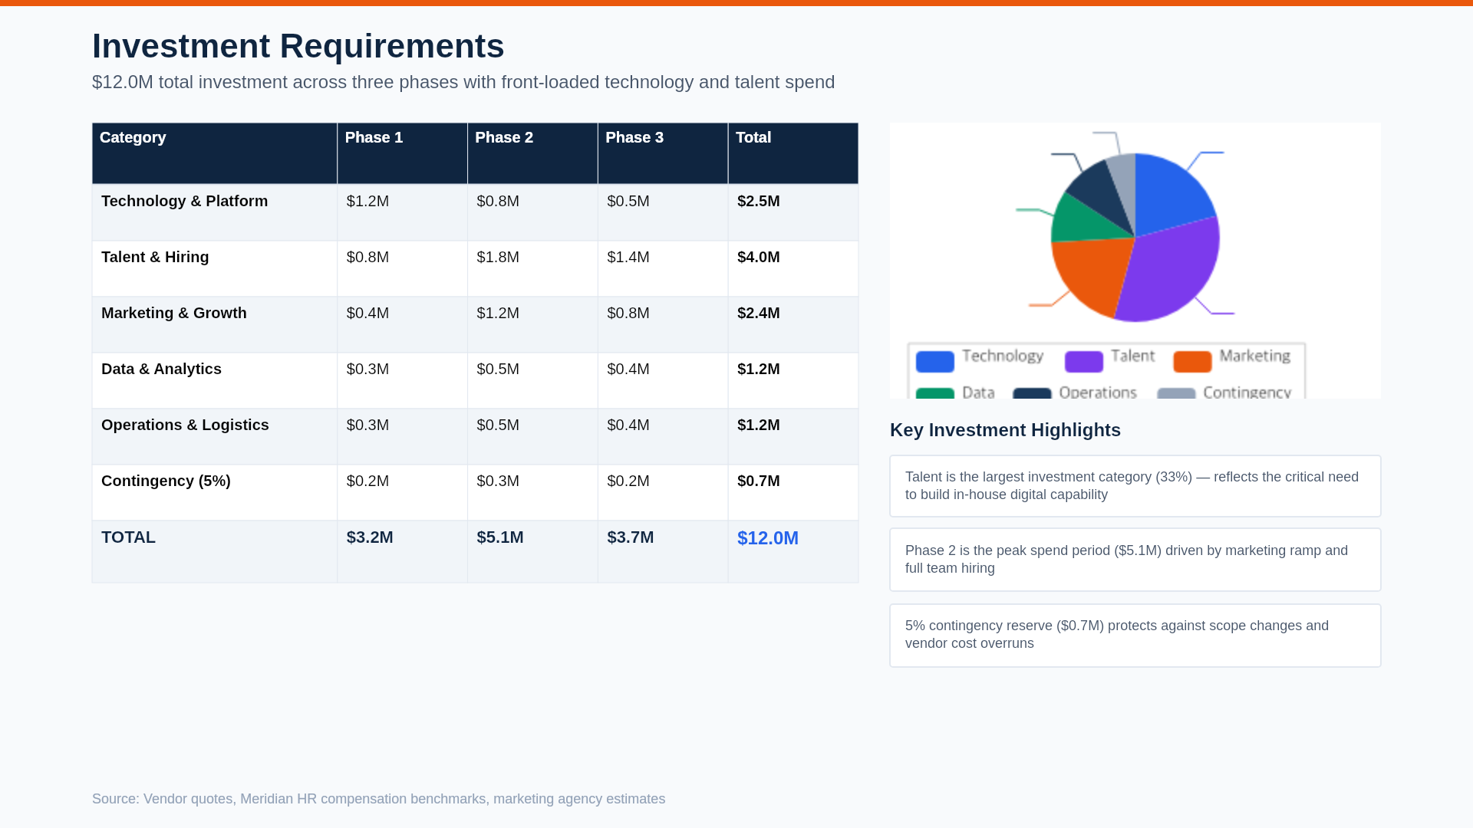

Slide 22
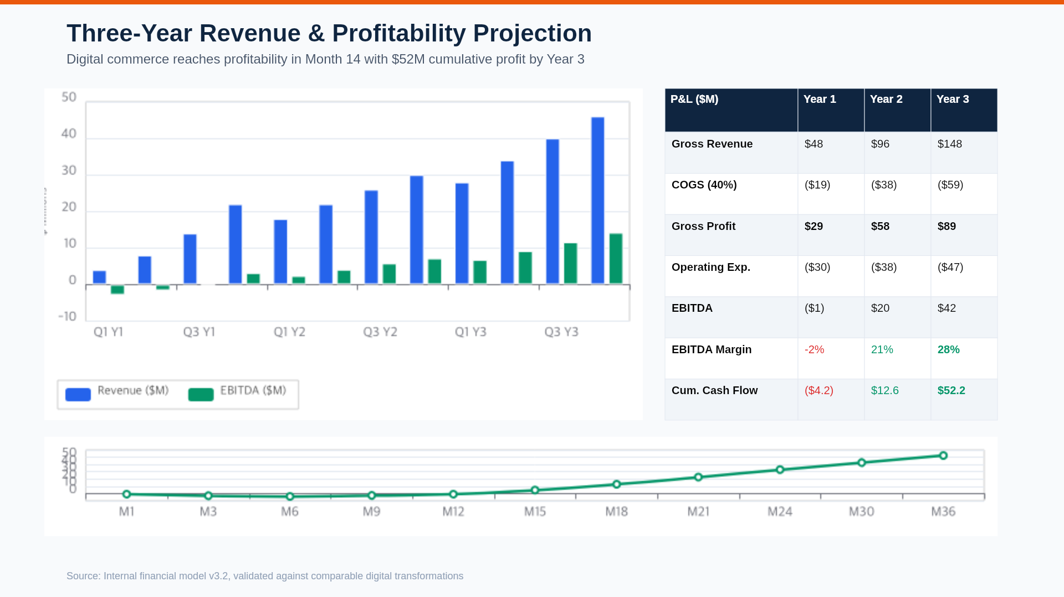

Slide 23
Sensitivity Analysis
Investment remains NPV-positive across all scenarios; downside case still achieves 18-month payback
Scenario | Y3 Revenue | Y3 EBITDA | NPV | IRR | Payback | ROI | Probability
Bull Case | $185M | $58M | $94M | 82% | 14 mo. | 480% | 20%
Base Case | $148M | $42M | $68M | 64% | 18 mo. | 340% | 55%
Bear Case | $105M | $24M | $38M | 42% | 22 mo. | 180% | 20%
Worst Case | $72M | $8M | $12M | 18% | 28 mo. | 65% | 5%
Key Assumptions
Sensitivity Drivers (Impact on NPV)
Base case conversion: 2.8% (vs. 1.1% current)
Base case AOV: $158 (vs. $127 current)
Customer acquisition cost: $32 (industry: $38)
Annual digital marketing spend: $2.4M at scale
Gross margin: 60% blended across channels
Driver | -20% | -10% | +10% | +20%
Conversion Rate | -$22M | -$11M | +$11M | +$22M
AOV | -$16M | -$8M | +$8M | +$16M
CAC | -$8M | -$4M | +$4M | +$8M
Source: Monte Carlo simulation (10,000 iterations), peer benchmarks, management inputs

Slide 24
Risk Assessment & Mitigation Plan
Eight key risks identified with specific mitigation strategies and risk owners
# | Risk | Impact | Prob. | Mitigation Strategy | Owner | Status
1 | Platform Delivery Delay | High | Medium | Agile methodology, 2-week sprints, vendor SLA with penalties, parallel workstreams | VP Digital | Mitigating
2 | Talent Acquisition | High | High | Retained search firms, competitive comp (75th pctile), remote-first policy, signing bonuses | CHRO | Active
3 | Legacy Integration | High | Medium | API-first architecture, middleware layer, phased migration, parallel run period | CTO | Planning
4 | Customer Adoption | Medium | Medium | Soft launch with loyalty members, incentive migration offers, UX testing (200+ users) | CMO | Planning
5 | Competitive Response | Medium | High | Differentiated CX, exclusive brands, loyalty moat, first-mover in underserved segments | CSO | Monitoring
6 | Data Security Breach | Critical | Low | PCI DSS L1 compliance, SOC 2 Type II, penetration testing, incident response plan | CISO | Mitigating
7 | Budget Overrun | Medium | Medium | 5% contingency reserve, monthly financial reviews, phase-gate approvals, vendor fixed pricing | CFO | Mitigating
8 | Change Management | Medium | High | Executive sponsor, dedicated change lead, training program, internal comms campaign | COO | Planning
Source: Risk workshop (Feb 2026), comparable project post-mortems, COSO framework

Slide 25
Next Steps
1. Board alignment on strategic direction and investment approval (March 7)
2. VP, Digital Commerce search kick-off with retained firm (March 15)
3. Platform vendor shortlist and RFP issuance (April 1)
4. Detailed Phase 1 project plan and budget sign-off (April 15)
5. Program kick-off and weekly SteerCo cadence begins (May 1)
Thank You
Questions? Contact the project team at digital-transformation@meridianretail.com

