Slide 1
Heroku Model Deployment

Slide 2
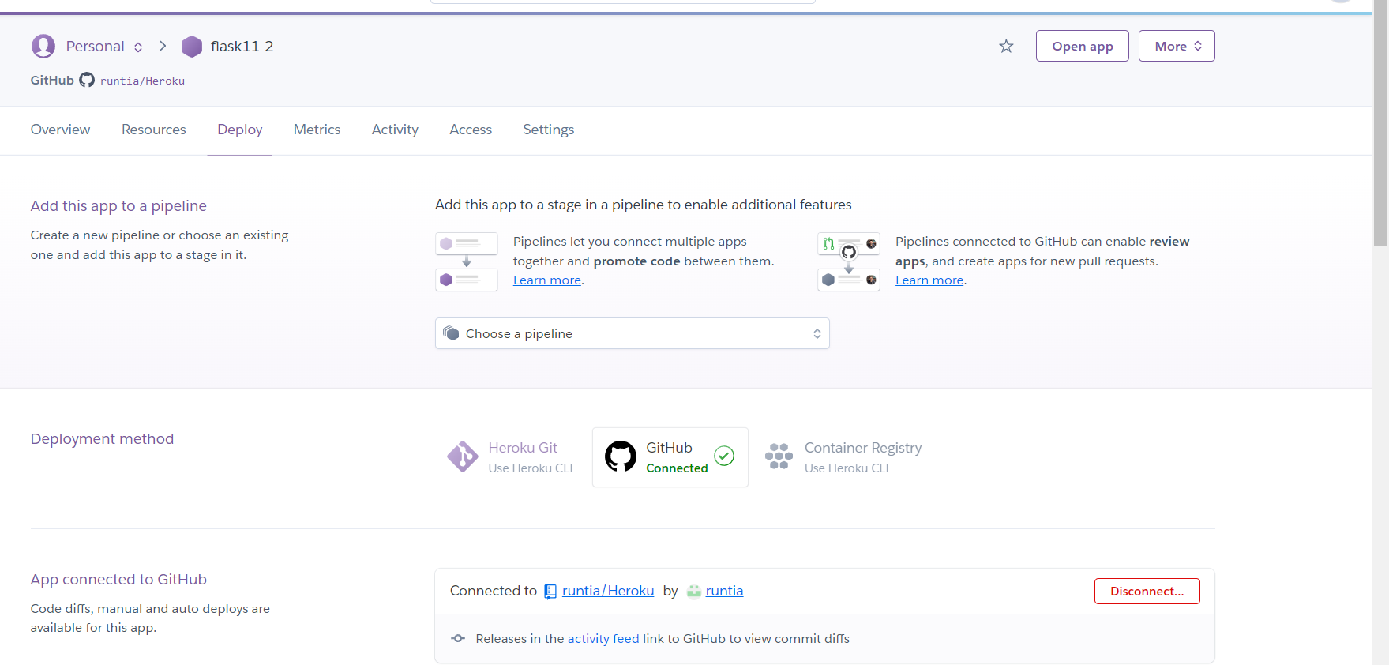
Using Heroku to connect the Github repo

Slide 3
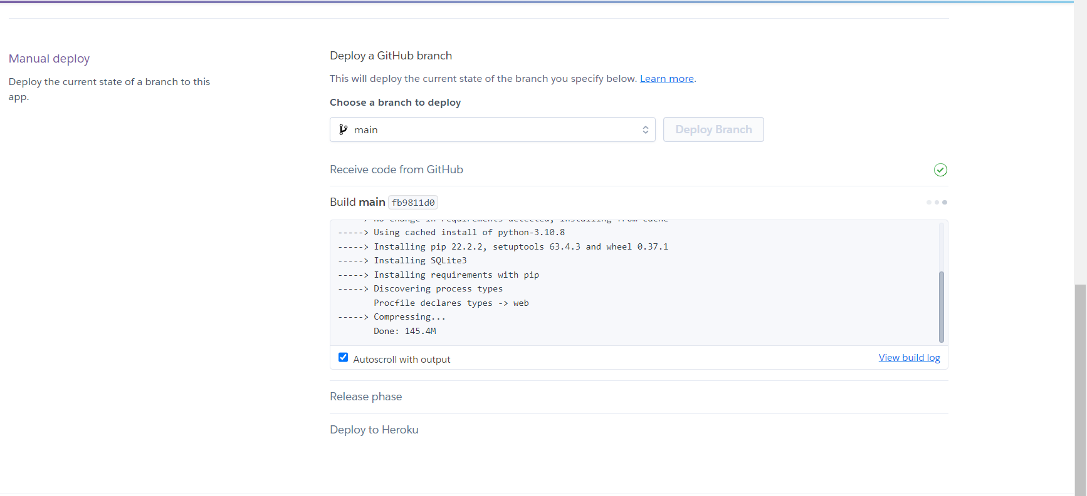
The Model is successfully deployed

Slide 4
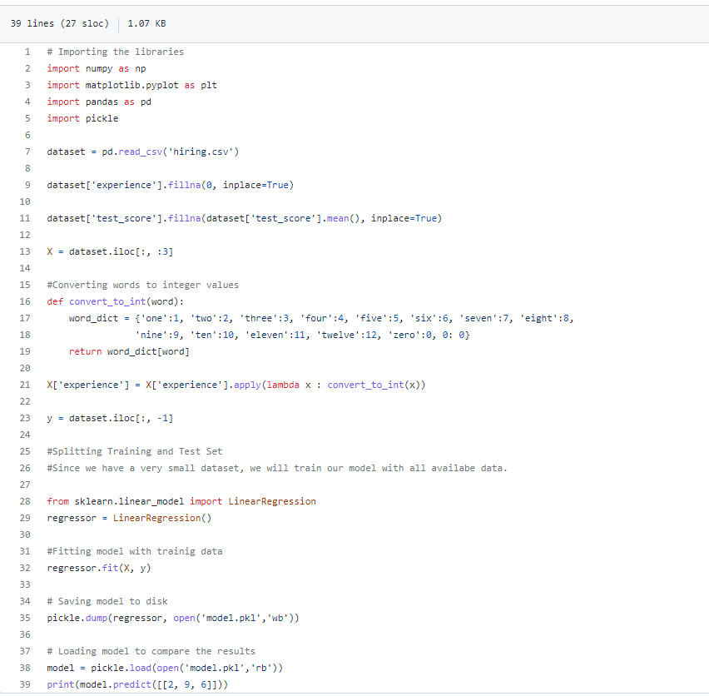
Here shows the details code.

Slide 5
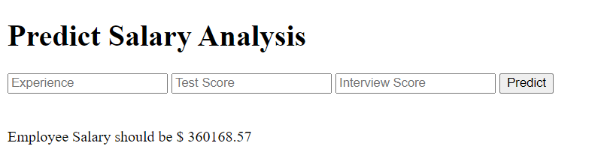
The result website can make a salary prediction.

