Slide 1

PROJECT PRESENTATION
NETWORK ARCHITECTURE OF THE LONG-DISTANCE PATHWAYS IN THE MACAQUE BRAIN
Group No. 1
Juhi Pandey 2018393
Yashraj 2018422
Ritik Malik 2018406

Slide 2

INTRODUCTION AND DATASETS
Link to the original paper
Link to Github repository
Aim: to understand the network structure of white matter communication pathway
Collation of Connectivity data on the Macaque brain (CoCoMac) neuroinformatic database was used
Our network consists of 383 hierarchically organized regions spanning cortex, thalamus, and basal ganglia; models the presence of 6,602 directed long-distance connections:
This is three times larger than any previously derived brain network
Contains subnetworks corresponding to classic corticocortical, corticosubcortical, and subcortico-subcortical fiber systems
The long distance network dataset has been taken from Collation of Connectivity data on the Macaque brain (CoCoMac) neuroinformatic database and consist of the following files :
Macaque_LongDistance_Network_nameslist : stored in NameList.txt
Each row corresponding to the 383 brain regions in our network
Macaque_LongDistance_Network_connectivity.edgelist : stored in EdgeList.txt
6602 rows representing edges
Macaque_LongDistance_Network_mapping.edgelist : stored in Mapping.txt (for hierarchy)
382 rows correspond to a parent-child relationship in our hierarchical brain map for 383 nodes

Slide 3
METHODOLOGY
Studied Network Properties
In- and out-degrees, are direct measures of how much information a vertex receives and sends
Out-closeness is defined as average shortest path to every other vertex and its in-closeness as the average shortest path to it from every other vertex
Betweenness centrality is defined as the number of shortest paths that pass through it & PageRank was developed in the context of Web searching to find how often a vertex will be visited during random network traversal
Hubs distribute information, whereas authorities aggregate information
Plotted Degree Distribution
The tail behavior of the frequency distribution of degrees tells us how connectivity is spread among vertices
A scale-free network follows a power law
The World-Wide Web, the Internet, some social networks, & the metabolic networks are all scale-free, whereas power grids, air traffic networks, and collaboration networks of company directors are all exponential
Found the Innermost Core
The innermost core is deeply nested, such that each vertex in the innermost core touches at least 29 other vertices and the innermost core has 122 vertices
There are 2,872 edges from the innermost core to itself, 1,707 edges from the crust to the innermost core, and 1,230 edges from the innermost core to the crust
88% of edges either originate or terminate from it and it contains 32% of the vertices in the core

Slide 4
CHARACTERISTICS STUDIED
In-degree : The node in-degree is the number of edges pointing in to the node
In-closeness : Closeness centrality of a node u is the reciprocal of the sum of the shortest path distances from u to all n -1 other nodes
Authorities : Authorities estimates the node value based on the incoming links
Out-degree : The node out-degree is the number of edges pointing out of the node
Out-closeness : Closeness centrality of a node u is the reciprocal of the sum of the shortest path distances from u to all n -1 other nodes
Hubs : Hubs estimates the node value based on outgoing links
Betweenness : Betweenness centrality of a node v is the sum of the fraction of all-pairs shortest paths that pass through v
PageRank : PageRank computes a ranking of the nodes in the graph G based on the structure of the incoming links
Assortativity : Assortativity measures the similarity of connections in the graph with respect to the node degree
Shortest Path Length : The average shortest path length is where V is the set of nodes in G, d(s, t) is the shortest path from s to t, and n is the number of nodes in G.

Slide 5
RESULTS
OBSERVATIONS
Roughly, 70% of the top 10 regions according to in-degree, in-closeness, and authorities reside primarily in prefrontal cortex (32, 46, 12o, 12l, 11, 14, 8A, 8B, 14, 9), suggesting that it serves as an integrator of information.
The top out-degree, out-closeness, and hub regions are distributed across prefrontal cortex (46, 9, 13, 13a, 45, 12, and 32), temporal lobe (TH, TF, and TE), parietal lobe (LIP and PGm), cingulate cortex (24 and 23), occipital lobe (V2), and thalamus (PM#3), with prefrontal cortex claiming 40% of the top 10 regions
This indicates that prefrontal cortex may also serve as a distributor of information
The top 10 regions according to betweenness and PageRank are distributed across prefrontal cortex (46, 13a, 32, 13, PS, 12o, 12l, and 11), temporal lobe (TF, PIT, and 36r), cingulate cortex (24 and 23c), parietal lobe (LIP), and thalamus (MD), with roughly half of the top regions residing in prefrontal cortex
Together, these facts strengthen the hypothesis that prefrontal cortex is an efficient intermediary of information serving both as an integrator and a distributor
CHARACTERISTIC | PROPERTY | TOP 15 NODES
Integrator | In-degree | 32, 46, 12o, 12l, 11, 24, (F7, 14), 8A, LIP, (13a, MD), (13, F2), PIT
 | In-closeness | 46, 12o, (32, 11), 24, 12l, MD, 8A, Cd, 23c, 8B, F7, LIP, (9, 6M)
 | Authorities | 32, 12o, 46, 12l, 11, 24, 14, F7, MD, 9, 8A, 8B, LIP, 10, 23c
Distributor | Out-degree | 46, 24, TF, 9, 13, 13a, (TH, TE), LIP, PGm, V2, 32, L#2, 36, PIT
 | Out-closeness | 46, 24, TF, TE, 9, TH, LIP, PGm, 45, 23, PM#3, 12, Idg, 13, L#2
 | Hubs | 46, 24, 9, TF, TE, TH, 13, 32, 12, 23, 45, PM#3, 10, 13a, Idg
Intermediary | Betweenness | 24, 46, LIP, 13a, MD, 32, PIT, TF, 13, PS, V2, TE, (PGm, 7b), 9
 | PageRank | 32, MD, (36r, 46), (PIT, 12o), 24, 23c, 12l, 11, 14, 13a, 8A, (F7, 8B)

Slide 6
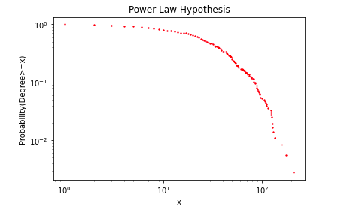
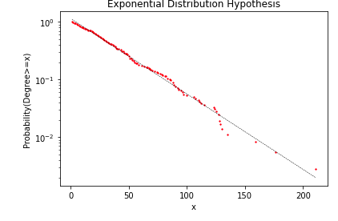
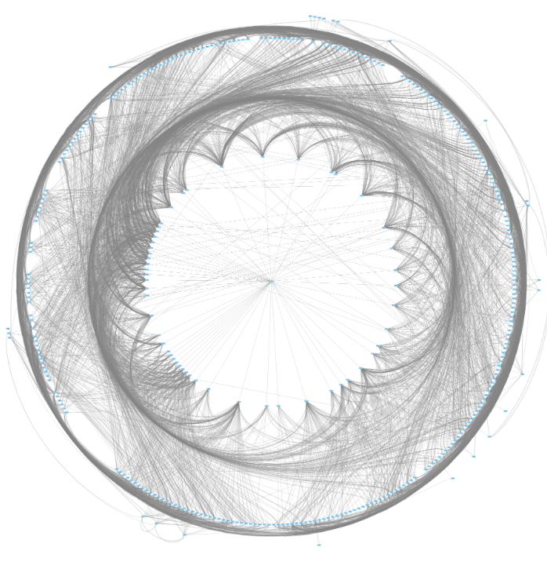

RESULTS
The Macaque Brain Network’s degree distribution loosely exhibits power law and is consistent with the hypothesis of exponential distribution
The visualisation of the whole brain network, showing the layers of the network, on the left
The visualisation of the core of the network, (obtained by peeling away layers till only nodes with degree>28 remained), on the right
More graphs in the folder provided

Slide 7

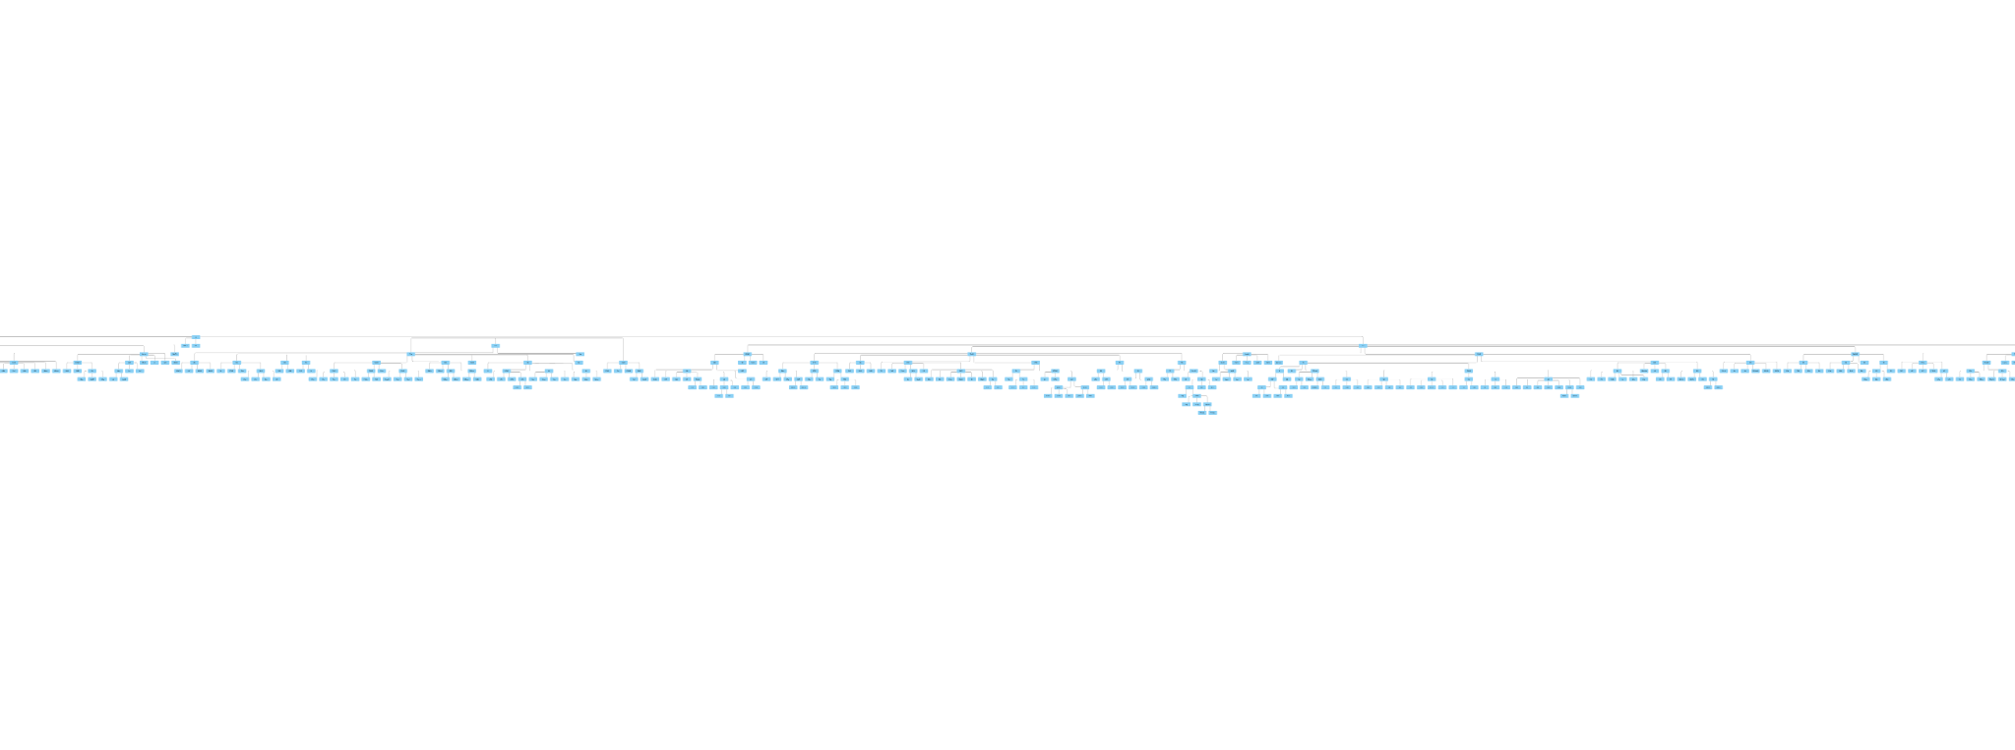
RESULTS
88% of all edges either originate or terminate in the innermost core, although it contains only 32% of the vertices.
The core contains most topologically central regions of the brain and therefore the network communicates mostly through the core
The innermost core spans premotor and prefrontal cortex, temporal lobe, parietal lobe, thalamus, basal ganglia, cingulate cortex, insula, and V4 in decreasing order of number of regions
Radial Model for Hierarchy
Dendrogram Model for Hierarchy

Slide 8
NOVELTY
Compared the Macaque Brain Network to existing models like Erdos Renyi, Barabasi-Albert, Directed scale-free graphs, etc
Directed Scale free - worst fit
Gnm random graph - bad fit
G(n,p) random graph/ Erdos Renyi - best at a small probability value like 0.05 but still a bad fit
Barabasi Albert - closest fit at no_of_edges=40 but the slope is steeper in the macaque brain network distribution and there are much fewer points with a degree >100 in macaque brain compared to barabasi albert
Studied the assortativity and average path length
Average Shortest Path Length of Graph: 2.5541705354379447
There are on average 1-2 hops from one region to another which makes the signalling fast
Average Shortest Path Length of Core: 1.929
There are on average 0-1 hops from one region to another which makes the signalling fast
Degree Assortativity of Graph : -0.1147765924196248
Degree Assortativity of Core : 0.003719185906300945
Both our core and original graph have assortativity close to 0 which means it is neither assortative nor disassortative
Checked to confirm if our hierarchical model follows a hierarchy flow hierarchy
Flow hierarchy was found to be 1.0 which means our mapping is perfectly hierarchical

