Slide 1
Anomaly Detection in Solar Power Systems
Using Machine Learning and Deep Learning
Site 1 Analysis | June - December 2025 | PyTorch

Slide 2
Problem Statement
Goal: Detect anomalies in solar power generation that indicate equipment faults, panel degradation, inverter failures, or sensor errors.
Why It Matters
Approach
Undetected faults reduce energy output and revenue
Early detection enables preventive maintenance
Reduces system downtime and extends equipment lifespan
Critical for scaling solar infrastructure reliably
Train models to learn the NORMAL relationship between weather conditions and solar generation
When actual output deviates significantly from predicted output, flag as ANOMALY
Use multiple models (ML + DL) and ensemble voting for robust detection

Slide 3
Data Description
Site 1 Solar Power Plant | June - December 2025
Sensor | Variable | Unit | Role | Resolution | Raw Rows
Generation | Solar production | kW | Target (Y) | ~1 min | 26,226
Irradiance | Solar radiation | W/m² | Feature (X) | ~1 min | 26,177
Temperature | Ambient temp | °C | Feature (X) | ~1 min | 26,195
Load | Power consumption | kW | Context | 15 min | 17,367
Variable Statistics (After Cleaning)
Variable | Mean | Std | Min | Max
Generation (kW) | 96.53 | 150.86 | 0.00 | 638.00
Irradiance (W/m²) | 157.76 | 243.96 | 0.00 | 1,073.00
Temperature (°C) | 28.73 | 3.01 | 0.00 | 37.05

Slide 4
Exploratory Data Analysis
Understanding the data before modeling

Slide 5
Data Preprocessing
Challenge: Different Time Resolutions
Stage | Rows | Note
Raw merged | 17,664 | Outer join
After cleaning | 15,013 | Usable data
Dropped | 2,651 | 15% loss
Gen, Irradiance, Temp: ~1-minute intervals
Load: 15-minute intervals
Cannot merge directly - need uniform resolution
Solution Pipeline
1. Resample all data to uniform 15-min intervals (mean aggregation)
2. Merge 4 variables via outer join on timestamp
3. Forward-fill small gaps (up to 1 hour)
4. Time-based interpolation for remaining short gaps
5. Drop rows with large unrecoverable gaps

Slide 6
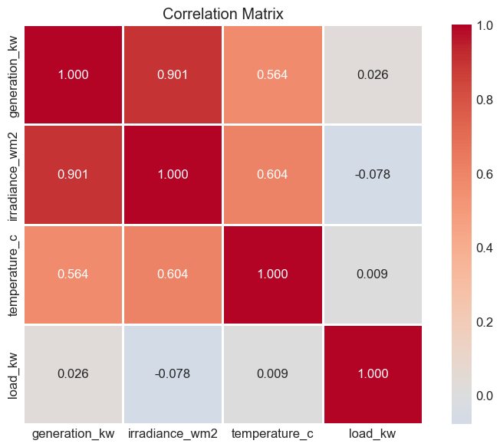
EDA: Correlation Analysis
Feature | Correlation | Strength
Irradiance (W/m²) | 0.901 | Very Strong
Temperature (°C) | 0.564 | Moderate
Load (kW) | 0.026 | Negligible
Key Insight
Irradiance: r=0.90 - primary driver of generation (physics-based)
Temperature: r=0.56 - moderate, co-varies with sunny hours
Load: r=0.03 - independent consumption pattern
Selected features for modeling: Irradiance + Temperature

Slide 7
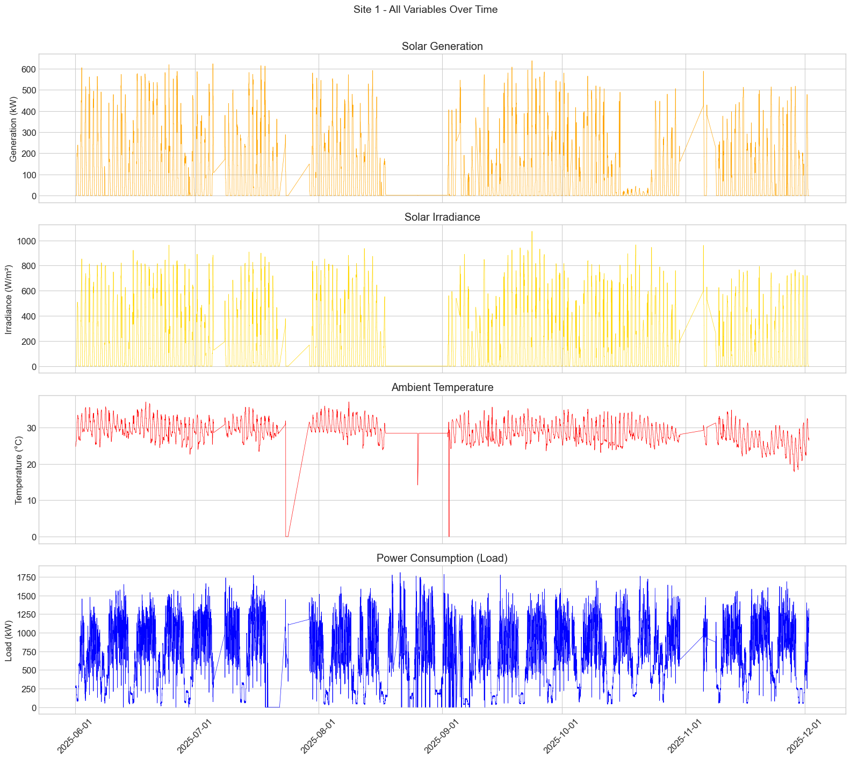
EDA: Time Series Overview (6 Months)

Slide 8
EDA: Time Series Overview (6 Months)

Slide 9
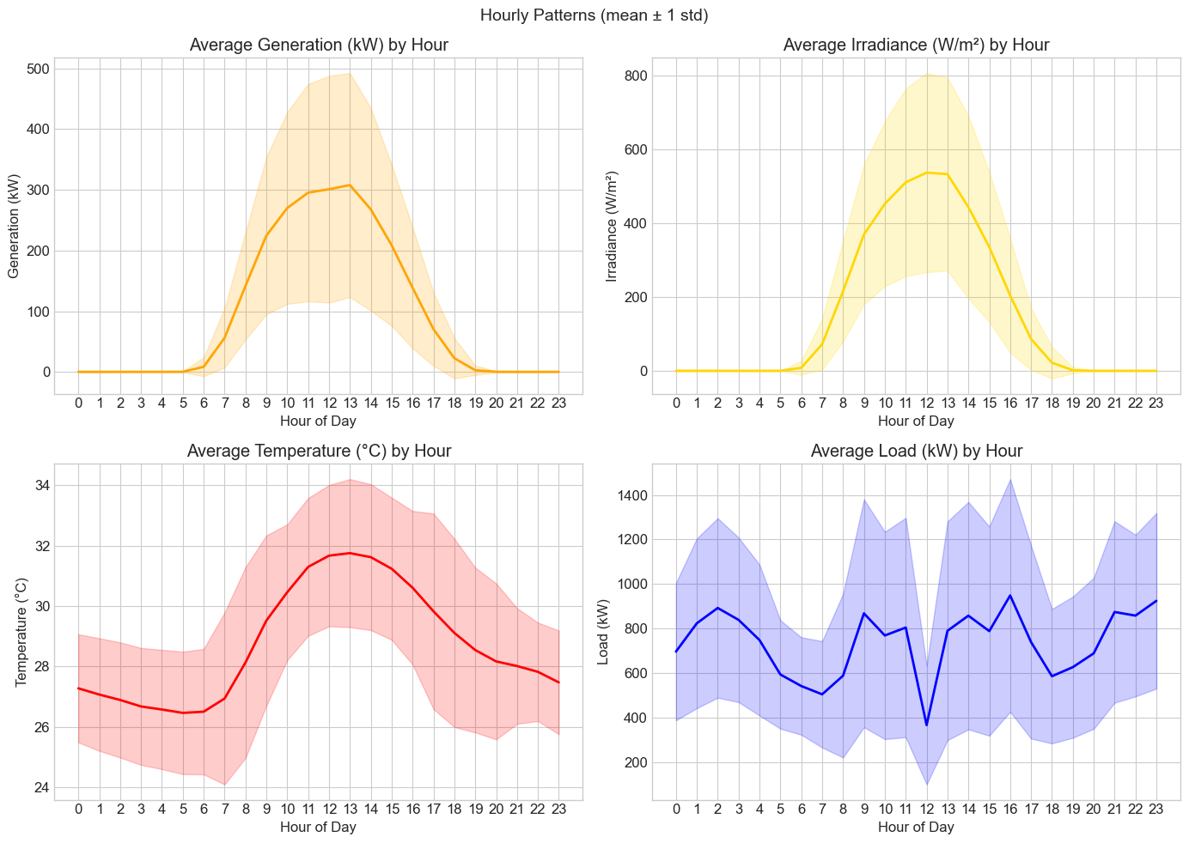
EDA: Daily Patterns & Scatter Analysis

Slide 10
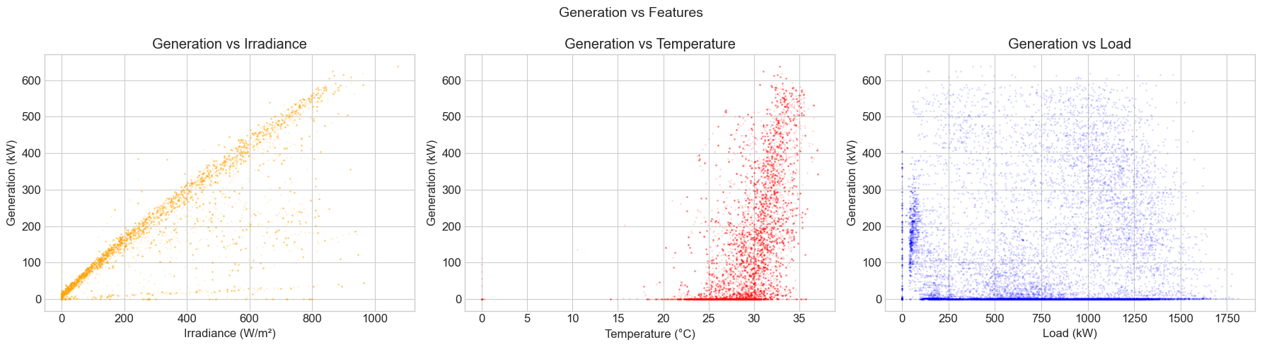
EDA: Daily Patterns & Scatter Analysis

Slide 11
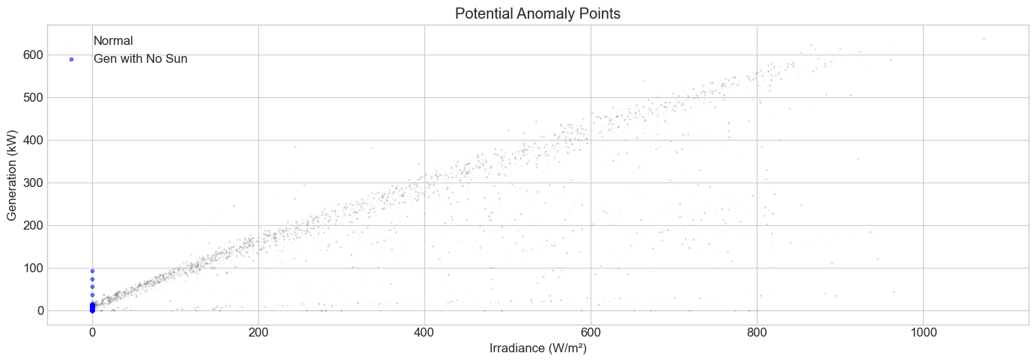
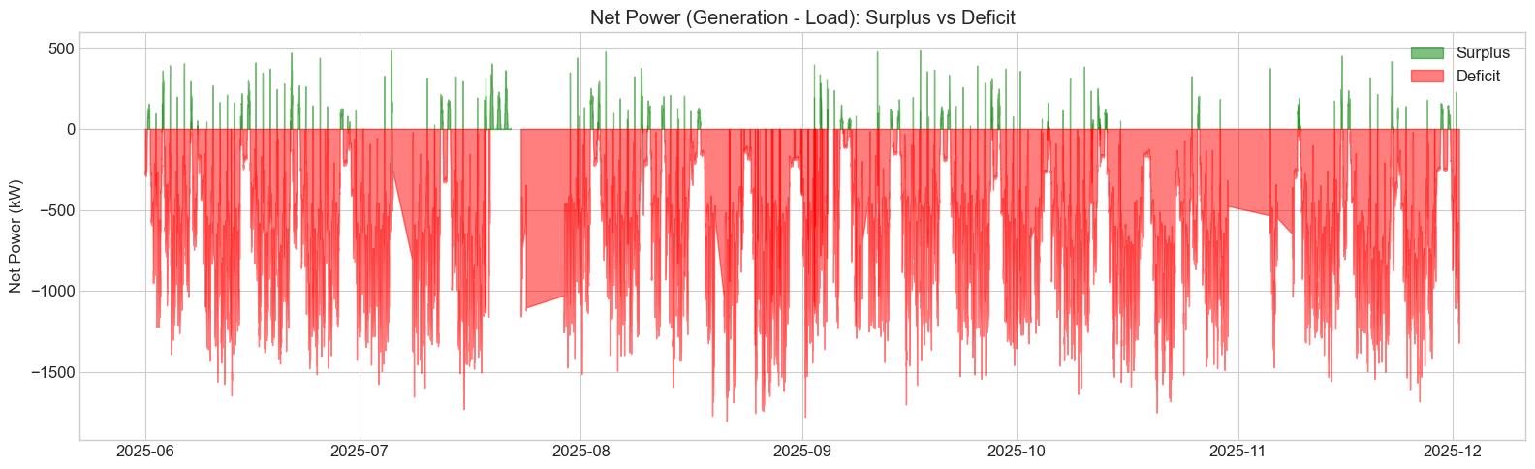
EDA: Key Observations
1,655 data points: Generation recorded with zero sunlight (potential sensor/logging error)
0 data points: High irradiance with zero generation (no obvious equipment failure detected)
Generation efficiency (daytime): mean = 0.71 kW/(W/m²)
Solar surplus covers only 10.8% of time
Site relies on grid power 89.2% of the time
Clear daily bell-curve pattern for generation/irradiance
Seasonal variation visible across Jun-Dec period

Slide 12
Model Training
Machine Learning & Deep Learning Approaches

Slide 13
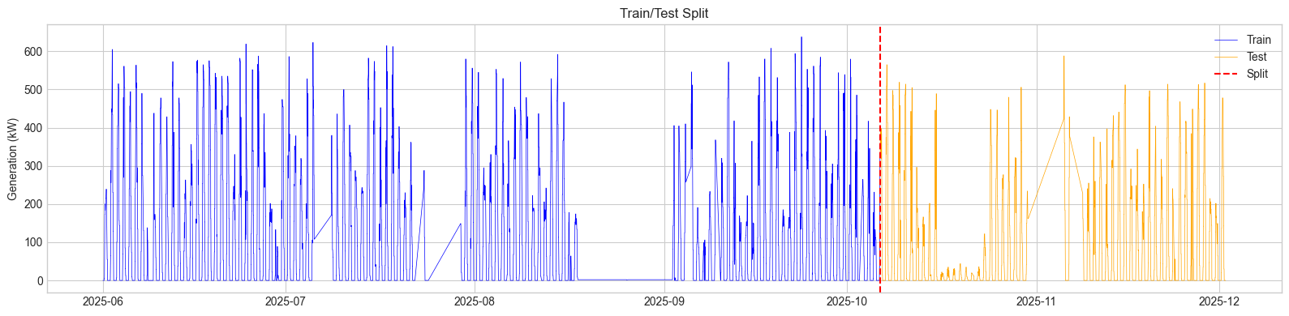
Methodology Overview
Train/Test Split (Time-Based, No Shuffle)
Set | Rows | Period | Ratio
Train | 10,509 | Jun 1 - Oct 6, 2025 | 70%
Test | 4,504 | Oct 6 - Dec 1, 2025 | 30%
6 Models Trained
# | Model | Category | Approach
1 | Isolation Forest | ML, Unsupervised | Detects statistically isolated points in feature space
2 | Random Forest | ML, Supervised | Regression prediction; large error = anomaly
3 | LSTM | DL, Sequential | Learns temporal patterns from 1-hour sliding windows
4 | CNN-LSTM | DL, Hybrid | CNN extracts local features + LSTM captures time dynamics
5 | LSTM Autoencoder | DL, Reconstruction | Compresses & reconstructs normal patterns
6 | Transformer | DL, Self-Attention | Multi-head attention captures all-timestep dependencies

Slide 14
Deep Learning Model Architectures
PyTorch | Input: 4 timesteps x 3 features | Output: 3 features
LSTM (53,123 params)
CNN-LSTM (8,819 params)
LSTM Autoencoder (16,611)
Transformer (~37K params)
2-layer LSTM (hidden=64)
Dropout 0.2
FC: 64 -> 32 -> 3
Last timestep output
Conv1D: 3->32->16 filters
1-layer LSTM (hidden=32)
FC: 32 -> 32 -> 3
Most parameter-efficient
Encoder: LSTM 3->32->16
Bottleneck: 16-dim
Decoder: LSTM 16->32->3
Reconstruct input sequence
Input proj + Pos Encoding
2 Encoder layers, 2 heads
d_model=32, ff_dim=64
Global avg pool + FC
Training Configuration
Parameter | Value | Parameter | Value
Optimizer | Adam (lr=0.001) | Batch Size | 32
LR Scheduler | ReduceLROnPlateau (factor=0.5) | Early Stopping | Patience=15
Loss Function | MSE | Gradient Clipping | Max norm=1.0
Scaling | MinMaxScaler (0-1) | GPU | NVIDIA RTX 3060 Ti

Slide 15
Anomaly Detection Method
3-Sigma Rule on Prediction Error
Prediction-Based (RF, LSTM, CNN-LSTM, Transformer)
Reconstruction-Based (LSTM Autoencoder)
1. Error = |Actual Generation - Predicted Generation|
2. Threshold = Mean(Error) + 3 x Std(Error)
3. If Error > Threshold --> ANOMALY
1. Reconstruct input sequence through bottleneck
2. Error = |Original Sequence - Reconstructed Sequence|
3. Threshold from training data (3-sigma)
High error = pattern not learned = anomalous
Why 3-Sigma?
In a normal distribution, 99.7% of data falls within 3 standard deviations
Points beyond 3-sigma are statistically rare (0.3%) and likely represent genuine anomalies
Tunable: 2-sigma = more sensitive (more detections, more false positives) | 4-sigma = more conservative
Consistent threshold applied across all prediction-based models for fair comparison

Slide 16
Results
Prediction Performance & Anomaly Detection

Slide 17
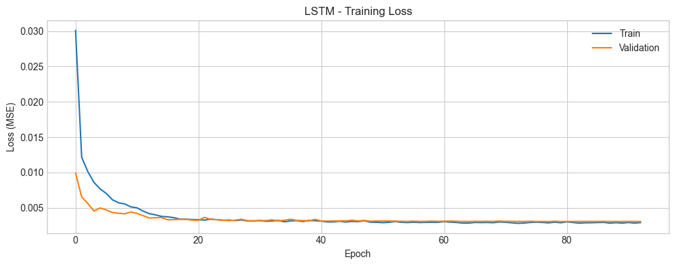
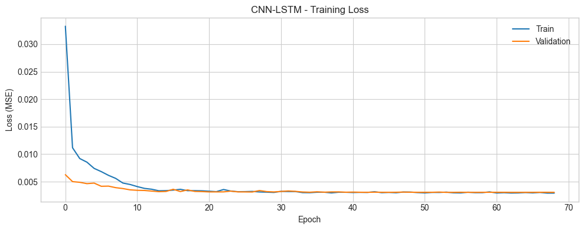
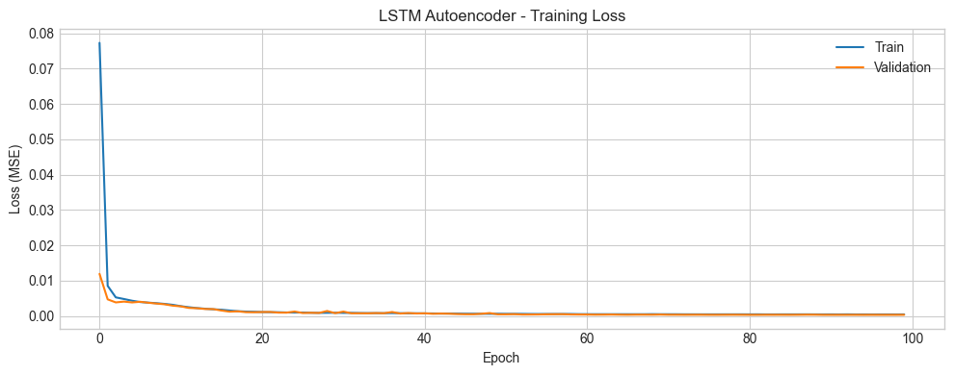
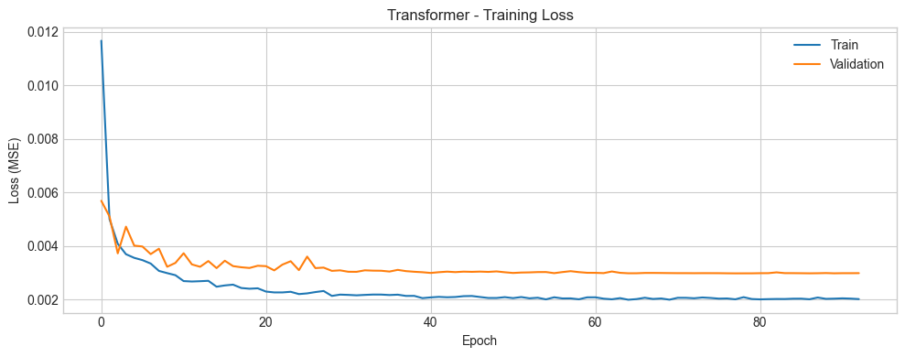
Training Loss Curves

Slide 18
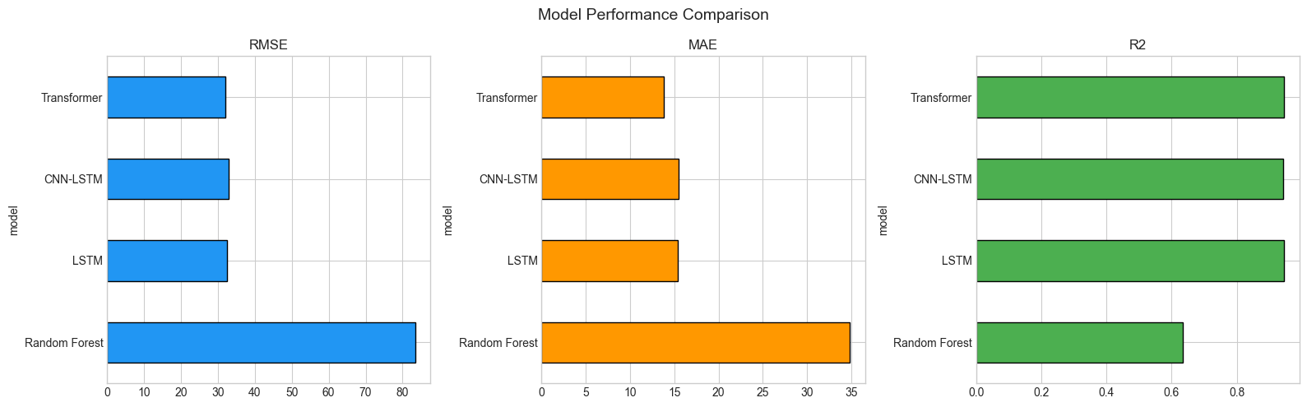
Prediction Performance (Test Set)
Model | RMSE | MAE | R² | Parameters
Random Forest | 83.37 | 34.80 | 0.6346 | -
LSTM | 32.46 | 15.43 | 0.9445 | 53,123
CNN-LSTM | 32.87 | 15.45 | 0.9431 | 8,819
Transformer * | 32.05 | 13.76 | 0.9459 | ~37K
* Best model

Slide 19
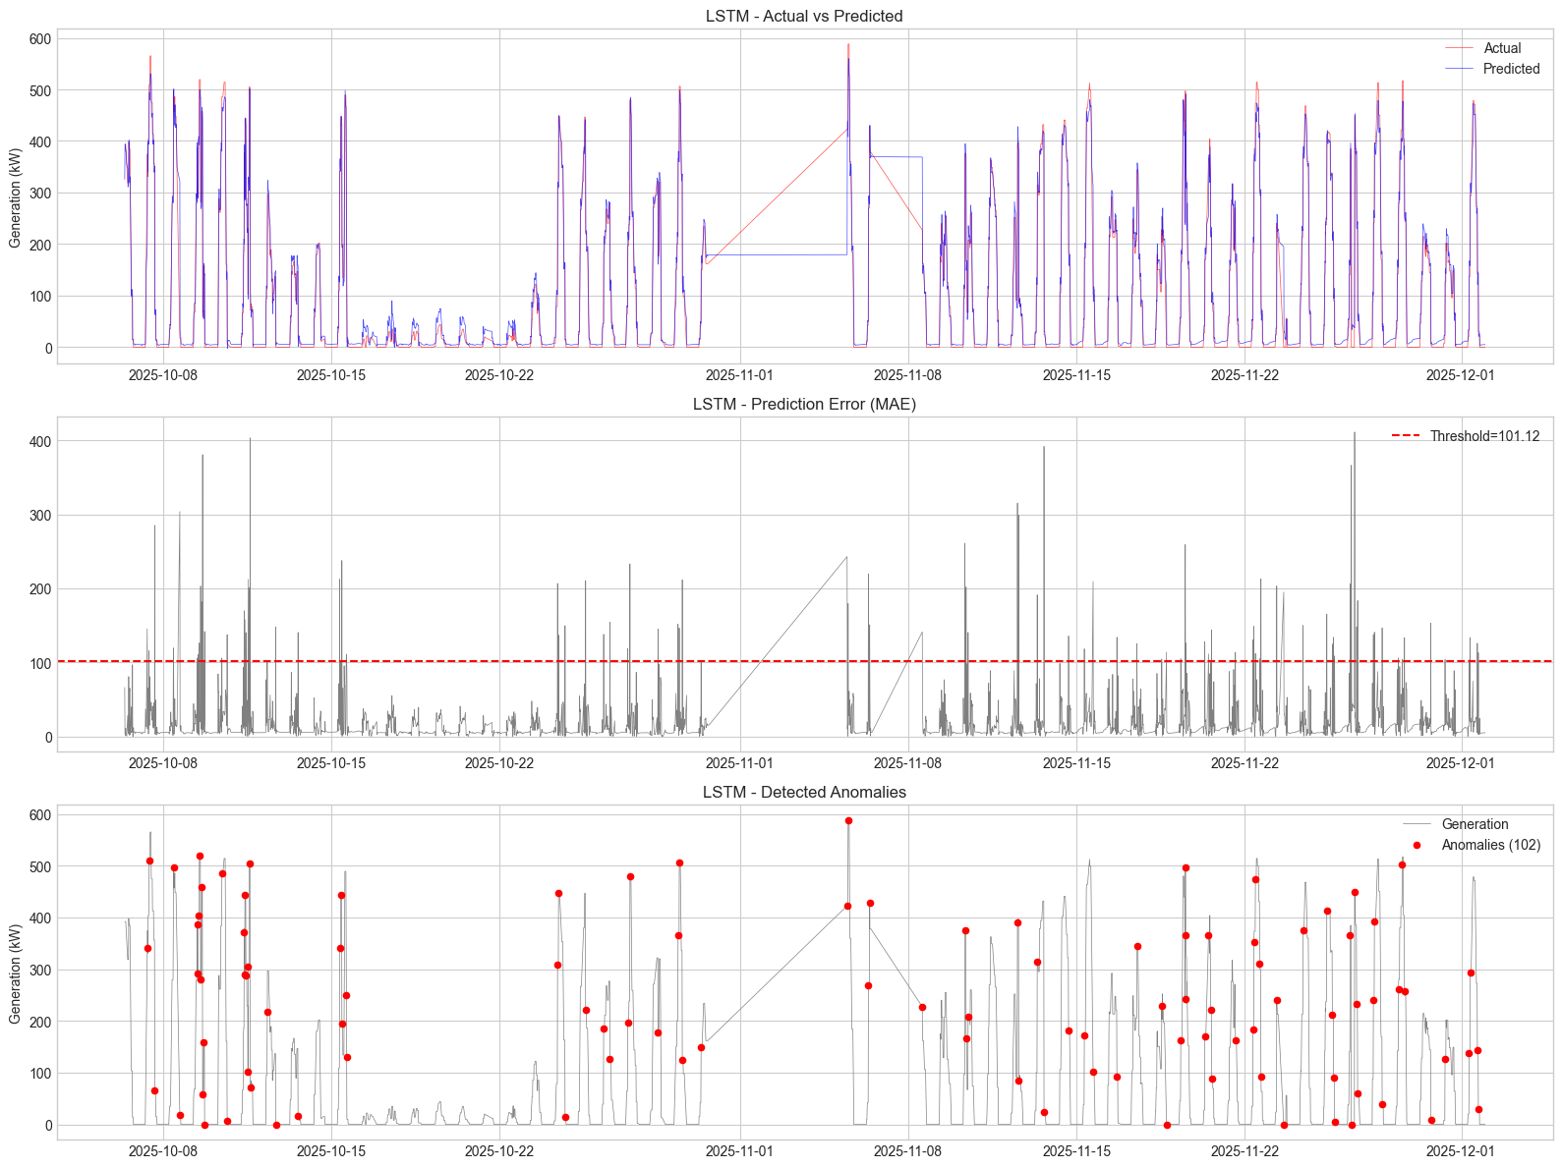
Prediction vs Actual: LSTM & LSTM

Slide 20
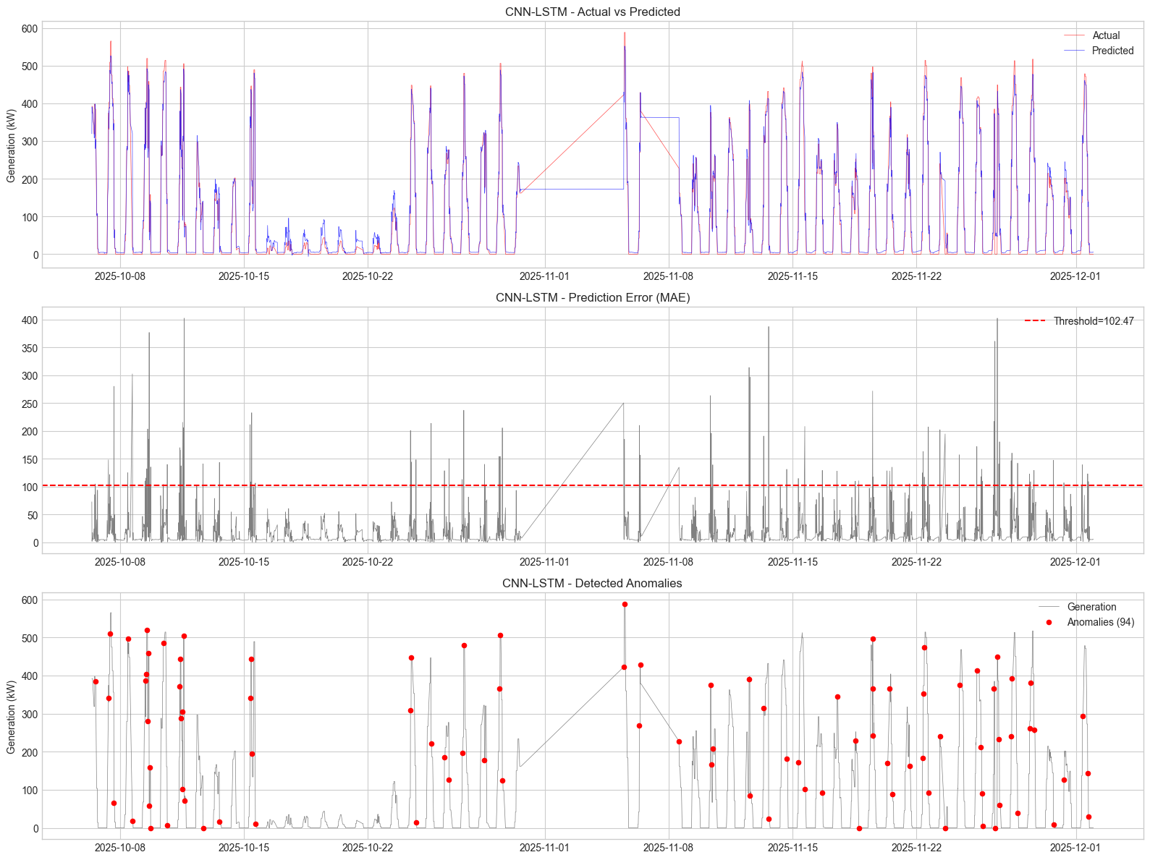
Prediction vs Actual: LSTM & CNN

Slide 21
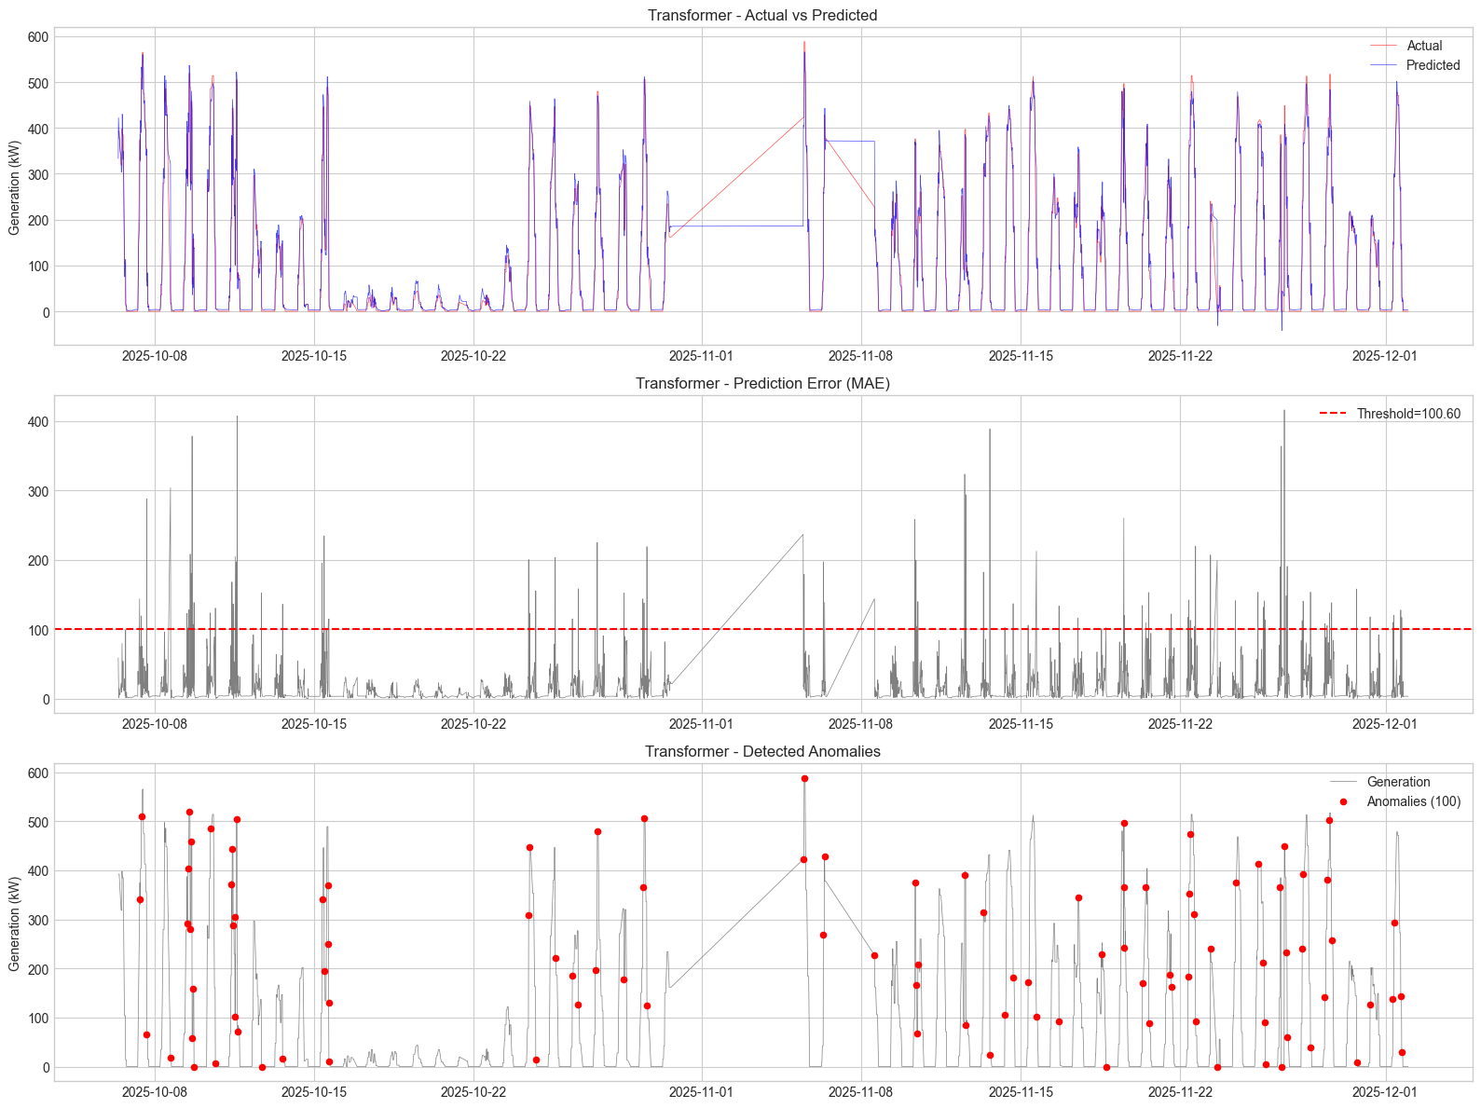
Prediction vs Actual: Transformer (Best Model)

Slide 22
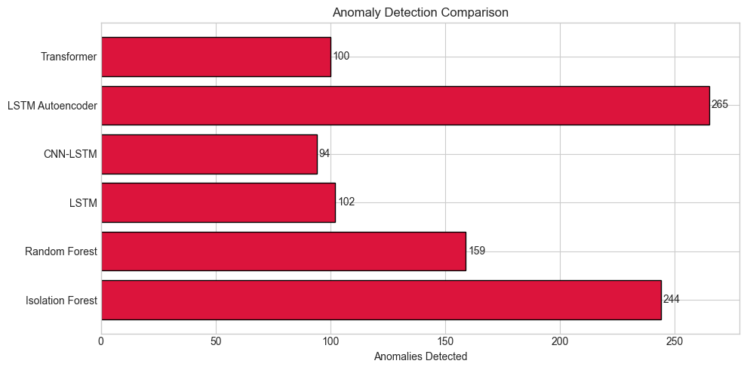
Anomaly Detection Results
Model | Method | Anomalies | % of Test
Isolation Forest | Isolation score | 244 | 5.4%
Random Forest | 3-sigma MAE | 159 | 3.5%
LSTM | 3-sigma MAE | 102 | 2.3%
CNN-LSTM | 3-sigma MAE | 94 | 2.1%
LSTM Autoencoder | 3-sigma recon. | 265 | 5.9%
Transformer | 3-sigma MAE | 100 | 2.2%
Most conservative: CNN-LSTM (94 anomalies, 2.1%)
Most sensitive: LSTM Autoencoder (265, 5.9%) - reconstruction-based catches more subtle deviations
DL prediction models converge at ~2.1-2.3% - consistent and reliable
Unsupervised methods (IF, AE) detect more anomalies but may include more false positives

Slide 23
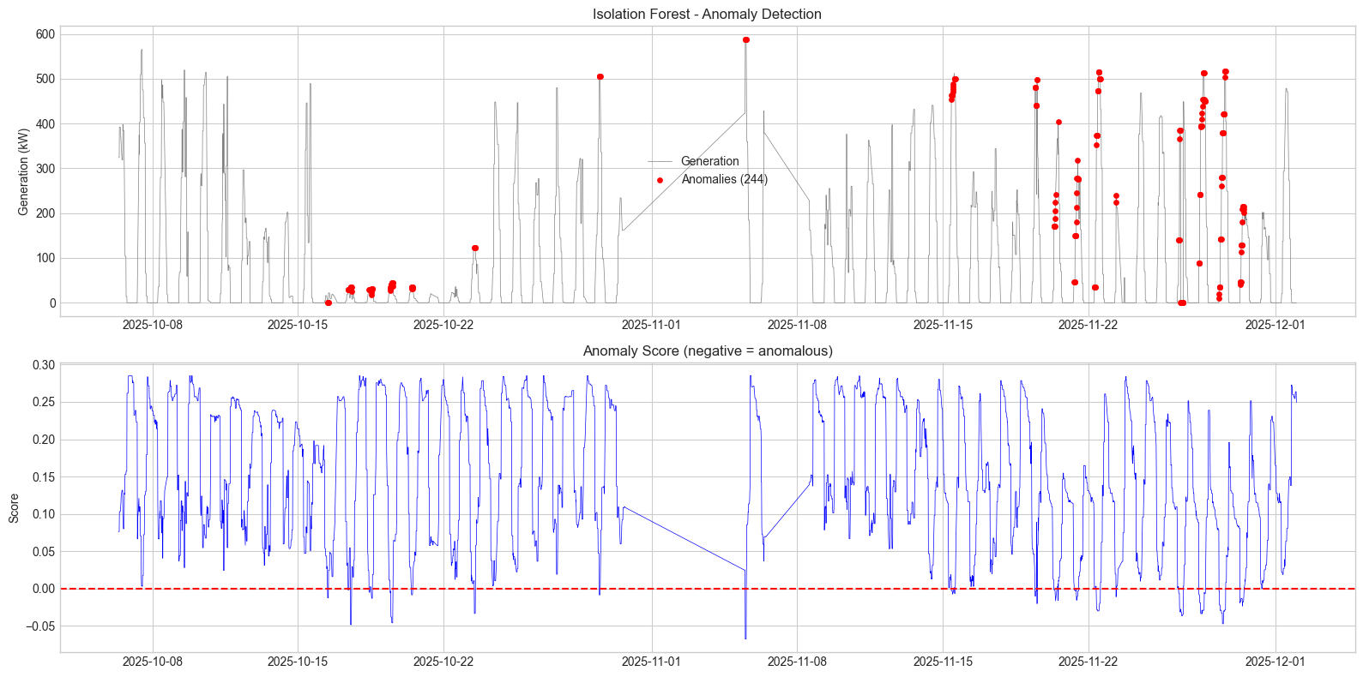
Anomaly Visualization: ML Models

Slide 24
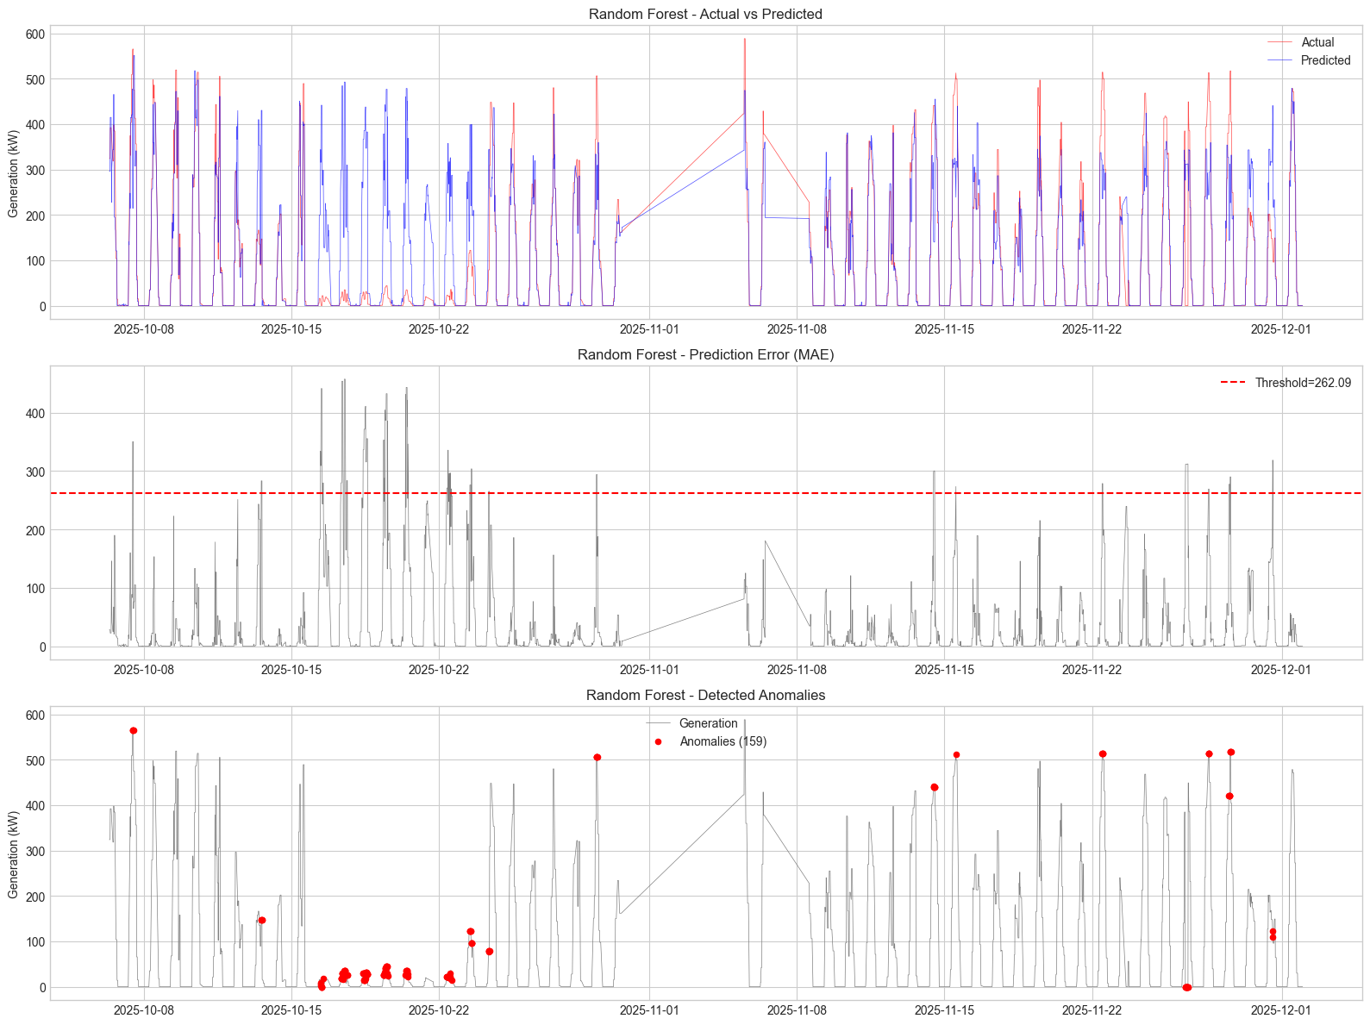
Anomaly Visualization: ML Models

Slide 25
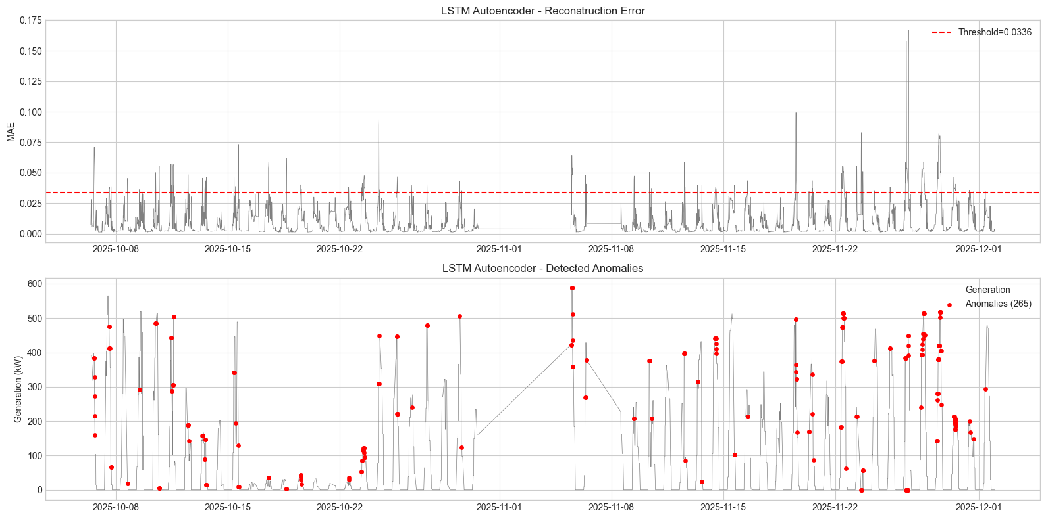
Anomaly Visualization: LSTM Autoencoder

Slide 26
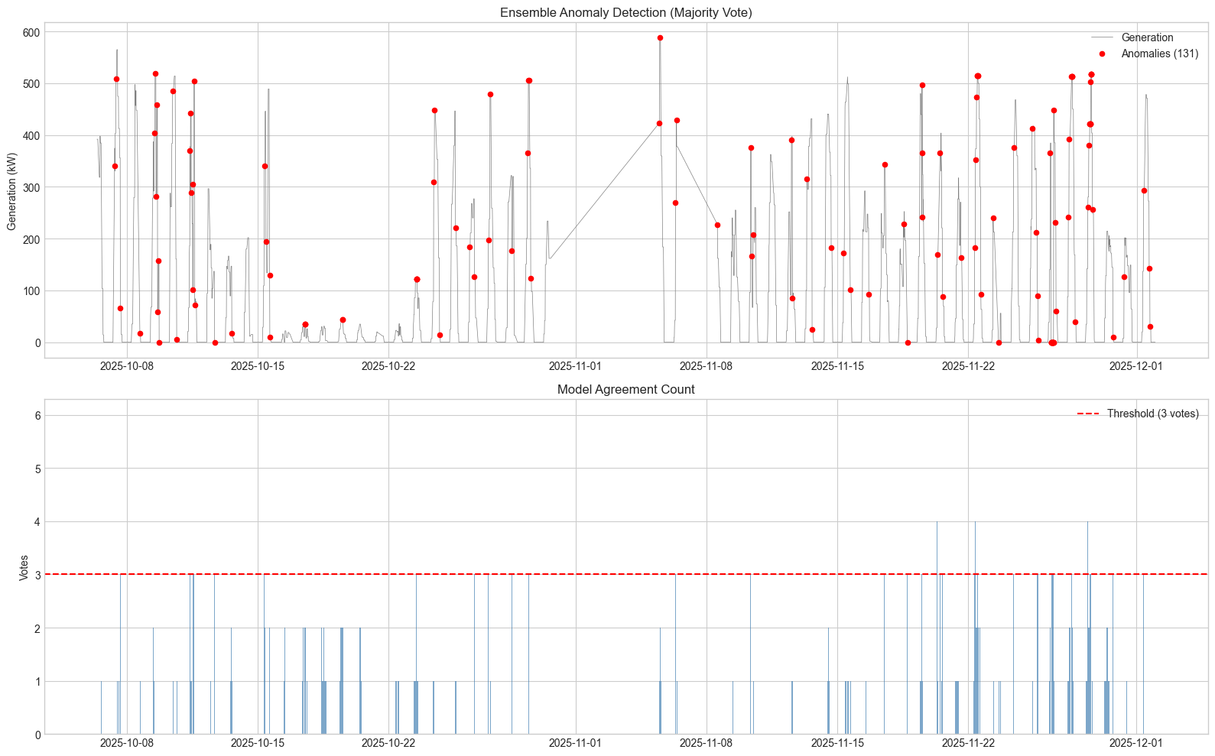
Ensemble Anomaly Detection (Majority Vote)
Agreement Level | Data Points | %
0 models (normal) | 3,939 | 87.5%
1 model only | 311 | 6.9%
2 models | 119 | 2.6%
3 models (anomaly) | 114 | 2.5%
4 models (anomaly) | 13 | 0.3%
5 models (anomaly) | 3 | 0.07%
6 models (anomaly) | 1 | 0.02%
Total Ensemble Anomalies: 131 (2.9%) Rule: Anomaly if >= 3 of 6 models agree

Slide 27
What Do These Anomalies Mean?
Anomaly Pattern | Possible Cause | Action Required
High irradiance + Low generation | Panel fault, inverter failure, shading | Inspect panels & inverters
Sudden generation drop | Equipment trip, grid disconnection | Check breakers & grid connection
Generation with zero irradiance | Sensor malfunction, data logging error | Calibrate sensors
Gradual efficiency decline | Panel degradation, dust accumulation | Schedule cleaning/maintenance
Unusual generation spikes | Sensor calibration drift | Verify sensor readings
Practical Impact
131 flagged time points in ~2 months of test data (Oct-Dec 2025)
Each represents a 15-minute window where the system behaved abnormally
Operations team can investigate clustered anomalies for root cause analysis
Reduces manual inspection effort by focusing attention on high-confidence alerts

Slide 28
Conclusion
1. Deep learning dramatically outperforms traditional ML: R² improved from 0.63 (Random Forest) to 0.95 (Transformer) - a 49% reduction in unexplained variance.
2. Transformer achieved the best prediction accuracy (RMSE=32.05, MAE=13.76, R²=0.9459), while CNN-LSTM is the most efficient (comparable accuracy with 6x fewer parameters).
3. Irradiance is the dominant predictor (94.6% feature importance), confirming the physics-based relationship between solar radiation and power generation.
4. Ensemble voting (majority of 6 models) identified 131 high-confidence anomalies (2.9%) in the test period, providing robust detection with reduced false positives.
5. The approach is interpretable: an anomaly means the system produced significantly different power than expected given current weather conditions.
6. 1,655 data points with generation at zero sunlight warrant investigation as potential sensor/data issues.

Slide 29
Future Work
Priority | Task | Description
High | Multi-site deployment | Extend to all 4 sites (currently only Site 1)
High | Threshold tuning | Calibrate sigma per site using operator feedback
Medium | Anomaly classification | Categorize type: inverter, panel, sensor, etc.
Medium | Real-time pipeline | Build streaming inference for continuous monitoring
Low | Transfer learning | Pre-train on Site 1, fine-tune on Sites 2-4
Low | Explainability | Add SHAP / attention visualization for root cause

Slide 30
Thank You
Anomaly Detection in Solar Power Systems Using Machine Learning and Deep Learning

Slide 31
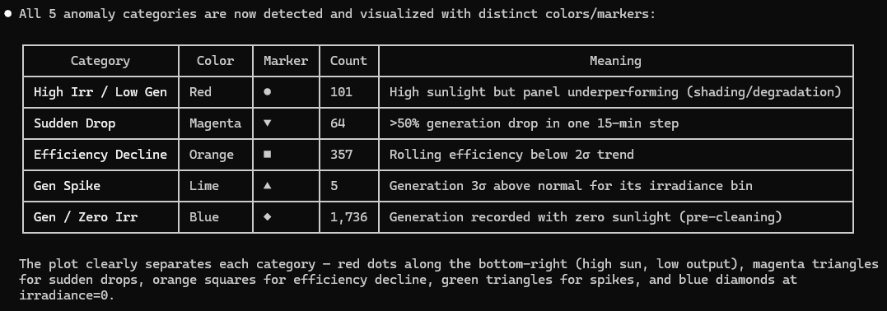

Slide 32
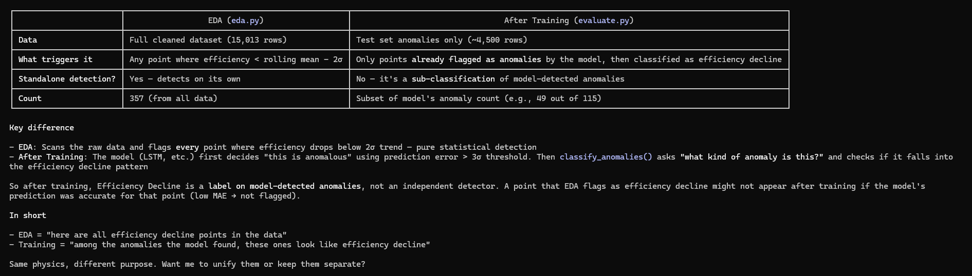

Slide 33
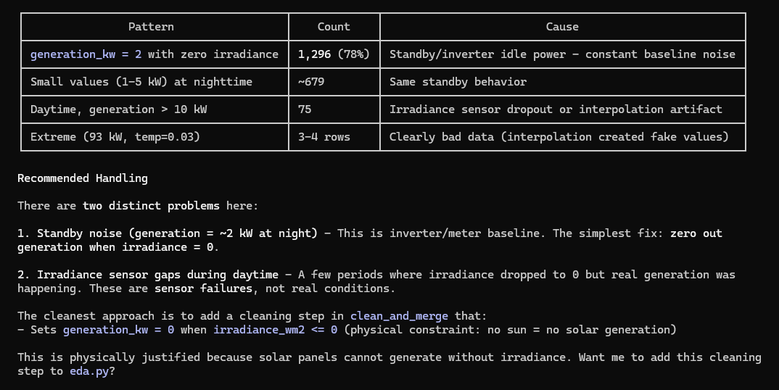

Slide 34
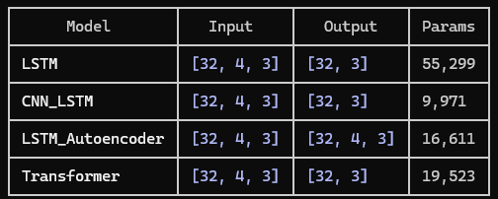

Slide 35
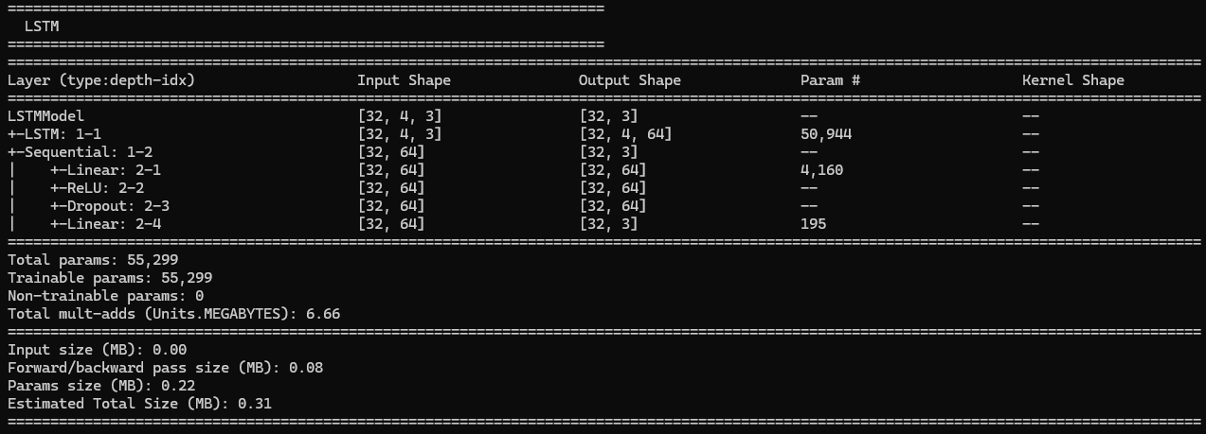

Slide 36
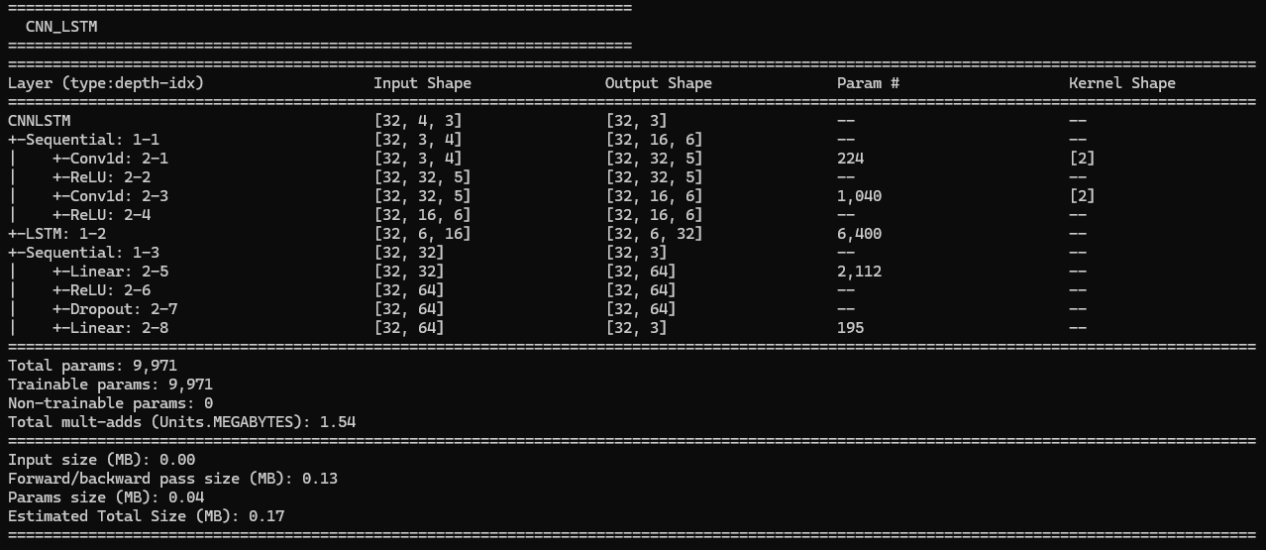

Slide 37
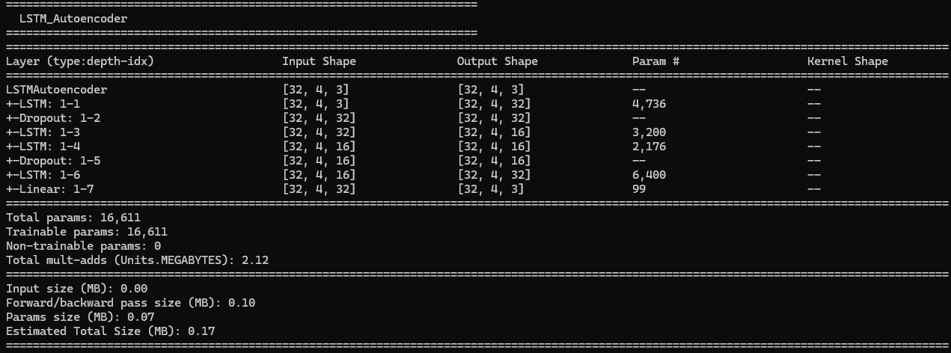

Slide 38
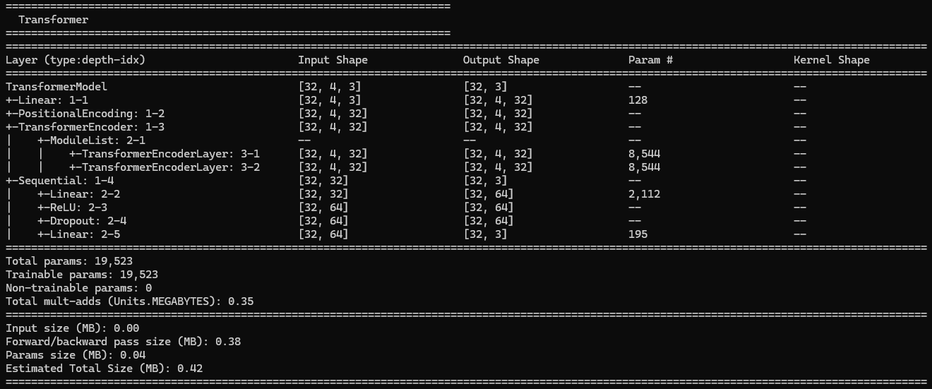

Slide 39
• Abnormality definition
- For the prediction-based models (Random Forest plus every PyTorch net), the script computes MAE = |actual - predicted| per timestep, then flags a point as anomalous whenever MAE > mean(MAE) + 3·std(MAE)
according to detect_anomalies_3sigma; this is the 3‑sigma rule highlighted at 02_training_anomaly_detection.py:124‑02_training_anomaly_detection.py:141 and reused wherever detect_anomalies_3sigma is called
(e.g., after the Random Forest and each DL model).
- The Autoencoder is construction-based, so it reconstructs each sequence and measures the average absolute error across the entire sequence (ae_recon_error = mean(|input – reconstruction|)); its threshold
is derived from the training reconstruction errors (ae_threshold = mean + 3·std of ae_train_error), then any test row exceeding that is flagged
(02_training_anomaly_detection.py:482‑02_training_anomaly_detection.py:502).
- The Isolation Forest uses its built-in predict output (−1 for anomalies) and counts those as abnormal points (02_training_anomaly_detection.py:241‑02_training_anomaly_detection.py:263).
- Finally, the ensemble treats a timestamp as abnormal if three or more of the six models (Isolation Forest, Random Forest, LSTM, CNN-LSTM, Autoencoder, Transformer) agree on an anomaly; the vote matrix and
thresholding happen at 02_training_anomaly_detection.py:586‑02_training_anomaly_detection.py:603.

Slide 40
