Slide 1

Recent updates to ANSI MH16.1: perforated rack member design and the Direct Strength Method
Cristopher D. Moen
RunToSolve LLC
Wei-Wen Yu International Specialty Conference on Cold-Formed Steel Structures, Madison, Wisconsin
runtosolve.github.io/ICCFSS2026_MoenRackStandards

Slide 2
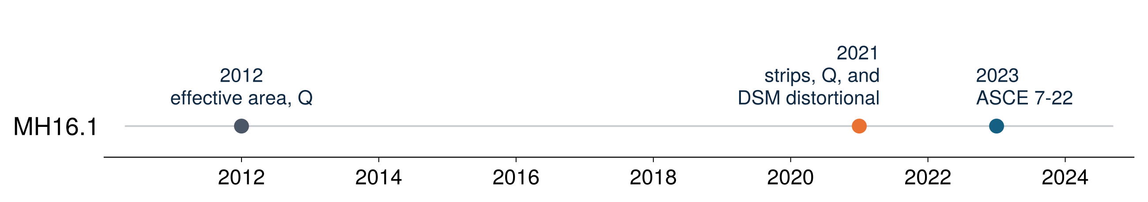
Three editions of MH16.1 in eleven years
ANSI MH16.1 (RMI) is the specification for industrial steel storage racks, referenced by ASCE 7 §15.5.3 and the IBC
Rack uprights are roll-formed, thin, open, and perforated along their full length, so local, distortional, and global buckling interact
The 2021 edition rewrote the member design chapter around elastic buckling analysis; the 2023 edition kept it
This talk: what changed from 2012 to 2023 and where the Direct Strength Method enters

Slide 3
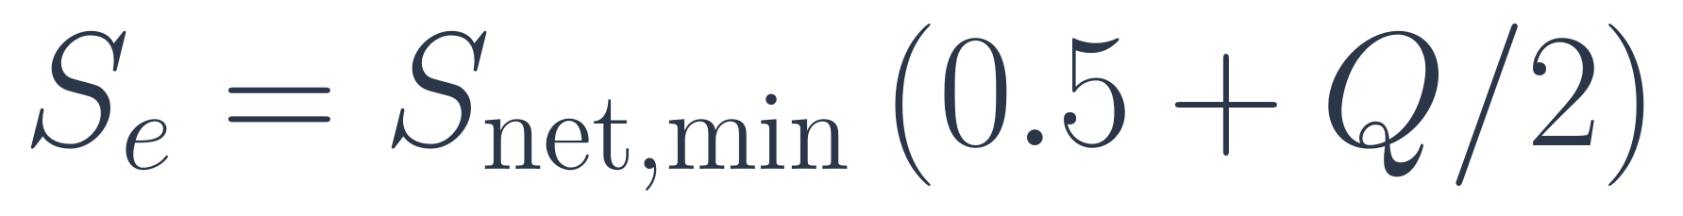
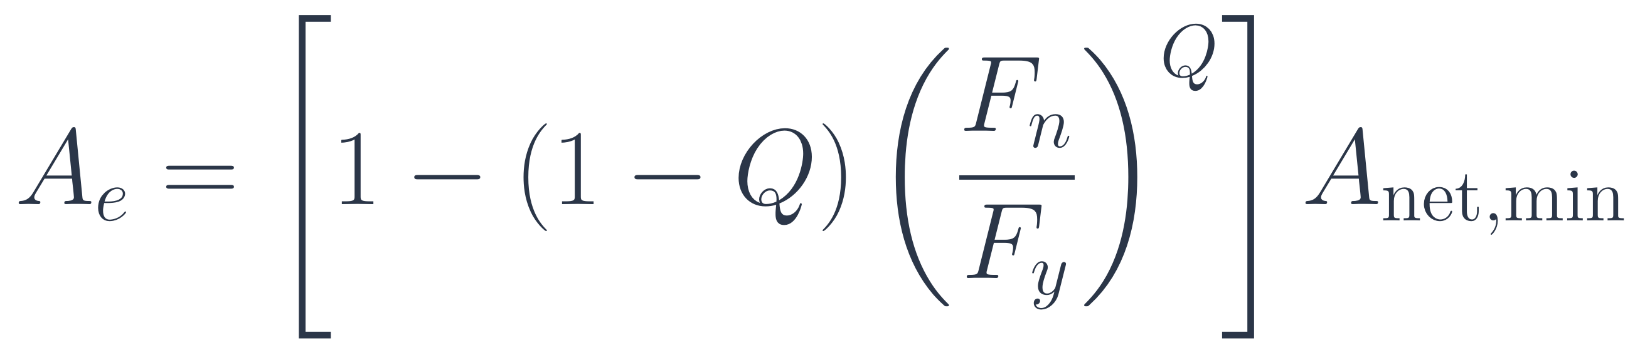
MH16.1-2012: effective area and the stub-column Q factor
Compression (§4.1.3.1)
Flexure (§4.1.2)
• Effective area from the stub-column test:
• Round corners for A and I; sharp corners permitted for J, C_{w}, r_{o}
• P_{n} = A_{e} F_{n}, with F_{n} from AISI S100 on the gross, unperforated section
Distortional (§4.1.3.2)
• Q = stub column strength / (F_{y} A_{net,min}) ≤ 1 (§9.2.2)
• One sentence: certain open sections "shall be checked … by testing or rational analysis"
• No equations, no elastic buckling load
Frame stability by the effective length method: down-aisle K_{x} = 1.7 for unbraced racks, K_{t} = 0.8

Slide 4
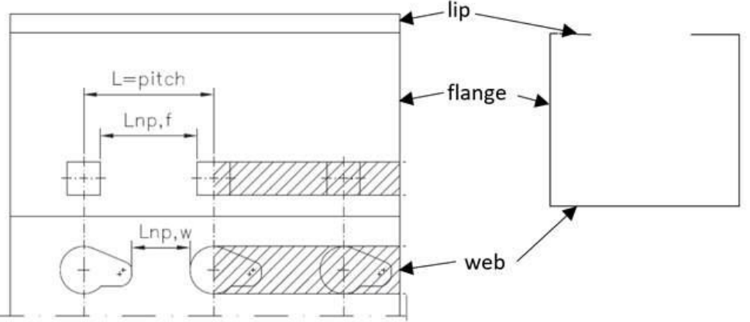
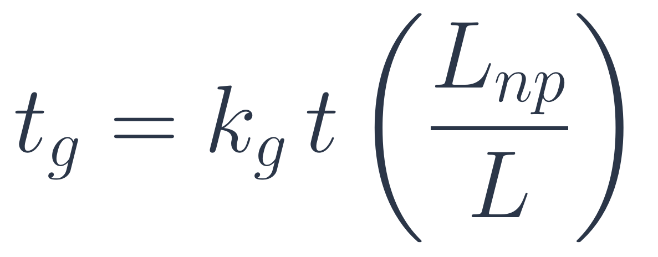
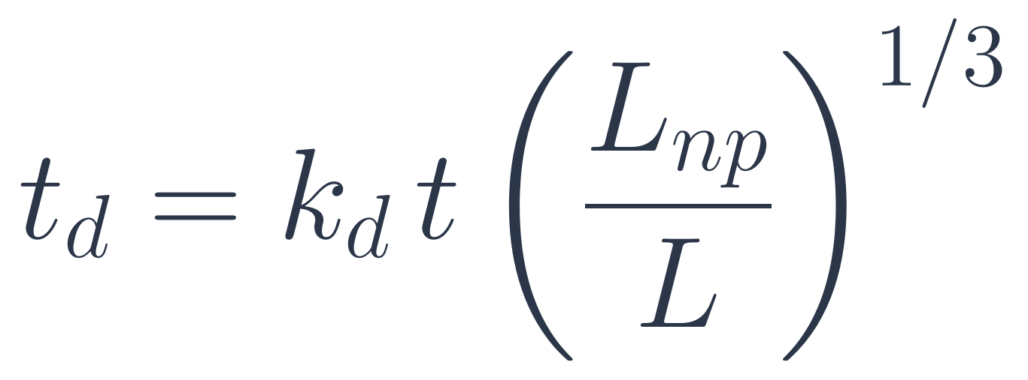
MH16.1-2021 §8.2.1: perforations become reduced-thickness strips
• Section properties use round corners for everything, including J and C_{w} (sharp corners are unconservative for torsion)
• Each strip of web or flange that contains perforations is replaced by a solid strip of reduced thickness
• Global and local buckling, k_{g} = 0.6:
Source: ANSI MH16.1-2023, Figure 8.2-1, example of perforation strips in a column
• Distortional buckling, k_{d} = 0.8:
• One idealized section feeds the frame model (§7.2.4), the global buckling check, and the finite strip model for P_{crd} and M_{crd}
• L_{np} is the solid length between holes, L the pitch

Slide 5
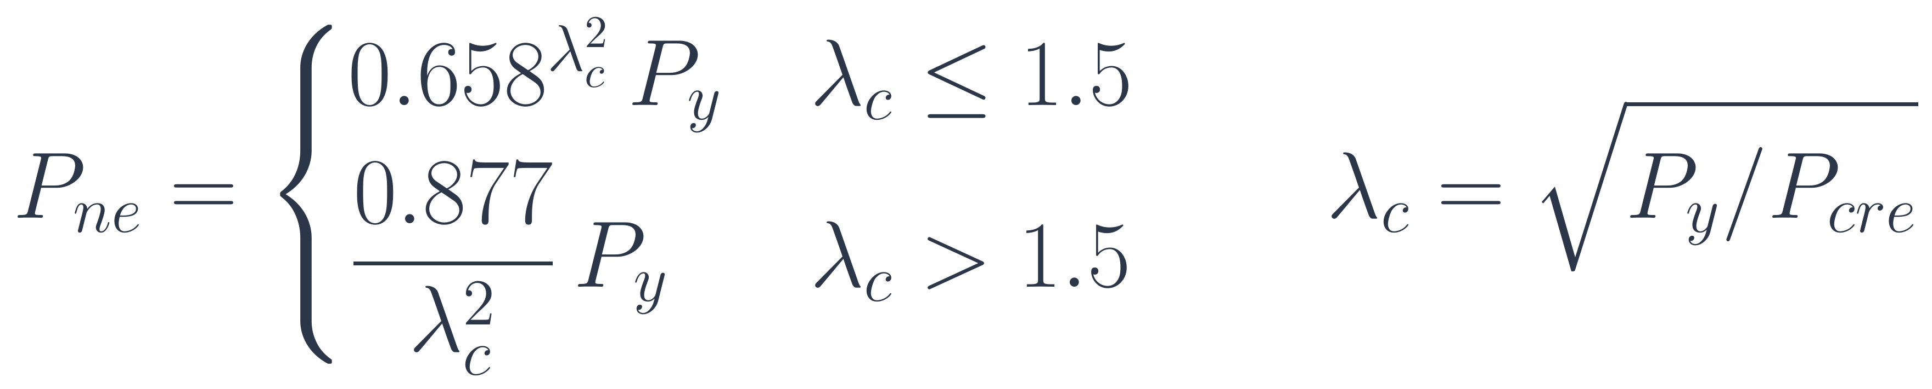
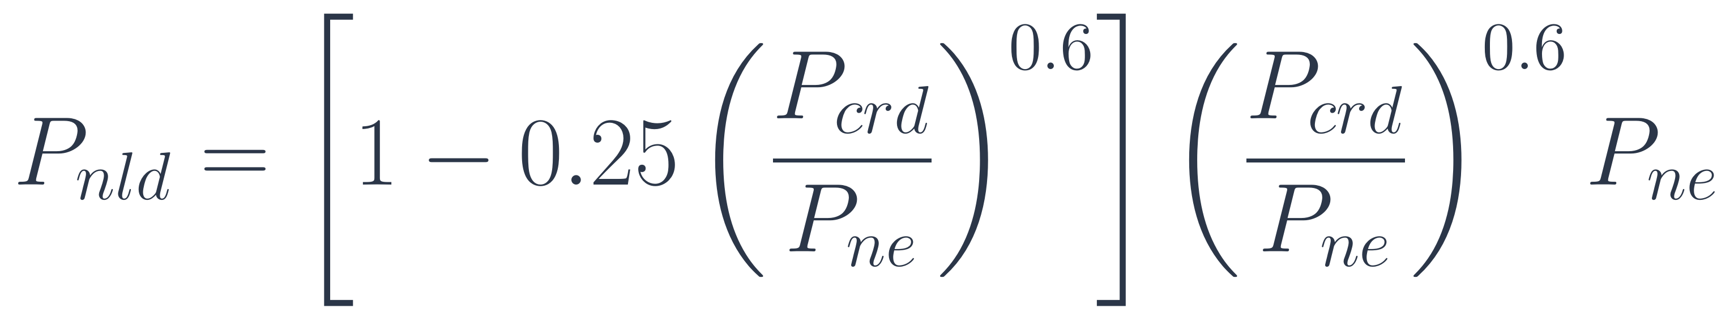
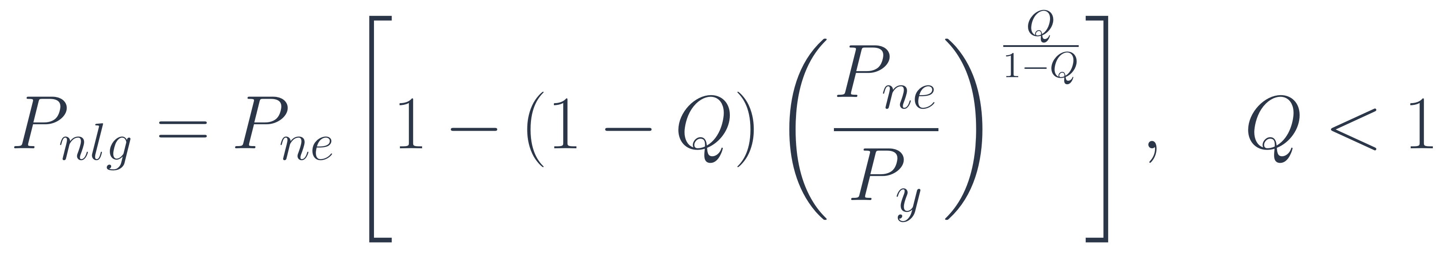
MH16.1-2021/2023 §8.2.2: perforated compression members
Global (8.2-3, 8.2-4)
Distortional + global (8.2-7, 8.2-8)
P_{y} = F_{y} A_{netg}; P_{cre} with K, L from §10.2, §10.3
for λ_{d} = √(P_{ne} / P_{crd}) > 0.561, else P_{nld} = P_{ne}
Local + global (8.2-5, 8.2-6)
• P_{n} = min(P_{nlg}, P_{nld})
• P_{crd}: elastic distortional buckling "in accordance with ANSI/AISI S100" on the t_{d} section
• Hot-rolled and closed sections: P_{nlg} only
P_{nlg} = P_{ne} if Q ≥ 1 (split out as its own equation in 2023)

Slide 6
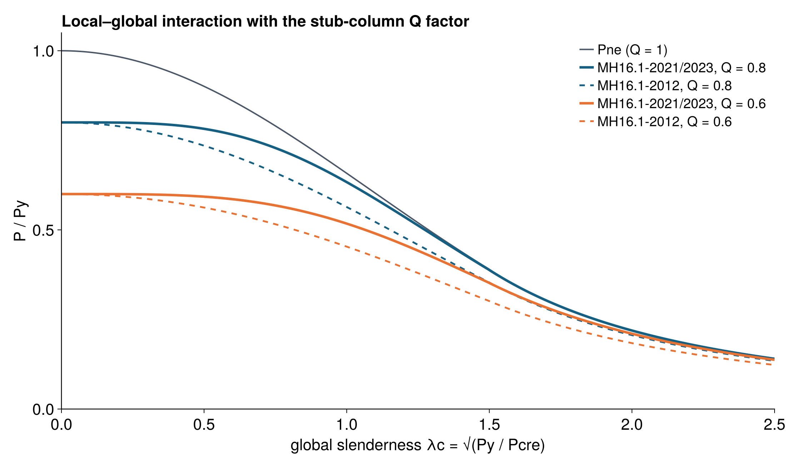
Local buckling: still the stub column, in a new form
Local buckling is not a DSM check: there is no P_{crℓ}. The perforation and local slenderness effects both come from the stub-column test (§13.2.3, Q = P_{test} / (F_{y} A_{netg}) ≤ 1, interpolated between t_{min} and t_{max})
The 2021 exponent Q/(1 − Q) makes the local penalty fade as the column becomes globally slender, the same trend as the DSM local–global curve
For a given Q, the new form is less severe at intermediate λ_{c}
Both forms with F_{n}/F_{y} = P_{ne}/P_{y} on the same area basis. 2012 used A_{net,min}; 2021 uses A_{netg} from the strip section.

Slide 7
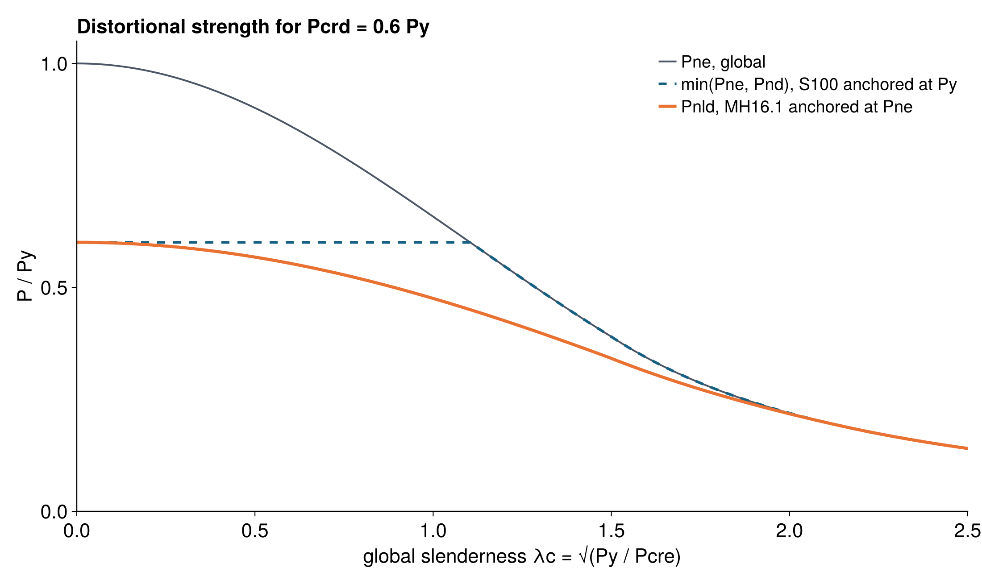
Distortional buckling: the Direct Strength Method piece
New in 2021: an explicit distortional check with an elastic buckling load, P_{crd} or M_{crd}, the DSM ingredient
Same 0.25 / 0.6 coefficients and 0.561 limit as the AISI S100 distortional curve, but anchored at P_{ne} instead of P_{y}
That captures distortional–global interaction, which tests and FE studies on perforated uprights showed (Casafont, Pastor, Roure, Bonada, Peköz)
At λ_{c} = 0 the two agree; at intermediate slenderness MH16.1 is lower, and both reach P_{ne} for slender columns
Example with P_{crd} = 0.6 P_{y}

Slide 8
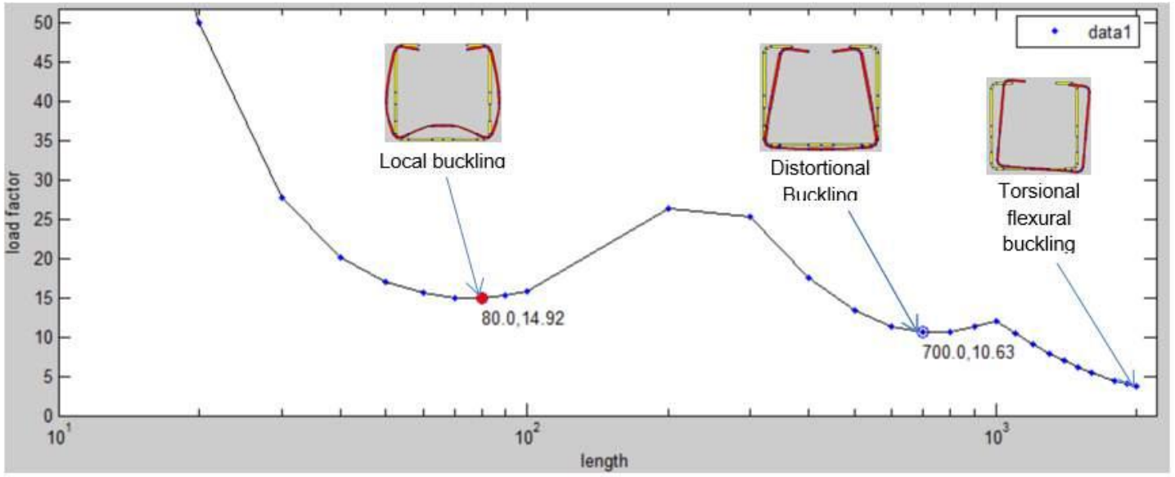
Finite strip analysis on the strip section
Commentary C8: the "most suitable design approach would be to use finite strip analysis combined with the expressions given"
Workflow
  build the round-corner section with t_{d} in the perforated strips
  run CUFSM (or any S100 Appendix 2 analysis)
  read P_{crd} at the distortional minimum
  the same model with t_{g} gives the global section properties
Basis: tests, shell FE and FSM studies on perforated uprights (Casafont et al., ASCE J. Struct. Eng. 2013, "Design of steel storage rack columns via the Direct Strength Method")
Source: ANSI MH16.1-2023 Commentary, Figure C8.2-5. CUFSM: local minimum at 80 mm (load factor 14.92), distortional at 700 mm (10.63)

Slide 9
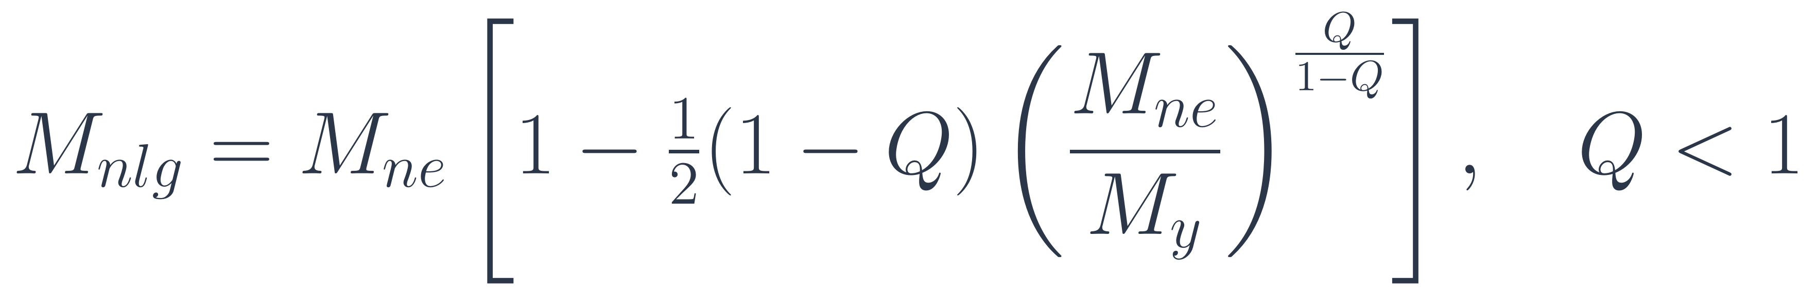
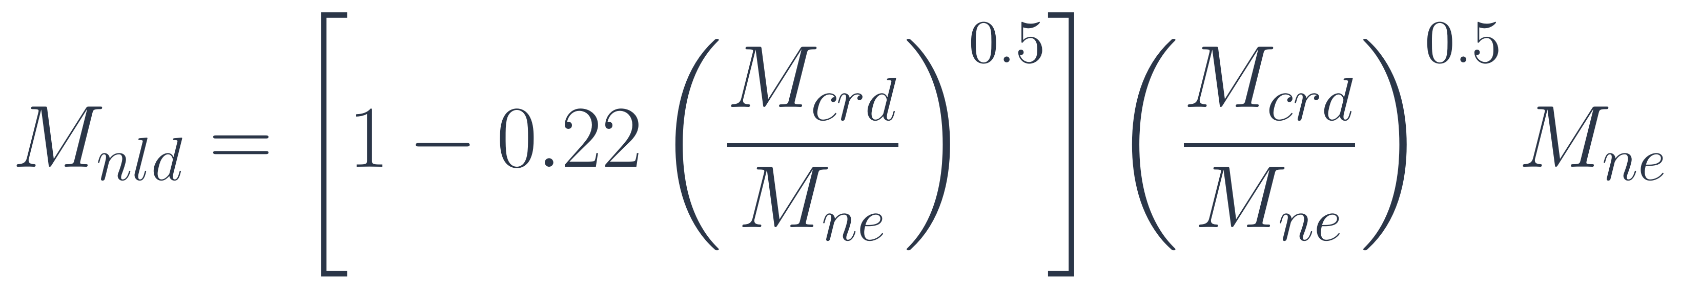
MH16.1-2021/2023 §8.2.3: flexure follows the same pattern
Local + global (8.2-9, 8.2-10)
Distortional + global (8.2-11, 8.2-12)
M_{y} = F_{y} S_{fy}, with S_{fy} on the reduced-thickness section
for λ_{d} = √(M_{ne} / M_{crd}) > 0.673, else M_{nld} = M_{ne}
• M_{n} = min(M_{nlg}, M_{nld}) for open cold-formed sections bending about the axis of symmetry; hot-rolled and closed sections use M_{nlg}
• The coefficients match the AISI S100 flexural distortional curve, anchored at M_{ne} like compression
• M_{crd} comes from finite strip analysis on the t_{d} section, as for P_{crd}

Slide 10
MH16.1-2021: from effective length to direct analysis
§7.2: second-order analysis with notional loads replaces the effective length method
  N_{i} = 0.004 αY_{i} with the stiffness reduction τ_{b}, or 0.005 αY_{i} without; minimum 0.002 αY_{i}
  B₂ = 1 / (1 − α P_{Δ} / (R_{m} H L))
  semi-rigid beam-to-column connections modeled with springs
Down-aisle K_{x} = 1.0 (§10.2.1)
Member and frame models use the same hole-reduced section properties
Connectors from cyclic tests (§13.5): design moment 0.75 M_{max}; stiffness is the secant at 0.8 M_{conn,d}
New tests: base fixity (§13.6) and frame bracing (§13.7); portal and upright frame tests removed
Seismic aligned to ASCE 7-16; redundancy factor for multiple rows; overstrength design of base plates and anchors (§11.3)
ISO-style reorganization of the whole document

Slide 11
Recent updates to ANSI MH16.1: perforated rack member design and the Direct Strength Method
Cristopher D. Moen
RunToSolve LLC
Wei-Wen Yu International Specialty Conference on Cold-Formed Steel Structures, Madison, Wisconsin
runtosolve.github.io/ICCFSS2026_MoenRackStandards

