Slide 1

Elastic buckling analysis of a cold-formed steel stud column with open-source shell finite element software
Cristopher D. Moen and Amoke Shabhari
RunToSolve LLC
Wei-Wen Yu International Specialty Conference on Cold-Formed Steel Structures, Madison, Wisconsin
runtosolve.github.io/ICCFSS2026_MoenShabhariStudElasticBuckling

Slide 2
Shell finite element analysis, in the open
Few modern shell implementations are available for public inspection, and what commercial codes do under the hood is hard to know
A multi-year effort built a trusted, open-source shell capability in Julia, connected to the general-purpose finite element framework Ferrite.jl
Two Mindlin shell elements are now published as packages with elastic and geometric stiffness matrices
  TriShellFiniteElement.jl, a 3-node triangle
  QuadShellFiniteElement.jl, a "4+2" quadrilateral
This talk walks through one eigenbuckling analysis of a common wall stud with holes
Thanks to Sándor Ádány for the shell element formulations and MATLAB reference implementations

Slide 3
Two flat Mindlin shells, six degrees of freedom per node
Triangle, TriShellFiniteElement.jl
  Constant-strain membrane; Mindlin bending with the Tessler–Hughes shear treatment (mid-side deflections condensed out)
  Shear relaxation 1/(1 + Cs α), Cs = 0.2, calibrated so a simply supported plate converges to k = 4.0
  Hughes–Brezzi drilling stiffness, so folded plates assemble without singular matrices
Quadrilateral, QuadShellFiniteElement.jl
  The "4+2" element of Moen and Ádány: bilinear shape functions plus two bubble functions, condensed at the element level, which relieves in-plane bending stiffness and part of the shear locking
  Same shear relaxation (Cs = 0.1) and drilling term
  Julia matrices reproduce the MATLAB reference to machine precision (a package test)
• Geometric stiffness from the Green–Lagrange membrane strains (Nx, Ny, Nxy and the gradients of all three translations)
• K φ = λ (−Kg) φ, and with a unit reference load the eigenvalue is the buckling load

Slide 4
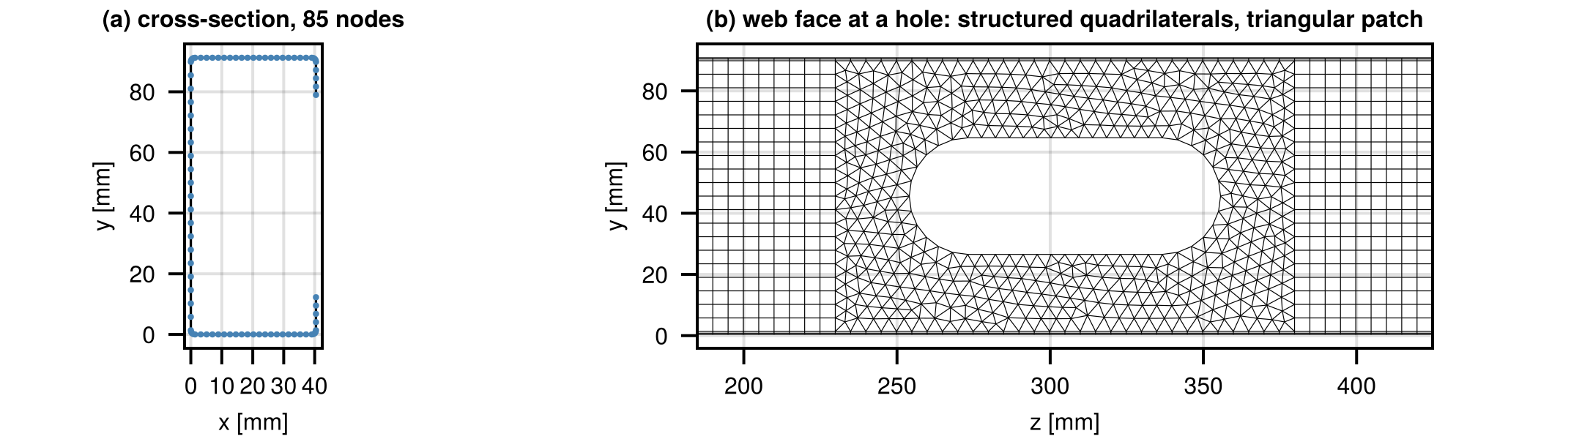
A 362S162-33 wall stud with SFIA service holes
Web 3.625 in, flange 1.625 in, lip 0.5 in, design thickness 0.0346 in; E = 29 500 ksi, ν = 0.3
Braced at midheight: Lx = Ly = Lt = 48 in; pinned, warping-free ends; uniform compression, Pref = 1 N
Four 1.5 × 4 in stadium-shaped holes at 12, 36, 60, and 84 in (24 in o.c.); the brace point is 12 in from the nearest holes
Centerline polyline from CrossSectionGeometry.jl: 85 nodes, corner radius 2t, 4 elements per lip, 20 per flange and web, 4 per corner arc
The same polyline goes to CUFSM.jl, so the shell and finite strip analyses share their geometry
(a) 85-node centerline polyline; (b) web mesh around a hole: structured quadrilaterals outside the 150 mm patch, triangles inside it

Slide 5
Degrees of freedom, boundary conditions, brace
Two element types, one DofHandler (patch-boundary nodes share dofs)
dh = DofHandler(grid)
sq = SubDofHandler(dh, quad_cells)
ipq = Lagrange{RefQuadrilateral, 1}()
add!(sq, :u, ipq^3); add!(sq, :θ, ipq^3)
st = SubDofHandler(dh, tri_cells)
ipt = Lagrange{RefTriangle, 1}()
add!(st, :u, ipt^3); add!(st, :θ, ipt^3)
close!(dh)
Ends: ux = uy = 0 at every end node, uz and all rotations free
Load: equal and opposite axial nodal forces by tributary centerline length, giving uniform P/A away from ends and holes
Brace: ux = 0 at the two web-flange corners (translation perpendicular to the web and twist), uy = 0 and the axial datum uz = 0 at the web mid-depth node on the symmetry axis, so no prebuckling stress is induced
Pinned warping-free ends and the midheight brace
ch = ConstraintHandler(dh)
add!(ch, Dirichlet(:u, end_nodes, # ux = uy = 0
(x, t) -> [0.0, 0.0], [1, 2]))
add!(ch, Dirichlet(:u, brace_corner_nodes, # ux = 0
(x, t) -> [0.0], [1]))
add!(ch, Dirichlet(:u, Set([brace_web_center]), # uy = uz = 0
(x, t) -> [0.0, 0.0], [2, 3]))
close!(ch)

Slide 6
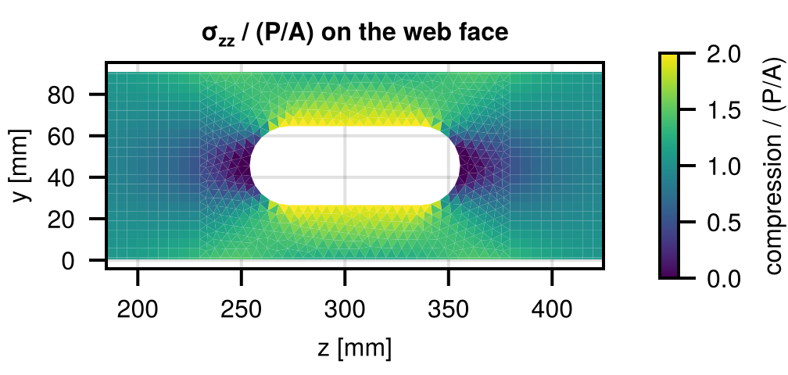
Pre-buckling stresses and geometric stiffness
One call per package, summed
Kq = QuadShellFiniteElement.assemble_global_Ke!(
allocate_matrix(dh, ch), sq, qr2, qr3,
IP4(), IP6(), E, ν, t; Cs = 0.1)
Kt = TriShellFiniteElement.assemble_global_Ke!(
allocate_matrix(dh, ch), st, qr1, qr3,
IP3(), IP6(), E, ν, t; Cs = 0.2)
K = Kq + Kt; apply!(K, F, ch)
u = K \ F; apply!(u, ch)
σ = membrane_stresses(dh, u, E, ν, t) # element frame
Kg = assemble_Kg(dh, ch, σ, t) # summed, too
• Static problem solved with Julia's sparse direct solver; membrane stresses recovered element by element (one per triangle, four Gauss points per quadrilateral)
• Normalized by P/A: 1.0 in the bulk, about 1.9 in the web strips beside a hole, 1.25 in the flanges at the hole plane, 0.5 just above and below the hole
Pre-buckling longitudinal membrane stress on the web face around a hole, normalized by P/A

Slide 7
Solving the eigenvalue problem with ARPACK
Lowest modes: K⁻¹(−Kg), one Cholesky factorization
Kfac = cholesky(Symmetric(K)); tmp = zeros(n)
op!(y, x) = (mul!(tmp, Kg, x); y .= Kfac \ -tmp)
μ, Φ = eigs(LinearMap(op!, n; ismutating = true);
nev = 12, which = :LM)
Pcr = 1 ./ real.(μ) # N, because P_ref = 1 N
Implicitly restarted Arnoldi on K⁻¹(−Kg): its largest eigenvalues are the reciprocals of the smallest buckling loads
A perforated member has hundreds of local modes below its distortional and global loads, so the bottom of the spectrum never reaches them
Shift-and-invert with targets from 14 to 60 kN, 40 modes per target, one indefinite factorization and about 20 s each
Every mode is classified automatically: displacement ratio at the hole patches (local at a hole), rigid-body energy fraction (global: weak-axis, strong-axis, torsion), flange-lip versus web-flange corner motion (distortional), else local
Shift-and-invert: modes nearest a target load σ
Mfac = ldlt(Symmetric(K + σ * Kg)) # indefinite
op!(y, x) = (mul!(tmp, Kg, x); y .= Mfac \ -tmp)
ν, V = eigs(LinearMap(op!, n; ismutating = true);
nev = 40, which = :LM)
Pcr = σ .+ 1 ./ real.(ν)

Slide 8
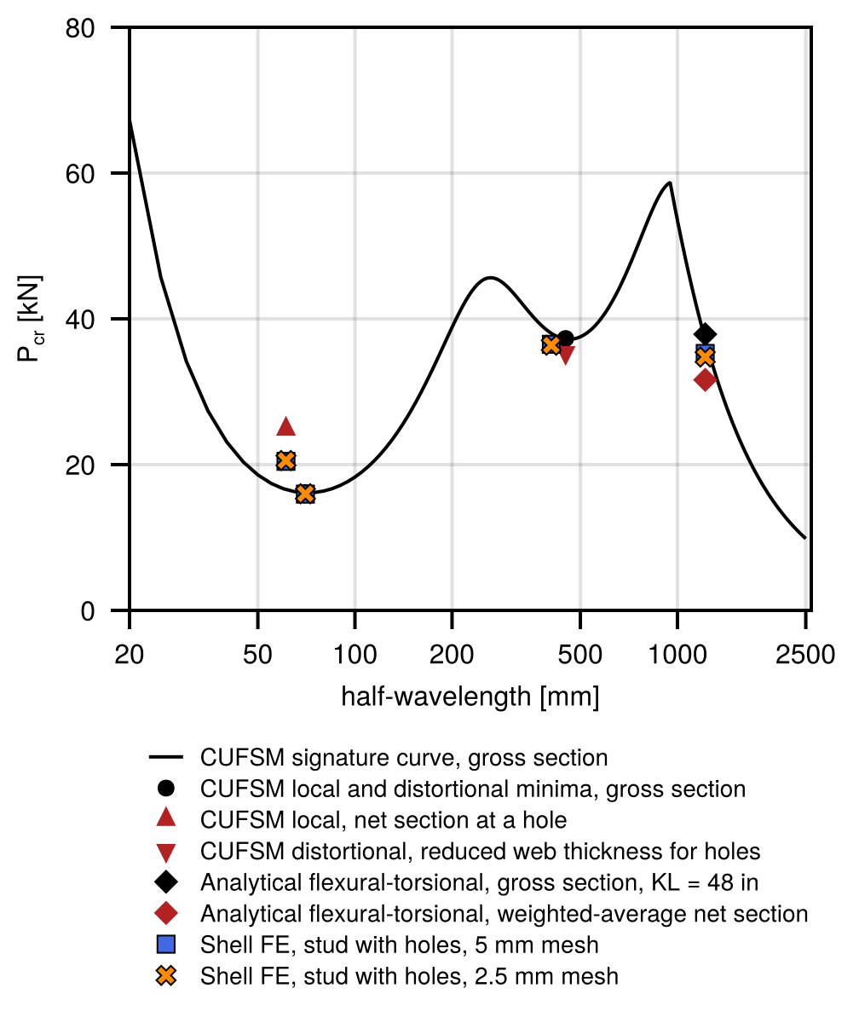
Finite strip and closed-form reference values
CUFSM.jl, gross section: local minimum 16.14 kN at 70 mm, distortional 37.20 kN at 460 mm
Hole approximations (CeeSectionBuckling.jl, the RunToSolve SFIA evaluation procedure)
  net section through the hole: local 24.88 kN, above the gross value, so the unperforated web governs
  AISI S100 reduced web thickness tr = t(1 − Lh/Lcrd)^(1/3) = 0.807 mm: distortional 37.30 → 35.35 kN
Closed form, KL = 48 in: Pex = 314.6, Pey = 56.9, Pt = 40.0, flexural-torsional 37.89 kN; weighted-average net properties 31.63 kN
Finite strip at one 1219 mm half-wave (section free to distort): 37.17 kN flexural-torsional, 49.58 kN weak-axis flexure

Slide 9
Shell finite element buckling loads, kN
Buckling mode | 5 mm mesh | 2.5 mm mesh | 5 mm, no holes | Finite strip / analytical
Local, lowest | 15.95 | 16.00 | 15.79 | 16.14 (CUFSM gross)
Local at the holes (web strips) | 20.45 | 20.56 | – | 24.88 (net section)
Distortional, 3 half-waves per segment | 36.51 | 36.38 | 37.37 | 35.35 (reduced t), 37.30 (gross)
Distortional–hole interaction, 5 half-waves | 32.63 | 32.33 | – | –
Global, flexural-torsional | 35.25 | 34.76 | 37.15 | 37.89 (closed form), 37.17 (CUFSM)
Global, weak-axis flexure | 46.74 | 47.70 | 49.58 | 56.93 (Euler), 49.58 (CUFSM mode 2)
Halving the element length changes every load by less than two percent. The lowest mode is local; the governing global mode is flexural-torsional.

Slide 10
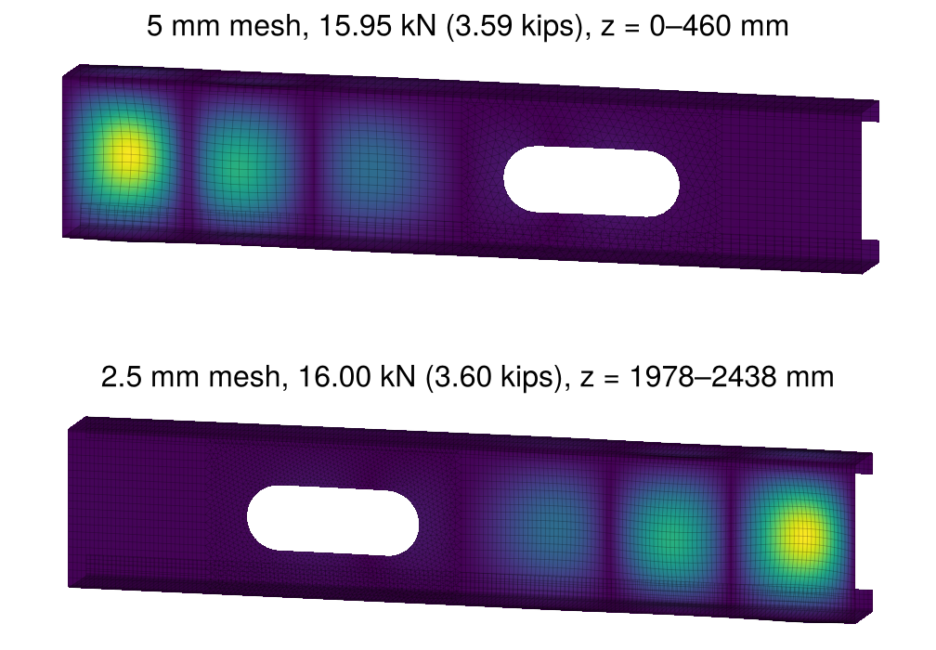
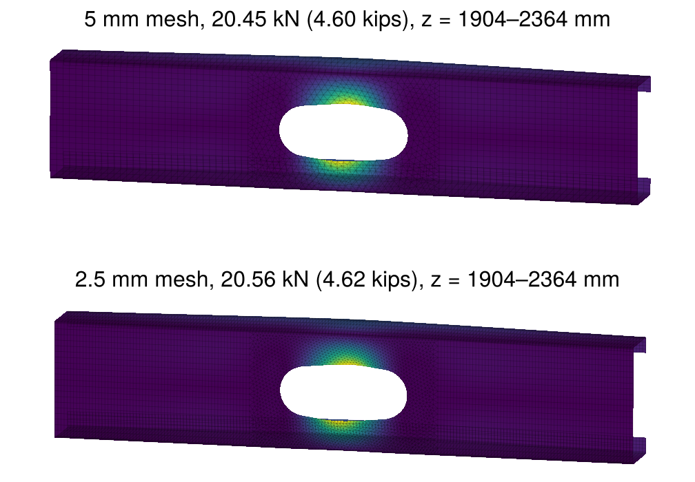
Local modes
Lowest local mode, 15.95 kN: the web buckles between the holes
Lowest mode at a hole, 20.45 kN: the two web strips bow in opposite directions
5 mm mesh (top) and 2.5 mm mesh (bottom) in each figure; color is displacement magnitude

Slide 11
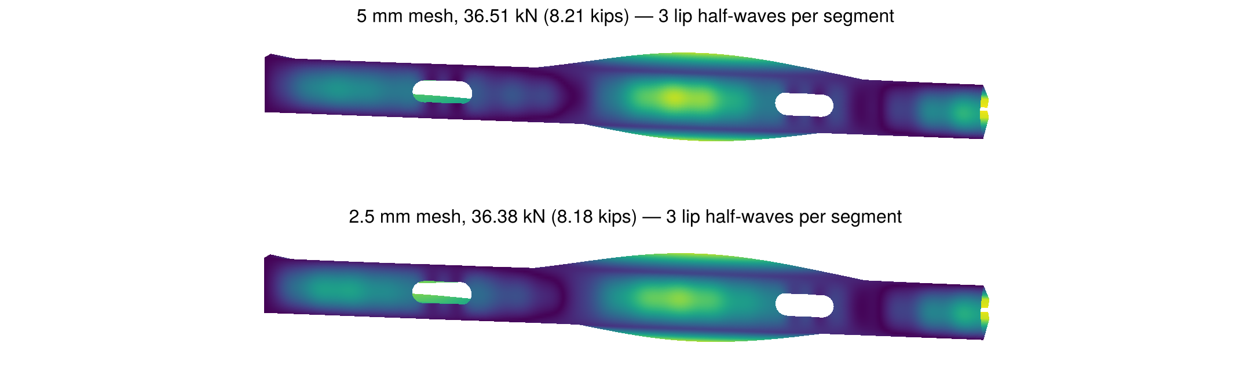
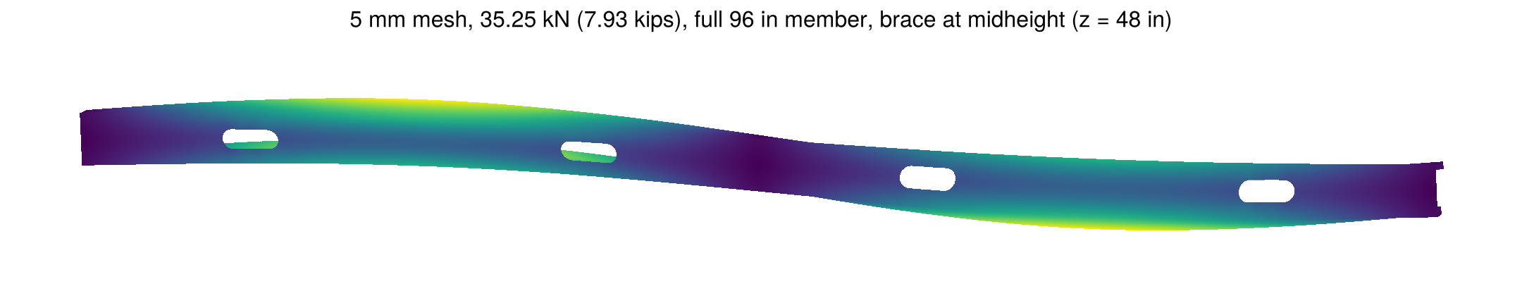
Distortional and global modes
Lowest distortional mode, 36.51 kN, lower 48 in braced segment: three half-waves per braced segment, the brace plane is a node
Lowest global mode, 35.25 kN, full 96 in member: lateral translation plus twist, one half-wave in each braced segment, the brace at midheight is a node

Slide 12
Six minutes on a laptop for a quarter-million dofs
Step | 5 mm mesh | 2.5 mm mesh
Degrees of freedom | 247 998 | 509 286
Assemble elastic stiffness | 6 s | 9 s
Static solve | 3 s | 6 s
Assemble geometric stiffness | 2 s | 3 s
Cholesky factorization of K | 10 s | 20 s
12 lowest modes (ARPACK) | 9 s | 18 s
13 shift-and-invert windows, 40 modes each | 356 s | 903 s
Apple M3 Max laptop, sparse factorizations on 7 threads, less than 2 GB of memory
Each shift-and-invert window is one indefinite factorization and about 27 s; the sweep yields about 190 distinct modes between 16 and 65 kN
Julia compiles the packages on first use, roughly a minute per session

Slide 13
Documentation and validation live on GitHub
Each repository README documents the element mechanics, the calling sequence with Ferrite.jl, and the default parameters; docstrings cover the public functions
The test suites are the validation record. For the triangle:
  element symmetry, rigid body modes, thickness independence
  uniform compression reproducing PL/EA
  simply supported plate converging to k = 4.0, clamped plate to k ≈ 10.07
  buckling load invariant to the orientation of the plate in space
  torsion of flat and folded strips and of a rounded lipped channel reproducing the thin-walled torsion constant within a few percent
For the quadrilateral: element-by-element comparison with the MATLAB reference, plus the plate bending, membrane, and column buckling benchmarks of the earlier paper
Pkg.test() on either package regenerates every number in this list

Slide 14
Elastic buckling analysis of a cold-formed steel stud column with open-source shell finite element software
Cristopher D. Moen and Amoke Shabhari
RunToSolve LLC
Wei-Wen Yu International Specialty Conference on Cold-Formed Steel Structures, Madison, Wisconsin
runtosolve.github.io/ICCFSS2026_MoenShabhariStudElasticBuckling

