Slide 1










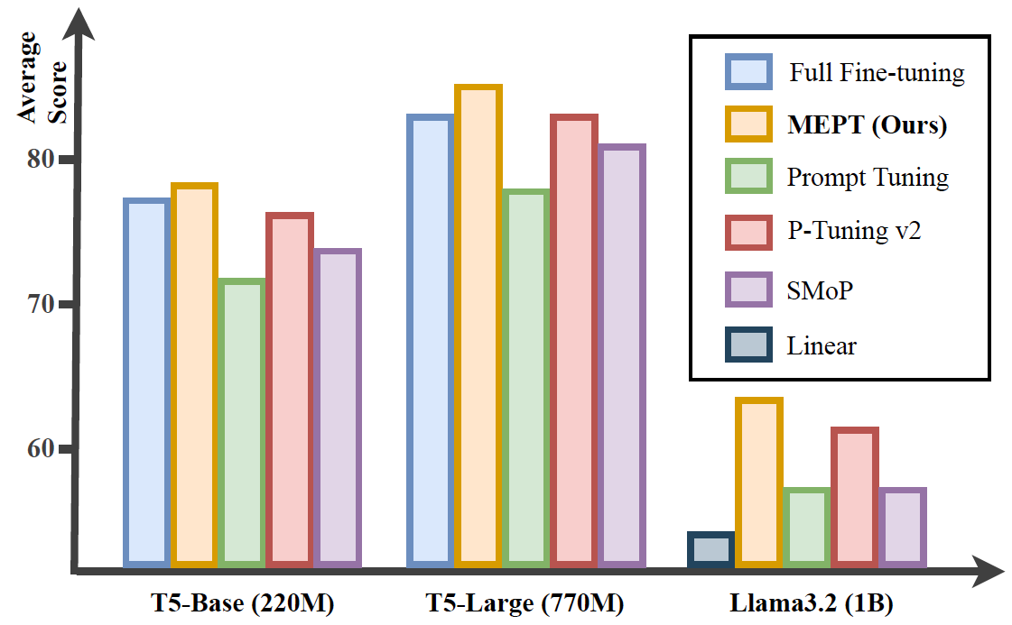
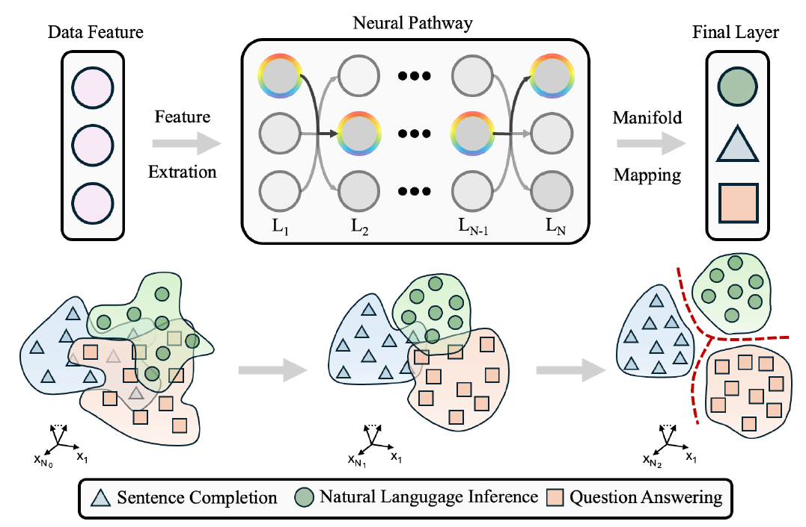



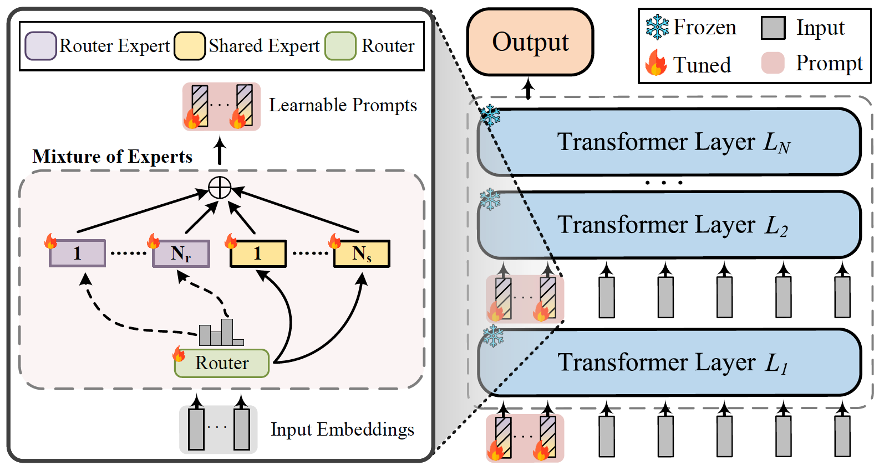
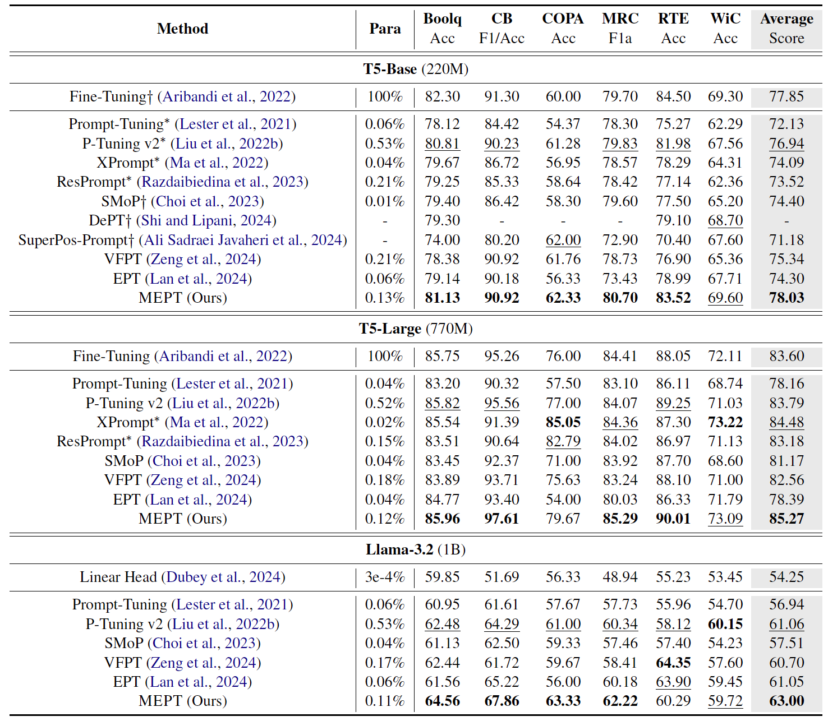


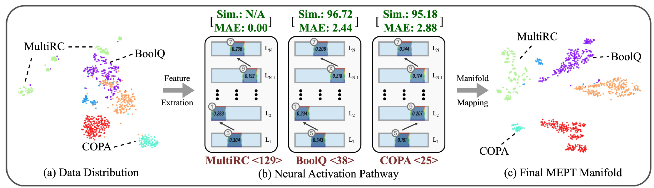

MEPT: Mixture of Expert Prompt Tuning as a Manifold Mapper
Runjia Zeng¹ Guangyan Sun² QifanWang³ Tong Geng^{2,4} Sohail Dianat¹
Xiaotian Han⁵ Raghuveer Rao⁶ Xueling Zhang¹ Cheng Han⁷ Lifu Huang⁸ Dongfang Liu^{1†}
¹Rochester Institute of Technology ²University of Rochester ³Meta AI ⁴Rice University
⁵Case Western Reserve University ⁶U.S. DEVCOM Army Research Laboratory
⁷University of Missouri - Kansas City ⁸UC Davis †Corresponding author
Introduction
Considering deep neural networks as manifold mappers, the pretrain-then-fine-tune paradigm can be interpreted as a two-stage process: pretrain establishes a broad knowledge base, and fine-tune adjusts the model parameters to activate specific neural pathways to align with the target manifold. Although prior fine-tuning approaches demonstrate success, their rigid parameter space limits their ability to dynamically activate appropriate neural pathways, rendering them ill-equipped to adapt flexibly to the diverse and evolving data distributions. In light of this view, we propose a novel approach, Mixture of Expert Prompt Tuning (MEPT), as an effective and efficient manifold-mapping framework. MEPT leverages the Mixture of Experts architecture by integrating multiple prompt experts to adaptively learn diverse and non-stationary data distributions. Empirical evaluations demonstrate that MEPT outperforms several state-of-the-art parameter efficient baselines on SuperGLUE, achieving notable improvements in mean accuracy (e.g., 1.94%) while significantly reducing activated prompts by 79.25%. The effectiveness of MEPT is further supported by theoretical insights from manifold learning and validated through neural activation pathway visualization results.
Main contributions:
Unveil the essence of neural network learning through manifold visualization, crossvalidating our motivation and effectiveness under manifold learning theory while elucidating the decision-making process.
Investigate the potential of mixture training using a universal prompt embedding, which imposes higher requirements for prompt generality. It highlights the importance of MoE, providing valuable insights for future PEFT architecture design.
Conduct comprehensive experiments on various tasks and LLM sizes in the Super-GLUE benchmark, demonstrating the effectiveness of MEPT over several state-of-the-art prompt tuning and full fine-tuning methods.
1
2
3
By employing a modular and adaptive MoE design, MEPT facilitates the handling of diverse and non-stationary data manifold mapping.
The sparse MoE architecture specializes in the representation of each prompt expert, enabling a compact and efficient neural pathway activation, which imposes no additional burden when scaling up the number of experts during training and inference.
We find that the effectiveness of our approach is directly supported by theoretical insights from manifold learning and further validated through instinct neural activation pathway visualization results.
MEPT
Main Results
Performance comparison result (%) on SuperGLUE development set. Para is the number of trainable parameters. The best results except fine-tuning are in bold with underline representing the second best ones. For tasks with two metrics, the average score is reported.
Router Experts as Representation Specialists:
Router Experts as Representation Specialists:
Training MEPT is to build a manifold mapper:
Manifold Mapping Pathway
Observation I: Neural activation pathways vary across distinct manifolds:
Observations from three tasks (MultiRC, BoolQ, COPA) in (b) show task-specific pathways, where semantically closer tasks (MultiRC, BoolQ) activate overlapping experts with higher similarity (MAE 2.88 vs. 2.44, cosine 95.18 vs. 96.72) than COPA. For example, MultiRC and BoolQ share expert 1 in L2, while COPA prefers expert 9, reflecting heterogeneous expert preferences.
Observation II: The improved linear separability of manifold mappings is facilitated by MEPT: As shown in (a) and (c), the combined dataset without MEPT yields entangled groups with poor boundaries, while MEPT training produces clear margins, compact clusters (e.g., green group), and stronger alignment of task representations across classes, enabling better separability consistent with the table results above.

