Slide 1

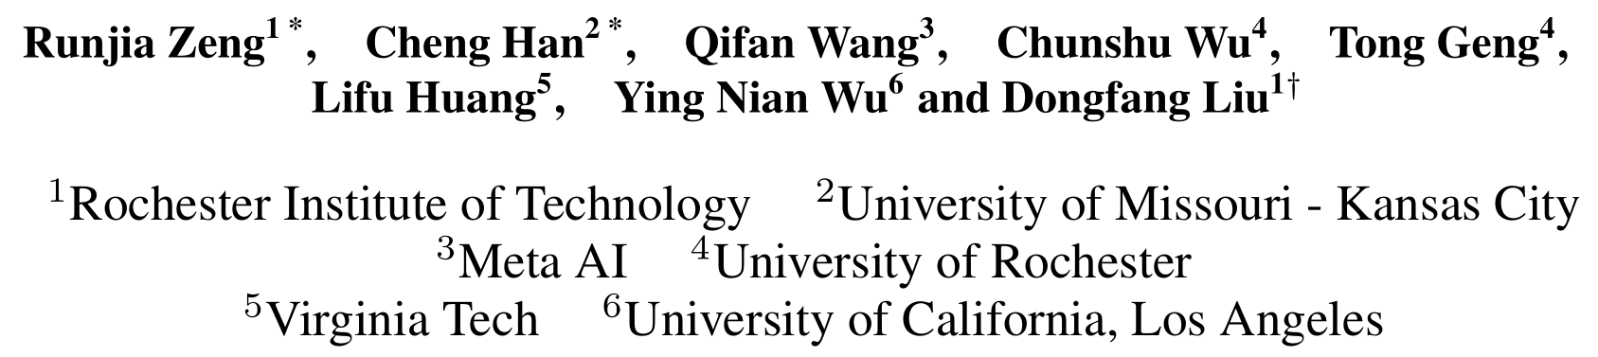
Visual Fourier Prompt Tuning
runjia.tech

Slide 2
Content
Introduction
Visual Fourier Prompt Tuning
Main Results
Study of Optimization
Study of Interpretability
Conclusion
runjia.tech

Slide 3
Introduction
runjia.tech

Slide 4
1. Introduction
Observation
A significant performance degradation occurs when there is a substantial disparity between the data used in pretraining and finetuning.
Key Idea
Integrating frequency domain information into learnable prompt embeddings to elegantly assimilates data from both spatial and frequency domains.
runjia.tech

Slide 5
Visual Fourier Prompt Tuning
runjia.tech

Slide 6
2. Visual Fourier Prompt Tuning
runjia.tech

Slide 7
Main Results
runjia.tech

Slide 8
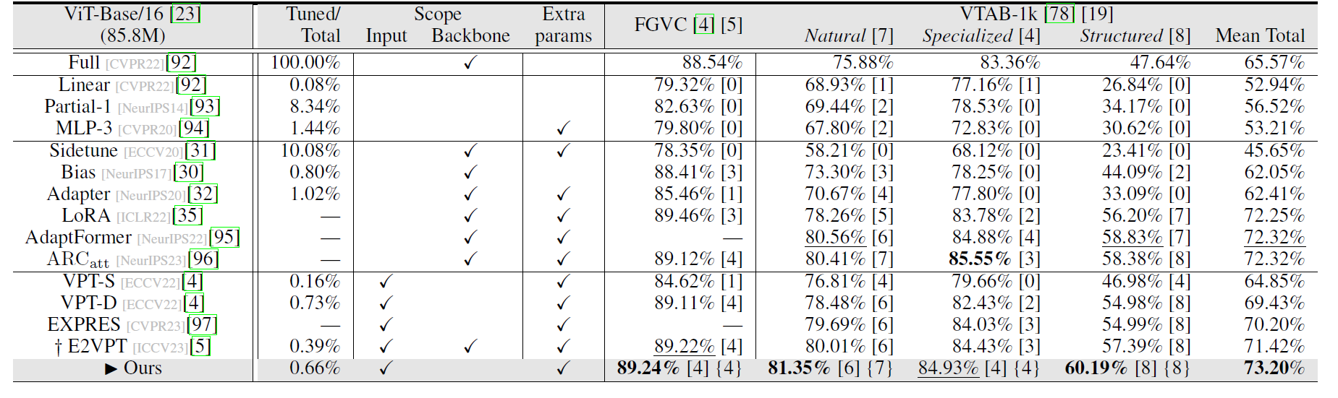
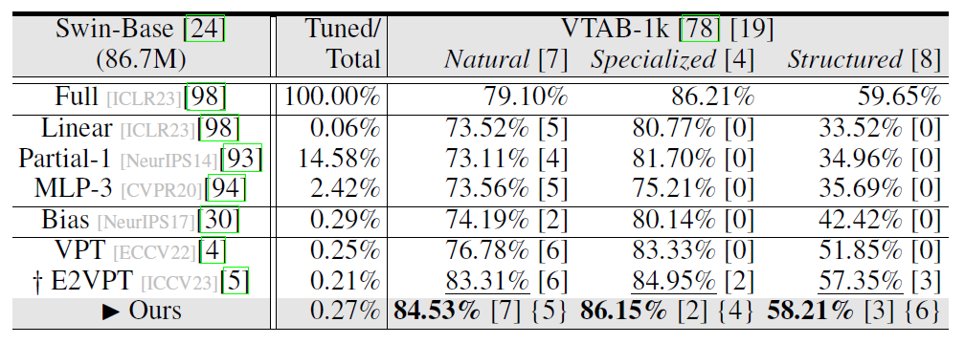
3. Main Results
runjia.tech

Slide 9
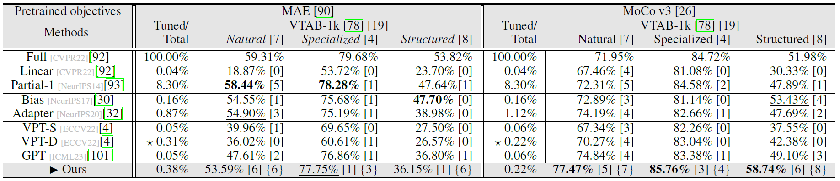
3. Main Results
runjia.tech

Slide 10
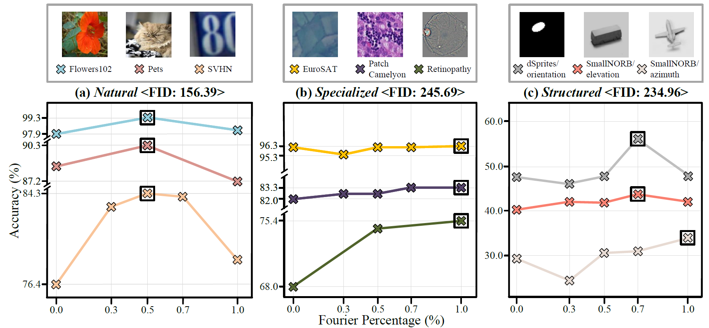
3. Main Results
runjia.tech

Slide 11
Study of Optimization
runjia.tech

Slide 12
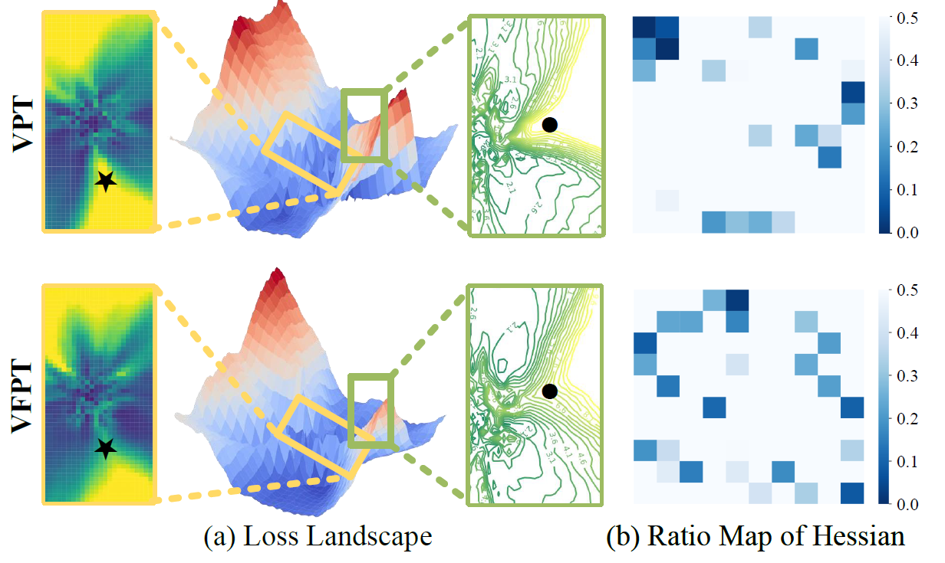
4. Study of Optimization
runjia.tech

Slide 13
Study of Interpretability
runjia.tech

Slide 14
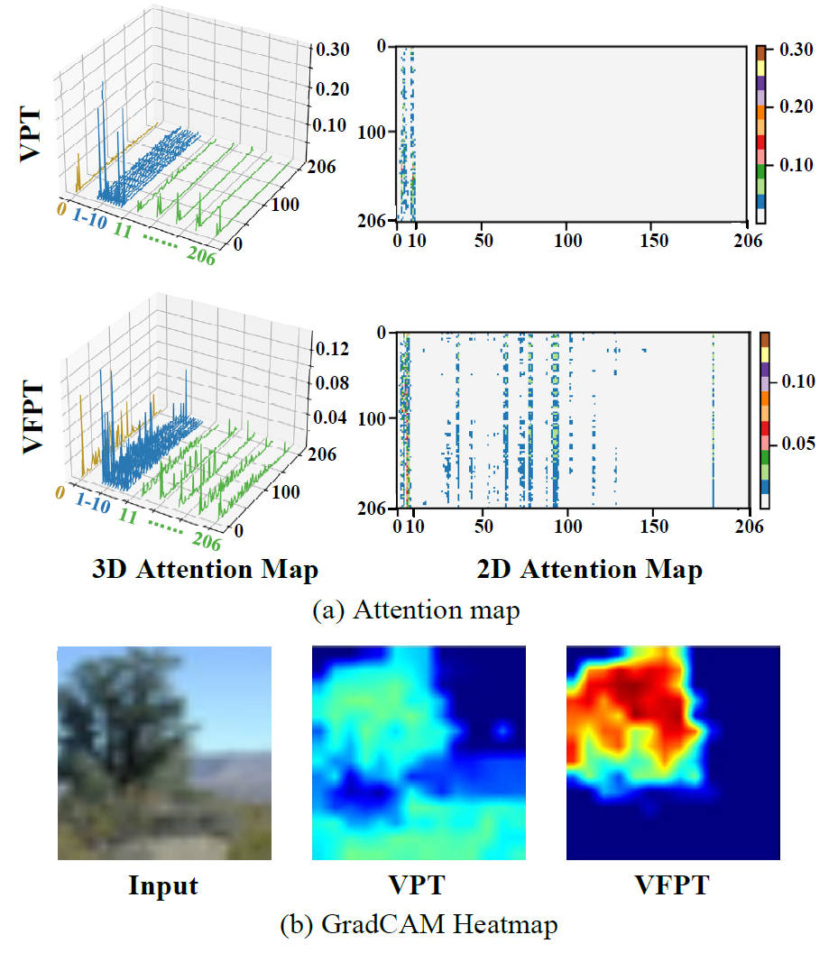
5. Study of Interpretability
runjia.tech

Slide 15
Conclusion
runjia.tech

Slide 16
6. Conclusion
Simplicity
Integrating spatial and frequency domain information through an intuitive yet effective design.
Generality
Demonstrating generality across datasets with varying disparities while ensuring powerful performance.
Interpretability
Thoroughly investigating the associations between learnable prompts and frozen
embeddings to elucidate our generality.
runjia.tech

Slide 17
THANK YOU!
runjia.tech

