Slide 1
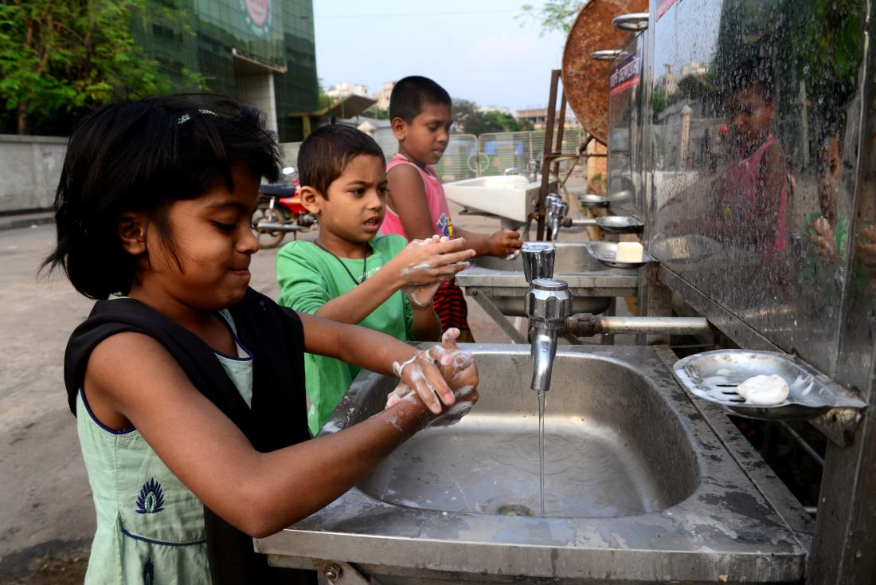
Changing Behavior with Entertainment
Evaluating the Impact of Edutainment on Hygiene in Bangladesh
By: Andre Poghosyan, Joanna Tang, Runxi Yu
SDG Focus: Goal 3 – Good Health and Well-being

Slide 2
Research Question – Part 1
The study aims to find out whether embedding hygiene edutainment into mobile entertainment can change real handwashing behavior
Previous public health campaigns often failed to improve actual hygiene behavior, despite improving knowledge
This study tests if behavior change can happen without changing what people explicitly know
Focus is on exposure frequency, timing, and cue-based habit formation

Slide 3
Research Question – Part 2
Authors use high-frequency data: timestamped soap dispenser use and minute-by-minute phone viewing
Machine learning applied to link exposure patterns to handwashing behavior
The importance of the question is that it challenges the traditional model where behavior follows belief updates
If behavior can shift through tacit cues, public health strategies can move beyond just information delivery

Slide 4
Treatment – Part 1
Treated households received a basic smartphone with calling and internet disabled
SD cards delivered monthly with 3 hours of dramas and cartoons
Short hygiene-focused clips (30 seconds to 7 minutes) embedded between episodes
Ads featured non-celebrity characters from public campaigns like Meena and Sesame Street

Slide 5
Treatment – Part 2
Study asks whether embedding hygiene edutainment into mobile entertainment can change real handwashing behavior
Previous public health campaigns often failed to improve actual hygiene behavior, despite improving knowledge
This study tests if behavior change can happen without changing what people explicitly know
Focus is on exposure frequency, timing, and cue-based habit formation

Slide 6
Subjects – Part 1
Sample: 333 households across 34 villages in Gaibandha District, Bangladesh
Inclusion criteria: female household head, child of primary school age, access to latrine, ownership of soap
Randomized assignment by computer with 50 percent in treatment
Each household received ~2 months of sensor data through rotating dispenser tracking

Slide 7
Subjects – Part 2
No significant baseline differences between treatment and control groups
Follow-up rates: 86 percent for endline survey, 85 percent for sensor data
Lower mobile phone data due to technical extraction issues
Households already had basic hygiene resources, so behavior could be isolated from infrastructure constraints
Generalizability strongest for similar low-income rural populations with access to mobile entertainment

Slide 8
Estimated Effects – Part 1
Treated households used soap 22 percent more than controls (p = 0.000)
No difference in whether they used it at all, only in how frequently
Machine learning identified strongest predictors of behavior as cumulative edutainment exposure in the last 3 to 4 weeks, and any entertainment exposure in the 30 minutes before mealtime
Exposure beyond one month had near-zero predictive power, meaning that older content or earlier exposure did not influence whether someone washed their hands later

Slide 9
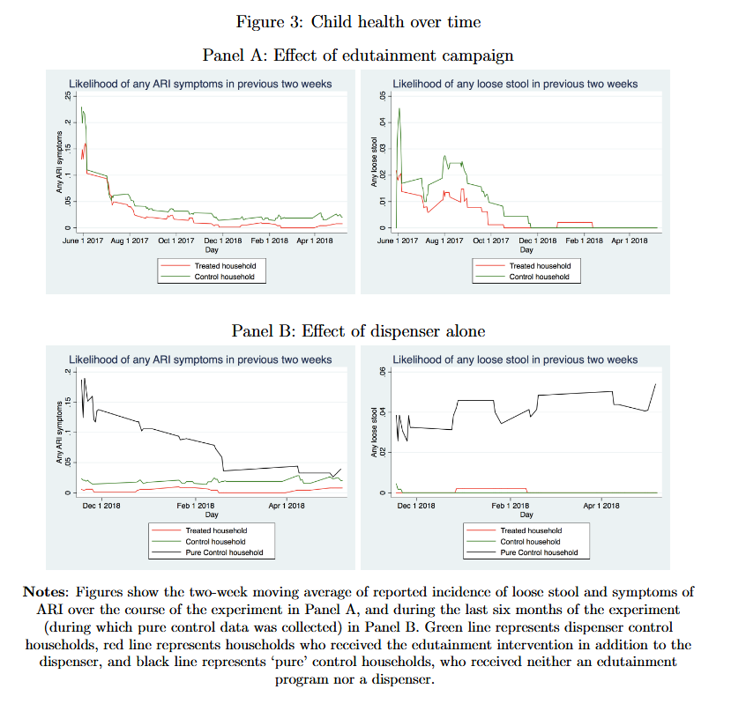

Slide 10
Estimated Effects – Part 2
No measurable gains in hygiene knowledge. Absolute index: +1.5 percent, not significant. Relative index: +0.4 percent, not significant
Children in treated households had better health. 54.4 percent fewer cases of loose stool (p = 0.036). 28.8 percent fewer cases of Acute Respiratory Infection (ARI) symptoms (p = 0.016)
No impact on other hygiene behaviors like latrine upgrades or water treatment
Results interpreted as habit formation rather than belief updating

Slide 11
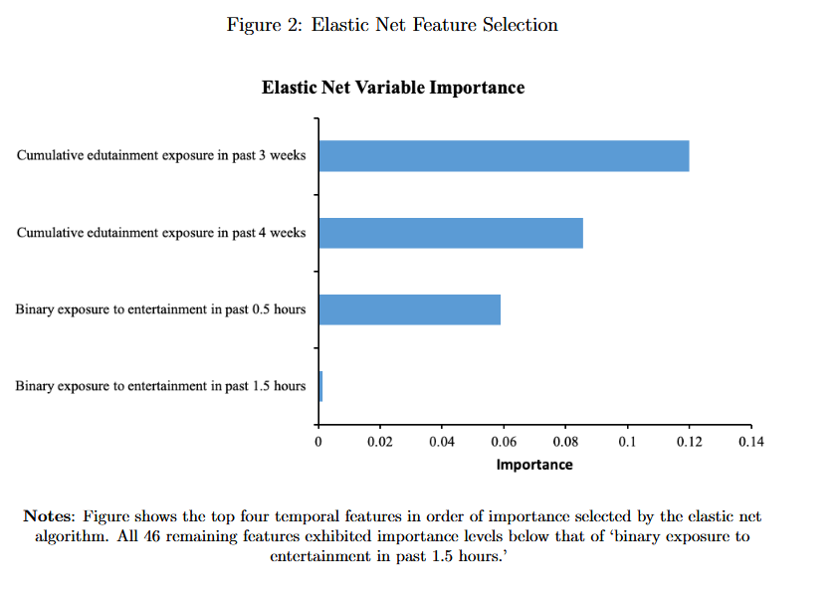

Slide 12
Statistical Significance – Part 1
All outcomes report p-values from regression models
Soap use: p = 0.000
Loose stool: p = 0.036
ARI symptoms: p = 0.016
Hygiene knowledge: p > 0.05 (not significant)
95 percent confidence intervals used to rule out small knowledge gains

Slide 13
Statistical Significance – Part 2
Regression models include randomized treatment, household and day fixed effects, controls chosen using the Least Absolute Shrinkage and Selection Operator (LASSO) method
P-values interpreted as credible due to clean experimental design
Results backed by machine learning prediction accuracy (62 percent)
The setup makes the p-values meaningful

Slide 14
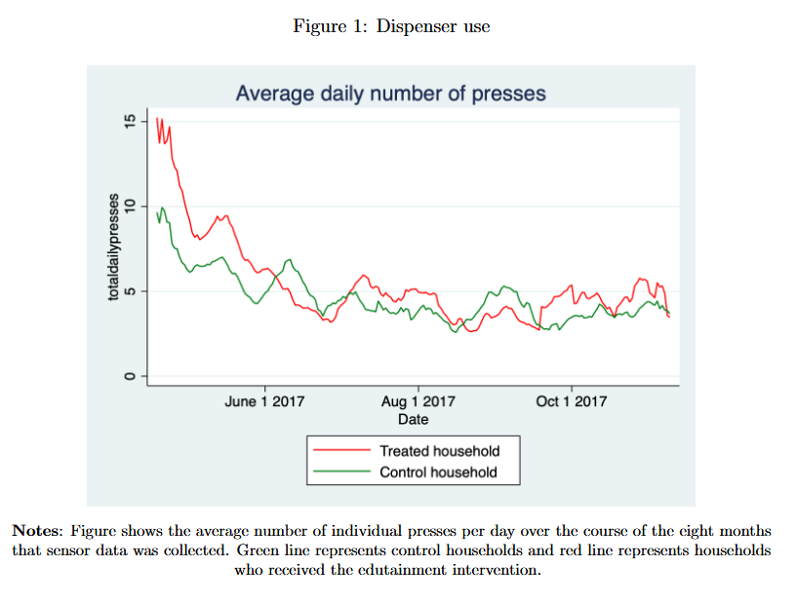

Slide 15
Normative Implications
Repeated exposure and habit cues may matter be more important than facts in changing public health habits
Shows that increased knowledge does not need to be the main focus of interventions as treated households washed their hands more and saw better health outcomes despite their hygiene knowledge typically remaining the same
Policymakers may want to focus less on lectures or info sheets and more on small reminders in daily life
Behavior can change without changing what people believe

Slide 16
Policy Implications
Embedding public health content in popular media is cheap and scalable
Works even in low-resource settings with limited internet or literacy
Public health agencies could deliver hygiene, vaccine, or nutrition messages through media such as movies and shows
When trying to promote a certain type of behavior, messages should focus on frequency and simplicity over technical content
Phones with preloaded content could be used in areas with poor network coverage

Slide 17
Thank you!

