Slide 1
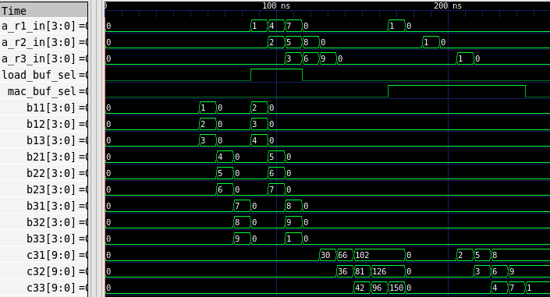

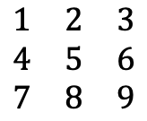
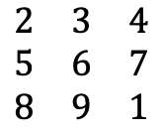
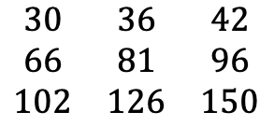

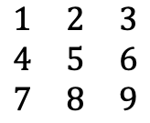
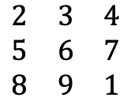
Demo for the 3x3 Systolic Array with Double Buffer
Result
Functional Result:
Testcase:
Expected:
$$\begin{matrix}1 & 2 & 3 \\ 4 & 5 & 6 \\ 7 & 8 & 9\end{matrix}$$
$$\begin{matrix}1 & 2 & 3 \\ 4 & 5 & 6 \\ 7 & 8 & 9\end{matrix}$$
$$\begin{matrix}30 & 36 & 42 \\ 66 & 81 & 96 \\ 102 & 126 & 150\end{matrix}$$
Op1:
$$×$$
PASS
Op2:
$$\begin{matrix}2 & 3 & 4 \\ 5 & 6 & 7 \\ 8 & 9 & 1\end{matrix}$$
$$\begin{matrix}2 & 3 & 4 \\ 5 & 6 & 7 \\ 8 & 9 & 1\end{matrix}$$
$$×$$
$$I$$
PASS
Loading next weight matrix during Op1 computation
Op1 finished
Op2 finished
Source code:
https://github.com/runyangtian/2x2_systolic_array_double_buffer.git
Find 3x3_version folder

